Slide 1
HOW DOES OXIDATIVE TOOTH WHITENING WORK?

Slide 2
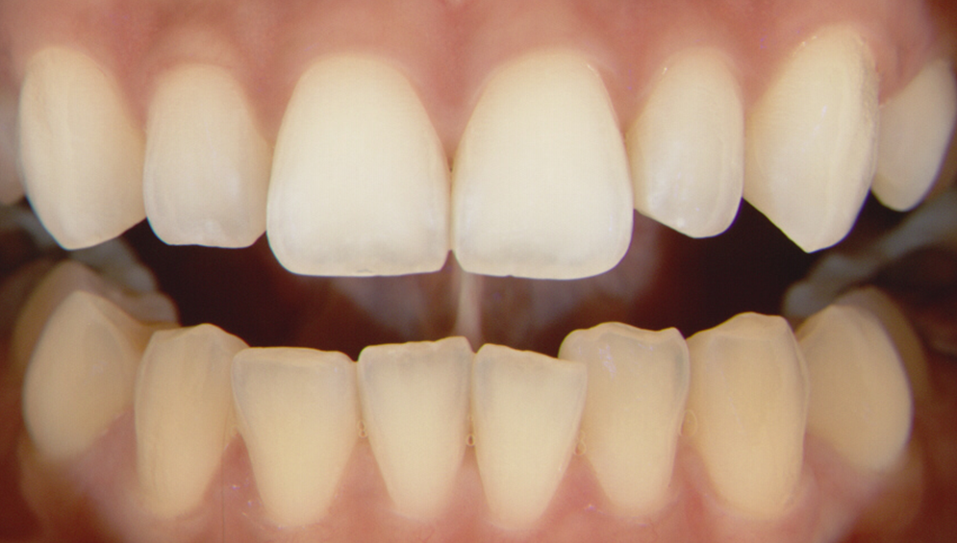
HOW DOES OXIDATIVE TOOTH WHITENING WORK?
For ALL forms of whitening
Concentration + Contact Time = Results
All forms continue to work until your teeth reach saturation point where they will not whiten further

Slide 3
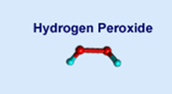
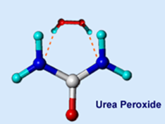
MOST COMMON AND STUDIED VITAL BLEACHING
ACTIVE INGREDIENTS
Hydrogen Peroxide [HP] (H₂O₂)
Carbamide Peroxide [CP] (CH₆N₂O₃)
Dissociates into H₂O₂ and urea CH₄N₂O in presence of water source (saliva)
Conversion is: HP% = CP% / 3
Example:
10% CP
3
= 3 % H₂O₂
Carbamide peroxide

Slide 4
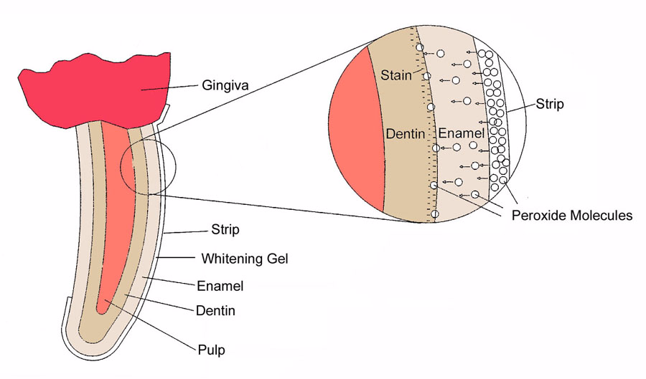
HOW DOES OXIDATIVE
TOOTH WHITENING WORK?
All whitening results are directly tied to:
Concentration
RETENTION DEVICE
diffusion of peroxide to the stains below the surface.
The higher the concentration, the faster the whitening
RETENTION DEVICE
Contact Time
The amount of time the H₂O₂ is in contact with tooth surface
Increasing contact time will increase results
Patients will begin to see a result in 3 or 4 days but increase the days used & you will increase the results

Slide 5
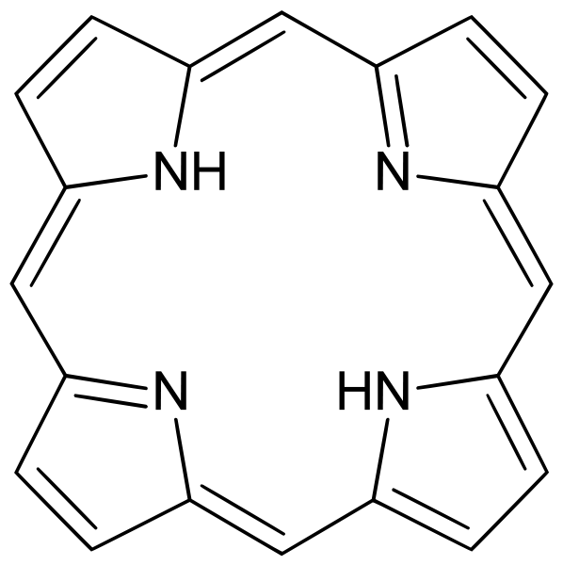
HOW DOES OXIDATIVE
TOOTH WHITENING WORK?
Common organic compounds in teeth that produce yellowish color include porphyrins.
Porphyrins are a class of natural biological chelators that chelate ions, like iron, in our body to control their levels.
Iron is also a catalyst for peroxide reactions.
Because porphyrin is often associated with iron, the stains often have a catalyst with them that helps enable the peroxide bleaching process.
When peroxide encounters a stain such a porphyrin, it takes electrons from the molecules in a process called oxidation.
When an electron is removed from a molecule, most often it changes its ability to filter light, rendering it colorless. For this process to occur the peroxide must be right next to the stain.
porphyrin
Fe⁺²/Fe⁺³
+ H₂O₂
Colorless
Fe⁺²/Fe⁺³
1.: Kihn PW. Vital tooth whitening. Dent Clin North Am. 2007 Apr;51(2):319-31, viii. doi: 10.1016/j.cden.2006.12.001. PMID: 17532915.
Notes:
These unstable free radicals attack organic pigmented molecules in the spaces between the inorganic salts in tooth enamel resulting in smaller, less heavily pigmented constituents. These smaller molecules reflect less light, thus creating a ‘‘whitening effect.’’ Kihn PW. Vital tooth whitening. Dent Clin North Am. 2007 Apr;51(2):319-31, viii. doi: 10.1016/j.cden.2006.12.001. PMID: 17532915.

