Slide 1
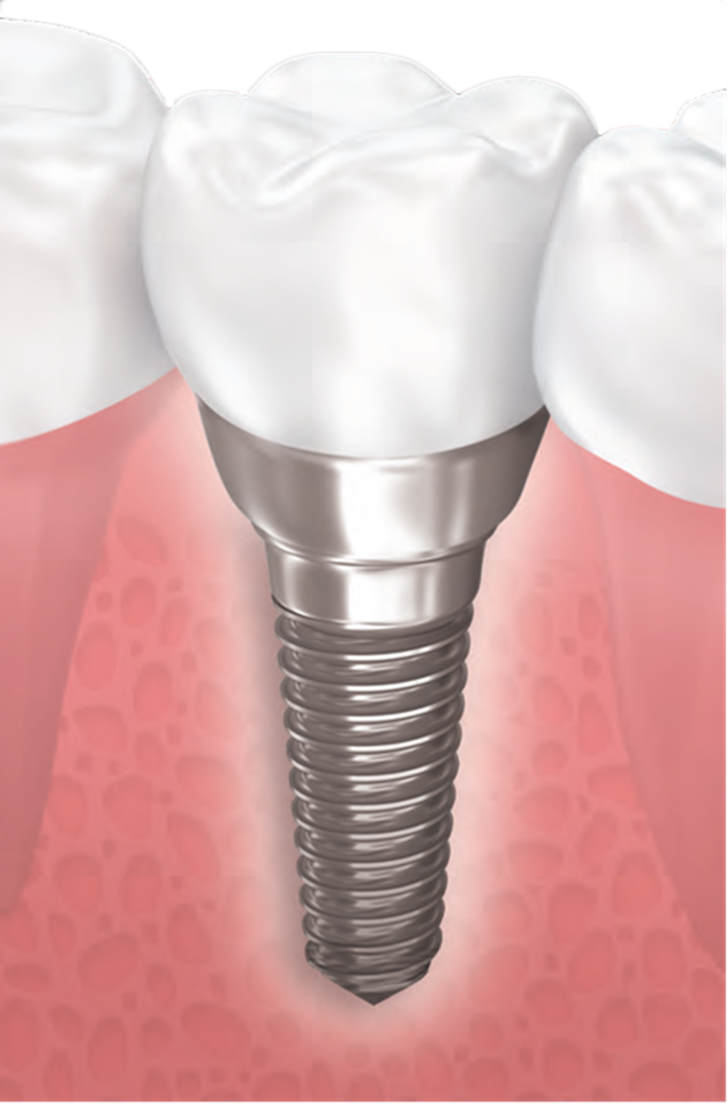
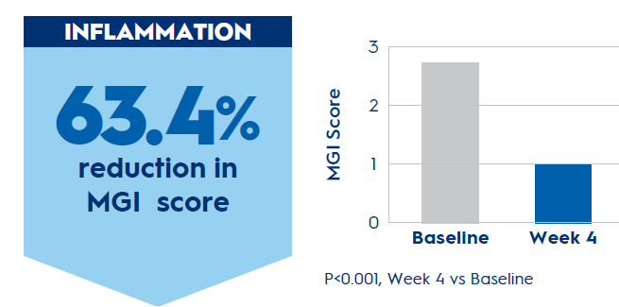
Stannous Fluoride Reduces Peri-Implant Mucositis¹
Crest stannous fluoride antibacterial dentifrice can help patients maintain oral health around implants.
Study Design | 4-week monadic trial. Baseline and Week 4- visits Change from baseline assessments
Study Participants | 20 Adults with at least 1 implant Presence of mucositis (based on clinical presentation of BoP and inflammation)
Clinical Assessments | Bleeding MGI (modified Gingival Index) Löe Silness Gingival Index Gingival Crevicular Fluid: oxidative stress markers (CML, LDH), bacterial endotoxins, pro-inflammatory cytokines (IL1b, IL12p70) Subgingival plaque: TLR-2, TLR-4
Product Use | Stannous fluoride dentifrice and soft manual toothbrush twice daily for 1 minute per brushing
Stannous fluoride binds to plaque toxins, such as lipopolysaccharides, reducing plaque virulence, inflammation, and oxidative stress.²⁻⁴
Stannous-containing dentifrice also demonstrates a reduction in the relative abundance of disease-associated bacteria and an increase in the relative abundance of health-associated bacteria.⁵
This change to the dental plaque microbiome composition is consistent with a return to a healthy no-mucositis microbiome and improved clinical signs and symptoms.
1) Ramji et al. J Dent Res (Spec Iss A) 2024; 103: Abstract 2509.
2)He T, et al. Am J Dent. 2021;34(4):222-227.
3) Klukowska M, et al. J Clin Dent. 2017;28(2):16-26.
4) Xie S, et al. Am J Dent. 2018;31(4):215-224.
5) Chen D, et al. Front Microbiol. 14 Feb 2024.

