Slide 1
IS H₂O₂ SAFE?
Evidence to date indicates that properly formulated peroxide sources are safe.
Kihn PW. Vital tooth whitening. Dent Clin North Am. 2007 Apr;51(2):319-31, viii. doi: 10.1016/j.cden.2006.12.001. PMID: 17532915.

Slide 2
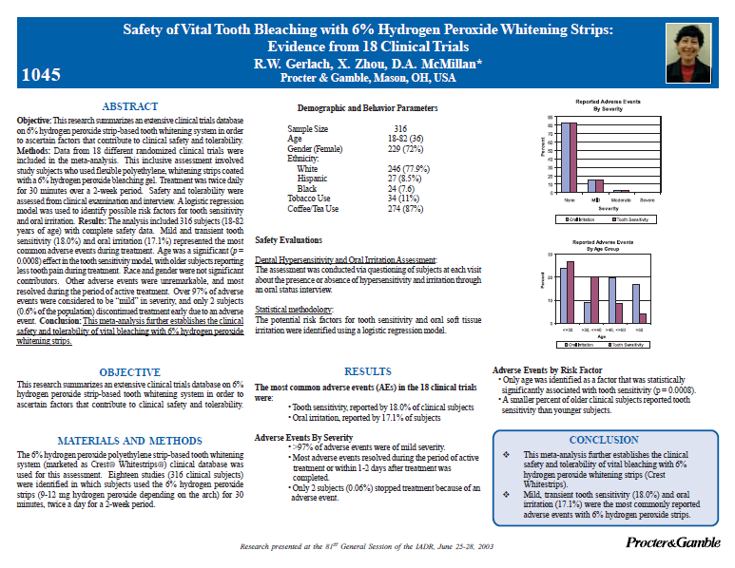
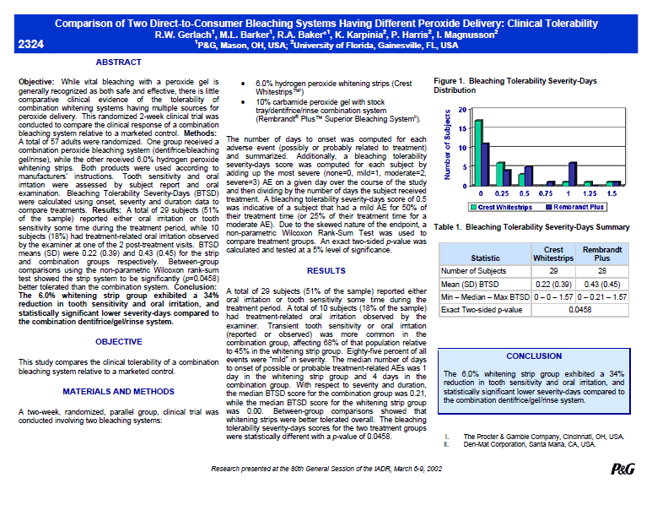
PEROXIDE
Most Extensively researched whitening technology
Short term & extended use trials
Positive & negative controls
Adults & children
P&G Bibliography
of over 183 published papers and presentations on Whitening Products

Slide 3
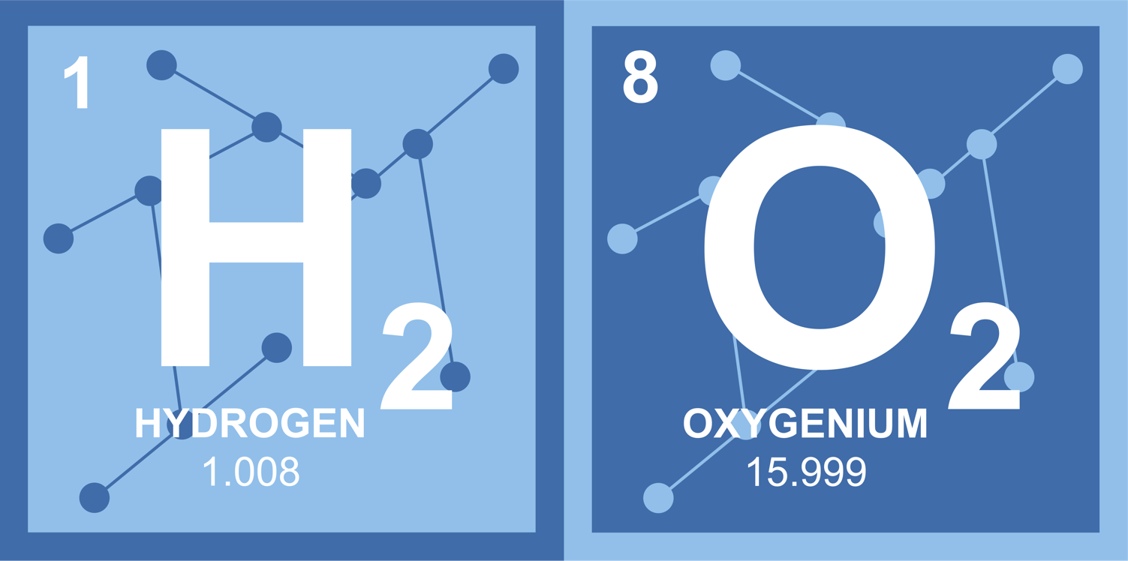
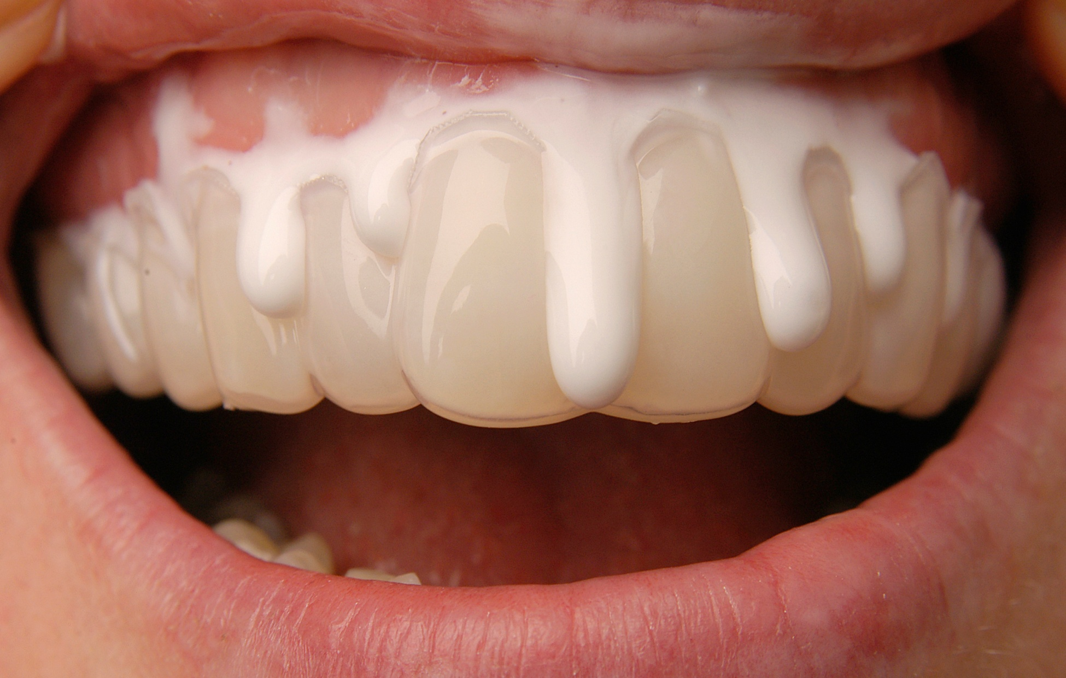
PEROXIDE SAFETY AND THE SOFT TISSUE
Peroxide dissipates relatively fast on soft tissue
The amount of peroxide applied to the soft tissue is important for maintaining integrity (Vs concentration)
1. Walsh LJ. Safety issues relating to the use of H₂O₂ in dentistry. Aust Dent J. 2000 Dec;45(4):257-69.
2. Liochev SI. Reactive oxygen species and the free radical theory of aging. Free Radic Biol Med. 2013 Jul;60:1-4.
3. Valko M, Rhodes CJ, Moncol J, Izakovic M, Mazur M. Free radicals, metals and antioxidants in oxidative stress-induced cancer. Chem Biol Interact. 2006 Mar 10;160(1):1-40.
4. Davies MJ. Protein oxidation and peroxidation. Biochem J. 2016 Apr 1;473(7):805-25.
5. Staerck C, Gastebois A, Vandeputte P, Calenda A, Larcher G, Gillmann L, Papon N, Bouchara JP, Fleury MJJ. Microbial antioxidant defense enzymes. Microb Pathog. 2017 Sep;110:56-65.
6. Zhang YJ, Gan RY, Li S, Zhou Y, Li AN, Xu DP, Li HB. Antioxidant Phytochemicals for the Prevention and Treatment of Chronic Diseases. Molecules. 2015 Nov 27;20(12):21138-56.
Notes:
Peroxide dissipates relatively fast on soft tissue, Greater degree of dilution (compared to hard tissue), Salivary enzymes neutralize peroxide (Convert peroxide into water and oxygen)
The amount of peroxide applied to the soft tissue is important for maintaining integrity
65. Walsh LJ. Safety issues relating to the use of H₂O₂ in dentistry. Aust Dent J. 2000 Dec;45(4):257-69.
66. Liochev SI. Reactive oxygen species and the free radical theory of aging. Free Radic Biol Med. 2013 Jul;60:1-4.
67. Valko M, Rhodes CJ, Moncol J, Izakovic M, Mazur M. Free radicals, metals and antioxidants in oxidative stress-induced cancer. Chem Biol Interact. 2006 Mar 10;160(1):1-40.
68. Davies MJ. Protein oxidation and peroxidation. Biochem J. 2016 Apr 1;473(7):805-25.
69. Staerck C, Gastebois A, Vandeputte P, Calenda A, Larcher G, Gillmann L, Papon N, Bouchara JP, Fleury MJJ. Microbial antioxidant defense enzymes. Microb Pathog. 2017 Sep;110:56-65.
70. Zhang YJ, Gan RY, Li S, Zhou Y, Li AN, Xu DP, Li HB. Antioxidant Phytochemicals for the Prevention and Treatment of Chronic Diseases. Molecules. 2015 Nov 27;20(12):21138-56.
71. Glorieux C, Calderon PB. Catalase, a remarkable enzyme: targeting the oldest antioxidant enzyme to find a new cancer treatment approach. Biol Chem. 2017 Sep 26;398(10):1095-1108.

Slide 4
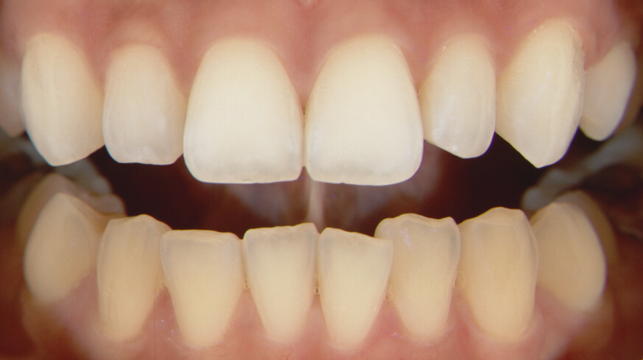
PEROXIDE SAFETY
AND THE SOFT TISSUE
H₂O₂ is created by the human body’s own immune systems as part of our protection against pathogens.
In the human body, immune system cells such as macrophages create H₂O₂ to help kill pathogens such as bacteria and viruses. If the body produces too much peroxide, our body's natural immunity produces an enzyme called catalase.¹⁻⁶
Catalase converts left over H₂O₂ into water and oxygen. The production of and elimination of H₂O₂ in our bodies is a normal function of our immune system
1. Walsh LJ. Safety issues relating to the use of H₂O₂ in dentistry. Aust Dent J. 2000 Dec;45(4):257-69.
2. Liochev SI. Reactive oxygen species and the free radical theory of aging. Free Radic Biol Med. 2013 Jul;60:1-4.
3. Valko M, Rhodes CJ, Moncol J, Izakovic M, Mazur M. Free radicals, metals and antioxidants in oxidative stress-induced cancer. Chem Biol Interact. 2006 Mar 10;160(1):1-40.
4. Davies MJ. Protein oxidation and peroxidation. Biochem J. 2016 Apr 1;473(7):805-25.
5. Staerck C, Gastebois A, Vandeputte P, Calenda A, Larcher G, Gillmann L, Papon N, Bouchara JP, Fleury MJJ. Microbial antioxidant defense enzymes. Microb Pathog. 2017 Sep;110:56-65.
6. Zhang YJ, Gan RY, Li S, Zhou Y, Li AN, Xu DP, Li HB. Antioxidant Phytochemicals for the Prevention and Treatment of Chronic Diseases. Molecules. 2015 Nov 27;20(12):21138-56.
Notes:
65. Walsh LJ. Safety issues relating to the use of H₂O₂ in dentistry. Aust Dent J. 2000 Dec;45(4):257-69.
66. Liochev SI. Reactive oxygen species and the free radical theory of aging. Free Radic Biol Med. 2013 Jul;60:1-4.
67. Valko M, Rhodes CJ, Moncol J, Izakovic M, Mazur M. Free radicals, metals and antioxidants in oxidative stress-induced cancer. Chem Biol Interact. 2006 Mar 10;160(1):1-40.
68. Davies MJ. Protein oxidation and peroxidation. Biochem J. 2016 Apr 1;473(7):805-25.
69. Staerck C, Gastebois A, Vandeputte P, Calenda A, Larcher G, Gillmann L, Papon N, Bouchara JP, Fleury MJJ. Microbial antioxidant defense enzymes. Microb Pathog. 2017 Sep;110:56-65.
71. Glorieux C, Calderon PB. Catalase, a remarkable enzyme: targeting the oldest antioxidant enzyme to find a new cancer treatment approach. Biol Chem. 2017 Sep 26;398(10):1095-1108.

Slide 5
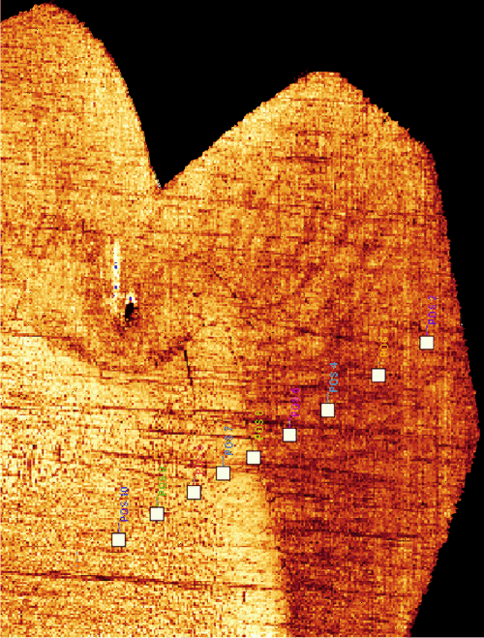
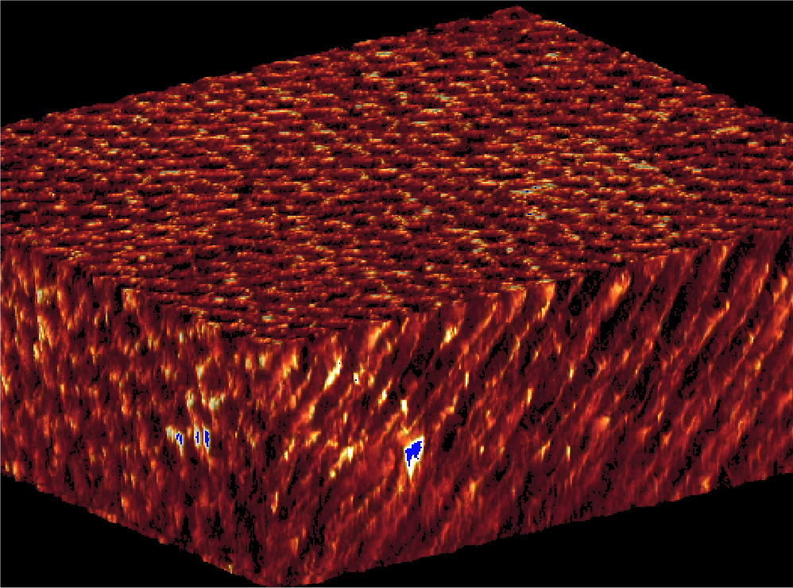
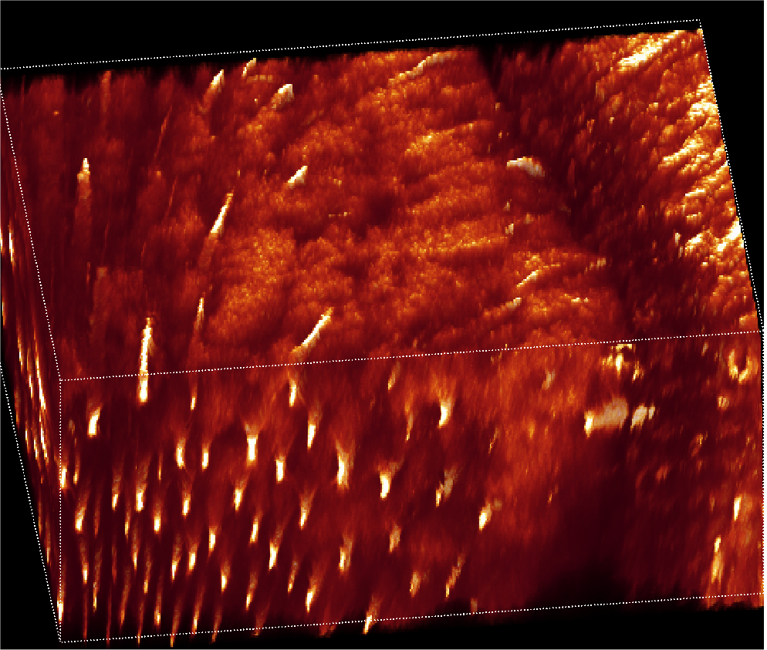
PEROXIDE SAFETY
AND THE HARD TISSUE
Bleaching Does Not Alter Mineral Composition
Properly formulated peroxide sources do not damage enamel surfaces.
Peroxides also have no substantial effects on the structure, ultrastructure, physical properties or chemical composition of surface enamel, subsurface enamel or (bleached) coronal dentin.
White DJ, Kozak KM, Zoladz JR, Duschner HJ, Götz H. Effects of tooth-whitening gels on enamel and dentin ultrastructure--a confocal laser scanning microscopy pilot study. Compend Contin Educ Dent Suppl. 2000;(29):S29-34; quiz S43. PMID: 11908407.
Notes:
CLSM By laser scanning and pin hole optics confocal laser scanning microscopy (in reflection mode) records pseudo colour coded tomographic optical sections either parallel or perpendicular to the surface of translucent specimen like enamel and dentin. By computer assisted overlay of image staples of about 200 individual images parallel to the surface, virtual three dimensional reconstructions can be generated.
No artifacts due to sample sectioning or polishing of sample surfaces, because images are recorded under the surface.

Slide 6
PEROXIDE SAFETY AND THE ENAMEL
Abrasion
Peroxide treatment has no effects on abrasion susceptibility of enamel or root dentin
Caries
Peroxide treatment has no effects on enamel caries susceptibility
Erosion
Peroxide treatment has no effects on enamel or dentin erosion susceptibility
.
White DJ, Kozak KM, Zoladz JR, Duschner H, Götz H. Peroxide interactions with hard tissues: effects on surface hardness and surface/subsurface ultrastructural properties. Compend Contin Educ Dent. 2002 Jan;23(1A):42-8; quiz 50. PMID: 11913294.
D.J. WHITE , M.A. KLUKOWSKA Bleach Effects on Dental Enamel Surface Hardness and Roughness 86th Session of the IADR, July 2-5, 2008, Toronto, Canada.2584

Slide 7
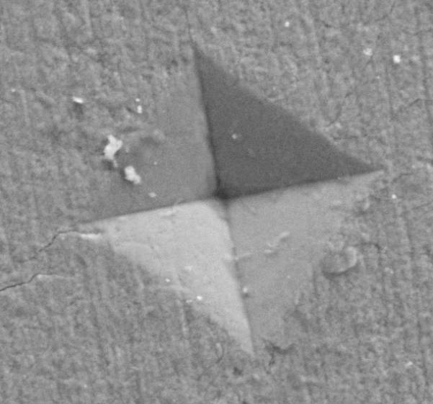
PEROXIDE SAFETY AND THE HARD TISSUE ¹⁻³
Crack Propagation analysis of teeth confirms whitening, even over whitening does not increase fracture susceptibility
Microscopy analysis reveal that whitening does not etch surface enamel of teeth
Whitening does not soften subsurface enamel
Whitening does not soften coronal subsurface dentin
Vickers Enamel Microhardness
Enamel Preparation for Testing Whitening Effects on Surface & Subsurface Microhardness
& Fracture Susceptibility
Ameri, H., Ghavamnasiri, M., & Abed, A. (2011). Effects of different bleaching time intervals on fracture toughness of enamel. Journal of conservative dentistry : JCD, 14(1), 73–75. https://doi.org/10.4103/0972-0707.80739
White DJ, Kozak KM, Zoladz JR, Duschner HJ, Götz H. Effects of tooth-whitening gels on enamel and dentin ultrastructure--a confocal laser scanning microscopy pilot study. Compend Contin Educ Dent Suppl. 2000;(29):S29-34; quiz S43. PMID: 11908407.
Götz H, Duschner H, White DJ, Klukowska MA. Effects of elevated H₂O₂ 'strip' bleaching on surface and subsurface enamel including subsurface histomorphology, micro-chemical composition and fluorescence changes. J Dent. 2007 Jun;35(6):457-66. doi: 10.1016/j.jdent.2007.01.004. Epub 2007 Mar 6. PMID: 17339072.
Notes:
Ameri, H., Ghavamnasiri, M., & Abed, A. (2011). Effects of different bleaching time intervals on fracture toughness of enamel. Journal of conservative dentistry : JCD, 14(1), 73–75. https://doi.org/10.4103/0972-0707.80739
2. White DJ, Kozak KM, Zoladz JR, Duschner HJ, Götz H. Effects of tooth-whitening gels on enamel and dentin ultrastructure--a confocal laser scanning microscopy pilot study. Compend Contin Educ Dent Suppl. 2000;(29):S29-34; quiz S43. PMID: 11908407.
Götz H, Duschner H, White DJ, Klukowska MA. Effects of elevated H₂O₂ 'strip' bleaching on surface and subsurface enamel including subsurface histomorphology, micro-chemical composition and fluorescence changes. J Dent. 2007 Jun;35(6):457-66. doi: 10.1016/j.jdent.2007.01.004. Epub 2007 Mar 6. PMID: 17339072.

Slide 8
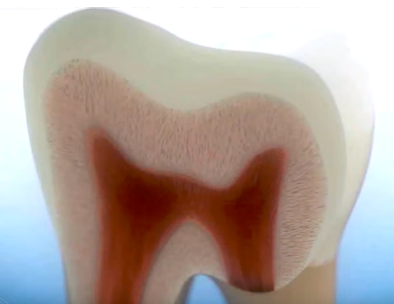
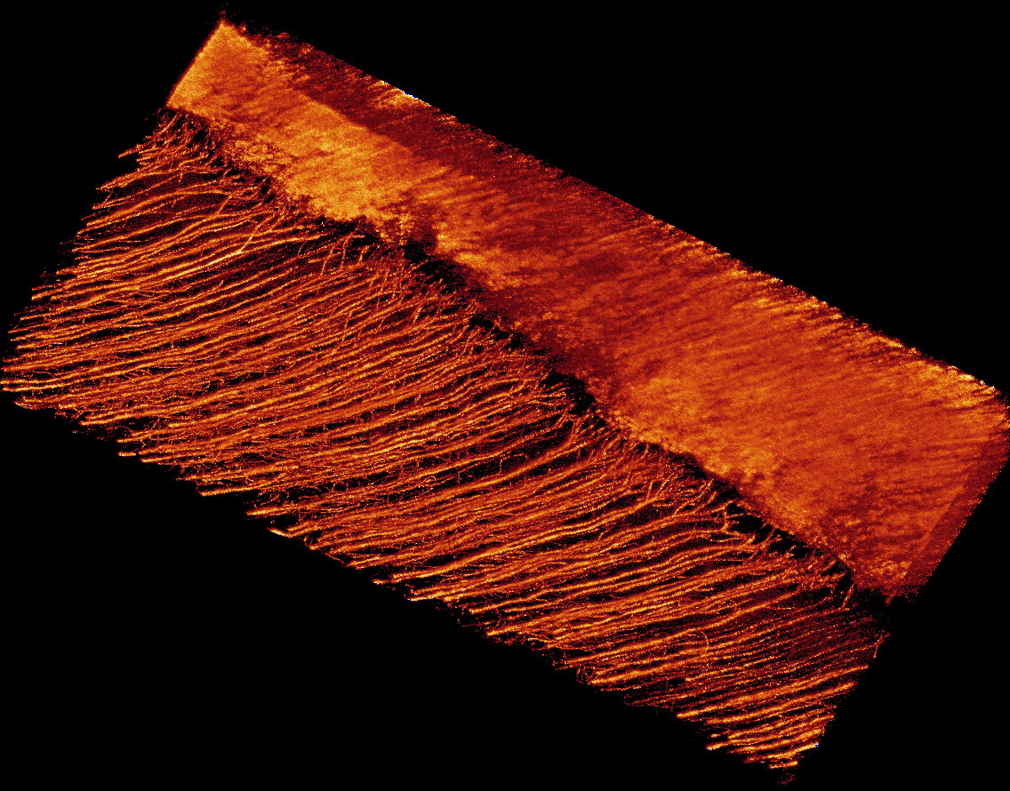
PEROXIDE SAFETY AND THE DENTIN
No Change in Surface Microhardness
No Change in Root Surface Morphology.
No evidence of smear layer solubilization
Confocal Laser Scanning Microscopy
Bleach Effects on DEJ Subsurface Reconstruction in 2D and 3D non-destructive
M.A. KLUKOWSKA, D.J. WHITE Effects of Extended Bleaching on Human Root Dentin 86th Session of the IADR, July 2-5, 2008, Toronto, Canada. 2585

Slide 9
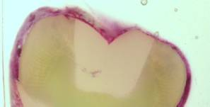
PEROXIDE SAFETY AND RESTORATIVE MATERIAL
BOND STRENGTHS, MICROLEAKAGE, NANOLEAKAGE
Ensure treatment does not promote formation of gaps in margins or bond loosening
No substantial effects on bond strengths or leakage susceptibility of restoration preparations
Post-bleach bonding should take place 2 weeks after bleaching in agreement with literature observations
No Change in MICROLEAKAGE¹
from 70 hours Bleaching with 6.5 % HP
No Change in NANOLEAKAGE²
from 70 hours Bleaching with 6.5 %
No Significant Change in DENTIN BOND STRENGTH³
from 70 Hours Bleaching with 6.5 %
White DJ, Duschner H, Pioch T. Effect of bleaching treatments on microleakage of Class I restorations. J Clin Dent. 2008;19(1):33-6. PMID: 18500158
Effect of Bleaching on Bond Strength of Composite Resin Bonded to Dentin D.J. WHITE1 , C. DOERFER2 , H. DUSCHNER3 , K.M. KOZAK1 , and T. PIOCH2 , 1 The Procter & Gamble Company, Mason, OH, USA, 2 University of Heidelberg, Germany, 3 Johannes Gutenberg-University, Mainz, Germany Research presented at the 81ST General Session of the IADR, June 25-28, 2003
Notes:
1,2 . White DJ, Duschner H, Pioch T. Effect of bleaching treatments on microleakage of Class I restorations. J Clin Dent. 2008;19(1):33-6. PMID: 18500158
3. Effect of Bleaching on Bond Strength of Composite Resin Bonded to Dentin D.J. WHITE1 , C. DOERFER2 , H. DUSCHNER3 , K.M. KOZAK1 , and T. PIOCH2 , 1 The Procter & Gamble Company, Mason, OH, USA, 2 University of Heidelberg, Germany, 3 Johannes Gutenberg-University, Mainz, Germany Research presented at the 81ST General Session of the IADR, June 25-28, 2003
ADA Prescribed Restoration Materials
Dental Gold - Stabilor H - Degussa
Dental Amalgam - Unison 3 - Caulk/Dentsply
Air Dried Glass Ionomer - GC Fuji II
Light Cured Glass Ionomer - GC Fuji II (resin reinforced)
Composite 3M Silox Plus
Porcelain - Duceram Plus (Ducera GMBH)

Slide 10
META-ANALYSIS ON THE SAFETY OF H₂O₂
Safety of vital tooth bleaching with 6% H₂O₂ Whitening
Strips: Evidence from 18 clinical trials
McMillan D, et al. J Dent Res (AADR/IADR) 2003;82. Abstract 1045
18 randomized clinical trials
Treatment: 2x/day for 30 mins. each over 14 days
316 subjects
Conclusion
Clinical safety and tolerability of Whitestrips with 6% H₂O₂ is established.
Mild, transient tooth sensitivity (18%) and oral irritation (17%) were the most commonly reported adverse event.*
* Most resolved during treatment phase or within 1-2 days post-treatment.
https://www.dentalcare.com/-/media/dentalcareus/research/pdf/cws/mcmillan2003.pdf?la=en&v=1-201604251148

