Slide 1
INTERNATIONALIZATION OF GBIF.ORG
Kyle Copas. GBIF Secretariat
GBIF Network Webinar 12 SePT 2018

Slide 2
goals for 2018
Provide user interface (UI) in
5 UN languages: English, Spanish, French, Russian and Simplified Chinese
plus Japanese and Portuguese
Arabic deferred until 2019 (right-to-left support)
Define and initiate minimum content for translation
Present progress report at GB25

Slide 3
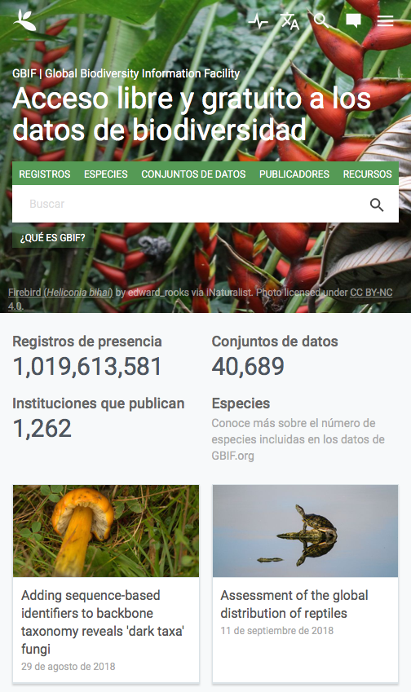
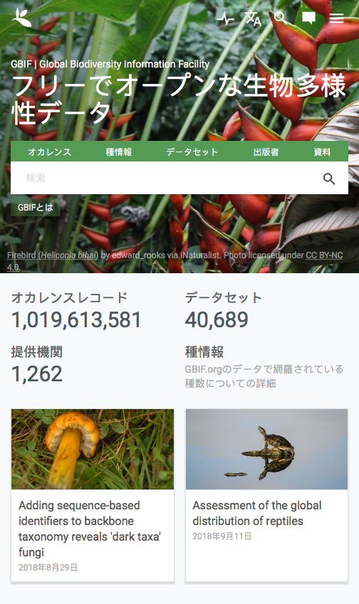
Progress to date
UI now available in
2 UN languages: English, Spanish, French, Russian and Simplified Chinese
plus Japanese and Portuguese
Arabic deferred until 2019 (right-to-left support)
Define and initiate minimum content for translation
Present progress report at GB25

Slide 4
Now Underway

Slide 5
Progress to date
UI now available in
2 UN languages: English, Spanish, French, Russian and Simplified Chinese
plus Japanese and Portuguese
Arabic deferred until 2019 (right-to-left support)
Define and initiate minimum content for translation
Present progress report at GB25
http://bit.ly/gbif-translations

Slide 6
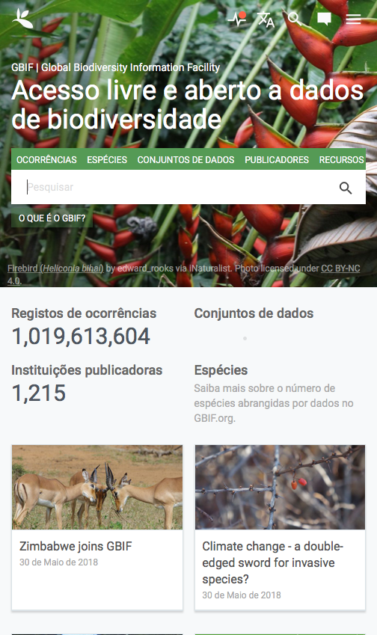
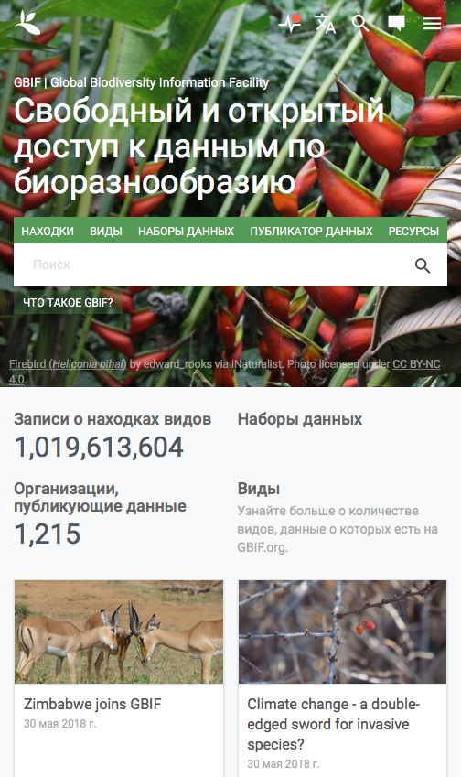
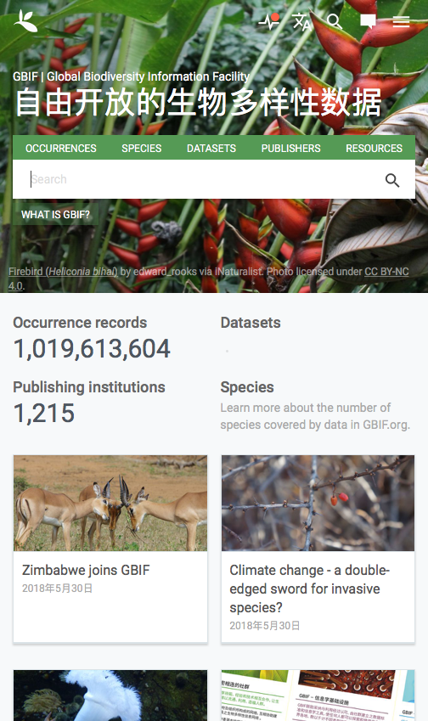
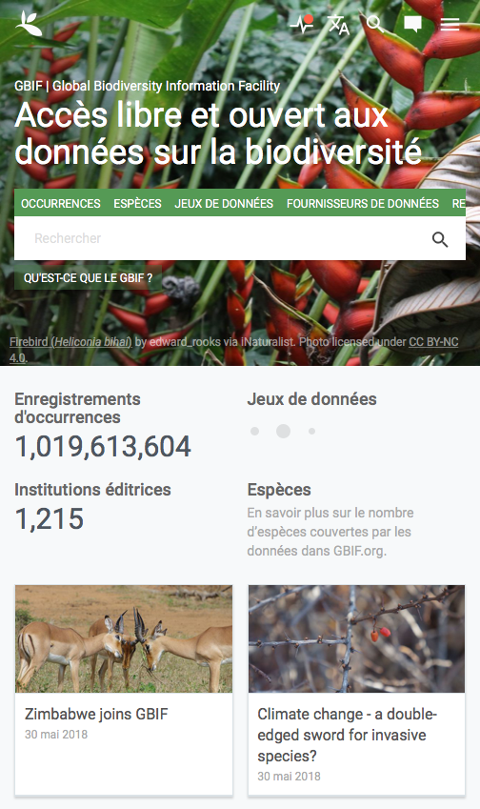
Now Underway
UI translation in
3 more UN languages: Spanish, French, Russian and Simplified Chinese
plus Japanese and Portuguese
Arabic deferred until 2019 (right-to-left support)
Content translation in Spanish and Japanese
Present progress report at GB25
https://www.gbif-uat.org

Slide 7
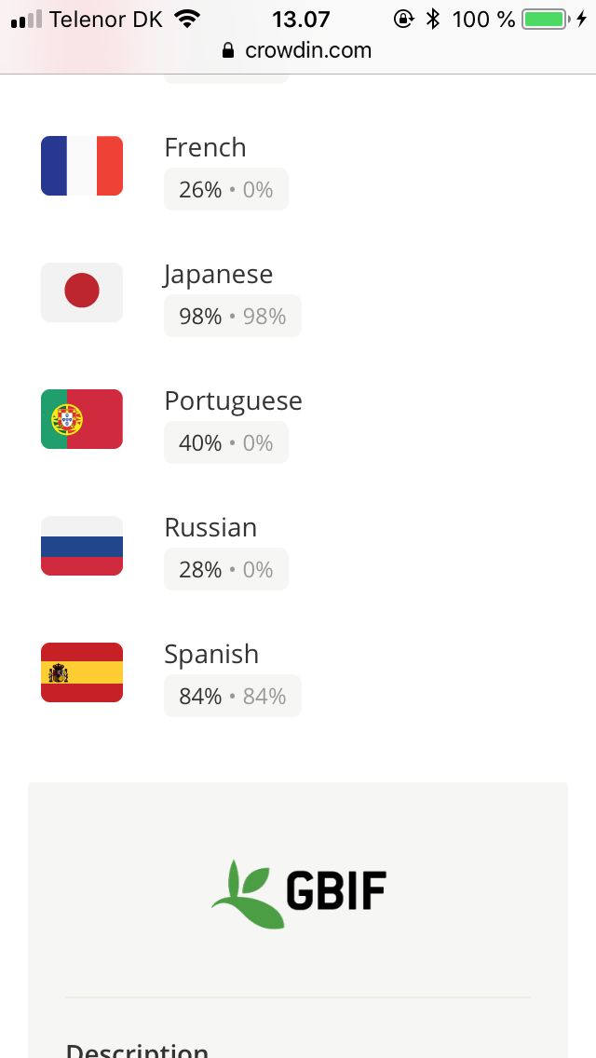
Now Underway
Sun 9/9
Mon 10/9
Tue 11/9
https://crowdin.com/project/gbif-portal

Slide 8
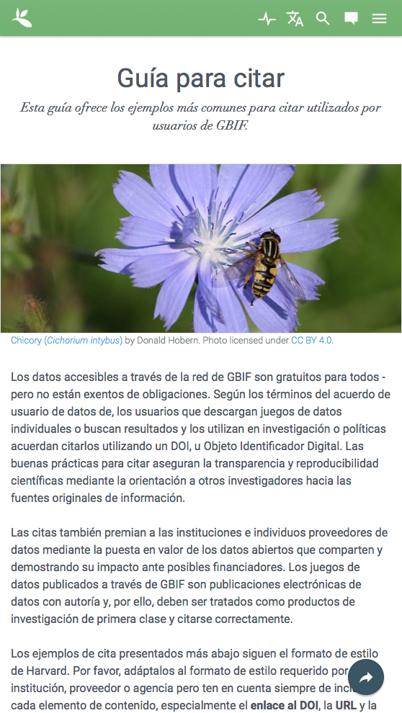
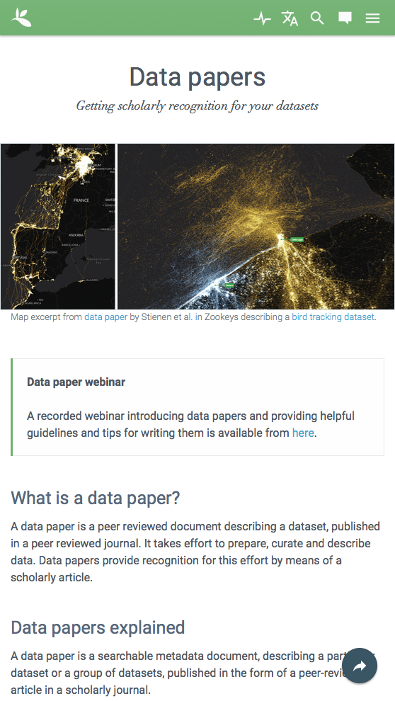
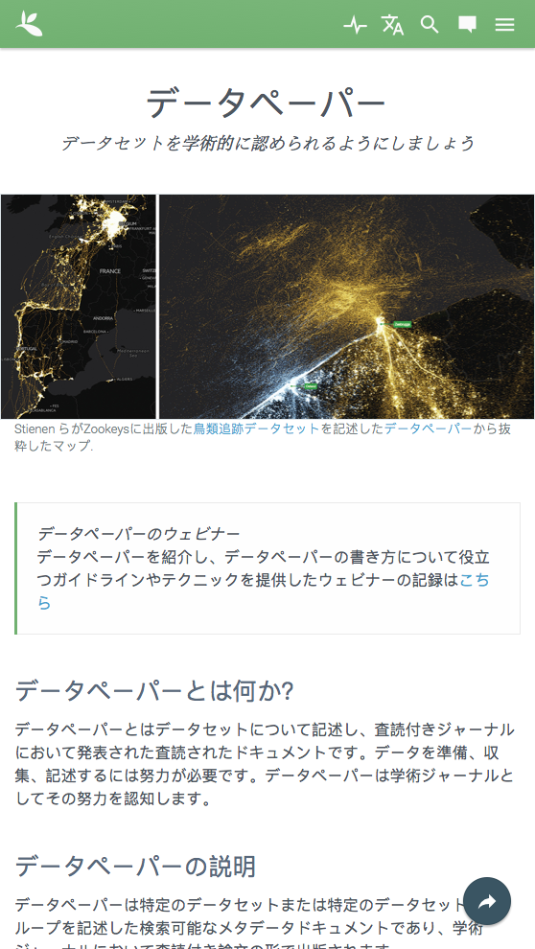
Now Underway
UI translation in
3 more UN languages: Spanish, French, Russian and Simplified Chinese
plus Japanese and Portuguese
Arabic deferred until 2019 (right-to-left support)
Content translation in Spanish and Japanese
Present progress report at GB25

Slide 9
What’s next?
Simplified Chinese translations to follow with the help of the China Biodiversity Conservation and Green Development Fund, assisted and reviewed by Chinese Academy of Sciences

Slide 10
What’s next?
Peer-review the Spanish (por favor)
Call for other native speakers to review work on the UI translations and achieve consensus on choices for ‘world Spanish’ (even when they’re wrong 😉)
Review the site
www.gbif.org/es
Join and comment in the CrowdIn project
bit.ly/gbif-spanish-review
Illustration 5 for Miguel de Cervantes’s Don Quixote by Gustave Doré, 1863.

Slide 11
Last Call for volunteers!
For speakers of French, Russian, Simplified Chinese or Portuguese, join the CrowdIn project—& next week’s online meeting
crowdin.com/project/gbif-portal
For speakers of Spanish and Japanese, join the content team communication@gbif.org
Any other questions? Email communication@gbif.org
Photo: Detroit, 1919—the day before Prohibition. Walter P. Reuther Library, Wayne State University. https://reuther.wayne.edu/node/8259

Slide 12
¡ Muchas Gracias y Arigato !
Miguel Vega, Cristina Villaverde, Felipe Castilla, Carmen Lujano & Katia Cezón GBIF Spain
Anabela Plos GBIF Argentina | Museo Argentino de Ciencias Naturales
Dairo Escobar & Leonardo Buitrago SiB Colombia
Paula Zermoglio VertNet
William Ulate Missouri Botanical Garden
Tsuyoshi Hosoya & Toshie Mizunuma JBIF | National Museum of Nature and Science
Kumiko Totsu National Institute for Environmental Studies

