Slide 1
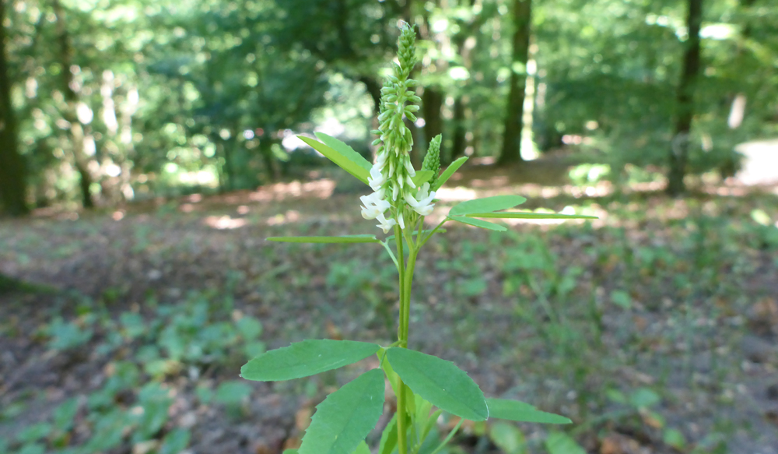
Overview
White sweet clover (Melilotus albus), observed in Wannsee, Berlin, 18 June 2017. Photo CC BY-SA W.-H. Kusber. From BoBO - Botanic Garden and Botanical Museum Berlin-Dahlem Observations https://demo.gbif.org/occurrence/1571031873.
August 2017

Slide 2
BY THE NUMBERS 1 August 2017
Species occurrence records
Datasets
796,839,302
35,562
Country Participants
Organizational Participants
Publishers
53
40
995
Records downloaded per month (avg Jan-Jun 2017)
Unique users per month (May-July avg)
35.2 billion
97,053
Notes:
Useful to see GBIF in its different modalities:
A window on biodiversity
An informatics infrastructure focuseD on tools and standards in service to science and society
A global network on bioinformatics

Slide 3
Current network
participation
https://demo.gbif.org/the-gbif-network

Slide 4
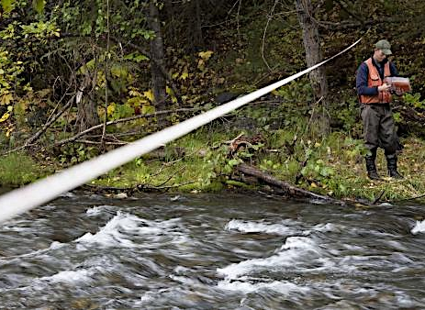
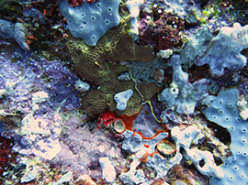
Latest news
communications
iDigBio joins GBIF as organizational member
New Participant coordinates and supports collections digitization in U.S. and globally Read more
Five Pacific Island projects selected to receive BID funding Two regional, two national projects and one ‘small grant’ to receive €361,435 in funding while leveraging €250,000 in co-funding. Read more
2017 Ebbe Nielsen Challenge seeks to liberate open data Annual innovation prize to award €14,000 for tools that enhance the interoperability and reuse of biodiversity records from public data repositories Read more
https://demo.gbif.org/resource/search?contentType=news
Photo credits: (left) Detail of specimen of pineland wild indigo (Baptisia lecontei) from University of South Florida Herbarium, digitized and hosted by iDigBio/ (centre) Coral, Solomon Islands. Photo by Kelsey Schwenk licensed under CC BY-NC 2.0.

Slide 5
Web traffic to GBIF.org, 2017
Rank | Country/Territory | Sessions | % Total Sessions | 2016 rank | Pages / Session
1 | United States | 131,590 | 13.10% | 1 | 4.50
2 | India | 79,631 | 7.92% | 2 | 1.99
3 | Mexico | 40,399 | 4.02% | 7 | 8.26
4 | United Kingdom | 39,646 | 3.95% | 5 | 6.49
5 | Brazil | 39,102 | 3.89% | 8 | 5.26
6 | Spain | 38,694 | 3.85% | 6 | 5.59
7 | Germany | 38,296 | 3.81% | 3 | 5.28
8 | France | 31,510 | 3.14% | 4 | 3.98
9 | Colombia | 28,139 | 2.80% | 13 | 6.32
10 | Indonesia | 21,737 | 2.16% | 12 | 2.58
data access and use

Slide 6
Data published through GBIF.org
data availability
www.gbif.org/analytics/global

Slide 7
Occurrence records published during 2017 by country as of 31 July 2017
 | Country | New records | Apr-17 rank
1 | United Kingdom | 59,462,652 | 13
2 | United States | 13,247,498 | 5
3 | Sweden | 11,841,540 | 1
4 | Spain | 11,451,395 | 2
5 | Belgium | 8,630,814 | 3
6 | Australia | 3,946,492 | 6
7 | Mexico | 3,516,388 | 4
8 | Germany | 3,060,787 | 7
9 | Norway | 1,697,195 | 8
10 | New Zealand | 1,515,343 | 9
data availability
http://www.gbif.org/country

Slide 8
Total number of occurrence records published by country as of 31 July 2017
1 | United States | 349,000,479
2 | United Kingdom | 74,814,012
3 | Sweden | 65,276,558
4 | France | 40,529,158
5 | Australia | 32,039,569
6 | Germany | 31,192,441
7 | Netherlands | 26,916,779
8 | Spain | 24,416,570
9 | Norway | 24,049,271
10 | South Africa | 21,164,432
data availability
http://www.gbif.org/country

Slide 9
Data download requests by country, 2017 as of 31 July 2017
 | Country | Downloads | Apr-17 rank
1 | United States | 9,825 | 1
2 | China | 9,526 | 3
3 | Mexico | 8,439 | 2
4 | Brazil | 5,762 | 4
5 | Colombia | 3,552 | 5
6 | Spain | 2,676 | 6
7 | United Kingdom | 2,400 | 7
8 | South Africa | 1,819 | 8
9 | Germany | 1,263 | 9
10 | Canada | 1,139 | 10
data access and use

Slide 10
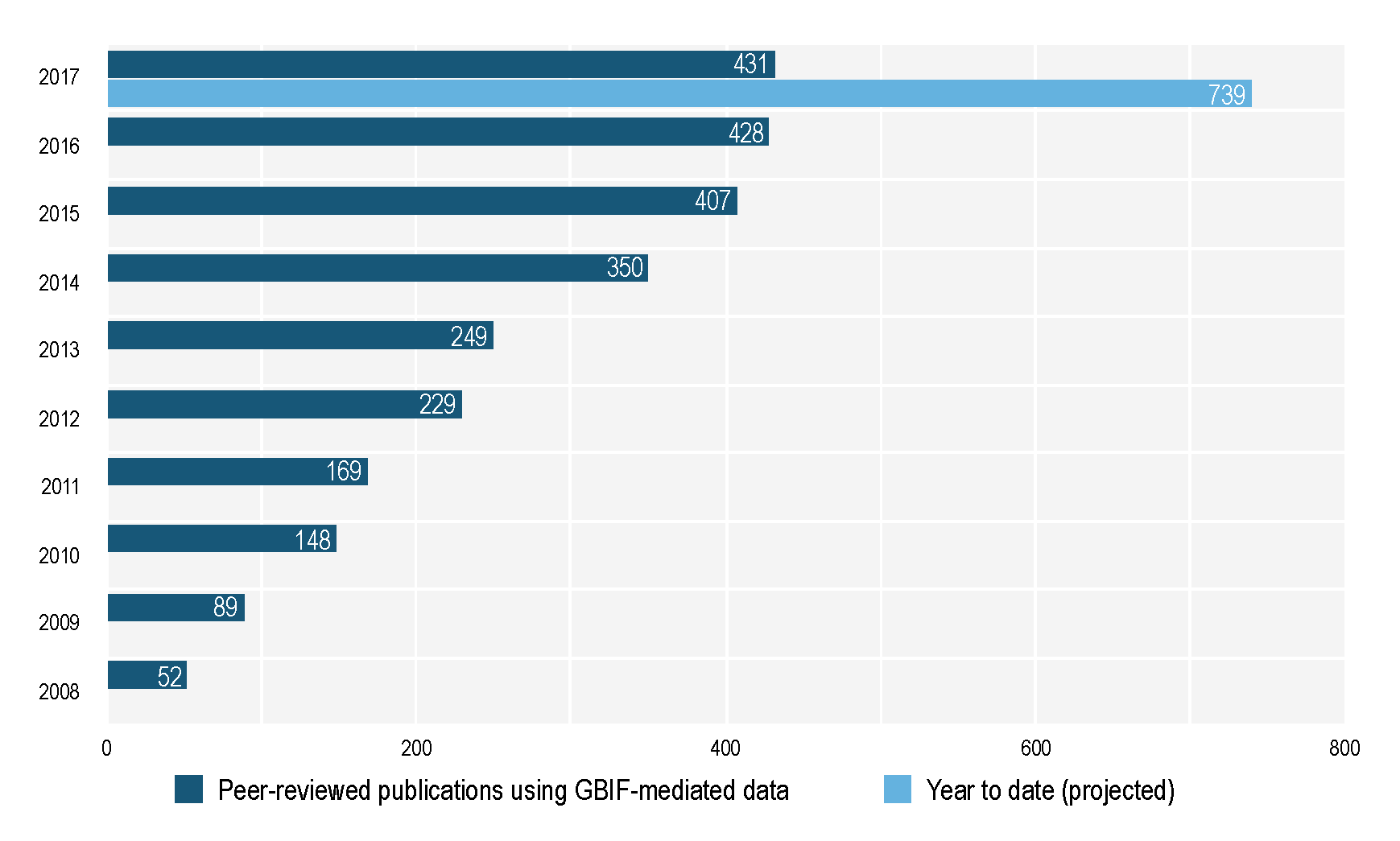
data access and use
Peer-reviewed publications using GBIF-mediated data through 31 July 2017

Slide 11
Peer-reviewed uses, by country and region, 2017
Total # of peer-reviewed papers by country
1 | United States | 122
2 | Brazil | 48
3 | United Kingdom | 47
4 | Germany | 40
5 | Mexico | 39
6 | Australia | 36
7 | Spain | 35
8 | China | 33
9 | Switzerland | 23
10 | France | 22
data access and use
Total # of papers by region
1 | Europe | 317
2 | Latin America | 154
3 | North America | 148
4 | Asia | 95
5 | Oceania | 44
6 | Africa | 32

Slide 12
Featured research May 2017 1/2
 | Amaral AG, Munhoz CBR, Walter BMT, Aguirre-Gutiérrez J & Raes N (2017) Richness pattern and phytogeography of the Cerrado's herb-shrub flora and implications for conservation. Journal of Vegetation Science doi:10.1111/jvs.12541 Author countries: Brazil, Netherlands
 | Ashraf U, Peterson AT, Chaudhry MN et al. (2017) Ecological niche model comparison under different climate scenarios: a case study of Olea spp. in Asia. Ecosphere 8(5): e18025: doi:10.1002/ecs2.1825 Author countries: United States, Pakistan
 | Cross T, Finn JT & Bradley BA (2017) Frequency of invasive plant occurrence is not a suitable proxy for abundance in the Northeast United States. Ecosphere 8(5): e01800. doi:10.1002/ecs2.1800 Author country: United States
 | Maestri R, Shenbrot GI & Krasnov BR (2017) Parasite beta diversity, host beta diversity and environment: application of two approaches to reveal patterns of flea species turnover in Mongolia. Journal of Biogeography. doi:10.1111/jbi.13025 Author countries: Brazil, Israel
 | Males J & Griffiths H (2017) Functional types in the Bromeliaceae: relationships with drought resistance traits and bioclimatic distributions. Functional Ecology. doi:10.1111/1365-2435.12900 Author country: United Kingdom
 | O'Hara CC, Afflerbach JC, Scarborough C, Kaschner K & Halpern BS (2017) Aligning marine species range data to better serve science and conservation. PLoS ONE 12(5): e0175739. doi:10.1371/journal.pone.0175739 Author countries: United States, Germany, United Kingdom
data access and use
Invasive alien species
Impact of climate change
Species conservation and protected areas
Biodiversity and human health
Food, farming and biofuels
Ecosystem services
Advancing biodiversity science
Data management
Data papers
https://demo.gbif.org/resource/search?contentType=literature&literatureType=journal

Slide 13
Featured research May 2017 2/2
 | Phillips HRP, Newbold T & Purvis A (2017) Land-use effects on local biodiversity in tropical forests vary between continents. Biodiversity and Conservation 26(9): 2251-2270. doi:10.1007/s10531-017-1356-2 Author countries: Germany, United Kingdom
 | Sapes G, Serra-Diaz JM, Lloret F (2017) Species climatic niche explains drought-induced die-off in a Mediterranean woody community. Ecosphere 8(5): e01833 doi:10.1002/ecs2.1833 Author countries: United States, Spain
 | Sokolow SH, Jones IJ, Jocque M et al. (2017) Nearly 400 million people are at higher risk of schistosomiasis because dams block the migration of snail-eating river prawns. Philosophical Transactions of the Royal Society B: Biological Sciences 372(1722): 20160127. doi:10.1098/rstb.2016.0127 Author country: United States
 | Stojanović DV, Vajgand D, Radović D, Ćurĉić N & Ćurĉić S (2017) Expansion of the range of the introduced moth Acontia candefacta in southeastern Europe. Bulletin of Insectology. http://bit.ly/2smQji3 Author country: Serbia
 | Truong TTA, Hardy GESJ & Andrew ME (2017) Contemporary Remotely Sensed Data Products Refine Invasive Plants Risk Mapping in Data Poor Regions. Frontiers in Plant Science 8: 770 doi:10.3389/fpls.2017.00770 Author countries: Australia, Viet Nam
data access and use
Invasive alien species
Impact of climate change
Species conservation and protected areas
Biodiversity and human health
Food, farming and biofuels
Ecosystem services
Advancing biodiversity science
Data management
Data papers
https://demo.gbif.org/resource/search?contentType=literature&literatureType=journal

Slide 14
Featured research June 2017 1/2
 | Barratt CD, Bwong BA, Onstein RE et al. (2017) Environmental correlates of phylogenetic endemism in amphibians and the conservation of refugia in the Coastal Forests of Eastern Africa. Diversity and Distributions. doi:10.1111/ddi.12582 Author countries: Switzerland, Netherlands, Kenya, Australia, Italy, United Kingdom
 | Chapman D, Purse BV, Roy HE & Bullock JM (2017) Global trade networks determine the distribution of invasive non-native species, Global Ecology and Biogeography. doi:10.1111/geb.12599 Author country: United Kingdom
 | Chefaoui RM & Serrão EA (2017) Accounting for uncertainty in predictions of a marine species: Integrating population genetics to verify past distributions. Ecological Modelling 359: 229-239. doi:10.1016/j.ecolmodel.2017.06.006 Author countries: Portugal
 | Klonner G, Dullinger I, Wessely J et al. (2017) Will climate change increase hybridization risk between potential plant invaders and their congeners in Europe? Diversity and Distributions. doi:10.1111/ddi.12578 Author countries: Austria, Denmark, France, United Kingdom, China, Czech Republic
 | Ludt WB, Morgan L, Bishop J & Chakrabarty P (2017) A quantitative and statistical biological comparison of three semi-enclosed seas: the Red Sea, the Persian (Arabian) Gulf, and the Gulf of California. Marine Biodiversity. doi:10.1007/s12526-017-0740-1 Author countries: United States, Kuwait
 | Oliveira U, Vasconcelos MF & Santos AJ (2017) Biogeography of Amazon birds: rivers limit species composition, but not areas of endemism. Scientific Reports 7: 2992. doi:10.1038/s41598-017-03098-w Author country: Brazil
data access and use
Invasive alien species
Impact of climate change
Species conservation and protected areas
Biodiversity and human health
Food, farming and biofuels
Ecosystem services
Advancing biodiversity science
Data management
Data papers
https://demo.gbif.org/resource/search?contentType=literature&literatureType=journal

Slide 15
Featured research June 2017 2/2
 | Pérez-Escobar OA, Chomicki G, Condamine FL et al. (2017) Recent origin and rapid speciation of Neotropical orchids in the world's richest plant biodiversity hotspot. New Phytologist 215(2): 891-905. doi:10.1111/nph.14629 Author countries: United Kingdom, Denmark, France, Netherlands, Costa Rica, Australia, Sweden, Switzerland
 | Ramirez-Cabral NYZ, Kumar L & Shabani F (2017) Global risk levels for corn rusts (Puccinia sorghi and Puccinia polysora) under climate change projections. Journal of Phytopathology. doi:10.1111/jph.12593 Author countries: Australia, Mexico
 | Ramírez-Toro W, Torres-Miranda A, González-Rodríguez A, Ruiz-Sanchez E, Luna-Vega I & Oyama K (2017) A Multicriteria Analysis for Prioritizing Areas for Conservation of Oaks (Fagaceae: Quercus) in Oaxaca, Southern Mexico. Tropical Conservation Science. doi:10.1177/1940082917714227 Author country: Mexico
 | Soudzilovskaia NA, Vaessen S, van’t Zelfde M & Raes N (2017) Global Patterns of Mycorrhizal Distribution and Their Environmental Drivers, in Biogeography of Mycorrhizal Symbiosis, ed. Tedersoo L. doi:10.1007/978-3-319-56363-3_11 Author country: Netherlands
 | Talaga S, Leroy C, Guidez A et al. (2017) DNA reference libraries of French Guianese mosquitoes for barcoding and metabarcoding. PLoS ONE 12(6): e0176993. doi:10.1371/journal.pone.0176993 Author country: France
 | Tanner R, Branquart E, Brundu G et al. (2017) The prioritisation of a short list of alien plants for risk analysis within the framework of the Regulation (EU) No. 1143/2014. NeoBiota. doi:10.3897/neobiota.35.12366 Author countries: France, Belgium, Italy, Switzerland, United Kingdom, Denmark, Netherlands
data access and use
Invasive alien species
Impact of climate change
Species conservation and protected areas
Biodiversity and human health
Food, farming and biofuels
Ecosystem services
Advancing biodiversity science
Data management
Data papers
https://demo.gbif.org/resource/search?contentType=literature&literatureType=journal

Slide 16
Featured research July 2017 1/2
 | Duffy GA, Coetzee BWT, Latombe G, Akerman AH, McGeoch MA & Chown SL (2017) Barriers to globally invasive species are weakening across the Antarctic. Diversity and Distributions. doi:10.1111/ddi.12593 Author country: Australia
 | García RM, Parra-Quijano M & Iriondo JM (2017) A Multispecies Collecting Strategy for Crop Wild Relatives Based on Complementary Areas with a High Density of Ecogeographical Gaps. Crop Science 57(3): 1059-1069. doi:10.2135/cropsci2016.10.0860 Author countries: Spain, Columbia
 | Lavery AH (2017) Annotated Checklist of the Spiders, Harvestmen, and Pseudoscorpions of the Falkland Islands and South Georgia. Arachnology 17(5): 210-228. doi:10.13156/arac.2017.17.5.210 Author country: United Kingdom
 | Ortega-García S, Guevara L, Arroyo-Cabrales J et al. (2017) The thermal niche of Neotropical nectar-feeding bats: Its evolution and application to predict responses to global warming. Ecology and Evolution. doi:10.1002/ece3.3171 Author country: Mexico
 | Osawa T, Baba Y, Suguro T, Naya N & Yamauchi T (2017) Specimen records of spiders (Arachnida: Araneae) by monthly census for 3 years in forest areas of Yakushima Island, Japan. Biodiversity Data Journal 5: e14789. doi:10.3897/BDJ.5.e14789 Author country: Japan
 | Quan Q, Che X, Wu Y et al. (2017) Effectiveness of protected areas for vertebrates based on taxonomic and phylogenetic diversity. Conservation Biology. doi:10.1111/cobi.12986 Author countries: China, United States
data access and use
Invasive alien species
Impact of climate change
Species conservation and protected areas
Biodiversity and human health
Food, farming and biofuels
Ecosystem services
Advancing biodiversity science
Data management
Data papers
https://demo.gbif.org/resource/search?contentType=literature&literatureType=journal

Slide 17
Featured research July 2017 2/2
 | Ruete A, Pärt T, Berg Å & Knape J (2017) Exploiting opportunistic observations to estimate changes in seasonal site use: An example with wetland birds. Ecology and Evolution. doi:10.1002/ece3.3100 Author country: Sweden
 | Schmitt S, Pouteau R, Justeau D, Deboissieu F & Birnbaum P (2017) SSDM: an R package to predict distribution of species richness and composition based on stacked species distribution models. Methods in Ecology and Evolution. doi:10.1111/2041-210X.12841 Author country: New Caledonia
 | Van Horn G, Aodha OM, Song Y et al. (2017) The iNaturalist Challenge 2017 Dataset. arXiv 1707.06642v1. https://arxiv.org/abs/1707.06642 Author country: United States
 | Wang C, Hawthorne D, Qin Y, Pan X, Li Z & Zhu S (2017) Impact of climate and host availability on future distribution of Colorado potato beetle. Scientific Reports 7: 4489. doi:10.1038/s41598-017-04607-7 Author countries: China, United States
 | Wheeler HC, Høye TT, Svenning JC (2017) Wildlife species benefitting from a greener Arctic are most sensitive to shrub cover at leading range edges. Global Change Biology. doi:10.1111/gcb.13837 Author countries: Denmark, Norway, France, Canada
 | Xu QF, Liang CF, Chen JH, Li YC, Qin H & Fuhrmann JJ (2017) Running bamboo invasion in native and non-native regions worldwide. Biological Invasions. doi:10.1007/s10530-017-1512-3 Author countries: China, United States
data access and use
Invasive alien species
Impact of climate change
Species conservation and protected areas
Biodiversity and human health
Food, farming and biofuels
Ecosystem services
Advancing biodiversity science
Data management
Data papers
https://demo.gbif.org/resource/search?contentType=literature&literatureType=journal

