Slide 1
Building a community of practice supporting biodiversity data
Melianie Raymond, GBIF Secretariat
Showcasing the work of the consortium of scientific partners on biodiversity, CBD Cop14, 19 November 2019

Slide 2
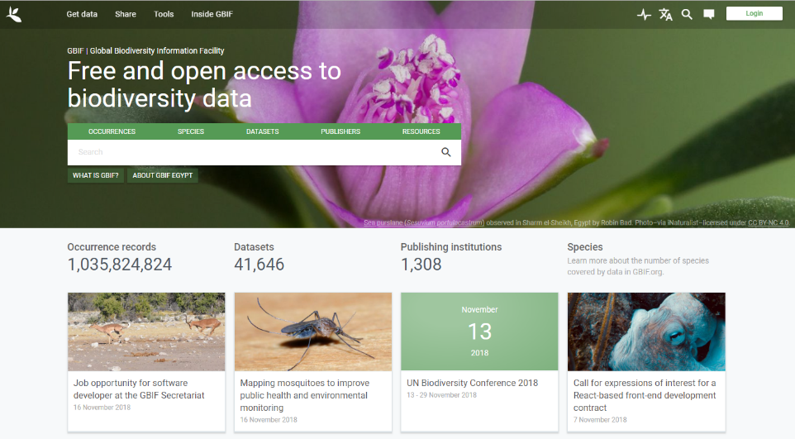
www.gbif.org

Slide 3
Enabling GBIF to be truly Global in scope

Slide 4
Core capacity enhancement programme
Supplementary funded programmes
Capacity enhancement workshops
Community of practice
Capacity self-assessments

Slide 5
Biodiversity Information for Development - BID
Overall objective:
Improved management of natural capital for human well-being; through increased application of biodiversity information as evidence for decision making

Slide 6
€3,9 million grant under the EuropeAid Biodiversity for Life (B4Live) flagship umbrella programme.
GBIF committed a further €1 million in-kind support
4 calls
63 funded projects
91 new data publishing institutions
690,362 occurrence records

Slide 7
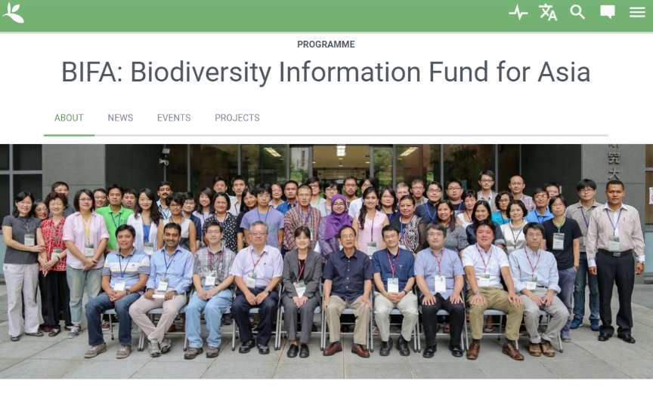
New Call for proposals open today

Slide 8
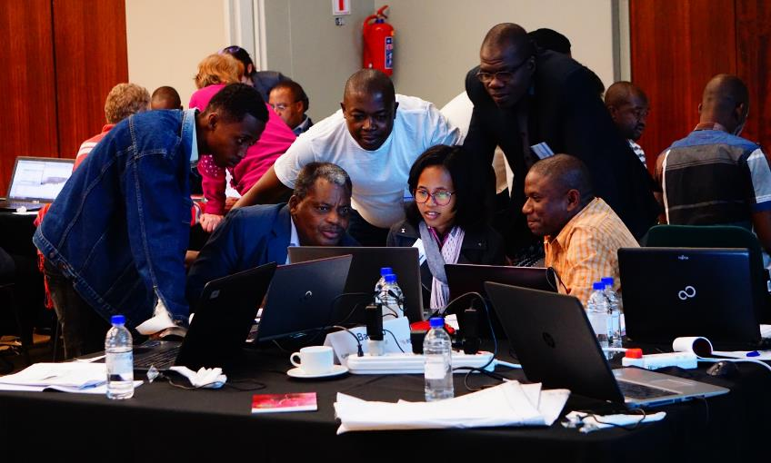
Enhanced capacity for effective mobilization and use of biodiversity information
Needs-based
Multilingual workshop and online curricula
Community of practice
Cape Town Data Use Workshop – April 2018

Slide 9
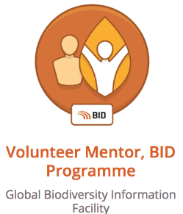
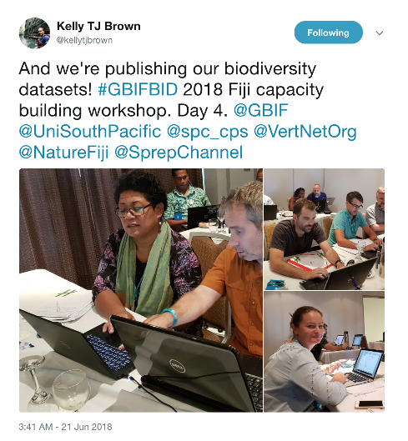
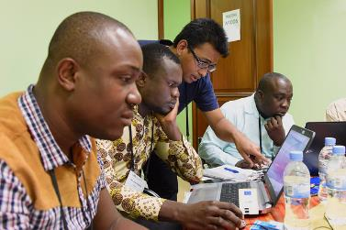
Community of practice
Andry Jean Marc Rakotomanjaka mentoring participants in the first BID data mobilization workshop

Slide 10
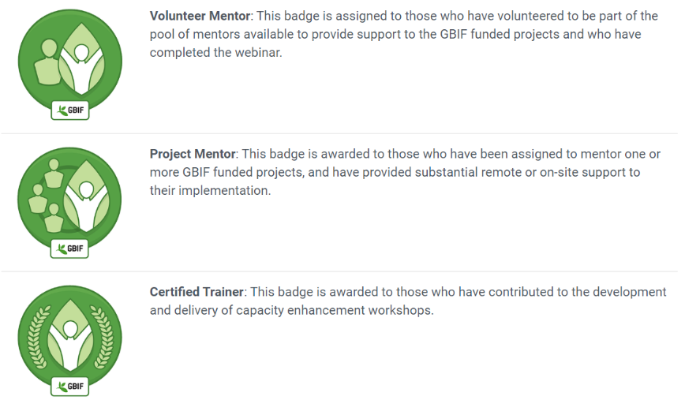
GBIF VOLUNTEER MENTORS FORMING A COMMUNITY OF PRACTICE

Slide 11
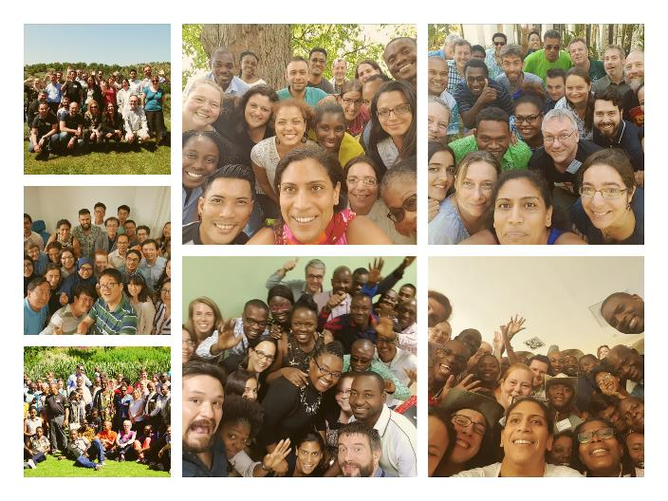
MENTORING EVENTS
Trinidad & Tobago 2017
Samoa 2017
Montenegro 2018
Beijing
2018
Cape Town 2018
Rwanda 2016
Cape Town 2017

Slide 12
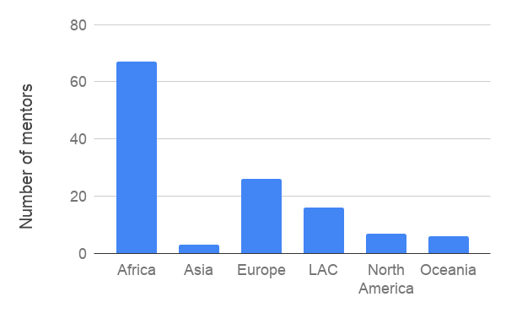
125 mentors & trainers

Slide 13
CSP PARTNERS CONTRIBUTING MENTORS

Slide 14
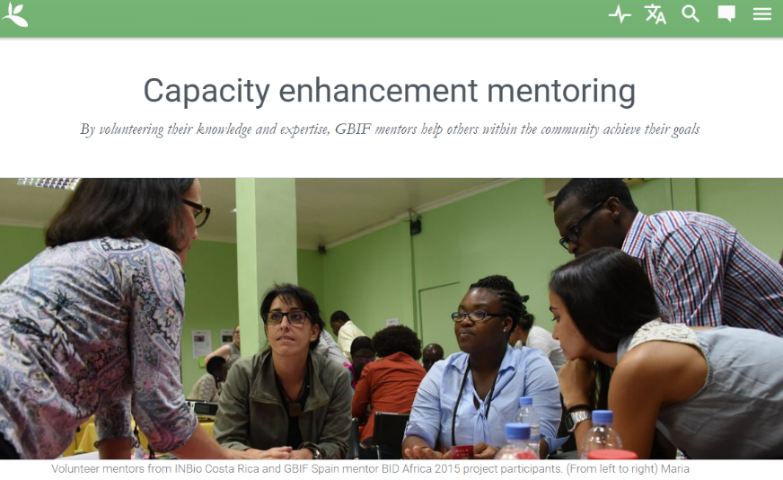
GET INVOLVED
http://bit.ly/gbif-mentor

Slide 15
POST 2020 FRAMEWORK
This approach can scale up capacity building
CSP can be a source of mentoring expertise in various fields
Mobilizing willing experts

Slide 16
Building a community of practice supporting biodiversity data
Melianie Raymond, GBIF Secretariat
Showcasing the work of the consortium of scientific partners on biodiversity, CBD Cop14, 19 November 2019

