Slide 1

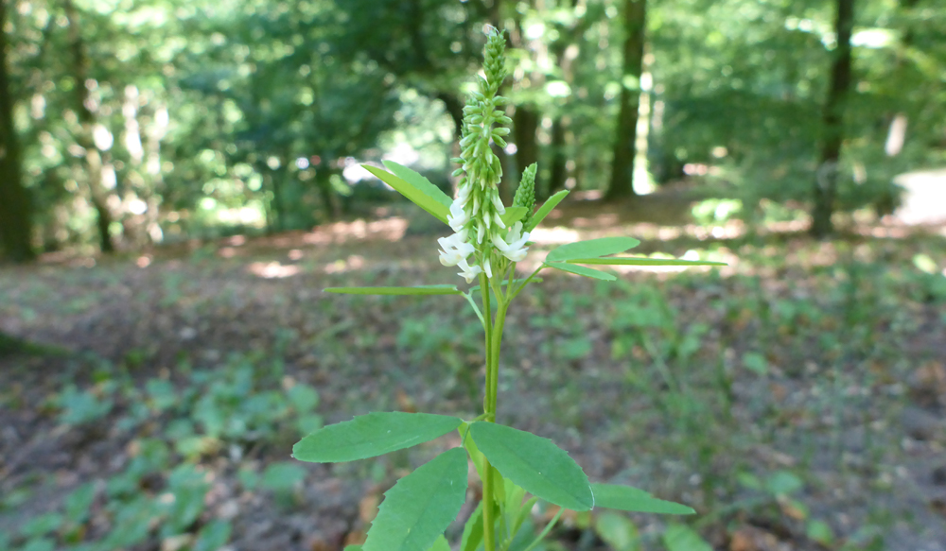
Overview
White sweet clover (Melilotus albus), observed in Wannsee, Berlin, 18 June 2017.
Photo CC BY-SA W.-H. Kusber. From BoBO - Botanic Garden and Botanical Museum Berlin-Dahlem Observations https://demo.gbif.org/occurrence/1571031873.
July 2017

Slide 2

BY THE NUMBERS
1 July 2017
Species occurrence records
Datasets
783,186,133
35,238
Country Participants
Organizational Participants
Publishers
54
40
895
Records downloaded per month (avg 2017)
Unique users per month (May-June avg)
35.2 billion
102,372
Notes:
Useful to see GBIF in its different modalities:
A window on biodiversity
An informatics infrastructure focuseD on tools and standards in service to science and society
A global network on bioinformatics

Slide 3
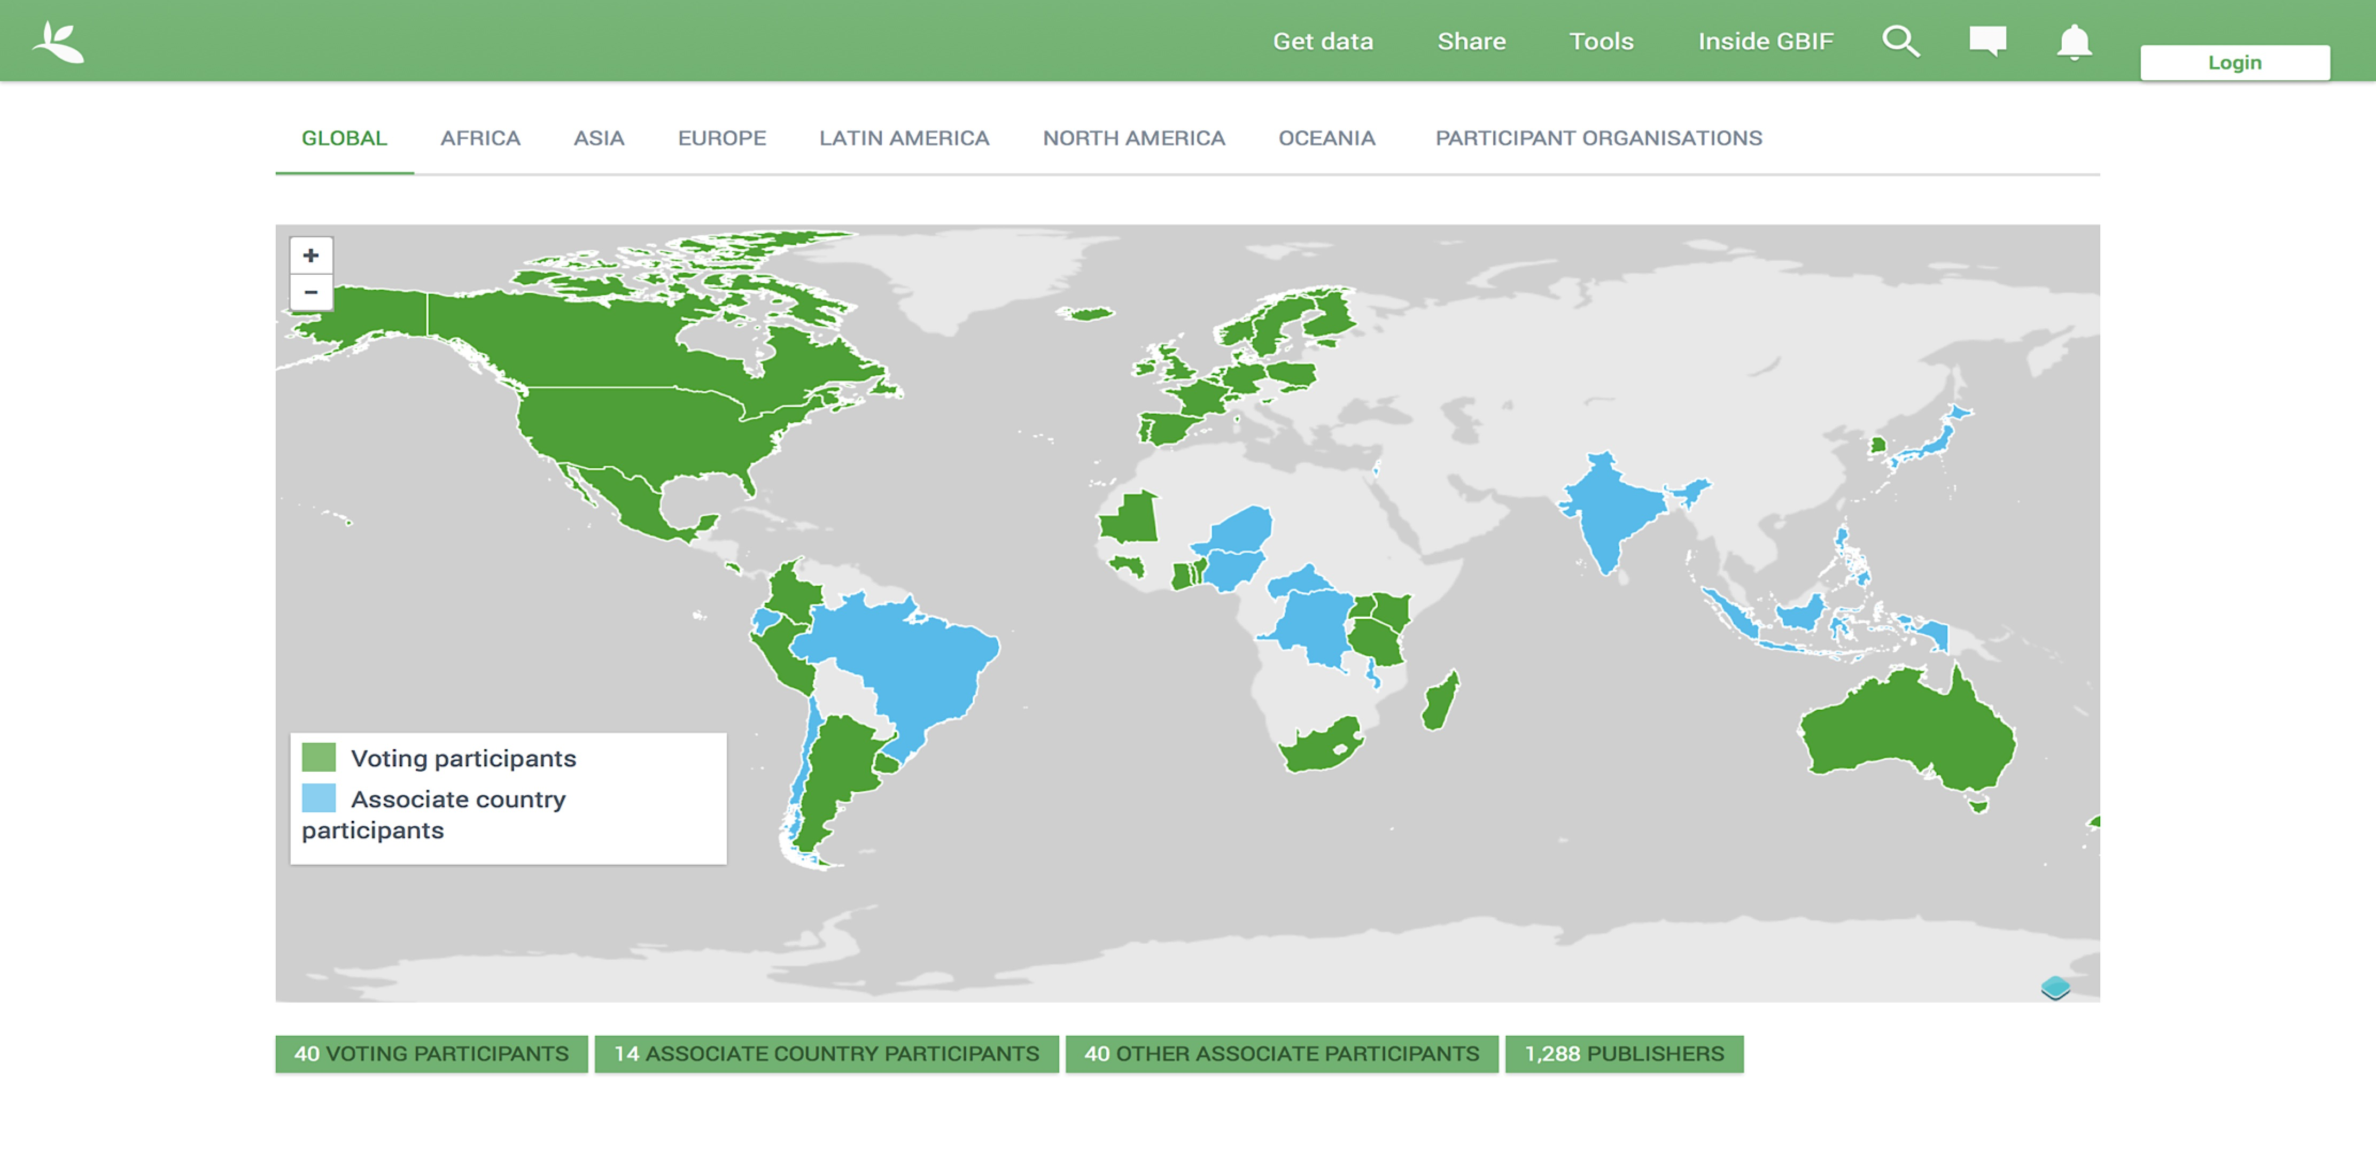
Current network
participation
https://demo.gbif.org/the-gbif-network

Slide 4
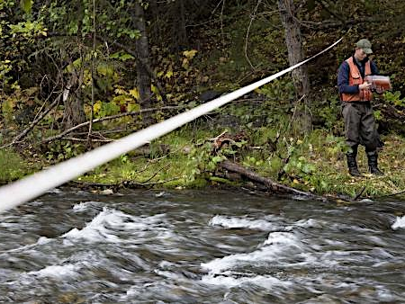
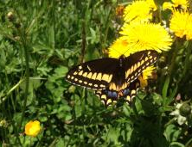
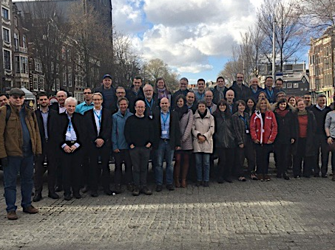
Latest news
communications
      Call for nominations opens for 2017 Young Researchers Awards
      Nominations due 15 July for 2017 programme focused on publication of sampling-event datasets
      Read more
      Canada resumes full participation in GBIF
      One of GBIF’s founding national delegations restores status and becomes 40th Voting Participant
      Read more
      GLOBIS-B workshop on developing an ‘EBV’ class for species traits
      Experts gathered to discuss creation of consistent ecological metrics for phenological and physiological traits and behaviours
      Read more (from GLOBIS-B)
http://www.gbif.org/newsroom/summary
Photo credits: (left) Surveying in Cooper Creek, Chugach National Forest, Alaska. Photo by USDA Forest Service Alaska Region, licensed under CC BY 2.0.
(centre) Short-tailed swallowtail (Papilio brevicauda). Photo by Jody Allair licensed under CC BY-NC 4.0. (right) Courtesy of GLOBIS-B.

Slide 5
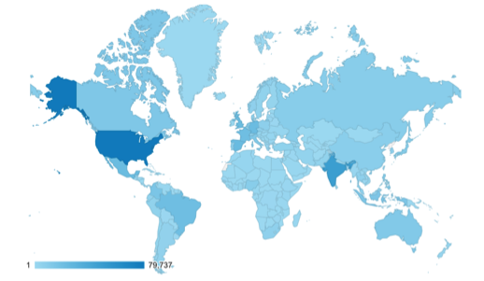
Web traffic to GBIF.org, 2017
Rank | Country/Territory | Sessions | % Total Sessions | 2016 rank | Pages / Session
1 | United States | 117,789 | 13.37% | 1 | 4.52
2 | India | 68,714 | 7.80% | 2 | 1.99
3 | Mexico | 36,338 | 4.12% | 7 | 8.40
4 | United Kingdom | 34,848 | 3.95% | 5 | 6.67
5 | Spain | 34,552 | 3.92% | 6 | 5.68
6 | Brazil | 33,898 | 3.85% | 8 | 5.33
7 | Germany | 33,191 | 3.77% | 3 | 5.35
8 | France | 28,224 | 3.20% | 4 | 3.77
9 | Colombia | 24,712 | 2.80% | 13 | 6.36
10 | Indonesia | 20,006 | 2.27% | 12 | 2.62
data access and use

Slide 6
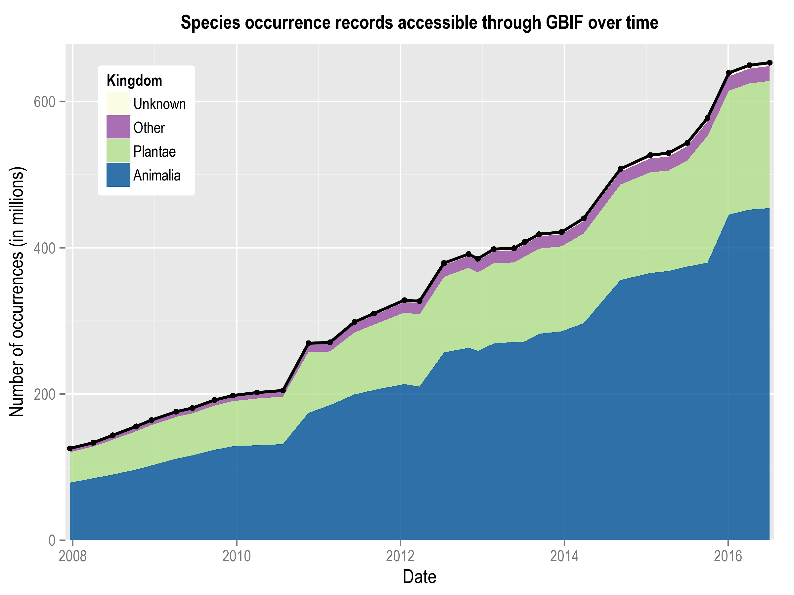
Data published through GBIF.org
data availability
www.gbif.org/analytics/global

Slide 7
Occurrence records published during 2017 by country
 | Country | New records | Feb-17 rank
1 | Sweden | 11,346,533 | 1
2 | Spain | 8,969,548 | 19
3 | Belgium | 7,541,222 | 9
4 | Mexico | 3,516,388 | 2
5 | United States | 3,220,424 | 5
6 | Australia | 2,597,168 | 16
7 | Germany | 1,870,213 | 17
8 | Norway | 1,630,498 | 3
9 | New Zealand | 1,499,975 | 6
10 | Canada | 723,367 | 7
data availability
http://www.gbif.org/country

Slide 8
Total number of occurrence records published by country as of 30 Apr 2017
1 | United States | 339,979,449
2 | Sweden | 65,190,071
3 | France | 40,519,027
4 | Australia | 31,451,021
5 | Germany | 30,325,909
6 | United Kingdom | 29,406,999
7 | Netherlands | 26,545,089
8 | Norway | 24,232,504
9 | Spain | 23,277,447
10 | South Africa | 21,218,378
data availability
http://www.gbif.org/country

Slide 9
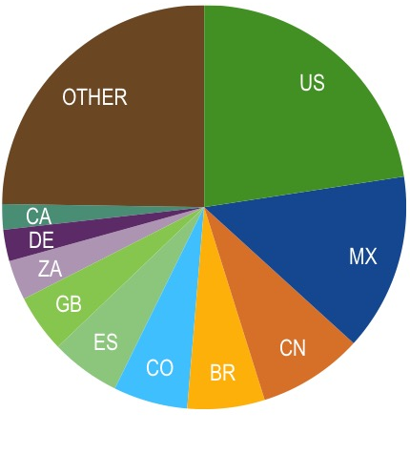
Data download requests by country, 2017
 | Country | Downloads | Feb-17 rank
1 | United States | 7,576 | 1
2 | Mexico | 4,756 | 2
3 | China | 2,818 | 5
4 | Brazil | 2,074 | 4
5 | Colombia | 1,994 | 9
6 | Spain | 1,873 | 6
7 | United Kingdom | 1,556 | 3
8 | South Africa | 1,071 | 7
9 | Germany | 844 | 8
10 | Canada | 683 | 12
data access and use

Slide 10
data access and use
Peer-reviewed publications using GBIF-mediated data

Slide 11
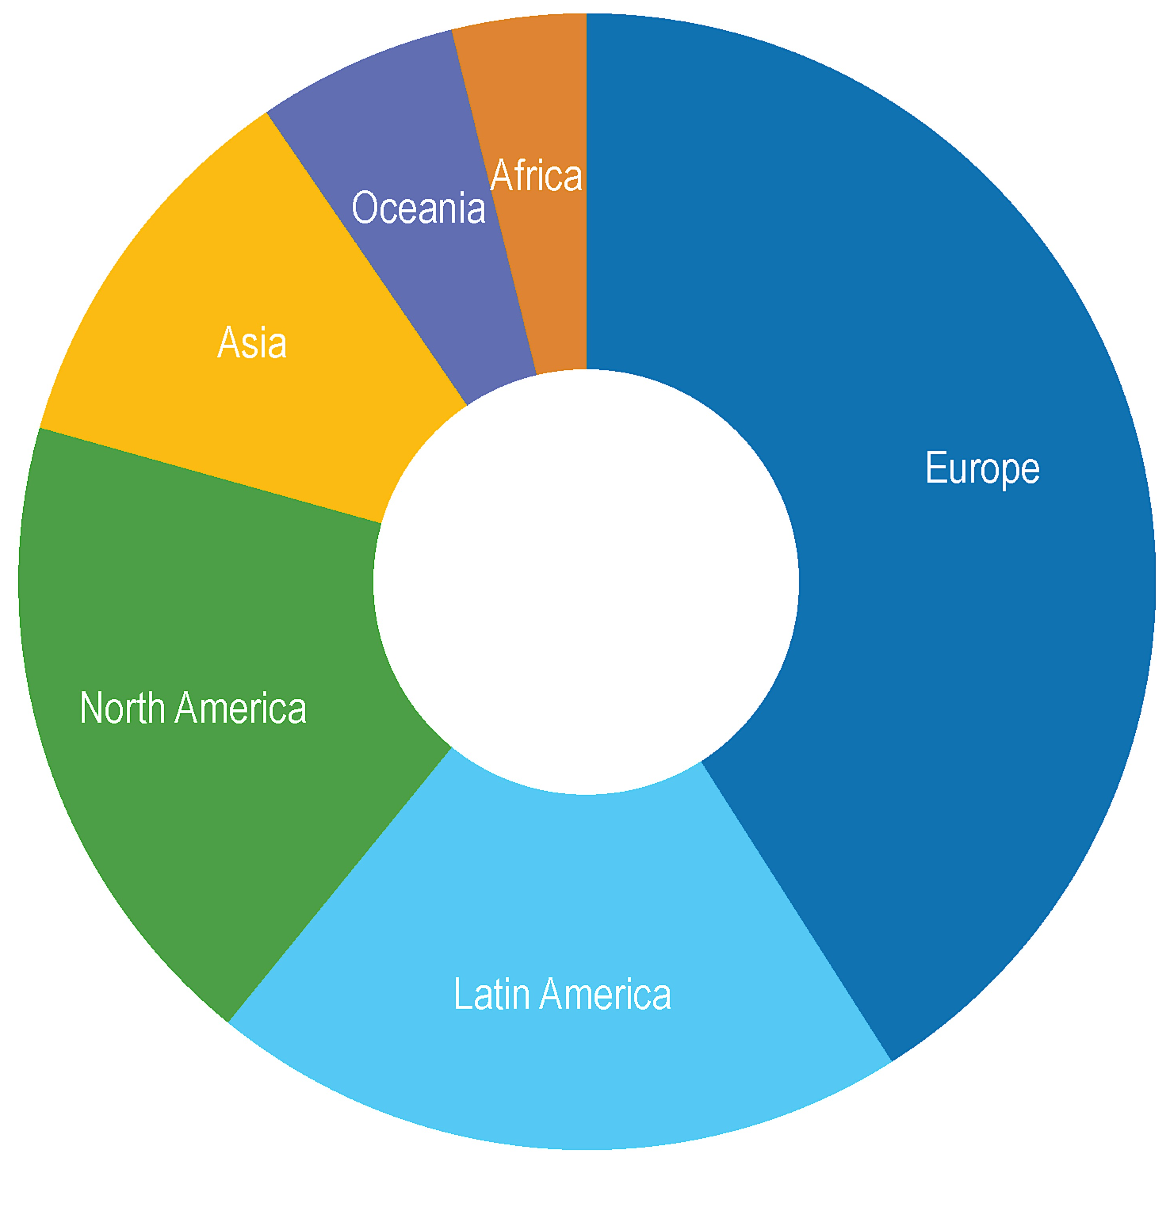
Peer-reviewed uses, by country and region, 2017
Total # of peer-reviewed papers by country
1 | United States | 102
2 | Brazil | 40
3 | United Kingdom | 39
4 | Germany | 32
5 | Australia | 31
6 | Mexico | 30
7 | Spain | 28
8 | China | 24
9 | Switzerland | 21
10 | France | 20
data access and use
Total # of papers by region
1 | Europe | 266
2 | Latin America | 129
3 | North America | 120
4 | Asia | 72
5 | Oceania | 37
6 | Africa | 25

Slide 12
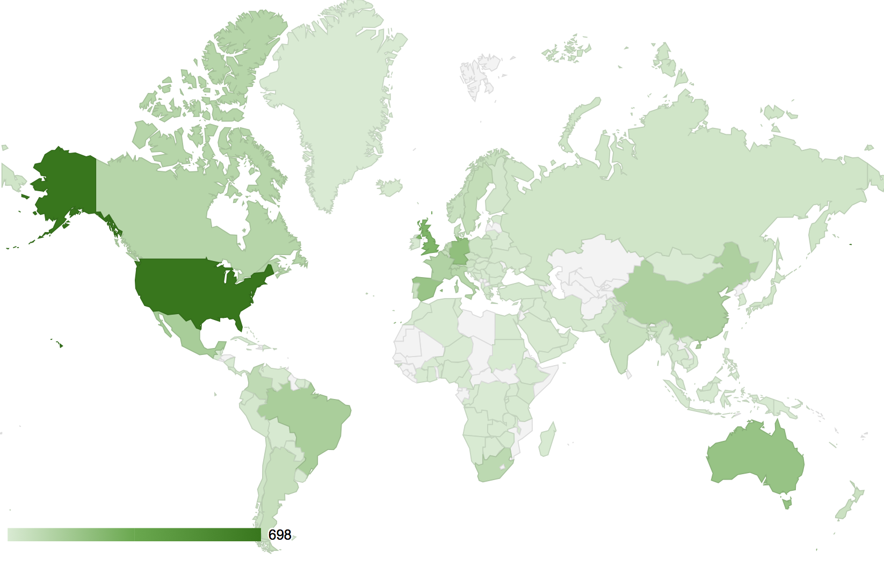
data access and use
Geography of GBIF-enabled research
2008-present
In this map, darker shades indicate a higher number of peer-reviewed papers citing use of GBIF as a data source, authored by researchers from institutions in the country shown.
To view an interactive version of this map, including the up to date number for each country, visit http://buff.ly/2nY4hY7

Slide 13
Featured research
May 2017
1/3
 | Amaral AG, Munhoz CBR, Walter BMT, Aguirre-Gutiérrez J & Raes N (2017) Richness pattern and phytogeography of the Cerrado's herb-shrub flora and implications for conservation. Journal of Vegetation Science doi:10.1111/jvs.12541 Author countries: Brazil, Netherlands Conservation
 | Ashraf U, Peterson AT, Chaudhry MN et al. (2017) Ecological niche model comparison under different climate scenarios: a case study of Olea spp. in Asia. Ecosphere 8(5): e18025: doi:10.1002/ecs2.1825 Author countries: United States, Pakistan Species distribution
 | Cross T, Finn JT & Bradley BA (2017) Frequency of invasive plant occurrence is not a suitable proxy for abundance in the Northeast United States. Ecosphere 8(5): e01800. doi:10.1002/ecs2.1800 Author country: United States
 | Maestri R, Shenbrot GI & Krasnov BR (2017) Parasite beta diversity, host beta diversity and environment: application of two approaches to reveal patterns of flea species turnover in Mongolia. Journal of Biogeography. doi:10.1111/jbi.13025 Author countries: Brazil, Israel Biogeography
 | Males J & Griffiths H (2017) Functional types in the Bromeliaceae: relationships with drought resistance traits and bioclimatic distributions. Functional Ecology. doi:10.1111/1365-2435.12900 Author country: United Kingdom Ecology
 | O'Hara CC, Afflerbach JC, Scarborough C, Kaschner K & Halpern BS (2017) Aligning marine species range data to better serve science and conservation. PLoS ONE 12(5): e0175739. doi:10.1371/journal.pone.0175739 Author countries: United States, Germany, United Kingdom Conservation
data access and use
Invasive alien species
Impact of climate change
Species conservation and protected areas
Biodiversity and human health
Food, farming and biofuels
Ecosystem services
Advancing biodiversity science
Data management
Data papers
https://demo.gbif.org/cms/search?type=data_use

Slide 14
Featured research
May 2017
2/2
 | Phillips HRP, Newbold T & Purvis A (2017) Land-use effects on local biodiversity in tropical forests vary between continents. Biodiversity and Conservation 26(9): 2251-2270. doi:10.1007/s10531-017-1356-2 Author countries: Germany, United Kingdom Conservation
 | Sapes G, Serra-Diaz JM, Lloret F (2017) Species climatic niche explains drought-induced die-off in a Mediterranean woody community. Ecosphere 8(5): e01833 doi:10.1002/ecs2.1833 Author countries: United States, Spain Conservation
 | Sokolow SH, Jones IJ, Jocque M et al. (2017) Nearly 400 million people are at higher risk of schistosomiasis because dams block the migration of snail-eating river prawns. Philosophical Transactions of the Royal Society B: Biological Sciences 372(1722): 20160127. doi:10.1098/rstb.2016.0127 Author country: United States
 | Stojanović DV, Vajgand D, Radović D, Ćurĉić N & Ćurĉić S (2017) Expansion of the range of the introduced moth Acontia candefacta in southeastern Europe. Bulletin of Insectology. http://bit.ly/2smQji3 Author country: Serbia
 | Truong TTA, Hardy GESJ & Andrew ME (2017) Contemporary Remotely Sensed Data Products Refine Invasive Plants Risk Mapping in Data Poor Regions. Frontiers in Plant Science 8: 770 doi:10.3389/fpls.2017.00770 Author countries: Australia, Viet Nam
data access and use
Invasive alien species
Impact of climate change
Species conservation and protected areas
Biodiversity and human health
Food, farming and biofuels
Ecosystem services
Advancing biodiversity science
Data management
Data papers
https://demo.gbif.org/cms/search?type=data_use

Slide 15
Featured research
June 2017
1/2
 | Barratt CD, Bwong BA, Onstein RE et al. (2017) Environmental correlates of phylogenetic endemism in amphibians and the conservation of refugia in the Coastal Forests of Eastern Africa. Diversity and Distributions. doi:10.1111/ddi.12582 Author countries: Switzerland, Netherlands, Kenya, Australia, Italy, United Kingdom Conservation
 | Chapman D, Purse BV, Roy HE & Bullock JM (2017) Global trade networks determine the distribution of invasive non-native species, Global Ecology and Biogeography. doi:10.1111/geb.12599 Author country: United Kingdom
 | Chefaoui RM & Serrão EA (2017) Accounting for uncertainty in predictions of a marine species: Integrating population genetics to verify past distributions. Ecological Modelling 359: 229-239. doi:10.1016/j.ecolmodel.2017.06.006 Author countries: Portugal Marine
 | Klonner G, Dullinger I, Wessely J et al. (2017) Will climate change increase hybridization risk between potential plant invaders and their congeners in Europe? Diversity and Distributions. doi:10.1111/ddi.12578 Author countries: Austria, Denmark, France, United Kingdom, China, Czech Republic
 | Ludt WB, Morgan L, Bishop J & Chakrabarty P (2017) A quantitative and statistical biological comparison of three semi-enclosed seas: the Red Sea, the Persian (Arabian) Gulf, and the Gulf of California. Marine Biodiversity. doi:10.1007/s12526-017-0740-1 Author countries: United States, Kuwait Biogeography
 | Oliveira U, Vasconcelos MF & Santos AJ (2017) Biogeography of Amazon birds: rivers limit species composition, but not areas of endemism. Scientific Reports 7: 2992. doi:10.1038/s41598-017-03098-w Author country: Brazil Biogeography
data access and use
Invasive alien species
Impact of climate change
Species conservation and protected areas
Biodiversity and human health
Food, farming and biofuels
Ecosystem services
Advancing biodiversity science
Data management
Data papers
https://demo.gbif.org/cms/search?type=data_use

Slide 16
Featured research
June 2017
2/2
 | Pérez-Escobar OA, Chomicki G, Condamine FL et al. (2017) Recent origin and rapid speciation of Neotropical orchids in the world's richest plant biodiversity hotspot. New Phytologist 215(2): 891-905. doi:10.1111/nph.14629 Author countries: United Kingdom, Denmark, France, Netherlands, Costa Rica, Australia, Sweden, Switzerland Biogeography
 | Ramirez-Cabral NYZ, Kumar L & Shabani F (2017) Global risk levels for corn rusts (Puccinia sorghi and Puccinia polysora) under climate change projections. Journal of Phytopathology. doi:10.1111/jph.12593 Author countries: Australia, Mexico
 | Ramírez-Toro W, Torres-Miranda A, González-Rodríguez A, Ruiz-Sanchez E, Luna-Vega I & Oyama K (2017) A Multicriteria Analysis for Prioritizing Areas for Conservation of Oaks (Fagaceae: Quercus) in Oaxaca, Southern Mexico. Tropical Conservation Science. doi:10.1177/1940082917714227 Author country: Mexico Conservation
 | Soudzilovskaia NA, Vaessen S, van’t Zelfde M & Raes N (2017) Global Patterns of Mycorrhizal Distribution and Their Environmental Drivers, in Biogeography of Mycorrhizal Symbiosis, ed. Tedersoo L. doi:10.1007/978-3-319-56363-3_11 Author country: Netherlands Species distribution
 | Talaga S, Leroy C, Guidez A et al. (2017) DNA reference libraries of French Guianese mosquitoes for barcoding and metabarcoding. PLoS ONE 12(6): e0176993. doi:10.1371/journal.pone.0176993 Author country: France Taxonomy
 | Tanner R, Branquart E, Brundu G et al. (2017) The prioritisation of a short list of alien plants for risk analysis within the framework of the Regulation (EU) No. 1143/2014. NeoBiota. doi:10.3897/neobiota.35.12366 Author countries: France, Belgium, Italy, Switzerland, United Kingdom, Denmark, Netherlands
data access and use
Invasive alien species
Impact of climate change
Species conservation and protected areas
Biodiversity and human health
Food, farming and biofuels
Ecosystem services
Advancing biodiversity science
Data management
Data papers
https://demo.gbif.org/cms/search?type=data_use

