Slide 1

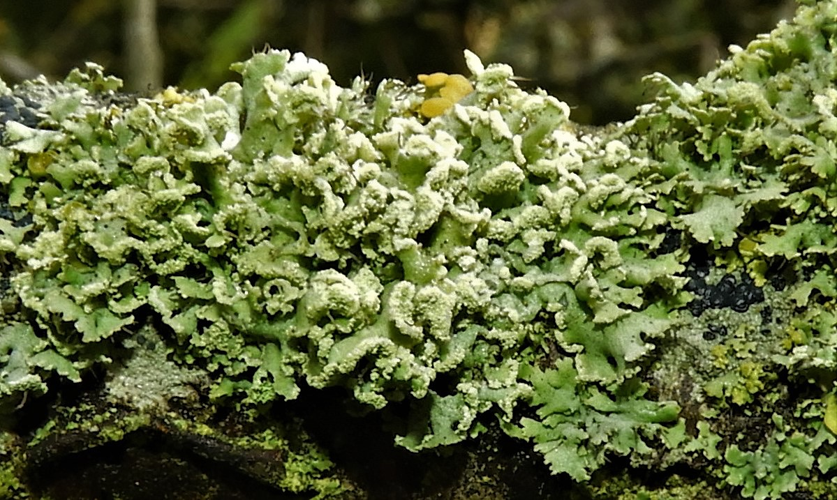
Overview
Fringed rosette lichen (Physcia tenella), Lehnskov Strand, Svendborg, Funen, Denmark, 12 July 2019.
Photo CC BY-NC Dan Schou via Danish Mycological Society https://www.gbif.org/occurrence/2274829755
July 2019

Slide 2

BY THE NUMBERS
17 July 2019
Species occurrence records
Datasets
1,329,638,311
45,486
Country Participants
Organizational Participants
Publishers
58
38
1,428
Average records served per month (Jan-May 2019)
Avg monthly user sessions (Jan-June 2019)
32.7 billion
187,547
Notes:
The numbers in the top two lines here can (and should) be updated ahead of use in presentation: find them on the home page, https://www.gbif.org.
1 July numbers
1,328,174,117
45,281
59
38
1,419

Slide 3
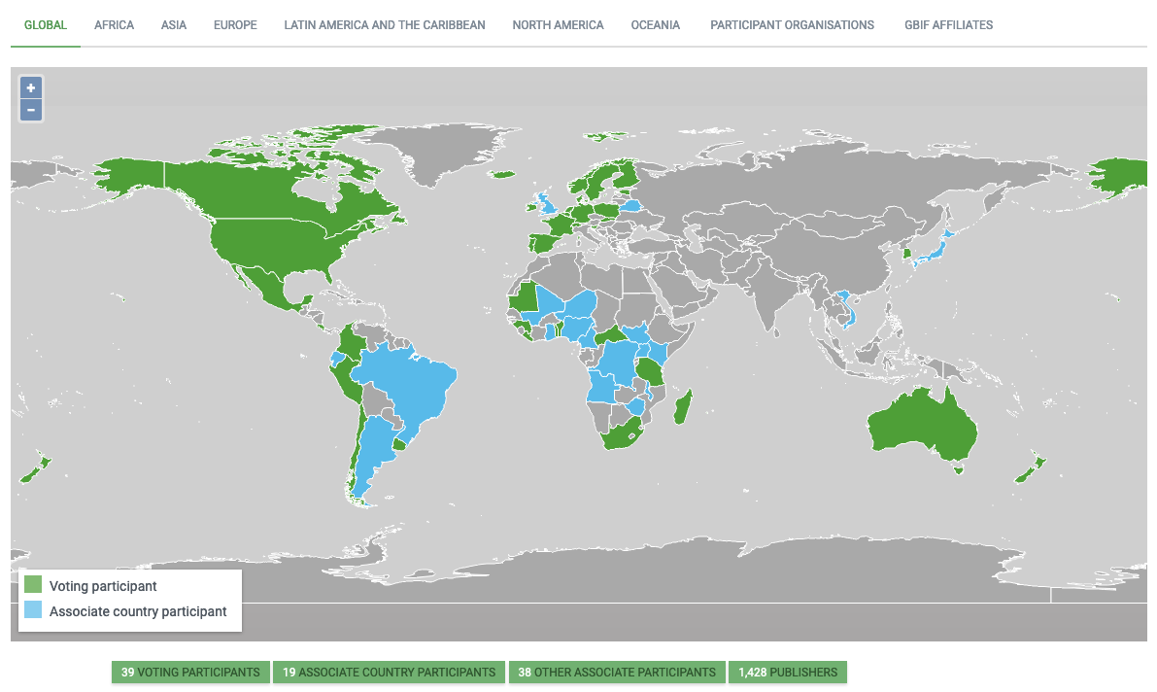
Current network
17 July 2019
participation
https://www.gbif.org/the-gbif-network

Slide 4
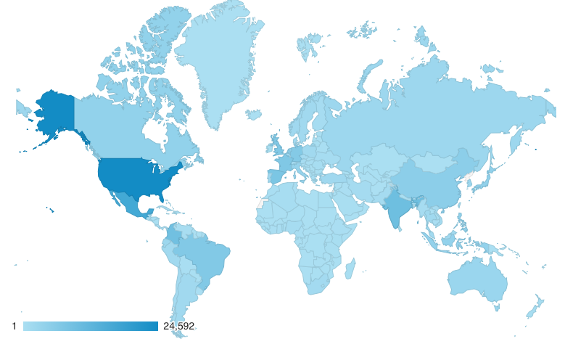
GBIF.org Web traffic
Year-to-date 1 June 2019
Rank | Country/Territory | Sessions | % total sessions | 3/19 rank | Pages / session
1 | United States | 82,586 | 12.07% | 1 | 2.52
2 | Mexico | 48,461 | 7.08% | 2 | 2.76
3 | India | 41,268 | 6.03% | 3 | 2.42
4 | Colombia | 37,285 | 5.45% | 4 | 3.80
5 | Spain | 28,189 | 4.12% | 5 | 3.24
6 | Brazil | 26,669 | 3.90% | 8 | 3.06
7 | United Kingdom | 25,293 | 3.70% | 7 | 3.19
8 | France | 24,124 | 3.52% | 6 | 2.66
9 | Germany | 22,883 | 3.34% | 9 | 3.02
10 | China | 20,059 | 2.93% | 10 | 3.67
data access and use

Slide 5
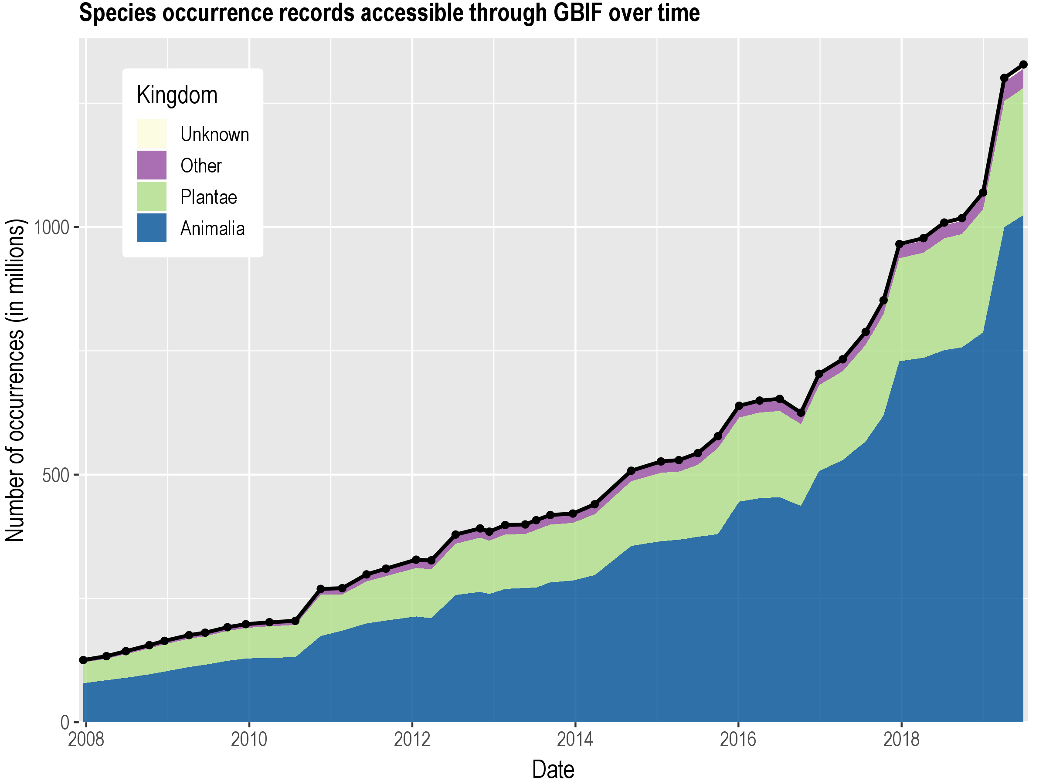
Data published through GBIF.org
data availability
www.gbif.org/analytics/global

Slide 6
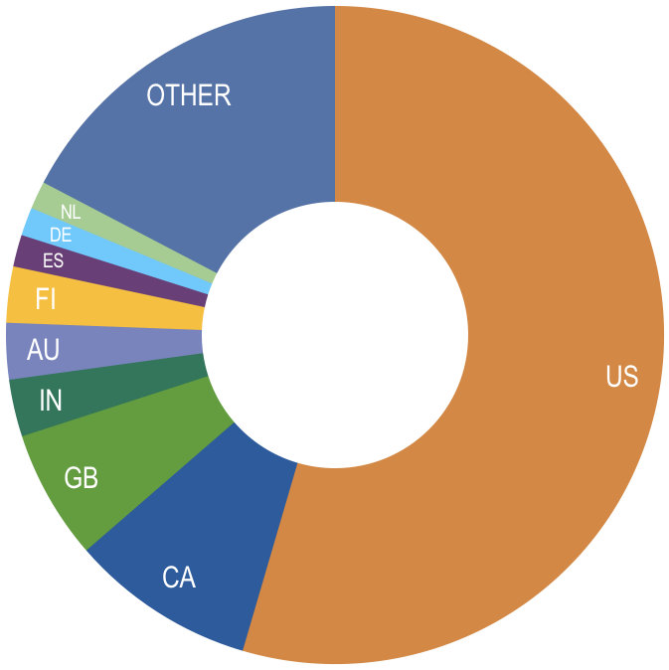
Occurrence records published during 2019, by country
31 May 2019
 | Country | New records | 2/19 rank
1 | United States | 137,201,940 | 2
2 | Canada | 22,916,023 | 7
3 | United Kingdom | 16,042,918 | 15
4 | India | 7,069,594 | –
5 | Australia | 6,968,886 | 37
6 | Finland | 6,927,069 | 1
7 | Spain | 3,397,688 | 10
8 | Denmark | 3,681,899 | 5
9 | Germany | 3,499,124 | 13
10 | Netherlands | 3,443,740 | 3
data availability
http://www.gbif.org/country

Slide 7
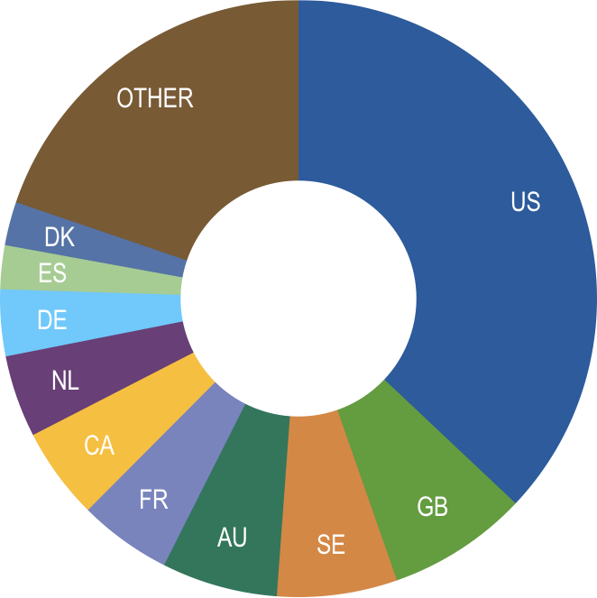
Total number of occurrence records published by country
31 May 2019
 | Country | Occurrences | 2/19 rank
1 | United States | 482,913,030 | 1
2 | United Kingdom | 99,358,210 | 3
3 | Sweden | 84,901,398 | 2
4 | Australia | 81,804,224 | 4
5 | France | 65,634,579 | 5
6 | Canada | 64,887,821 | 8
7 | Netherlands | 58,002,955 | 6
8 | Germany | 47,018,927 | 7
9 | Spain | 30,932,654 | 9
10 | Denmark | 30,798,872 | 10
data availability
http://www.gbif.org/country

Slide 8
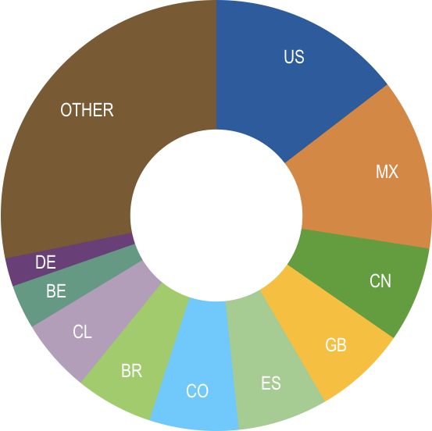
Data download requests by country
Year-to-date 31 May 2019
 | Country | Downloads | 2/19 rank
1 | Mexico | 9,308 | 2
2 | United States | 7,942 | 1
3 | Brazil | 4,326 | 7
4 | United Kingdom | 3,556 | 4
5 | China | 3,282 | 3
6 | Colombia | 3,271 | 6
7 | Spain | 3,054 | 5
8 | Chile | 2,310 | 8
9 | South Africa | 1,778 | 25
10 | Belgium | 1,294 | 9
data access and use

Slide 9
data access and use
Peer-reviewed publications using GBIF-mediated data
31 May 2019

Slide 10
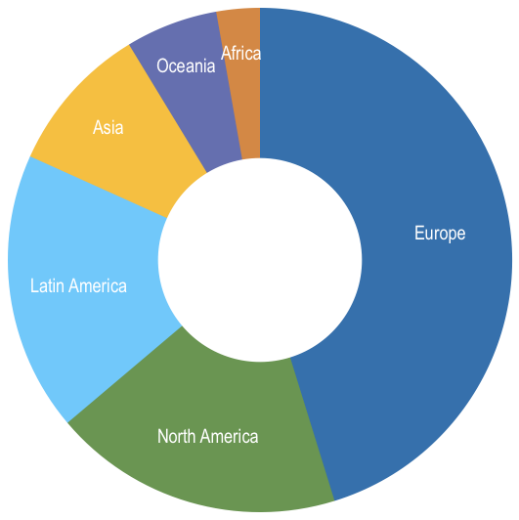
Peer-reviewed uses, by country and region
Year-to-date 31 May 2019
Total # of peer-reviewed papers by country |  |  | 2/19 rank
1 | United States | 86 | 1
2 | Brazil | 39 | 2
3 | United Kingdom | 36 | 3
4 | China | 31 | 4
5 | Germany | 28 | 5
6 | Australia | 27 | 6
7 | Mexico | 25 | 7
8 | Spain | 22 | 7
9 | Canada | 21 | 9
10 | Italy | 20 | 10
data access and use
Total # of papers by region
1 | Europe & Central Asia | 260
2 | North America | 107
3 | Latin America & the Caribbean | 103
4 | Asia | 55
5 | Oceania | 34
6 | Africa | 16

Slide 11

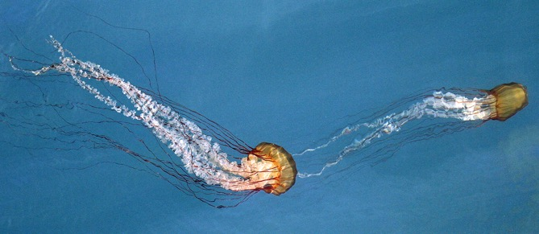
Upcoming opportunities
GBIF incentive-prize competition
on biodiversity data solutions
€34,000 in prizes
Open to individuals or teams
Deadline: 1 September 2019
bit.ly/ebbe2019
Sign on and subscribe to the
alliance for biodiversity knowledge
Help shape a biodiversity knowledge commons
Pacific sea nettle (Chrysaora fuscescens) by Robin Agarwal via iNaturalist. Photo licensed under CC BY-NC 4.0.
biodiversityinformatics.org

