Slide 1

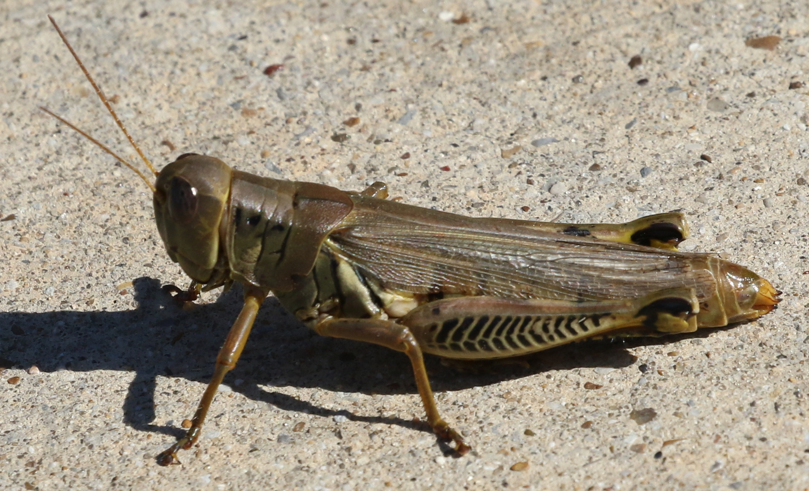
Overview
Differential grasshopper (Melanoplus differentialis), Dallas, Texas, United States, 2 Nov 2017.
Photo BY-NC 4.0 by Justin. From iNaturalist Research-grade Observations https://www.gbif.org/occurrence/1699395693
January 2018

Slide 2

BY THE NUMBERS
31 Jan 2018
Species occurrence records
Datasets
965,329,783
37,572
Country Participants
Organizational Participants
Publishers
54
36
1,143
Average records downloaded per month, 2017
User sessions (Sept-Dec avg)
70.4 billion
135,735
Notes:
Useful to see GBIF in its different modalities:
A window on biodiversity
An informatics infrastructure focuseD on tools and standards in service to science and society
A global network on bioinformatics

Slide 3
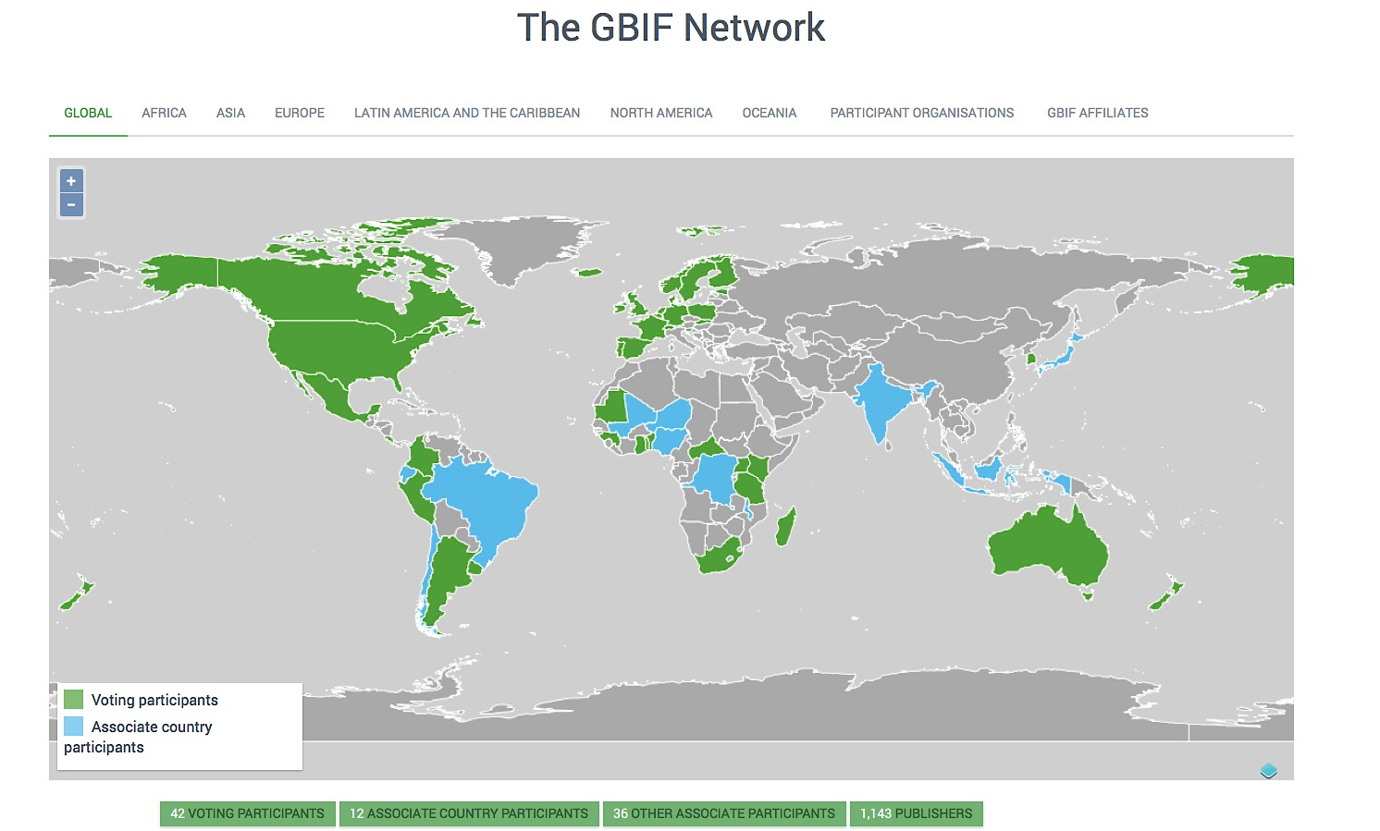
Current network
participation
https://www.gbif.org/the-gbif-network

Slide 4
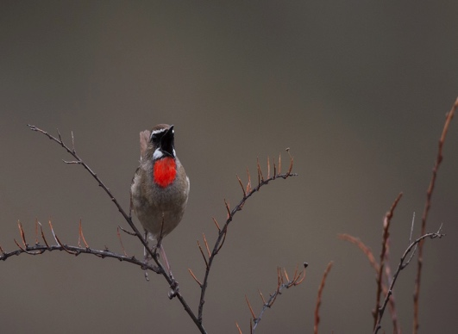

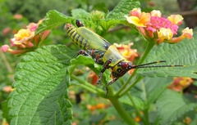
Latest news
communications
      Annual eBird refresh adds more than 85 million observation records
      Update to world’s largest citizen science dataset puts GBIF.org on the cusp of 1 billion species occurrences
      Read more
      New Participant, new voting Participant
      SPREP joins GBIF as a key partner in the Pacific Islands while Luxembourg commits to full voting membership
      Twenty-seven new projects in Sub-Saharan Africa funded by BID programme
      Teams led by institutions in 17 different countries receive more than €700,000 in financial support from the European Union Read more
https://www.gbif.org/resource/search?contentType=news
Photo credits: (left) Siberian Rubythroat (Calliope calliope) © 2016 Ian Davies via eBird, the Macaulay Library and GBIF.org (center) Seawhip goby (Bryaninops yongei), Fiji. Photo by Mark Rosenstein licensed under CC BY-NC 4.0. (right) Variegated grasshopper (Zonocerus variegatus), Cameroon. Photo by Jakob Fahr licensed under CC BY-NC 4.0.

Slide 5
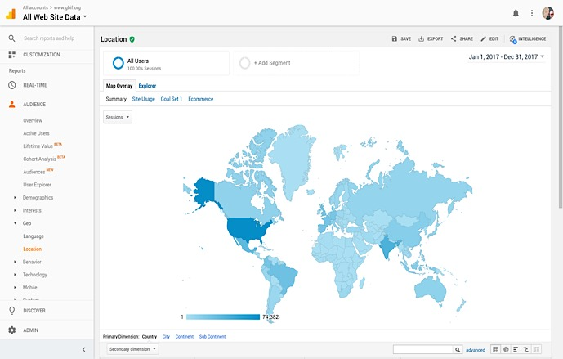
Web traffic to GBIF.org, 2017
Rank | Country/Territory | Sessions | % Total Sessions | 2016 rank | Pages / Session
1 | United States | 208,835 | 12.48% | 1 | 4.13
2 | India | 127,671 | 7.65% | 2 | 2.26
3 | Mexico | 75,392 | 4.52% | 8 | 6.76
4 | Brazil | 66,861 | 4.00% | 5 | 4.77
5 | United Kingdom | 65,197 | 3.91% | 7 | 5.93
6 | Spain | 62,176 | 3.76% | 6 | 5.07
7 | Germany | 62,125 | 3.72% | 4 | 4.84
8 | France | 55,879 | 3.35% | 3 | 4.11
9 | Colombia | 52,921 | 3.17% | 9 | 5.37
10 | Indonesia | 38,495 | 2.31% | 12 | 2.71
data access and use

Slide 6
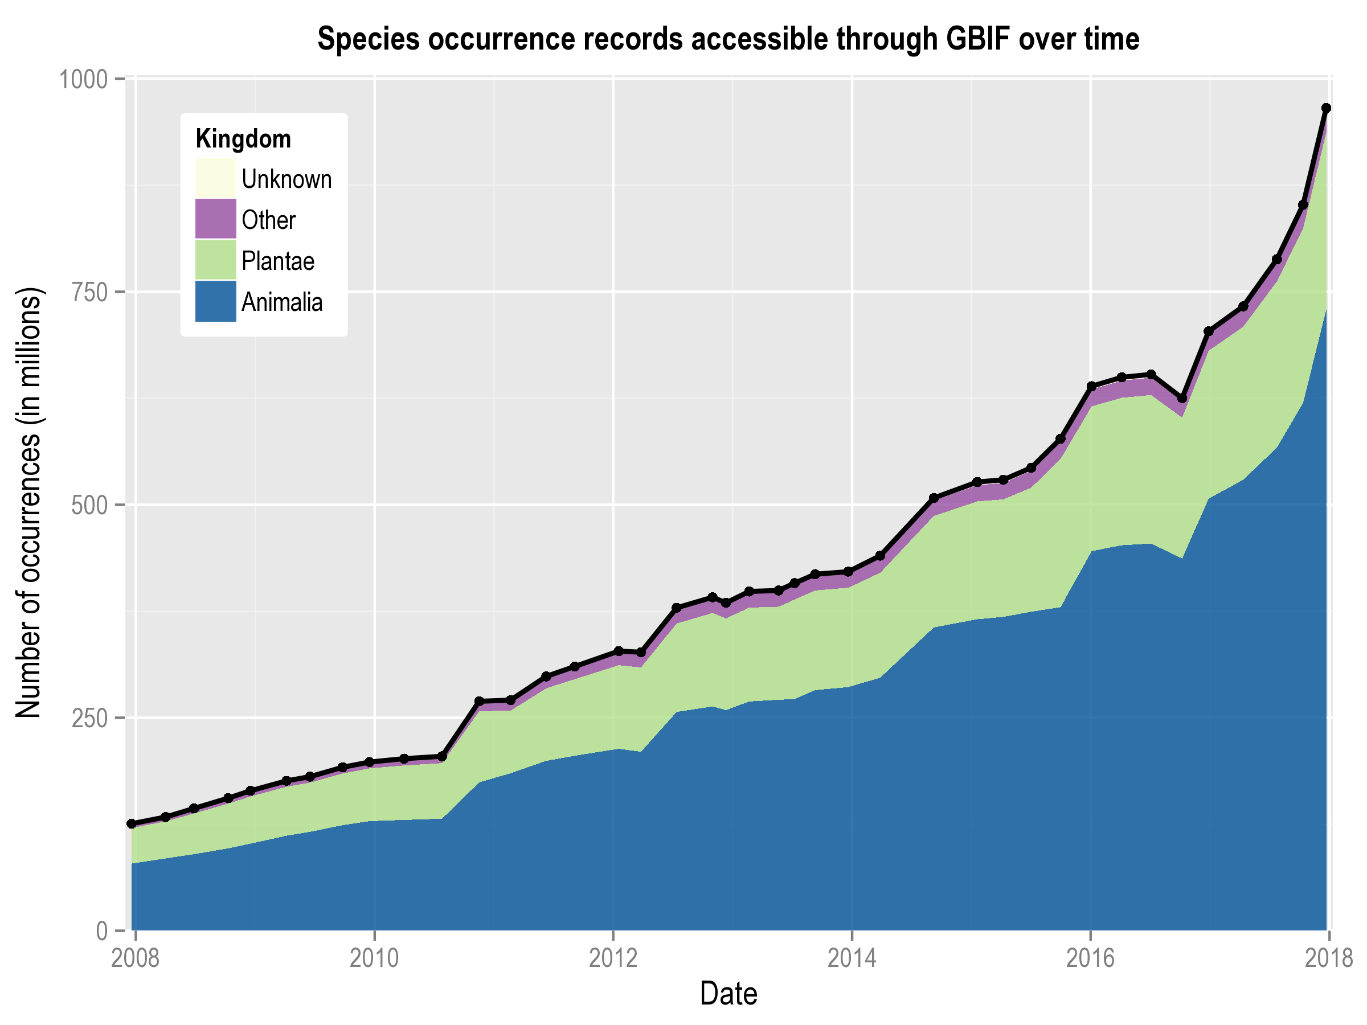
Data published through GBIF.org
data availability
www.gbif.org/analytics/global

Slide 7
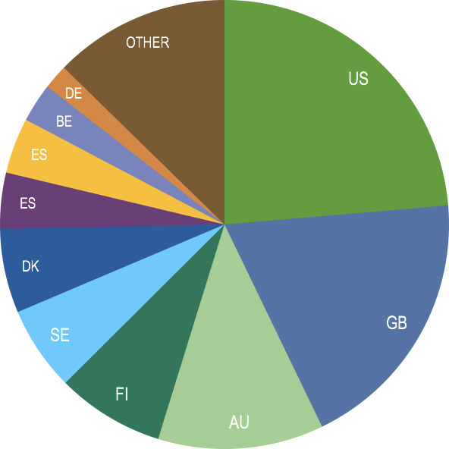
Occurrence records published during 2017 by country
 | Country | New records | Oct-17 rank
1 | United States | 75,459,902 | 5
2 | United Kingdom | 61,271,306 | 2
3 | Australia | 38,108,415 | 2
4 | Finland | 24,760,158 | 3
5 | Sweden | 19,434,390 | 4
6 | Denmark | 19,413,633 | 26
7 | Spain | 12,797,843 | 6
8 | Canada | 12,537,299 | 14
9 | Belgium | 8,929,239 | 7
10 | Germany | 5,705,020 | 8
data availability
http://www.gbif.org/country

Slide 8
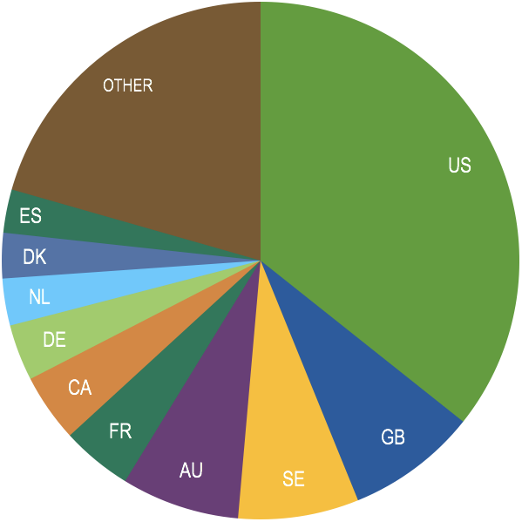
Total number of occurrence records published by country as of 31 Dec 2017
 | Country | Downloads | Aug-17 rank
1 | United States | 343,727,404 | 1
2 | United Kingdom | 78,561,592 | 2
3 | Sweden | 72,640,178 | 3
4 | Australia | 71,015,071 | 5
5 | France | 42,591,092 | 4
6 | Canada | 40,920,553 | 18
7 | Germany | 33,902,462 | 6
8 | Netherlands | 28,219,095 | 7
9 | Denmark | 27,296,537 | 13
10 | Spain | 26,070,259 | 9
data availability
http://www.gbif.org/country

Slide 9
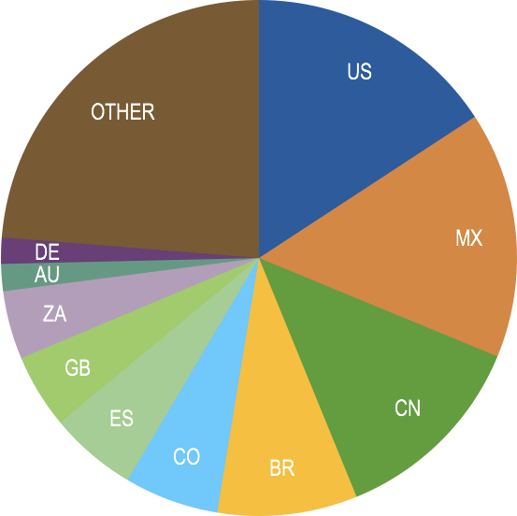
Data download requests by country, 2017
 | Country | Downloads | Oct-17 rank
1 | United States | 17,763 | 1
2 | Mexico | 17.402 | 2
3 | China | 14,171 | 3
4 | Brazil | 9,875 | 4
5 | Colombia | 6,655 | 5
6 | Spain | 6,192 | 6
7 | United Kingdom | 5,238 | 7
8 | South Africa | 4,819 | 8
9 | Australia | 1,916 | 9
10 | Germany | 1,849 | 10
data access and use

Slide 10
data access and use
Peer-reviewed publications using GBIF-mediated data
through 31Dec 2017

Slide 11
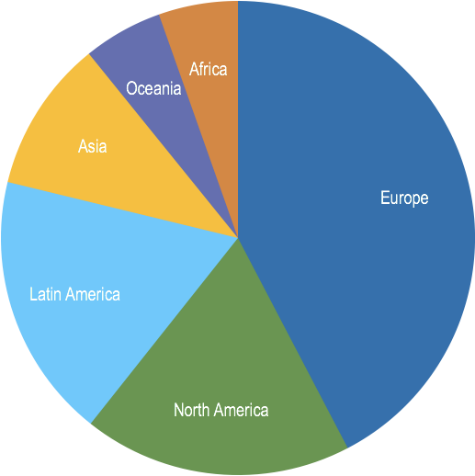
Peer-reviewed uses, by country and region, 2017
Total # of peer-reviewed papers by country
1 | United States | 194
2 | United Kingdom | 82
3 | Brazil | 75
3 | Germany | 75
5 | Spain | 67
6 | Australia | 58
7 | Mexico | 55
8 | China | 53
9 | Canada | 49
10 | France | 47
data access and use
Total # of papers by region
1 | Europe | 563
2 | North America | 244
3 | Latin America | 241
4 | Asia | 138
5 | Oceania | 72
5 | Africa | 72

Slide 12
Featured research
Nov 2017
1 / 3
 | Alexandre H, Faure J, Ginzbarg S, Clark J & Joly S (2017) Bioclimatic niches are conserved and unrelated to pollination syndromes in Antillean Gesneriaceae. Royal Society Open Science 4: 170293. https://doi.org/10.1098/rsos.170293 Author countries: Canada, United States
 | Alvarez B, Frings PJ, Clymans W, Fontorbe G & Conley DJ (2017) Assessing the Potential of Sponges (Porifera) as Indicators of Ocean Dissolved Si Concentrations. Frontiers in Marine Science. https://doi.org/10.3389/fmars.2017.00373 Author country: Sweden
 | Alvez-Valles CM, Balslev H, Carvalho FA, Garcia-Villacorta R, Grandez C & Menini Neto L (2017) Endemism and conservation of Amazon palms. Biodiversity and Conservation. https://doi.org/10.1007/s10531-017-1463-0 Author countries: Brazil, Denmark, United States, Peru
 | Bauer AM, DeBoer JC & Taylor DJ (2017) Atlas of the Reptiles of Libya. Proceedings of the California Academy of Sciences ser. 4, 64(8): 155-318. http://bit.ly/2DaeWVx Author country: United States
 | Fourcade Y, Besnard AG & Secondi J (2017) Paintings predict the distribution of species, or the challenge of selecting environmental predictors and evaluation statistics. Global Ecology and Biogeography. https://doi.org/10.1111/geb.12684 Author countries: France, Sweden
 | Lin YP, Lin WC, Lien WY, Anthony J & Petway J(2017) Identifying Reliable Opportunistic Data for Species Distribution Modeling: A Benchmark Data Optimization Approach. Environments 4(4): 81. https://doi.org/10.3390/environments4040081 Author country: Taiwan
data access and use
Invasive alien species
Impact of climate change
Species conservation and protected areas
Biodiversity and human health
Food, farming and biofuels
Ecosystem services
Advancing biodiversity science
Data management
Data papers
https://www.gbif.org/resource/search?contentType=literature

Slide 13
Featured research
Nov 2017
2 / 3
 | Long PR, Benz D, Martin AC et al. (2017) LEFT - a web-based tool for the remote measurement and estimation of ecological value across global landscapes. Methods in Ecology and Evolution. https://doi.org/10.1111/2041-210X.12924 Author countries: UK, Norway
 | Manjarrés-Hernández AM, Guisande C, García-Roselló E et al. (2017) A procedure to assess the spatial variability in the importance of abiotic factors affecting distributions: the case of world freshwater fishes. Current Zoology zox063. https://doi.org/10.1093/cz/zox063 Author countries: Colombia, Spain
 | McArt SH, Urbanowicz C, McCoshum S, Irwin RE & Adler LS (2017) Landscape predictors of pathogen prevalence and range contractions in US bumblebees. Proceedings of the Royal Society B: Biological Sciences 284: 20172181. https://doi.org/10.1098/rspb.2017.2181 Author country: United States
 | Meiri S, Bauer AM, Allison A et al. (2017) Extinct, obscure or imaginary: The lizard species with the smallest ranges. Diversity and Distributions. https://doi.org/10.1111/ddi.12678 Author countries: Israel, United States, Colombia, France, Brazil, Malaysia, Germany, Cameroon, Belgium, Australia, United Kingdom, Italy, Ecuador, Senegal, China
 | Quijada L, Ribes M, Negrín R & Beltrán-Tejera E (2017) Lignicolous species of Helotiales associated with major vegetation types in the Canary Islands. Willdenowia 47(3): 271-291. https://doi.org/10.3372/wi.47.47310 Author country: Spain
 | Reino L, Figueira R, Beja P, Araújo MB, Capinha C & Strubbe D (2017)Networks of global bird invasion altered by regional trade ban. Science Advances 3(11): e1700783. https://doi.org/10.1126/sciadv.1700783 Author countries: Portugal, Spain, Denmark, Germany, Belgium
 | Szabolcs M, Mizsei E, Jablonski D, Vági B, Mester B, Végvári Z & Lengyel S (2017) Distribution and diversity of amphibians in Albania: new data and foundations of a comprehensive database. Amphibia-Reptilia 38(4): 435-448. https://doi.org/10.1163/15685381-00003126 Author countries: Hungary, Slovakia
 | Wan JZ, Wang CJ & Yu FH (2017) Modeling impacts of human footprint and soil variability on the potential distribution of invasive plant species in different biomes. Acta Oecologica 85: 141-149. https://doi.org/10.1016/j.actao.2017.10.008 Author country: China
data access and use
Invasive alien species
Impact of climate change
Species conservation and protected areas
Biodiversity and human health
Food, farming and biofuels
Ecosystem services
Advancing biodiversity science
Data management
Data papers
https://www.gbif.org/resource/search?contentType=literature

Slide 14
Featured research
Nov 2017
2 / 3
 | Reino L, Figueira R, Beja P, Araújo MB, Capinha C & Strubbe D (2017)Networks of global bird invasion altered by regional trade ban. Science Advances 3(11): e1700783. https://doi.org/10.1126/sciadv.1700783 Author countries: Portugal, Spain, Denmark, Germany, Belgium
 | Szabolcs M, Mizsei E, Jablonski D, Vági B, Mester B, Végvári Z & Lengyel S (2017) Distribution and diversity of amphibians in Albania: new data and foundations of a comprehensive database. Amphibia-Reptilia 38(4): 435-448. https://doi.org/10.1163/15685381-00003126 Author countries: Hungary, Slovakia
 | Wan JZ, Wang CJ & Yu FH (2017) Modeling impacts of human footprint and soil variability on the potential distribution of invasive plant species in different biomes. Acta Oecologica 85: 141-149. https://doi.org/10.1016/j.actao.2017.10.008 Author country: China
data access and use
Invasive alien species
Impact of climate change
Species conservation and protected areas
Biodiversity and human health
Food, farming and biofuels
Ecosystem services
Advancing biodiversity science
Data management
Data papers
https://www.gbif.org/resource/search?contentType=literature

Slide 15
Featured research
Dec 2017
1 / 3
 | Alkishe AA, Peterson AT & Samy AM (2017) Climate change influences on the potential geographic distribution of the disease vector tick Ixodes ricinus. PLoS ONE 12(12): e0189092. https://doi.org/10.1371/journal.pone.0189092 Author countries: Libya, United States, Egypt
 | Atwater DZ, Ervine C & Barney JN (2017) Climatic niche shifts are common in introduced plants. Nature Ecology & Evolution 2: 34-43. https://doi.org/10.1038/s41559-017-0396-z Author country: United States
 | Cassemiro FAS, Bailly D, da Graça WJ & Agostinho AA (2017) The invasive potential of tilapias (Osteichthyes, Cichlidae) in the Americas. Hydrobiologia. https://doi.org/10.1007/s10750-017-3471-1 Author country: Brazil
 | Cooper JC & Soberón J (2018) Creating individual accessible area hypotheses improves stacked species distribution model performance. Global Ecology and Biogeography 27(1): 156-165. https://doi.org/10.1111/geb.12678 Author country: United States
 | Dauby G, Stévart T, Droissart V et al. (2017) ConR: An R package to assist large‐scale multispecies preliminary conservation assessments using distribution data. Ecology and Evolution 7(24): 11292-11303. https://doi.org/10.1002/ece3.3704 Author countries: France, Belgium, United States, Cameroon
 | Desnoues E, Ferreira de Carvalho J, Zohner CM & Crowther TW (2017) The relative roles of local climate adaptation and phylogeny in determining leaf-out timing of temperate tree species. Forest Ecosystems 4:26. https://doi.org/10.1186/s40663-017-0113-z Author countries: Netherlands, Switzerland
data access and use
Invasive alien species
Impact of climate change
Species conservation and protected areas
Biodiversity and human health
Food, farming and biofuels
Ecosystem services
Advancing biodiversity science
Data management
Data papers
https://www.gbif.org/resource/search?contentType=literature

Slide 16
Featured research
Dec 2017
2 / 3
 | Kass J, Vilela B, Aiello-Lammens M, Muscarella R, Merow C & Anderson RP (2017) Wallace: a flexible platform for reproducible modeling of species niches and distributions built for community expansion. Methods in Ecology and Evolution. https://doi.org/10.1111/2041-210X.12945 Author countries: United States, Denmark
 | Kriebel R, Khabbazian M & Sytsma KJ (2017) A continuous morphological approach to study the evolution of pollen in a phylogenetic context: An example with the order Myrtales. PLoS ONE 12(12): e0187228. https://doi.org/10.1371/journal.pone.0187228 Author country: United States
 | Kuzmina ML, Braukmann TWA, Fazekas AJ et al. (2017) Using Herbarium-Derived DNAs to Assemble a Large-Scale DNA Barcode Library for the Vascular Plants of Canada. Applications in Plant Sciences 5(12): 1700079. https://doi.org/10.3732/apps.1700079 Author countries: Canada, United Kingdom
 | Li G, Zhang X, Huang J, Wen Z & Du S (2018) Afforestation and climatic niche dynamics of black locust (Robinia pseudoacacia). Forest Ecology and Management 407: 184-190. https://doi.org/10.1016/j.foreco.2017.10.019 Author country: China
 | Maghsoudlou A, Momtazi F, Nasiri K et al. (2017) A review on the state of the biodiversity knowledge on Iran’s southern seas: introducing a methodology to evaluate the validity of the reported cases. Marine Biodiversity. https://doi.org/10.1007/s12526-017-0835-8 Author country: Iran
data access and use
Invasive alien species
Impact of climate change
Species conservation and protected areas
Biodiversity and human health
Food, farming and biofuels
Ecosystem services
Advancing biodiversity science
Data management
Data papers
https://www.gbif.org/resource/search?contentType=literature

Slide 17
Featured research
Dec 2017
3 / 3
 | Mellert KH, Lenoir J, Winter Set al. (2017) Soil water storage appears to compensate for climatic aridity at the xeric margin of European tree species distribution. European Journal of Forest Research. https://doi.org/10.1007/s10342-017-1092-x Author countries: Germany, France, Slovenia, Spain, Serbia, Greece, Switzerland
 | Rooduijn B, Bongers F & van der Wal H (2018) Wild native trees in tropical homegardens of Southeast Mexico: Fostered by fragmentation, mediated by management. Agriculture, Ecosystems & Environment 254: 149–161. https://doi.org/10.1016/j.agee.2017.10.015 Author countries: Netherlands, Mexico
 | ülker ED, Tavşanoğlu Ç & Perktaş U (2017) Ecological niche modelling of pedunculate oak (Quercus robur) supports the ‘expansion–contraction’ model of Pleistocene biogeography. Biological Journal of the Linnean Society blx154. https://doi.org/10.1093/biolinnean/blx154 Author countries: Turkey, United States
 | Wang, Chun-Jing;Wan, Ji-Zhong;Qu, Hong;Zhang, Zhi-Xiang (2017) Modelling plant invasion pathways in protected areas under climate change: implication for invasion management. Web Ecology 17: 69-77. https://doi.org/10.5194/we-17-69-2017 Author country: China
data access and use
Invasive alien species
Impact of climate change
Species conservation and protected areas
Biodiversity and human health
Food, farming and biofuels
Ecosystem services
Advancing biodiversity science
Data management
Data papers
https://www.gbif.org/resource/search?contentType=literature

