Slide 1
Open Access, Open Data Open Science
Ms Sangita Dubey, FAO Regional Statistician for Asia and the Pacific
22 November 2022
Asia Regional Engagement meeting and Symposium on Open Science and Data Use

Slide 2
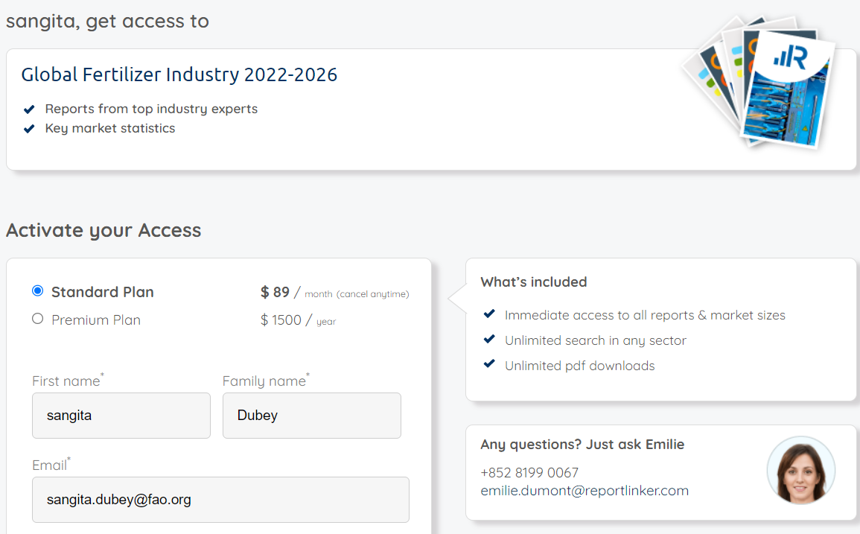
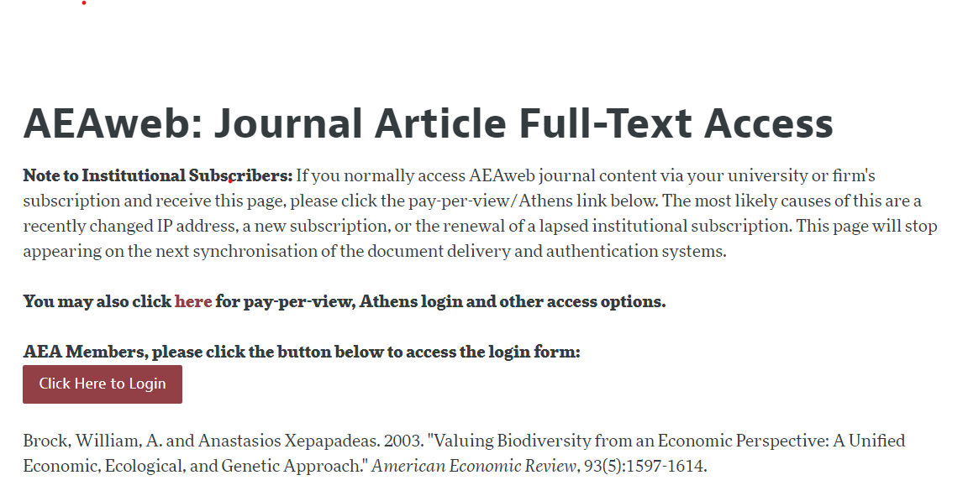
The Problem

Slide 4
Should Knowledge Be Free? - Bing video
First 2 minutes and 25 seconds …

Slide 5
A Solution: Open Access, Open Data , Open Science

Slide 6
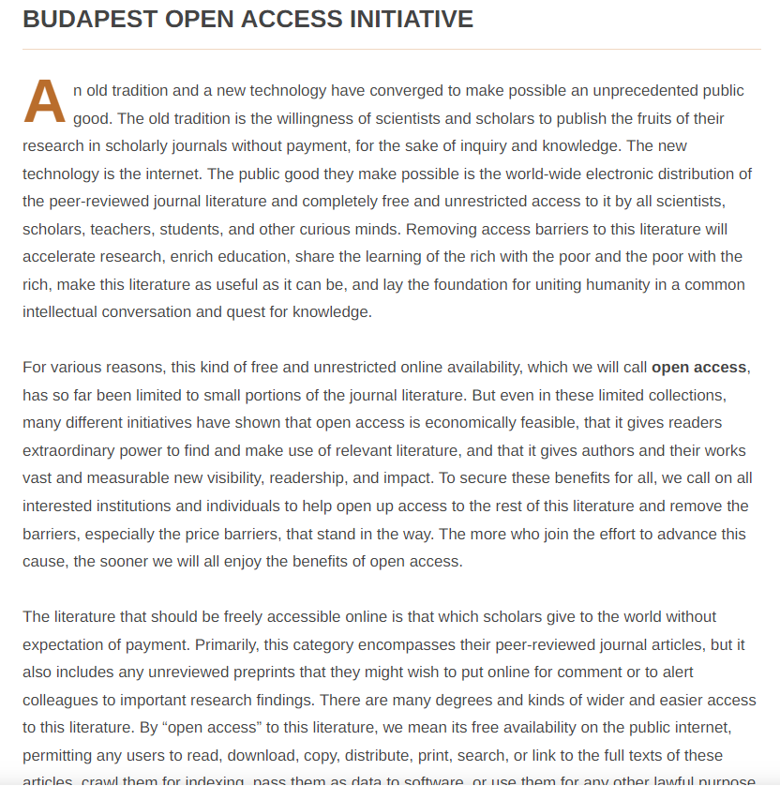
Open Access > Free Access
Open-access (OA) literature is digital, online, free of charge, and free of most copyright and licensing restrictions:¹
removes price barriers
removes most permission barriers, but may limit
commercial re-use
derivative works
.
Budapest Open Access Initiative : By 'open access’ … we mean … free availability on the public internet, permitting any users to read, download, copy, distribute, print, search, or link to the full texts of these articles, crawl them for indexing, pass them as data to software … and the only role [… is] to give authors control over the integrity of their work and the right to be properly acknowledged and cited."
¹Source: Suber, Peter. "Open Access Overview". Archived from the original on 19 May 2007. Retrieved 29 November 2014.

Slide 7
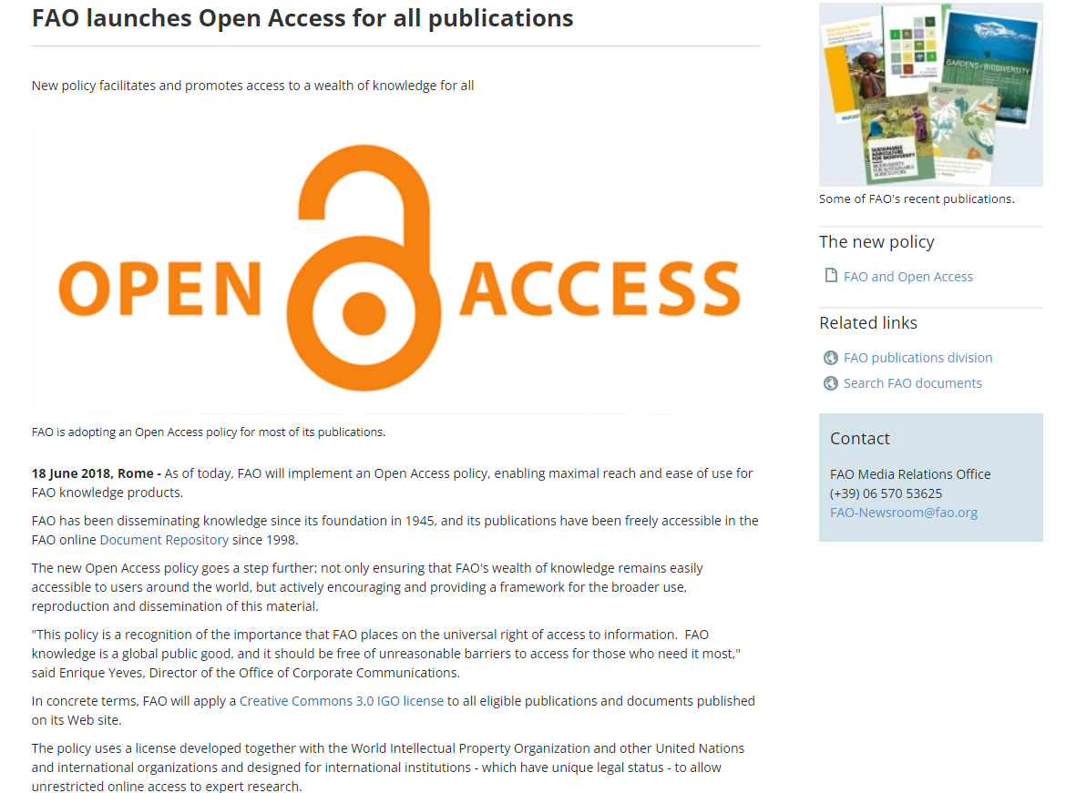

Slide 8
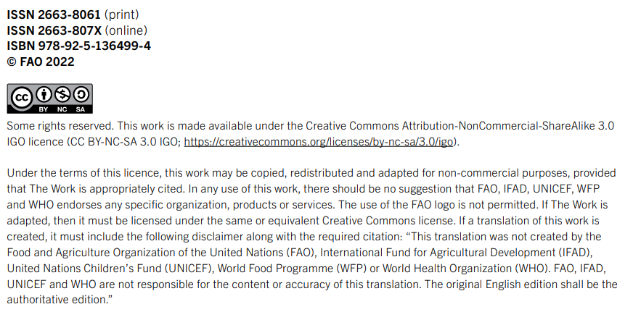

Slide 9
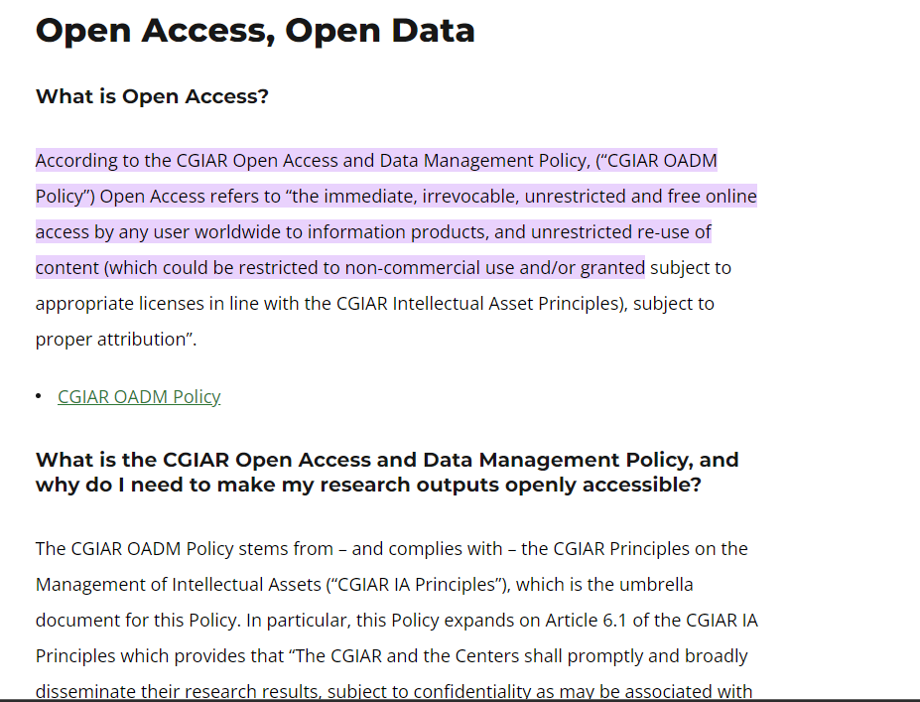

Slide 10
Open Data > Free Data
Technically Open
Machine Readable
Accessible through non-proprietary software
Legally Open
Free to use
Free to republish
Terms of Use
5-star graphic measures degree of “open-ness”
Clear (limits to) obligations of producers and users
Avoids liability from misuse / misinterpretation
Constraint on republication depends on license adopted
Availability of free/open (creative commons) licenses

Slide 11
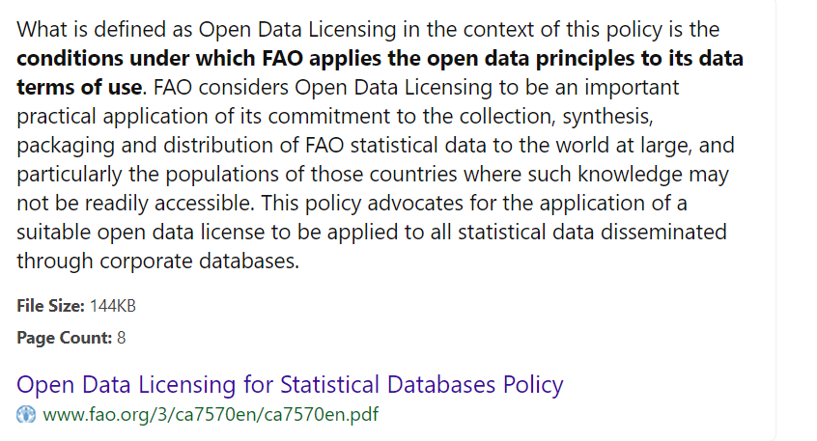

Slide 12
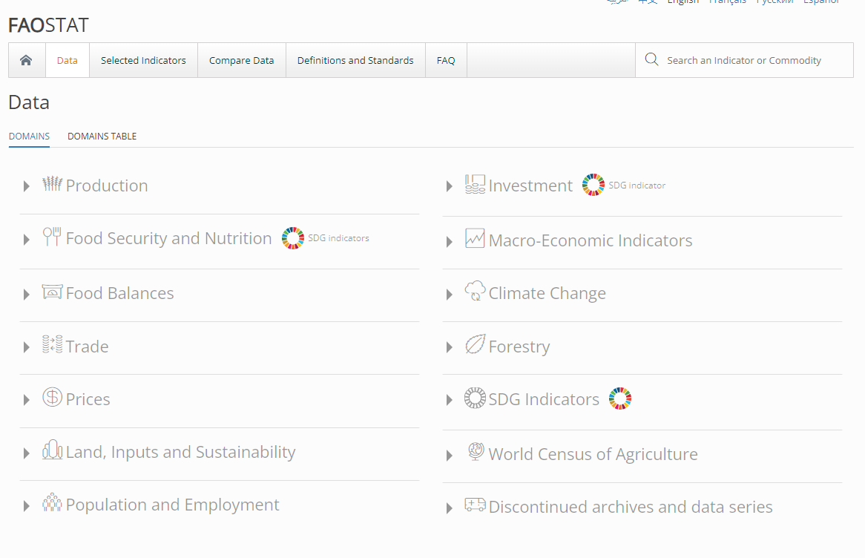

Slide 14
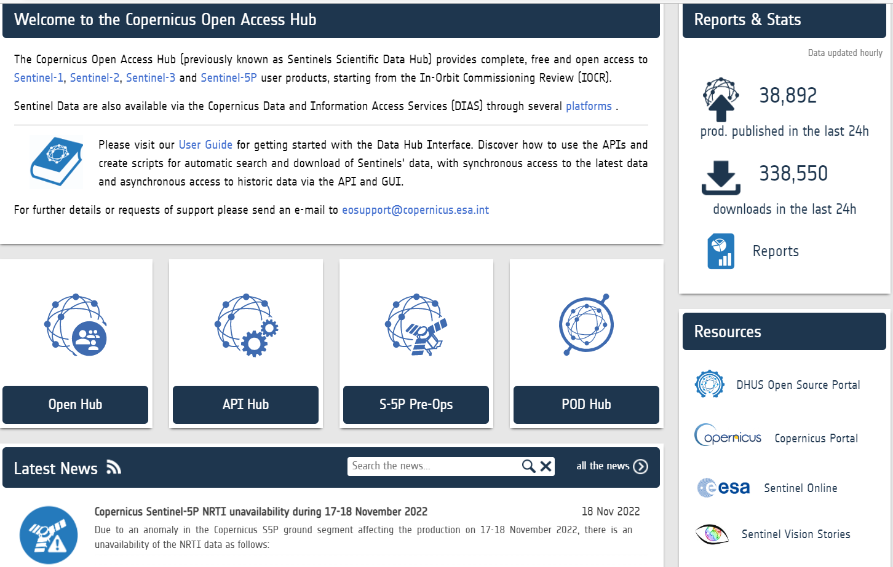

Slide 15
What is “Open”?

Slide 16
Technically Open – the 5 star system

Slide 17
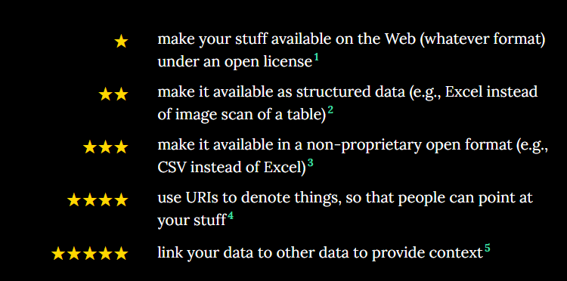
Technically Open – the 5 star system

Slide 18
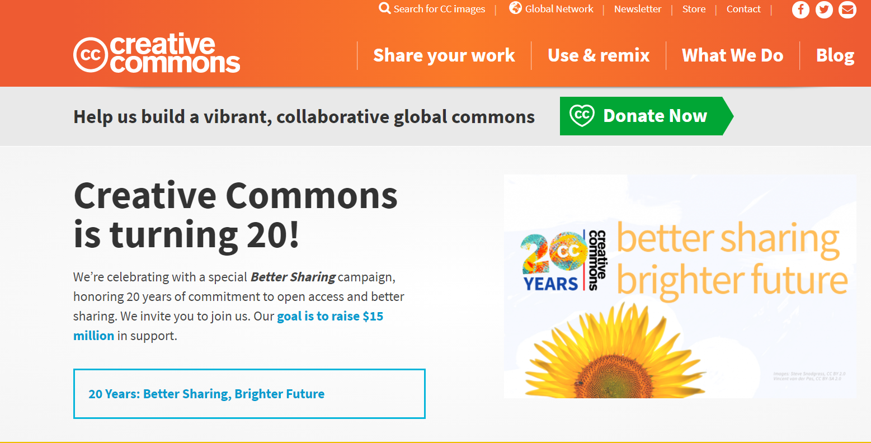
Legally Open – Creative Commons licenses

Slide 19
Legally Open – 6 Creative Commons licenses
CONDITIONS |  | CC-BY | CC-BY-SA | CC-BY-NC | CC-BY-NC-SA | CC-BY-ND | CC-BY-NC-ND
BY - Credit must be given to the creator |  | X | X | X | X | X | X
NC – Only noncommercial uses of the work are permitted |  |  |  | X | X |  | X
SA – Adaptations must be shared under the same terms |  |  | X |  | X
ND – No derivatives or adaptations of the work are permitted |  |  |  |  |  | X | X
Source: Creative Commons

Slide 20
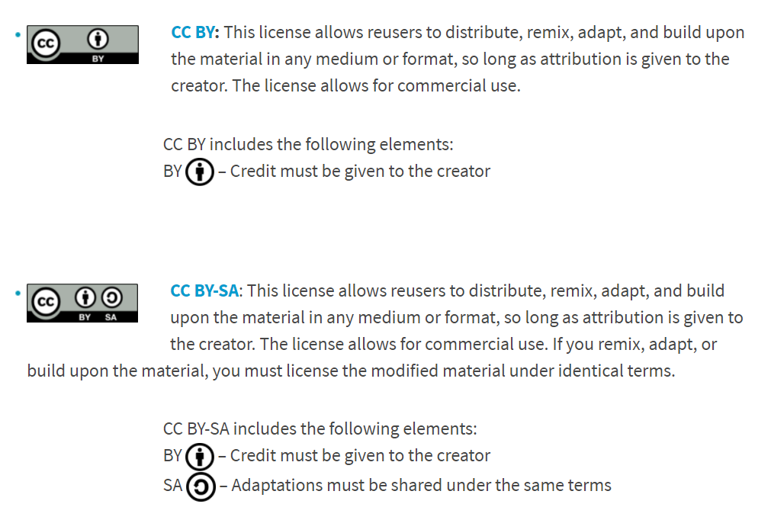
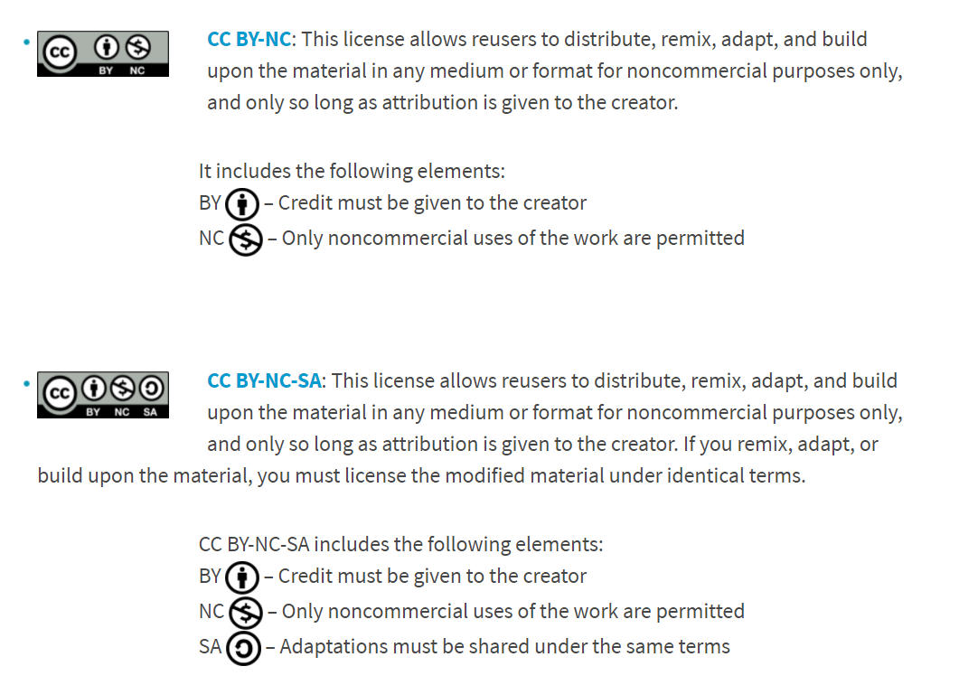
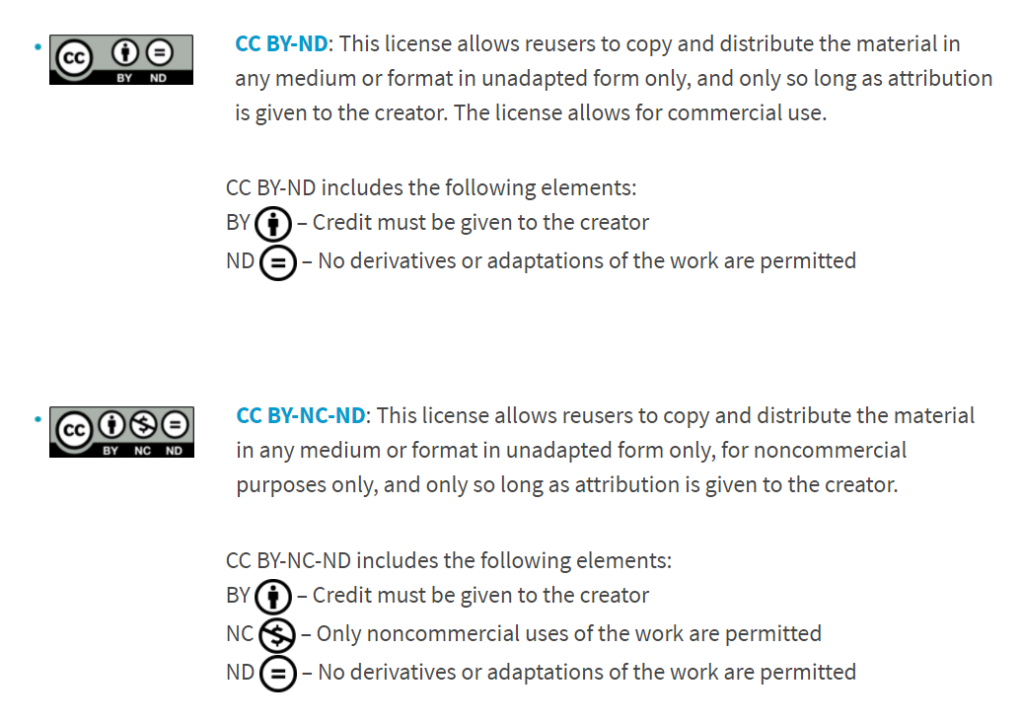
Legally Open – Creative Commons licenses
Source: Creative Commons
Notes:
Selecting a license: Creative Commons License Chooser.
Is the material copyrightable? … CC licenses do not apply to material in the public domain. Different countries have different standards for what is in the public domain.
Do you own the material you want to license or are you otherwise authorized to license it under the specific CC license?
Are you aware that CC licenses are not revocable? You are free to stop offering material under a CC license at any time, but this will not affect the rights associated with any copies of your work already in circulation.
Always read the terms and conditions of the specific license you plan to apply. Additionally, there are several terms that may differ in the earlier versions of the license, both unported and ported. If you choose to use a pre-4.0 version or any ported version, clauses such as choice of law may affect your desired choice of license.

Slide 21
Terms of Use
Terms of Use are essential to outline the responsibilities of producers and users of data and metadata
For statistical databases, they may include:
General information regarding terms of use
Recommended citation
Use of Material
Links to Website
Use of Logos
Disclaimers
Limitations of Liability
Prohibited Conduct
Examples: FAOSTAT, OECD databases
Source: Creative Commons

Slide 22
Privacy Considerations

Slide 23
Data Privacy
Public and private entities mandated by national privacy legislation to protect the privacy and confidentiality of individuals, households and enterprises.
EU Data Protection Regulation
Thailand’s Data Protection Act
FAO’s 2022 FAO Data Protection Policy (covers data for statistical uses including third party use; does not apply to public data nor anonymized data)
Privacy Legislation applies throughout the data cycle:
production, compilation, storage, use, exchange, archiving.
Deletion of data after a set period of time;
Ensuring data users apply the same level of protection.
Anonymized microdata are typically exempt from privacy polities and laws

Slide 24
Contact Information: Sangita.Dubey@fao.org

