Slide 1
Pacific participation in GBIF
Tim Hirsch, Deputy Director
28 july 2017

Slide 2
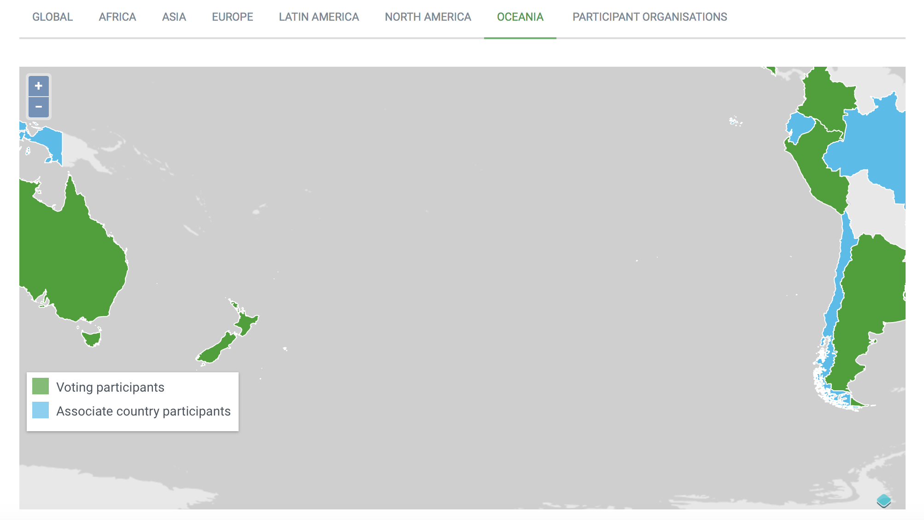
Models of participation
National participation (signing MoU on behalf of government)
  Voting Participation - voting member of GBIF Governing Board, makes annual contribution to GBIF core budget, linked to GDP
  Associate Participation – non-voting member of GBIF Governing Board, no annual contribution, limited to five years

Slide 3
Models of participation
Organization participation (signing MoU as an associate organization)
  Can include regional, thematic organizations (e.g. SPREP)
  Non-voting member of Governing Board
  No financial contribution to GBIF core budget
  Can take part in regional meetings, capacity projects

Slide 4
Benefits of national participation
Become part of global collaborative community on biodiversity data access and use
Eligible for programmes and projects restricted to GBIF nodes (e.g. Capacity Enhancement Support Programme)
Help meet commitments to Convention on Biological Diversity
Build long-term arrangements for data mobilization and access in your country

Slide 5
How to join gbif
http://www.gbif.org/participation/how-to-join
Letter of Intent from appropriate authority, indicating type of participation (model letters)
MoU sent to nominated person for signature
MoU signature approved, you’re in!
Nominate Head of Delegation, Node Manager
Establish Participant Node, start work!

Slide 6
Establishing a participant node
Key functions:
Promoting, supporting mobilization of biodiversity data
Providing expertise on data management, improving data quality
Encouraging optimum re-use of available data
Fostering collaboration
http://www.gbif.org/resource/80925

Slide 7
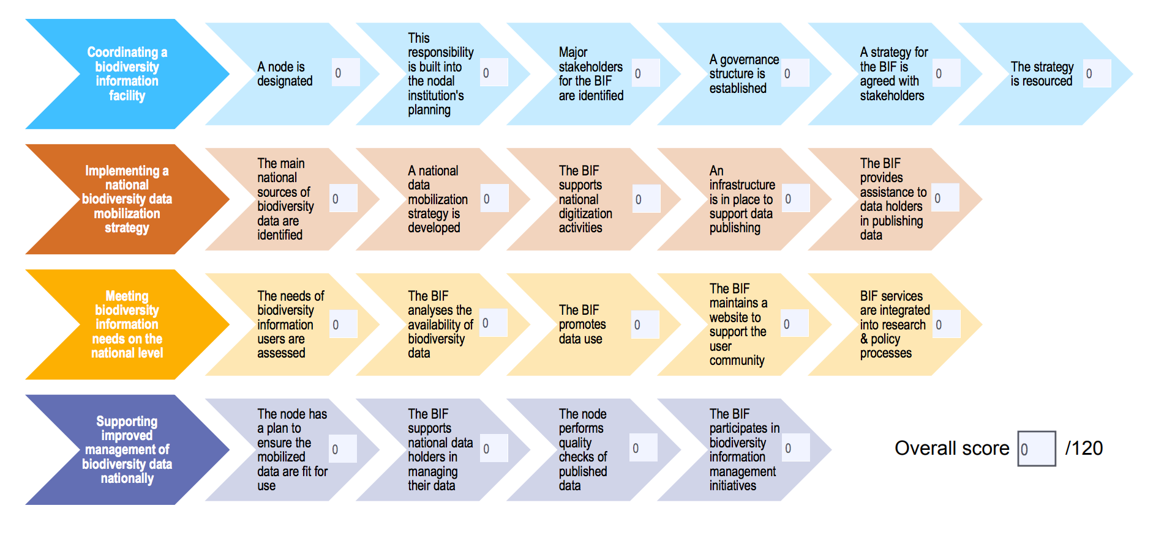
Establishing a participant node
National capacity self-assessment tool
http://www.gbif.org/resource/82277

Slide 8


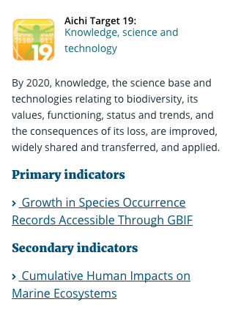
GBIF and cbd
Data mobilization through GBIF is the only primary indicator of progress towards Aichi Target 19
Also providing knowledge support for …
Target 9 (invasive alien species)
Target 10 (climate vulnerability)
Target 11 (protected areas)
Target 12 (extinction risk)
Target 13 (genetic diversity) …

Slide 9

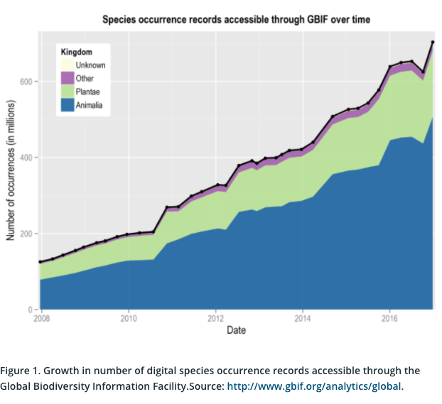
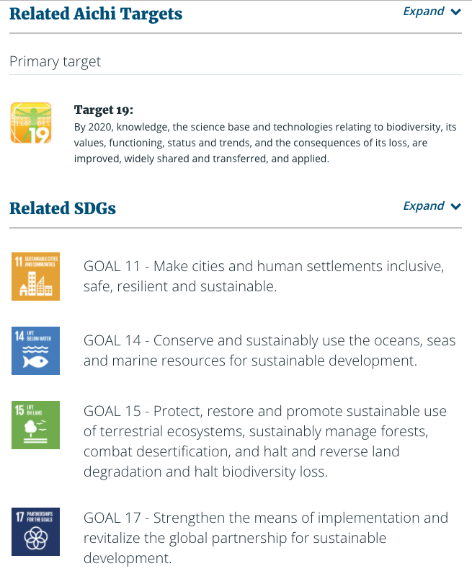
GBIF and cbd
a
… and the Sustainable Development Goals

Slide 10
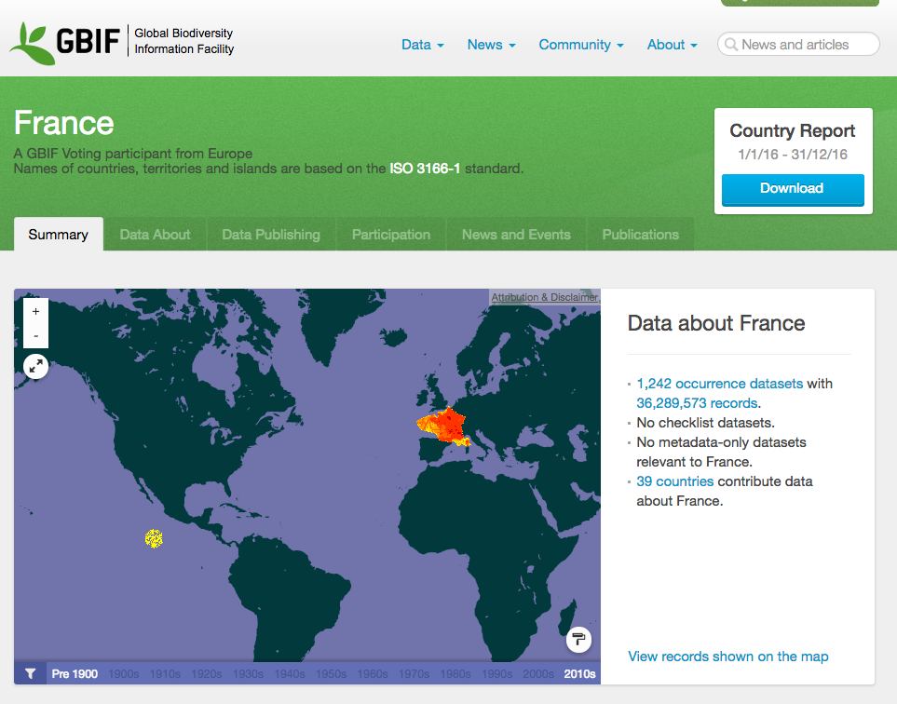
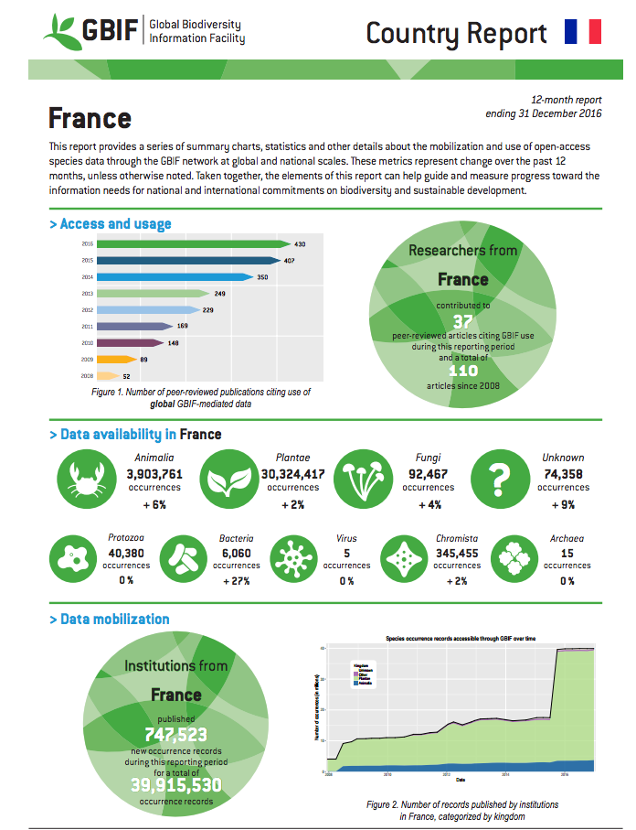
GBIF and cbd
Metrics on GBIF.org enable countries easily to disaggregate the global indicator into national reports of progress towards Aichi Target 19

Slide 11
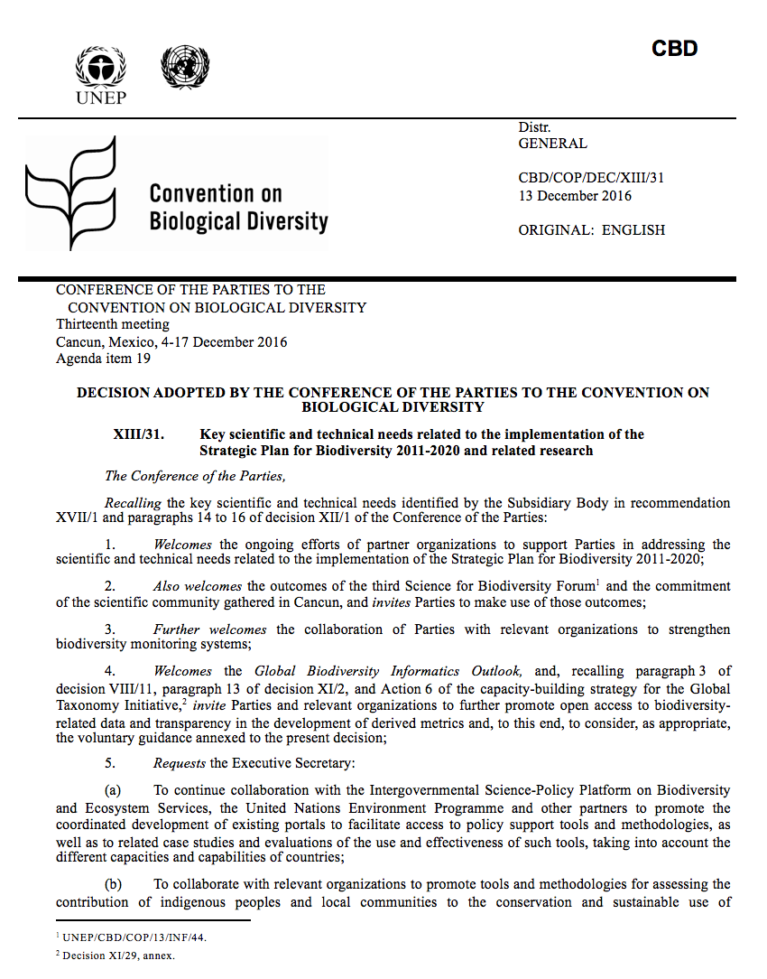
GBIF and CBD
The last Conference of the Parties to the CBD (COP13) agreed on new guidelines for countries, drafted by GBIF Secretariat, on improving accessibility of biodiversity related data and information - CBD/COP/DEC/XIII/31
THE GUIDELINES
Promote open data access through policy incentives
Promote the use of common data standards
Invest in digitization of natural history collections
Establish national biodiversity information facilities
Enhance national capacity in biodiversity informatics
…

Slide 12
GBIF and CBD
THE GUIDELINES (continued)
…
Engage the public in biodiversity observation through citizen science networks
Encourage data sharing from the private sector
Develop national platforms for data discovery, visualization and use
Analyse data and information gaps to prioritize new data mobilization
Engage with and support regional and global networks for data mobilization

Slide 13
Voting participation costs
Country | Basic financial contribution p.a. (2017-21)
Fiji | €280
Micronesia, Fed. States of | €23
Kiribati | €12
Marshall Islands | €14
Palau | €17
Papua New Guinea | €1,119
Samoa | €58
Solomon Islands | €77
Timor-Leste | €107
Tonga | €31
Tuvalu | €3
Vanuatu | €58

