Slide 1
THE FOUR-DAY WEEK: The UK trial and political reaction
Brendan Burchell Department of Sociology & President | Magdalene College, University of Cambridge
With Dr David Frayne and also Niamh Bridson Hubbard, Dr Daiga Kamerade, Franne Mullens and Jon White.

Slide 2
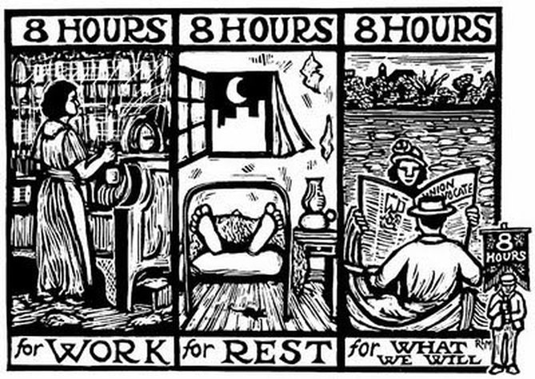
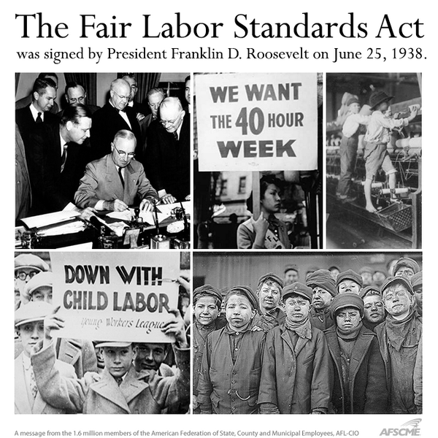
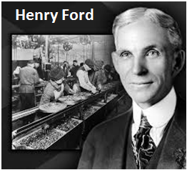
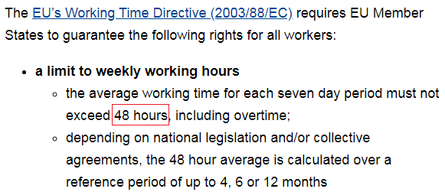
Full-Time=40-hour working week: Right?

Slide 3
Rejuvenated interest in 4dw
Renewed interest in 4dw coming from New Zealand, Perpetual Guardian 2017
4dw to offset mass unemployment from reduced demand for labour due to robots, AI and Big Data?
Pandemic and Furlough increased interest in possible alternatives to “full-time” work

Slide 4
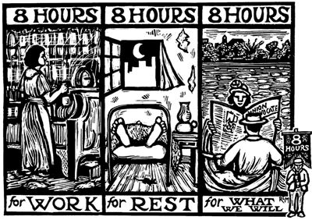
The roots of working time reduction
WTR in classical texts, where the role of future technology and revolution is central (Marx’s ‘realm beyond necessity’, or Keynes’ forecast of a radically reduced working week)
Contemporary research on the impacts of automation suggests that this is not a natural development, but would have to be demanded
The history of working time as a history of labour organising: the 10-hour movement of C19th and the 8-hour movement of the C20th
Reductions in working time often opposed by the captains of industry
‘Time for what we will’

Slide 5
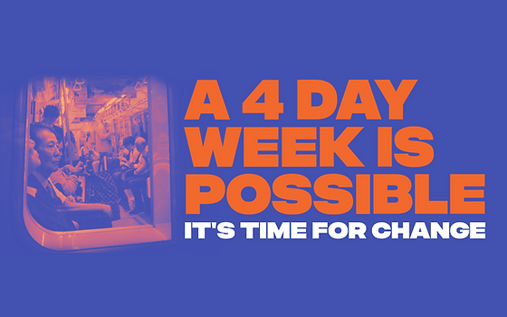
Political and ethical diversity
The notable diversity of cases for work-time reduction
‘Degrowth’ visions of WTR, involving a scaling back of entire industries
‘Post-work’ interest in WTR, greasing the path to more radical change
Today’s public discourse around the ‘4 Day Week’
Advocated on a variety of grounds - from enriching family time, to improving health and well-being, job creation, reducing the gender pay gap, sharing social reproduction and more
https://youtu.be/lNZqg3kfKK4

Slide 6
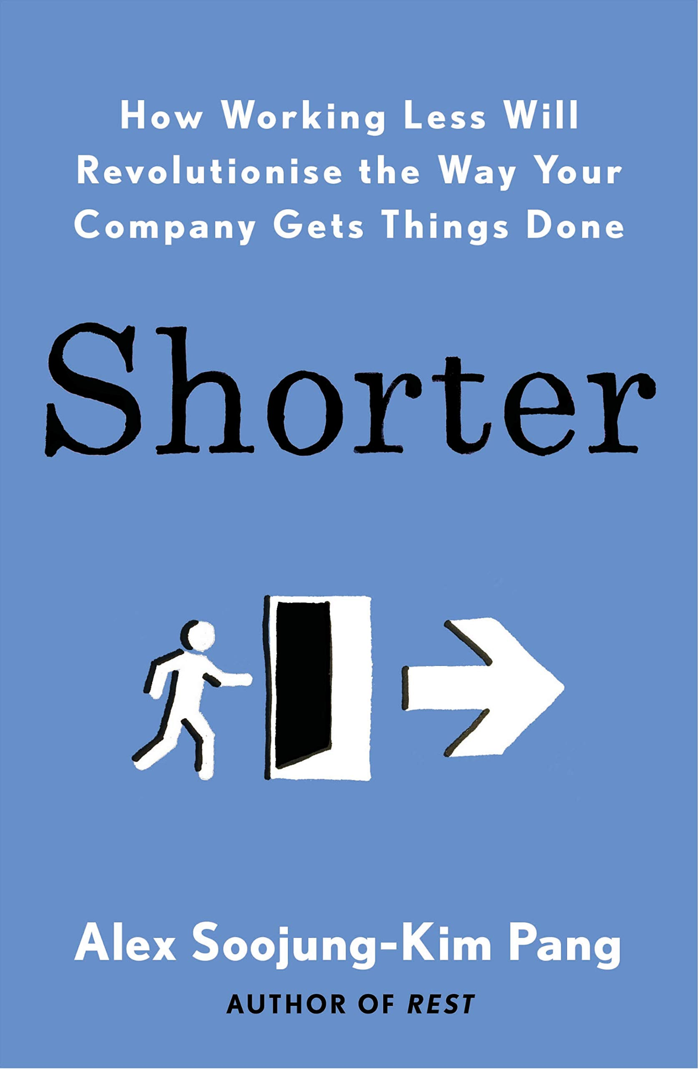
The employer-led shorter working week
The ‘smart business’ ethos of current interest in a shorter working week
Perceived synergies between employee needs (for more free-time) and employer needs (like productivity, reputation, recruitment)
The ‘100-80-100’ model (full productivity, four days, full pay)
Trials now completed in US, Ireland, UK.

Slide 7
The UK Four Day Week Trial
UK trial of 60 employers, 3,000 employees, six months June – December 2022
Employers Given consultancy / coaching / chatroom to prepare
100-80-100 model – reduced hours, same performance, same pay
Investigating employer motives, employer experiences, employee attitudes, carbon footprint, time use, etc
Formal publication of results in February 2023
US and Ireland results published December 2022

Slide 8
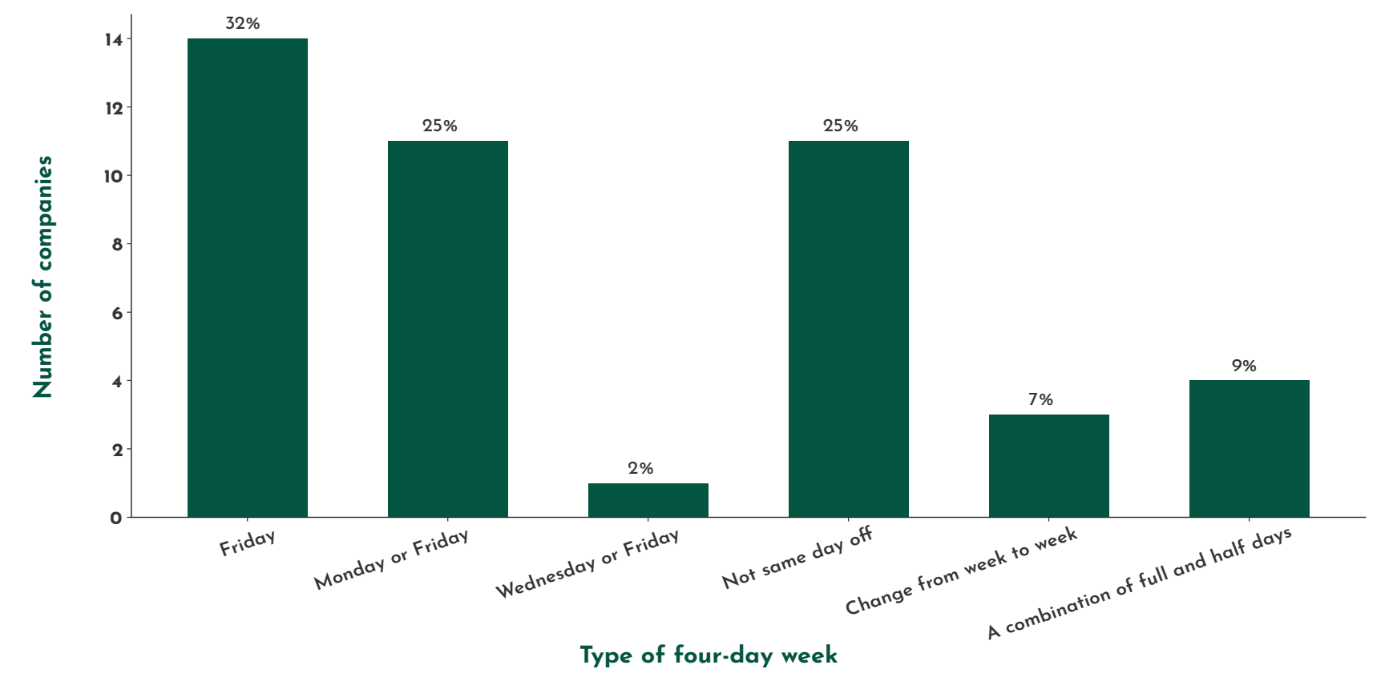
What types of four-day week were being trialled?
Fifth Day Stoppage
Staggered
Decentralised
Annualised
Conditional

Slide 9
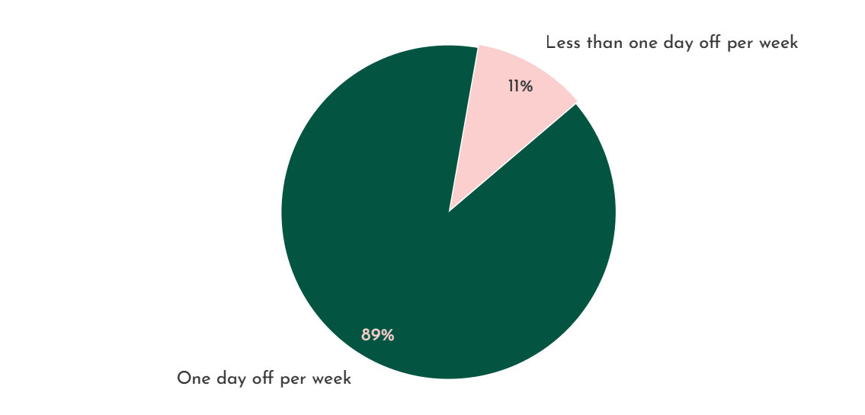
Staff working arrangements during the trial

Slide 10
Organisational Outcomes
Big Claims
Increased Productivity
Reduced Absenteeism
Reduced Turnover
Organisational Revenue:
Start-to-end trial data + 1.4%
Comparison with previous year +34.5%

Slide 11
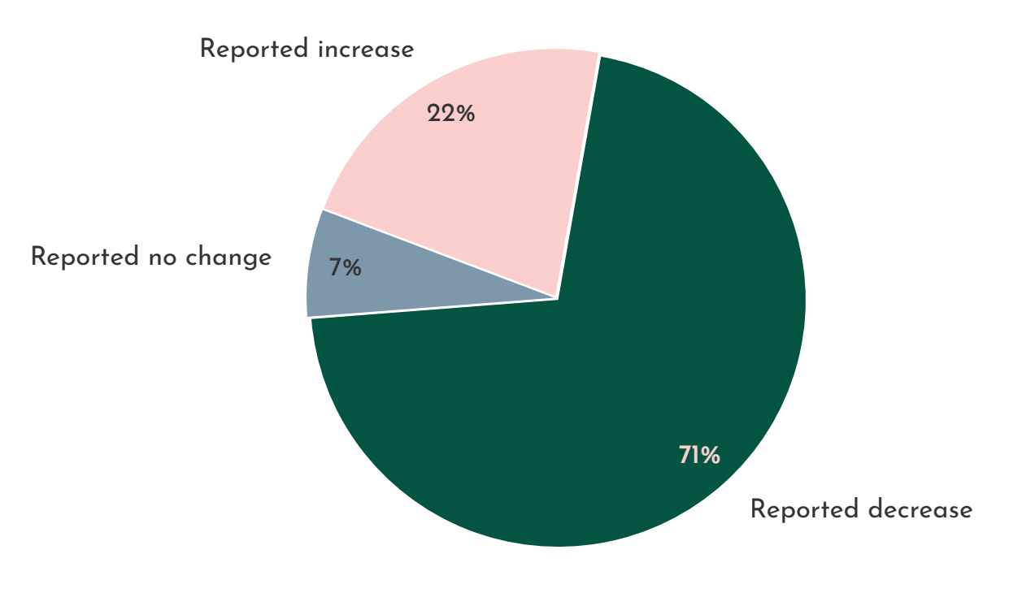
Better Sleep
Better Mental Health
Lower Anxiety
Employees’ reported levels of ‘burnout’ trial beginning and end.

Slide 12
“The conversations people were having, they would not have had if not for the shared incentive of making this work… It has been like flicking on a switch for some folks.”
(CEO of a non-profit organisation)
Semi-Structured interviews with bosses and employees
Efficiencies achieved through better ways of working

Slide 13
Preliminary insights
What were staff doing with their time off?
‘Life admin’: socially reproductive labour that would have been done at the weekend
Some employers ambivalent about their staff’s non-working activities
Others more paternalistic, keen to stress the importance of virtuous activities: eating healthily, being good parents, voluntary work and so on
Others still, intervened in this area, educating staff about the dangers of weekday drinking, ‘brainstorming’ ways to use time off, or considering a stipulation that the ‘day off’ ought to be community-focused
Too early to tell the longer-term effects – takes time for employees to change their lifestyles / hobbies / habits. And still waiting for it to go permanent.

Slide 14
Preliminary insights
Motivations: centrality of the business case
"We started talking about it as a possibility, because we'd seen studies coming out that showed people were roughly as productive anyway” - Video game studio
"The decision for the four day workweek was somewhat selfish, to be honest, because a happy worker is a good worker” - Digital marketing consultancy
Or a good excuse for a shake-up; ditch traditional unproductive methods?
Difficulties in recruiting – gives organisation a USP.

Slide 15
Preliminary insights
Conditionality: You can have the Friday off ‘if your work is done’
“Working less”, or higher intensity working?
Professional workers with ‘fuzzy’ boundaries between work and life
Emphasis on having the ‘right mindset’ or character for a 4DW
Interviewees often vague on what happens if the work does not get done
Stories of people with the ‘wrong mindset’ being let go
Changes to the labour process
Cutting out meetings, first and foremost.
It was common for the ‘day off’ to be used for ancillary tasks (business development, client emails and so on)
These breaches of the ‘4 Day Week ethic’ were often concealed by senior staff
Use of project management and communications software

Slide 16
96% of staff have a preference for a four-day week.
They rated the pilot experience a 9 / 10 in terms of overall satisfaction.

Slide 17
91% of companies will continue with their four-day week.
18 have confirmed this will be a permanent change.

Slide 18
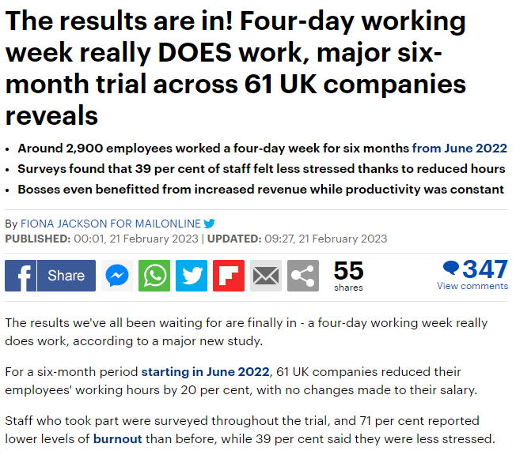
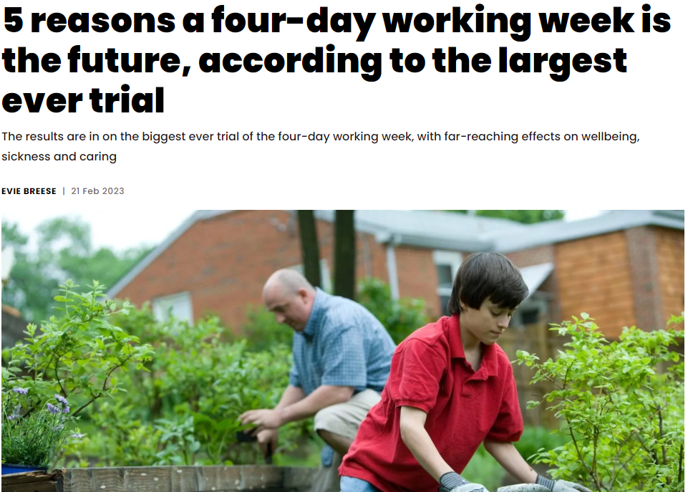
Private sector UK trial reactions

Slide 19
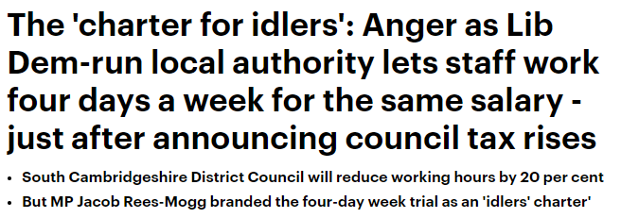
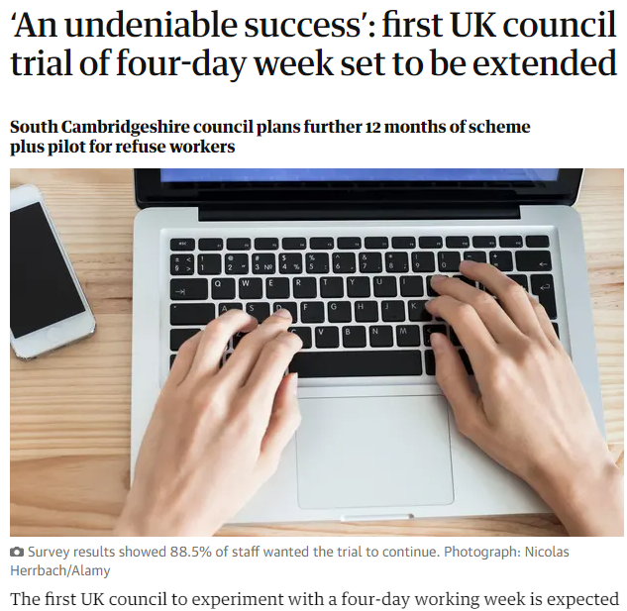
Public sector reactions

Slide 20
Many thanks for listening…
Brendan Burchell - bb101@cam.ac.uk
David Frayne - dmf43@cam.ac.uk
@DosageProject

