Slide 1
Year 2 Treasures

Slide 2
Good News about God
Jesus said, “Just think about the wild flowers. Not even Solomon, the greatest king our people ever had was dressed as beautifully as one of these flowers.

Slide 3
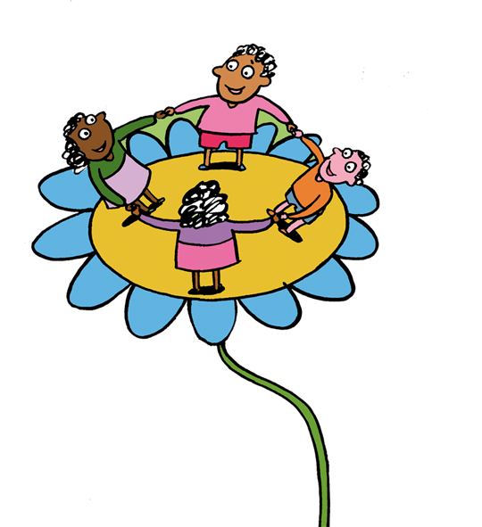
God clothes these wild flowers so beautifully, flowers which are here today and gone tomorrow, burned up in the heat of the sun.

Slide 4
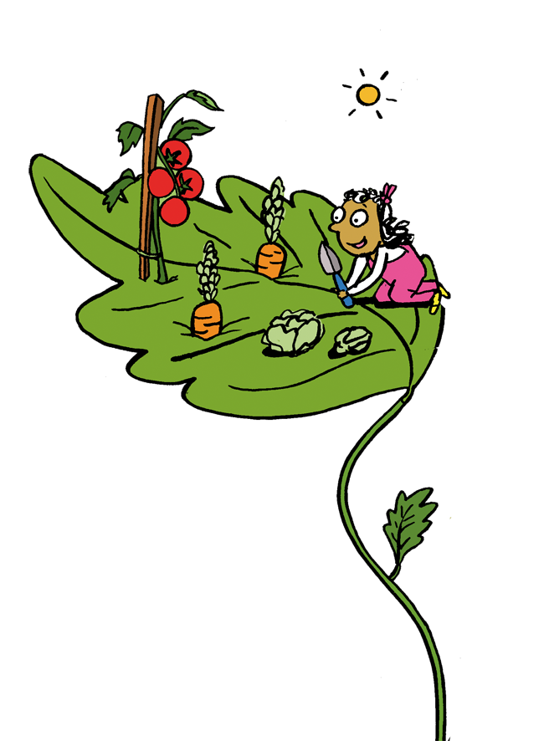
You can be sure that God will take even greater care of you. Never be upset or worried, God your Father knows all your needs and will take care of you.
(based on Luke 12:27-28, 29-30)

Slide 5
We are all God’s treasures

Slide 6
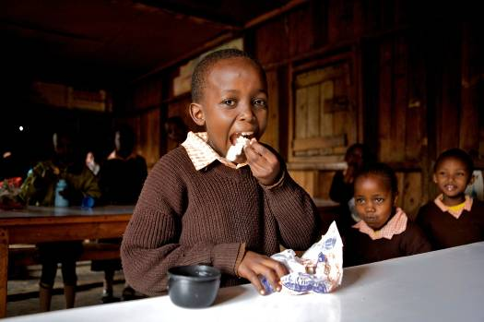
Charles from Kenya feels happy because he is enjoying a delicious lunch.
How is God taking care of Charles?
Notes:
Photo:Frederic Courbet
COUNTRY: Kenya LOCATION: Mathare slum, Nairobi
Charles Mwanoli, 7yrs, primary school, Class 1.

Slide 7
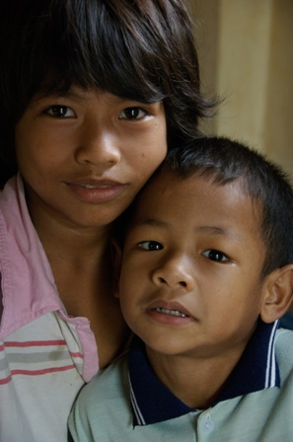
Prak Phearmon and Chhin from Cambodia live happily in an orphanage for children whose parents have died.
How is God guarding Prak and Chhin?
Notes:
Photo: Annie Bungeroth COUNTRY: Cambodia LOCATION: Boentgunpun area of Phnom Penh
Prak Phearmon, 6yrs, (right) with Chhin Sreynea, 6yrs, at Maryknoll Group home 10 orphanage for children living with HIV. Sreynea's sister 11-year-old Sreythea also lives in the home.

Slide 8
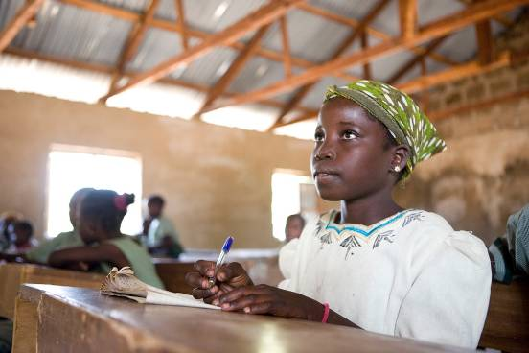
Archal from Nigeria feels happy because God has given her the chance to learn in school.
How does God show love for Archal?
Notes:
Photo: Simon Rawles COUNTRY: Nigeria LOCATION: Zing Local Government, Taraba State, North East Nigeria
Archal Alphonsius, 11yrs, at school

Slide 9
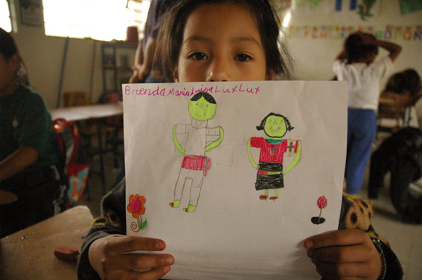
Brenda from Guatemala enjoys drawing people she loves in God’s world.
How does God care for Brenda and the people she loves?
Notes:
Photo: Marcella Haddad
COUNTRY: Guatemala LOCATION: Santa Maria Chiquimula
Brenda, aged seven, from Chiquimula parish school with her drawing of typical Chiquimula clothing. The parish focuses on health, education, vocational training & indigenous culture, working towards strengthening levels of community organisation & participation & increasing knowledge of Mayan traditions & values.

Slide 10
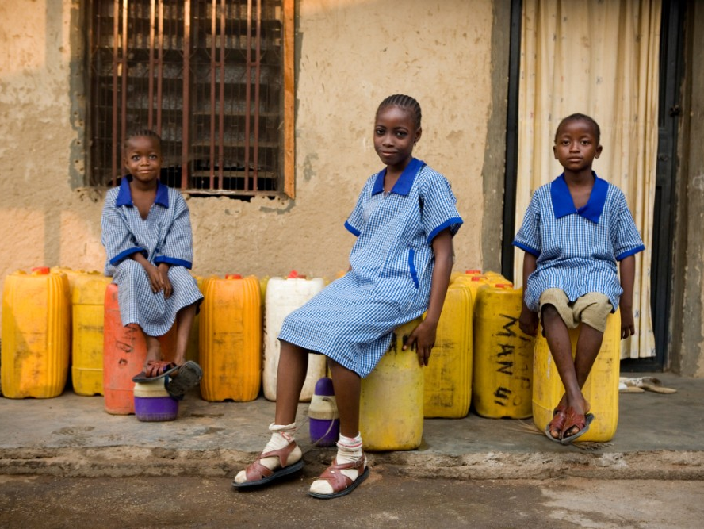
How is God protecting these children?
Latifa, Muleka and Hauwaw from Nigeria are happy because they have clean water from a new water tank, provided by CAFOD.
Notes:
Nigeria
PHOTOGRAPHER: Simon Rawles
Halima Mohammed's daughters (left to right) Latifa, 6yrs, Muleka, 11yrs, and Hauwaw, 8yrs. Her family has benefited from a constant supply of water due to a rainwater catchment tank provided by CAFOD partner the Archdiocese of Jos.

Slide 11
You can be sure that God will take even greater care of you. Never be upset or worried, God your Father knows all your needs and will take care of you.
(based on Luke 12:27-28, 29-30)
How is God looking after YOU?

Slide 12
Picture credits:
Annie Bungeroth,
Simon Rawles,
Marcella Haddad,
Frederic Courbet.
Illustrations: Per Karlen

