Slide 1
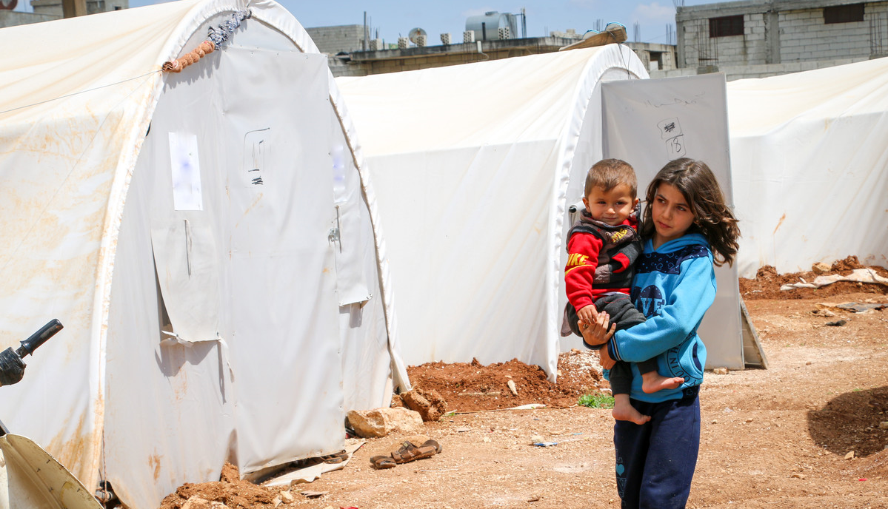
A prayer for refugees
Jesus, friend and brother,
You know what it is like
to be hungry and thirsty.
You know what it feels like
to be a stranger who is made unwelcome.
You know the suffering
of all who have lost everything.
We pray that by welcoming refugees
we may show love for our neighbour
and be closer to you.
Amen.
Tony Singleton/CAFOD
Notes:
Prayer: Tony Singleton/CAFOD
Picture credit: Withheld for security reasons

Slide 2
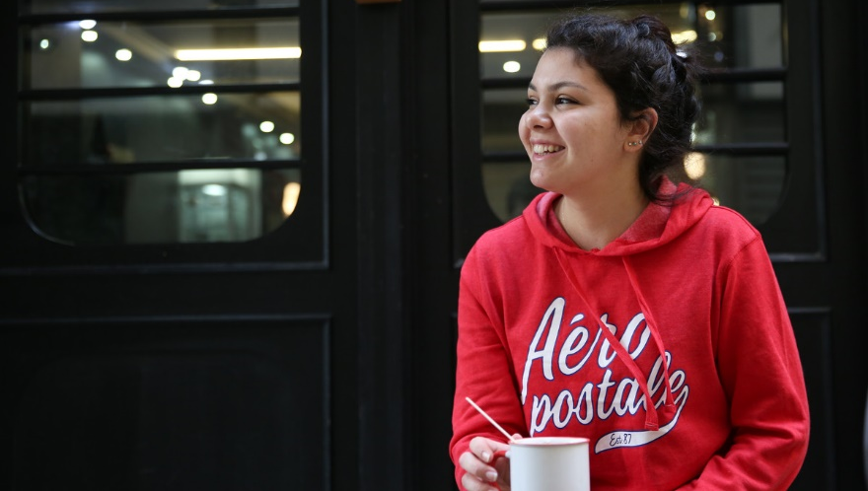
A prayer of welcome
Lord Jesus, you told us
that in your Father’s house
there are many rooms.
Make our hearts wide and welcoming
so that those we meet
may feel that they have found a home.
Amen
Notes:
Prayer: Gemma Simmonds CJ
Picture: CAFOD

