Slide 1
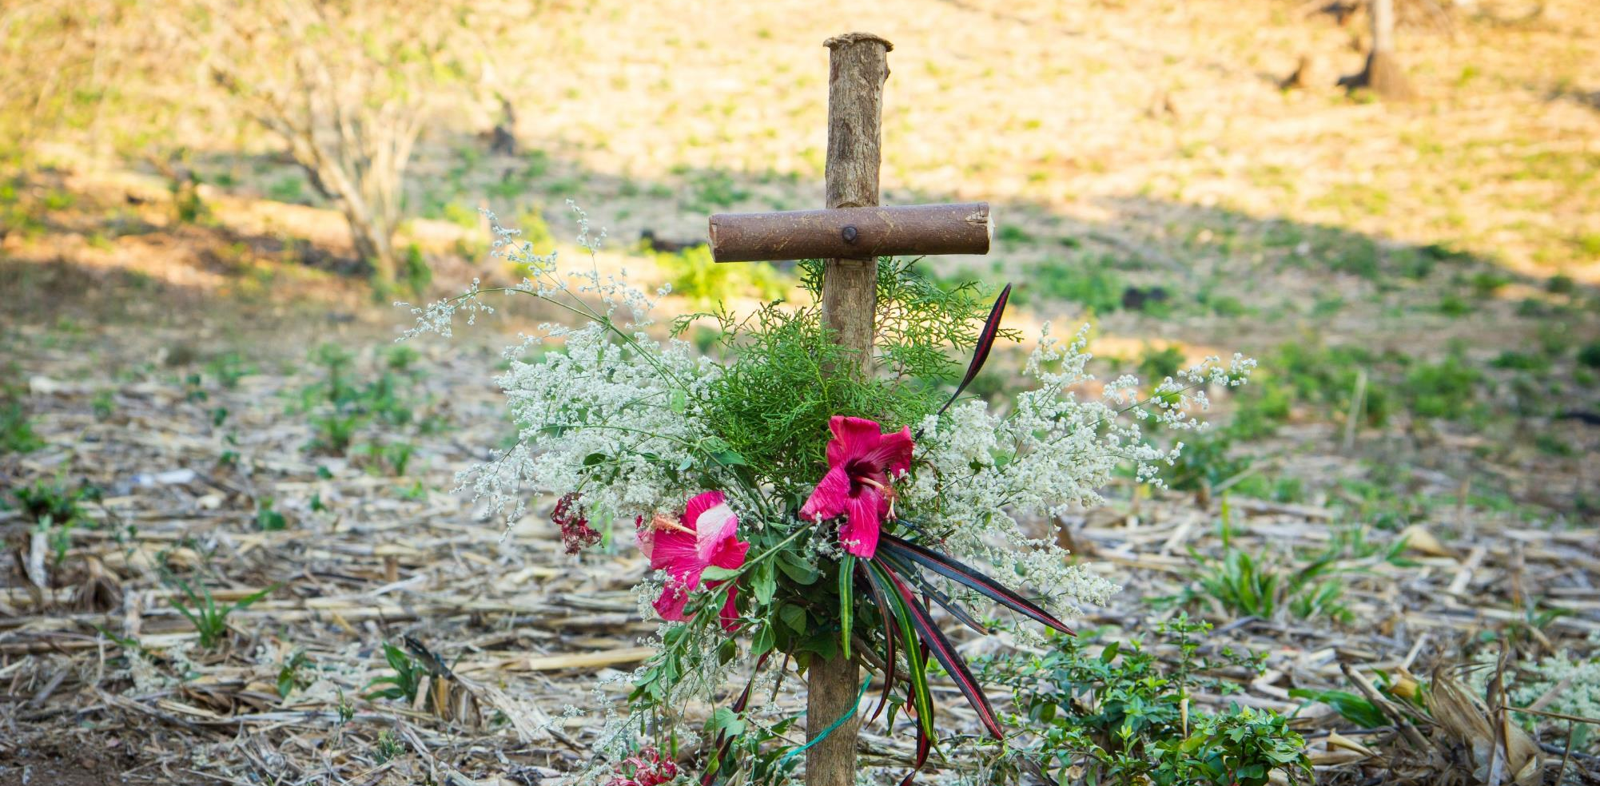
Notes:
Leader: We gather together to pray the Stations of the Cross.
Let us pray that these Stations will move our hearts to know God’s mercy and to share it with others.
Photo credit: Mark Chamberlain | CAFOD
Stations of the cross in Puentecitos, El Salvador

Slide 2
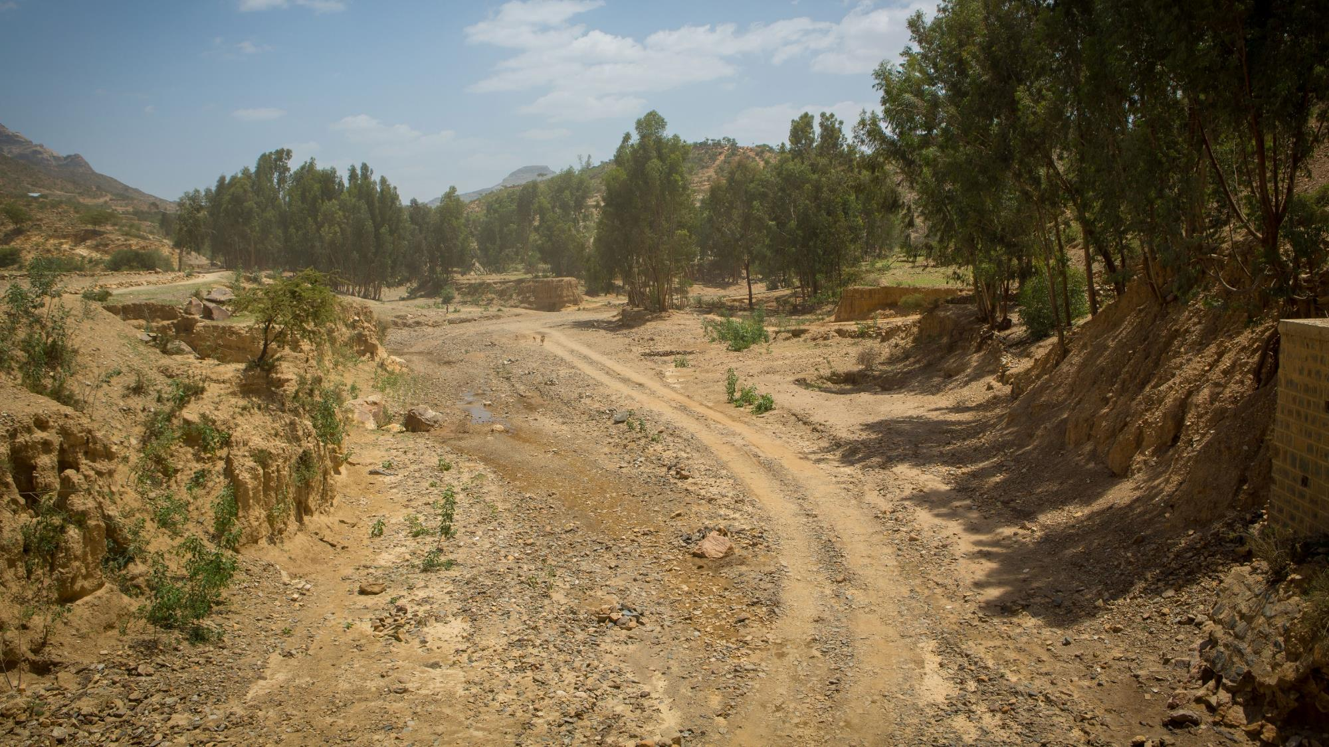
The first Station: Jesus is sentenced to death
Notes:
Jesus is sentenced is death
Jesus stood before Pontius Pilate.
Jesus was alone.
Jesus had done nothing wrong.
Jesus had spent his whole life only doing good things.
Jesus was condemned to death.
Jesus was sentenced to death.
Think:
Think about the times you have felt alone. How does that feel? Think about a time you stood up for something you believed in and others laughed. How does that feel?
Prayer:
Jesus, you know what it means
to stand alone
in front of those
who reject you and don’t understand you.
Walk with us
When we feel that we can’t make a difference
help us to keep going.
When we see someone lonely in the playground
help us to be their friend.
Teach us to share your love.
Photo credit: Louise Norton | CAFOD
Landscape in Adigrat, Tigray region, Ethiopia

Slide 3
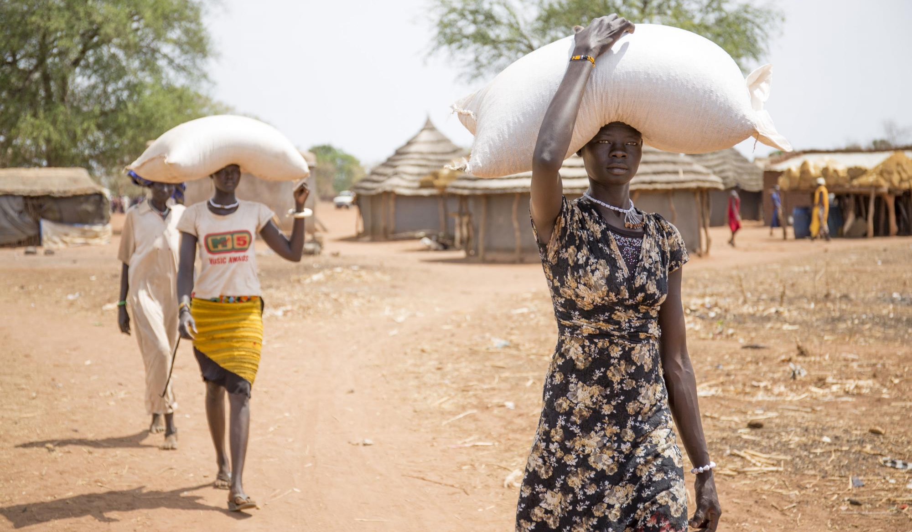
The second Station: Jesus carries his cross
Notes:
The soldiers give Jesus a large wooden cross to carry.
The cross is very heavy.
Jesus knew it would not be easy and that it would lead to his death.
Jesus takes the cross and carries it along the way.
Think:
Think about the times you were not treated fairly. How does that feel? Think about Jesus’ reaction of taking a heavy cross.
Prayer:
Jesus, you picked up Your cross,
even though you knew it would lead to your death.
Walk with us
When we feel scared and afraid
help us to be brave.
Give us, your children, the courage
to speak out
to change our world,
so that all our sisters and brothers
have a fair share.
Photo credit: David Mutua
Women carry food received during a food distribution conducted by CAFOD and Trocaire in South Sudan, reaching internally displaced people who have taken refuge in the village following the drought and conflict.

Slide 4
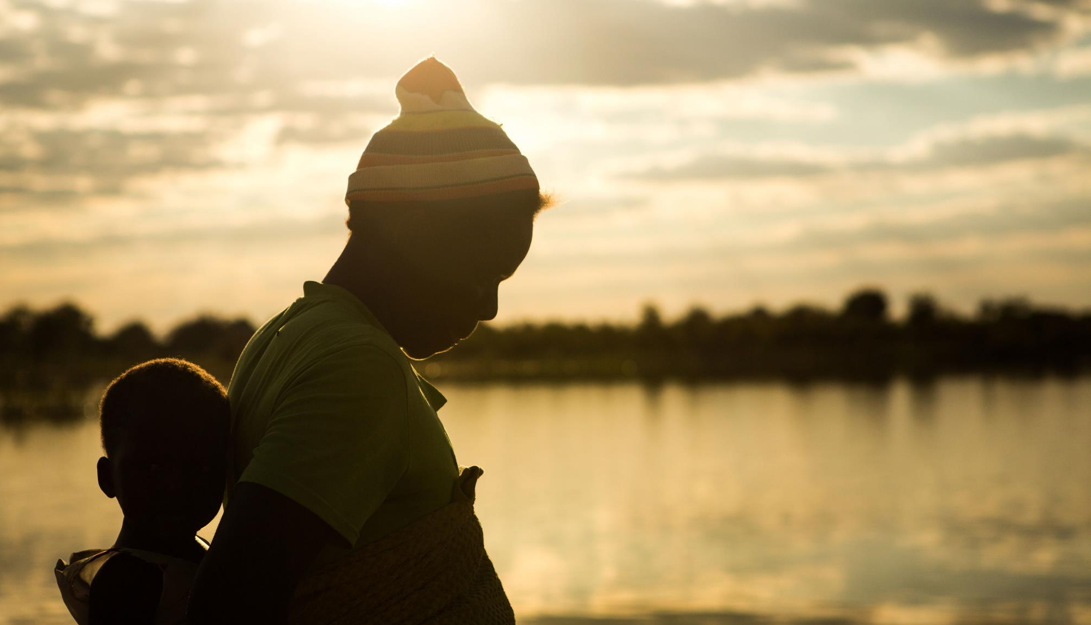
The third Station: Jesus falls for the first time
Notes:
Jesus starts walking.
Jesus is tired.
The soldiers are pushing Jesus.
Jesus falls.
The soldiers pick Jesus up.
Jesus starts walking again.
Think:
Think about the times you are really tired but you have to do something. How does that feel? Think about Jesus falling with that heavy cross.
Prayer:
Jesus, you know how it feels
to struggle and to fall.
Walk with us
Show us how to walk with others
to know what it feels like to be in another’s shoes.
Photo credit: Thom Flint | CAFOD
Memory at Chiwashira Dam, Zimbabwe. Memory used to have to walk through the night to collect water over eight miles away. She carried 20 litres back but it was only enough for drinking and cooking. With match funding from the 2012 Lent Appeal, Caritas has restored a reservoir near to Memory’s home. The family now have plenty of water for drinking, cooking and washing.

Slide 5
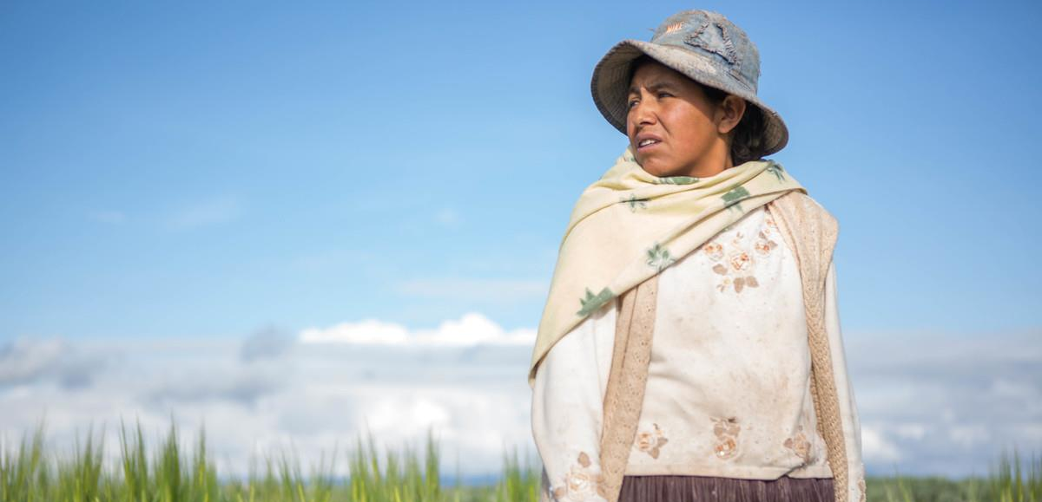
The fourth Station: Jesus meets his mother
Notes:
Jesus sees his mother, Mary.
Mary reaches out to Jesus but the soldiers push him.
Mary is very sad and hurt.
Jesus sees Mary’s eyes.
It gives Jesus strength.
Think:
Think about the people you love. What is important and special about them? How do they help you when things are difficult?
Prayer:
Jesus, you looked through the crowd
and saw your mother’s eyes.
Her love gave you the strength to carry on.
Walk with us
When we don’t want to listen
open our ears to hear.
When it would be easier to look away,
open our eyes to see.
Just as our mothers and fathers love us,
help us to share lovingly with the whole human family.
Photo credit: Ben White | CAFOD
The Altiplano, high in Bolivia, has poor soil and increasingly unpredictable storms. Elizabeth struggled to feed her children nutritious food. A CAFOD partner gave her family high-quality seeds, along with training about good nutrition and how to grow vegetables and make organic pesticides and fertiliser. Now that the family can grow more nutritious food, Elizabeth’s children are healthier and growing well.

Slide 6
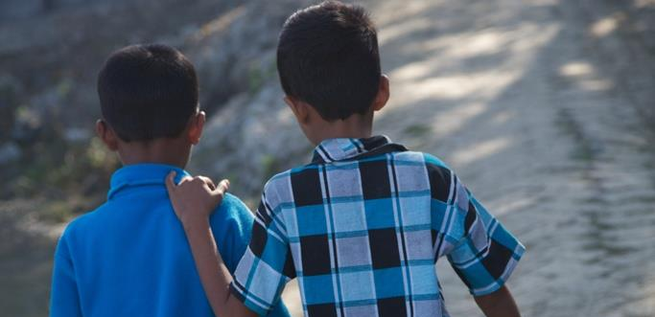
The fifth Station: Simon of Cyrene carries the cross
Notes:
Jesus is weak.
The soldiers make a man named Simon help Jesus carry the cross.
Simon carries it with Jesus.
Think:
Simon didn’t want to help at first. But he did his best to help and soon he was very glad to be helping Jesus. Think about the times you have helped someone. How did you feel? How do you think the other person felt?
Prayer:
Jesus, you know what it means
to depend on someone
and need their help.
Walk with us
When my friends need help,
teach me to work with them.
Show me how to listen carefully
so that I can offer what they need.
Photo credit: Phil Knox | Purple Flame
8-year-old Musa (right) and his best friend, Sunny, walking along a street in Mongla District, Bangladesh. Musa’s family is supported by CAFOD partner, Action on Disability and Development.

Slide 7
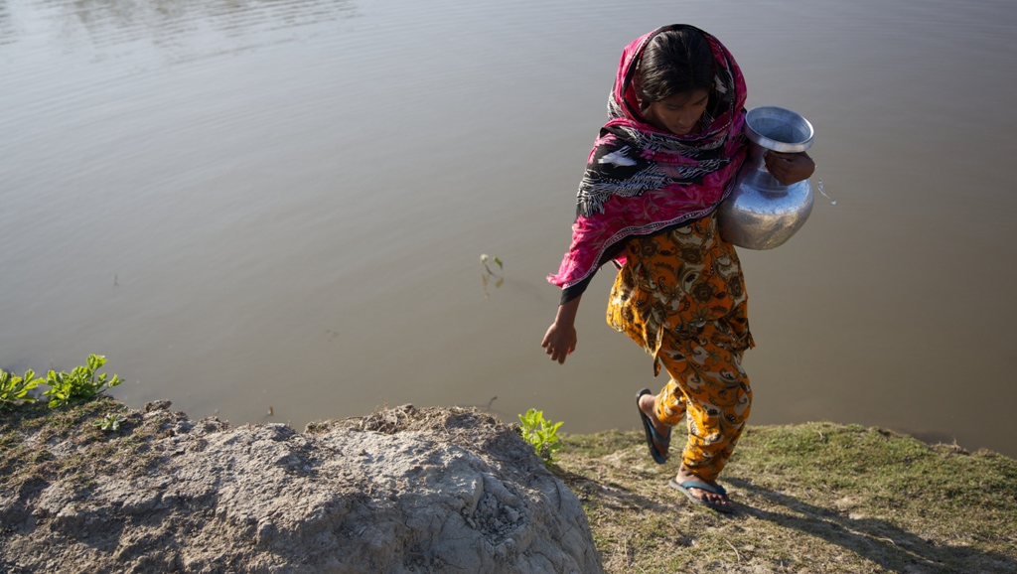
The sixth Station: Veronica wipes the face of Jesus
Notes:
A woman called Veronica walks towards Jesus with a cloth.
She wants to comfort him.
She gently wipes the face of Jesus.
The soldiers push her back.
Think:
Veronica was very brave to ignore the soldiers in order to comfort Jesus. When have you reached out to comfort a vulnerable person, like a child or someone who is unwell?
Prayer:
Jesus, you know how it feels
to be hurt and to cry out in pain and fear.
Walk with us.
Show us how to walk together with others.
Show us how to love the people around us
And to be there for those who need us.
Photo credit: Phil Knox | Purple Flame (2013)
Bristi, 12 years, Bangladesh, collecting water for her family. Bristi’s family receives support from CAFOD partner, Action on Disability and Development.

Slide 8
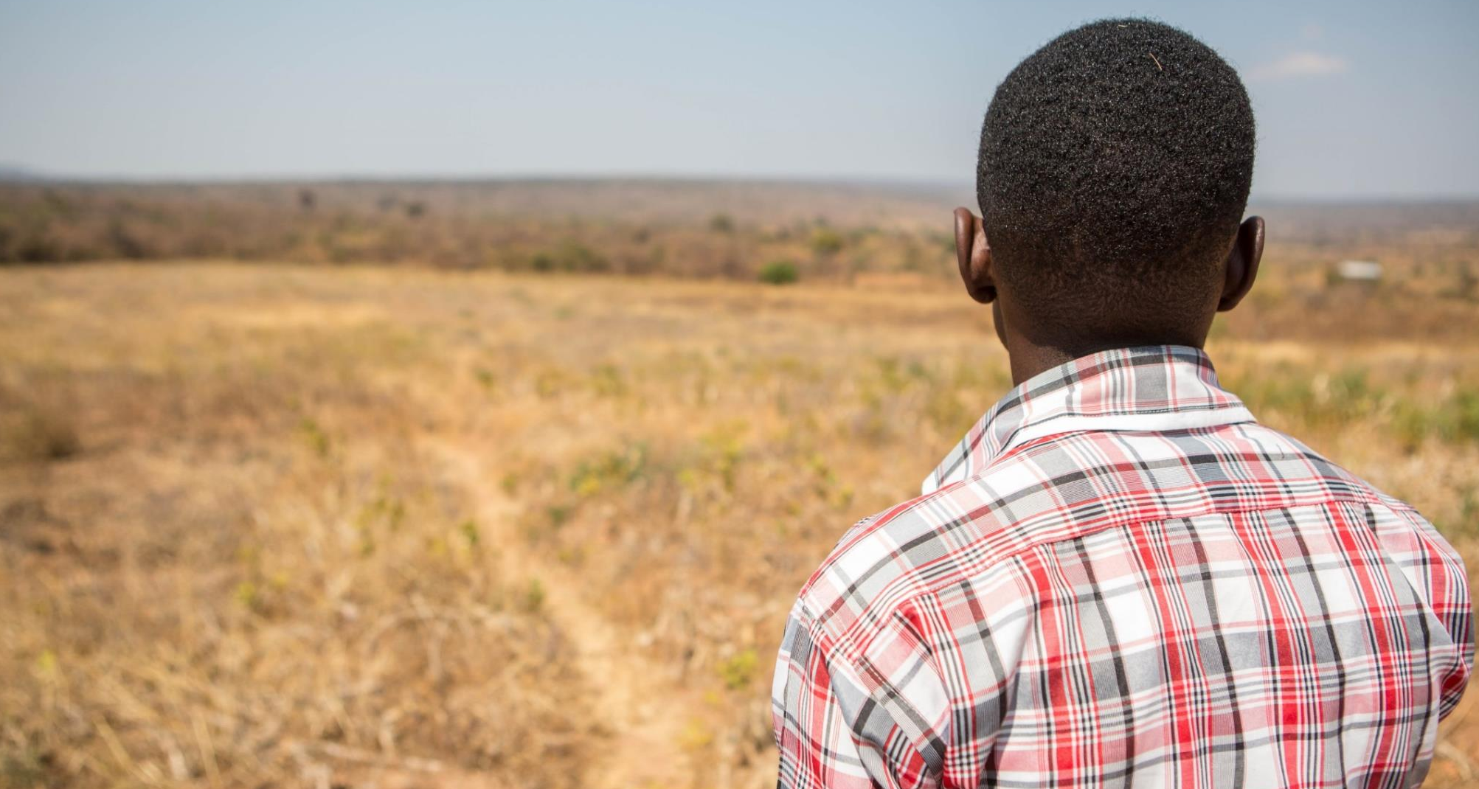
The seventh Station: Jesus falls for the second time
Notes:
Jesus is even more tired.
Jesus is getting weaker.
Jesus falls again, even with Simon’s help.
Jesus struggles to get up.
Jesus keeps trying until he is up on His feet.
Think:
Think about Jesus struggling to get up. Sometimes when things get too difficult we have to keep trying. Jesus doesn’t give up. How do you think Jesus felt?
Prayer:
Jesus, you stumbled and fell.
You lost strength
and became tired.
And yet you carried on.
Walk with us
When we find it hard to go on,
give us the strength we need
to finish our work as well as we can
and show love to others.
Photo credit: Ben White | CAFOD
Patrick, 23, Mbala, Zambia. When he was very young, Patrick’s mother didn’t have enough to feed him. Without clothes or shoes, Patrick was sent to the Orphan Centre in Mbala town to feed him, clothe him and give him life skills. With CAFOD’s support, Patrick has learned tailoring, finished his education and understands how to grow crops on his own land. Patrick now teaches basic tailoring to people living with disabilities.

Slide 9
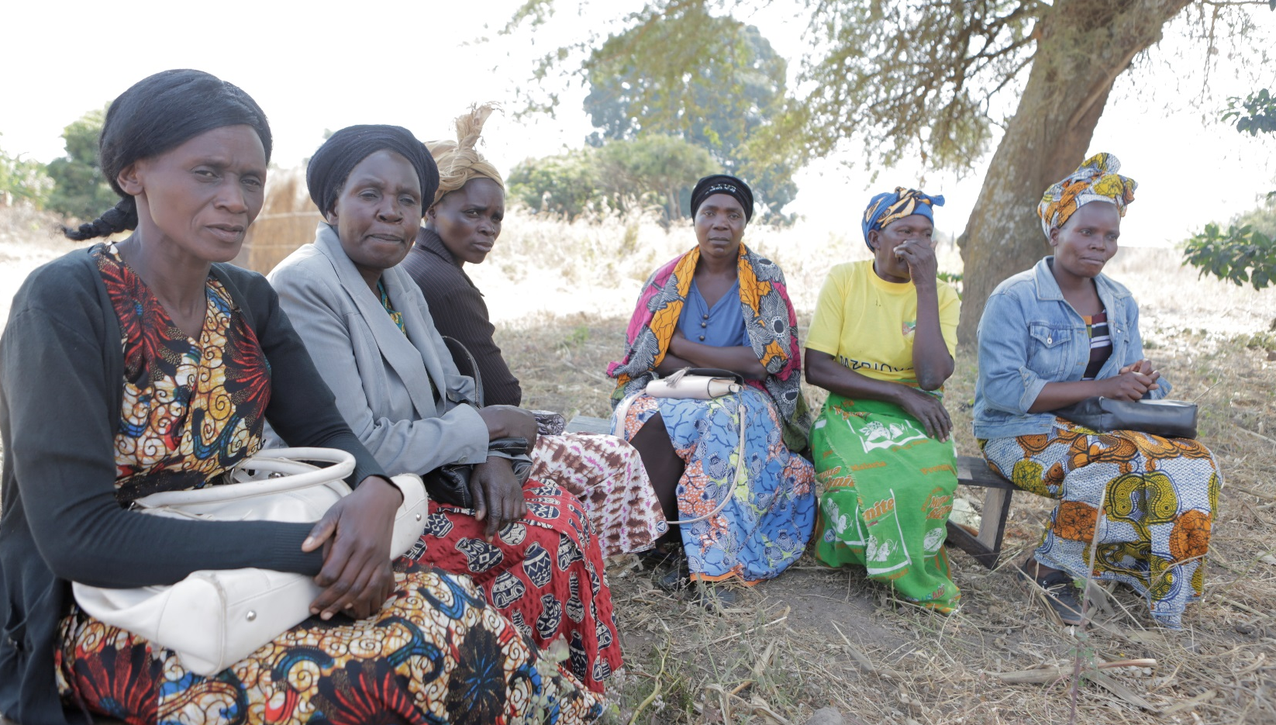
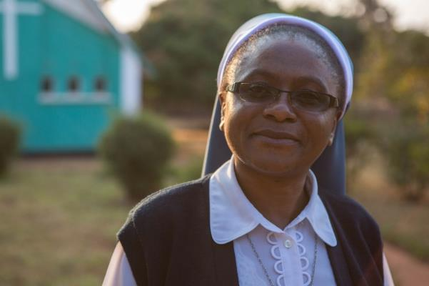
The eighth Station: Jesus meets the women of Jerusalem
Notes:
There are some women in the crowd so sorry for Jesus that they are crying.
Jesus stops and talks to them.
Think:
Even at this difficult time, Jesus was still not thinking of himself, but showing love to those who needed it. Think of a time when you thought only of yourself rather than what was best for others. How could you speak up for others?
Prayer:
Jesus, you cared and spoke out,
even on the road to your death.
You knew and felt the suffering of others.
Walk with us
As we hear the stories of our sisters and brothers who live in poverty,
give us the courage to raise our voices,
so that together we can work for change.
Photo credit: Ben White | CAFOD
Beauty (far right), with her Village Orphan Support Group (VOSG) in Zambia. With CAFOD’s support, Beauty was taught crop diversification as well as business skills. She now has dreams of opening her own business.

Slide 10
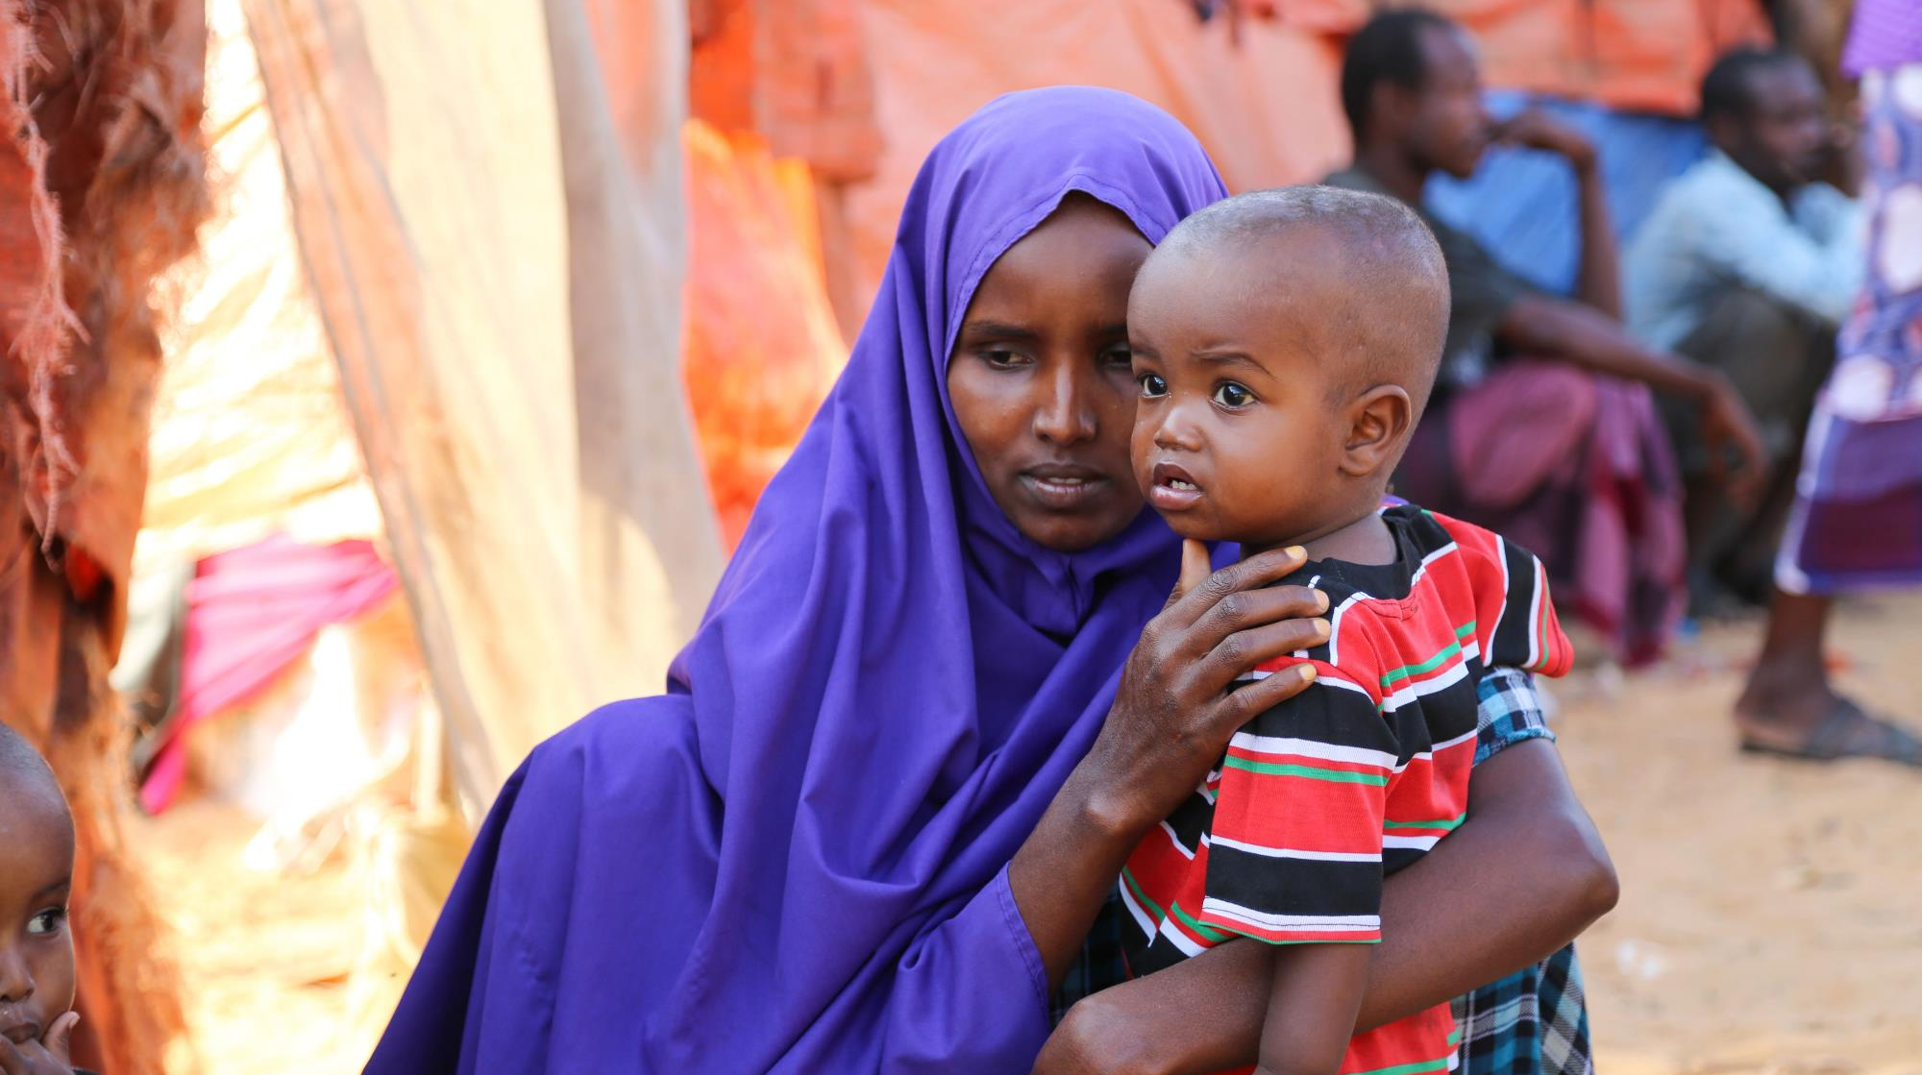
The ninth Station: Jesus falls the third time
Notes:
Jesus has almost no strength left.
Jesus is tired, in pain, and is pushed by the soldiers.
Jesus climbs a hill carrying a heavy cross.
Jesus falls again.
Jesus gets up again.
Think:
When you feel like you can’t keep trying, when things feel too difficult, who could you turn to? How can we be there for others when they are finding things too difficult?
Prayer:
Jesus, you felt the darkness around You,
the crowds surrounded You,
You fell once more.
Walk with us
When we lose hope,
when everything is just too difficult,
show us how to reach out to each other and hold hands
So that none of us have to do everything on our own.
Help us to know that you walk alongside us
even when we feel most alone.
Photo credit: Mohamed Sheik Nor | Catholic Relief Services (2017)
Haway, Somalia, fled from Berdale due to drought that caused lack of water and food. Catholic Relief Services and Caritas are responding to the crisis throughout East Africa.

Slide 11
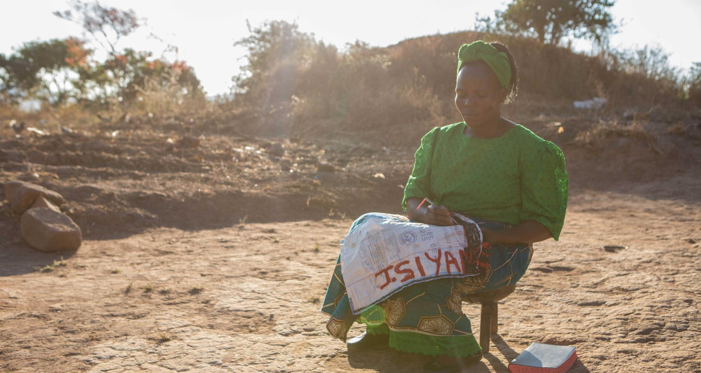
The tenth Station: Jesus is stripped of his clothes
Notes:
Jesus’ clothes are taken.
Jesus reaches the top of the hill.
The soldiers remove his clothes.
They laugh at Jesus.
Think:
How do you think Jesus was feeling as the soldiers laughed at him? Think about a time when others treated you badly. What did you do? What did other people do to help you? What can you do the next time you see someone being treated badly and laughed at?
Prayer:
Jesus, you have been insulted and treated badly.
Walk with us
When we see someone being treated unfairly,
being picked on and bullied,
give us the courage to stand up for them.
We are your global family made of many
different colours, different cultures and different religions.
Make us one family united in you.
Photo credit: Ben White | CAFOD (2016)
Beauty Nanyangwe from Zambia, is a single mother who struggled to grow enough food. She joined a women’s group supported by a CAFOD partner where she learned new farming and business skills. Beauty is now a successful farmer, selling her excess crops.

Slide 12
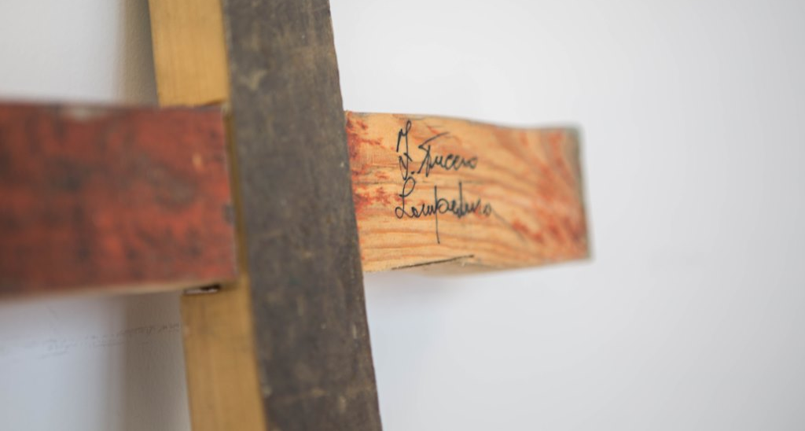
The eleventh Station: Jesus is nailed to the cross
Notes:
The soldiers make Jesus lie down on the cross.
They nail Jesus’ hands and feet to the cross.
Think:
Sometimes we say or do hurtful things to others. How do you think they feel? How could we make them feel better?
Prayer:
Jesus, in pain,
you cry out.
Walk with us
Challenge us,
when we hold people back,
when we look down on them,
when we don’t treat them with respect.
Help us to remember that everyone is equal,
That we are all made in your image.
Photo credit: Ben White | CAFOD
In 2013, a boat set sail for Europe with more than 500 refugees fleeing Eritrea and Somalia. The boat caught fire and sank near the Italian island of Lampedusa; 311 people perished. Mr Tuccio, a local carpenter, collected broken pieces of wood that had washed ashore and made crosses to offer a small but powerful symbol of hope for each of the survivors. The Lampedusa Cross is a story of solidarity and love.

Slide 13
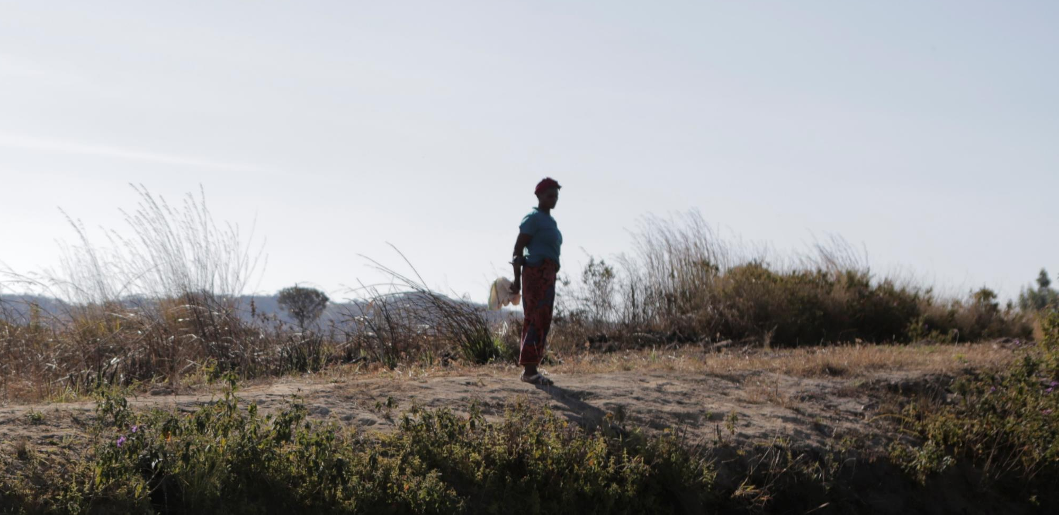
The twelfth Station: Jesus dies on the cross
Notes:
Suggested action:
If appropriate, you could switch off the lights or extinguish a candle during this station.
Jesus asks God to forgive those who are killing him.
Then Jesus gives everything to his Father.
A few moments later Jesus said: "It is finished." Jesus died. (If you can, pause briefly to genuflect at this point)
It was daylight, 3.00pm, but suddenly the sky turned dark and the earth shook.
Think:
Even at the last minute Jesus is thinking of others, he asks for them to be forgiven. Think about all the suffering Jesus has just gone through. Jesus still shows love and kindness to others. When do I show love and kindness to others? Do I only show love and kindness to others when I’m in a good mood? Or do I also show love and kindness even when it is difficult?
Prayer:
Jesus, you know what it’s like
to feel alone,
lost and afraid.
Walk with us
And show us how to walk with others,
who live in fear, who face death
through hunger, thirst, violence and war.
Show us how to pray
for our sisters and brothers that we do not know
and will not meet,
but who are always loved by you.
Photo credit: Ben White | CAFOD
Florence Nachinsambwe, Zambia. After her husband died, Florence struggled to make a living. With CAFOD’s help she learned how to grow different crops to support herself on her own bit of land. She was also given small, starter fish by our partner to start her own fish ponds. She now trains others how to farm fish.

Slide 14
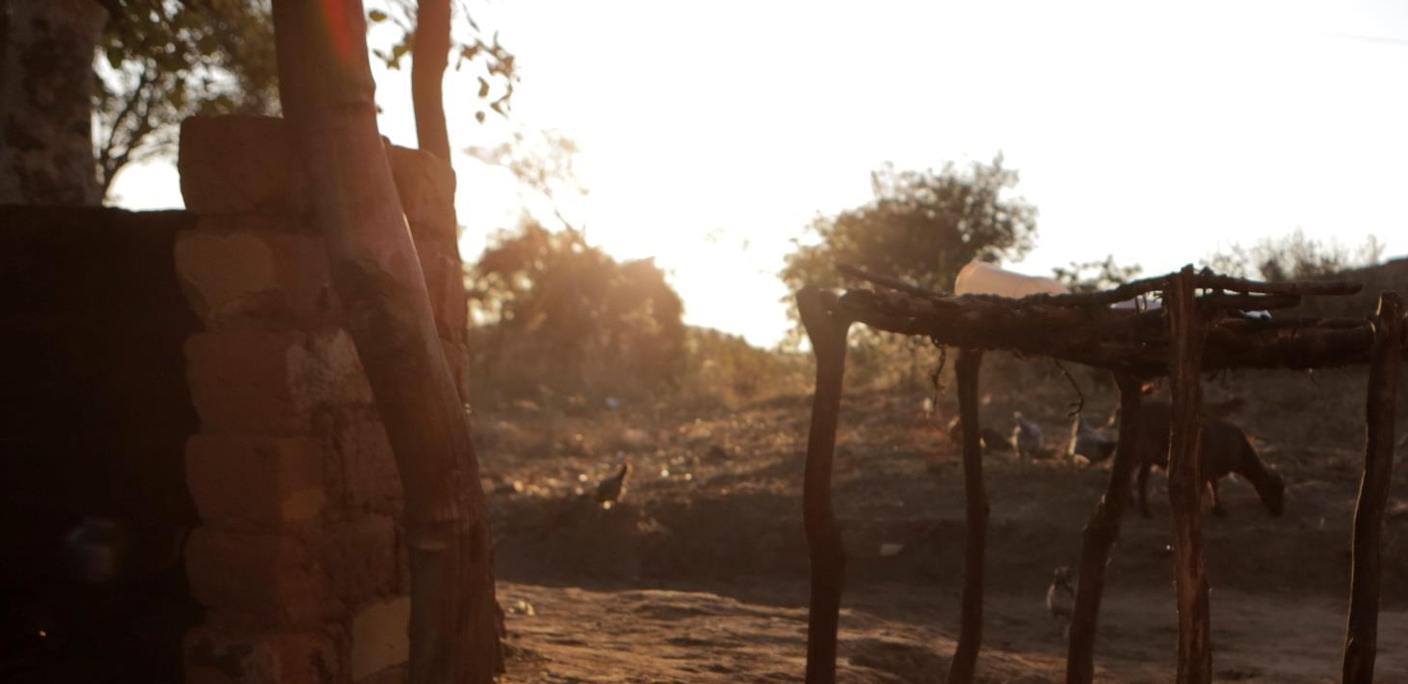
The thirteenth Station: Jesus’ body is taken down from the cross
Notes:
Everybody goes away.
Mary stays at the foot of the cross with her son.
Two friends come and gently take Jesus down from the cross.
Mary holds Jesus.
Think:
Mary held Jesus like when he was a baby. How must Mary have felt remembering all the happy days she had with Jesus? Think about the friends and family that make you happy. Why do they make you happy? What does it mean to be a really good friend?
Prayer:
Jesus, you know what it means
to have friends,
who risked their own lives
to take Your body from the cross.
Walk with us
And show us how to be friends to those close to us and to those far away.
Teach us to see you in everybody,
to be kind,
to be loving
to be strong
to be like you.

Slide 15
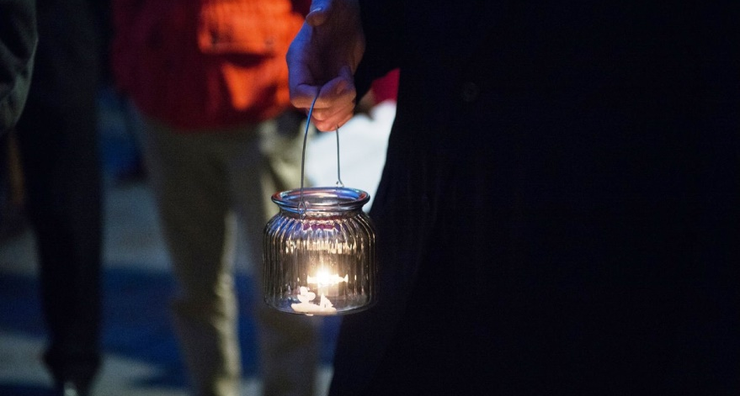
The fourteenth Station: Jesus is laid in the tomb and covered in incense
Notes:
Jesus is buried in a tomb.
A stone is rolled across the entrance.
Think:
Jesus’ friends are sad. They think it is the end of the story of Jesus. Jesus will no longer be around them, be able to teach them, eat with them or pray with them. But Jesus is always with us. Can you think of a time you have turned to Jesus to help you?
Prayer:
Jesus, in the darkness of the tomb
those who loved you felt sad and alone.
They did not know what to do.
Walk with us
Help us to be generous and gentle, kind and loving.
Guide us in difficult times,
So that we can share you with our sisters and brothers
when they feel sad and alone.
Photo credit: Marcin Mazur
A woman holds a lamp during a candlelit vigil in London to pray for refugees.

Slide 16
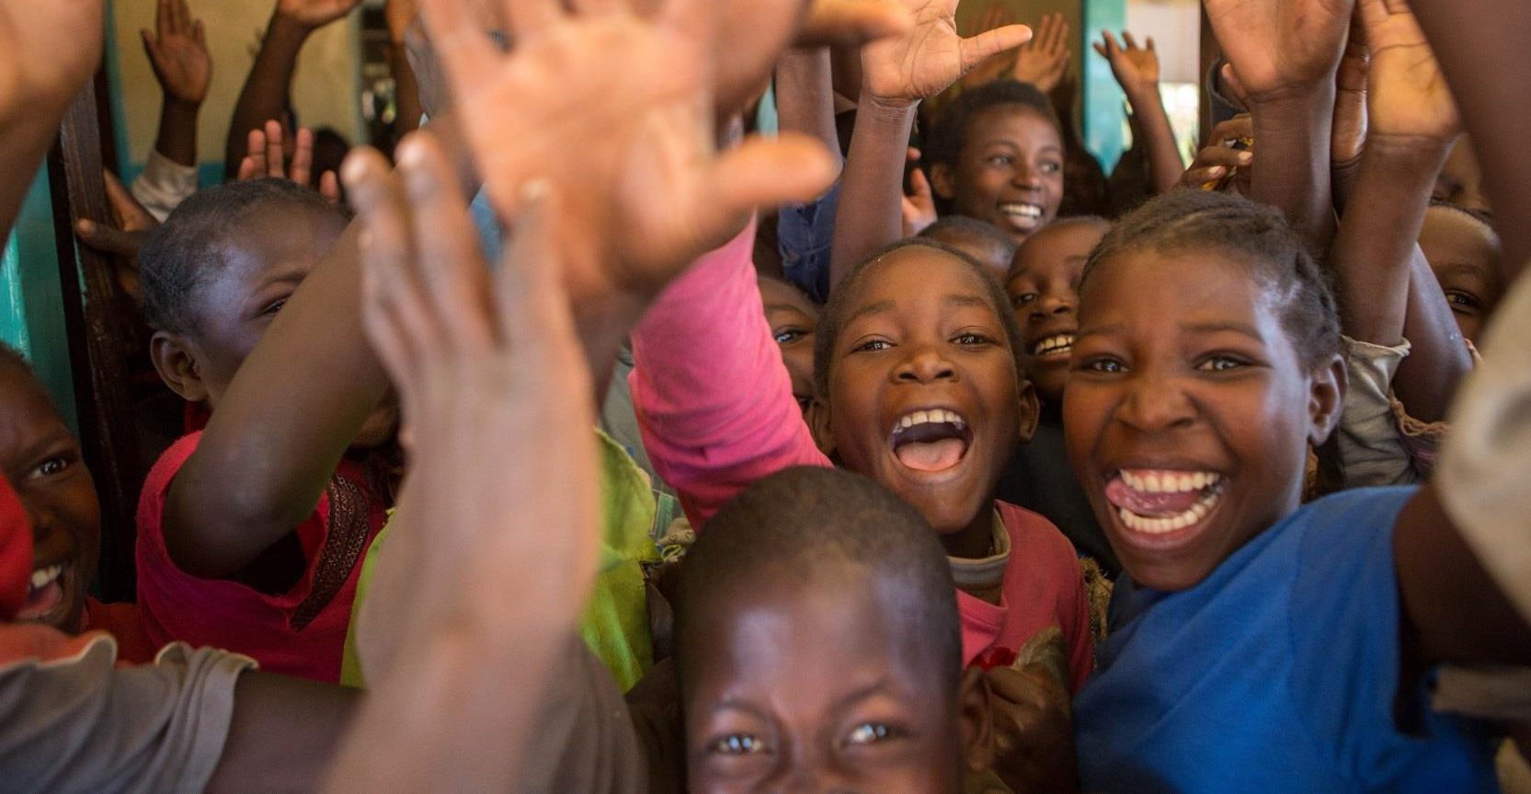
The fifteenth Station: Jesus rises from the dead
Notes:
Three days later, Jesus rose from the dead.
Think:
Jesus is risen from the dead. His message of love is still alive in the world today. He has shown us that he is the Son of God and he is a light for all who follow him. How will you follow Jesus in your life and share his light with others?
Prayer:
Jesus, you share your life,
your light and your peace
with us all.
Walk with us
Show us how to live out your love
so that our sisters and brothers
around the world may know the joy of new life
and we may all be changed by living in your light.
Photo credit: Ben White | CAFOD
Pupils at a school for orphaned children in Mbala, Zambia which is run by CAFOD partner, the Sisters of the Sacred Hearts of Jesus and Mary.

