Slide 1
Prayer for the world’s people
Heavenly Father,
You hold the whole world deep in your heart,
sharing our pains and burdens,
delighting in our joys and successes.
We offer you our prayers –
both spoken and unspoken –
and ask you to hear us
as we pray for others around our world.
[Those who wish to, each name a country]
We make these prayers
in the name of the Father,
and the Son and the Holy Spirit. Amen.

Slide 2
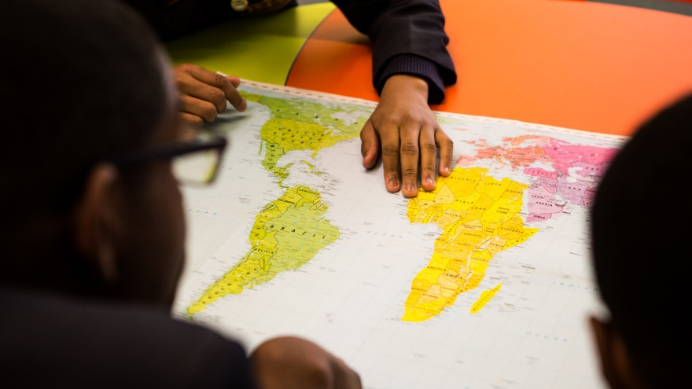
Here and now
Here and now, Lord,
I hold before you simply
some of the seven billion people
with whom I share this world.
Although I may never meet them
nor even know their names,
I place them in your loving care.
Guide them. Support them. Be with them.
May they be full of your love
and share it with those they meet,
as I, once more, commit myself to do the same.
Amen.
Notes:
Prayer: Stephen Davies/CAFOD
Picture: CAFOD

Slide 3
For all your people
We pray for all your people, Lord.
For those in places of despair that they may find hope,
we pray for all your people, Lord.
For those who bring hope to others,
we pray for all your people, Lord.
For those who hunger or thirst, that their needs may be met,
we pray for all your people, Lord.
For those with the power to help those who hunger or thirst,
we pray for all your people, Lord.
For those who are homeless that they may find shelter,
we pray for all your people, Lord.
For those who can work to create a fairer world,
we pray for all your people, Lord.
Notes:
Prayer: Mo Baldwin/CAFOD
Picture: CAFOD (In a church in Moroto, Karamoja. A young girl who goes to school nearby lit the candle.)

