Slide 1
STEP UP TO THE PLATE
Secondary school assembly
Notes:
Good morning/afternoon everyone. Welcome to our CAFOD assembly.

Slide 2
Something is broken about our global food system - the way we grow and share food in our world.
Let’s find out more.
Notes:
We all know that food poverty is a growing problem in the UK. People are hungry in other places too. In fact, around the world, one person in every ten is hungry. And often the hungry people are the ones who are growing food!
Something is broken about our global food system. In other words, the way we grow and share food in our world is not fair. Let’s find out more.

Slide 3
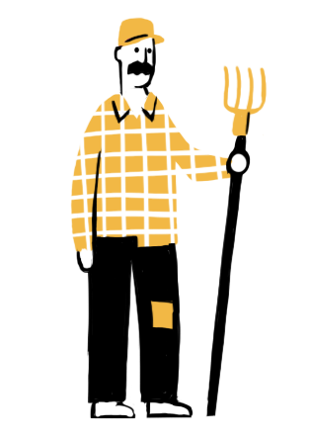
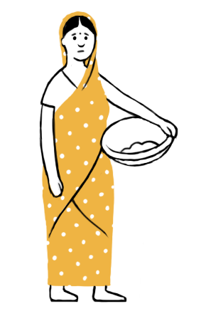
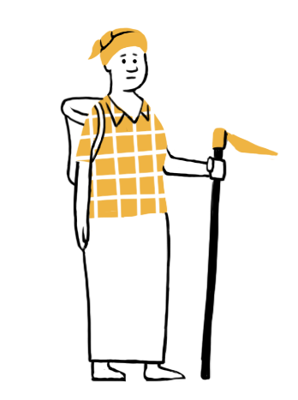
Watch the
animation
Notes:
The animation is at cafod.org.uk/secondary

Slide 4
As we heard…
Food is grown in ways that worsen the climate crisis
and make it hard for our global family to have enough to eat.
Our food system supports big companies as they take land from small farmers, control their seed markets, destroy rainforest and use chemicals that harm people and the soil.
Notes:
But it doesn’t have to be like this!

Slide 5
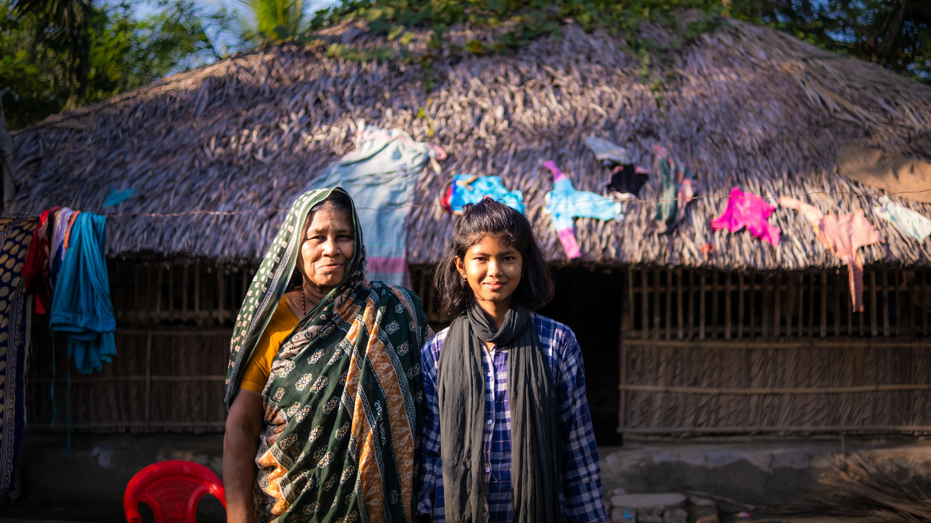
There are solutions!
Notes:
Picture credit: Amit Rudro
Around the world, communities are showing that it is possible to grow food in healthy, sustainable ways that do no harm.
Toma is 10 years old. She lives in southern Bangladesh.
In Toma’s area, the climate crisis is causing more and stronger tropical storms, flooding the land with sea water and making the soil salty. This kills many plants and makes it hard to grow food.
Some of Toma’s community received training from local experts supported by CAFOD. They learned ways to grow food even where the land is salty, and they shared what they had learned. Now her community has become an “Eco-village”, committed to living sustainably.

Slide 6
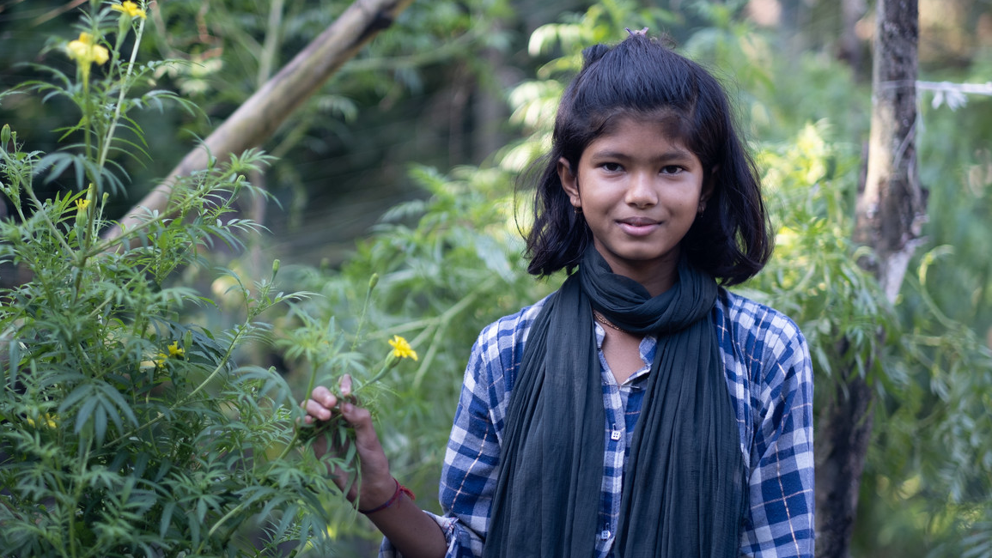
Notes:
Picture credit: Amit Rudro
They use “permaculture”. This is a way to grow food and live sustainably, without wasting anything. Food scraps are used to make compost. No chemical fertilisers are used.
Toma said: “We make our own fertilisers at home—so it helps plants to grow.” Her house is surrounded by greenery and Toma says that the food her family grows is tastier and healthier.

Slide 7
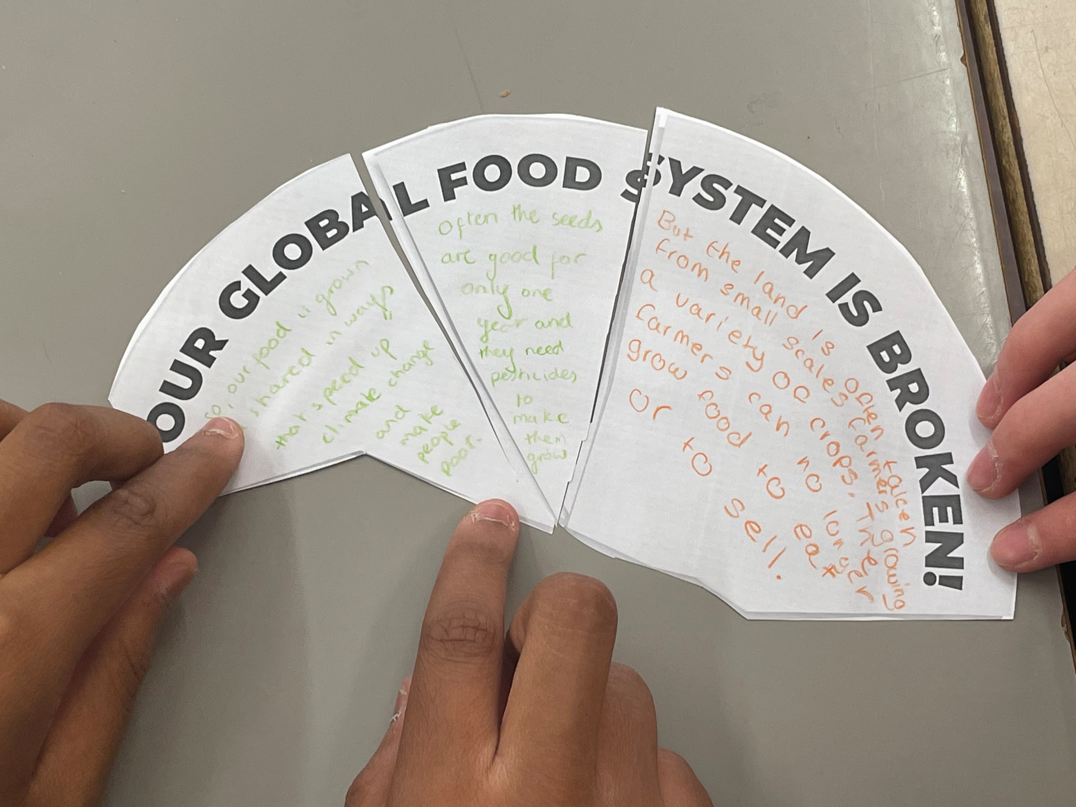
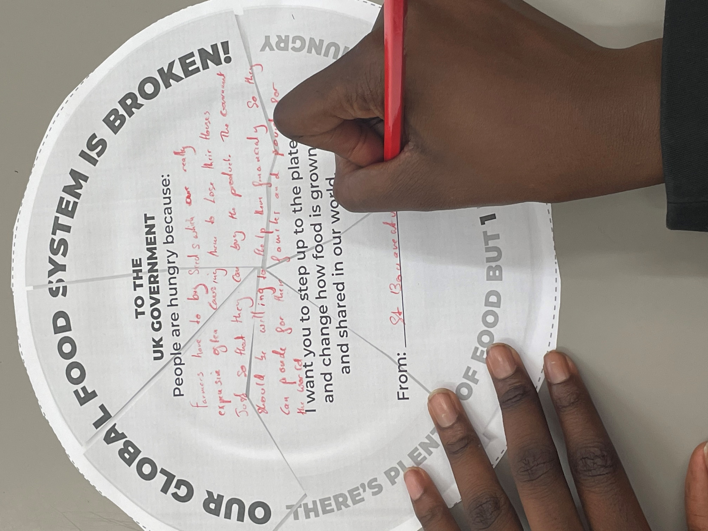
What can we do?
Let’s tell our government to STEP UP TO THE PLATE and start to fix the food system.
We can write messages, send photos, and let CAFOD know how many people demand change:
cafod.org.uk/secondary
Notes:
Teachers/chaplains: After the assembly, in tutor time or whenever is most appropriate, please go to CAFOD’s website to copy the templates with instructions and do our campaign activity with your students. Please remember to tell us how many have taken part, so that we can tell the government.
We also have extra resources to help students explore the issues in more depth.

Slide 8
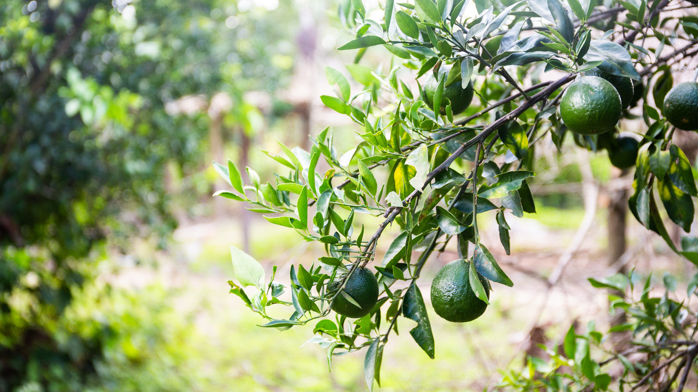
Lord Jesus,
You welcomed everyone to your table.
Remind us that all are invited
to share the feast,
as one family,
who share one common home.
You fed the hungry crowds.
Open our eyes
to the needs of others
and help us to follow your example
of love and service.
Amen
Notes:
We can also help by praying. So let’s do that now…

Slide 9
STEP UP TO THE PLATE
cafod.org.uk/secondary

