Slide 1
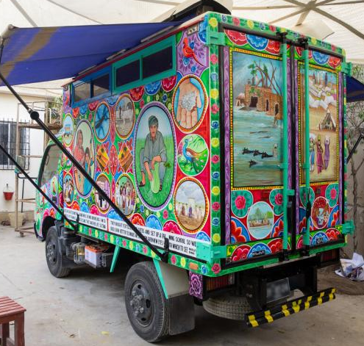
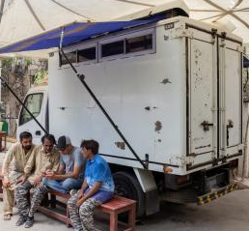
Notes:
Photo credits: Zoral Naik

Slide 2
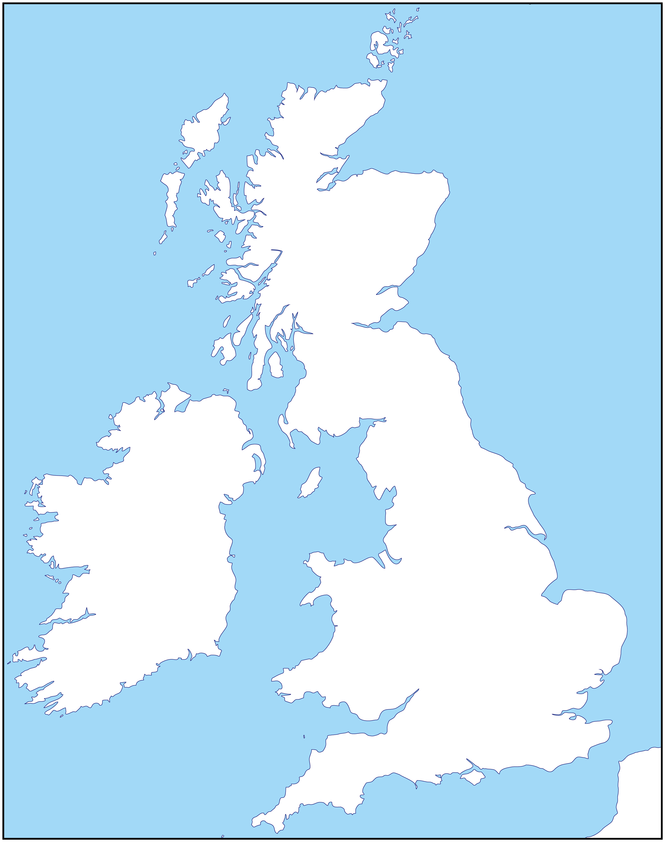
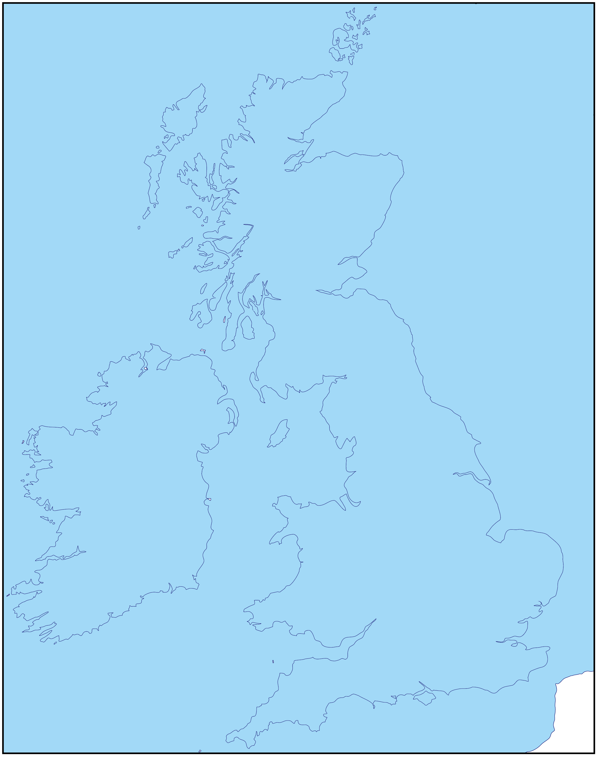
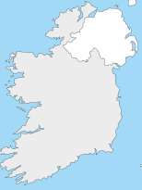
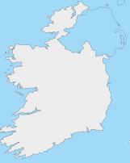
Harvest
Imagine the whole of the UK covered in floodwater...
…not just a few places, but everywhere.
Notes:
Picture credit: Community World Service Asia (CWSA)
Map: D-maps.com

Slide 3
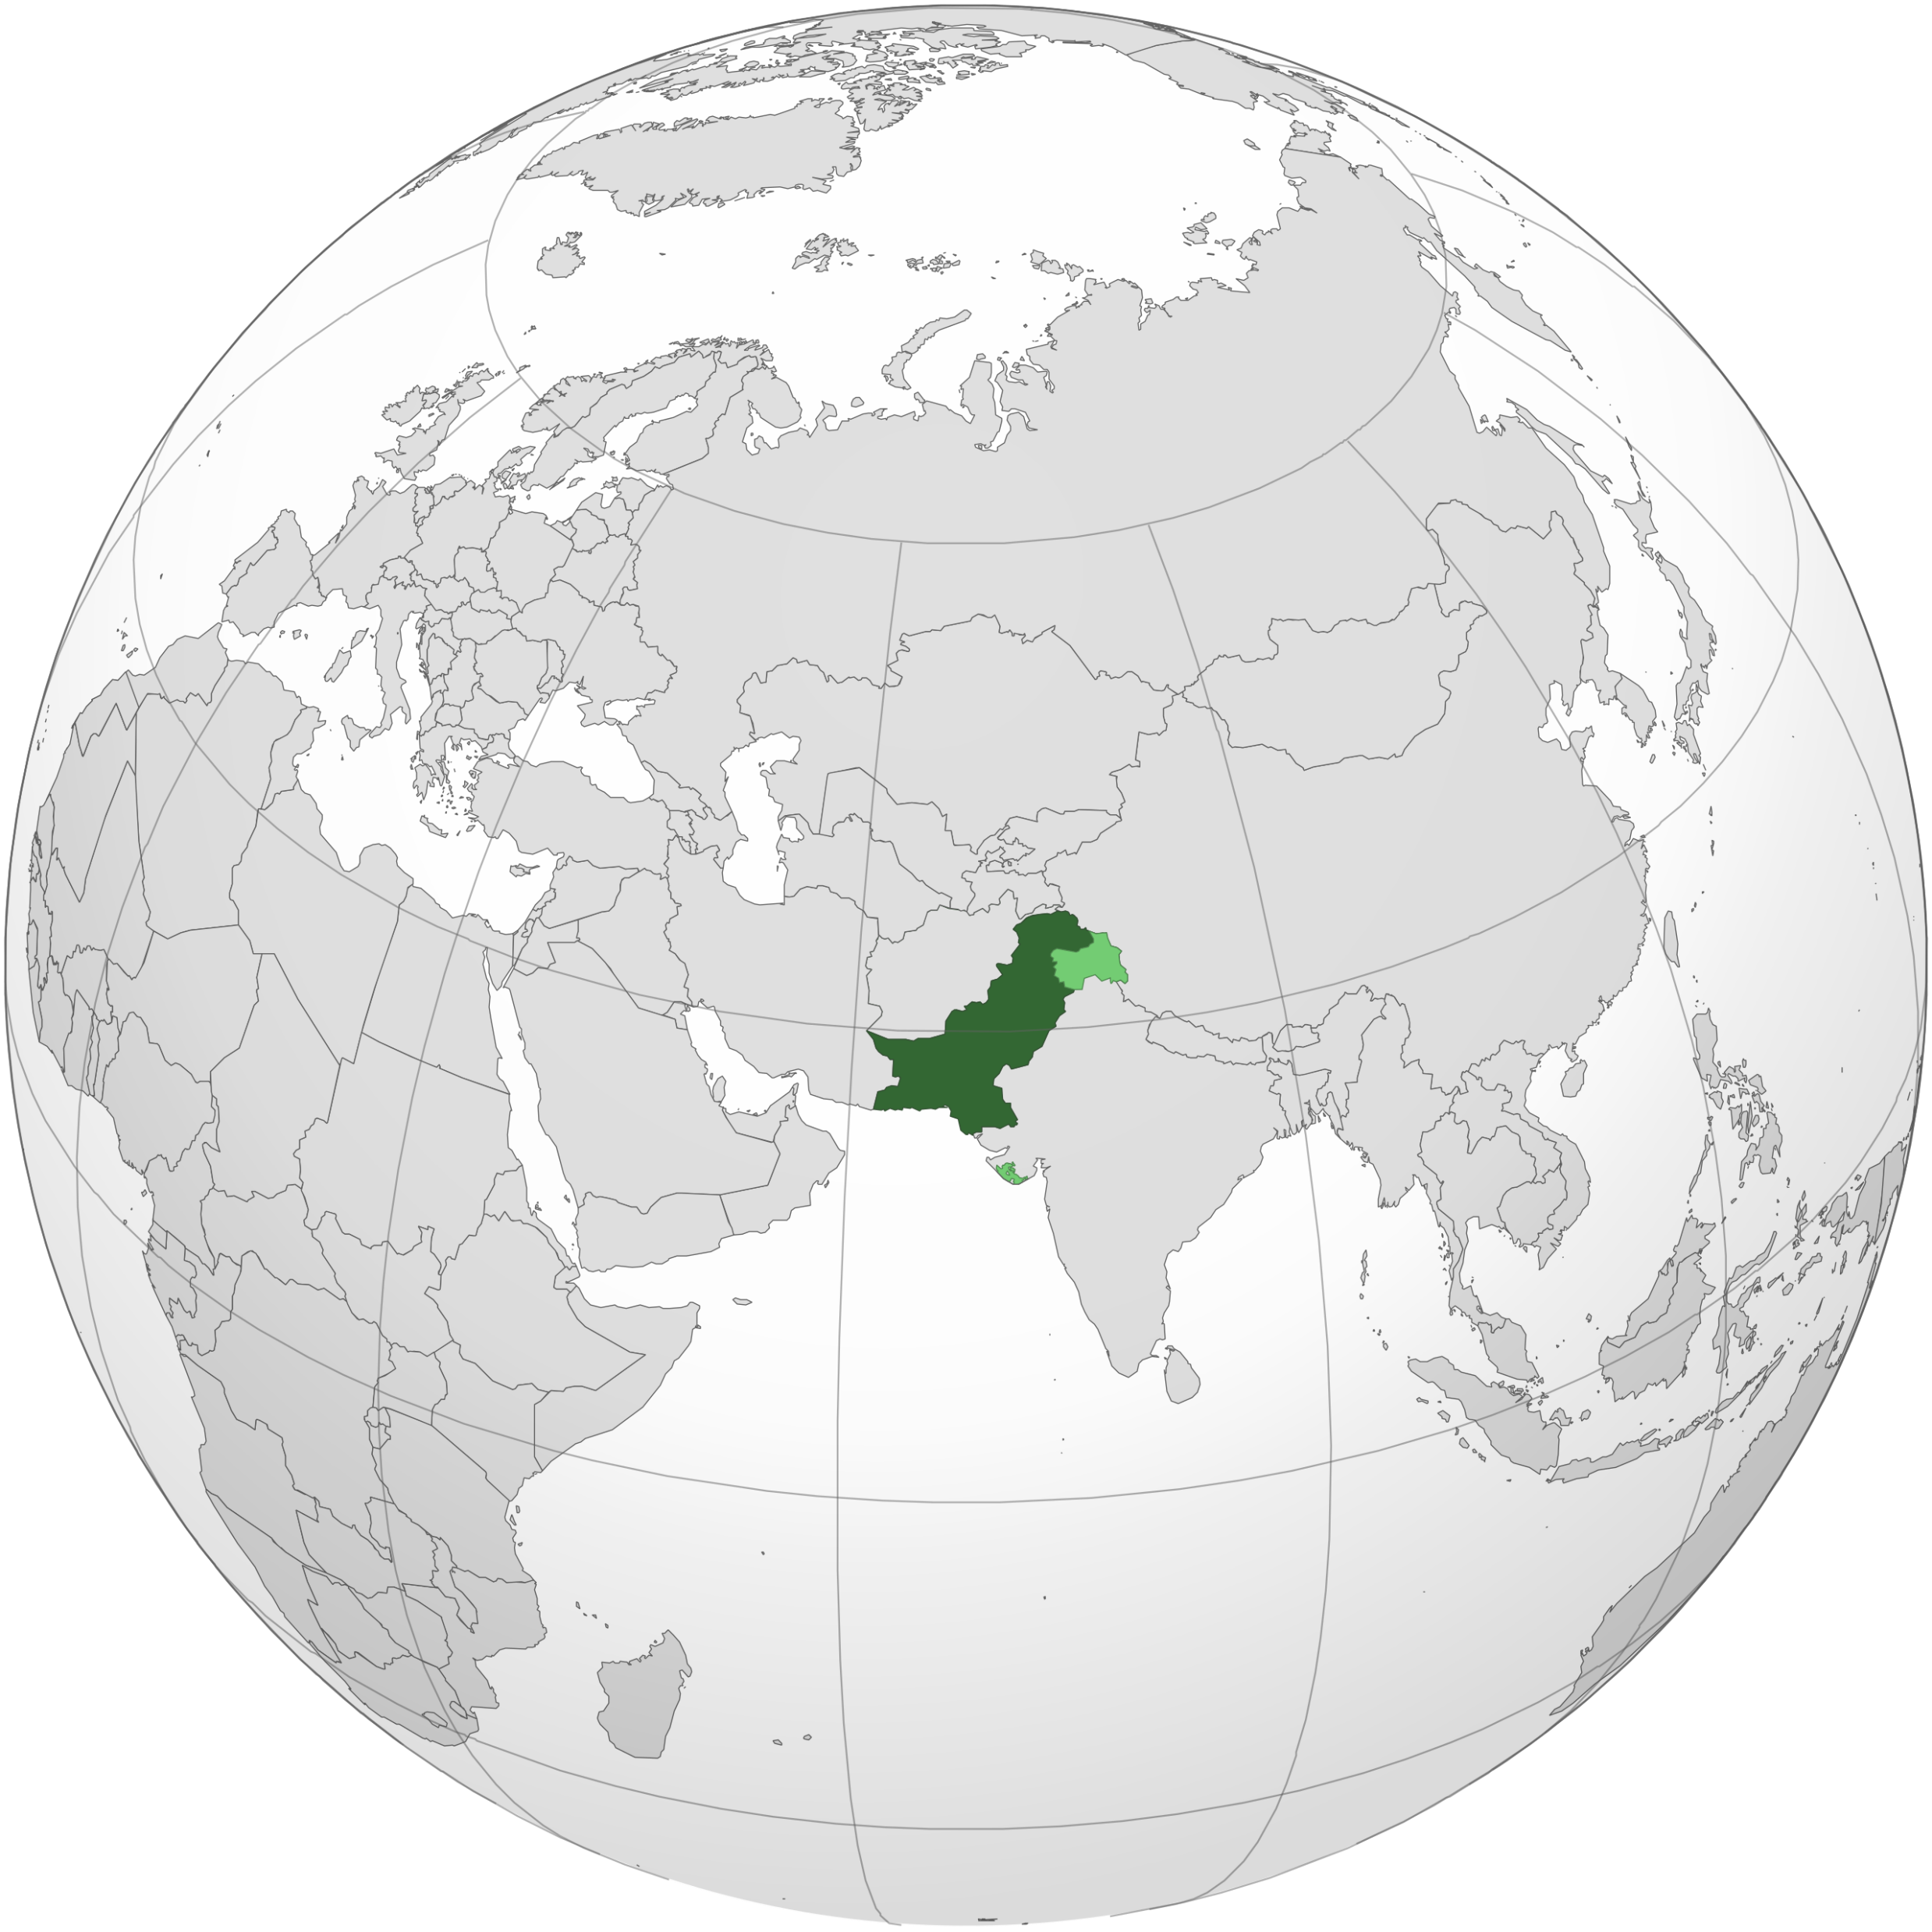
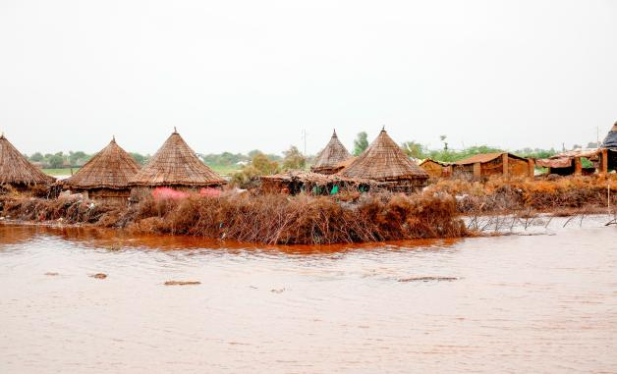
Harvest
Last summer, in Pakistan, an area the same size as the UK was under water as terrible floods swept away people, homes and animals.
By harvest time, when farmers usually gather in their crops, there was no harvest to gather.
Notes:
Picture credit: Community World Service Asia (CWSA)
Map: Wikipedia

Slide 4
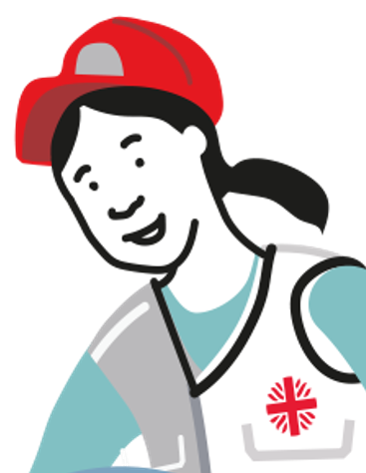
‘Caritas’ means ‘love’
Many people died in the floods, and many others were injured.
As part of the global Caritas network, CAFOD was quickly able to help.
Caritas has experts all around the world - organisations like CWSA, Community World Service Asia.

Slide 5
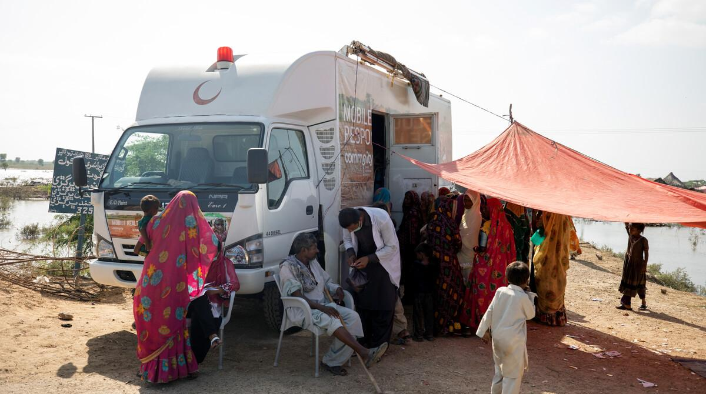
No-one beyond reach
CWSA sent mobile clinics to reach some of the people who most
needed medical help, funded
in part by fundraising
in schools like ours.
Notes:
[If you have time, at this point, click the arrow to show the 2-minute video about the mobile health clinic at cafod.org.uk/secondary]
Picture credit: Community World Service Asia (CWSA)

Slide 6
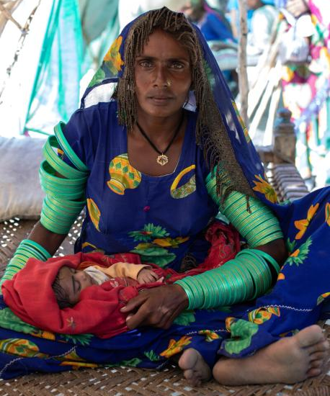
True stories
Meera gave birth to a daughter, Marwi, during the floods.
While at the hospital, the family’s home was swept away.
They moved into a temporary shelter on the roadside, with little food and only contaminated water to drink.
Diseases spread through the camp.
Notes:
[Meera and Marwi are pseudonyms]
Photo credit: Community World Service Asia (CWSA)

Slide 7
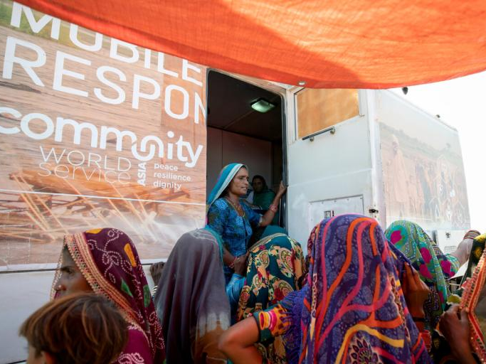
True stories
Meera recalls: “Our children got sick, and we had no medicines.”
Then a CWSA mobile clinic run by Doctor Nasha and her team arrived in Meera’s village.
Meera hurried to bring her children and got them the
life-saving medicines and treatment they needed.
Notes:
Photo credit: Community World Service Asia (CWSA)

Slide 8
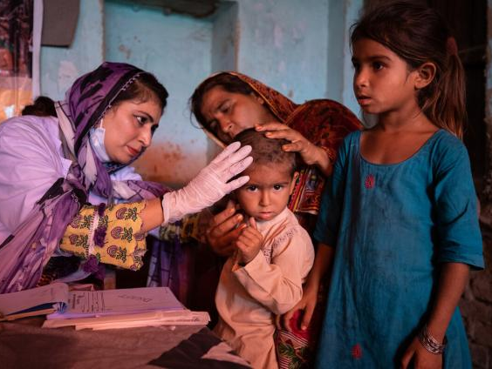
True stories
Another person who attended the clinic was ten-year-old Ayra, whose mother, Sultana, brought her to the clinic for help.
The family were forced to leave their home when it was damaged in the floods. Ayra and her siblings were suffering from malnutrition and skin infections.
The clinic provided medicine at no cost.
Notes:
Photo credit: Khaula Jamil/ CWSA

Slide 9
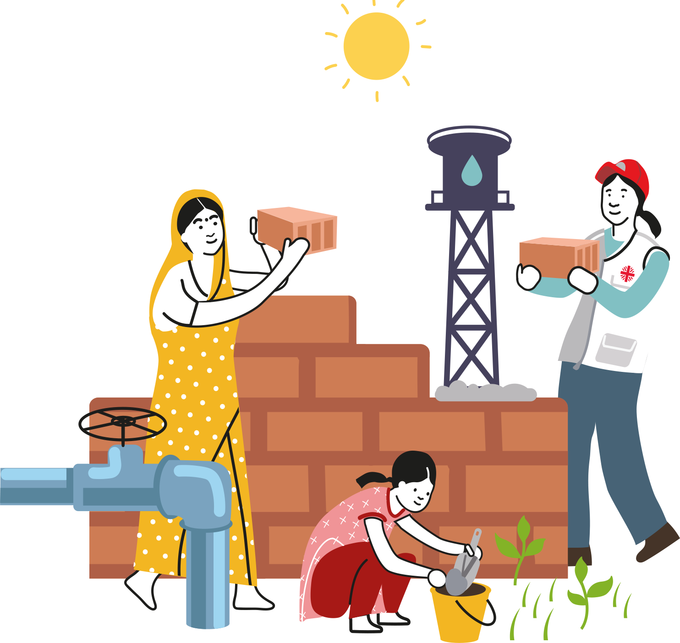
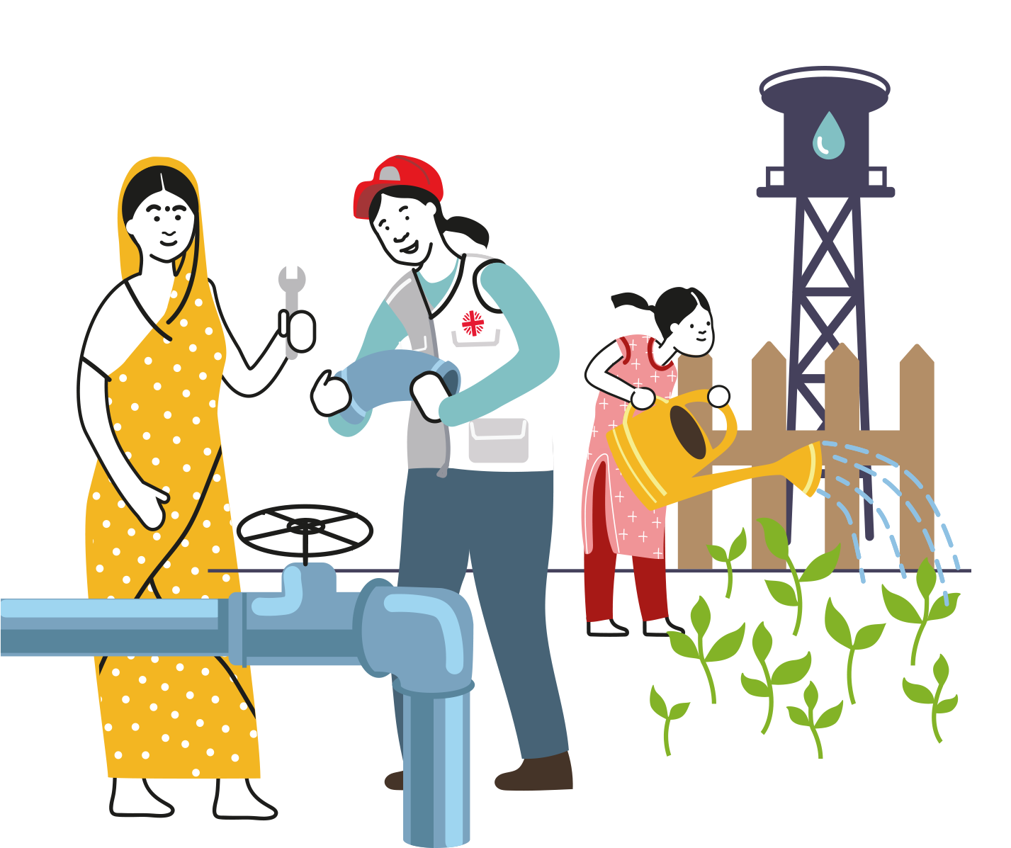
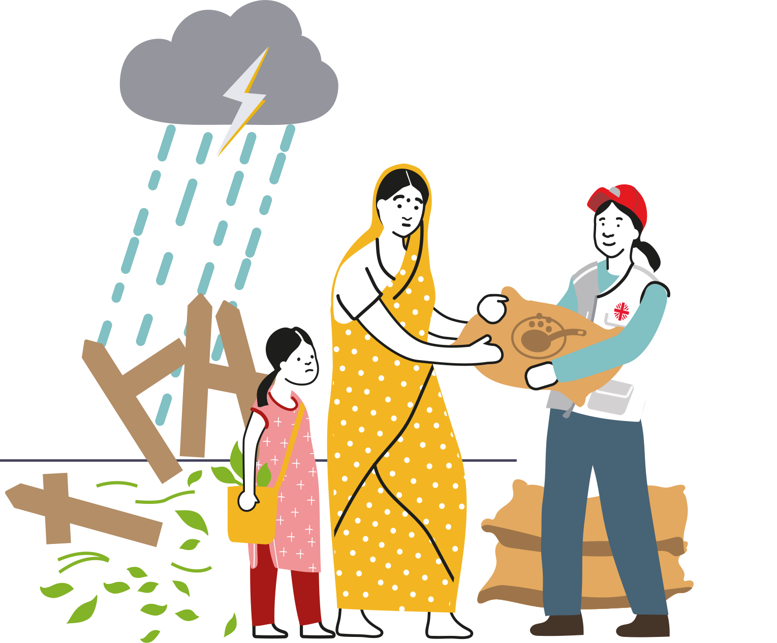
CAFOD does not leave after an emergency but continues to support communities as they rebuild so that they are better prepared for the next emergency.
BEFORE
>
>
DURING
AFTER
…any emergency
Notes:
Photo credit: Khaula Jamil/ CWSA

Slide 10
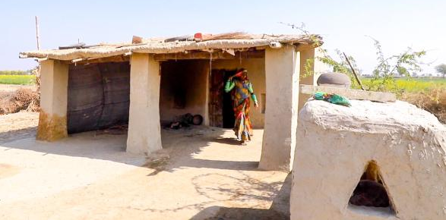
A year later
Meera’s baby, Marwi, is now a healthy one-year-old.
Together, Meera and her husband have rebuilt their home and are working hard to recover what they lost in the floods.
Notes:
Photo credits: Community World Service Asia (CWSA)

Slide 11
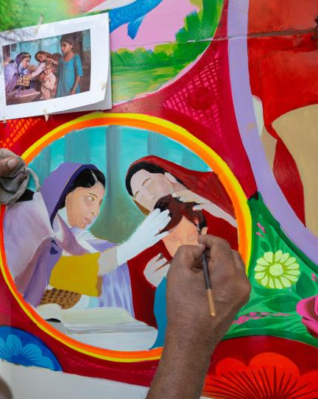
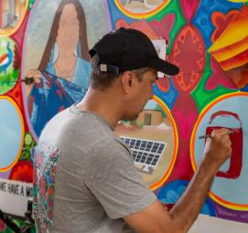
A year later
Ayra made a full recovery… and is now famous!
Her story has been painted on the mobile clinic that she attended.
Local artists, Ali Salman Anchan and his team, painted the van with bright colours to celebrate the flood survivors. Ali said: “I felt how brave they are during this national disaster.”
Notes:
Photo credits: Zoral Naik

Slide 12
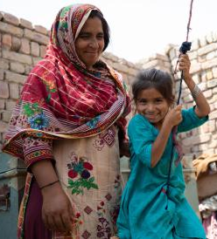
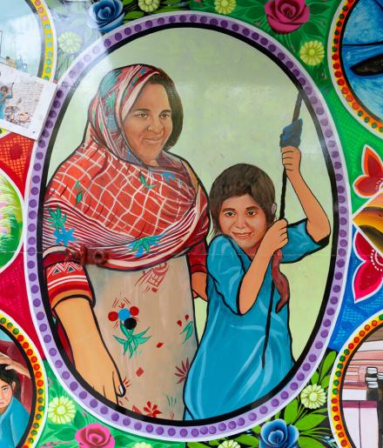
A year later
Ayra’s mother loved the paintings.
She said: “We are happy to see the painting on the truck!”
“I am filled with joy and so is my daughter.”
Notes:
Photo credits: Zoral Naik; Khaula Jamil/ CWSA

Slide 13
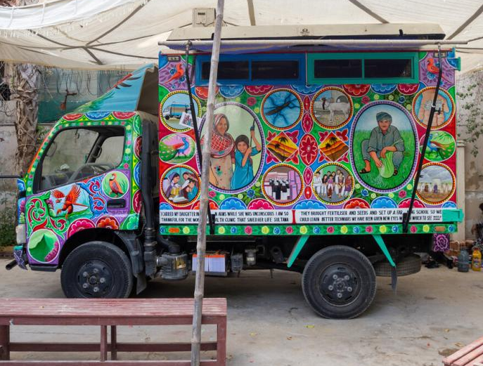
Brightening lives
This van is back on the road, bringing life-saving medical help to remote communities.
And brightening their lives too!
Ali said: “We put our identities, stories, faith and culture into this truck. Wherever it goes it brings joy to the people.”
Notes:
Photo credit: Zoral Naik

Slide 14
Brighten Up this harvest
You can Brighten Up our world too…
and you don’t have to wait for the next emergency.
Notes:
[Add here the details of whatever Brighten Up fundraising you are doing in school.]

Slide 15
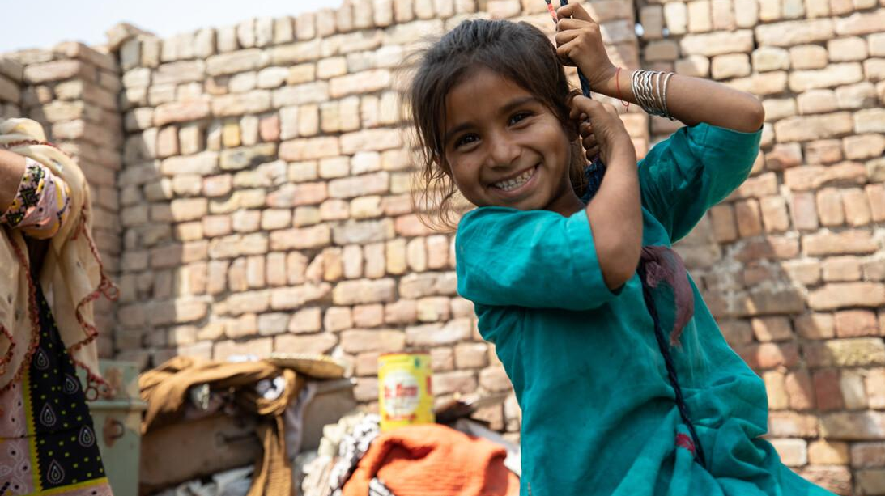
Let’s pray together:
Loving God, we stand
with our sisters and brothers,
who have done little to cause
the climate crisis,
yet are forced to endure its impacts.
Give us determination
to work with them for justice,
generosity
to share your gifts more fairly,
and inspiration
to care for creation together,
until everyone can live life to the full.
We ask this through Christ our Lord.
Amen.
Notes:
Photo credit: Khaula Jamil/ CWSA

Slide 16
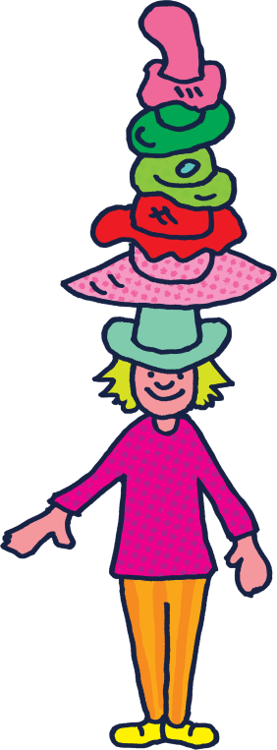
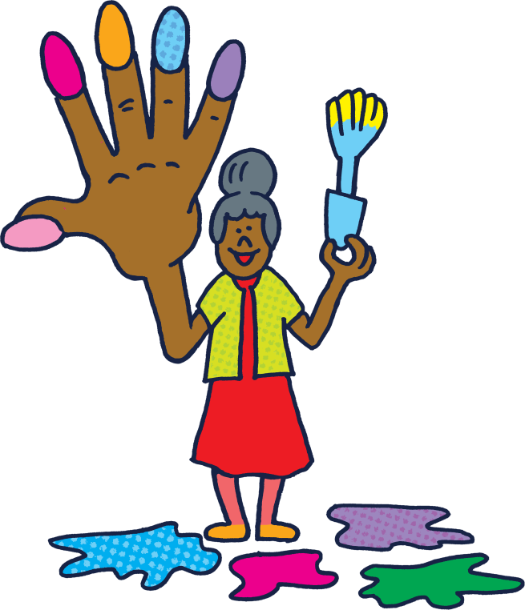
Thank you
Find out more: cafod.org.uk/secondary

