Slide 1

Dudley (edit)

Slide 2
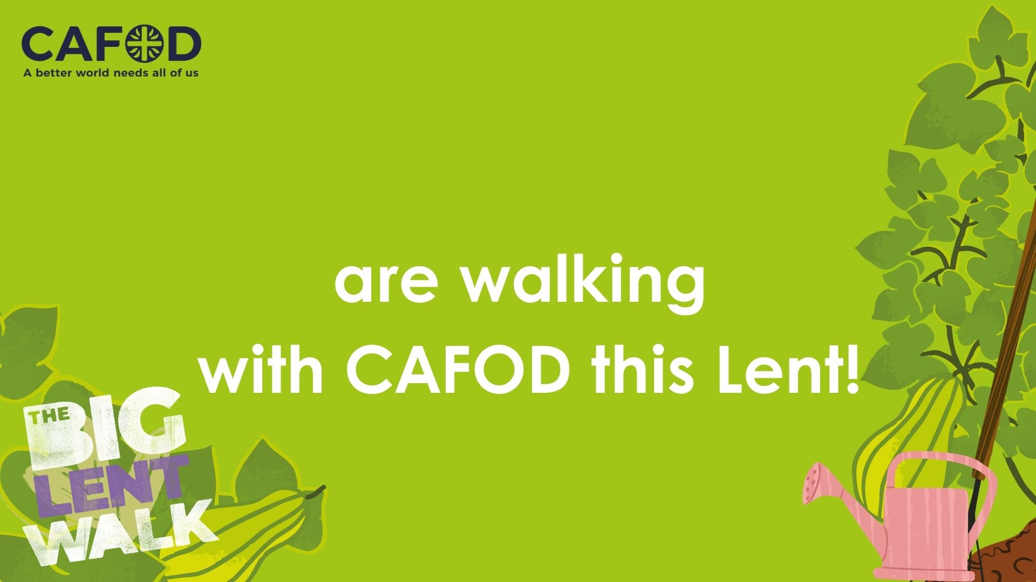
St Michael’s (editable)

Slide 3


Slide 4


