Slide 1
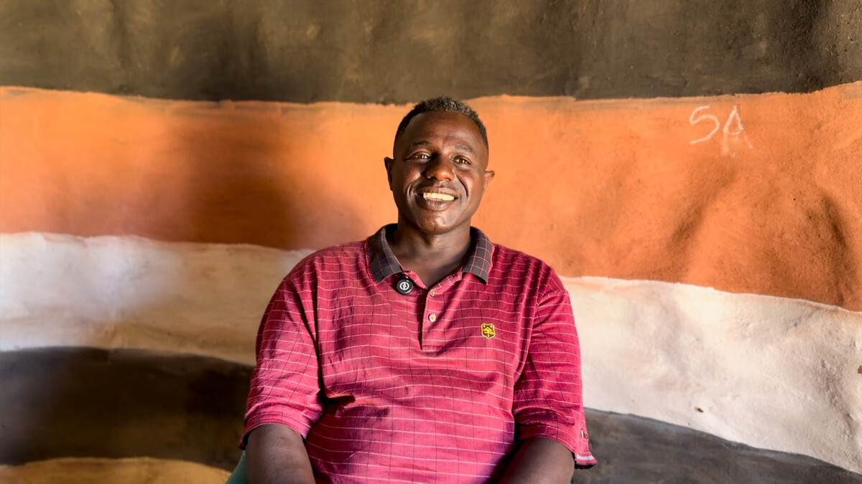

Slide 2
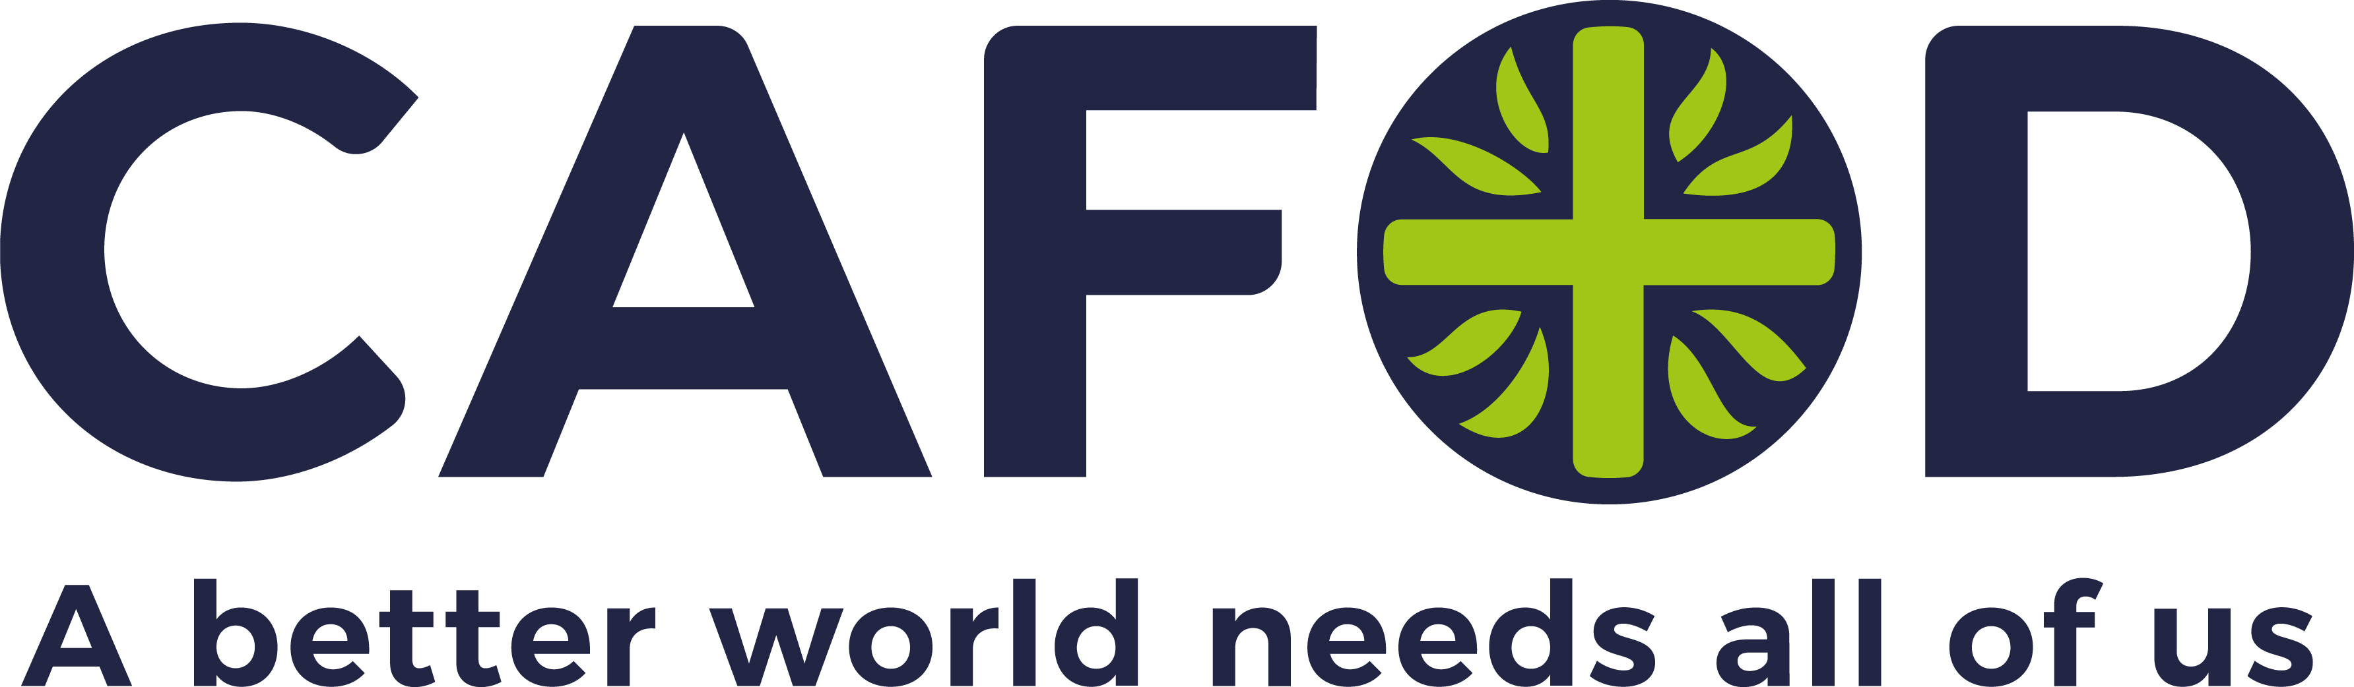
Photo
1
"My name is Abbiott. This area is Southern Ethiopia. And also, I am the one who is the focal person for the Climate Action Project, and also I am working for CIFA [CAFOD’s partner] in Ethiopia. Now we are serving the communities. We are supporting the community in different dimensions."
Abbiott
Abbiott works on conservation projects with the communities including soil and water conservation. This is to mitigate against the effects of climate change. "But a little bit, gradually, human behaviour is changing. It is very difficult to do all at once. Gradually, awareness may bring radical change. So we even try to mobilize individually. But not individually alone, as a group. We educate them, we tell them, and we are informing them."
Photo credit: Louise Norton, CAFOD

Slide 3
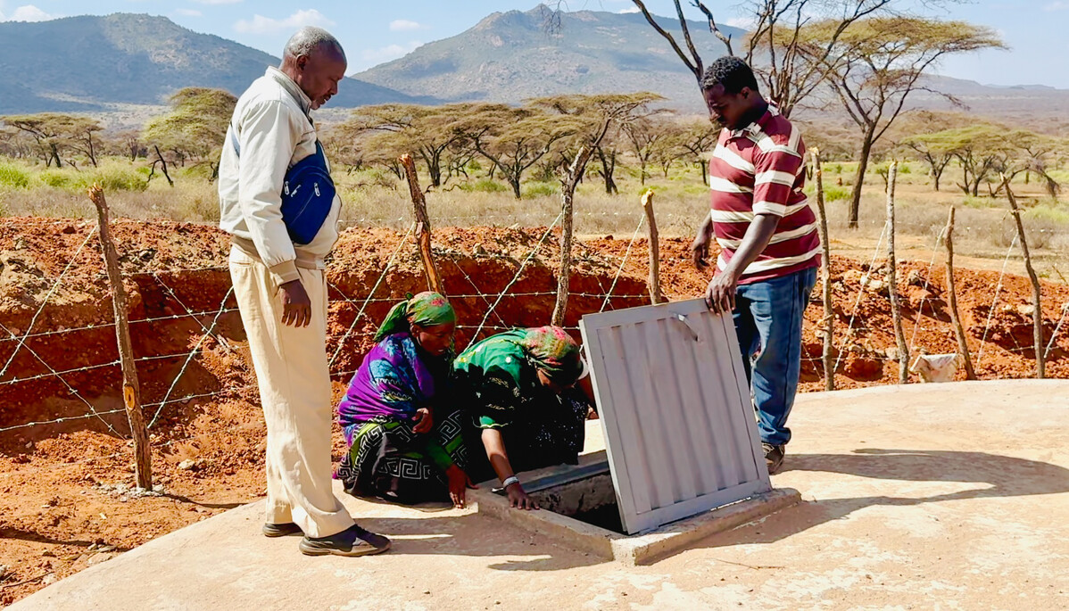

Slide 4
Photo
2
"When the community are digging the wall, I am digging the wall. When the community are excavating the soil, I'm excavating the soil. When the community are breaking the wood, I will go with them, and I will bring that."
Abbiott
Abbiott supported the community in building a water tank. The Borana community do not follow the same way of having an ‘expert’ who orders everyone else. Abbiott was keen to follow the ways of the community to show solidarity. "When you come to the Borana, culturally, they are socially supporting each other. So I am one who was born from this community and I am also adapting the behaviour, the culture, everything, I am doing like that. Because when you are doing something yourself, the people are looking and working like you. When we are simply giving orders and stay at one place, it's not good. It's not good. It's not the cultural way."
Photo credit: Louise Norton, CAFOD

Slide 5
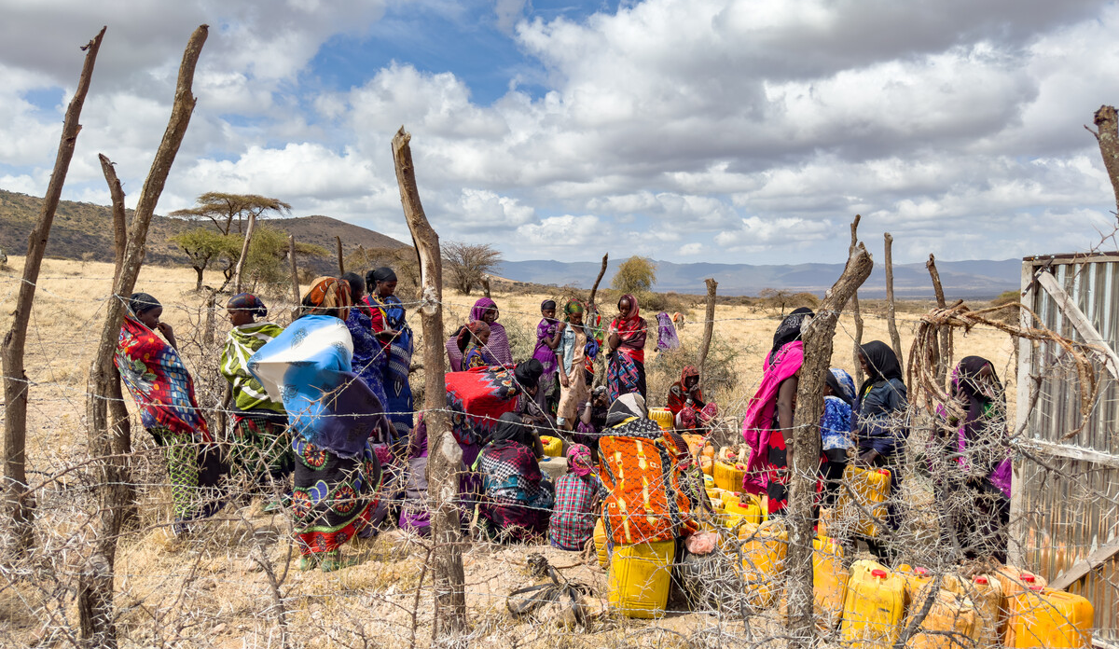

Slide 6
Photo
3
"The main thing is that in Borana, it is obvious, fetching belongs under women, fetching water, especially. Sometimes boys are bringing it back by donkey, but the women are bringing it by themselves on their back. So women are the ones who are the most affected ones in order to search for pasture and water, especially in Borana."
Abbiott
The projects work with over 90% women. Abbiott explains why in the quote above. The burden fell mostly on the women because they were walking for six hours a day to a small water hole in the crevice of a mountain. Now, the women only walk for 30 minutes to the water tank. This means they are able to earn more income with the time they have saved.
Photo credit: Louise Norton, CAFOD

Slide 7
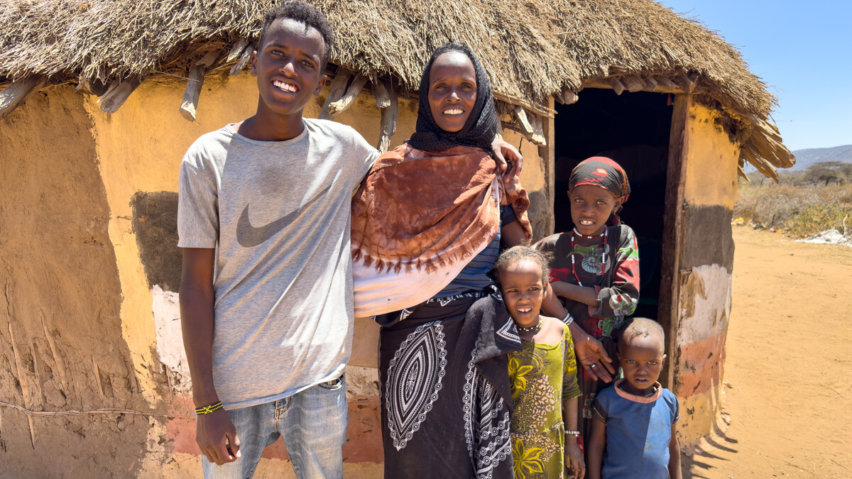

Slide 8
Photo
4
"There were no problems, there was no hunger, and generally, there has been a very good life before this recurring drought."
Adi
Adi and her family live in a village close to a water tank that was completed in 2023. The tank was able to harvest some rain during the first rainy season in 2024, and that small amount of water has seen the local community through more than six months of dry spells and a failed second rainy season. Adi is the chairwoman of the water management committee – a group of people chosen by their community to care for and manage the water tank – and her careful planning has helped the water last as long as it has.
Photo credit: Louise Norton, CAFOD

Slide 9
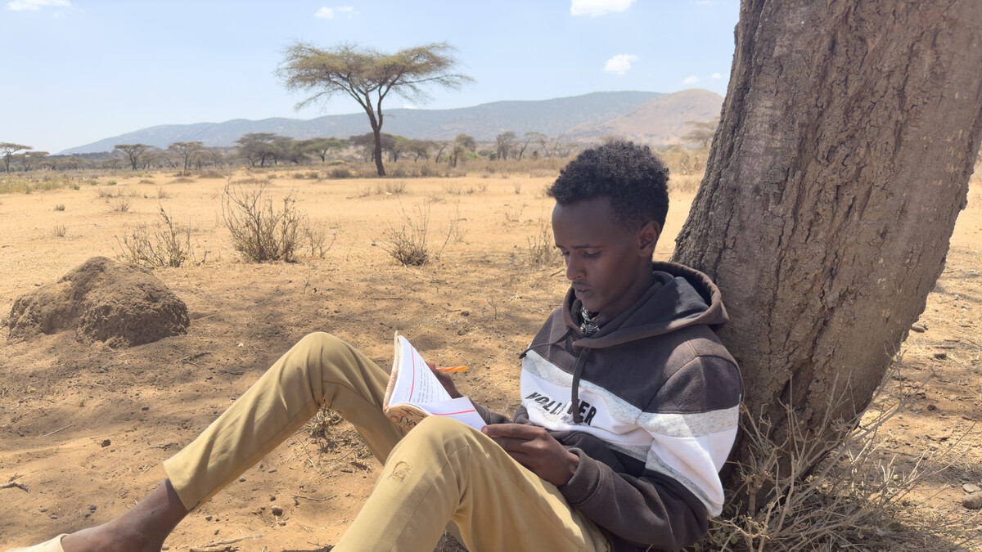

Slide 10
Photo
5
"For someone of my background, where I come from, how my family is sacrificing for me to get an education, I think the major responsibility is paying them back. I have to make changes in the life of a family that has never gone to school, but made me go to school."
Abadhalee
Abadhalee is Adi’s oldest son. He told us that London is his favourite place in the world, and he dreams of visiting it one day – but he says though he’d like to live in a big city like Addis for a few years after university, he’d always want to return to the country, and to his home region in particular. "One of my dreams is to found an organisation that will support not only my family, but my entire community."
Photo credit: Louise Norton, CAFOD

Slide 11
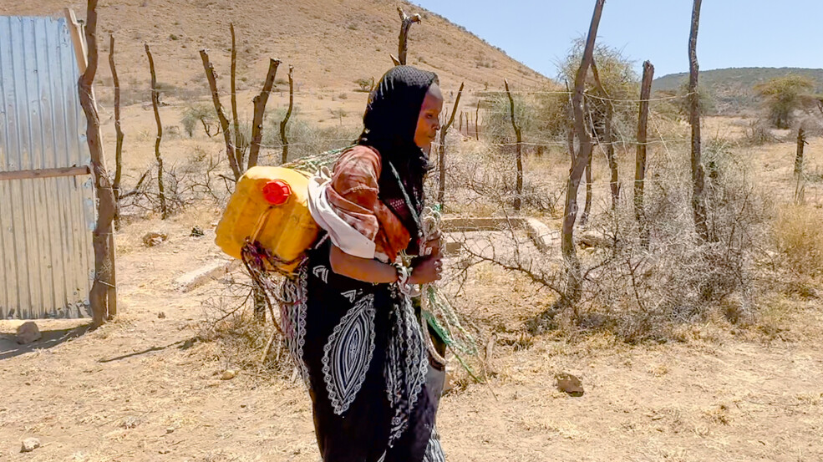

Slide 12
Photo
6
"One of the things I'm known for in my village, and my character, I'm a person who understands people that have a good character. I have a good relationship with most of my village. That was why I was first chosen as a member of the committee, and also Chair of that committee, managing that."
Adi
Adi was selected as the chair of the management committee. She helped to organise the rest of the community to have funds for the maintenance and repairs for the water structure. She checks on the water tank daily. Abadhalee is very proud of his mother being selected for this role. He said, "She has also been a very committed woman in the community and I think that track record made her be selected as a chair of the water management community.’"
Photo credit: Louise Norton, CAFOD

Slide 13
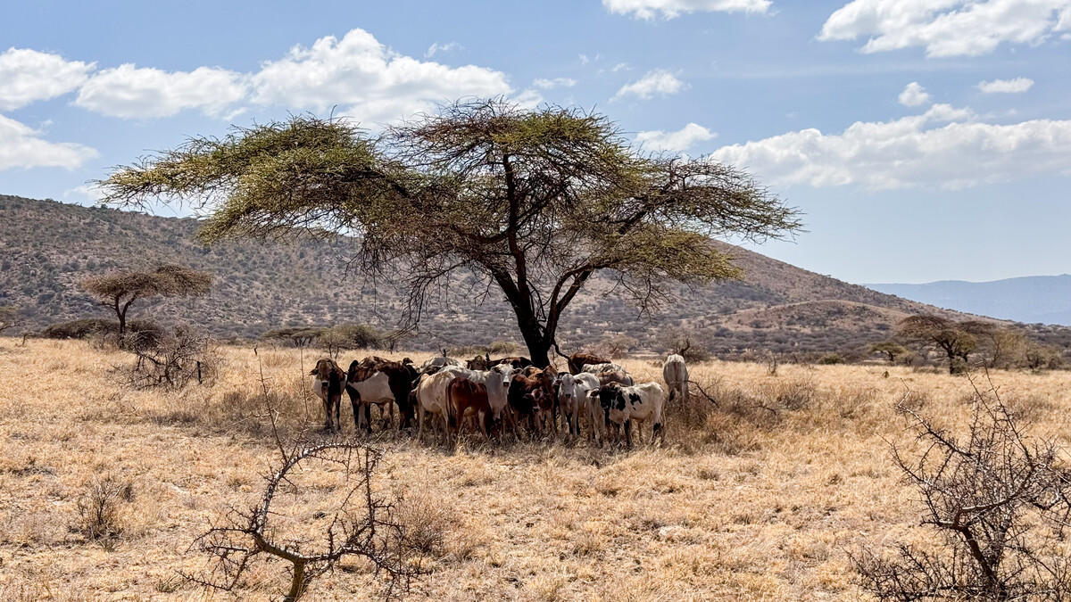

Slide 14
Photo
7
"I think climate change is already happening in Borana, from time to time. The worst drought was two years ago - between 2022 and 2023 according to the Ethiopian calendar. That drought period was really the worst drought and extremely affected this community, and more than 3.3 million livestock were lost from this community. Almost the whole livestock was lost as a result of drought, and it affected the whole community. From the top down, almost all communities lost their livestock as a result of the past drought period."
Abbiott
The Borana community live in southern Ethiopia. It is a pastoralist community which means they rely on animals. Typically, they would have moved with the animals but now they also farm on the land.
Photo credit: Louise Norton, CAFOD

Slide 15
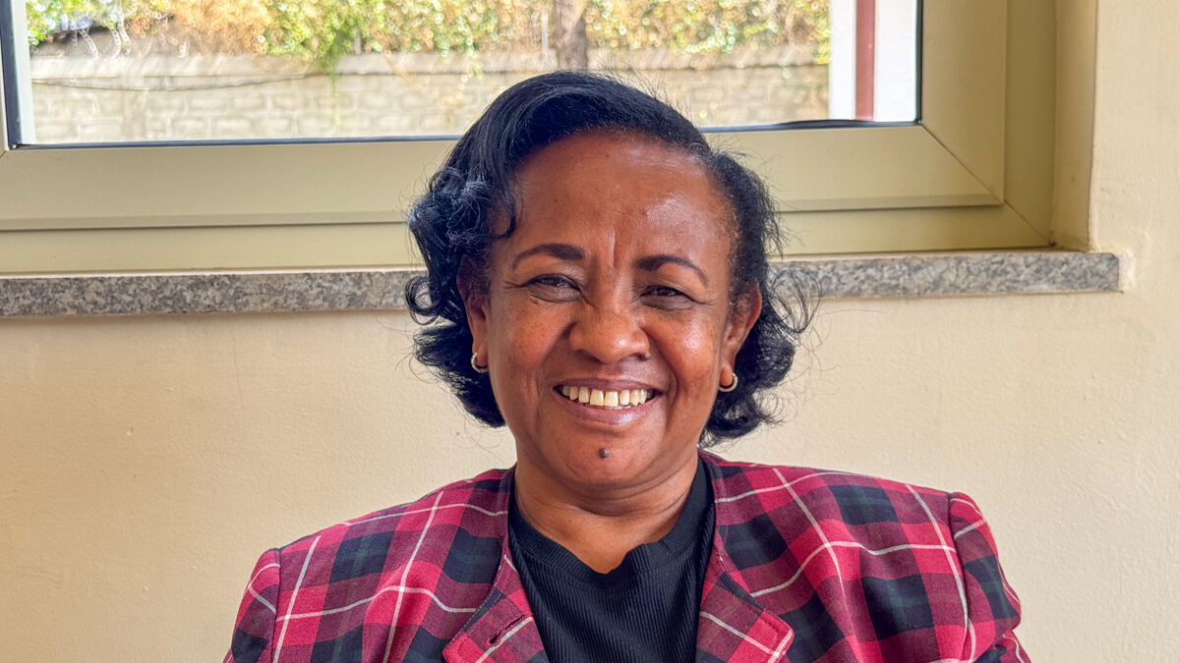

Slide 16
Photo
8
"Through the faith I have, I lead my work, I communicate with people. I hope that working together will bring us to a better world."
Teamrat
Teamrat is the CAFOD representative in Ethiopia. She leads all the projects in Ethiopia which means that she would have worked closely with Abbiott in delivering the water tank project. She told us that only 1% of the population of Ethiopia are Catholics and yet they are the second largest provider of education and healthcare in Ethiopia after the government.
Photo credit: Louise Norton, CAFOD

Slide 17
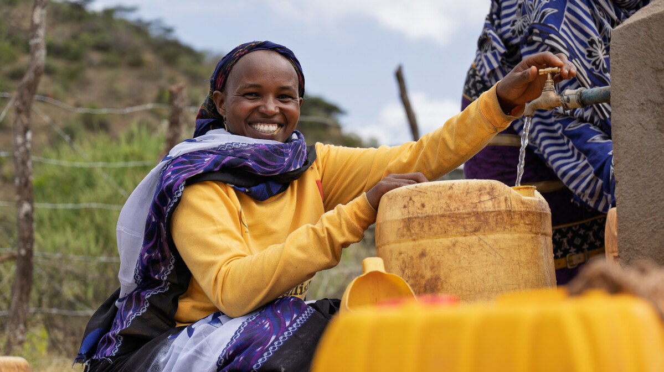

Slide 18
Photo
9
"I had many fears. We would wake up at 5am in the morning and then start to go and look for water and forage for the weak animals. Then we would arrive at that place at nine in the morning. Then our fear was that: 'Are we even going back to our homes? Are we sure that we will be able to go back in peace to our homes? Will these livestock survive?'"
Waré
Waré lives in a slightly different area to Adi and their water-tank was built more recently. Unfortunately, the first rainy season failed and no rain came to fill the tank. Thankfully though, there has been some rain so their water-tank is fully operational. During the drought, Waré was pregnant. She was very scared. There is a big contrast with the completion of the water tank project: "We were extremely, extremely happy. We were happy working together to achieve something by building that tank."
Photo credit: James Cave, SCIAF

