Slide 1
Template for LiveSimply for Schools evidence
Hello,
This is an optional template to create your PowerPoint of evidence. In this PowerPoint we have included two slides for each of your nine actions, the first is designed for you to add text about your action and the second for you to be able to add photos/videos of the action and pupil voice. Should you wish to add more slides in please feel free (ideally no more than 30 slides in total please). Alternatively, you can create your own PowerPoint, but please ensure you include evidence for all the actions, including the faith, learning and, with regards to the three main actions, the whole school and wider community involvement.
This has been created with your 3 global actions first, followed by your 3 local actions and then your 3 school actions. Please read your registered action plan to ensure you are adding the correct evidence for each action. (Applicable for any school who registered their action plan from August 2024.)
Once you have completed your actions, please email your PowerPoint to schools@cafod.org.uk or you can send the file via www.fromsmash.com
You may wish to delete this slide before sending. Any queries, please contact schools@cafod.org.uk
Thank you

Slide 2

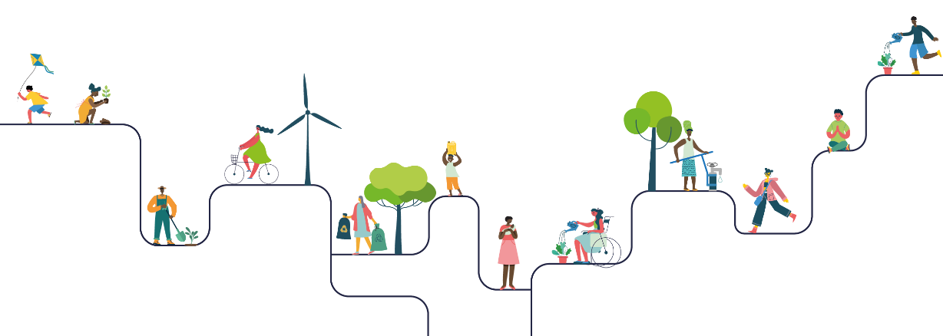
Please enter your school’s name
Please enter the name of your LiveSimply lead person (adult)

Slide 3

Global Action 1 – Main living in solidarity action
What did we do? (Please tell us about the action you took and any impact.)
How did faith inspire and encourage our action?
What did we learn by participating in this action?
How did we involve the wider community in this action?
As this was one of our main actions, we involved the whole school by…

Slide 4
Global Action 1 – Main living in solidarity action
Photos/videos/pupil voice
Enter pupil voice here
Please add photos/videos here
Please add photos/videos here
Please add evidence fundraising has been sent to CAFOD
Enter pupil voice here

Slide 5

Global Action 2 – Living in solidarity
What did we do? (Please tell us about the action you took and any impact.)
How did faith inspire and encourage our action?
What did we learn by participating in this action?

Slide 6
Global Action 2 – Living in solidarity
Photos/videos/pupil voice
Please add photos/videos here
Please add photos/videos here
Enter pupil voice here
Enter pupil voice here

Slide 7
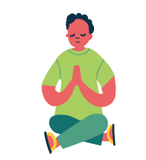
Global Action 3 – Living simply
What did we do? (Please tell us about the action you took and any impact.)
How did faith inspire and encourage our action?
What did we learn by participating in this action?

Slide 8
Global Action 3 – Living simply
Photos/videos/pupil voice
Please add photos/videos here
Please add photos/videos here
Enter pupil voice here
Enter pupil voice here

Slide 9

Local Action 1 – Living simply
What did we do? (Please tell us about the action you took and any impact.)
How did faith inspire and encourage our action?
What did we learn by participating in this action?

Slide 10
Local Action 1 – Living simply
Photos/videos/pupil voice
Please add photos/videos here
Please add photos/videos here
Enter pupil voice here
Enter pupil voice here

Slide 11

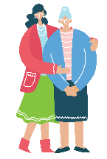
Local Action 2 – Living sustainably/simply
What did we do? (Please tell us about the action you took and any impact.)
How did faith inspire and encourage our action?
What did we learn by participating in this action?

Slide 12
Local Action 2 – Living sustainably/simply
Photos/videos/pupil voice
Please add photos/videos here
Please add photos/videos here
Enter pupil voice here
Enter pupil voice here

Slide 13
Local Action 3 – Living in solidarity
What did we do? (Please tell us about the action you took and any impact.)
How did faith inspire and encourage our action?
What did we learn by participating in this action?

Slide 14
Local Action 3 – Living in solidarity
Photos/videos/pupil voice
Please add photos/videos here
Please add photos/videos here
Enter pupil voice here
Enter pupil voice here

Slide 15

School Action 1 – Main living simply action
What did we do? (Please tell us about the action you took and any impact.)
How did faith inspire and encourage our action?
What did we learn by participating in this action?
How did we involve the wider community in this action?
As this was one of our main actions, we involved the whole school by…

Slide 16
School Action 1 – Main living simply action
Photos/videos/pupil voice
Enter wider community voice here (parent/parishioner)
Please add photos/videos here
Please add photos/videos here
Enter pupil voice here
Enter pupil voice here

Slide 17

School Action 2 – Main living sustainably action
What did we do? (Please tell us about the action you took and any impact.)
How did faith inspire and encourage our action?
What did we learn by participating in this action?
How did we involve the wider community in this action?
As this was one of our main actions, we involved the whole school by…

Slide 18
School Action 2 – Main living sustainably action
Photos/videos/pupil voice
Enter wider community voice here (parent/parishioner)
Please add photos/videos here
Please add photos/videos here
Enter pupil voice here
Enter pupil voice here

Slide 19

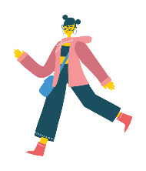
School Action 3 – Living sustainably
What did we do? (Please tell us about the action you took and any impact.)
How did faith inspire and encourage our action?
What did we learn by participating in this action?

Slide 20
School Action 3 – Living sustainably
Photos/videos/pupil voice
Please add photos/videos here
Please add photos/videos here
Enter pupil voice here
Enter pupil voice here

Slide 21
Is there anything else you would like to tell us about your LiveSimply journey?

