Slide 1
Health assembly images

Slide 2
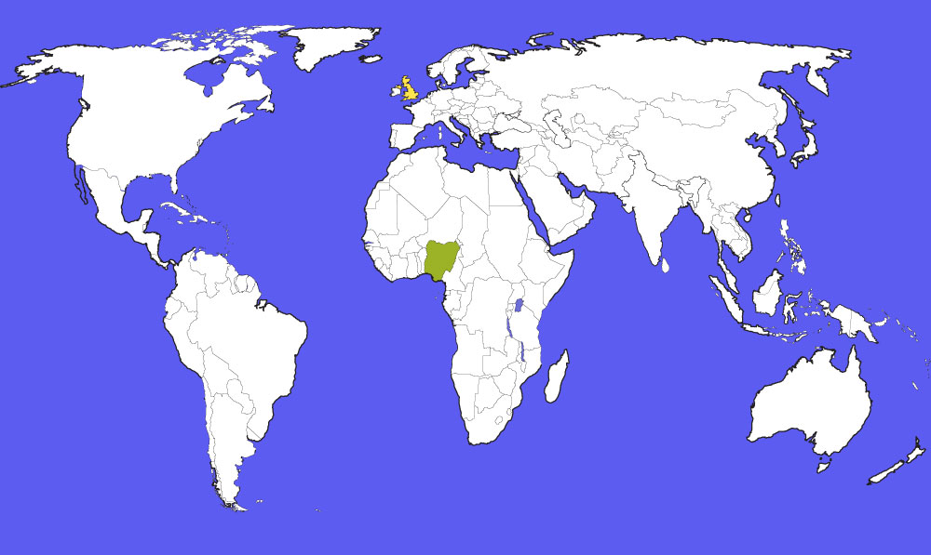
UK
Nigeria

Slide 12
Let us pray…
God our Father, we thank you for your gift of life.
We pray that children everywhere may be given all that they need to live long and happy lives.

