Slide 1
Year 1 Neighbours

Slide 2
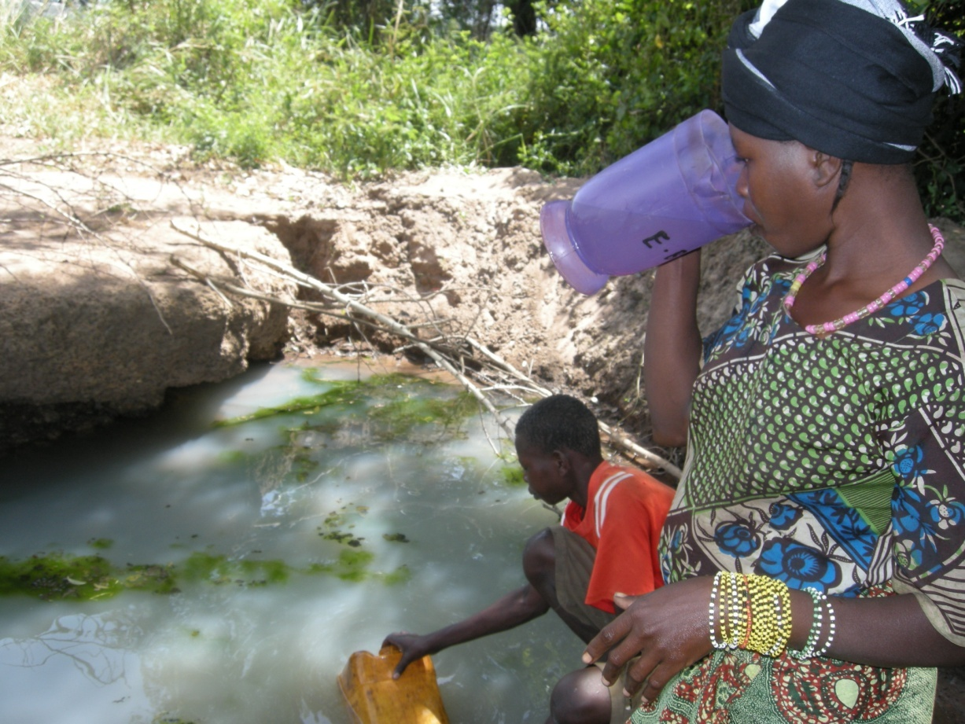
Water from a dirty spring
Notes:
Sudan
Angelina Juma, 30yrs, IDP, Tambura, drinking water from a dirty spring.

Slide 3
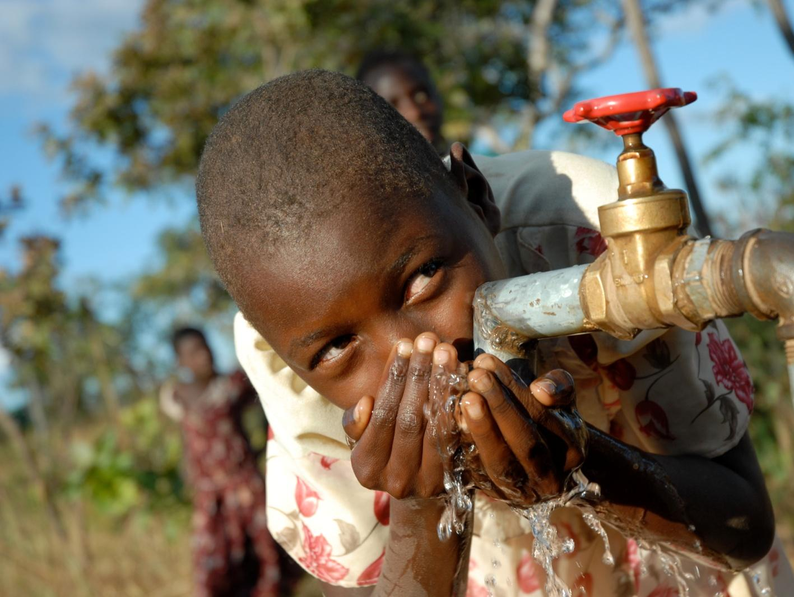
Clean water from a tap
Notes:
Zambia
Myambo family: Odetta Myambo, 9 yrs. The children go to the radio interactive school.The Diocese supports a development project within a church centre there which focuses on water shortages, irrigation, radio school and other initiatives to provide a better quality of life to the inhabitants of Kalisowe.

Slide 4
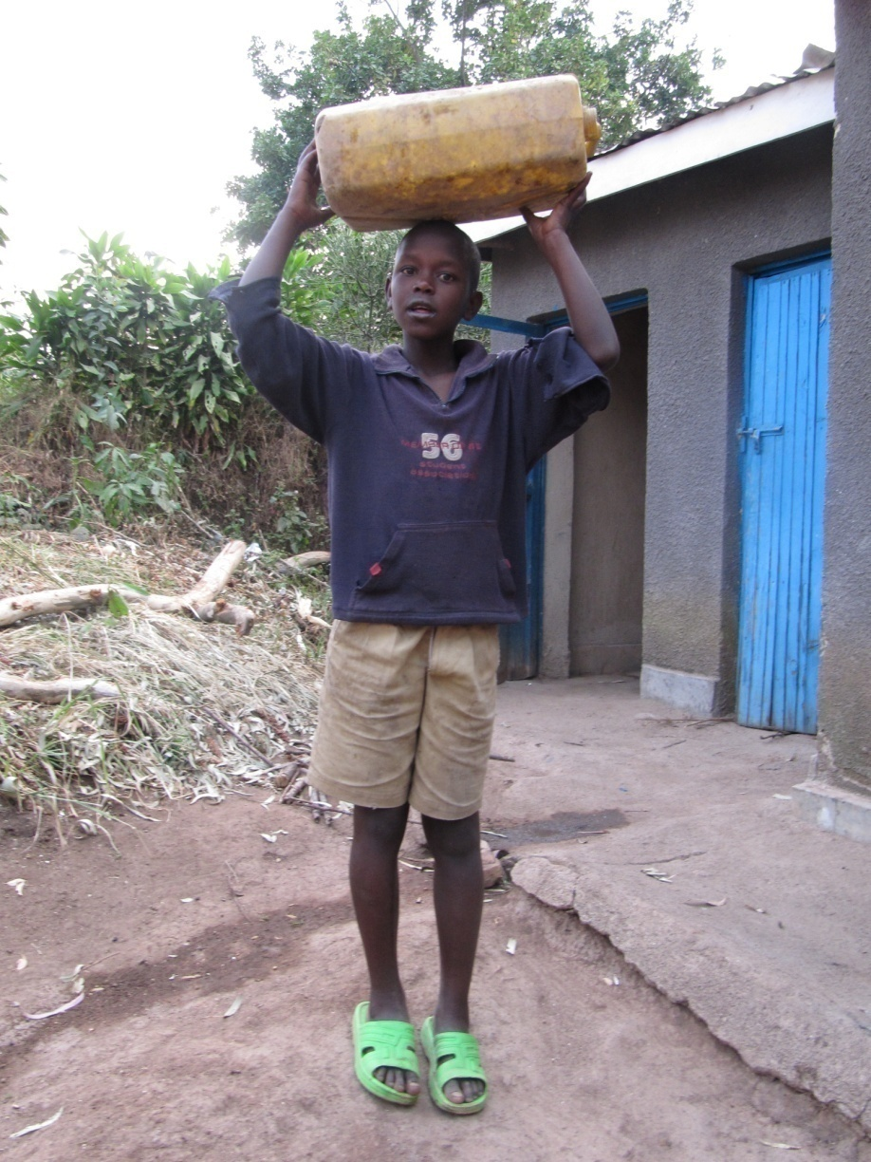
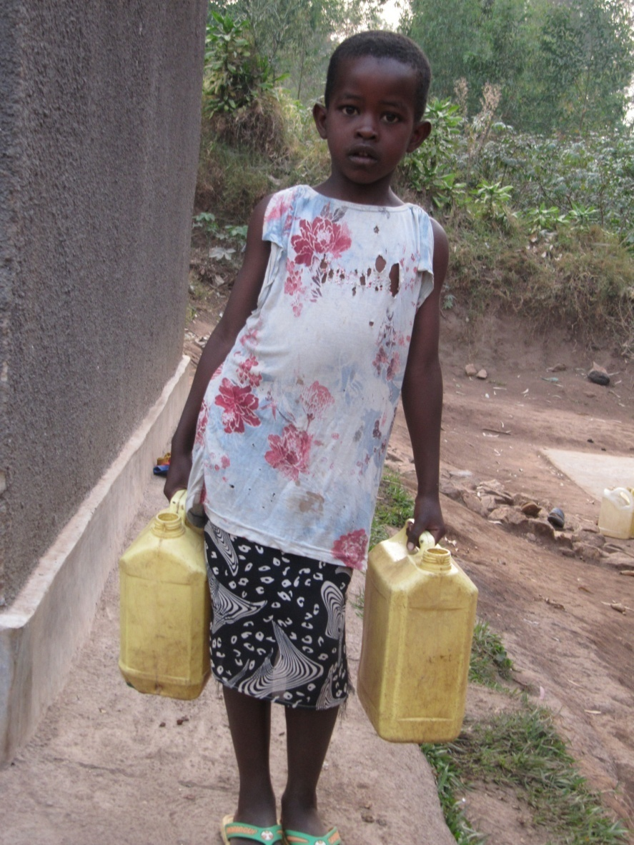
Collecting
water
Notes:
Rwanda
Billy Goat took the photographs. He says, “This is a picture of my older brother carrying water on his head”.
Bill Goats says, “This is my sister, she is fetching water. She goes to fetch water two times a day.”

Slide 5
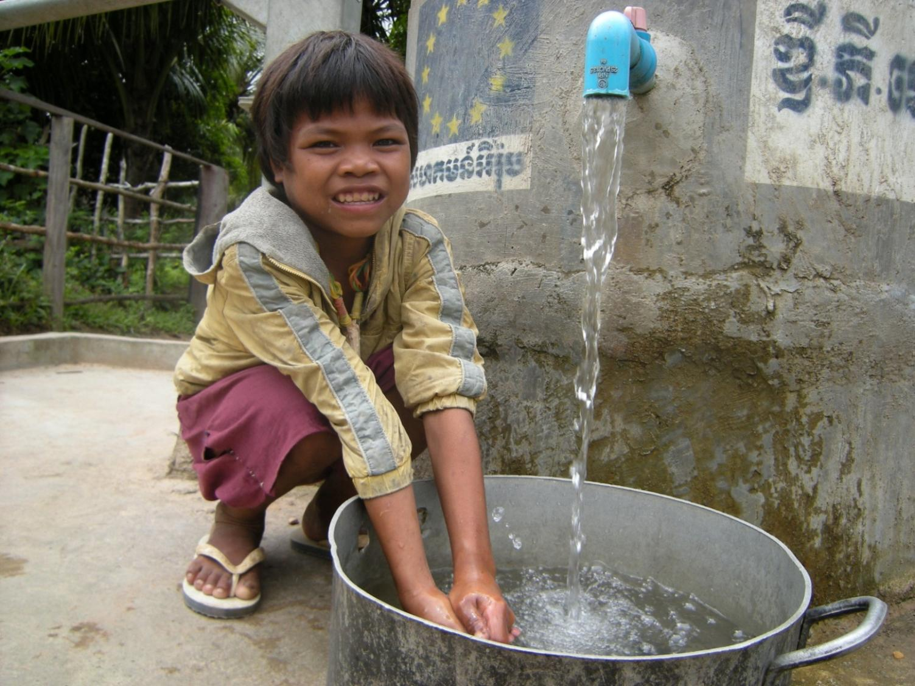
Water to
wash with
Notes:
Cambodia
A child washing hands

Slide 6
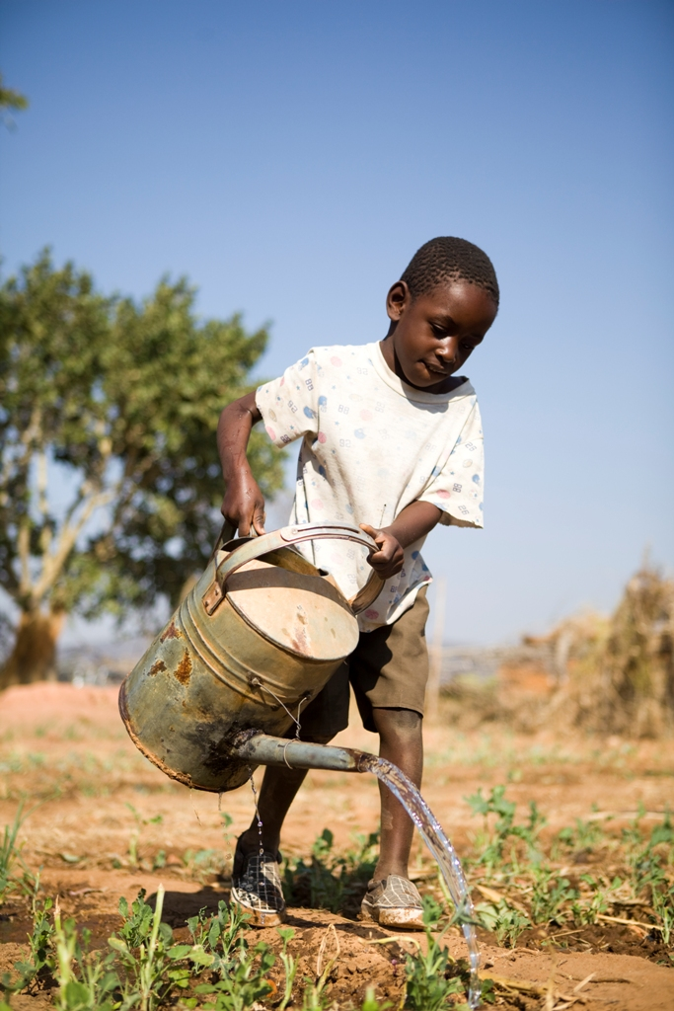
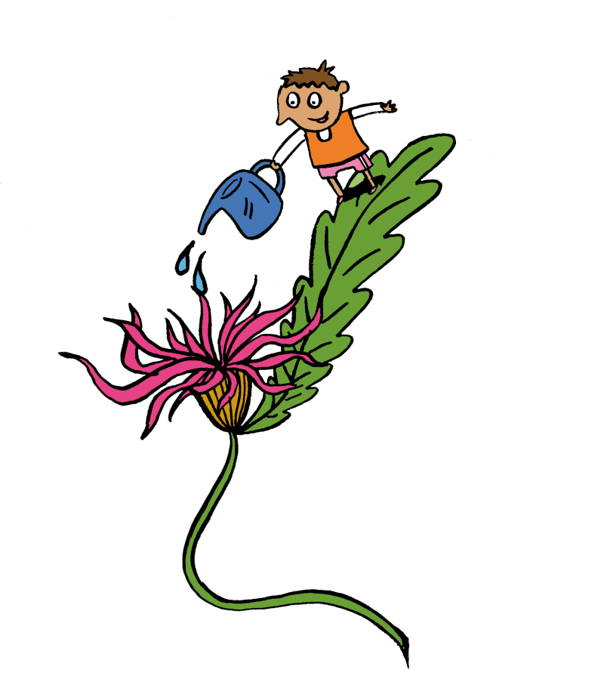
Water to
grow plants
Notes:
Zimbabwe
PHOTOGRAPHER: Simon Rawles

Slide 7
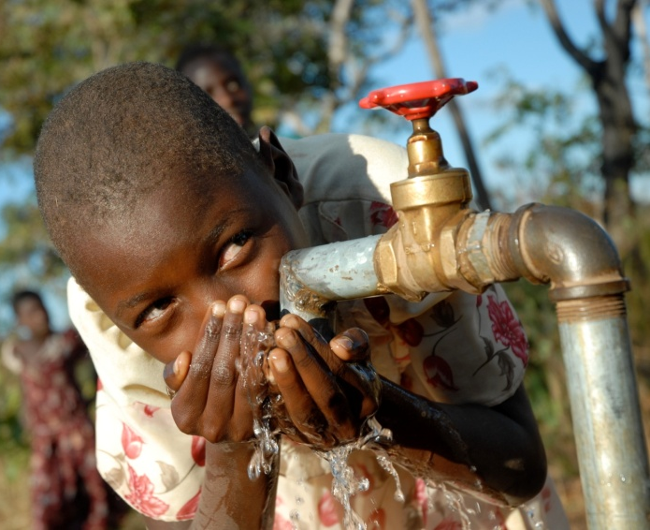
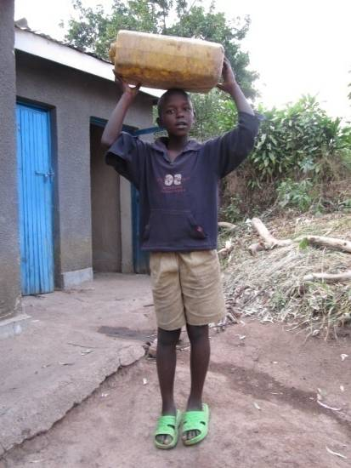
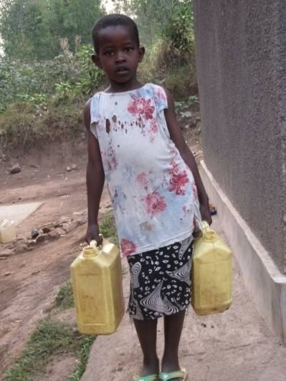
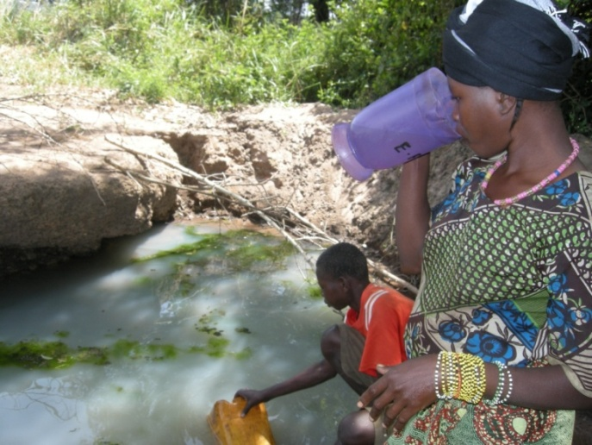
Fair or unfair?

Slide 8
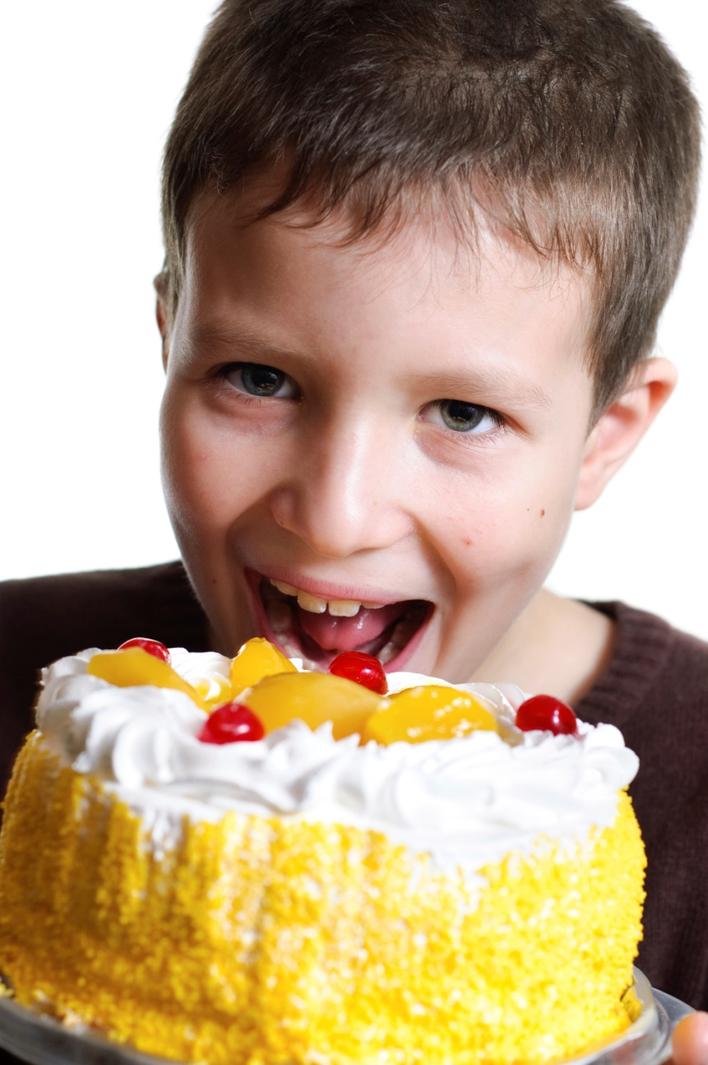
Eating a
whole cake

Slide 9
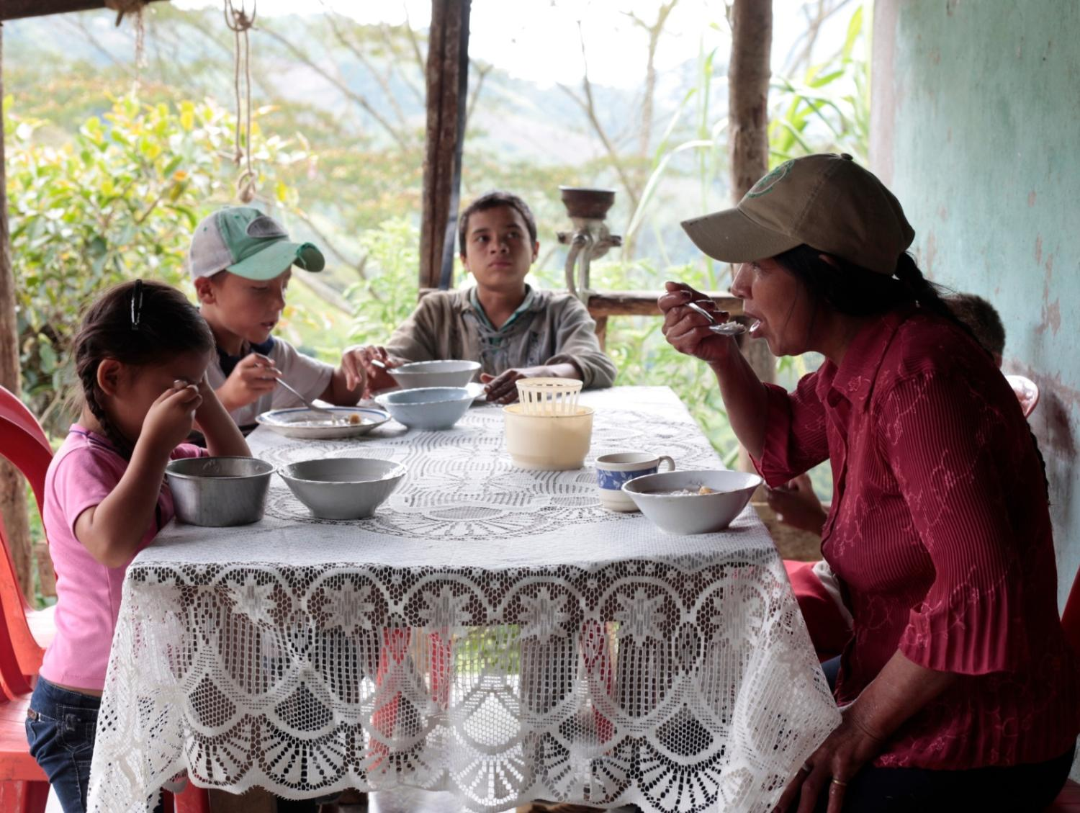
A family
eating lunch
Notes:
Colombia
Coffee farmer Bolivar Palechor, 48yrs, and his family eating lunch. Bolivar is a member of the Eurocafe - a coffee business supported by CAFOD, which helps coffee farmers in the remote region of Chontaduro.

Slide 10
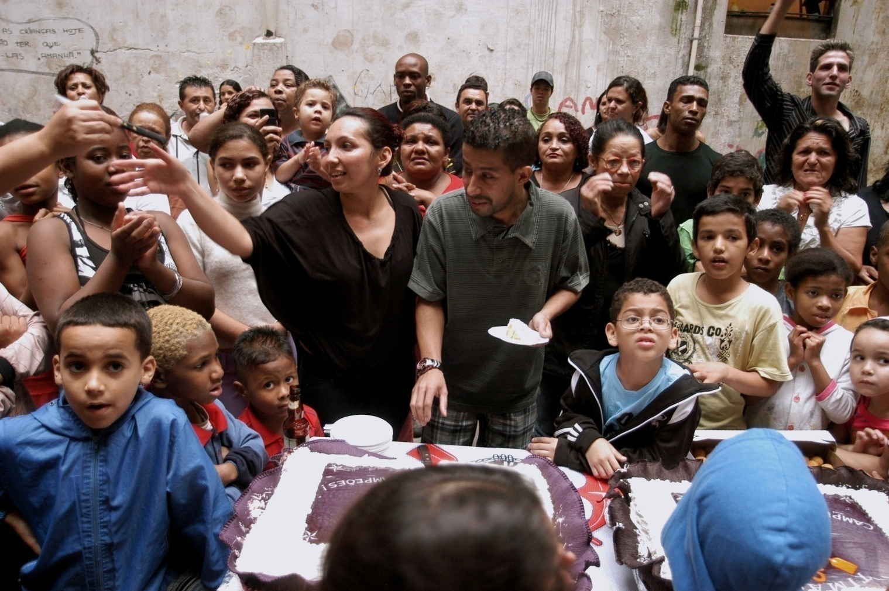
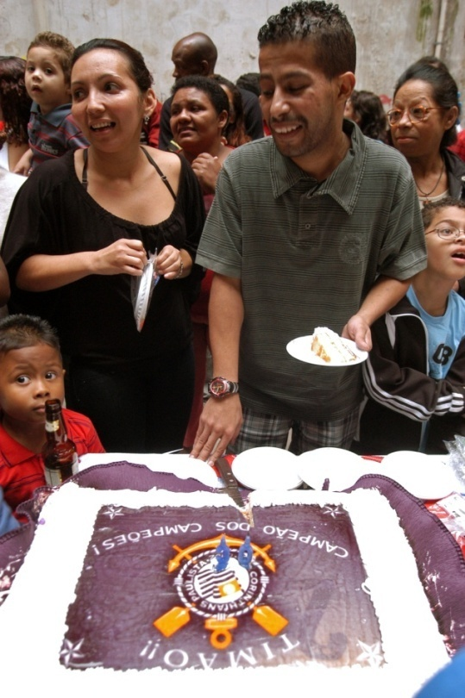
Sharing a cake
Notes:
Brazil São Paulo
Sukita and his wife with the celebratory cake decorated in the colours of his favorite football team. They are sharing the cake with residents at the celebration of the second anniversary of the occupation of the Maua Building.

Slide 11
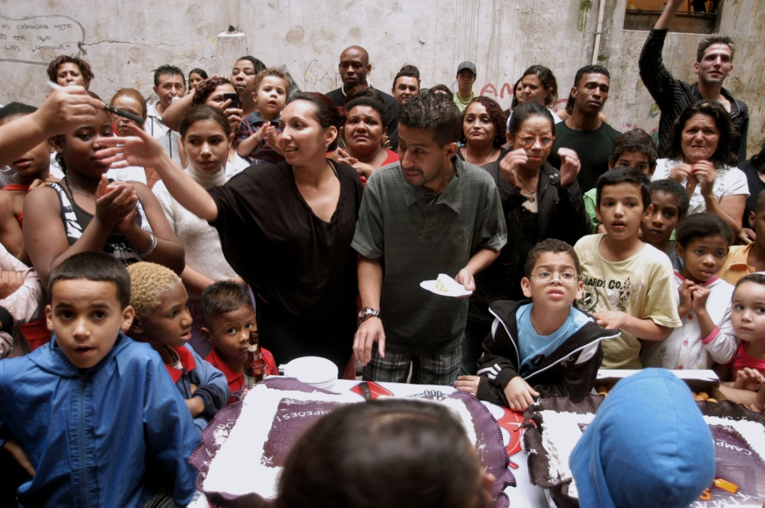
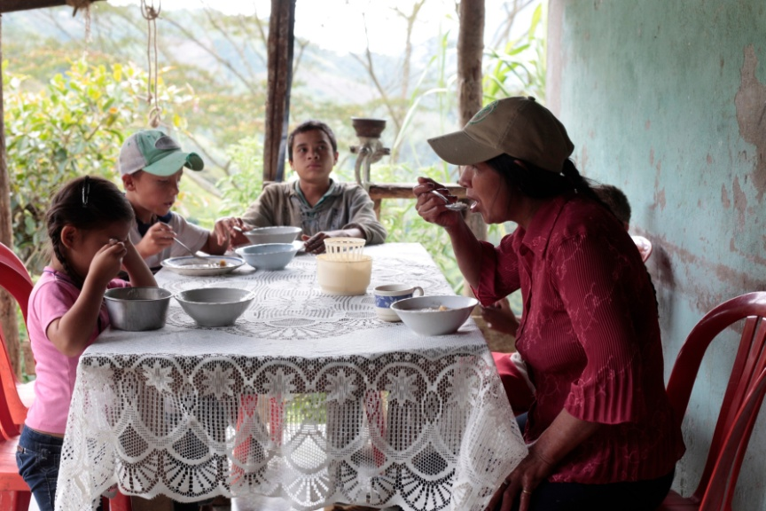
Fair or unfair?

Slide 12
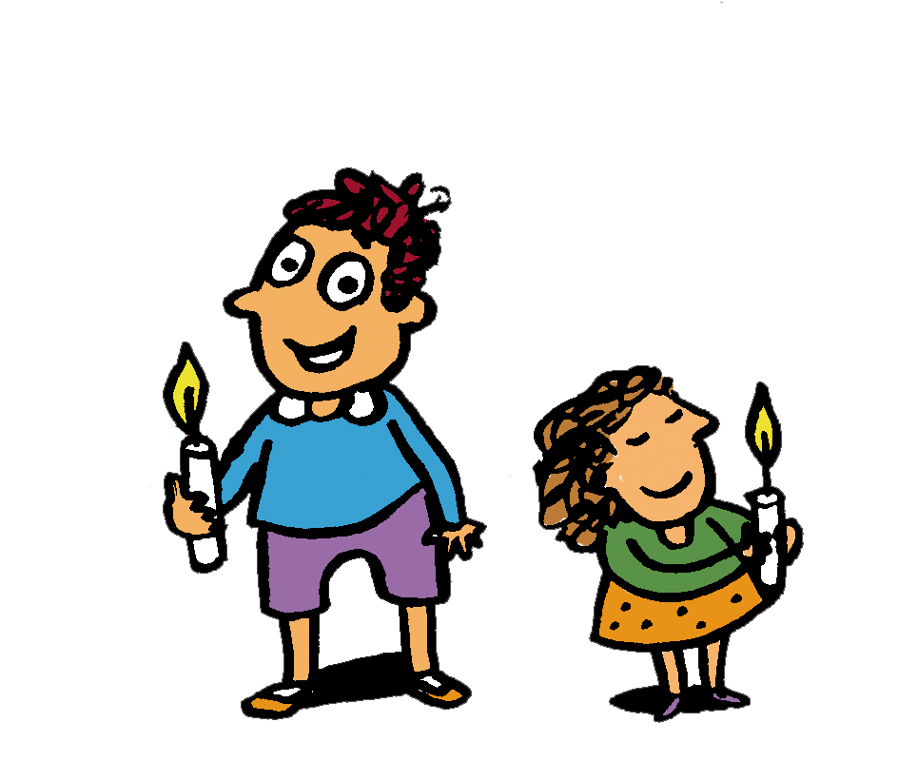
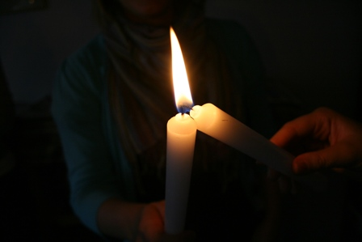
Lord Jesus, teach me to care,
Lord Jesus, teach me to share,
Lord Jesus, teach me to be kind to neighbours everywhere.
Lord Jesus, help our sisters and brothers all over the world to have a fair share.
Amen
Notes:
PHOTOGRAPHER: Adrian White

Slide 13
Photographs by: Bridget Burrows, Caroline Irby, Simon Rawles, Paul Smith, Anderson Barbaso, Adrian White, CAFOD, Victor Potasyev/istockphoto.com.
Illustrations: Per Karlen

