Slide 1
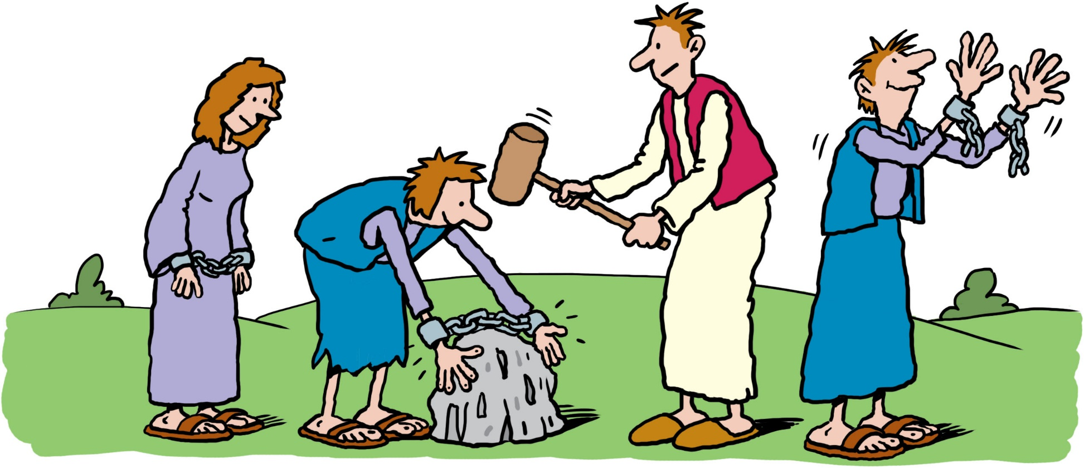
A prayer for the oppressed
Jesus, you knew what it was to be poor and oppressed,
ignored and ridiculed, unjustly accused and unfairly convicted.
Be with everyone whose rights are ignored.
And may we stand with them too.
Embolden us to speak truth to power,
to break the chains of injustice
and to set free the oppressed.
Amen.
“Is not this the kind of fasting
I have chosen: to loose the chains of injustice and
untie the cords of the yoke,
to set the oppressed free…?”
Isaiah 58:6
Illustration by Ellis Nadler

