Slide 1
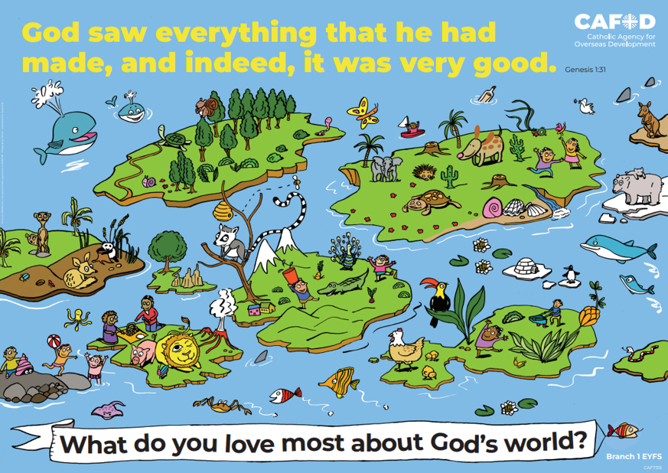
Year 3 RED poster activities
Branch 1: Creation and Covenant
Order the RE CAFOD poster set
Notes:
Timings
This presentation has been designed to last for 15-20 minutes. It can be used as a stand-alone lesson or incorporated into a scheme. Due to the strong focus of Creation and Stewardship in the RED for Y3, this presentation contains more material than other year groups so that teachers can select what is most appropriate do
Extension
Although this presentation was designed to simply engage pupils in discussion about key RED themes, the sessions can be developed in many ways. Some of the examples are included below:
Give pupils the poster (or a part of it) to discuss and annotate in groups
Provide pupils with their own A4 version of the poster to put in their own RE books (double page spread). This can be labelled in various ways, such as with references to scripture or Laudato Si’
Invite children to draw or list their own additions and suggestions to the poster
Offer children the opportunity to create their own poster, for example through artwork or through drama (creating freeze frames).

Slide 2
Year 3 Year 4
“Human life is grounded in three fundamental and closely intertwined relationships: with God, with our neighbour and with the earth itself.” (Pope Francis, Laudato Si’ 66) Why is it important to look after our relationship with God, with our neighbours and with the earth itself? | “Human life is grounded in three fundamental and closely intertwined relationships: with God, with our neighbour and with the earth itself.” (Pope Francis, Laudato Si’ 66) Why is it important to look after our relationship with God, with our neighbours and with the earth itself?
Human dignity Stewardship Ecological virtues Laudato Si’ Canticle of Creation | Good neighbour Virtues of faith, hope and love
U3.1.2, U3.1.3, U3.1.4, U3.1.5, U3.1.6, D3.1.1, D3.1.2, D3.1.3, R3.1.1, R3.1.2, R3.1.3 | U4.1.6, D4.1.1, R4.1.1, R4.1.2
CAFOD poster
Themes
RED outcomes
Notes:
For teachers’ use only.
Note: The RED outcomes which are highlighted are most relevant to these CAFOD posters are highlighted in bold.

Slide 3
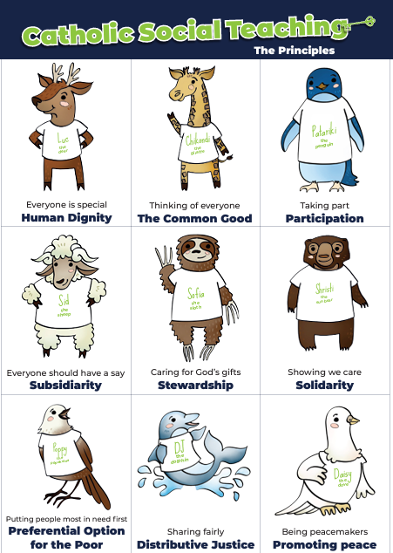
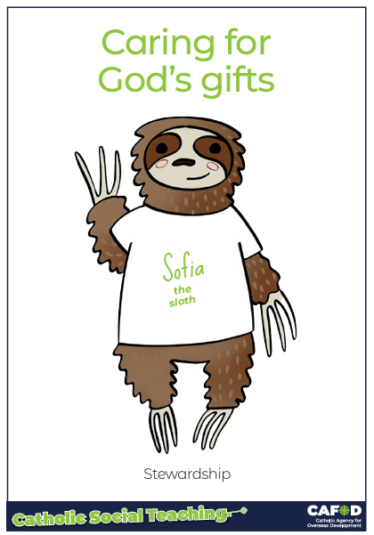
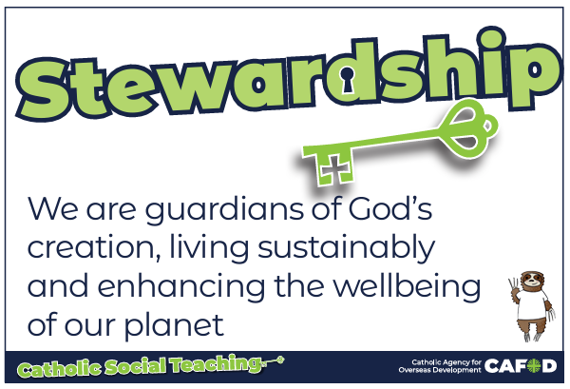
God’s gifts
Notes:
For teachers:
This gives a brief overview of CST which includes stewardship. These posters support CST and look more closely at stewardship and how we can be better stewards.
Catholic Social Teaching helps us to know how to treat each other and the world. One principle is ‘stewardship’. Sofia the sloth reminds us about Stewardship – it is about caring for God’s gifts.
This means:
Caring for all people
Caring for the world
Making things fair
Sharing with others
Looking after the poor and those in need
For teacher support for embedding CST throughout the school see:
https://cafod.org.uk/education/primary-teaching-resources/cst-pack-for-children

Slide 4
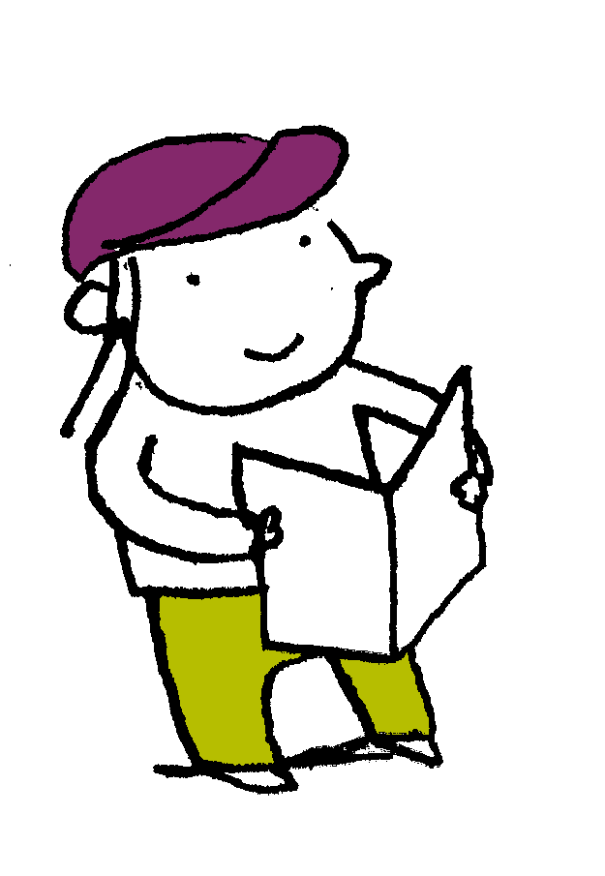
“So God created man in his own image, in the image of God he created him; male and female he created them. God blessed them. And God said to them, “Be fruitful and multiply and fill the earth and subdue it and have dominion over the fish of the sea and over the birds of the heavens and over every living thing that moves on the earth.”…. And it was so. And God saw everything that he had made, and behold, it was very good. Genesis 1: 27-31
Scripture
Notes:
Read this piece of scripture before discussing the posters.
Optional: light a candle, play some gentle music and invite pupils to reflect on these words of scripture and what they mean. Read them from the Bible to demonstrate its importance and tell pupils that these words come from Genesis, the first book of the Bible.

Slide 5
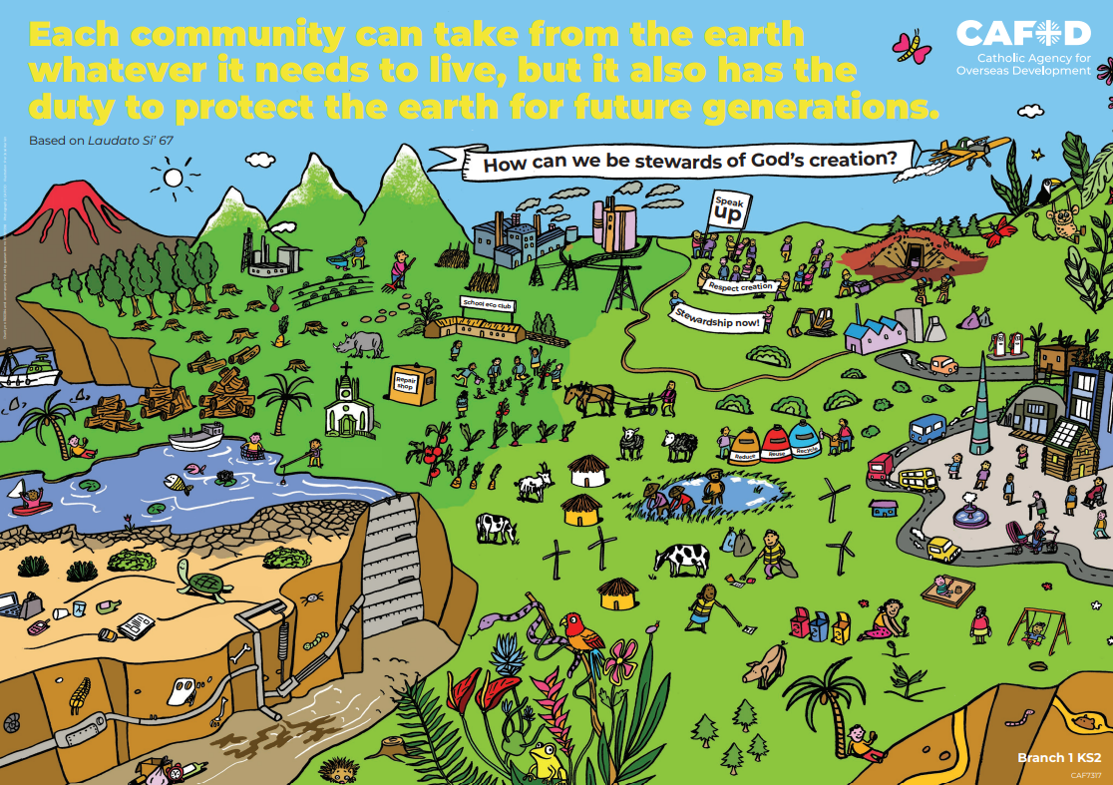
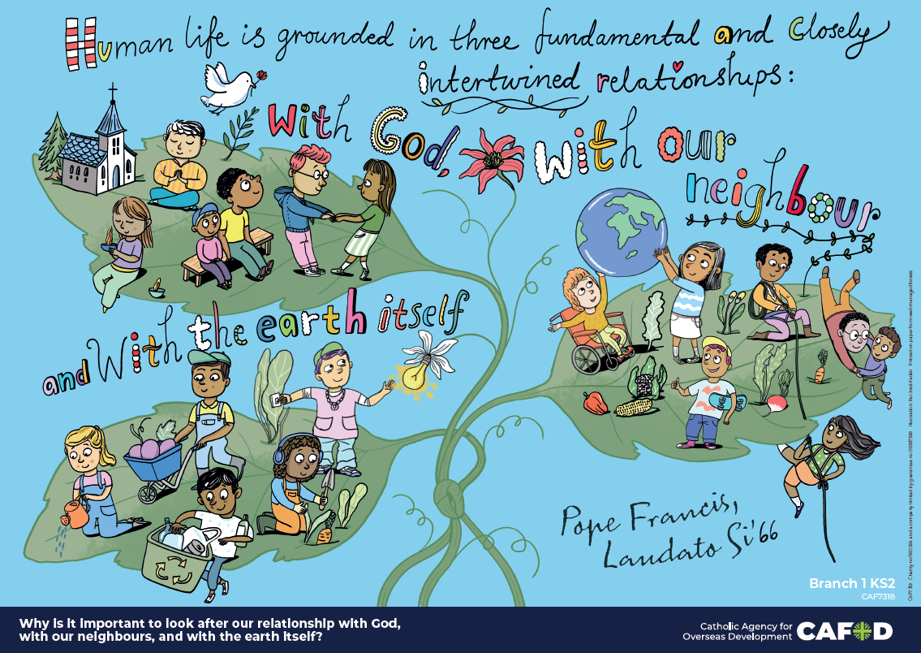
God’s world
Key words:
Laudato Si’, Canticle of Creation, human dignity, stewardship, ecological virtues
Key questions:
Why is it important to look after our relationship with God, with our neighbour and with the earth itself?
Notes:
Explain that you will be looking at these posters. Read through the key words you will be exploring and the key question(s) you will be answering. Ask pupils if they can recognise how these posters links to the word from the Bible they have just heard.
Note that this session may be broken into two small parts or be done as a full lesson.

Slide 6
God’s world
Relationships
What does it mean to be in ‘good relationship’?
How and why are relationships damaged?
How are we interconnected with God, others and the world?
Notes:
Being in ‘good relationship’ means being respectful and at peace. Not trying to be dominant and destroy others through our thoughts, words and actions, treating others with dignity…
Relationships are damaged when people care more about themselves than others, including the world... When they abuse others or the world… When they take them for granted and do not treat them with care, love or respect. When they treat others unfairly…
We are interconnected because when we are in a good and proper relationship with God, it can help us to be in a good relationship with others and the world and vice versa.

Slide 7
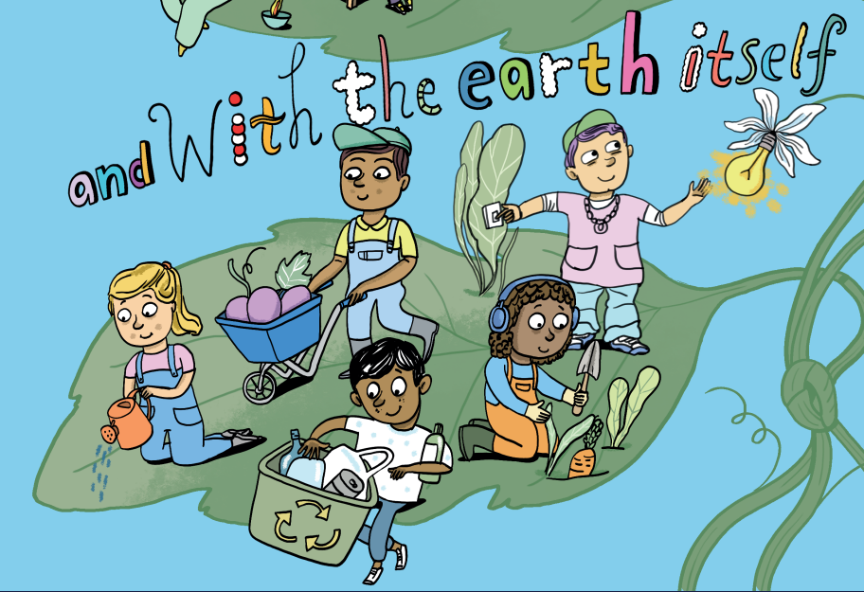
God’s world
Ecological virtues
The ecological virtues are good habits in looking after the earth and everything in it.
The 4 cardinal virtues are named as:
Justice
Temperance
Prudence
Fortitude
Notes:
Explain that Pope Francis spoke about developing “ecological virtues”. This can be summed up as developing good habits in looking after the earth and all created things. These link to cardinal virtues (see slide). Read through each of these virtues on the slide and how they link to creation.
The 4 cardinal virtues can be named and defined as:
Justice - always ensuring that God, our neighbour and the earth receive their due.
Temperance (temperateness) – enjoying things in moderation.
Prudence (practical wisdom) – exercising good judgement in moral situations.
Fortitude (courage) – demonstrating constancy in pursuit of what’s good, overcoming temptations, obstacles and fears.
For teachers:
For an overview of ecological virtues and how they link to Catholic Social Teaching see https://cafod.org.uk/education/primary-teaching-resources/re-resources-catholic-primary-schools

Slide 8
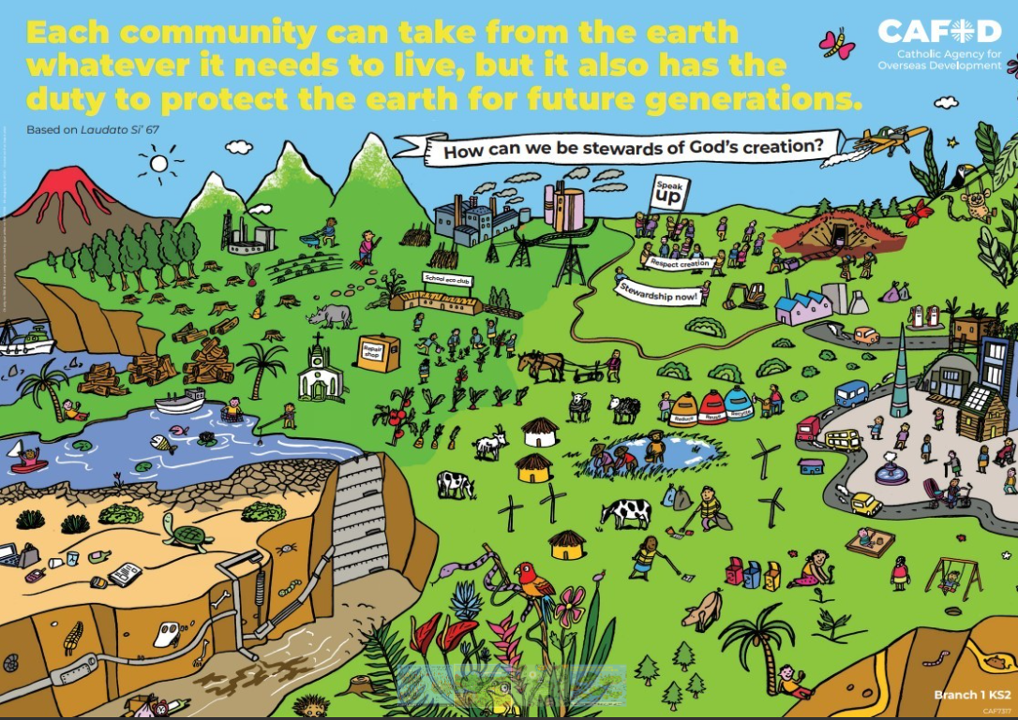
God’s world
Being a good steward of God’s creation means taking care of the world for God. It means looking after the interests of the planet and everything in it.
Notes:
Discuss other parts of this poster. Ask
Is everyone taking care of the world? How do you know? (Draw their attention to the left side and top of the poster). Explain that there is a close up of the left side that we will explore soon.
Discuss what it means to be a good steward and to look after the interests of others, not just our own.

Slide 9
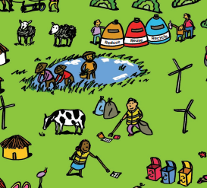
God’s world
Ecological virtues
In what way are the people in this picture demonstrating (or not) ecological virtues?
I wonder
How can you show ecological virtues?
Notes:
Ask pupils how the children in the poster are demonstrating ecological virtues.
Answers might include:
Recycling
Conserving energy/turning off the lights
Taking care of living things including plants (watering them…)
Only taking what is needed (fruit and veg…)
For an overview of ecological virtues and how they link to Catholic social teaching see https://cafod.org.uk/education/primary-teaching-resources/re-resources-catholic-primary-schools

Slide 10
God’s world
Stewardship How are the people in the picture being good stewards of the earth? Human dignity How are they respecting the human dignity of others?
Notes:
For teachers
Discuss the questions on the slide. Answers may be similar to those from previous slides, although note there is an absence of any damage or harm here. This is because they are in good relationship with God and others (relationships are intertwined).
Discuss human dignity. Answers may include:
Helping those who have fallen or are hurt in any way, or preventing them from doing so by keeping everyone safe
Working together and helping those in difficulty (pulling up with a rope)
Looking after those with disabilities so that they have equal rights and can flourish
Sharing food so everyone has enough to eat
Having a shared responsibility for the earth
Their own responses will vary. Encourage them to think about respecting the dignity of others in their home/class/community but also in other countries.

Slide 11
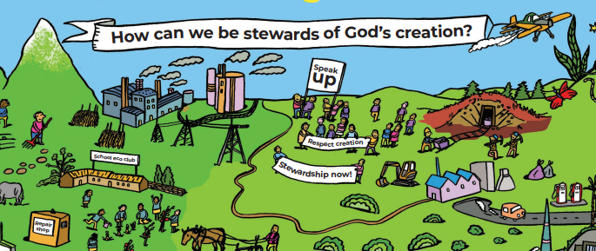
God’s world
Stewardship How are the people in this poster being good stewards and respecting human dignity?
What other details could be included to show stewardship?
Notes:
Discuss the questions. Answers may include:
Speaking up for those who have no voice (those who are poor, uneducated or have no power/say)
Campaigning to make changes and challenging those in power
Educating others so that they know how to make good choices and how to be good stewards
Their own responses may vary. Encourage them to think about looking after all living things, and how to treat each other well – the people and living things we know as well as those we don’t.

Slide 12
God’s world
Laudato Si’ In Laudato Si’, Pope Francis tells us to look after the world and not damage it.
How could caring for the world change it for the better?
Notes:
In Laudato Si’ Pope Francis said: “Each community can take from the bounty of the earth whatever it needs for subsistence, but it also has the duty to protect the earth and to ensure its fruitfulness for coming generations.” (LS’ 67). This means: Every group of people can use what they need from the Earth to live, but they also have to take care of it and make sure it stays healthy for children in the future.
Discuss these words from Pope Francis in Laudato Si’ 67. What might they mean and what is he trying to say (we take what we really need, don’t be greedy and wasteful, leave enough for others and take care of the world so that our children and their children can be healthy and flourish on the earth.)

Slide 13
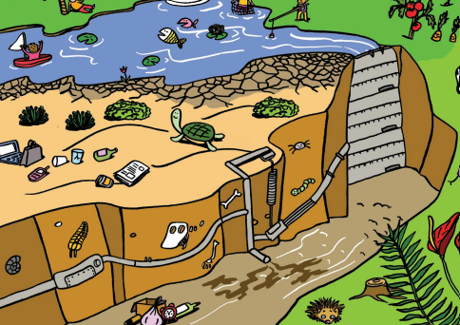
God’s world
Laudato Si’ In Laudato Si’, Pope Francis tells us to be good stewards and cultivate ecological virtues.
What would happen to the world if we weren’t good stewards or cultivated ecological virtues?
Notes:
Ask pupils if everyone is a good steward in the poster. How do we know?
Answers might include:
People have left their rubbish lying around
The equipment is broken
There is chemical waste/leakage
There are factory emissions
Discuss the consequences of not being good stewards and cultivating virtues.

Slide 14
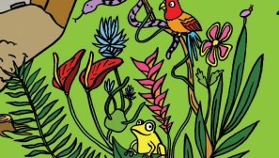
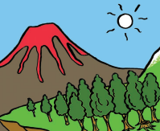
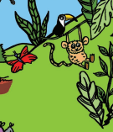
God’s world
Canticle of Creation In his prayer, St Francis praised God for creation and all living things. He called them his ‘sisters’ and ‘brothers’.
I wonder
What parts of creation would you like to give praise to God for?
How could you praise God?
Notes:
Discuss questions on the slide. Children’s answers will vary. Emphasise the importance of everyone having different views and experiences as the earth is so varied.
Explain also that people can express their praise in different ways: words, prayers, songs, poems, artwork, dance/movement, plays… God created the world. People can create things too.
For the canticle, see https://cafod.org.uk/pray/prayer-resources/canticle-of-the-sun
This slide could be used at the beginning or end of the session. It could also be the basis for a separate prayer session or a lesson.
Prayer
If it is for prayer, pupils could listen to/say the canticle. They could give God praise and thank him in prayer. A video version can be found here: https://www.youtube.com/watch?v=3X4tv19Muk4
Lesson
If it is for a lesson, pupils could explore the language of this prayer and then complete activities based on this (independent or collaborative) such as artwork, music/song, poetry…

Slide 15
God’s world
Key words:
Laudato Si’, Canticle of Creation, human dignity, stewardship, ecological virtues
Key questions:
Why is it important to look after our relationship with God, with our neighbour and with the earth itself?
Notes:
Review

Slide 16
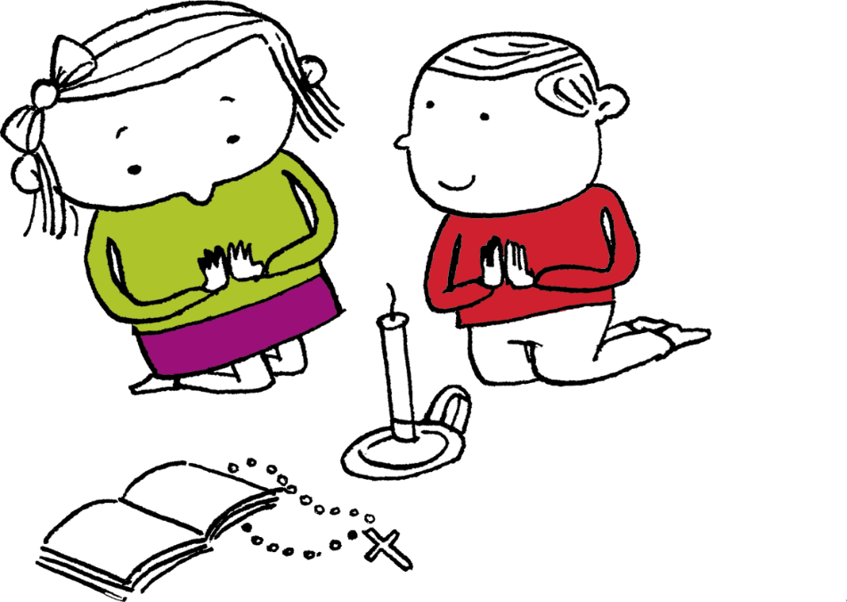
Let us pray
Thank you, God,
For giving us the popes and saints to help guide us.
Help us to have good relationships
with you, with others
and with the earth itself.
Help us to recognise the human dignity in all people. Amen

Slide 17
Order the RE CAFOD poster set

