Slide 1
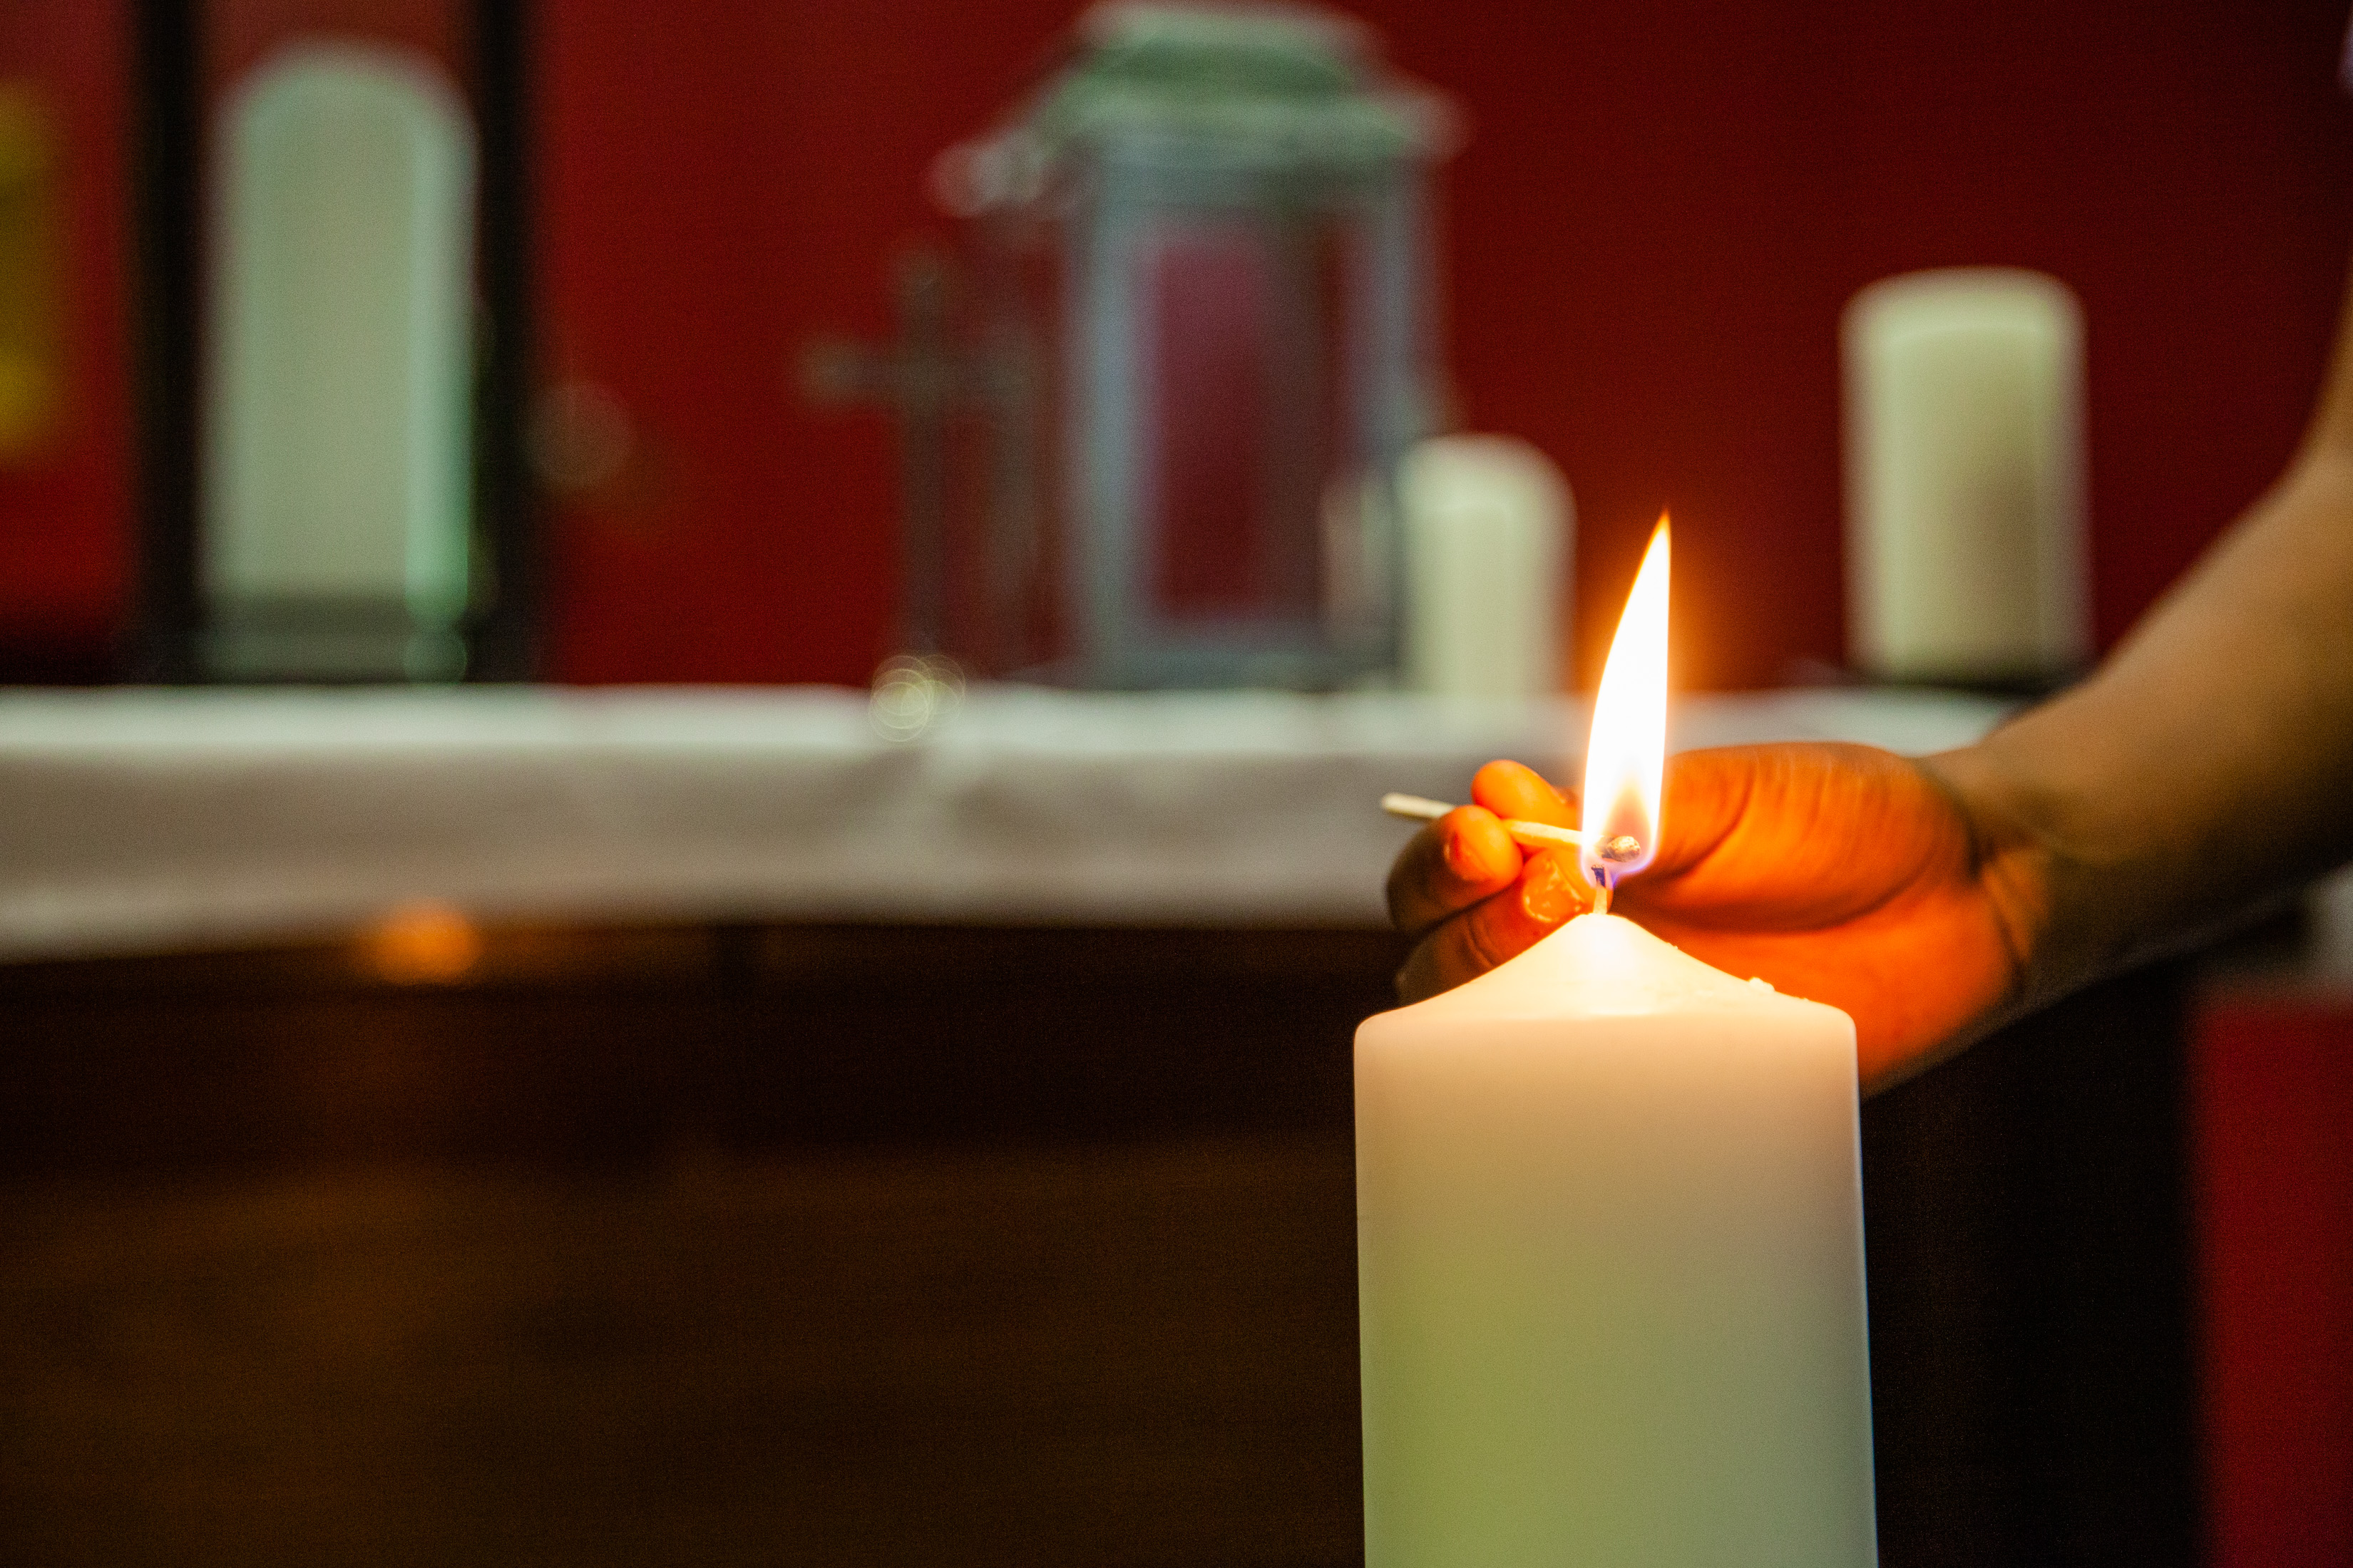
Loving God, Father of all,
We pray for our sisters and brothers in Myanmar.
We ask that, through the power of your love,
You bring comfort to those who need your help.
Give hope to those who do not have shelter,
And give courage to those who help and support.
Amen

