Slide 1
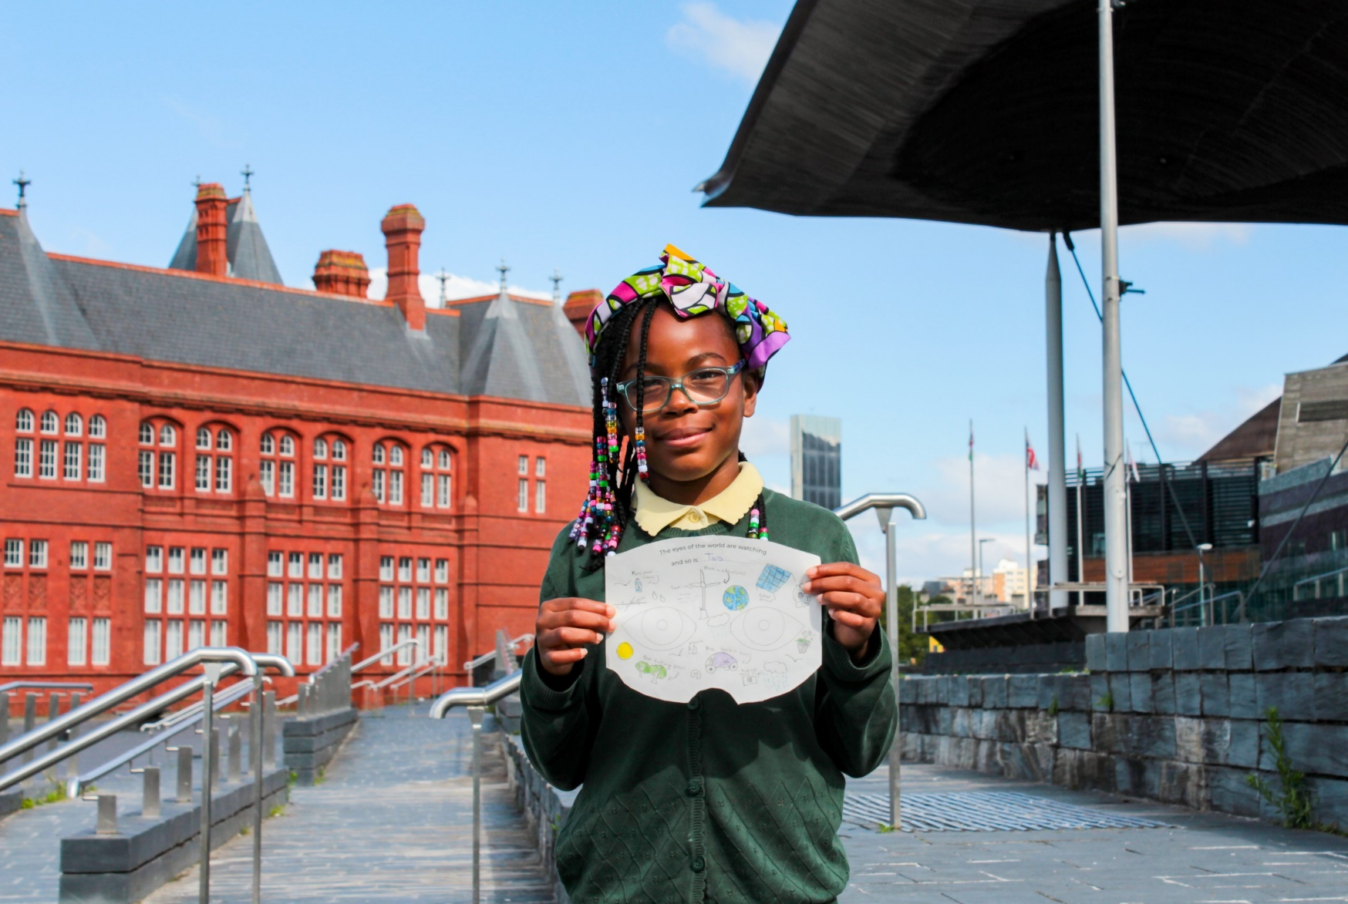
What changes can I make to help others this week?
Gather
Notes:
Children’s liturgy – Second Sunday in Ordinary Time (Year C)
Preparation of the worship space
Colour: green
Song suggestions: Make me a channel of your peace (898, Laudate)
Welcome: In today’s gospel we hear how Jesus did something very special at a wedding in Cana, changing water into wine. Let’s think about the changes we can make in our lives and in our world.
A pupil from St Cuthbert's Catholic Primary School

Slide 2
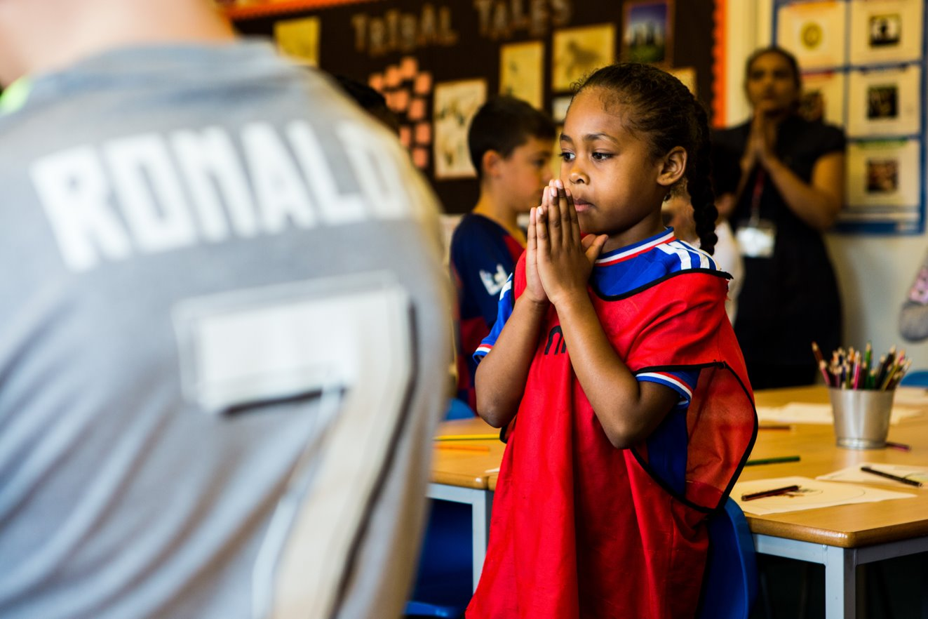
God of wonder,
we know all things are possible for you. Help us to work together to change the world, so that it becomes a fairer place for all to live. Amen.
Notes:
Children at Our Lady Queen of Heaven Primary School
Photo credit: Thom Flint

Slide 3
Gospel: John 2:1-11
Two days later there was a wedding in the town of Cana in Galilee. Jesus' mother was there, and Jesus and his disciples had also been invited to the wedding. When the wine had given out, Jesus' mother said to him, “They have no wine left.”
“You must not tell me what to do,” Jesus replied. “My time has not yet come.” Jesus' mother then told the servants, “Do whatever he tells you.”
The Jews have rules about ritual washing, and for this purpose six stone water jars were there, each one large enough to hold about a hundred litres. Jesus said to the servants, “Fill these jars with water.” They filled them to the brim, and then he told them, “Now draw some water out and take it to the man in charge of the feast.”
They took him the water, which now had turned into wine, and he tasted it. He did not know where this wine had come from (but, of course, the servants who had drawn out the water knew); so he called the bridegroom and said to him, “Everyone else serves the best wine first, and after the guests have had plenty to drink, he serves the ordinary wine. But you have kept the best wine until now!”
Jesus performed this first miracle in Cana in Galilee; there he revealed his glory, and his disciples believed in him.
Word

Slide 4
What do you remember from the Gospel reading?
Jesus, his mother Mary, and the disciples were at a wedding, where they ran out of wine. Mary asked Jesus to help and so he changed some water into wine so that the celebration could continue.
How do you think that the servants must have felt when they saw that the water had turned into wine? It must have been very surprising for them and the bride and groom.
What do you think the word 'miracle' means?
Respond
Notes:
Photo credit: Akira Hojo on Unsplash

Slide 5
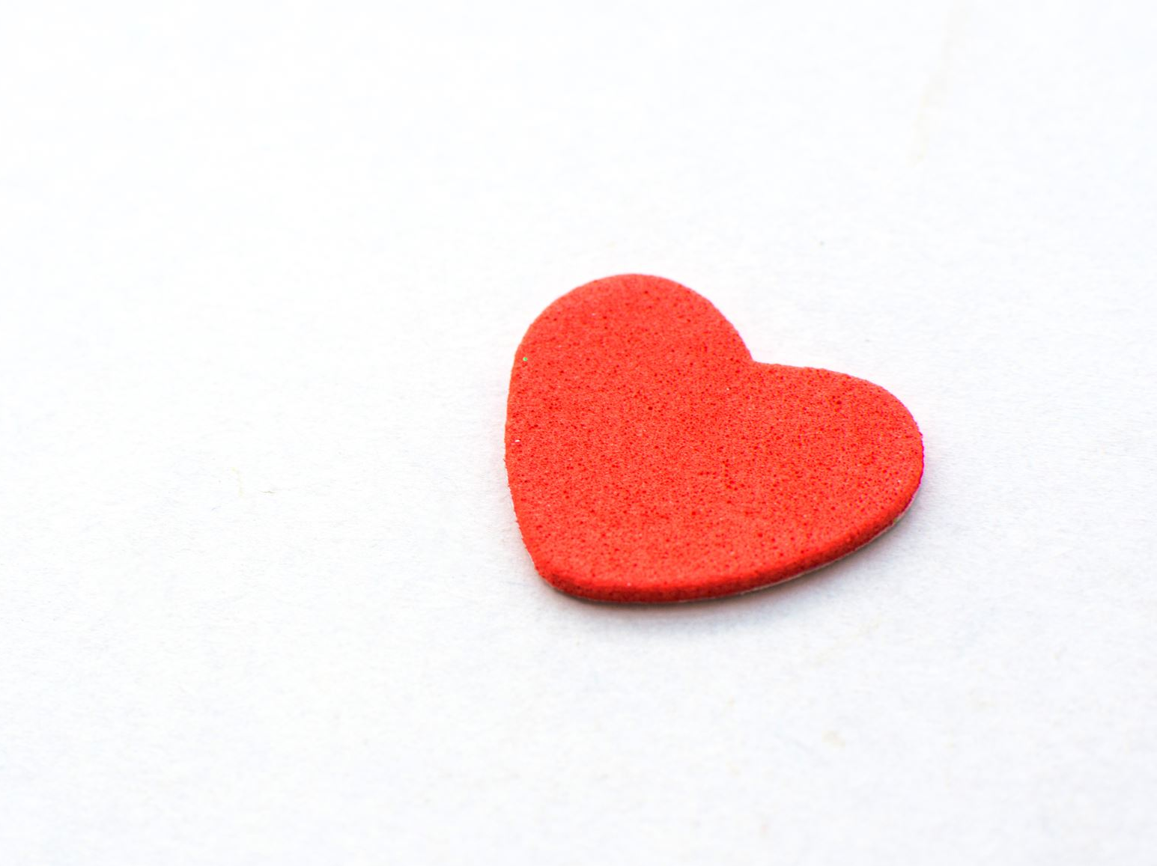
When we don't know how something happens, and we know it can only have been done by God, we call it a miracle. Turning the water into wine is the first miracle that Jesus performs. Can you think of any others?
Why do you think Jesus performed this miracle, turning the water into wine? What does it tell us about him?
The miracle shows us how special and important Jesus is. It shows us that he is the Son of God and that he can do anything.
Notes:
Photo credit: Stock image

Slide 6
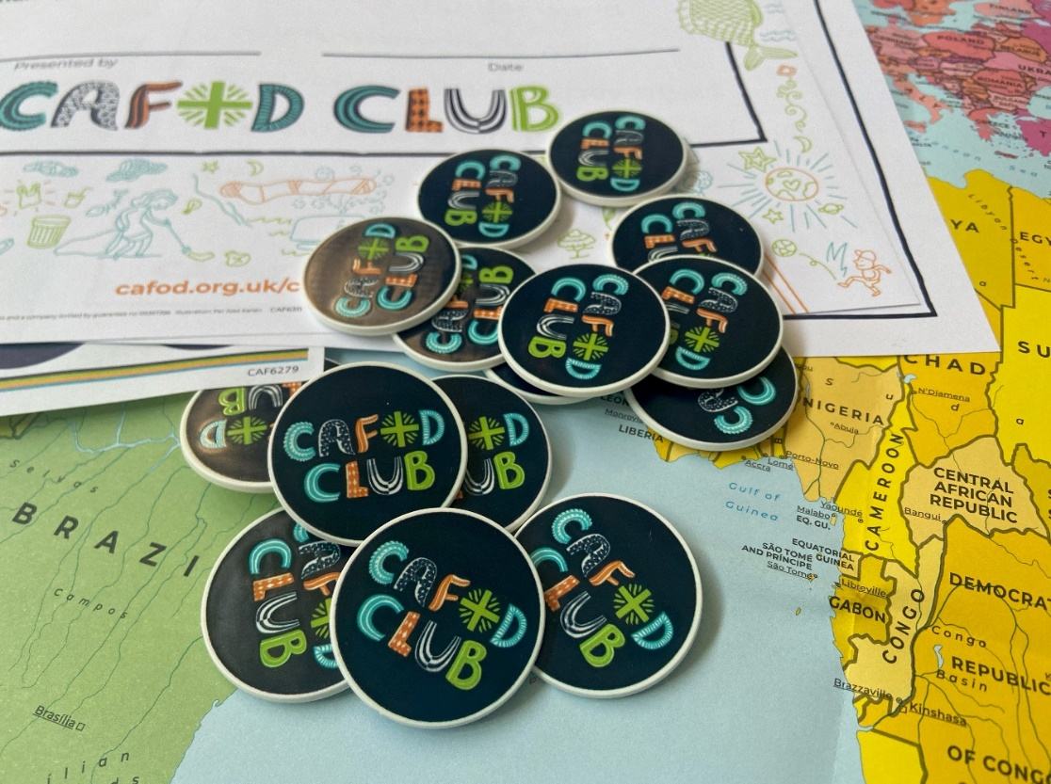
While we cannot work miracles, we can make real changes that make a difference to our own lives and the lives of others.
What changes do you think we can make to help build a fairer world, so that all people have what they need to live happy, healthy and peaceful lives?
Joseph is a member of the CAFOD Club in his primary school. They meet at lunchtime to do different activities and learn about, pray and help other children around the world who live in poverty.
Joseph and his friends planned a CAFOD fundraiser to raise money for the families and children they learn about.
Notes:
Photo credit: CAFOD

Slide 7
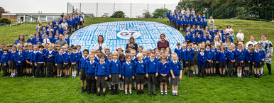
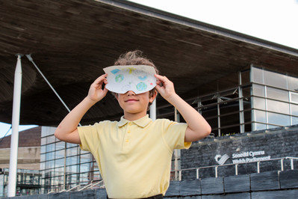
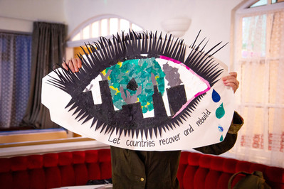
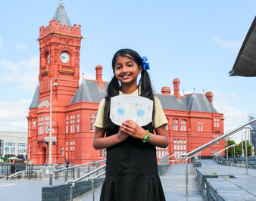
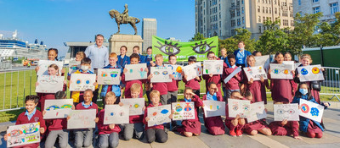
Thousands of children across England and Wales have spoken up with CAFOD for their brothers and sisters living in poverty across the world.
They have made their voices heard on behalf of those who do not have enough food to eat, clean water to drink or who are facing challenges because of the changing climate.
Notes:
Children from England and Wales campaigning for CAFOD
Photo credits: Tamala Ceasar, Victoria Ahmed, Annie Bungeroth

Slide 8
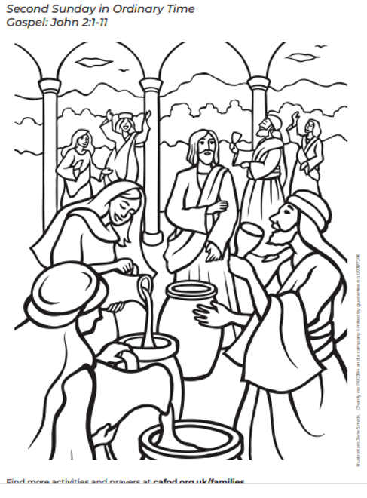
Through seeing Jesus’ miracle the disciples believed in him. Through our actions we hope that others will see that we believe in Jesus too.
Notes:
Illustration: Jane Smith

Slide 9
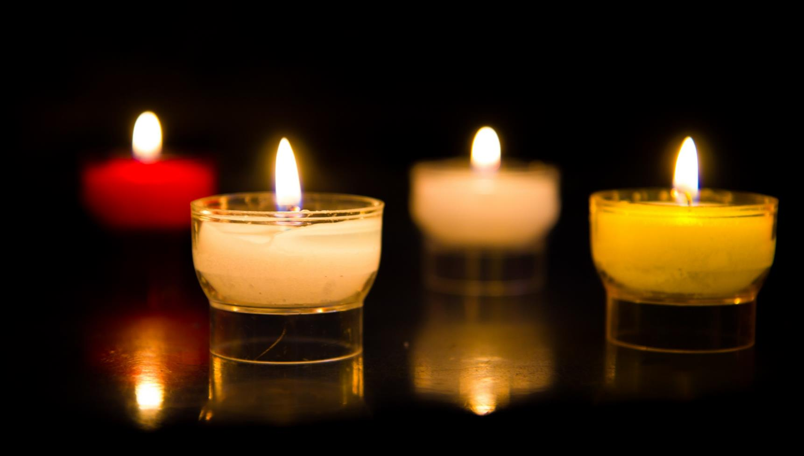
Let us pray…

Slide 10
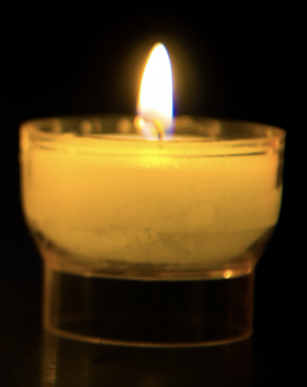
We pray for world leaders: that they may use their power wisely so that all of their people can live free from poverty.
Lord, in your mercy…
We pray for people who are living in poverty throughout the world: that together with them we may never stop working for a fairer world and a future filled with hope.
Lord, in your mercy…

Slide 11
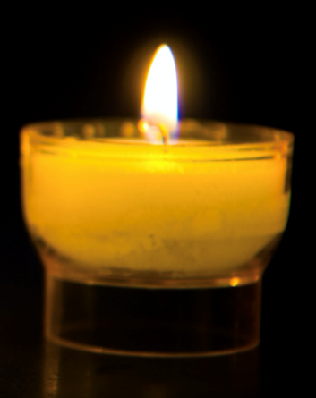
We pray for our parish, families and friends: that we may be inspired to make a difference, to change our own lives and reach out to help others who are trying to change their lives too. Lord, in your mercy…
God of life, may we be inspired by the miracles that your Son Jesus performed, to do our best to make a real difference to others around the world. Amen.

Slide 12
How will you try to make a real difference to someone else, either locally or overseas, this week?
Send
Notes:
A pupil from St Cuthbert's Catholic Primary School

Slide 13
Activity suggestions
Invite the children to colour in the accompanying illustration and on the back to write or draw one thing that they would like to change about the world.
Encourage the children to share all that they have heard and thought about today with the people at home.
The Jubilee Year is a landmark moment in the life of the global church. School communities are invited to join together as pilgrims of hope, pledging to work together for God’s kingdom of justice, peace and love. Find resources for Launch Day on 24 January: Jubilee for schools 2025 – Pilgrims of Hope
Why not make the Big Lent Walk part of your Jubilee pledge? For sign up and more information go here: BLW25 Schools Sign up - Formstack
A CAFOD club could strongly support the Catholic life of your school. Find out more: https://cafod.org.uk/Education/For-teachers/CAFOD-clubs

Slide 14
Notes:
Illustration: Jane Smith

