Slide 1
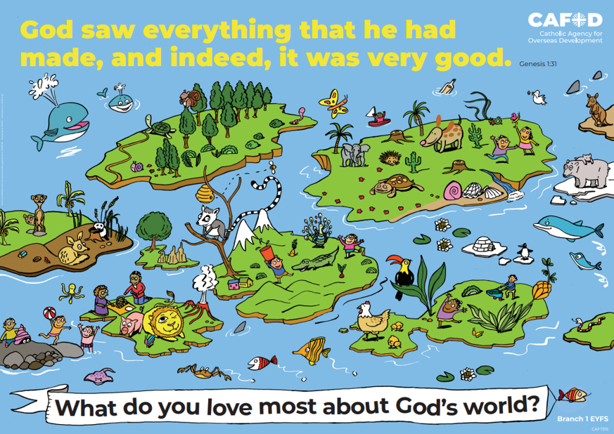
Year 6 RED poster activities
Branch 1: Creation and Covenant
Order the RE CAFOD poster set
Notes:
Timings
This presentation has been designed to last for 15-20 minutes. It can be used as a stand-alone lesson or incorporated into a scheme.
Extension
Although this presentation was designed to simply engage pupils in discussion about key RED themes, the sessions can be developed in many ways. Some of the examples are included below:
Give pupils the poster (or a part of it) to discuss and annotate in groups
Provide pupils with their own A4 version of the poster to put in their own RE books (double page spread). This can be labelled in various ways, such as with references to scripture or Laudato Si’
Invite children to draw or list their own additions and suggestions to the poster
Offer children the opportunity to create their own poster, for example through artwork or through drama (creating freeze frames).

Slide 2
Year 5 Year 6
“Each community can take from the earth everything it needs to live, but it also has the duty to protect the world for future generations.” (Based on Laudato Si’ 67) How can we be stewards of God’s creation? | “Each community can take from the earth everything it needs to live, but it also has the duty to protect the world for future generations.” (Based on Laudato Si’ 67) How can we be stewards of God’s creation?
Welcoming asylum seekers and refugees Common good Love of neighbour | Laudato Si’ Created world & Stewardship Dignity & equality Greatness of God Damage
U5.1.6, U5.1.2, D5.1.3, R5.1.4 | U6.1.2, U6.1.5, R6.1.1, R6.1.2, R6.1.3
CAFOD poster
Themes
RED outcomes
Notes:
For teachers’ use only.
Note: The RED outcomes which are highlighted are most relevant to these CAFOD posters are highlighted in bold.

Slide 3
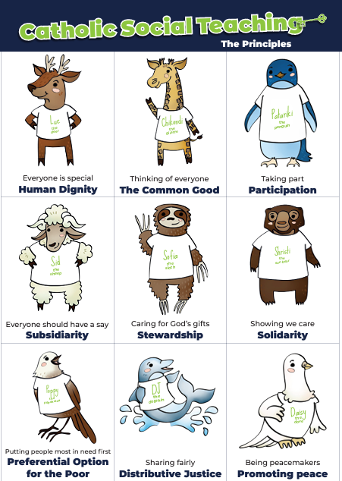
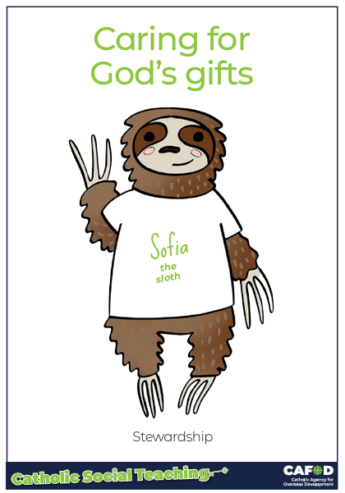
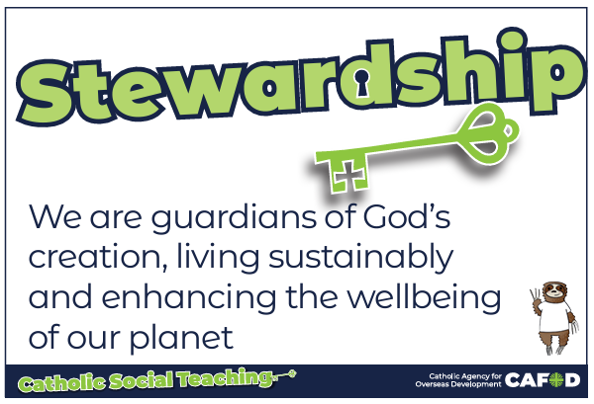
God’s gifts
Notes:
For teachers:
This gives a brief overview of CST which includes stewardship. These posters support CST and look more closely at stewardship and how we can be better stewards.
Catholic Social Teaching helps us to know how to treat each other and the world. One principle is ‘stewardship’. Sofia the sloth reminds us about Stewardship – it is about caring for God’s gifts.
This means:
Caring for all people
Caring for the world
Making things fair
Sharing with others
Looking after the poor and those in need
For teacher support for embedding CST throughout the school see:
https://cafod.org.uk/education/primary-teaching-resources/cst-pack-for-children

Slide 4
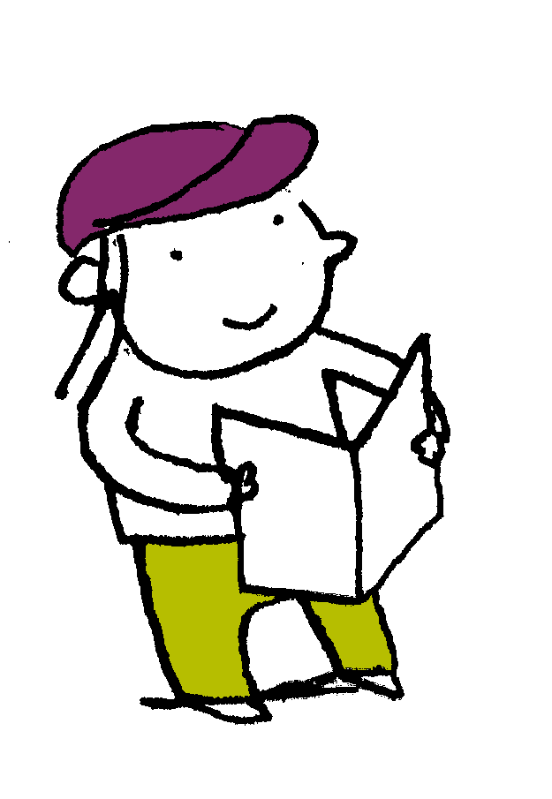
“God blessed them. And God said to them, “Be fruitful and multiply and fill the earth and subdue it and have dominion over the fish of the sea and over the birds of the heavens and over every living thing that moves on the earth.”…. And it was so. And God saw everything that he had made, and behold, it was very good. Genesis 1: 28-31
Scripture
Notes:
Read this piece of scripture before discussing the posters.
Optional: light a candle, play some gentle music and invite pupils to reflect on these words of scripture and what they mean. Read them from the Bible to demonstrate its importance and tell pupils that these words come from Genesis, the first book of the Bible.

Slide 5
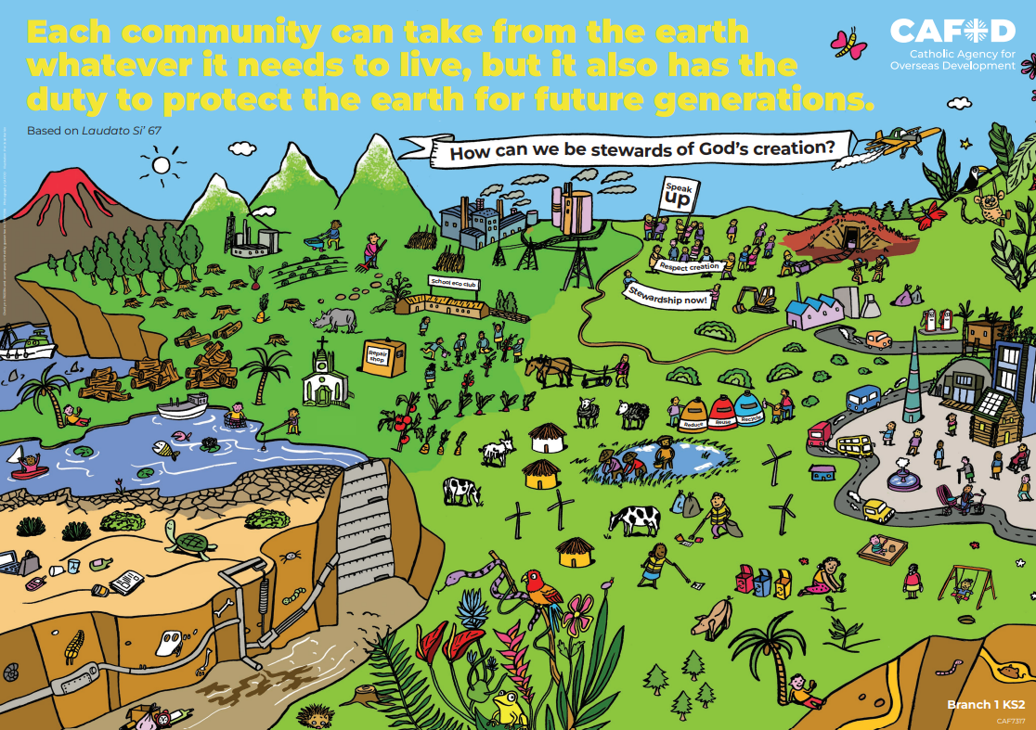
God’s world
Key words:
Laudato Si’, common good, stewardship, created world, dignity and equality, greatness of God, damage
Key questions:
How can we be stewards of God’s creation?
How can we protect the earth for future generations?
Notes:
Explain that you will be looking at this poster. Read through the key words you will be exploring and the key question(s) you will be answering. Ask pupils if they can recognise how this poster links to the words from the Bible they have just heard.

Slide 6
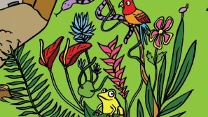
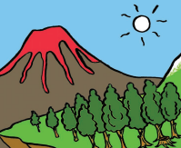
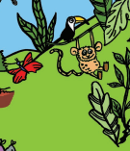
God’s world
Greatness of God The psalms, St Francis’ Canticle of Creation and other prayers and songs praise God for his greatness and for the created world.
Where can you see the greatness of God?
How could you praise God for his greatness?
Notes:
Revise previous learning briefly (psalms, canticle of creation, Laudato Si’, Pope Francis and St Francis, creation… ). Note that this slide could be used on its own for classroom prayer or a lesson.
Lesson
Discuss the slide and the questions, using the images for ideas. Encourage pupils to think about details (eg the patterns on a butterfly’s wings, the diversity of plants, their pet…). Ask them also to to think about events when God and others have helped them and been kind to them.
Discuss the greatness of God and how different people express this in different ways (St Francis, Pope Francis, King David…)
Challenge: Look at how Mary proclaimed the greatness of God in her prayer/song, the Magnificat. This will be part of future learning in Y6. See https://blog.cafod.org.uk/2024/07/30/the-magnificat-a-prayer-for-all-time/
Prayer
Listen to a prayer/song about the greatness of God (St Francis’ Canticle, Psalm, Magnificat). Reflect on the greatness of God and create/write your own prayer or response. Share.

Slide 7
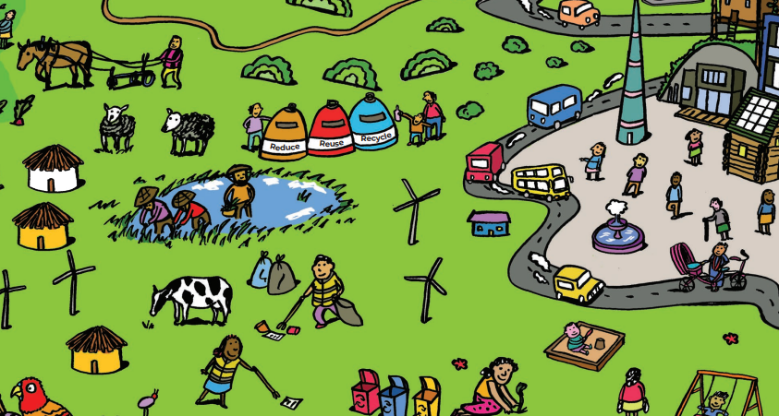
God’s world
Dignity and equality
Every person has been created by God and has human dignity. Everyone is valued and equal in God’s eyes.
What are they doing in the picture to show dignity and equality?
What could be added to the picture?
Notes:
Discuss the questions on the slide.
Answers may include:
Taking care of waste (different coloured bins – reduce, reuse, recycle)
Conserving energy (wind turbines)
Keeping the earth clean and tidy (picking up litter)
Cultivating the land
Taking care of the animals (respectful farming)
How does the poster show the common good and looking after the most vulnerable (eg asylum seekers, those living in poverty…)?
Challenge 1: You may wish to ask pupils about how this poster might link to Beatitudes (blessed are the peacemakers, blessed are the merciful, blessed are the meek, blessed are those who hunger and thirst for what is right…). This is a part of future learning for Y5.
Challenge 2: Ask pupils how this poster shows any of the fruits of the Holy Spirit (love, joy, peace, patience, kindness, goodness, faithfulness, gentleness, self-control). This is also a part of future learning for Y5.

Slide 8
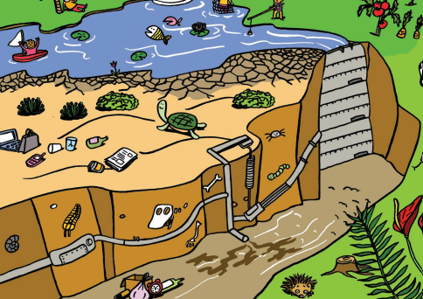
God’s world
Laudato Si’
In Laudato Si’, Pope Francis tells us to look after the created world and not damage it. How might people damage the world and their relationships with God and others? What could be added to the picture to show the damage we have done to the earth?
Notes:
Explain that pupils may be familiar with this poster and Laudato Si’ However, they have not yet looked in detail at the damage and consequences of their actions. Highlight that when we damage our relationship with God and others, it is called ‘sin’.
Discuss the question on the slide and how people can damage relationships due to sin/bad choices.
The question on what could be added to the picture could have two types of answers:
What other damage is being done to the earth and others?
How could this damage by repaired/healed?
Challenge: Ask pupils to link this to God’s Kingdom (part of Y6 learning).
Ask: Does this image show what God’s kingdom should look like?

Slide 9
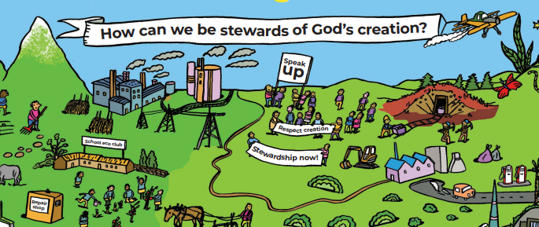
God’s world
Stewardship
How are the people in the picture being good stewards?
How could YOU be a good steward?
Notes:
Explain that when people take too much for themselves or waste what they have, others do not get what they need. This is not sustainable or fair.
Discuss the questions on the slide.
Answers might include:
Looking after the poor and vulnerable by being a voice for them
Campaigning for stewardship so that people can get what they need
Working for sustainability
Other answers may also be valid.

Slide 10
God’s world
Key words:
Laudato Si’, common good, stewardship, created world, dignity and equality, greatness of God, damage
Key questions:
How can we be stewards of God’s creation?
How can we protect the earth for future generations?
Notes:
Review

Slide 11
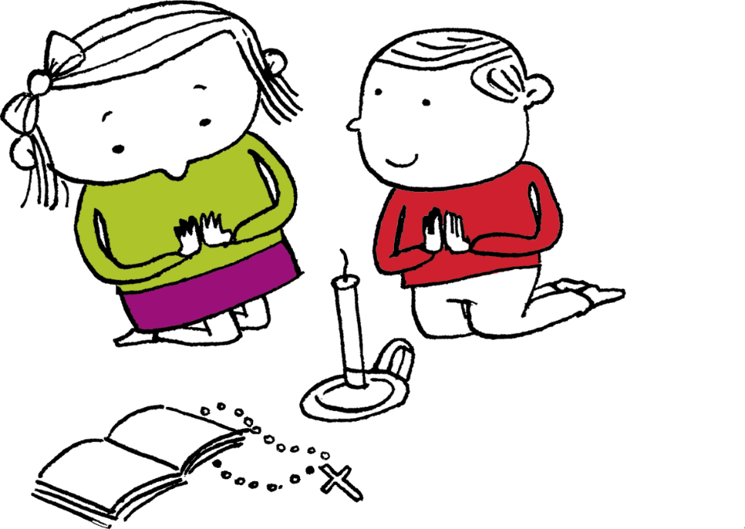
Let us pray
Thank you, God,
For making us all in your image and likeness.
Help us to treat everyone equally and fairly and to stand up against any injustices so that we protect others and the earth itself. Help us to be good stewards. Amen

Slide 12
Order the RE CAFOD poster set

