Slide 1
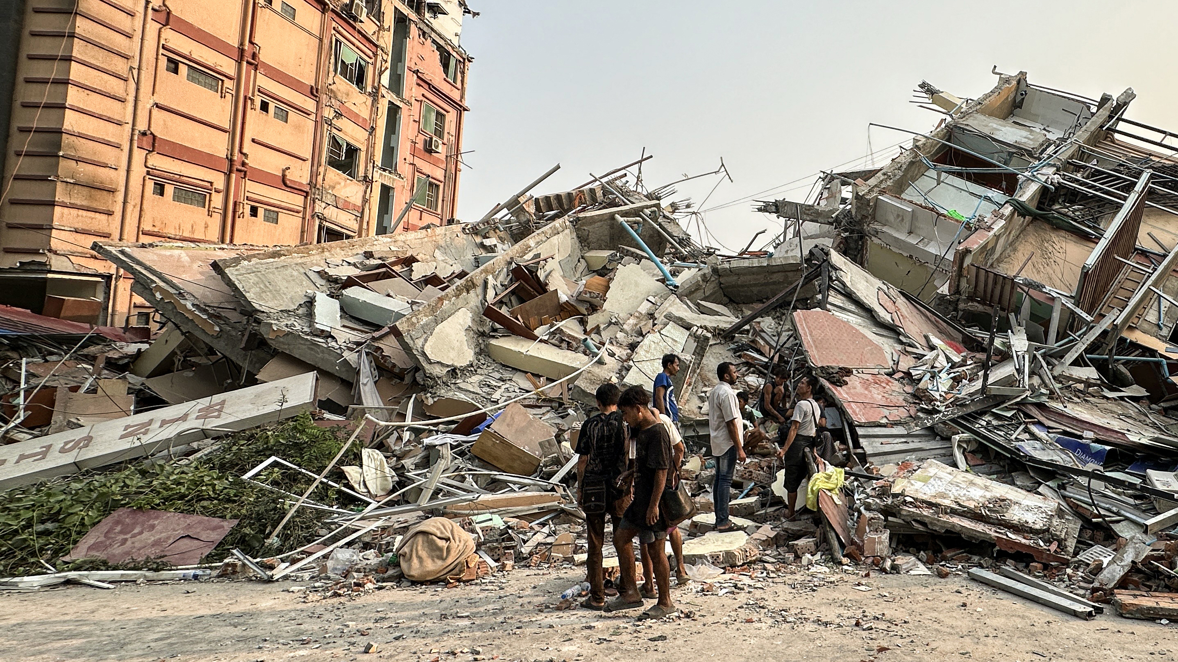
DEC Myanmar Earthquake Appeal
School fundraising assembly

Slide 2
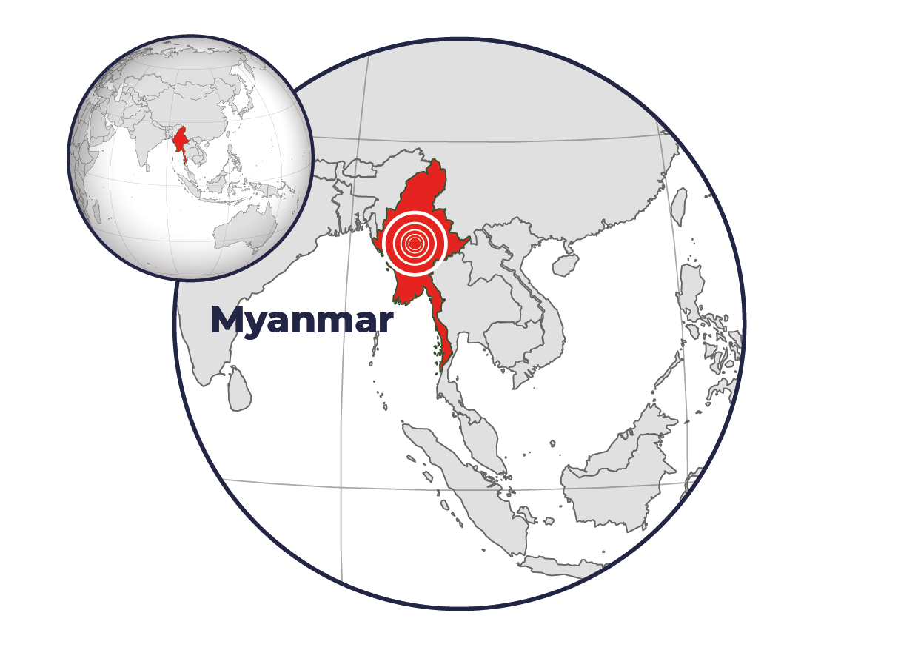
What has happened?
As you may have seen on the news, a powerful 7.7 magnitude earthquake struck Myanmar on 28 March.

Slide 3
The Disasters Emergency Committee has announced a humanitarian appeal for Myanmar.
There are 15 members of the DEC and CAFOD is one of them.
Notes:
Image credit: Caritas Jerusalem

Slide 4
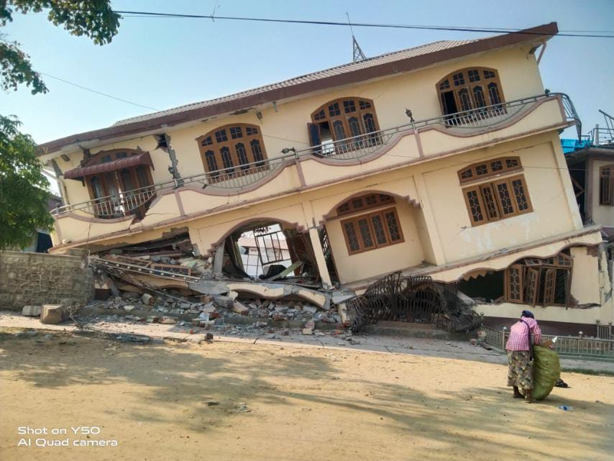
This is the strongest earthquake to hit the country in many years.
Over 2000 people have died and millions of people are in need of shelter, food, clean water, and medical care.
Notes:
Photo: Withheld for security reasons

Slide 5
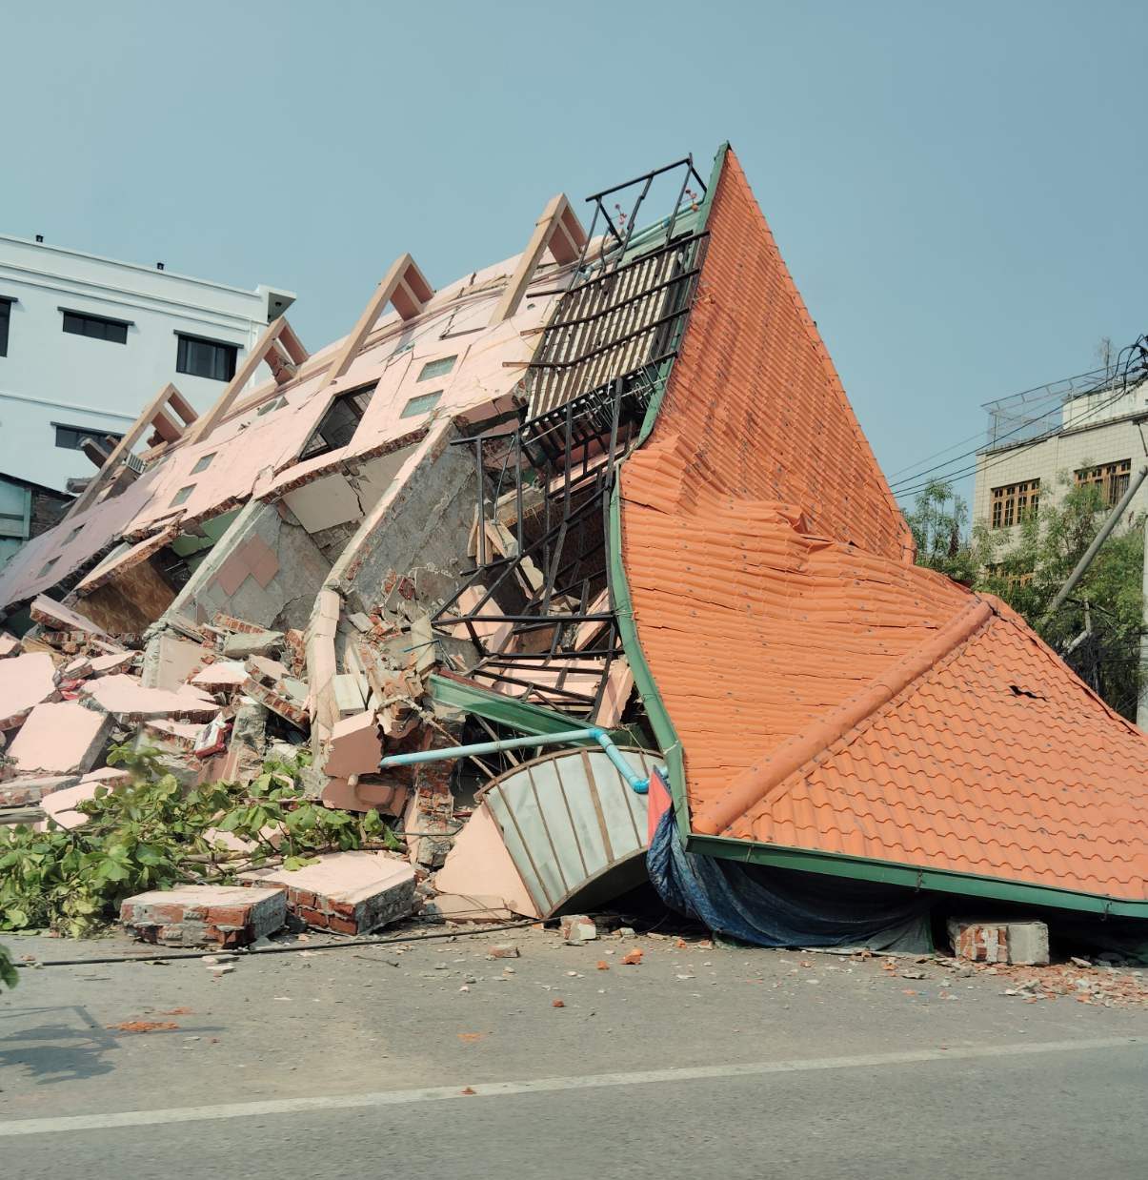
Whole communities have been torn apart, with roads and buildings destroyed.
Many people are still trapped under rubble.
Families are forced to sleep outside, fearful of further aftershocks.
Notes:
Photo: Withheld for security reasons

Slide 6
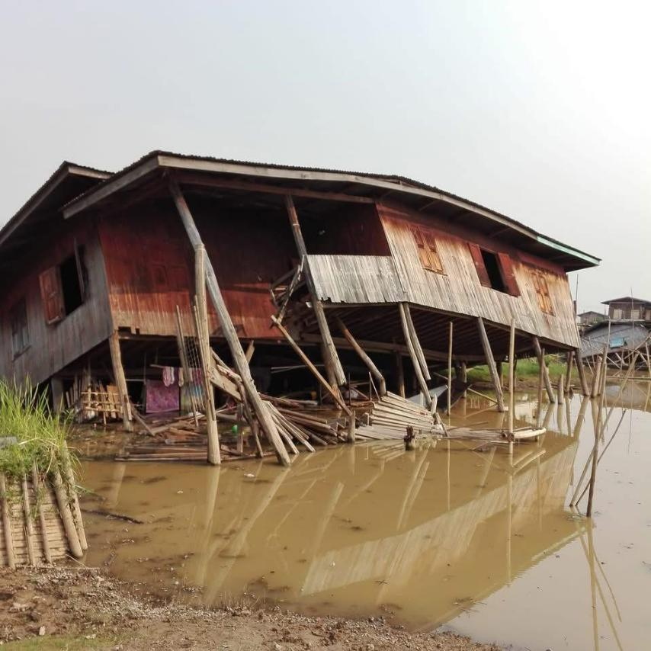
Now, more than ever, the people of Myanmar need our help.
In Myanmar, Cardinal Bo shares
“We are deeply touched by the promise of support by the Catholic Church everywhere. The people need food, shelter, medicine, and all life-saving materials.”
Notes:
Photo: Withheld for security reasons

Slide 7
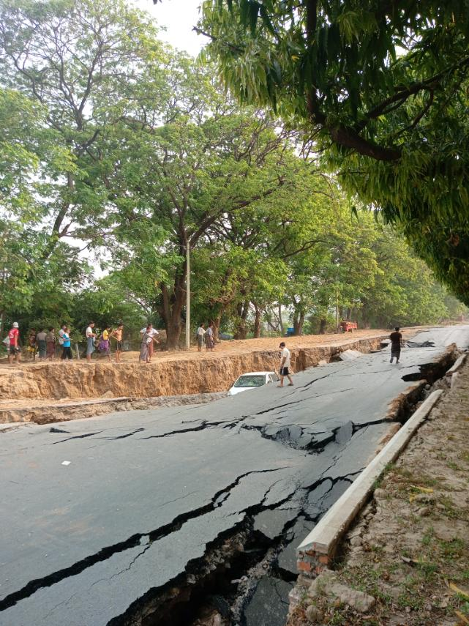
How CAFOD is helping
Through the Catholic Church, we can provide the emergency help that affected families will need – food, water and shelter.
Notes:
Photo: Withheld for security reasons

Slide 8
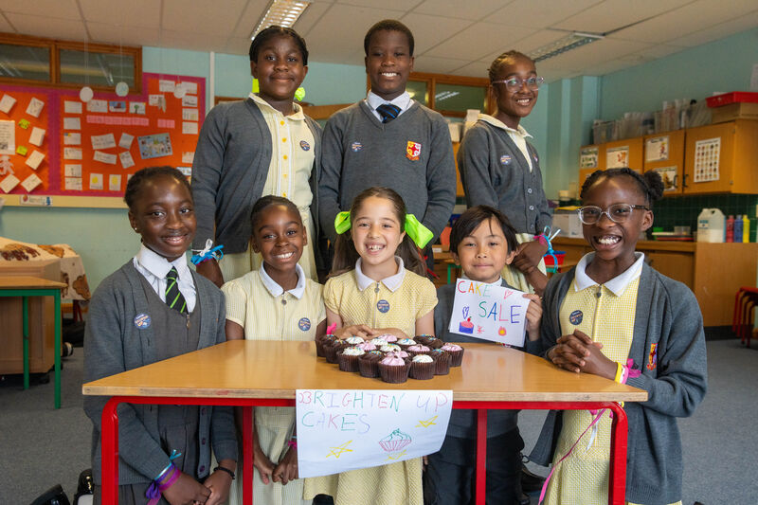
What can we do to help?
A better world needs all of us. Fundraising for CAFOD can make an immediate, life-saving difference for those affected by this disaster.
Notes:
Photo credit: Victoria Ahmed and Joe Newman

Slide 9
How our fundraising can help
CAFOD and the DEC will send our donations through a trusted partner to support local groups who are helping in Myanmar.
Baby food, solar lights, mosquito nets and water purification tablets are among the items urgently needed for families.

Slide 10
Let us pray together.
Loving God, Father of all,
We pray for our sisters and brothers in Myanmar.
We ask that, through the power of your love,
you bring comfort to those who need your help.
Give hope to those who do not have shelter,
and give courage to those who help and support.
Amen

