Slide 1
Understanding the Refugee Crisis in Europe
Notes:
Teacher notes:
The content of this presentation may be upsetting for students, so be aware of this when discussing with your class/school. You may wish to remove some of the slides or information, depending on the needs and experiences of the students in your class/school.

Slide 2
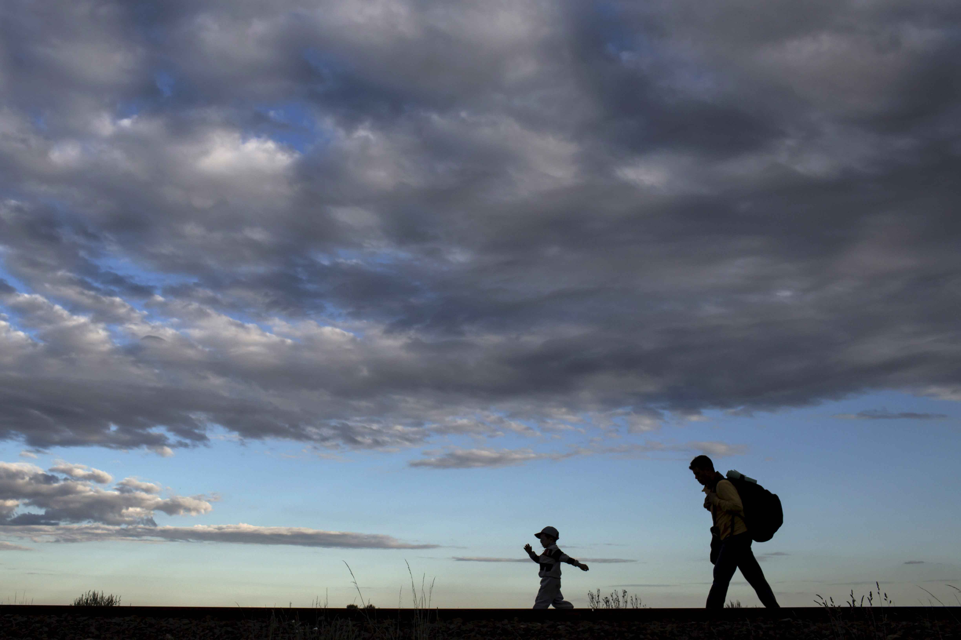
The movement of people is not new.
For thousands of years, people have moved from one area of the world to another.
This is called migration.
But why do people move?
Notes:
Teacher notes:
Ask the students to think about and discuss the question: Why do people move?
Ensure that students are aware that there are many different reasons that people move. Explore the difference between moving out of choice and forced migration. Discuss what is meant by the terms migrant and refugee, and that the difference between them is.
The UN Refugee Agency / UNHCR describes the difference between refugees and migrants:
Refugees – have to move in order to save their lives or preserve their freedom. They have no protection from their own state.
Migrants – choose to move in order to improve the prospects of themselves and their families.

Slide 3
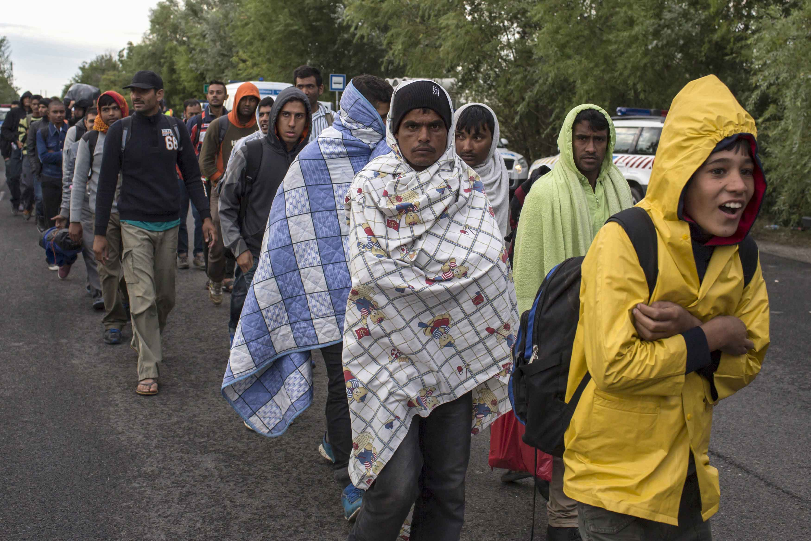
Refugees and migrants often use the same routes and modes of transport, as they make their journey.
Notes:
Teacher notes:
In the photograph, a group are walking along a road as they walk towards a reception camp near the village of Roszke, Hungary.

Slide 4
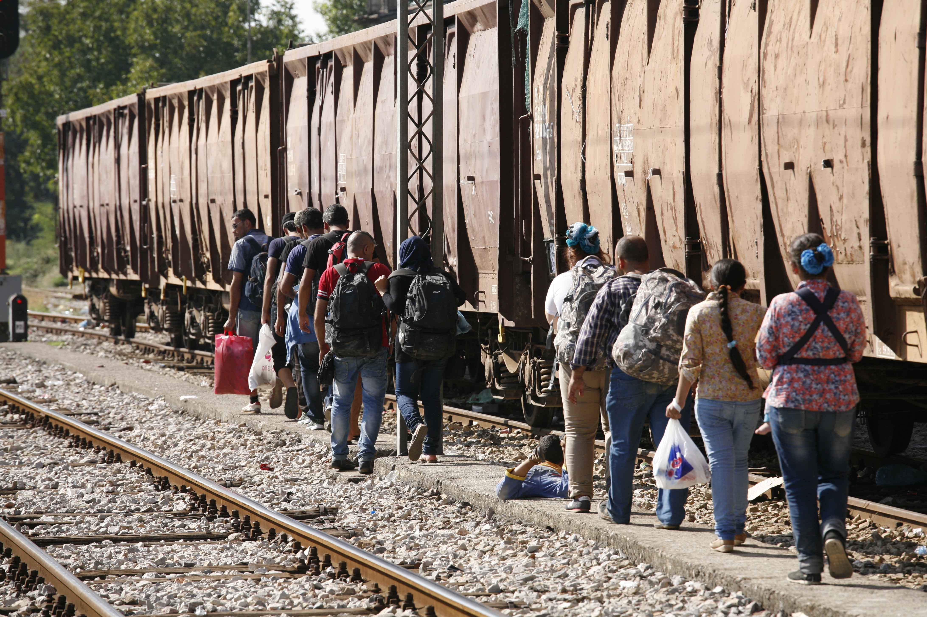
People often put their life at risk, as they try to find a safe place to live or a better life.
Notes:
Teacher notes:
Discuss with the students why people take such risks to make such journeys. Discuss what it might feel like to be forced to leave your home, in order to find somewhere safe to live.

Slide 5
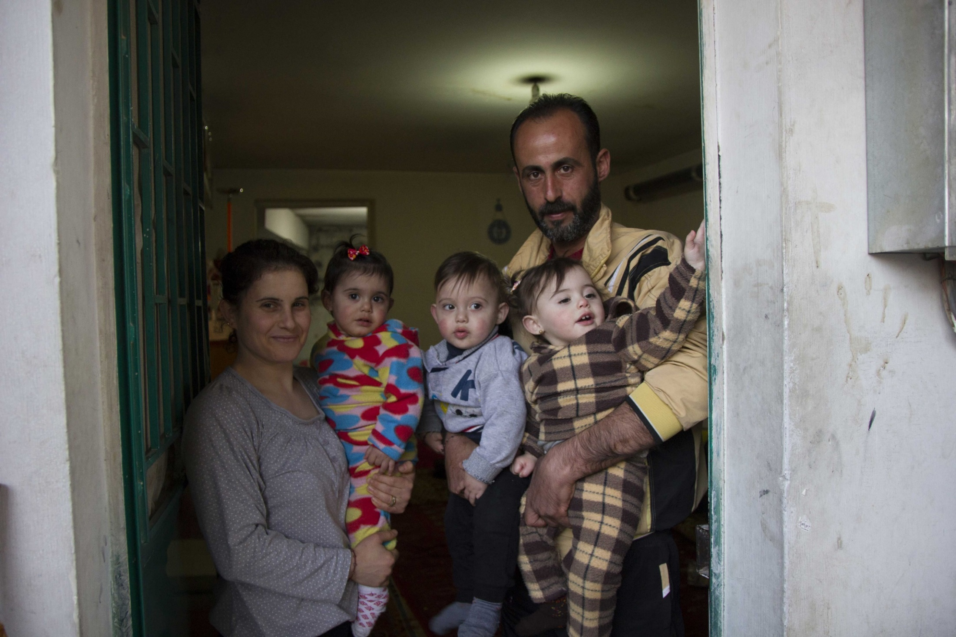
Like many others, Abir and Tony’s family fled from Syria to Lebanon, a neighbouring country.
Notes:
Teacher notes:
Explain to the students that at times of crisis, people usually flee to other places within their own country - this is called internal displacement. If they cannot find safety in their own country, they then might travel to their closest/ neighbouring countries. Many fewer travel to countries further afield.
Some facts:
Most Syrian displaced people are located within Syria itself.
The top three countries hosting Syrian refugees are: Turkey, Lebanon and Jordan.

Slide 6
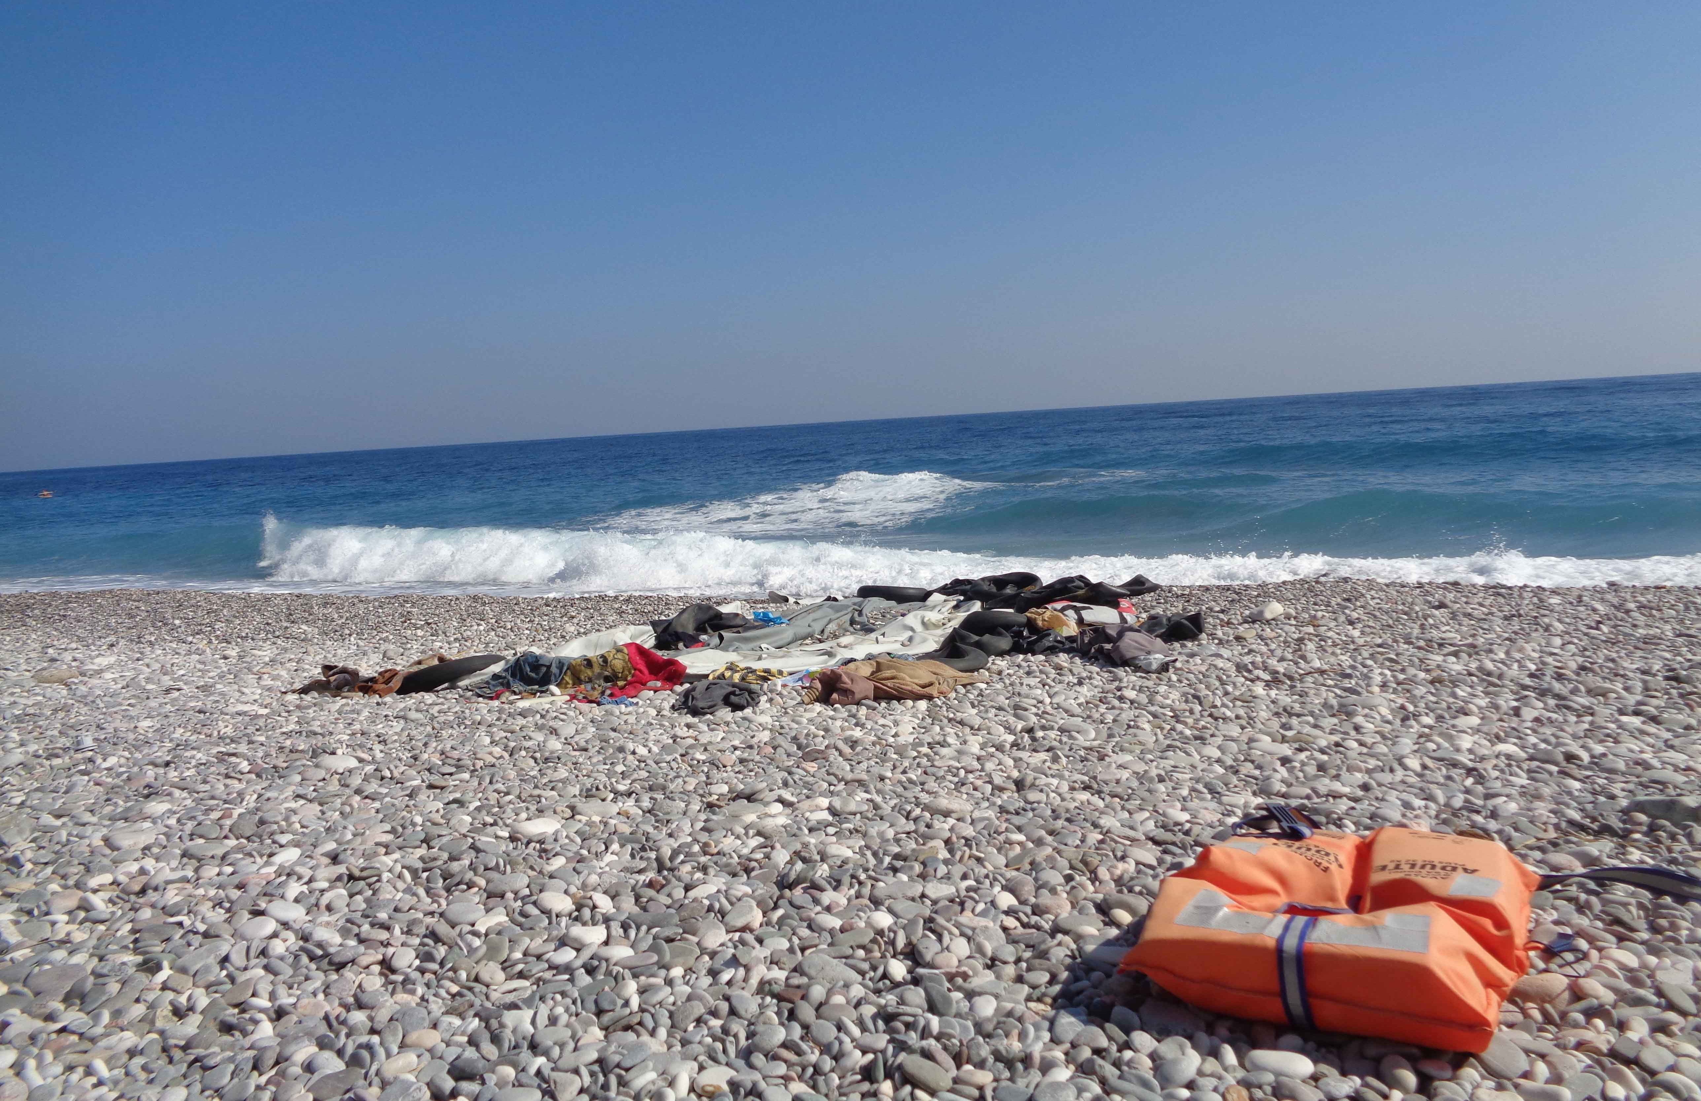
Thousands of people have crossed the Mediterranean.
Notes:
Teacher notes:
Over recent months, there has been lots of coverage of the Refugee Crisis in Europe in the news, which the students are likely to have seen. Much of this will have been distressing, so be sensitive to this when discussing with the students.
Note that while approximately half of people making the journey to Europe have fled the conflict in Syria. However, this accounts for only a small minority of Syrians who have been made homeless by the war. Lebanon, a country one hundred times smaller than the EU, currently accommodates 1 million Syrian refugees. (Source: Available from: http://data.unhcr.org/syrianrefugees/regional.php. Accessed 12.10.16)
Use a map of the area to aid the discussion. Locate Syria, surrounding countries and the Mediterranean on the map and use the map to help students to visualise and understand better the pattern of movement in this region. Look at the most recent statistics (see our latest update PowerPoint) alongside the map, to discuss why people are likely to have moved in such a way.

Slide 7
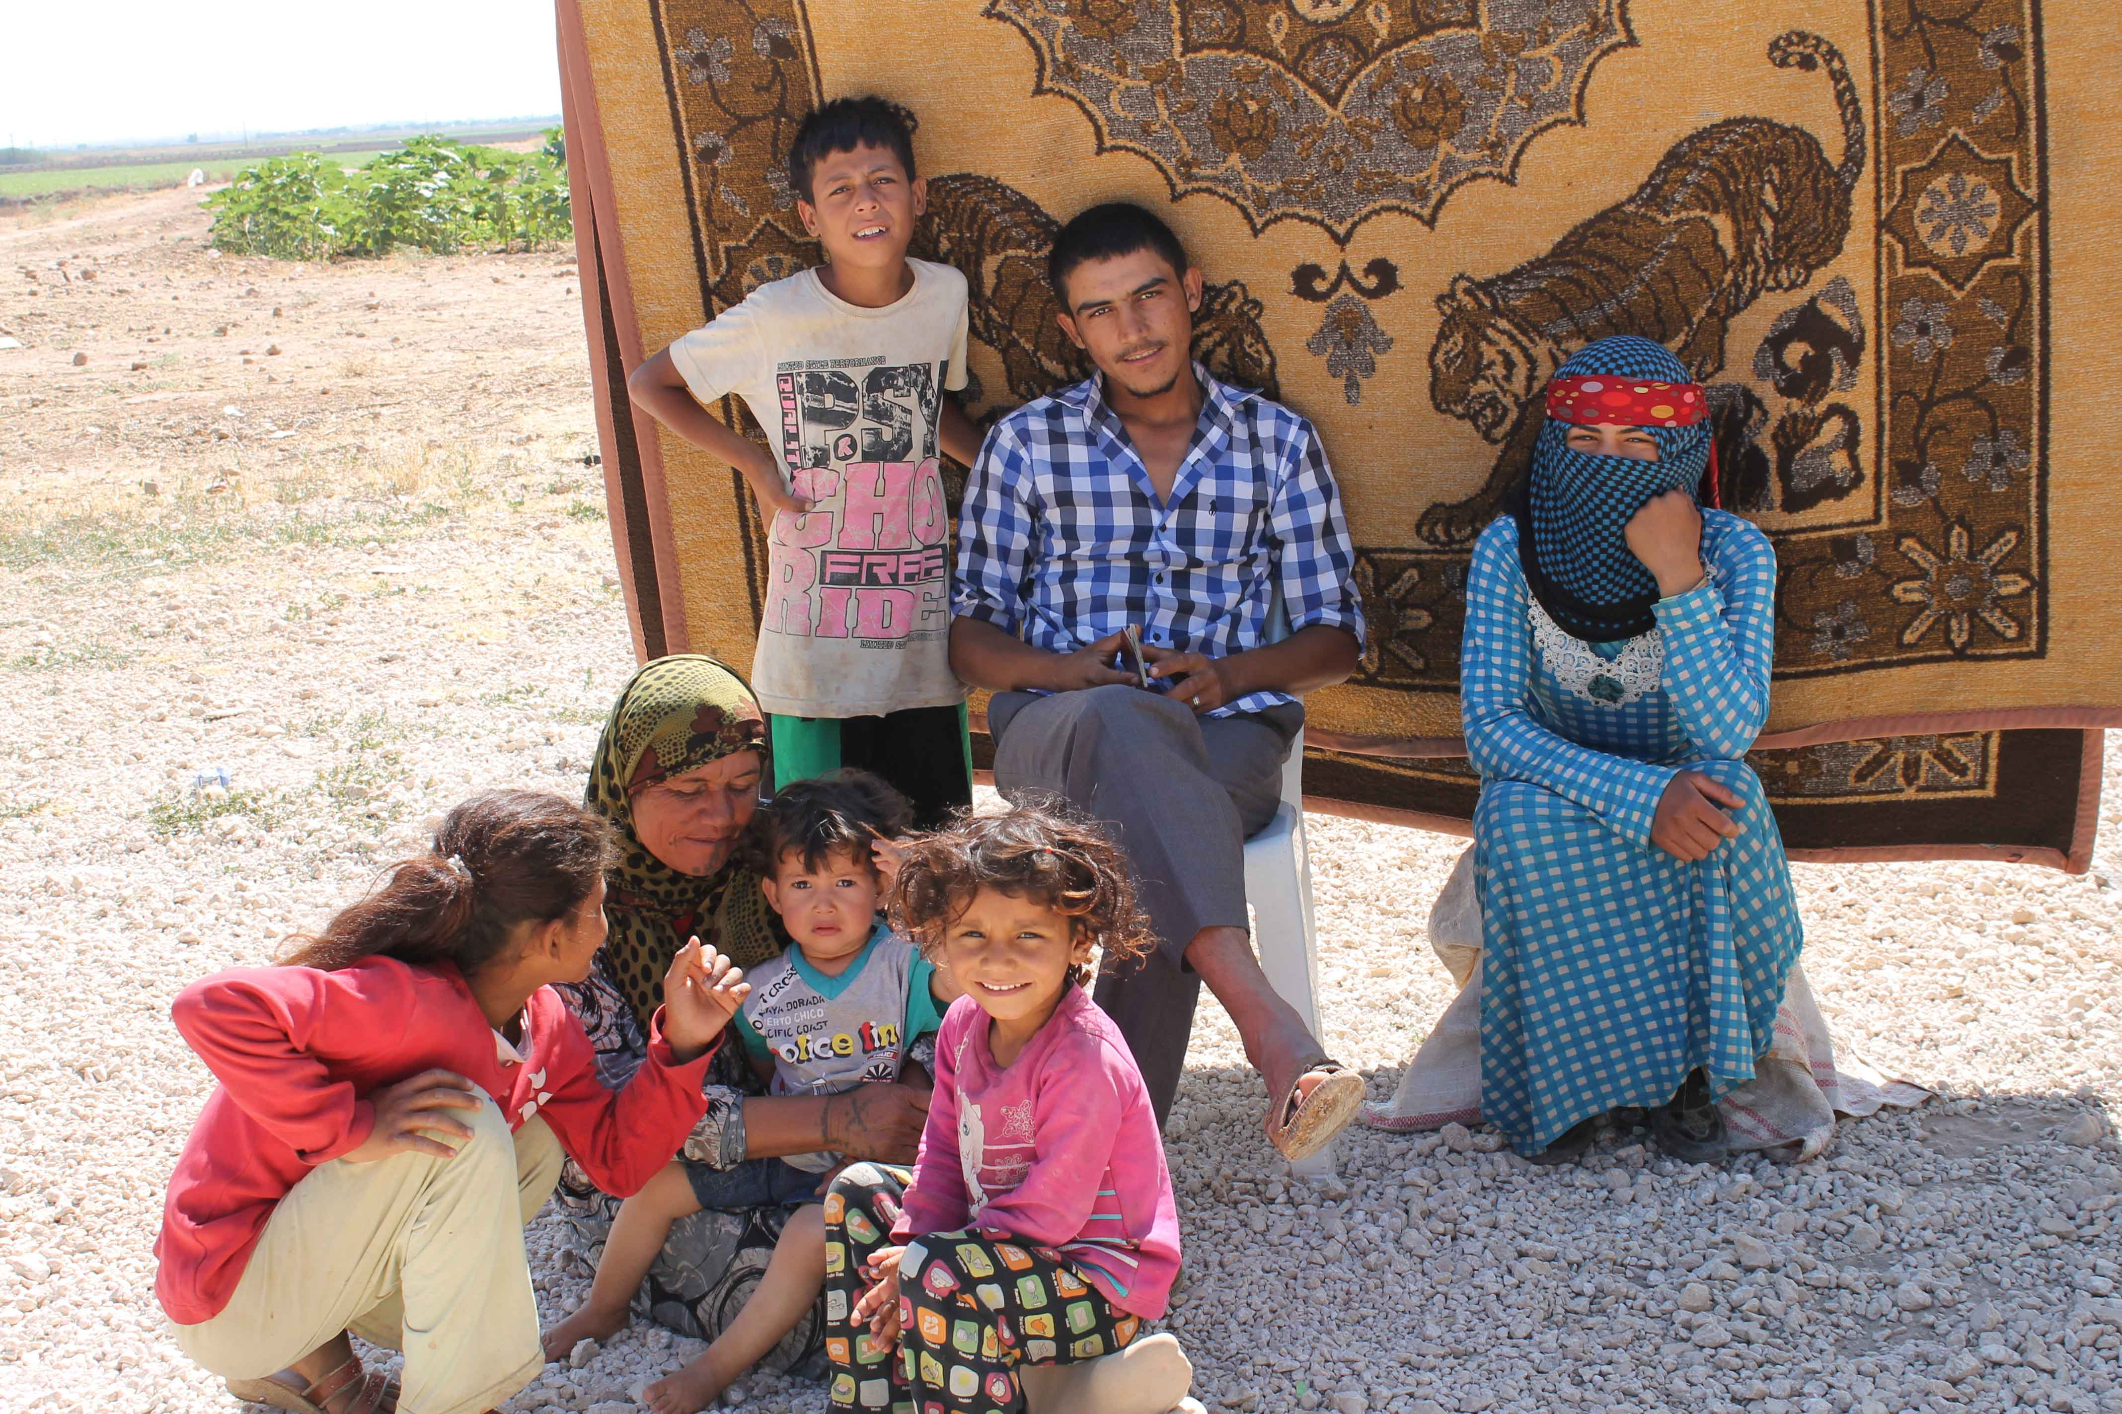
Why are more people seeking a new life in Europe?
Notes:
Teacher notes:
A large percentage of the people who have arrived in Europe come from countries affected by conflict such as Syria, Afghanistan and Somalia. The answer to the question on this slide is complex, but it is largely due to humanitarian crises around the world. Many people are leaving their countries because it is unsafe – they are trying to find a safe place to live and a better life.

Slide 8
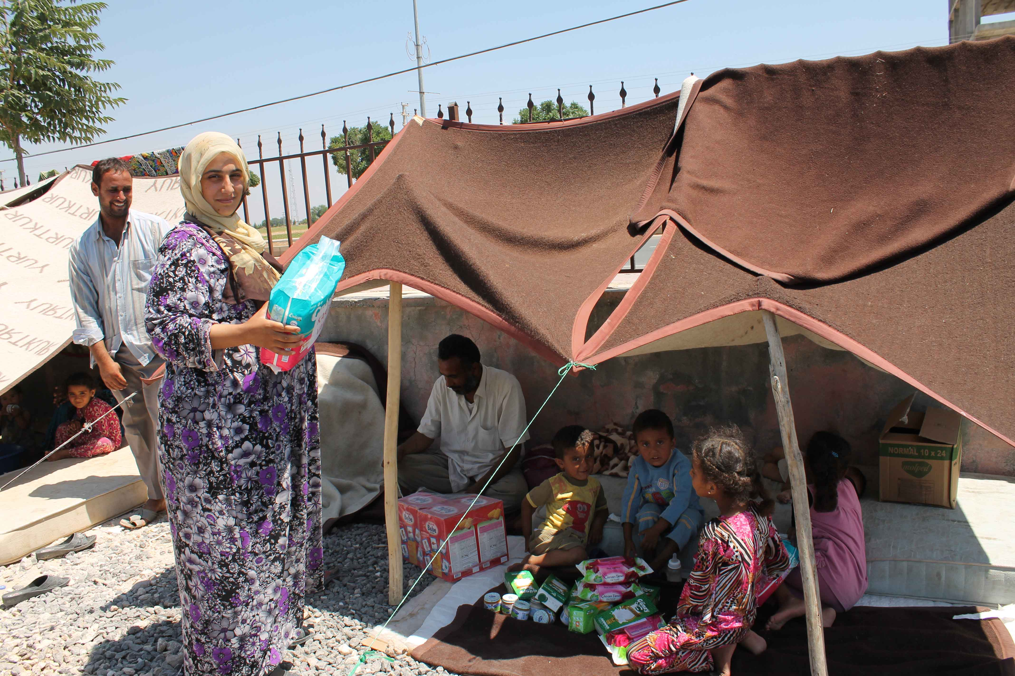
People arrive in new countries in search of safety and a better life.
Notes:
Teacher notes:
Ask the students to imagine what it would be like to leave your home and most of your possessions behind. Ask the students: What would you need if you arrived in a new country? Discuss the need for basic human rights like shelter, food and water. What else would you want? Discuss the right to education, and to play, relax with friends. etc (see UN Convention on the Rights of the Child).
Many people who have made the difficult journey to Europe are now living in poor conditions, with European governments struggling to provide the things they need.
Without help from neighbouring countries, people will continue to live in poor conditions without any rights.

Slide 9
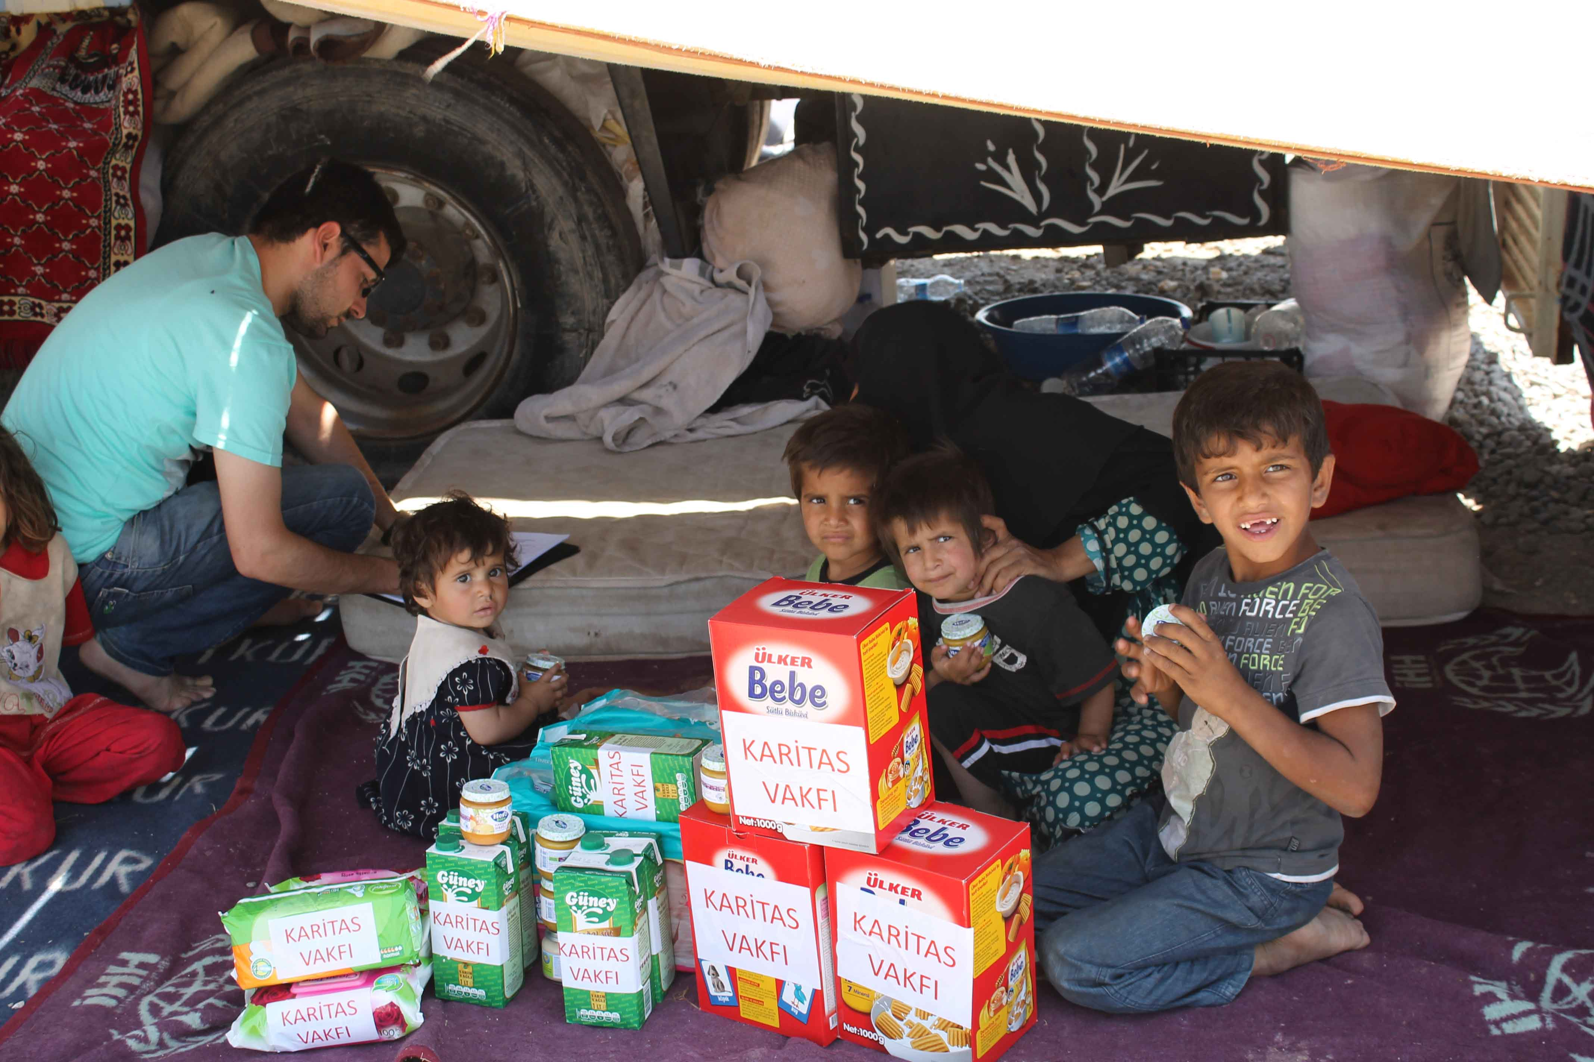
What is CAFOD doing?
Notes:
Teacher notes:
As well as working hard to ensure governments provide a safe place for refugees, CAFOD works in many of the countries where refugees and migrants come from, including Syria. CAFOD is also collecting donations for our Caritas partners in Europe, who are working with and supporting refugees.
cafod.org.uk/News/International-news/Refugee-crisis-Q-A
cafod.org.uk/News/Emergencies-news/Syria-Q-A

Slide 10
Love your neighbour
Jesus, friend and brother,
You know what it is like
to be hungry and thirsty.
You know what it feels like
to be a stranger who is made unwelcome.
You know the suffering of all
who have lost everything.
We pray that by welcoming refugees
we may show love for our neighbour
and be closer to you.
Amen.
Notes:
Teacher notes:
As we understand more about the refugee crisis in Europe, let us pray for refugees all over the world, as they seek safety and try to rebuild their lives.
Prayer – Tony Singleton/CAFOD

Slide 11
cafod.org.uk
Credits: REUTERS/Marko Djurica, REUTERS/Kai Pfaffenbach, Caritas Greece, Caritas Turkey

