Slide 1
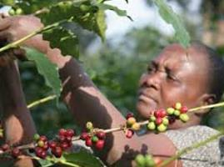
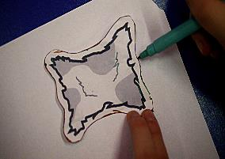
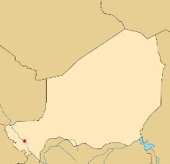
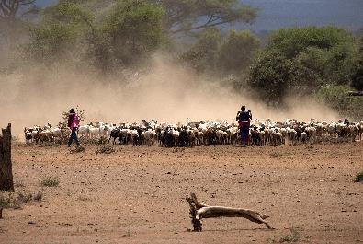
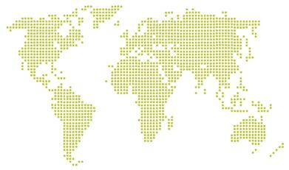
Your work:
Rearing goats and selling their hides.
Your task:
To produce goat hides and take your produce to market. You do this by drawing and cutting out the shape of the hides using the template provided.
Your goal:
To provide a dignified life for your whole family. At the very minimum you want to stay above the poverty line.
If you fall below the poverty line you may experience increasing hardships like illness, inability to pay for medication and school fees.
The poverty line for your country can be seen on the balance sheet, which will be visible to all.
Be aware!
Your family may be affected by a number of things beyond your control. If and when things happen, as a family, you must discuss your situation in light of the new circumstances. You may be forced to make some difficult choices.
Exchange:
The banker/market will pay you for your produce – be aware they may drive a hard bargain. Your income will be registered and displayed on the electronic balance sheet.
Elect:
Elect one person to be the head of your family. It is the role of this person to make sure that everyone in your family participates in all the activities and discussions.
cafod.org.uk
Family Role Card
You are:
The Chuckwa Family
Dodoma
Your location:
A small village in Niger
Photo: ©Andrzej Kubik/Shutterstock.com
cafod.org.uk

Slide 2
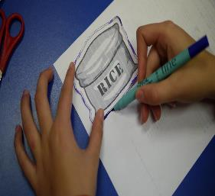
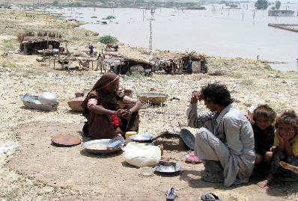
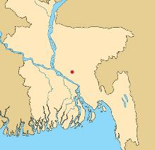
cafod.org.uk
Be aware!
Your family may be affected by a number of things beyond your control. If and when things happen, as a family, you must discuss your situation in light of the new circumstances. You may be forced to make some difficult choices.
Elect one person to be the head of your family. It is the role of this person to make sure that everyone in your family participates in all the activities and discussions.
Elect:
The banker/market will pay you for your produce – be aware they may drive a hard bargain. Your income will be registered and displayed on the electronic balance sheet.
Exchange:
To provide a dignified life for your whole family. At the very minimum you want to stay above the poverty line.
If you fall below the poverty line you may experience increasing hardships like illness, inability to pay for medication and school fees.
The poverty line for your country can be seen on the balance sheet, which will be visible to all.
Your goal:
To produce sacks of rice and take your produce to market. You do this by drawing and cutting out the shape of sacks containing rice using the template provided.
Your task:
Planting and harvesting rice.
Your work:
Family Role Card
You are:
The Dhali Family
Your location:
A small village in Bangladesh
Photo: ©Asianet-Pakistan/Shutterstock.com
cafod.org.uk

Slide 3
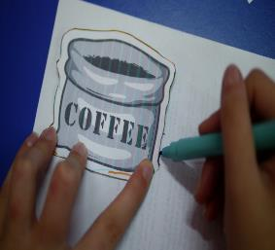
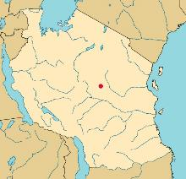
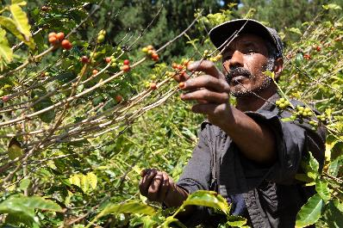
cafod.org.uk
Your work:
Planting and harvesting coffee beans.
Your task:
To produce sacks of coffee beans and take your produce to market. You do this by drawing and cutting out the shape of sacks containing coffee beans using the template provided.
Your goal:
The banker/market will pay you for your produce – be aware they may drive a hard bargain. Your income will be registered and displayed on the electronic balance sheet.
To provide a dignified life for your whole family. At the very minimum you want to stay above the poverty line.
If you fall below the poverty line you may experience increasing hardships like illness, inability to pay for medication and school fees.
The poverty line for your country can be seen on the balance sheet, which will be visible to all.
Be aware!
Your family may be affected by a number of things beyond your control. If and when things happen, as a family, you must discuss your situation in light of the new circumstances. You may be forced to make some difficult choices.
Exchange:
Elect:
Elect one person to be the head of your family. It is the role of this person to make sure that everyone in your family participates in all the activities and discussions.
cafod.org.uk
Family Role Card
You are:
The Chenge Family
Dodoma
Your location:
A small village in rural Tanzania
Photo: ©Darrin Henry/Shutterstock.com
cafod.org.uk

Slide 4
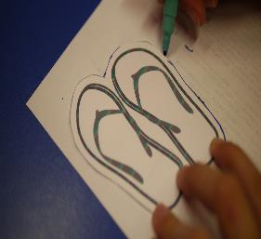
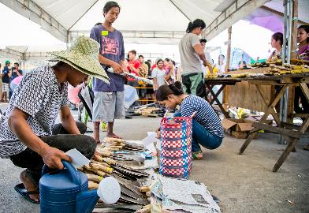
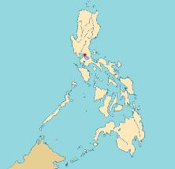
cafod.org.uk
Your work:
Designing and manufacturing Flip flops.
Your task:
To produce Flip flops and take your produce to market. You do this by drawing and cutting out the shape of Flip flops using the template provided.
Your goal:
The banker/market will pay you for your produce – be aware they may drive a hard bargain. Your income will be registered and displayed on the electronic balance sheet.
To provide a dignified life for your whole family. At the very minimum you want to stay above the poverty line.
If you fall below the poverty line you may experience increasing hardships like illness, inability to pay for medication and school fees.
The poverty line for your country can be seen on the balance sheet, which will be visible to all.
Be aware!
Your family may be affected by a number of things beyond your control. If and when things happen, as a family, you must discuss your situation in light of the new circumstances. You may be forced to make some difficult choices.
Exchange:
Elect:
Elect one person to be the head of your family. It is the role of this person to make sure that everyone in your family participates in all the activities and discussions.
cafod.org.uk
Family Role Card
You are:
The Navarro Family
Dodoma
Your location:
The outskirts of a busy city in the Philippines
cafod.org.uk

Slide 5
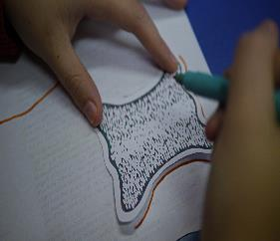
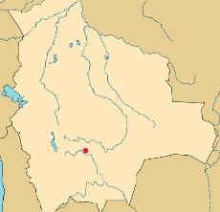
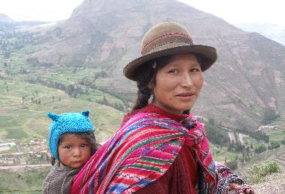
cafod.org.uk
Your work:
Rearing alpacas and producing wool.
Your task:
To produce sacks of wool and take your produce to market. You do this by drawing and cutting out the shape of the woolen fleeces using the template provided.
Your goal:
The banker/market will pay you for your produce – be aware they may drive a hard bargain. Your income will be registered and displayed on the electronic balance sheet.
To provide a dignified life for your whole family. At the very minimum you want to stay above the poverty line.
If you fall below the poverty line you may experience increasing hardships like illness, inability to pay for medication and school fees.
The poverty line for your country can be seen on the balance sheet, which will be visible to all.
Be aware!
Your family may be affected by a number of things beyond your control. If and when things happen, as a family, you must discuss your situation in light of the new circumstances. You may be forced to make some difficult choices.
Exchange:
Elect:
Elect one person to be the head of your family. It is the role of this person to make sure that everyone in your family participates in all the activities and discussions.
Family Role Card
You are:
The Lopez Family
Dodoma
Your location:
A small village in Bolivia
Photo: "Qechua Woman & Child" by Thomas Quinne. Licensed under CC-BY-2.0
cafod.org.uk

Slide 6
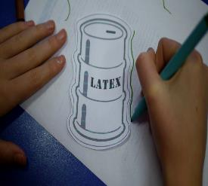
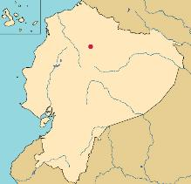
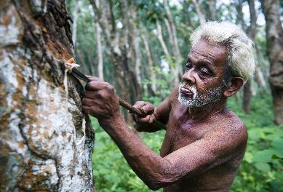
cafod.org.uk
Your work:
Collecting latex from rubber trees.
Your task:
To produce barrels of latex and take your produce to market. You do this by drawing and cutting out the shape of barrels containing latex using the template provided.
Your goal:
The banker/market will pay you for your produce – be aware they may drive a hard bargain. Your income will be registered and displayed on the electronic balance sheet.
To provide a dignified life for your whole family. At the very minimum you want to stay above the poverty line.
If you fall below the poverty line you may experience increasing hardships like illness, inability to pay for medication and school fees.
The poverty line for your country can be seen on the balance sheet, which will be visible to all.
Be aware!
Your family may be affected by a number of things beyond your control. If and when things happen, as a family, you must discuss your situation in light of the new circumstances. You may be forced to make some difficult choices.
Exchange:
Elect:
Elect one person to be the head of your family. It is the role of this person to make sure that everyone in your family participates in all the activities and discussions.
Family Role Card
You are:
The Mendez Family
Dodoma
Your location:
A small village in Ecuador
Photo: ©Rawpixel/Shutterstock.com
cafod.org.uk

