Slide 1
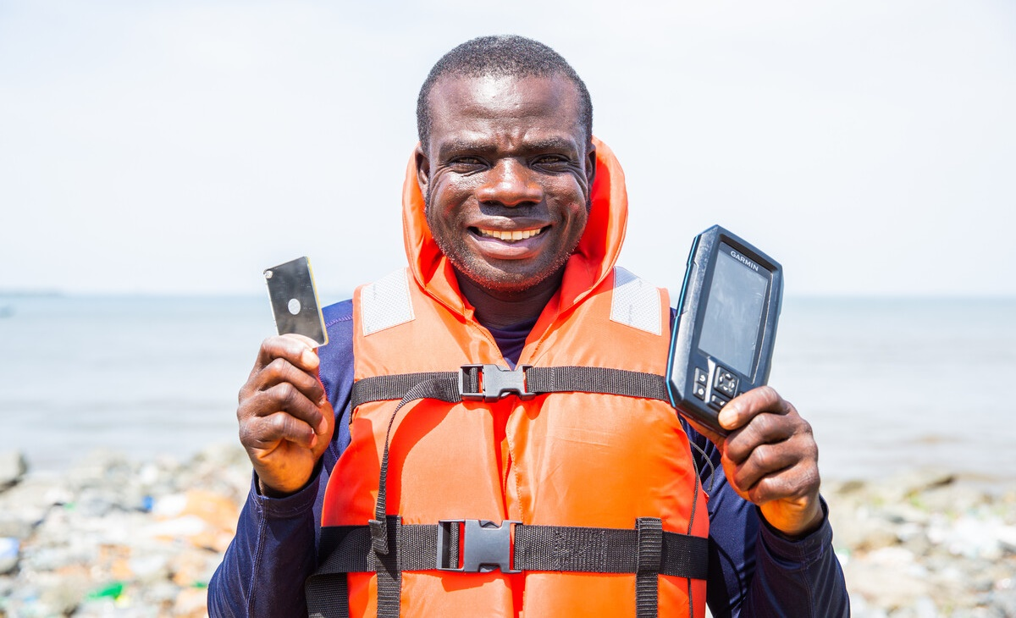
Stations
of the
Cross
A prayerful journey of transformation
Notes:
Image: In Liberia, James shows us the safety mirror, GPS fish finder and life jacket that he received as part of a safety at sea project.
Picture credit: Thom Flint

Slide 2
Let us pray together for God to transform our lives
and the lives of others.
Notes:
Opening reflection
Leader: As we reflect on the final journey of Jesus, leading to his death on the cross, we do so in solidarity with all those, here at home and across the world, who are suffering today. We contemplate the lives of our sisters and brothers in Liberia. Through the Cross, Jesus has brought hope and new life, and we can glimpse this too in the lives of the fishermen featured in the CAFOD Lent appeal.
Let us pray together for God to transform our lives and the lives of others:
Loving God, when our boat is rocked on the sea of life, by poverty, illness or disaster, you quiet the waves, calm the storm and lead us safely to shore.
When we work hard, for our daily bread, but at the end of the day go hungry, you walk alongside us,
call, “cast out your nets”, knowing there is enough for all.
When we are lost,
and uncertain of how
to make a change in our world, your words ring out:
“Come, follow me”,
guiding us to new life with you.
Lead us, Lord, to play our part
in calming the storm and sharing your gifts with each other, so that all people throughout the world may look to the future with hope.
Amen.

Slide 3
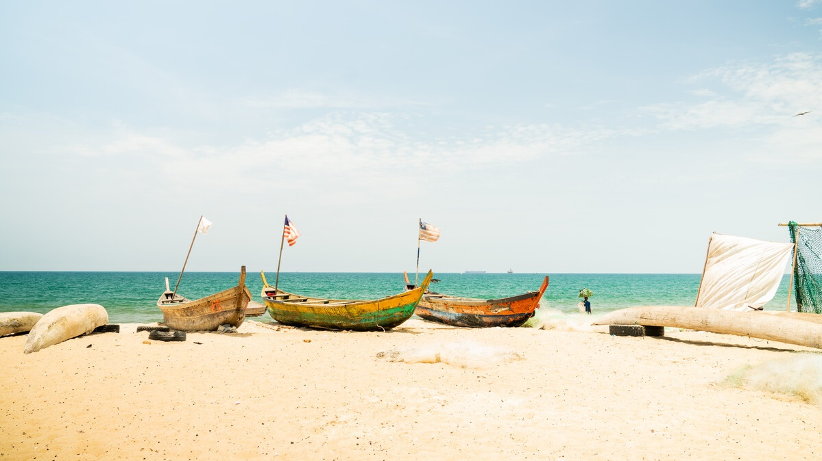
“…he handed him over to be crucified.”
Matthew 27:26
Notes:
Reader: “The governor again said to them, ‘Which of the two do you want me to release for you?’ And they said, ‘Barabbas’. Pilate said to them, ‘Then what should I do with Jesus who is called the Messiah?’ All of them said, ‘Let him be crucified!’… When Pilate saw that it was no use to go on, but that a riot might break out, he took some water and washed his hands in front of the crowd ….Pilate released Barabbas for the crowd; and after flogging Jesus, he handed him over to be crucified.”
Matthew 27:21-26
Leader: We adore you, O Christ, and we praise you,
All: because by your Holy Cross you have redeemed the world.
Reflect:
In our world today many are condemned to lives of hardship and poverty. James is a fisherman in Liberia who faces perilous conditions when he goes out to sea to earn a living for himself and his family. The fishermen risk their lives in small boats, and often face dangerous storms.
Until recently around four to five fishermen were dying a month in Liberia. It was a regular occurrence.
Do we wash our hands of our brothers and sisters or do we respond in some way?
What is our response? Do we wash our hands of our brothers and sisters or seek to act in solidarity?
Prayer:
Jesus, you know what it means to stand alone
in front of those who reject you and don’t understand you.
Walk with us.
When we feel that we can’t make a difference, help us to keep going.
Teach us to share your love.

Slide 4
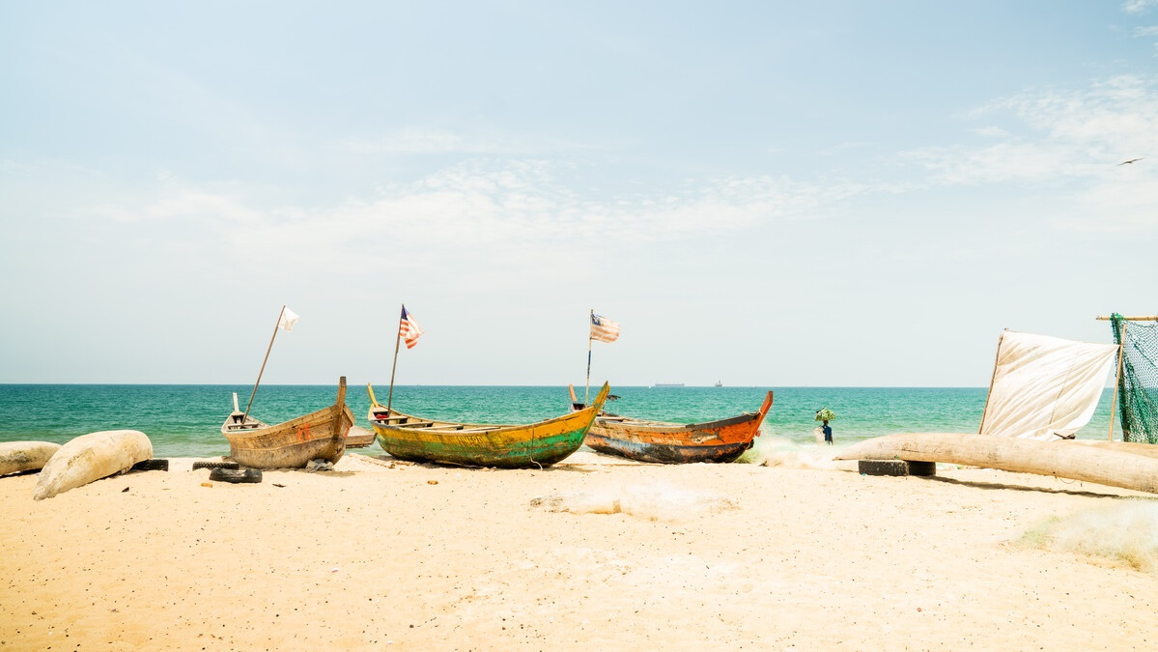
We adore you, O Christ, and we praise you
R/ Because by your Holy Cross you have redeemed the world.
Prayer
Jesus, you know what it means to stand alone
in front of those who reject you and don’t understand you.
Walk with us.
When we feel that we can’t make a difference,
help us to keep going.
Teach us to share your love.
Notes:
Image: Fishing boats on the beach at New Kru Town in Liberia
Picture credit: Carielle Doe
.

Slide 5
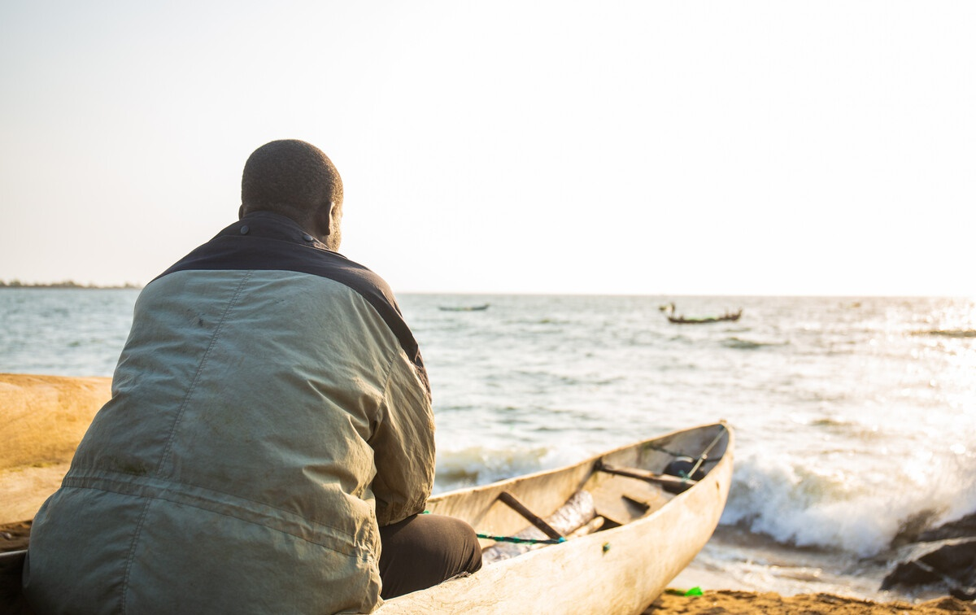
“Then they led him away to crucify him.” Matthew 27:31
Notes:
Reader: “After mocking Jesus, the soldiers stripped him of the robe and put his own clothes on him. Then they led him away to crucify him.” Matthew 27:28-31
Leader: We adore you, O Christ, and we praise you,
All: because by your Holy Cross you have redeemed the world.
Reflect: The guards dress Jesus up as a king, with a crown made of thorns, and mock him. They give him a heavy wooden cross to carry. Jesus knows that the way will not be easy and that it will lead to his death. And yet he shoulders his burden and starts on his way.
The burden of hunger is one that too many people must bear. Before James received training and a GPS tracker to help find the fish, there were times when he struggled to catch enough for his family to eat or to sell.
Things were very difficult as his wife Cynthia explains: “Sometimes there wasn’t any food at all to eat. Sometimes we hoped that if there was no food in the morning, we would get food in the evening to eat. But when the evening comes, there is no food. My son was five at the time…. There were days when we didn’t eat anything. I felt terrible. But we had to keep going.”
We all have burdens to carry. We also place burdens on others. In what ways do I place unnecessary loads on other people?
Prayer:
Jesus, your love led you to take up the cross.
Walk with us.
When we feel afraid, help us to be brave.
Give us the courage to speak out to change our world,
so that all our sisters and brothers
can experience a fair chance.

Slide 6
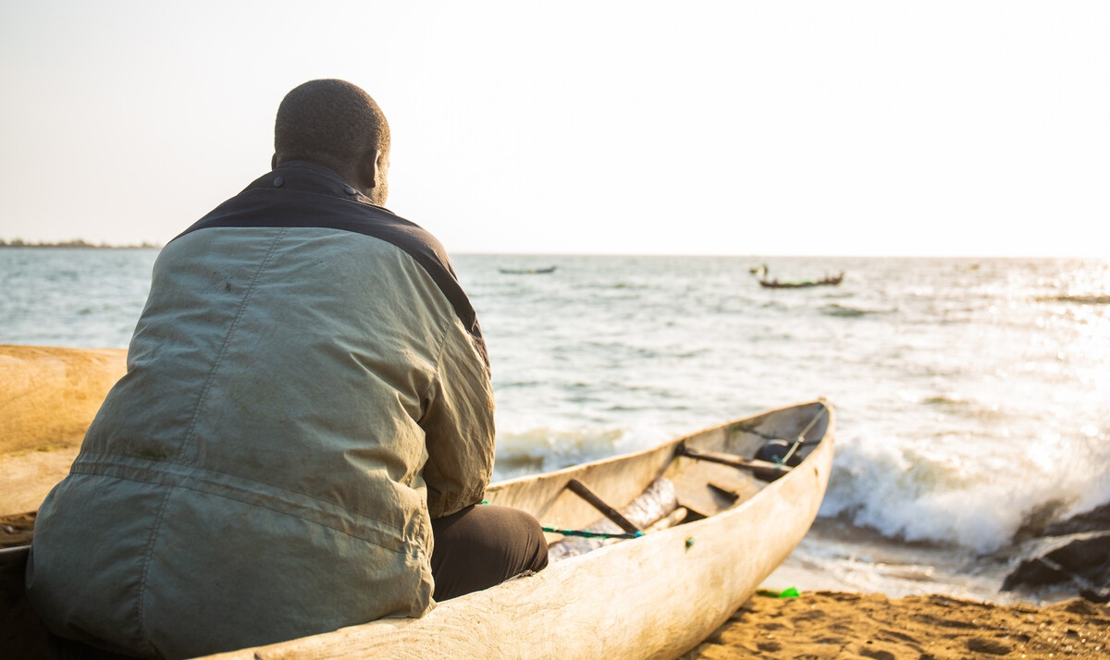
We adore you, O Christ, and we praise you
R/ Because by your Holy Cross you have redeemed the world.
Prayer
Jesus, your love led you to take up the cross.
Walk with us.
When we feel afraid, help us to be brave.
Give us the courage to speak out to change our world,
so that all our sisters and brothers
can experience a fair chance.
Notes:
Image: James sits in the boat he inherited from his father.
Picture credit: Thom Flint

Slide 7
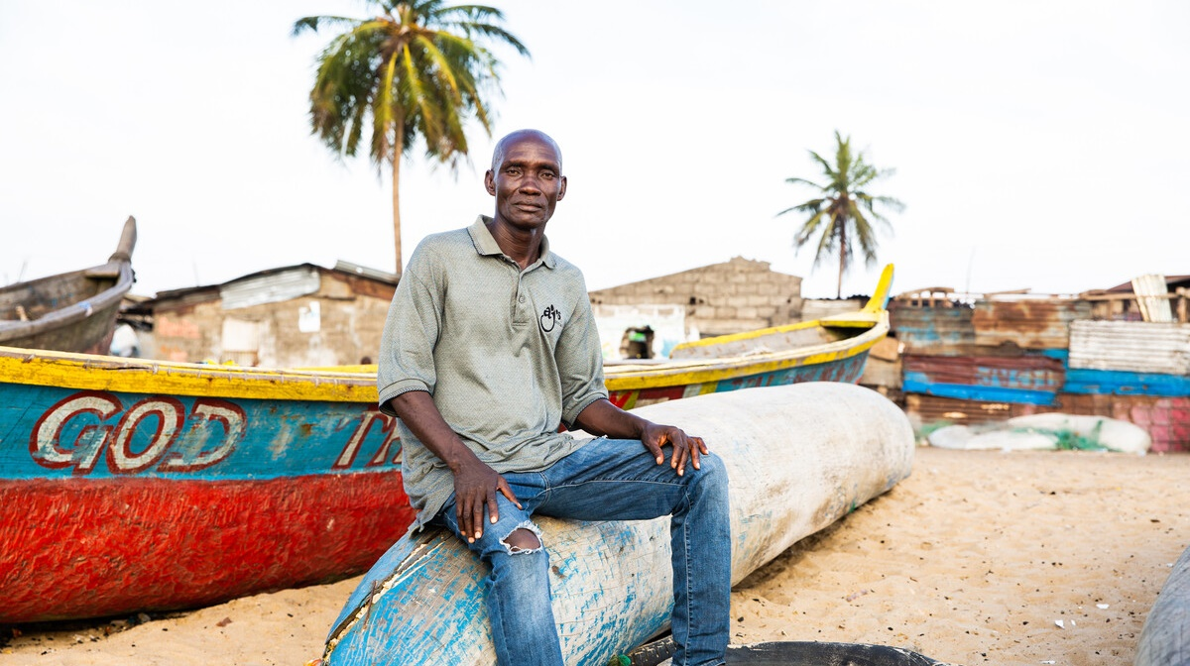
“Blessed is anyone who
perseveres when trials come…”
James 1:12
Notes:
Reader: “Blessed is anyone who perseveres when trials come. Such a person is of proven worth and will win the prize of life, the crown that God promised to those who love him.”
James 1:12
Leader: We adore you, O Christ, and we praise you,
All: because by your Holy Cross you have redeemed the world.
Reflect:
Burdened by his heavy cross, worn down by fatigue and pain, Jesus falls. Yet he pushes himself up and continues to walk.
One day Augustine went out to fish in his canoe in Liberia as usual. But while he was out at sea, his boat capsized. He spent over two hours in the water, trying to stay alive. Fellow fishermen came to his rescue and managed to get him to safety. But because he had spent so long in the water, he was very unwell for five months afterwards. During this time, Augustine and his family struggled to make ends meet.
He eventually recovered and was able to go back out to sea again, even though he is sometimes fearful, especially in stormy weather.
We pray for all those who continue to persevere in the face of adversity. We pray for strength and determination when we face challenges.
Prayer:
Jesus, you know how it feels to struggle and to fall.
Walk with us.
Show us how to walk with others
to know what it feels like to be in another’s shoes.
You reach out to us with caring hands.
Show us how to join our hands with communities around the world
who are bringing hope to their neighbour.

Slide 8
We adore you, O Christ, and we praise you
R/ Because by your Holy Cross you have redeemed the world.
Prayer
Jesus, you know how it feels to struggle and to fall.
Walk with us.
Show us how to walk with others,
to know what it feels like to be in another’s shoes.
You reach out to us with caring hands.
Show us how to join our hands with communities around the world
who are bringing hope to their neighbour.
Notes:
Image: Augustine spent over two hours in the water when his boat capsized and was sick for a long time afterwards, which meant his family struggled to get enough food. Picture credit: Thom Flint

Slide 9
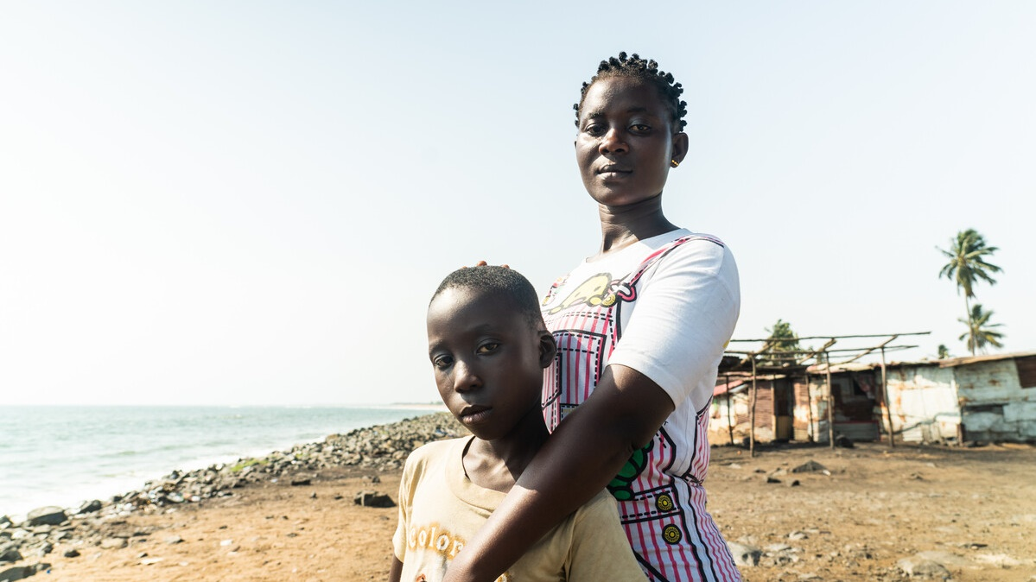
“…a sword will pierce your own soul too.” Luke 2:34
Notes:
Reader: “Then Simeon blessed them and said to his mother Mary, ‘This child is destined for the falling and the rising of many in Israel, and to be a sign that will be opposed so that the inner thoughts of many will be revealed – and a sword will pierce your own soul too.” Luke 2:33-35
Leader: We adore you, O Christ, and we praise you,
All: because by your Holy Cross you have redeemed the world.
Reflect:
This was the fulfilment of Simeon’s prophecy, the sword that ran through Mary’s soul. She who nurtured Jesus as a baby, witnessed his first steps and words, now meets her son on this final journey. What pain Mary must have felt, unable to reach out to help or comfort Jesus. Yet she remains present and steadfast, as so many mothers throughout the world do in challenging times.
Cynthia in Liberia did all that she could to try and make sure her son had enough to eat, even when her partner James was not catching much fish. She borrowed food from neighbours, took out loans and watched others braiding hair, so that she could learn how to do it herself and earn some money.
Thankfully, due to the training and equipment that James has received, he is catching more fish and Cynthia is able to sell these for a profit.
Let us look to the example of Mary and not turn our faces away from those who are suffering.
Prayer:
Jesus, you looked through the crowd
and saw your mother’s eyes.
Her love gave you the strength to carry on.
Walk with us.
When we don’t want to listen, open our ears to hear.
When it would be easier to look away, open our eyes to see.

Slide 10
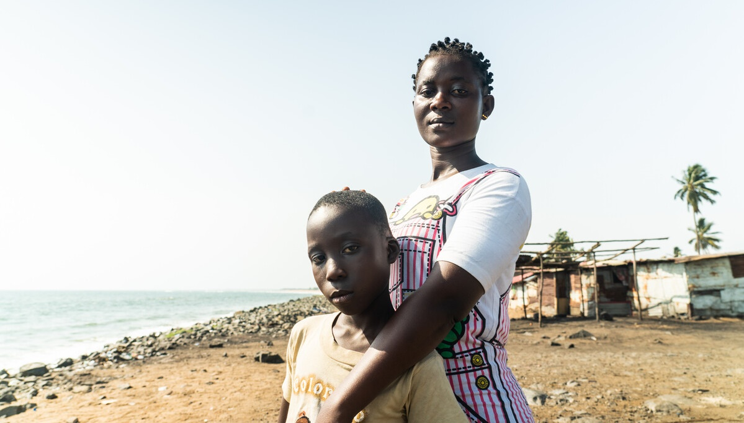
We adore you, O Christ, and we praise you
R/ Because by your Holy Cross you have redeemed the world.
Prayer
Jesus, you looked through the crowd
and saw your mother’s eyes.
Her love gave you the strength to carry on.
Walk with us.
When we don’t want to listen,
open our ears to hear.
When it would be easier to look away,
open our eyes to see.
Notes:
Image: Cynthia with her son Messi. She did all she could to get enough food for Messi to eat, when her partner James was struggling to catch enough fish.
Picture credit: Carielle Doe

Slide 11
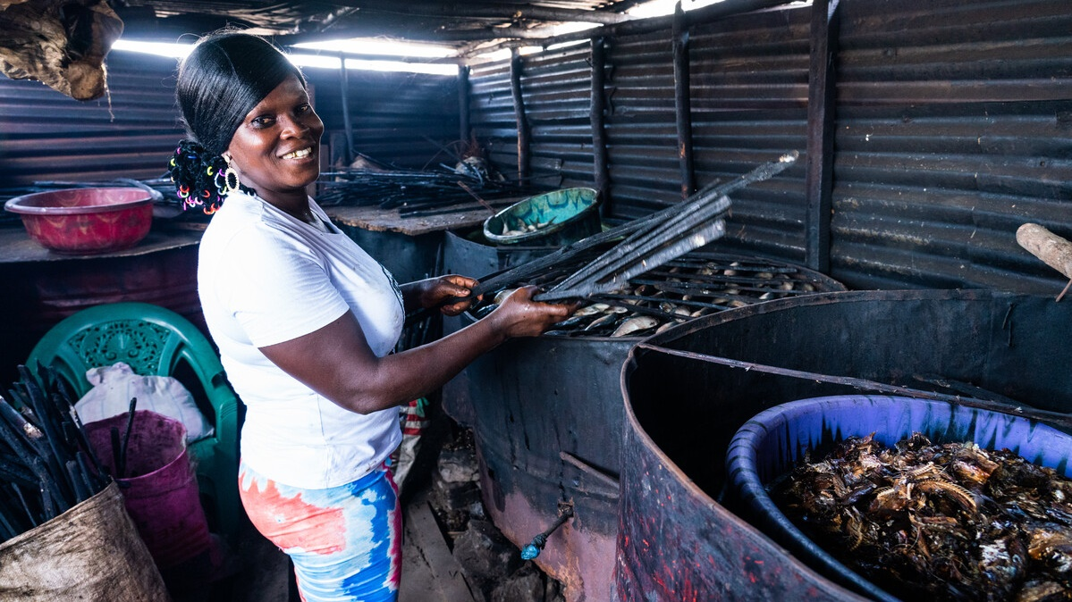
“The soldiers compelled a passer-by…
to carry his cross.” Mark 15:21
Notes:
Reader: “The soldiers compelled a passer-by, who was coming in from the country, to carry his cross; it was Simon of Cyrene, the father of Alexander and Rufus.” Mark 15:21
Leader: We adore you, O Christ, and we praise you,
All: because by your Holy Cross you have redeemed the world.
Reflect: Simon of Cyrene comes into the city of Jerusalem on the day of Jesus’ death. He finds himself in the crowds along Jesus’ pathway to Golgotha and is enlisted to help carry his cross. He does not know Jesus but lends his strength to carrying the heavy weight of the wood.
Comfort lives in Liberia and sells the fish that her husband Lewis catches. When they were just starting out, Lewis’ aunt helped them through some challenging times, and now Comfort does her best to repay this kindness as well as support others in her community when they are struggling.
“I remember this now and I help her and my neighbours because of her kindness… It’s really important to share because there is sorrow in my heart if I see another person struggling and I don’t help.”
Do we look for opportunities to help others, or do we try to keep out of the way, telling ourselves that it is not our responsibility?
Prayer:
Jesus, you know what it means to depend on someone and to need their help.
Walk with us.
When my friends need help, teach me to work with them to lighten their load.
Show me how to listen carefully so that I can offer what they need.
We are your global family of many different cultures and religions.
Make us one family united in you.

Slide 12
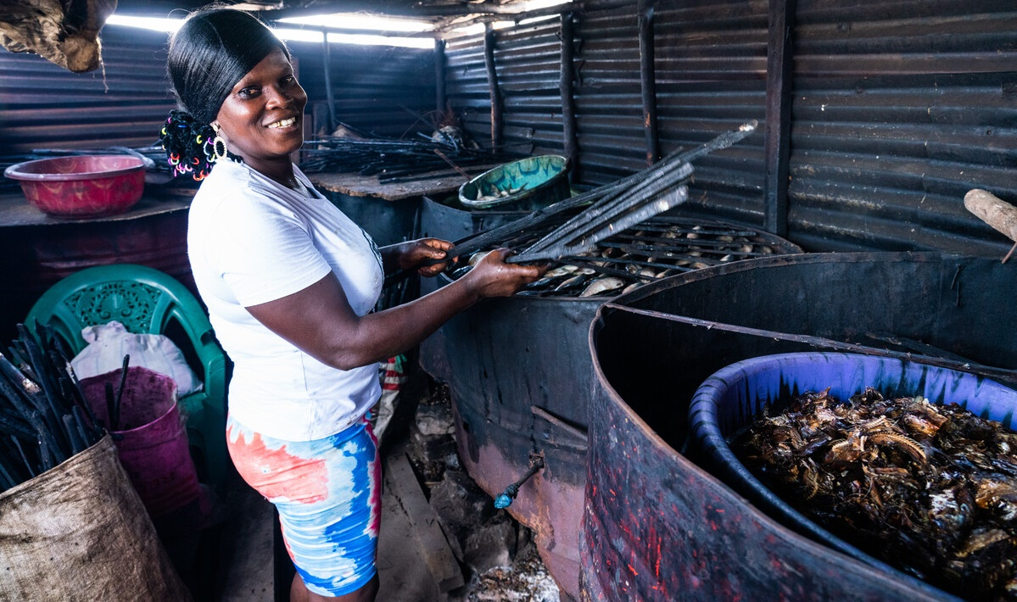
We adore you, O Christ, and we praise you
R/ Because by your Holy Cross you have redeemed the world.
Prayer
Jesus, you know what it means
to depend on someone and to need their help.
Walk with us.
When my friends need help,
teach me to work with them to lighten their load.
Show me how to listen carefully so that I can offer what they need.
We are your global family of many different cultures and religions.
Make us one family united in you.
Notes:
Image: Comfort sells the fish her husband Lewis catches and helps others in her community whenever she can.
Picture credit: Carielle Doe

Slide 13
“Just as you did this to one of the least of these, you did it to me” Matthew 25:40
Notes:
Reader: “And the king will answer them, ‘Truly I tell you, just as you did it to one of the least of these who are members of our family, you did it to me.’” Matthew 25:37-40
Leader: We adore you, O Christ, and we praise you,
All: because by your Holy Cross you have redeemed the world.
Reflect:
Moved by Jesus’ pain, Veronica’s love overcomes her fear, and she courageously steps forward to wipe the blood and sweat from Jesus’ face. She cannot change his fate, but recognising his dignity, she faithfully performs her small act of compassion. As the guards force Jesus onward, the image of his face is left on Veronica’s veil.
We too are called to compassion. It is easy to be discouraged by the scale of poverty and need in the world, but each day offers us the opportunity to perform small acts of kindness and generosity. In so doing, we recognise the face of Jesus in our neighbour and he imprints his face on each of us.
James and his fellow fishermen do not keep the good fishing places secret. They share tips on the best places to go. They help one another if they get into difficulty on the water.
He says, “The town provides a way of giving when you don’t have anything. If you need something, a person will help you and you will pay them back later.”
Do we carry out small acts of generosity and love? Are we attentive to the face of Christ in our brothers and sisters?
Prayer:
Jesus, you know how it feels
to be hurt and to cry out in pain and fear.
Walk with us.
Show us how to walk together with others.
Show us how to love the people around us
And to be there for those who need us.

Slide 14
We adore you, O Christ, and we praise you
R/ Because by your Holy Cross you have redeemed the world.
Prayer
Jesus, you know how it feels
to be hurt and to cry out in pain and fear.
Walk with us.
Show us how to walk together with others.
Show us how to love the people around us
and to be there for those who need us.
Notes:
Image: Part of a safety at sea training session just off the coast of New Kru Town, Liberia. The fishermen help each other if they get into difficulty on the water. Picture credit: Thom Flint

Slide 15
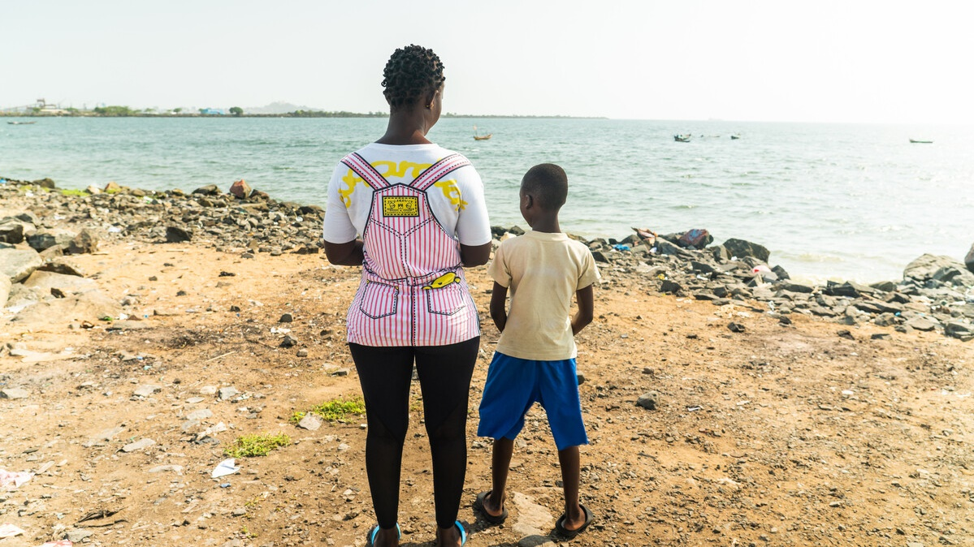
“Come to me all you who labour,
and I will give you rest.” Matthew 11:28
Notes:
Reader: “Come to me all you who labour, and I will give you rest. Take my yoke upon you, and learn from me; for I am gentle and lowly in heart, and you will find rest for your souls. For my yoke is easy and my burden light.” Matthew 11:28-30
Leader: We adore you, O Christ, and we praise you,
All: because by your Holy Cross you have redeemed the world.
Reflect:
Under the weight of the cross, Jesus is once again brought to his knees. After this second fall, Jesus’ struggle to rise up again is much harder.
Many people in our communities are falling under the heavy weight of the cost-of-living crisis. People here at home and throughout the world do not have enough healthy food to eat, despite the fact that there is enough food in the world for everyone.
We think of all among us who are trying to hold onto hope in the daily struggle to get enough food, those who are striving to make ends meet in a system that is broken and which keeps people poor.
How can we live in solidarity with those who feel despondent or invisible?
Prayer:
Jesus, you stumbled and fell.
You lost strength and became tired.
And yet you carried on.
Walk with us.
When we find it hard to keep going,
give us the strength we need
to finish our work as well as we can
and show love to others.

Slide 16
We adore you, O Christ, and we praise you
R/ Because by your Holy Cross you have redeemed the world.
Prayer
Jesus, you stumbled and fell.
You lost strength and became tired.
And yet you carried on.
Walk with us.
When we find it hard to keep going,
give us the strength we need
to finish our work as well as we can
and show love to others.
Notes:
Image: Cynthia and Messi looking out to sea. They used to struggle to get enough food to eat.
Picture credit: Carielle Doe

Slide 17
“women…were beating their breasts and wailing for him.” Luke 23:28
Notes:
Reader: “A great number of the people followed him, and among them were women who were beating their breasts and wailing for him.” Luke 23:27-28
Leader: We adore you, O Christ, and we praise you,
All: because by your Holy Cross you have redeemed the world.
Reflect: As Jesus draws closer to the place of execution, he encounters the women of Jerusalem weeping for him. There is a shared empathy here as Jesus recognises their difficulties and tells them not to weep for him, but for themselves and their children.
As we recall this exchange, we remember the many societies where women face huge challenges. Today, women represent the majority of the world’s poorest people. Globally, they are less likely than men to be involved in decision making, to own land or property, or to have access to education, technology and employment.
Lawrencia’s mother used to dry fish and sell it to earn money in Liberia. From a young age, Lawrencia helped her mother as well as making extra money by selling items like milk, biscuits, sugar and soap. She saved her money and used it to pay her school fees and help fund her university studies.
Now Lawrencia works with the women in the community she grew up in who clean, store and sell the fish. Thanks to her training, the women have increased their profits and been able to save for their children’s school fees.
What causes us to weep? Which situations in the world make us cry out to God?
Prayer:
Jesus, you cared and spoke out, even on the road to your death.
You knew and felt the struggles of others.
Walk with us.
As we hear the stories of our sisters and brothers who live in poverty,
give us the courage to raise our voices, so that together we can work for change.

Slide 18
We adore you, O Christ, and we praise you
R/ Because by your Holy Cross you have redeemed the world.
Prayer
Jesus, you cared and spoke out,
even on the road to your death.
You knew and felt the suffering of others.
Walk with us.
As we hear the stories
of our sisters and brothers who live in poverty,
give us the courage to raise our voices,
so that together we can work for change.
Notes:
Image: Lawrencia (right) worked with women in the fishing community she grew up in to help them learn to increase their profits and save money for difficult times.
Picture credit: Carielle Doe

Slide 19
“For nothing will be impossible with God.”
Luke 1:37
Notes:
Reader: “For nothing will be impossible with God.” Luke 1:37
Leader: We adore you, O Christ, and we praise you,
All: because by your Holy Cross you have redeemed the world.
ReflectJesus falls a third and final time. He must surely now be completely drained, and yet he finds the strength to rise and continue on his path to Calvary.
“The sky was black,” says Tekon, a Liberian fisherman who was caught in a particularly bad storm. Even though he and his friends tied three boats together to stop them from drifting in the wind, they were carried a long way off. Everyone was panicking. They were afraid.
But Tekon had been given training in how to stay safe at sea and he had a GPS tracker on board. It took them almost 24 hours but all the fishermen made it home.
Sometimes we may feel overwhelmed by difficulties: illness, caring responsibilities, loneliness, anxiety, our own moments of weakness and failure. Sometimes the challenges facing us and our global family – hunger, climate change, poverty and injustice – can feel overwhelming, impossible to address.
Love gave Jesus the strength to stand again and continue onwards. We pray for ourselves, and for all those who need strength and courage, that in the face of so many struggles, Christ’s love will urge us on.
Prayer:
Jesus, you felt the darkness around you,
the crowds surrounded you.
You fell once more.
Walk with us.
When we lose hope, when everything is just too difficult,
show us how to reach out to each other and hold hands, so that none of us have to do everything on our own.
Help us to know that you walk alongside us even when we feel most alone.

Slide 20
We adore you, O Christ, and we praise you
R/ Because by your Holy Cross you have redeemed the world.
Prayer
Jesus, you felt the darkness around you,
the crowds surrounded you.
You fell once more.
Walk with us.
When we lose hope, when everything is just too difficult,
show us how to reach out to each other and hold hands,
so that none of us have to do everything on our own.
Help us to know that you walk alongside us
even when we feel most alone.
Notes:
Image: Tekon on his boat. When he and some friends was caught in a very bad storm and were carried off by the wind, Tekon was able to use his training and his GPS tracker to get them all safely home.
Picture credit: Thom Flint

Slide 21
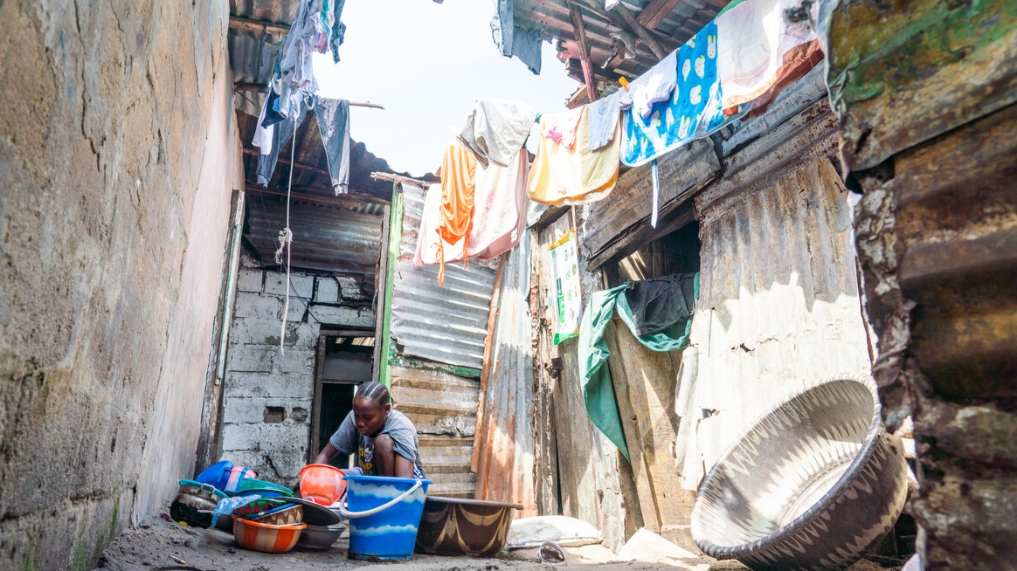
“The soldiers took his clothes.”
John 19:23
Notes:
Reader: “The soldiers took his clothes and divided them into four parts, one for each soldier. They also took his tunic…”
John 19:23-24
Leader: We adore you, O Christ, and we praise you,
All: because by your Holy Cross you have redeemed the world.
Reflect: Jesus has nothing left. Arriving at his place of execution, even his clothes are taken from him. He holds nothing back.
Around the world, people who are poor or marginalised continue to be stripped of what is theirs. The climate crisis wipes away homes, crops and lives. Conflict strips away peace and the chance to learn and live freely. Too many people are prevented from the opportunities that they need to flourish.
Pope Francis urges us to “refuse to turn a blind eye to the tragedy of rampant poverty that prevents millions of men, women, young people and children from living in a manner worthy of our human dignity.”
Hearing these words, how am I challenged? What am I being called to do for those who have been stripped of so much?
Prayer:
Jesus, you sacrificed everything and endured mockery for our sake.
Walk with us.
When we value possessions more than people,
or look down on someone who has less,
show us your face in theirs.

Slide 22
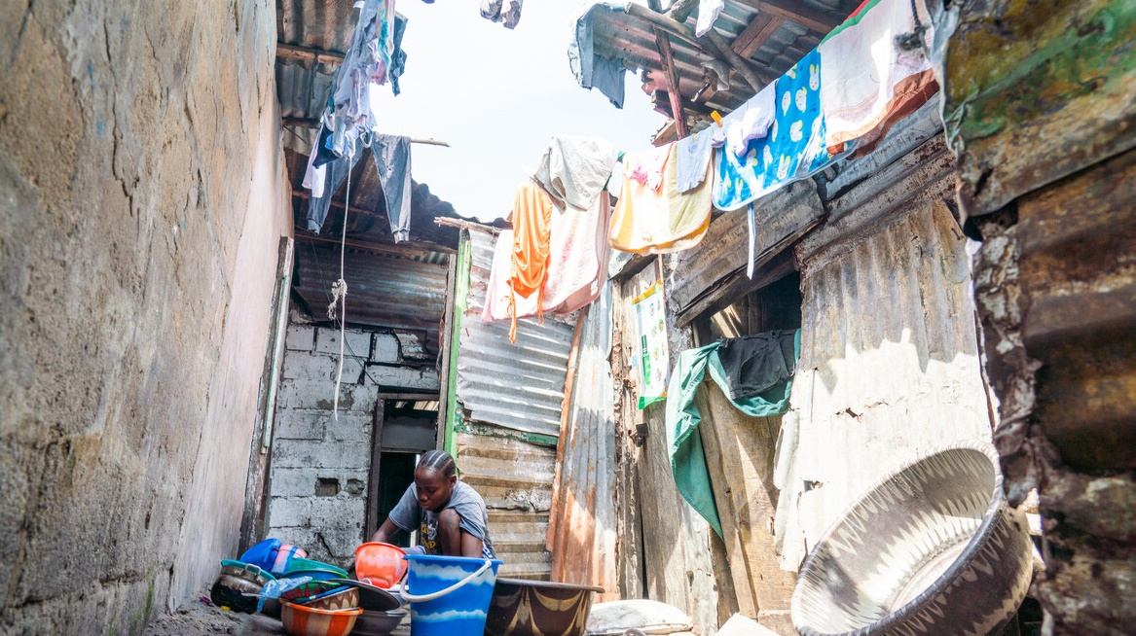
We adore you, O Christ, and we praise you
R/ Because by your Holy Cross you have redeemed the world.
Prayer
Jesus, you sacrificed everything
and endured mockery for our sake.
Walk with us.
When we value possessions more than people,
or look down on someone who has less,
show us your face in theirs.
Notes:
Image: Mary helping to wash fish in an alleyway with drying laundry hanging above her. Picture credit: Carielle Doe

Slide 23
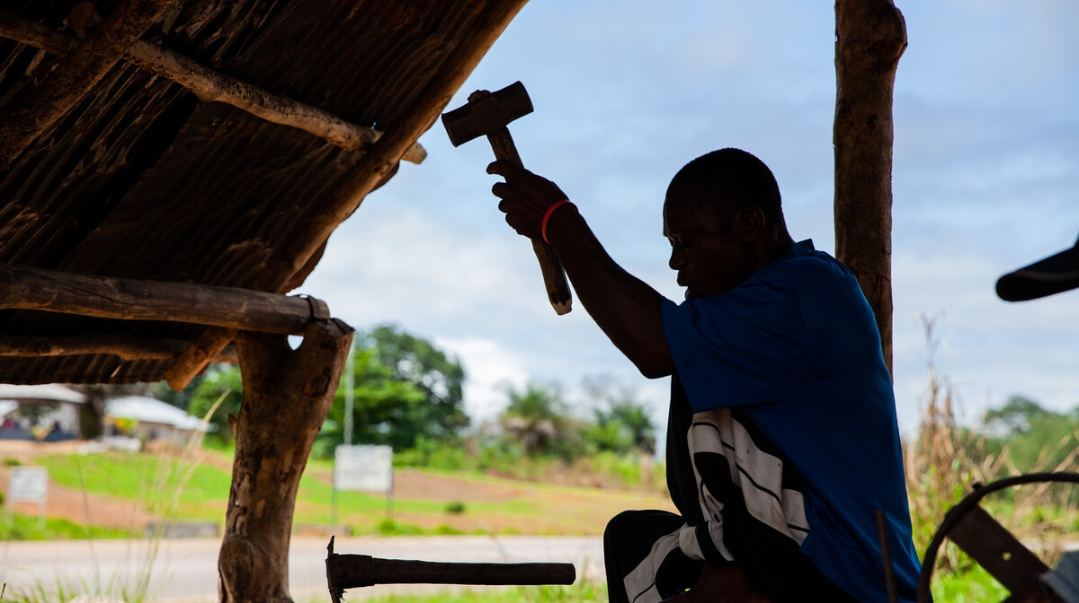
“Father, forgive them,
they know not what they do.” Luke 23:35
Notes:
Reader: “When they came to the place that is called The Skull, they crucified Jesus there with the criminals, one on his right and one on his left. Then Jesus said, ‘Father, forgive them, they know not what they do.’” Luke 23:33-35
Leader: We adore you, O Christ, and we praise you,
All: because by your Holy Cross you have redeemed the world.
Reflect: The soldiers drive the nails into Jesus’ hands and feet. Yet even in this moment he shows his compassion, praying for those who crucify him.
Jesus continues to be crucified in all who suffer in our world. He is present in those whom society marginalises: people who are hungry or homeless, refugees or asylum seekers. He is hurt in the exploitation of our common home, the earth and its resources.
As followers of Jesus, may we show his compassion and so be a source of hope for all our brothers and sisters, our global family, and our common home, the earth.
Prayer:
Jesus, you cry out in pain.
Walk with us.
Challenge us -
when we hold people back,
when we don’t treat them with respect.
Help us to remember that everyone is equal,
that we are all made in the image of God.

Slide 24
We adore you, O Christ, and we praise you
R/ Because by your Holy Cross you have redeemed the world.
Prayer
Jesus, you cry out in pain.
Walk with us.
Challenge us -
when we hold people back,
when we don’t treat them with respect.
Help us to remember that everyone is equal,
that we are all made in the image of God.
Notes:
Image: Ishmael is a blacksmith in Sierra Leone.
Picture credit: Thom Flint

Slide 25
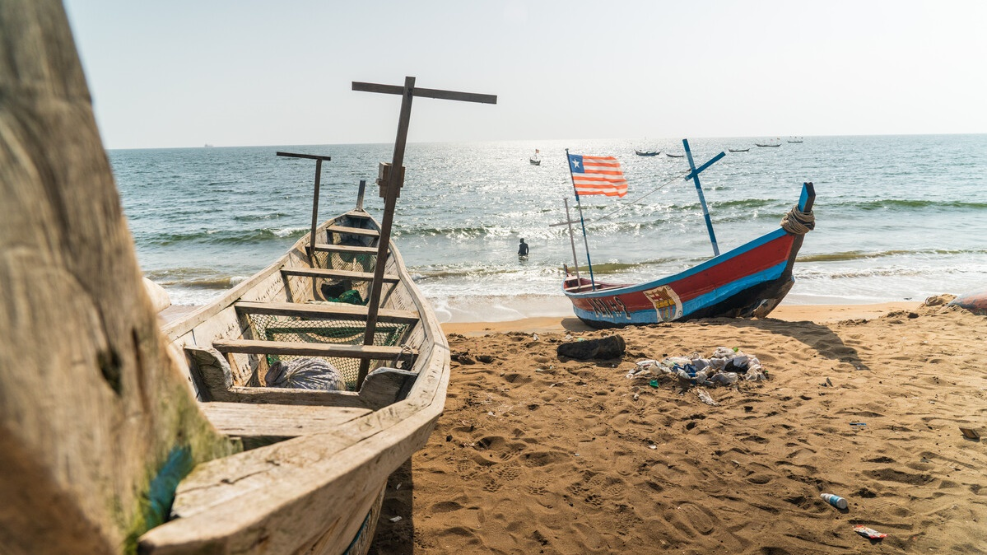
“I am thirsty.” John 19:28
Notes:
Reader: “Later, knowing that everything had now been finished, and so that Scripture would be fulfilled, Jesus said, ‘I am thirsty.’ A jar of wine vinegar was there, so they soaked a sponge in it, put the sponge on a stalk of the hyssop plant, and lifted it to Jesus’ lips. When he had received the drink, Jesus said, ‘It is finished.’ With that, he bowed his head and gave up his spirit.” John 19:28-30
Leader: We adore you, O Christ, and we praise you,
All: because by your Holy Cross you have redeemed the world.
Reflect:
Just before he dies on the cross Jesus cries out that he is thirsty. We can hear him continue to say these words to us, through our brothers and sisters who each day must strive for enough water or enough food to eat. Through all those who thirst for a fairer world, where everyone has enough and is able to reach their full potential.
These last words of Jesus challenge us. They call us to see his face in all those who thirst for a fairer world and to stand alongside them raising our own voices for change. They invite us to make the connections between how we live as individuals and nations and the causes of hunger and poverty in our world.
Jesus dies with his arms outstretched on the cross, embracing all humanity. Do we allow ourselves to be caught up in this loving embrace? Having experienced this great love, how do we share it with others in our world?
Prayer:
Jesus, you know what it’s like to feel alone,
lost and afraid, betrayed and abandoned.
Walk with us.
And show us how to walk with others,
who live in fear and face death through hunger, thirst and conflict.
Show us how to pray for sisters and brothers that we have never met,
but who are always loved by you.

Slide 26
We adore you, O Christ, and we praise you
R/ Because by your Holy Cross you have redeemed the world.
Prayer
Jesus, you know what it’s like to feel alone,
lost and afraid, betrayed and abandoned.
Walk with us.
And show us how to walk with others,
who live in fear and face death through hunger, thirst and conflict.
Show us how to pray for sisters and brothers that we have never met,
but who are always loved by you.
Notes:
Image: Fishing boats on the beach in Liberia. The masts look a bit like a cross.
Picture credit: Carielle Doe

Slide 27
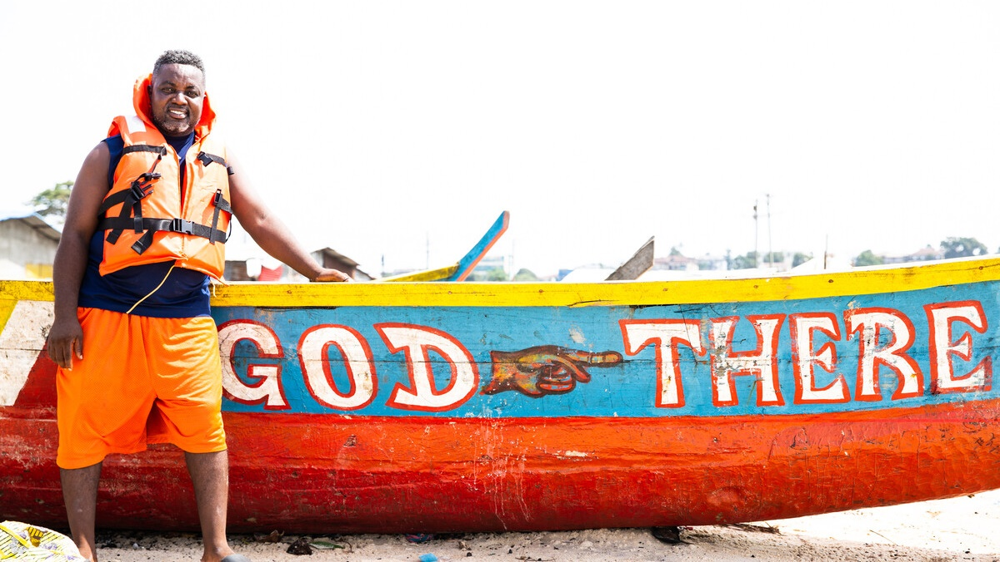
“Pilate gave him permission so he came and removed the body.” John 19:28
Notes:
Reader: “Joseph of Arimathea, who was a disciple of Jesus, though a secret one because of his fear of the Jews, asked Pilate to let him take away the body of Jesus. Pilate gave him permission; so he came and removed the body.” John 19:38
Leader: We adore you, O Christ, and we praise you.
All: because by your Holy Cross you have redeemed the world.
Reflect: The bodies of those crucified were usually left on the cross to decay. Joseph of Arimathea has been a secret follower of Jesus, but now he finds the courage to go to Pilate and ask for Jesus’ body. He acts despite the fear he must have felt, in order to ensure the lifeless body of his teacher is, at least now, treated with dignity and gentleness.
The fishermen in Liberia face their fears every time they go out to sea. Tekon shares how his faith gives him the courage to do what he must for his family.
“We just pray – a short prayer – and we say our family motto: ‘Godere’. It means God is there. God is ahead. God is going to help me and provide safety.”
We pray that at times of difficulty we too will have the courage to take action, to face our fears and to do what is right, treating others as we would wish to be treated.
Prayer:
Jesus, you knew what it meant to have friends,
who risked their own lives to take your body from the cross.
Walk with us.
Show us how to be friends to those close to us and to those far away.
Teach us to see you in everybody,
to be kind, loving and strong.
To be like you.

Slide 28
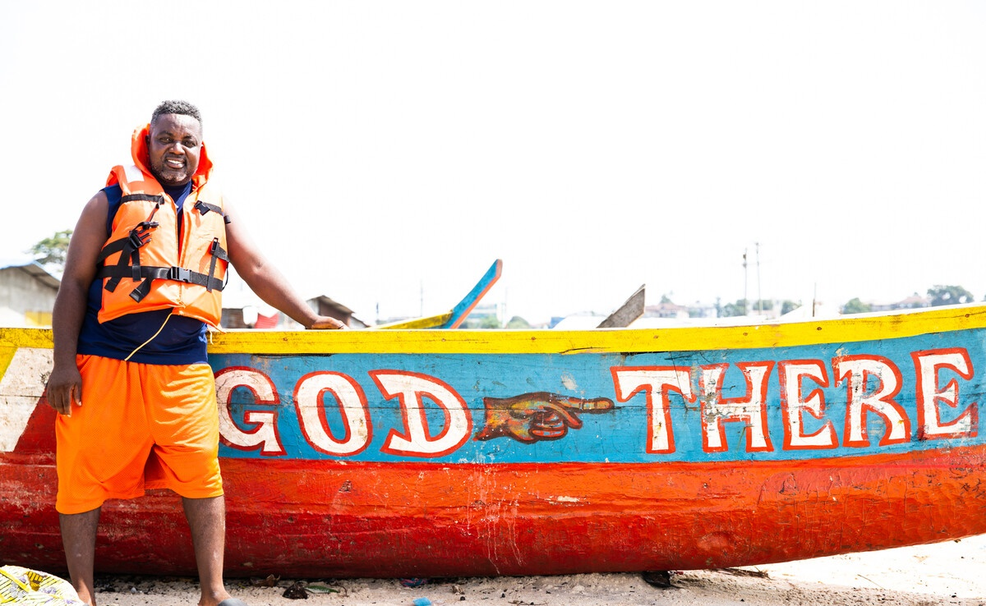
We adore you, O Christ, and we praise you
R/ Because by your Holy Cross you have redeemed the world.
Prayer
Jesus, you know what it means to have friends,
who risked their own lives to take your body from the cross.
Walk with us.
Show us how to be friends to those close to us and to those far away.
Teach us to see you in everybody,
to be kind, loving and strong.
To be like you.
Notes:
Image: Tekon on the beach with his boat, painted with the phrase “God there” which gives him courage as he heads out to sea.
Picture credit: Thom Flint

Slide 29
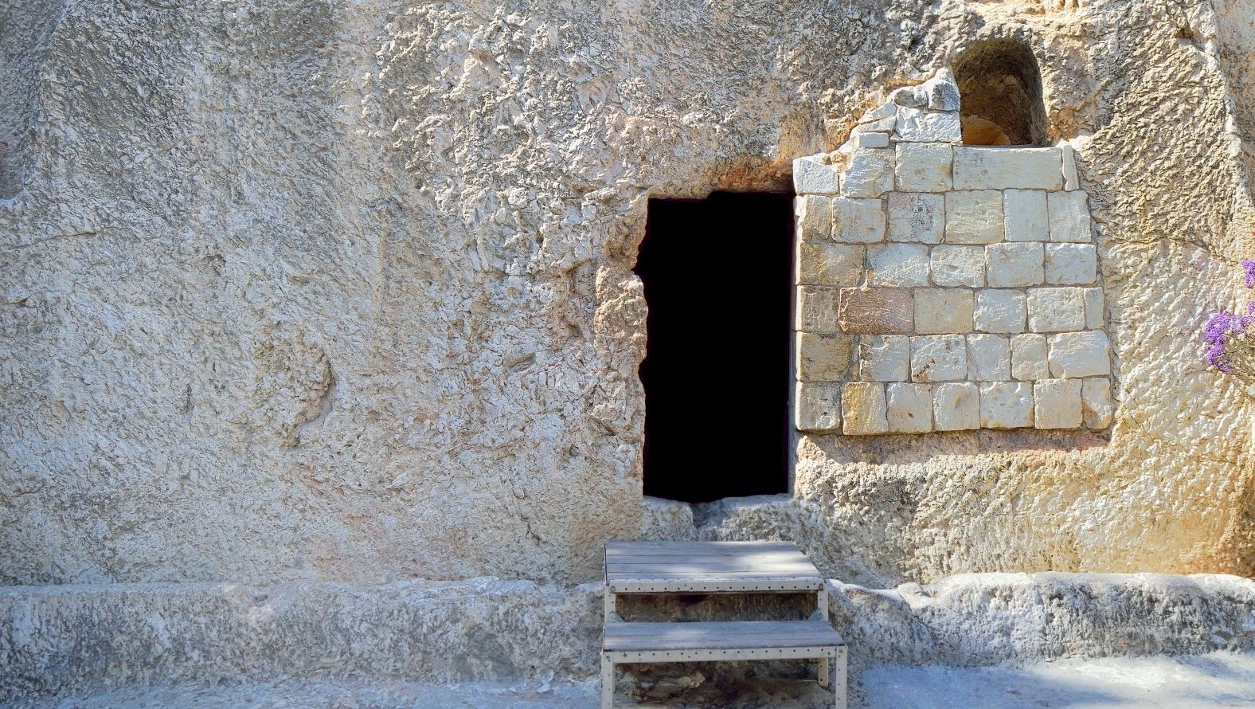
“He rolled a stone against the door of the tomb.” Mark 15:45-47
Notes:
Reader: “Joseph bought a linen cloth, and taking down the body, wrapped it in the linen cloth, and laid it in a tomb that had been hewn out of the rock. He then rolled a stone against the door of the tomb. Mary Magdalene and Mary the mother of Joseph saw where the body was laid.” Mark 15: 45-47
Leader: We adore you, O Christ, and we praise you,
All: because by your Holy Cross you have redeemed the world.
Reflect: There has been little time to prepare Jesus’ body for burial. Joseph has to move quickly to place it in the tomb before the Sabbath begins.
We too must act quickly if we are to protect our common home, the earth, for future generations. We pray that we may have a sense of urgency and hope, even in dark times, as we seek to make a difference.
Despite the time constraints, Joseph tries his best to give Jesus dignity in death. He wraps the body in a simple linen cloth and rolls the stone over the door.
Have there been times when have we failed to uphold the dignity of our brothers and sisters around the world? How could we make sure we reflect the fact that each person is made in God’s image and likeness in the way that we treat one another?
Prayer:
Jesus, as you were sealed in the tomb
those who loved you felt sad and alone.
They did not know what to do.
Walk with us.
Guide us in difficult times,
so that we can share you with our sisters and brothers when they feel sad and alone.

Slide 30
We adore you, O Christ, and we praise you
R/ Because by your Holy Cross you have redeemed the world.
Prayer
Jesus, as you were sealed in the tomb
those who loved you felt sad and alone.
They did not know what to do.
Walk with us.
Guide us in difficult times,
so that we can share you with our sisters and brothers
when they feel sad and alone.
Notes:
Image: Garden Tomb in Jerusalem, one of two sites proposed as the place of Jesus’ burial.
Picture credit: Manuel F-O/ istock

Slide 31
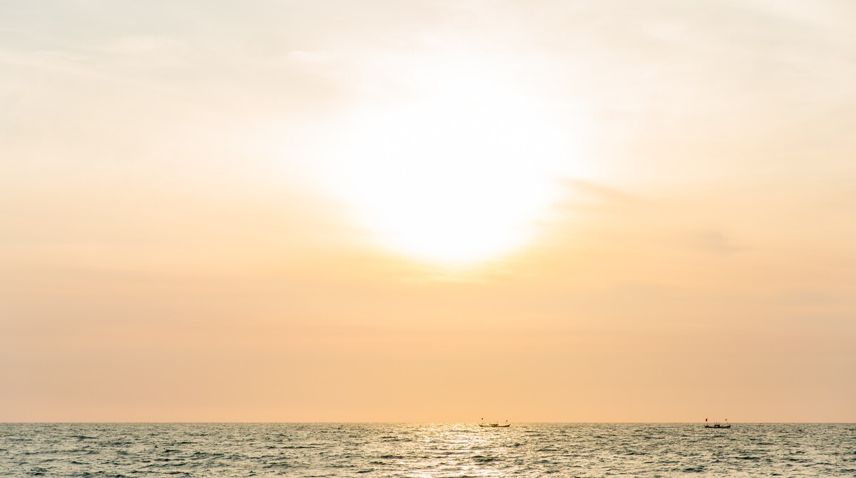
“He is not here, but has risen.” Luke 24:5
Notes:
Reader: “Why do you look for the living among the dead? He is not here, but has risen.” Luke 24:5
Leader: We adore you, O Christ, and we praise you,
All: because by your Holy Cross you have redeemed the world.
Reflect: Jesus is alive. He has conquered death and is here among us.
His resurrection opens the way of hope and assures us that injustice, pain and death can be overcome.
As Cynthia, in Liberia reflects, “I look at the past and see how far we have come. We have got over so many difficult challenges from before. We have overcome so much together.”
As we reflect on Jesus’ final journey, we pray for the strength to live each day as people transformed through God’s love. May we radiate God’s love to all our sisters and brothers throughout the world.
Prayer:
Jesus, you share your life, your light and your peace with us all.
Walk with us.
Show us how to live out your love
so that our sisters and brothers,
here and around the world,
may know the joy of new life.
May we all be changed by living in your light.

Slide 32
We adore you, O Christ, and we praise you
R/ Because by your Holy Cross you have redeemed the world.
Prayer
Jesus, you share your life, your light
and your peace with us all.
Walk with us.
Show us how to live out your love
so that our sisters and brothers,
here and around the world,
may know the joy of new life.
May we all be changed by living in your light.
Notes:
Image: The sun shines over Atlantic at West Point on the coast of Liberia. May we radiate God’s love to all our sisters and brothers throughout the world.
Picture credit: Thom Flint

