Slide 1
How can I follow Jesus and share his message of love?
Gather
Notes:
Children’s liturgy – Fifth Sunday in Ordinary Time
Preparation of the worship space
Colour: green
Song suggestions: Here I am, Lord (865, Laudate)
Follow me, follow me (863, Laudate)
Welcome: Today we hear something special that happened when Jesus went fishing, and how the fishermen left everything to follow him. Let’s think a bit about how we can follow Jesus in our lives today…

Slide 2
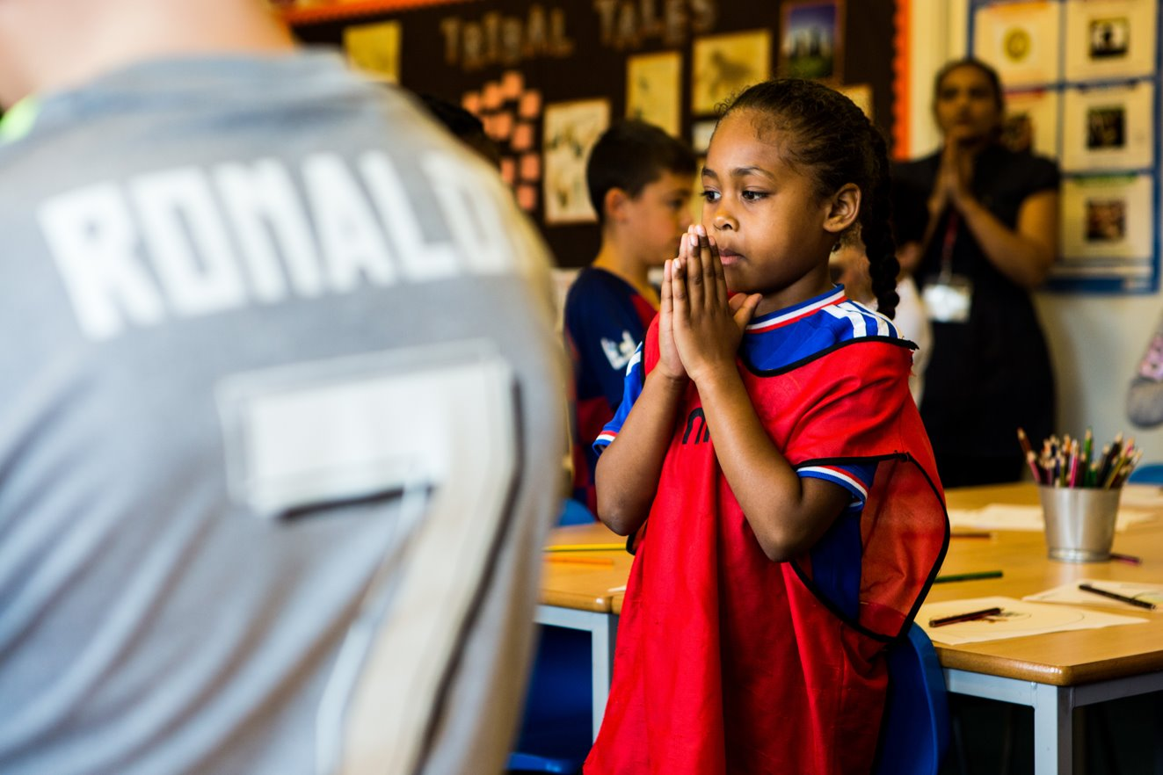
God of love,
give us the strength and courage to follow your Son Jesus in all that we say and do.
May our words and actions spread your message of love for all people. Amen.
Notes:
Children at Our Lady Queen of Heaven Primary School
Photo credit: Thom Flint

Slide 3
Gospel: Luke 5:1-11
One day Jesus was standing on the shore of Lake Gennesaret while the people pushed their way up to him to listen to the word of God. He saw two boats pulled up on the beach; the fishermen had left them and were washing the nets. Jesus got into one of the boats—it belonged to Simon—and asked him to push off a little from the shore. Jesus sat in the boat and taught the crowd.
When he finished speaking, he said to Simon, “Push the boat out further to the deep water, and you and your partners let down your nets for a catch.”
“Master,” Simon answered, “we worked hard all night long and caught nothing. But if you say so, I will let down the nets.” They let them down and caught such a large number of fish that the nets were about to break. So they motioned to their partners in the other boat to come and help them. They came and filled both boats so full of fish that the boats were about to sink. When Simon Peter saw what had happened, he fell on his knees before Jesus and said, “Go away from me, Lord! I am a sinful man!"
He and the others with him were all amazed at the large number of fish they had caught. The same was true of Simon's partners, James and John, the sons of Zebedee. Jesus said to Simon, “Don't be afraid; from now on you will be catching people.”
They pulled the boats up on the beach, left everything, and followed Jesus.
Word

Slide 4
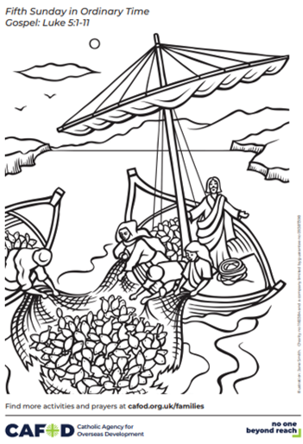
What do you remember from the Gospel reading?
When Jesus has finished speaking to the crowd, he asks Simon Peter to put his fishing nets out into the water. What does Simon Peter say? He does not think they will catch anything as they haven't caught anything all night.
What happens when they put out the nets? How do you think the disciples felt when they pulled up their nets and found a big catch of fish?
Many people around the world still make their living from catching fish today. Do you know anyone who goes fishing – either for work or in their spare time? Have you ever been fishing? What was it like?
Respond
Notes:
Illustration: Jane Smith

Slide 5
Chico lives in the Brazilian Amazon rainforest. He is a leader of the indigenous Tururukare community and lives beside the river.
Chico takes his nine-year-old daughter fishing with him, when she is not at school or helping with housework. She really likes going fishing with her dad and uses a bow and arrow to catch the fish.
Every week the whole village community comes together to share a meal, including the fish they have caught in the river.
Notes:
Photo credit: Stock image

Slide 6
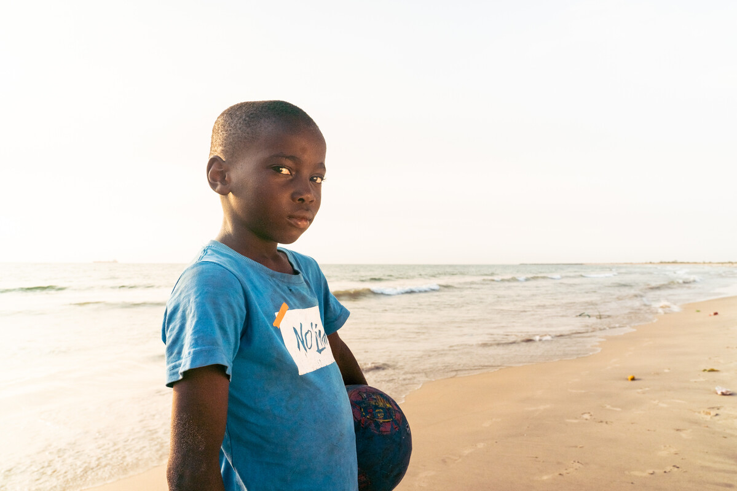
Aaron lives in Liberia with his grandparents.
His grandfather is a fisherman. "I would like to be a fisherman," says Aaron, but being a fisherman is hard and dangerous work. The fish are becoming more and more difficult to find.
With CAFOD's help, local fisherman use fishfinders on their boats so they can safely catch fish to eat and sell.
Aaron's grandparents can give Aaron food, clean water and the things he needs to be happy - as everyone deserves.
Notes:
Aaron, Monrovia, Liberia
Photo credit: Carielle Doe

Slide 7
Jesus tells the disciples that they will become fishers of people. What do you think that this means?
At the end of the reading, the disciples leave everything behind to follow Jesus. From now on they will spend their time with him, sharing his message with the other people they meet.
Notes:
Photo credit: Stock image

Slide 8
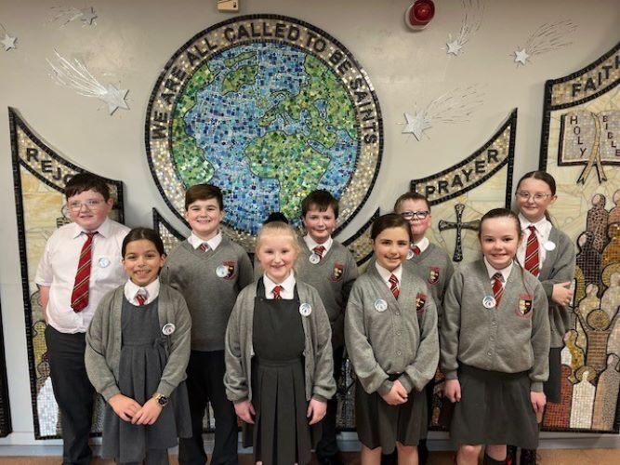
How do you think it must have felt for the disciples to leave all their belongings and all their family and friends behind, to follow Jesus? How do you think their family and friends felt?
Jesus calls us all to follow him. How do you think we can follow Jesus in our lives and share his message of love and good news for all people?
Notes:
Pupils from All Saints Catholic Primary School in Anfield, Liverpool have formed a group called 'Poverty Busters', whose ambition is to help tackle poverty in the UK and around the world.
Photo credit: All Saints

Slide 9
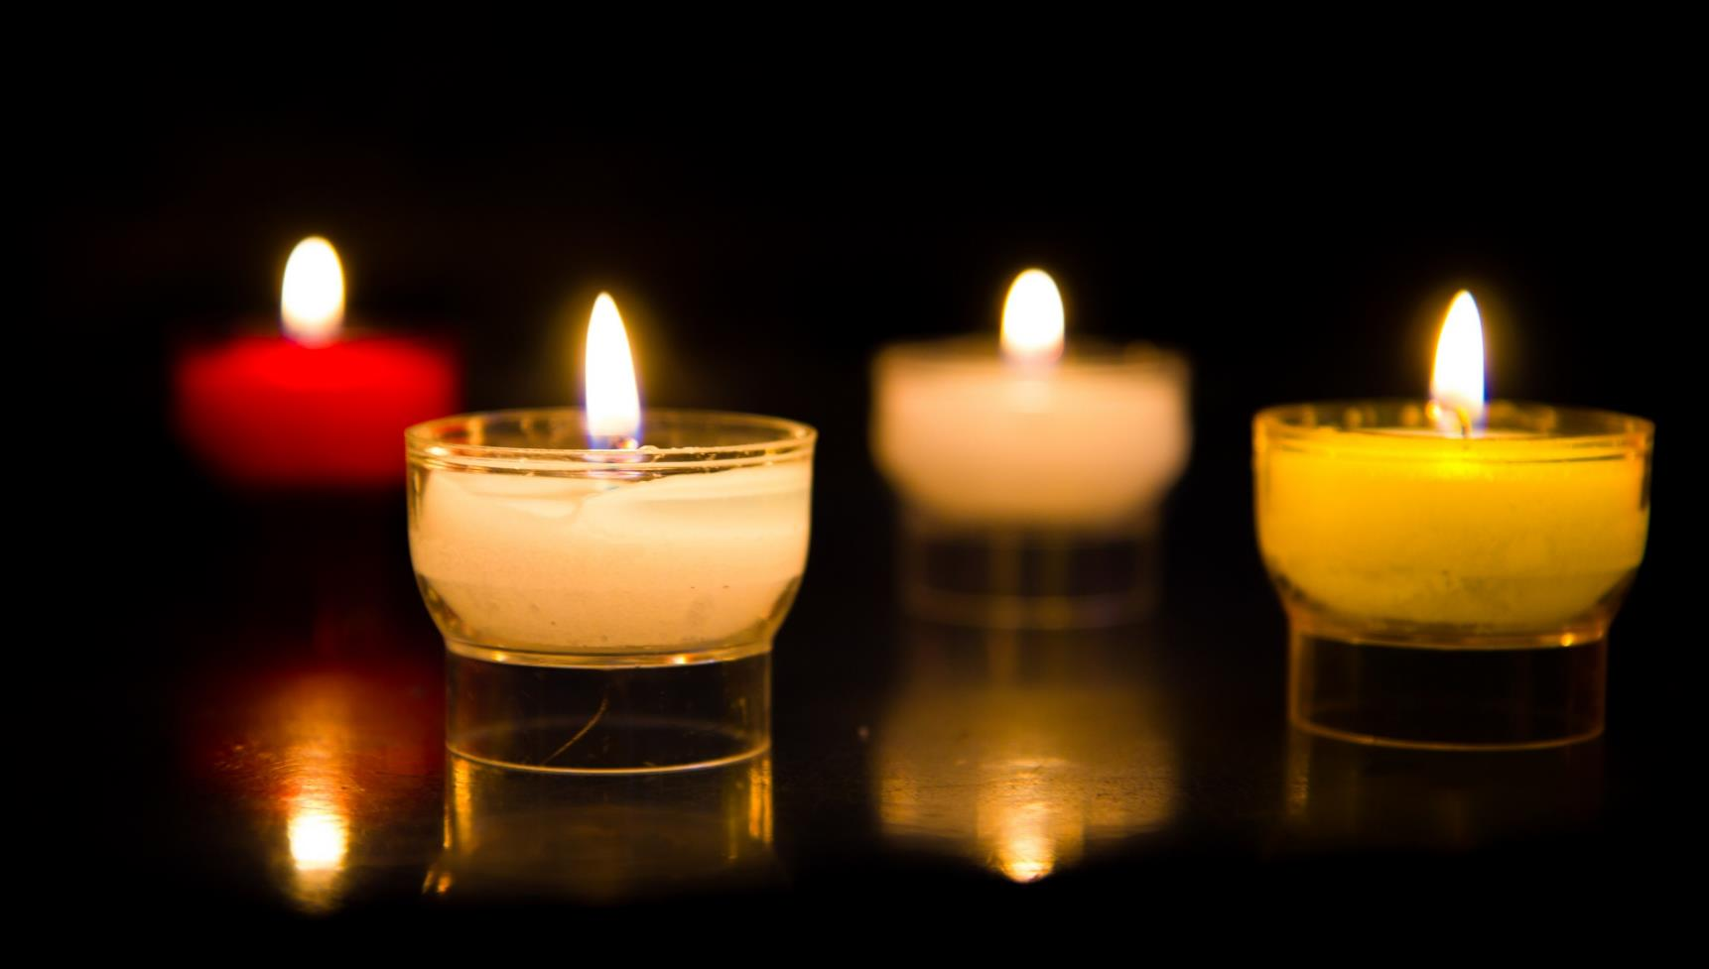
Let us pray…

Slide 10
We pray for world leaders: that they may seek the truth and so bring peace to the world. Lord, in your mercy…
We pray for all fisherfolk throughout the world: that they may stay safe while out on the water and catch enough fish to meet their needs.
Lord, in your mercy…

Slide 11
We pray for our parish, families and friends: that we may follow Christ and show our faith in our words and in our actions. Lord, in your mercy…
Loving God, may we try our best to follow your Son and to serve you faithfully each day, in what we do and how we treat others, especially our brothers and sisters who are living in poverty. Amen.

Slide 12
Jesus calls us all to follow him. How will you show others that you follow Jesus in the coming week?
Send
Notes:
Young campaigners at the G7 summit, Cornwall
Photo credit: Annie Bungeroth

Slide 13
Activity suggestions
Invite the children to colour in the accompanying illustration and on the back to draw how they will show others that they are followers of Jesus during the coming week.
Give the children a fish cut out of paper or card and encourage them to colour it in or decorate it. They could perhaps write or draw how they will show they are followers of Jesus. Or they could draw a picture of Chico or his daughter, or Aaron, who all go fishing, to remind them to pray for them during the next week.
Encourage the children to share all that they have heard and thought about today with the people at home, to pray for all fisherfolk during the coming week and to think about how they will show that they are followers of Jesus.

Slide 14
Jubilee activities!
The Jubilee Year is a landmark moment in the life of the global church. School communities are invited to join together as pilgrims of hope, pledging to work together for God’s kingdom of justice, peace and love. Find resources at:
Jubilee for schools 2025 – Pilgrims of Hope
Why not make the Big Lent Walk part of your Jubilee pledge?
For sign up and more information go here:
BLW25 Schools Sign up - Formstack
A CAFOD club could strongly support the Catholic life of your school, particularly in this Jubilee year. Find out more:
https://cafod.org.uk/Education/For-teachers/CAFOD-clubs

Slide 15
Notes:
Illustration: Jane Smith

