Slide 1
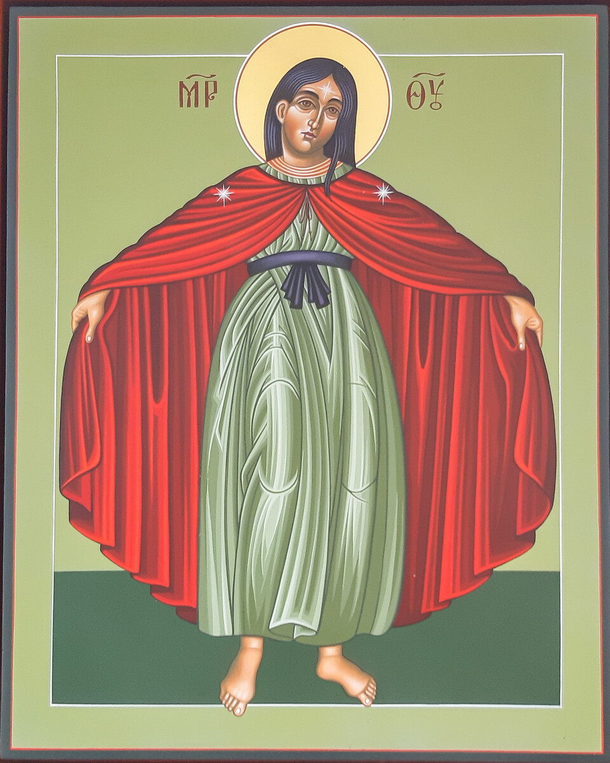
Mary of the Magnificat: Mother of the Poor
Notes:
From Religious Education Directory for Catholic schools, Y9 , Prophecy and Promise:
Live – Artistic expression, for example... Marian iconography, for example... CAFOD icon for the Jubilee Year 2000: Mary of the Magnificat: Mother of the Poor.
R9.2.2. Compare their own and others' responses to questions of belief in the importance of social justice, leading to reasonable explanations of their own and others’ views, in the light of the words of the Magnificat.
R9.2.3. Consider a particular Marian artwork which appeals to them and reflect on what meaning it conveys to them.
R9.2.4 Consider how they could be a person of the Magnificat.
Photo credit: Louise Norton/CAFOD
Iconographer: Father William Hart McNichols S.J.

Slide 2
The Magnificat
In Luke 1, the Angel Gabriel told Mary that she would be mother of Jesus, and that her cousin Elisabeth was also expecting a baby.
The Magnificat is Mary’s joyful hymn of praise when she arrived at Elisabeth’s, according to Luke 1:46-54.
“My soul magnifies the Lord,
and my spirit rejoices in God my Saviour,
for he has looked with favour on the lowliness of his servant.
Surely, from now on all generations will call me blessed;
for the Mighty One has done great things for me,
and holy is his name.
His mercy is for those who fear him
from generation to generation.
He has shown strength with his arm;
he has scattered the proud in the thoughts of their hearts.
He has brought down the powerful from their thrones,
and lifted up the lowly;
he has filled the hungry with good things,
and sent the rich away empty.
He has helped his servant Israel,
in remembrance of his mercy,
according to the promise he made to our ancestors,
to Abraham and to his descendants forever.”
Notes:
(NRSV Catholic Edition)
Ask the students:
The Magnificat has often been prayed by oppressed people around the world. Why do you think this is?
In at least three countries, oppressive regimes banned people from reading out the Magnificat. Can you work out why?
What does the Magnificat say about social justice? Why does social justice matter?
Think of a situation of injustice today. If you were in that situation, which lines of the Magnificat might ‘speak’ to you?

Slide 3

What is a Jubilee Year?
The Catholic Church holds a ‘Jubilee Year’ every 25 years. For example, 2025 is a Jubilee Year with the theme ‘Pilgrims of Hope’. The purpose of jubilee years is to encourage holiness of life.
In the Old Testament, jubilee years were a time when debts were cancelled and slaves freed (Leviticus 25:8-55).
In the Jubilee Year 2000, organisations around the world, including CAFOD, united in a coalition calling for cancellation of debt owed by the world's poorest nations to foreign creditors.
As a result, billions of pounds worth of debt owed by more than 35 countries was cancelled, freeing up money for things like hospitals and schools.
Notes:
Reference: https://www.advocacyinternational.co.uk/featured-project/jubilee-2000

Slide 4
The icon
As part of Jubilee Year 2000, CAFOD asked
Father William Hart McNichols S.J. to write the icon,
Mary of the Magnificat: Mother of the Poor.
Icons are prayerfully painted (or ‘written’) as a ‘window into heaven’, to assist people in prayer as they gaze on the icon quietly and patiently.
CAFOD believes that Catholics, and all Christians, are called to walk in hope and solidarity alongside people who are living in poverty.
This icon reminds us that Mary sang praise to God who loves the poor and raises them up.
Notes:
Ask students what they notice or what they know about icons. Answers could include:
Mary is barefoot, a simple of simplicity and of poverty. Mary lived in a poor town in Galilee.
Mary has her arms extended, holding out her cloak as if to let people shelter beneath it. It may remind students of Jesus saying that he had often wanted to shelter the people of Jerusalem "as a hen gathers her brood under her wings" (Luke 13:34).
The fact that Mary's head is uncovered in this icon may remind students of her poverty, simplicity and, perhaps, her youth. At the time of visiting Elisabeth, Mary would still have been a young girl. In Byzantine icons, Mary is never shown with an uncovered head.
The colour red in icons can symbolise love and life-giving energy, as well as sacrifice.
Green is the colour of natural, living things. Ancient iconographers often painted the earth green to denote where life began. Catholics honour Mary as Mother of Jesus, source of all life.
In icons, a gold background indicates that what is depicted is in heaven, and a halo represents the grace of God shining forth.
The Greek letters are short for Μητερ Θεου (Mother of God).
In iconography, stars have sometimes been understood to represent the Holy Trinity. They have also been used to represent that Mary is ever-virgin.
What are your students' own interpretations of the colours and the way Mary has been depicted? For example, why might she be standing on a dark surface? Might there be other reasons for the colour choice for the background and for Mary’s garment? Why might Mary have been shown wearing a belt?
Photo credit: Louise Norton/CAFOD
Iconographer: Father William Hart McNichols S.J.

Slide 5
Questions to ponder
What details do you notice about the image?
What meaning does it convey to you?
How could YOU be a person of the Magnificat?

