Slide 1
www.cafod.org.uk

Slide 2
Dear Lord,
We thank you for all the great things
we have done at this school.
We have learnt so much;
we have had fun;
we have grown up.
Look after us as we prepare
for a future in a new school.
Help us stay true to the faith and values
that have been so important in this school.
Help us aspire to be more.
Amen

Slide 3
We are part of a community, we build it together.
We aspire to be more.
We aspire to build a strong community in our school.

Slide 5
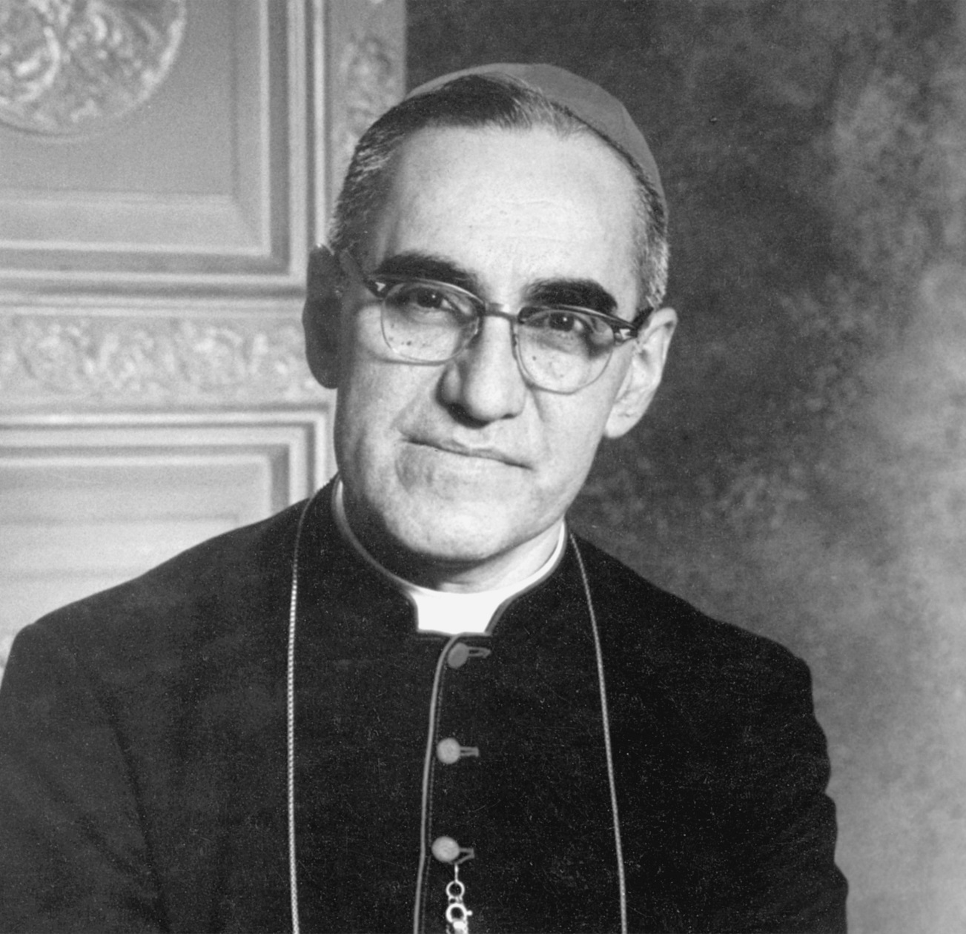
Saint
Oscar
Romero

Slide 6
[Jesus said] “Can you not buy two sparrows for a penny? And yet not one falls to the ground without your Father knowing. Why, every hair on your head has been counted. So there is no need to be afraid; you are worth more than hundreds of sparrows.” (Matthew 10:29-31)
The Gospel of the Lord.
Praise to you, Lord Jesus Christ.

Slide 7
Our school
Insert pictures of your school here
Notes:
Replace these pictures with pictures of your own school

Slide 8
Our school
Insert pictures of your school here
Notes:
Replace these pictures with pictures of your own school

Slide 10
We aspire to be more.
We aspire to build a strong global community.
We aspire to make the world a better place.

Slide 11
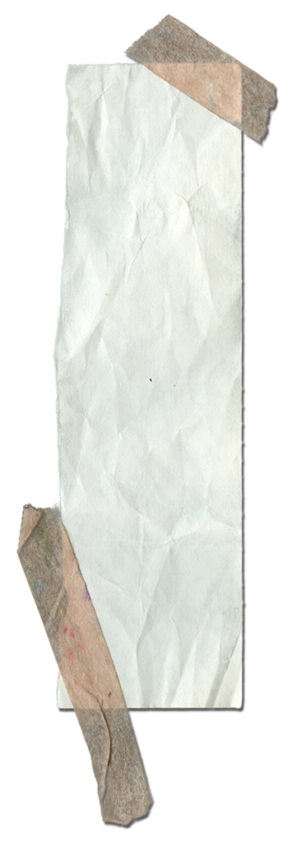

Slide 12
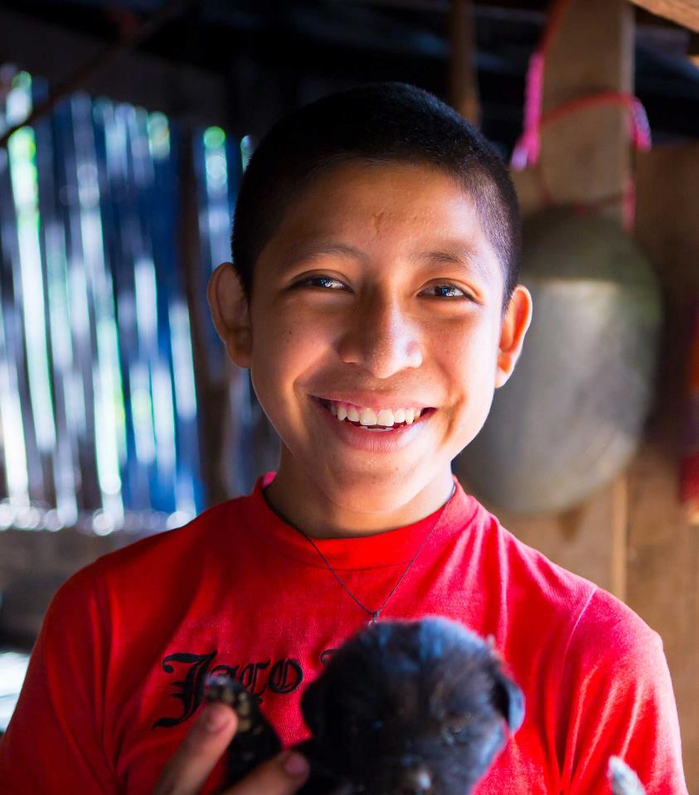
CAFOD aspires to build a world free from poverty and injustice… …where everyone has enough to eat.
Notes:
Tomás’ family are farmers. It's difficult to grow enough in the soil where they live. Plus, extreme weather is wiping out crops. CAFOD have helped the family by training them in good farming practices and teaching them to grow their own seeds, as they are expensive to buy. Now the family grows enough to have what they need.
Photo credit: Louise Norton

Slide 13
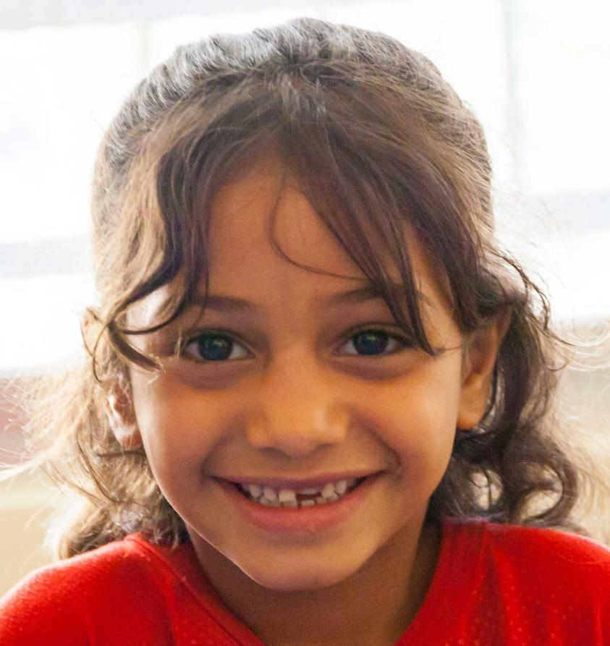
CAFOD aspires to build a world free from poverty and injustice… …where children can rebuild their lives.
Notes:
Mary is 7 years old and comes from Syria. She had to leave her home because of the war. Mary now lives in Jordan, where she can go to a puppet class with other refugees, supported by CAFOD.
In the puppet class, the children watch films, make their own puppets and talk about the difficult things they have experienced. In this way they can start to rebuild their lives.
Photo credit: Louise Norton

Slide 14
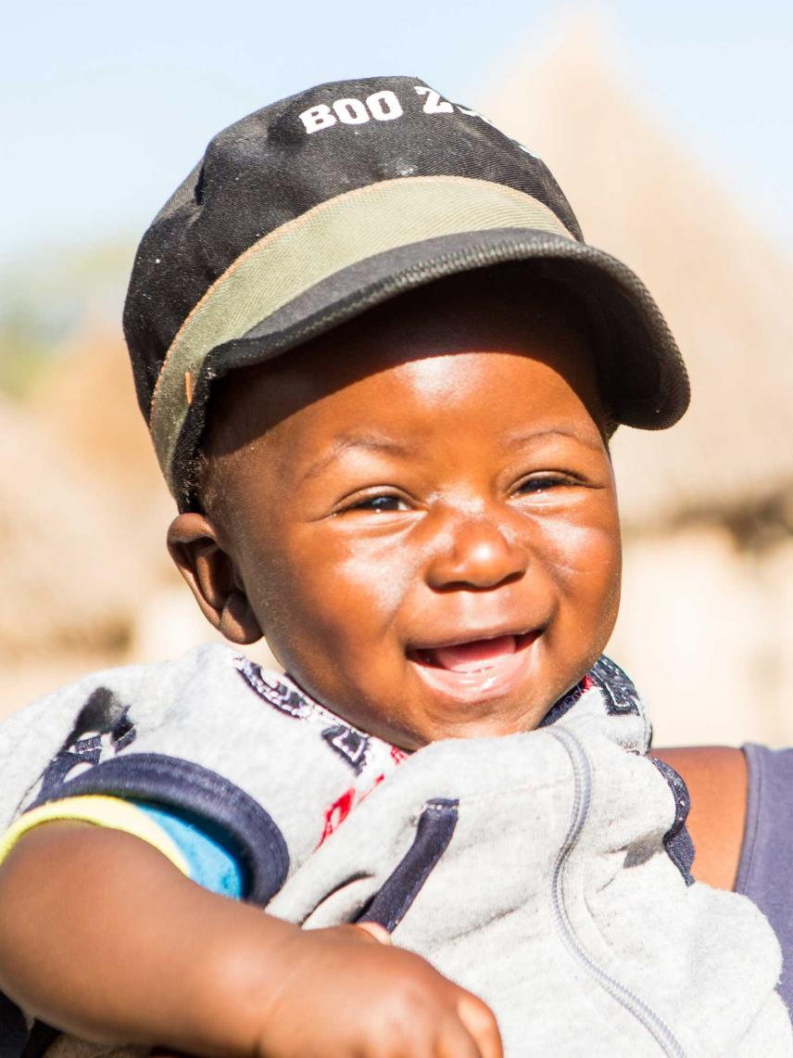
CAFOD aspires to build a world free from poverty and injustice… …where everyone can be healthy and happy.
Notes:
When Twalumba was born, he was not growing as well as other children his age.
His mum joined a support group, funded by CAFOD, to teach new mums about good nutrition and feeding. Now Twalumba is feeding well and growing up healthy.
Photo credit: Thom Flint

Slide 15
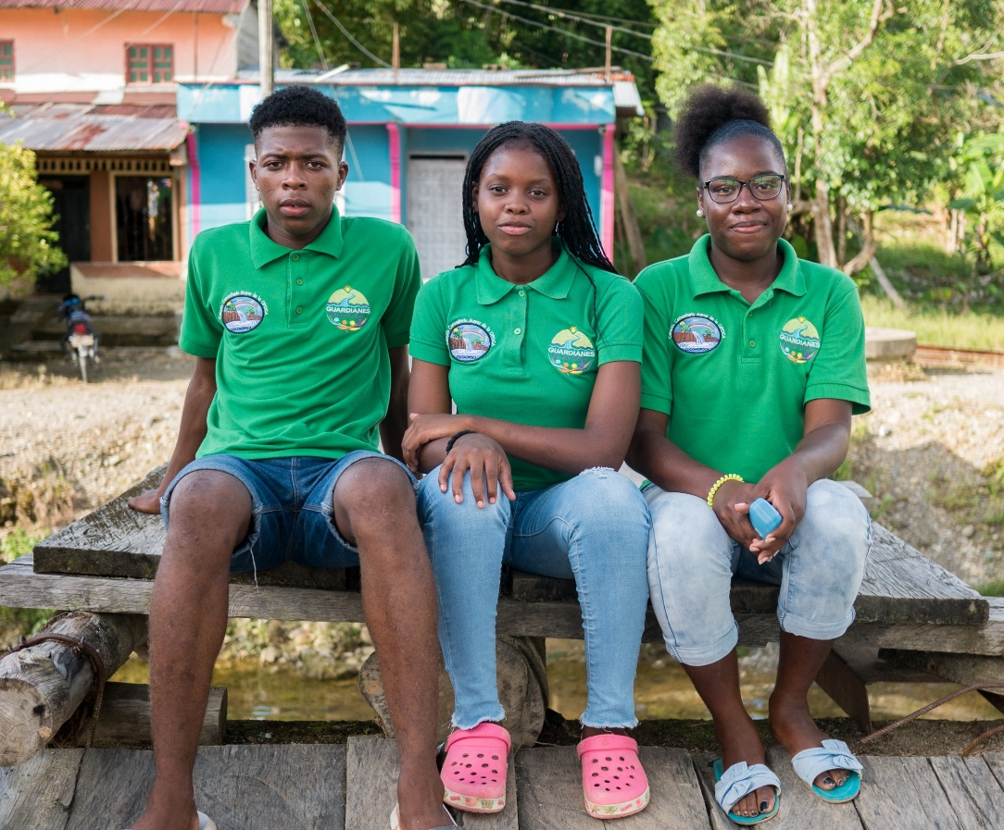
CAFOD aspires to build a world free from poverty and injustice… …where creation is cared for.
Notes:
Proto, Fiona and Dana are ‘young guardians’ of the Atrato river. They live in the north west of Colombia, an area with many different plants and animals, but also at high risk from climate change. In order to help care for the river and their area, they learn about how to take actions such as cleaning the river and raising awareness in their community.
Photo credit: Matts Olssen

Slide 16
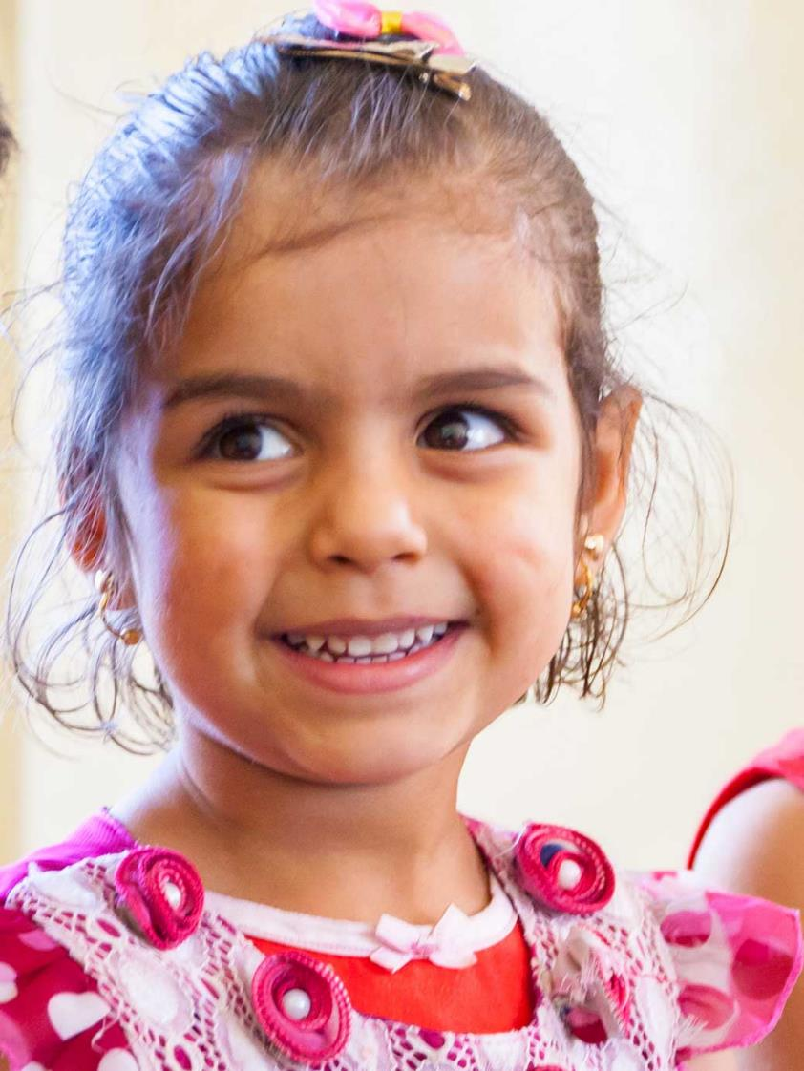
CAFOD aspires to build a world free from poverty and injustice… …where all children can go to school.
Notes:
Waed had to leave her home in Syria. She now lives in Jordan. With CAFOD support, she goes to a school for Syrian refugee children. She has English, Arabic and Maths lessons.
Waed says: “I like English. I just want to play.”
Photo credit: Louise Norton

Slide 17
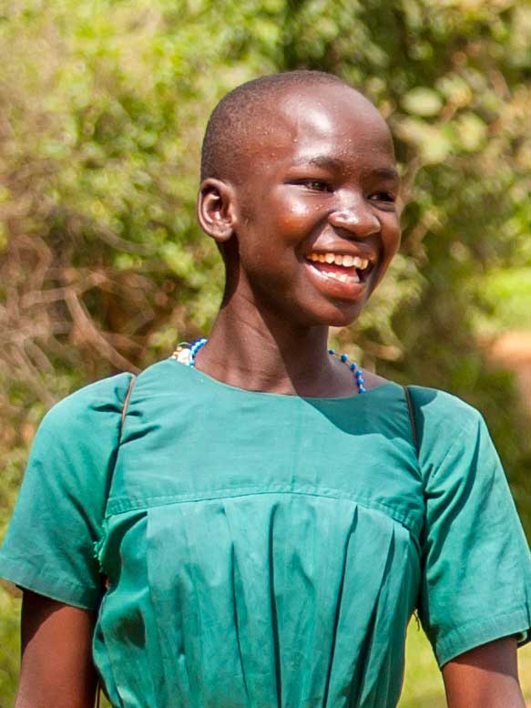
CAFOD aspires to build a world free from poverty and injustice… …where everyone has clean, safe drinking water.
Notes:
Two of Proscovia’s sisters had to drop out of school to collect water. The same thing almost happened to her.
Through CAFOD, the borehole/well near her home was fixed, so she no longer has to go far for water. This means can stay clean and stay in school. Proscovia is happy learning with her friends.
(A borehole is similar to deep well, typically drilled by a machine.)
Photo credit: David Mutua

Slide 18
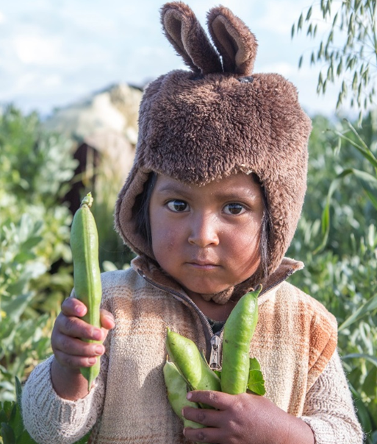
CAFOD aspires to build a world free from poverty and injustice… …where everyone gets a fair price for the work they do and the crops they grow.
Notes:
CAFOD’s partner has helped Joel’s parents to learn to grow more food in the hard conditions of the Altiplano in Bolivia. They have been helped to build a greenhouse to protect some of their crops. They have learnt how to build a wormery so that they have good fertiliser for their soil so that they grow more and better crops.
Now not only does the family grow enough food for themselves but they have extra of some crops such as onions, chard, potatoes and beans which Elizabeth takes into the nearest town to sell at market. Modesto also sells some of the fertiliser from the wormery, because people can see how good it is.
Photo credit: Ben White

Slide 19
CAFOD aspires to build a world free from poverty and injustice… …where everyone can live in peace.
Notes:
In Magdalena Medio, conflict has been a part of life for such a long time. Violence is seen as a normal way to deal with disagreements and conflicts, even at home.
Despite the peace agreement, violence continues between neighbours, school children and among families. We’re been talking to students, parents and teachers to find out how conflict has affected them, so we can decide which issues to tackle in our school workshops.
These students from San Pablo Secondary School are some of the many that will be supported through the CAFOD’s peacebuilding work.
Photo credit: Louise Norton

Slide 21
We are part of a community, we build it together.
We aspire to be more.
We aspire to build strong communities in our new schools.

Slide 22
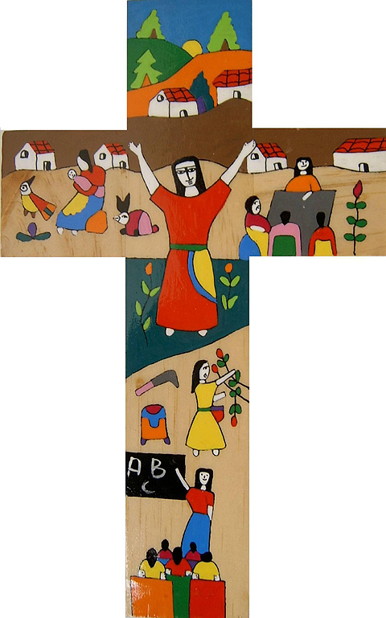

Slide 23
Thank you, Lord, for giving us St Oscar Romero, a prophet living in modern times. Thank you for his words that continue to inspire us. Give us the strength and courage to ‘be more’.

Slide 24
Thank you for all the wonderful things we have learnt at this school and all the fantastic friends we have made.
Thank you for all the wonderful teachers who have worked so hard for us.

Slide 25
Thank you for our parents who have helped us to grow up. Care for us as your children, and help us not to worry about the changes ahead of us. Help us to remember that you are always with us.

Slide 26
Help us to build a strong community in our new school.
Assist us as we try every day to be better global citizens, thinking how our small actions can help to make the world a better place.
Amen.

Slide 28
Picture credits: Louise Norton, Thom Flint, David Mutua, Matts Olssen, Ben White, CAFOD

