Slide 1
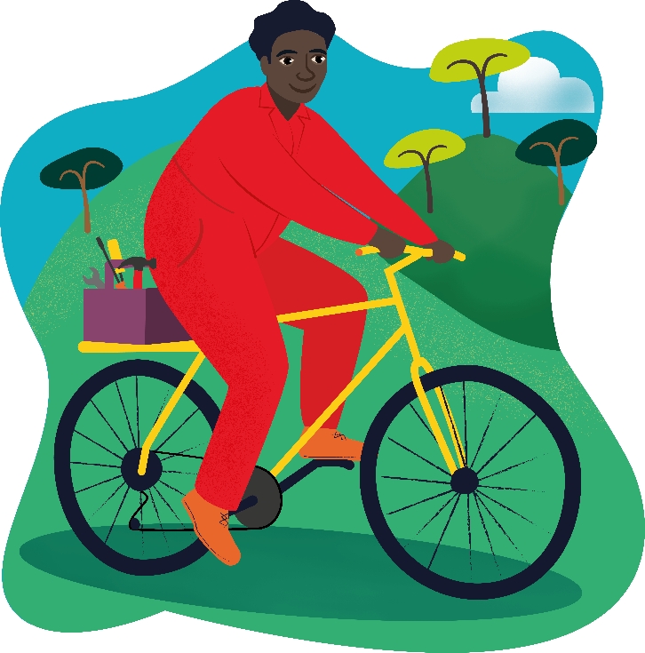
Raphael’s Bike

Slide 2
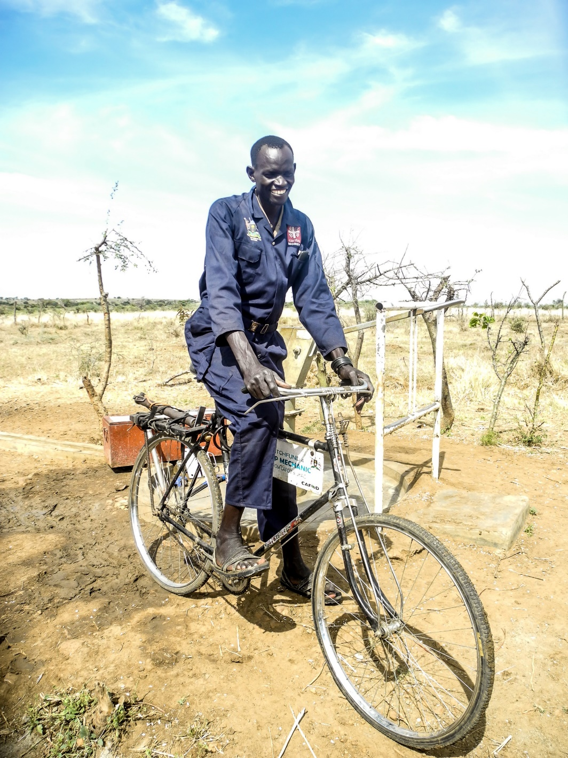
This is Raphael.

Slide 3
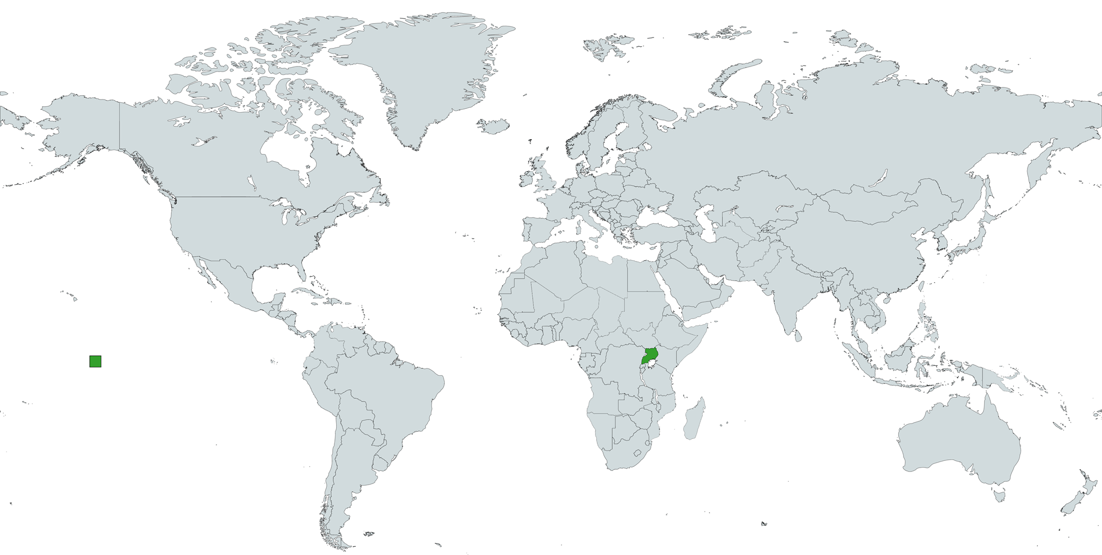
Raphael lives in Uganda.
Uganda is a country in Africa.
Uganda

Slide 4
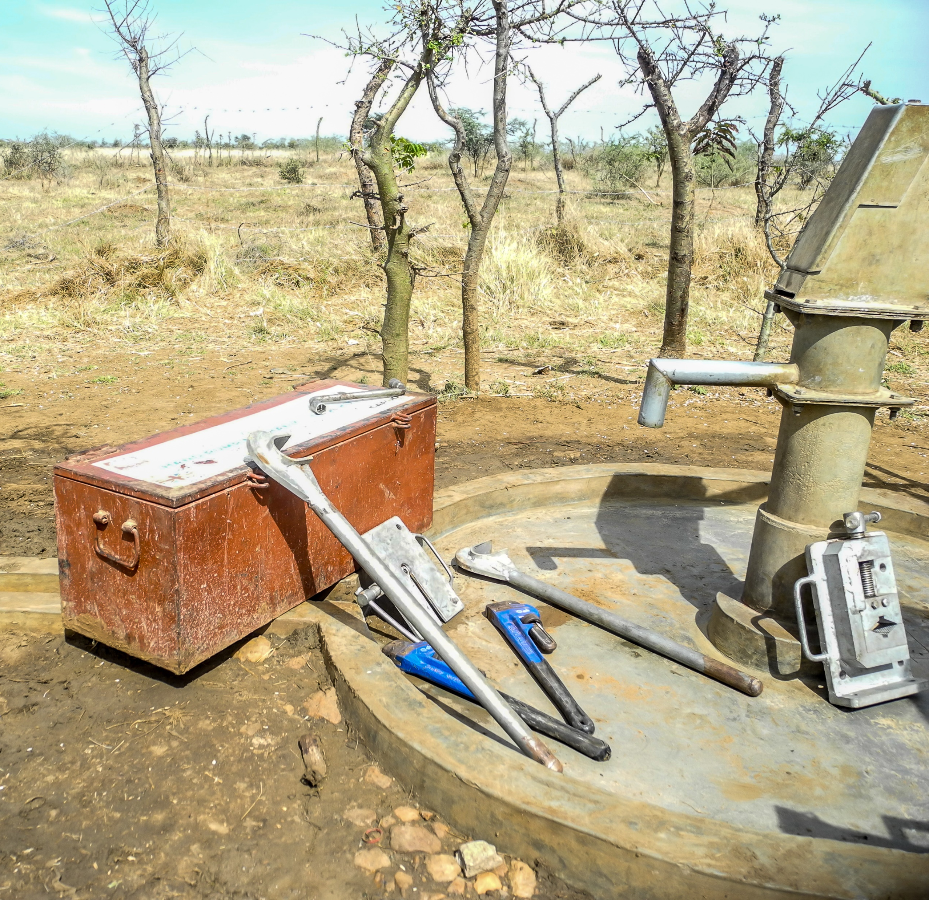
Many people in Uganda do not have an easy way to get water.
They need pumps to bring water up from underground.

Slide 5
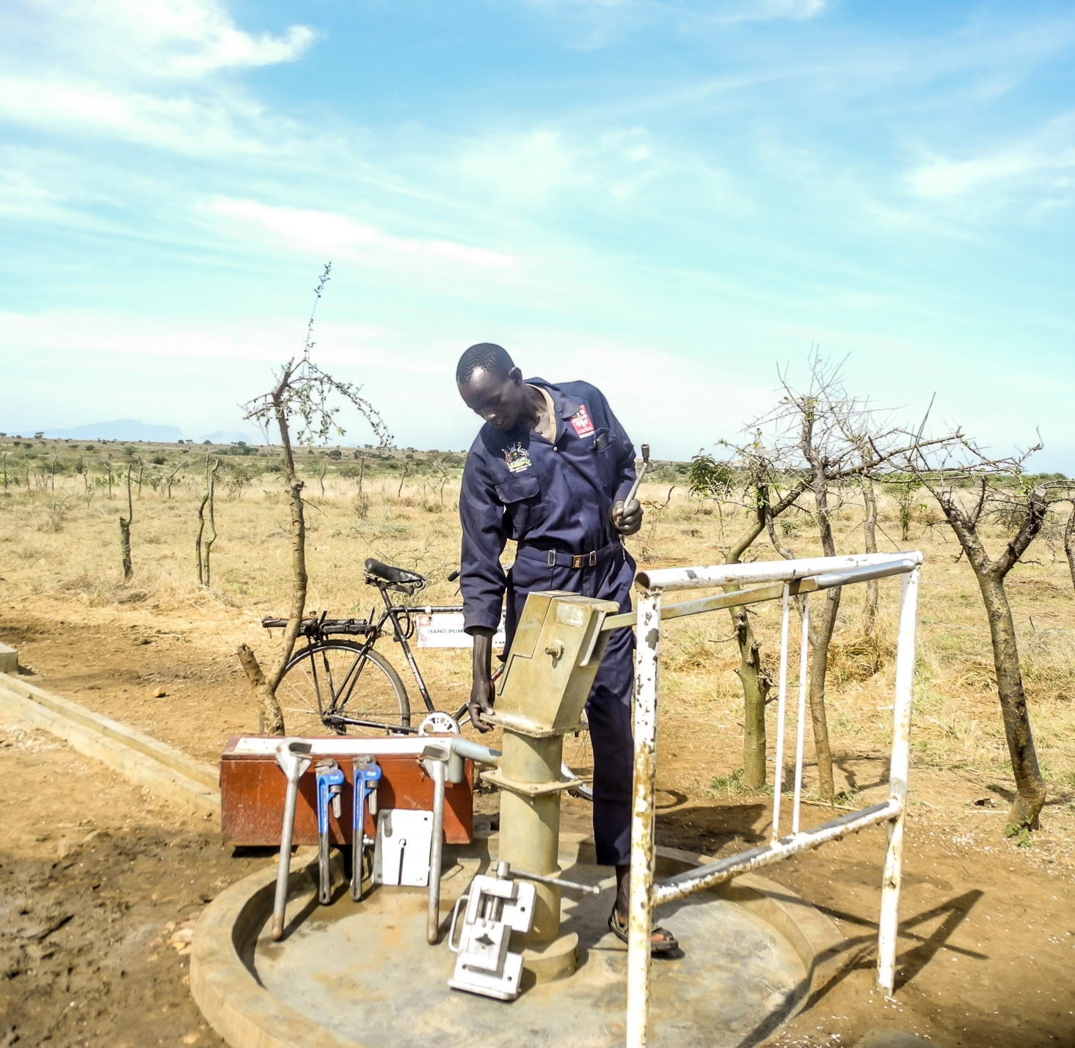
Raphael works as a water mechanic.
This means he helps to mend broken water pumps in his area.

Slide 6
Raphael rides his bike to the town to buy spare parts to fix water pumps.

Slide 7
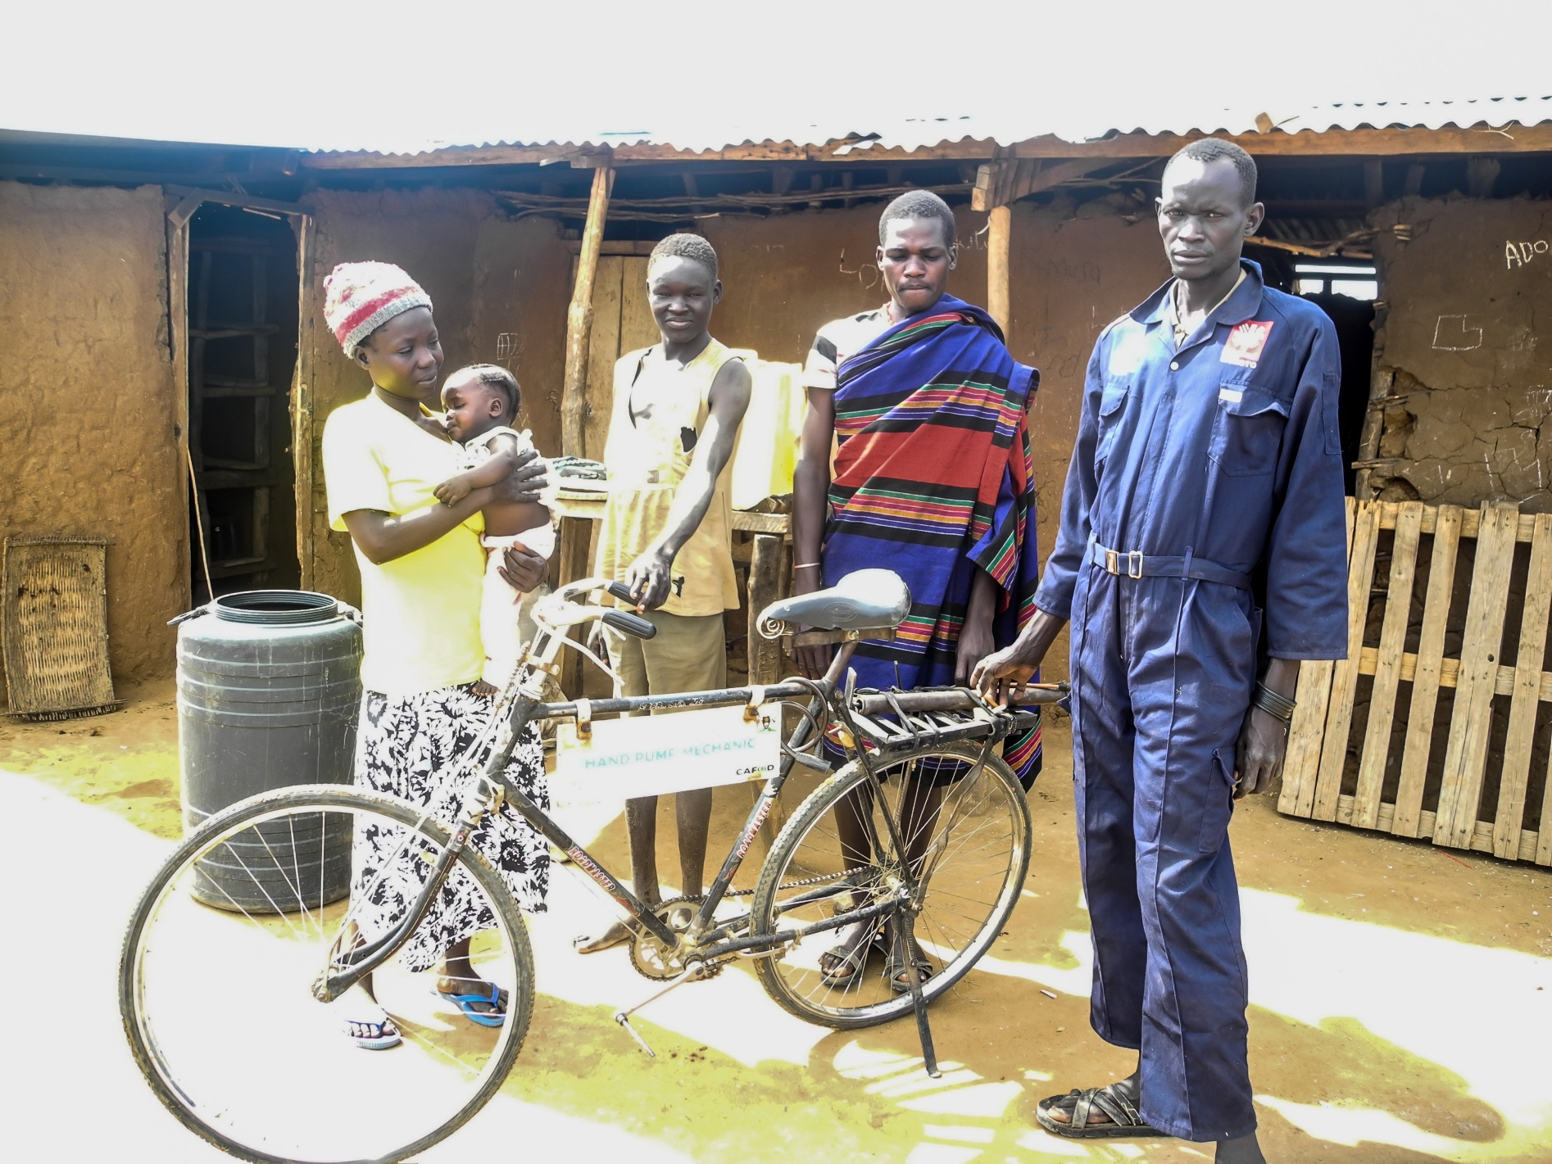
The bike helps me with my daily life … such as carrying a sick person to the hospital and buying food from the market.
He helps his neighbours in other ways too.
I take my children to school on the bike.

Slide 8
What makes a good neighbour?
How is Raphael being a good neighbour in his area?
How can you be a good neighbour?
Jesus taught his friends to be good neighbours. We can work with CAFOD to be good neighbours by sharing and caring for others. How did CAFOD help our global neighbours in Uganda?

Slide 9
Before he had his bike, Raphael had to walk to the water pumps. This took a long time.
CAFOD was able to help Raphael because of the support of people in England and Wales.
People like you – thank you!

Slide 10
Raphael’s Bike
Photo credit: Mark Kipkirui Baiywoh, Caritas Moroto

