Slide 1
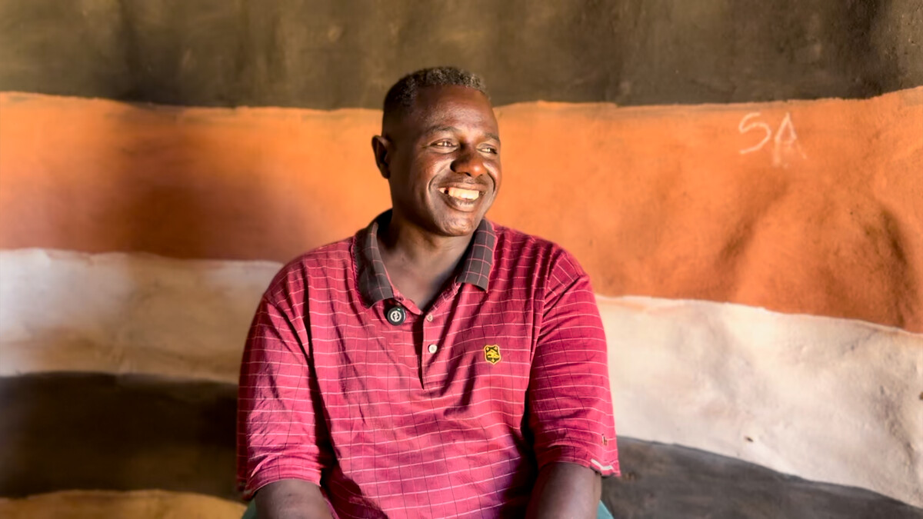

How will you share God's love with others?
Gather
Notes:
Children’s liturgy: The Exaltation of the Holy Cross
Preparation of the worship space
Colour: red
Props: coloured pens and pencils, coloured card
Song suggestions
Love is his word, love is his way (803, Laudate) He is Lord, he is Lord (761, Laudate)
Welcome
The cross is a very special symbol of our faith because it reminds us of Jesus’ death and resurrection. Today we celebrate the cross and remember how much God loves the world and all of us.
Abbiott, Climate change officer, Southern Ethiopia
Photo credit: Louise Norton

Slide 2
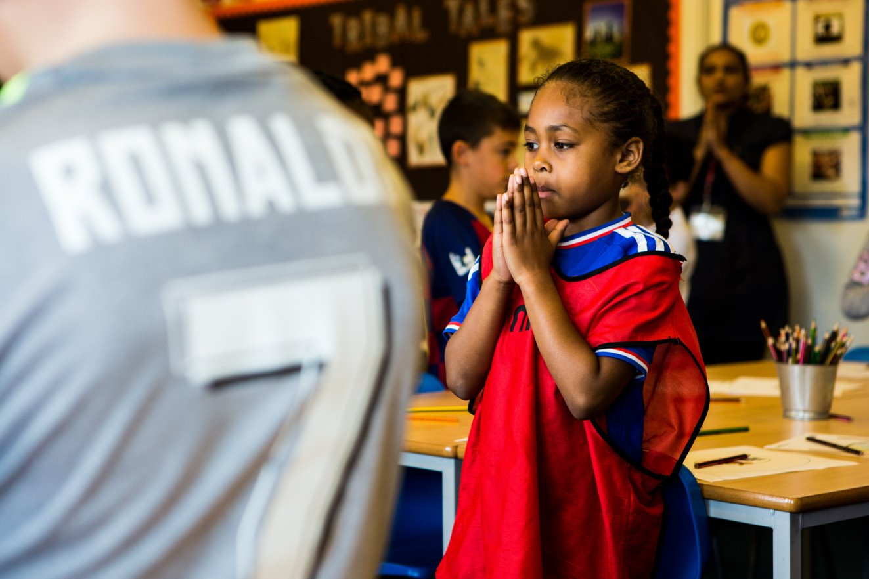
Generous God,
We thank you for sending us your Son, whose death on the cross is a sign of new life. Thank you for loving us so much. Help us to share this love with one another.
Amen.
Notes:
Children at Our Lady Queen of Heaven Primary School
Photo credit: Thom Flint

Slide 3

Gospel: John 3:13-17
Jesus said to Nicodemus:
“And no one has ever gone up to heaven except the Son of Man, who came down from heaven.
"As Moses lifted up the bronze snake on a pole in the desert, in the same way the Son of Man must be lifted up, so that everyone who believes in him may have eternal life.
"For God loved the world so much that he gave his only Son, so that everyone who believes in him may not die but have eternal life. For God did not send his Son into the world to be its judge, but to be its saviour.”
Word

Slide 4
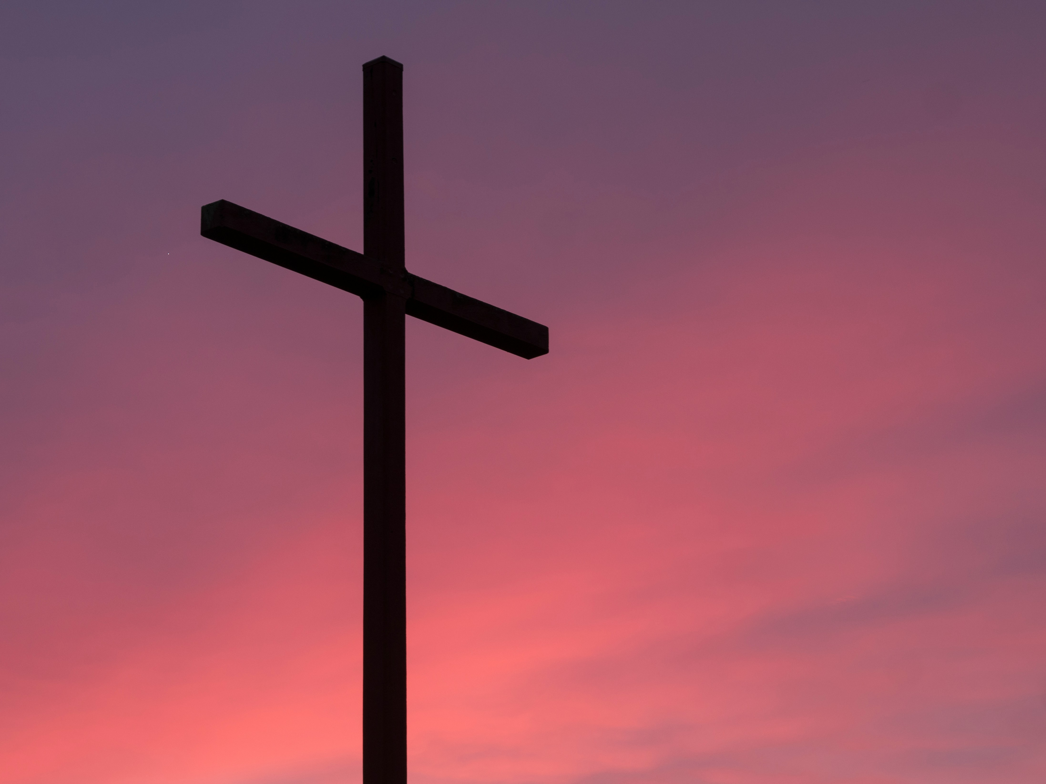

What do you remember from the
Gospel reading?
In today’s reading we hear that God loved the world so much that he sent us Jesus, to help bring us closer to him.
God sent us his Son, even though he knew that Jesus would be put to death on the cross. God knew that Jesus Christ would rise again three days later.
Through his death and resurrection, Jesus gave us all new life. He is the saviour of the world. This is what we celebrate today.
Respond
Notes:
The cross
Photo credit: Aaron Burden on Unsplash

Slide 5
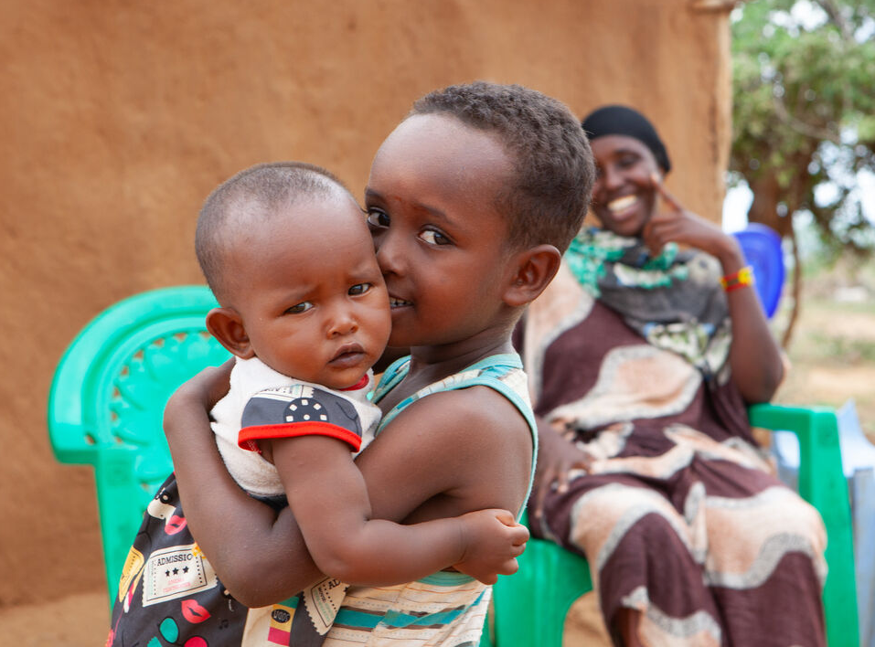
How does it make you feel to know God loves us all so much he was willing to send his only son, Jesus, to be with us here on earth, and to die for us?
Can you tell me two people who love you? And two people that you love?
How should we treat someone that we love?
Notes:
Tume and her family, Marsabit, Kenya
Photo credit: Louise Norton

Slide 6
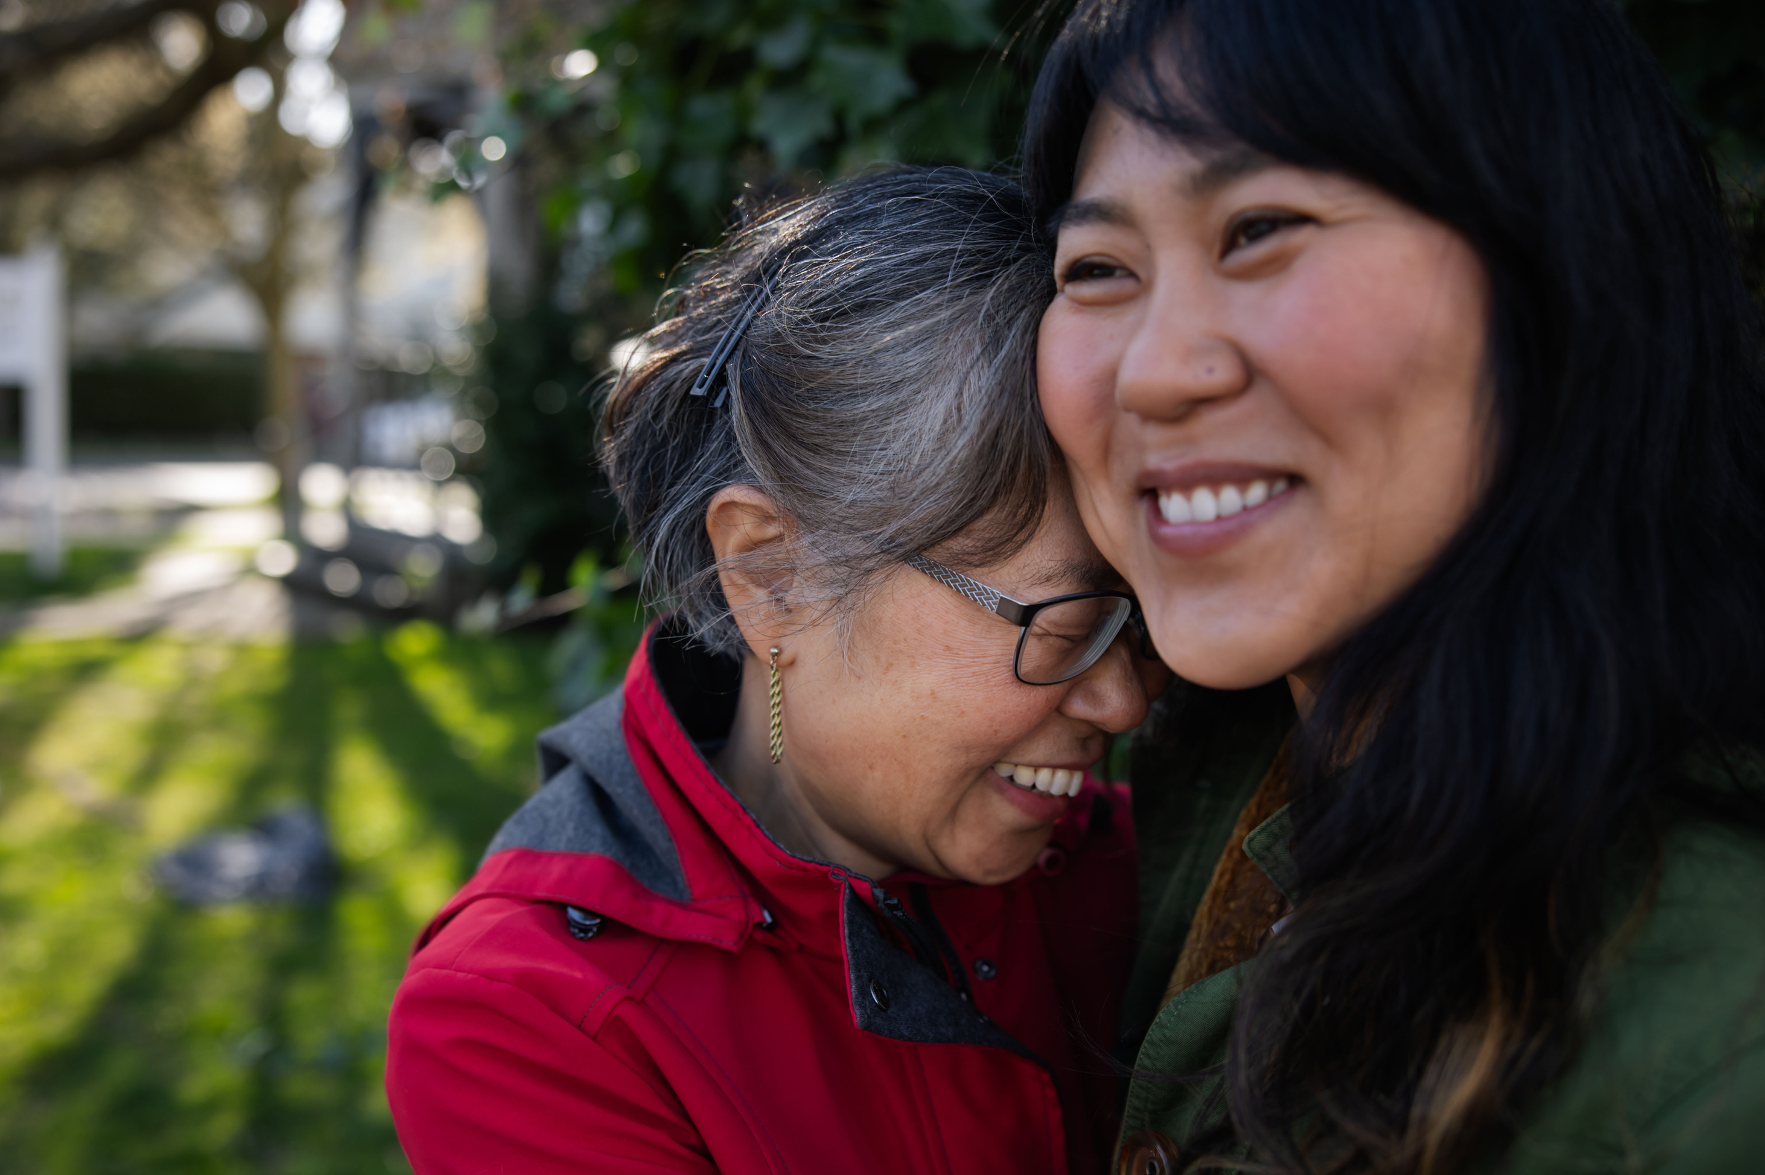
When we love someone, we want what is best for them.
We help them, we care for them, we try to make them happy.
We support them when things are difficult and we celebrate with them when they are joyful.
Notes:
Joyful
Photo credit: Stock image

Slide 7
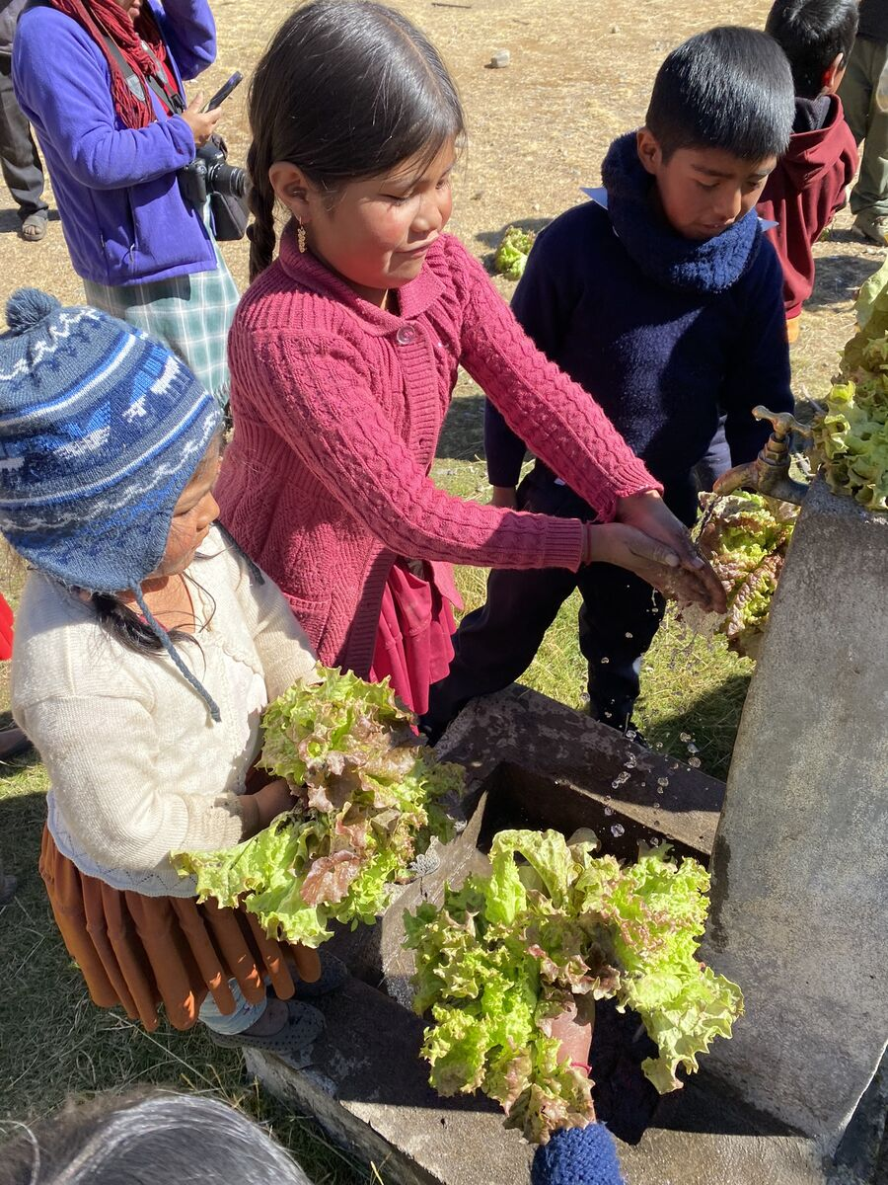
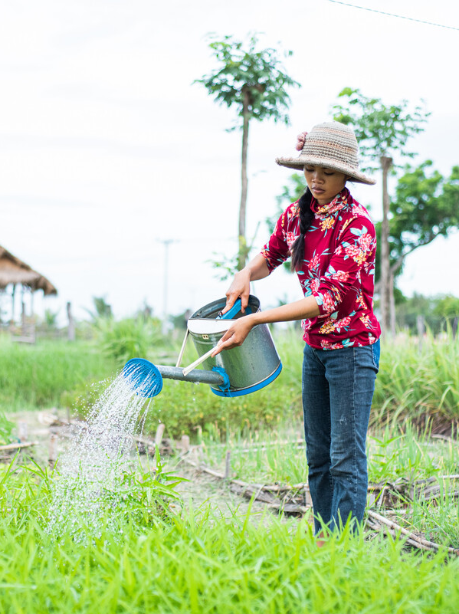
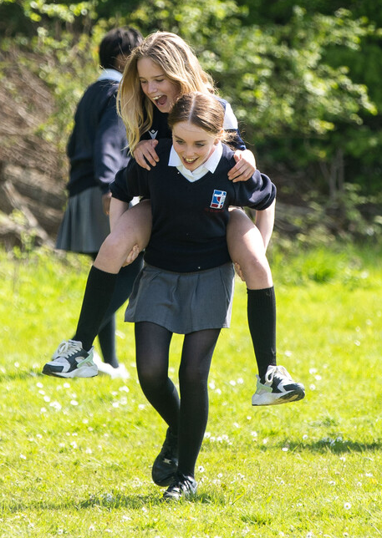
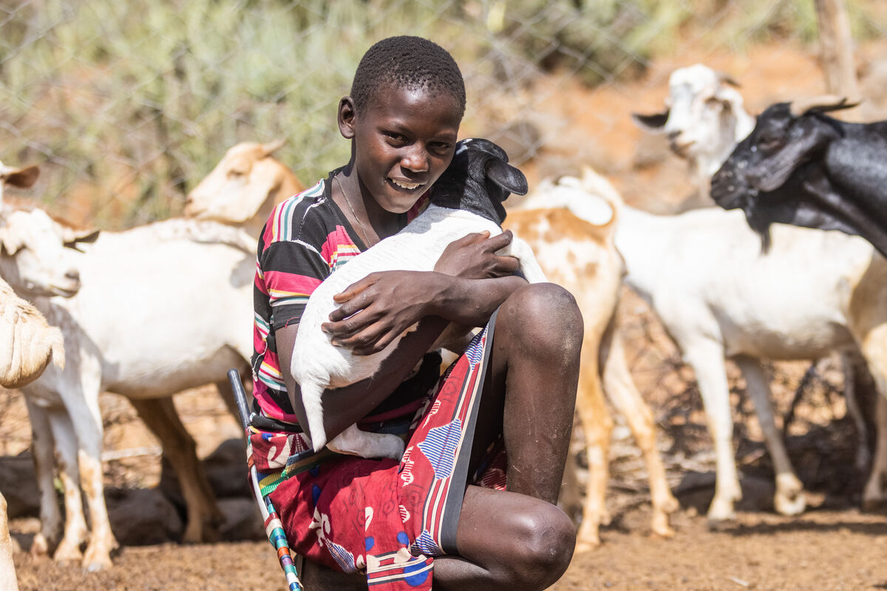
God does not just love you and me, God loves everybody.
God loves all people whether they are rich or poor, no matter where they live or where they come from. No matter whether they are healthy or ill, no matter the colour of their skin.
We are all God’s children. We are part of one global family.
Notes:
Rosa and her friends, Bolivia
Photo credit: Nikki Evans
Miss Long Sreyneang, Cambodia
Photo credit: Tom Chheat
Saidimu and his goats, Kenya
Photo credit: Mwangi Kirubi
Big Lent Walk at St Gregory's Catholic School, UK
Photo credit: Joe Newman

Slide 8
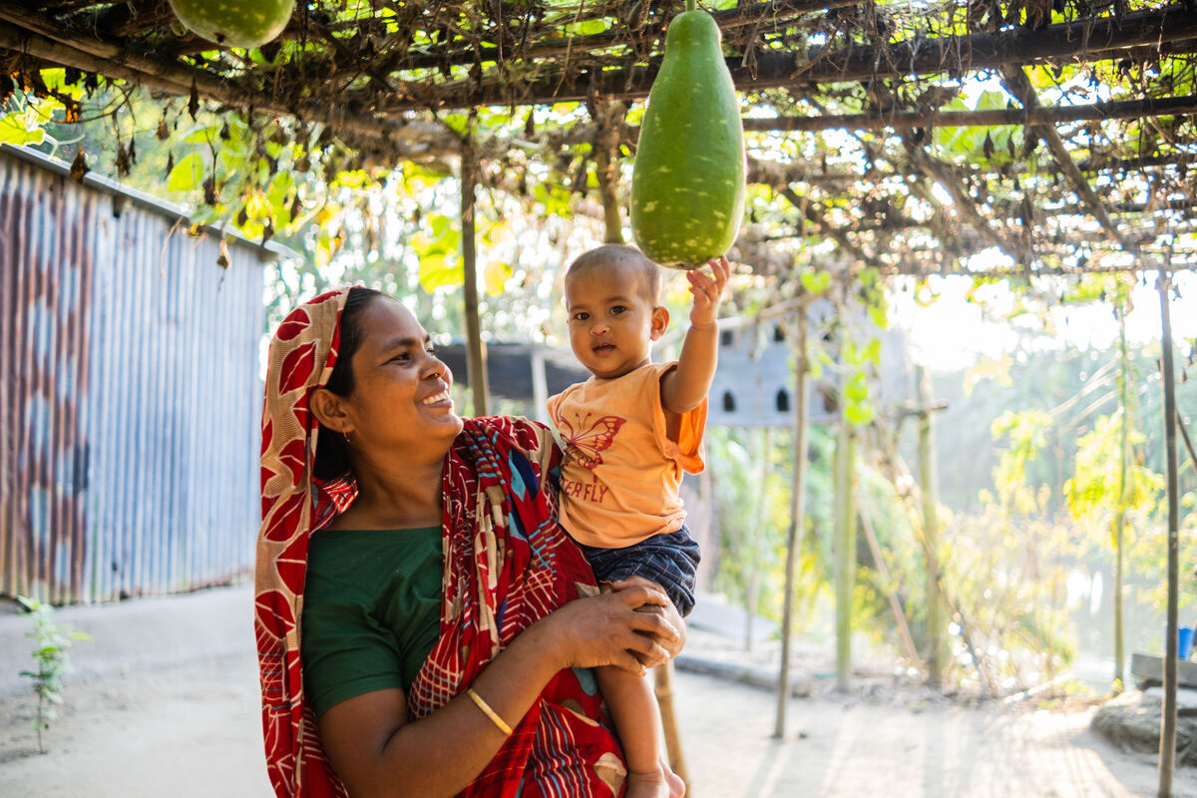
We were made by God to love God and one another.
God intended for us all to live our lives the best way we can, but sometimes we do not make the right choices.
Together, we can build a better world where God’s love for all shines through and all people have what they need to flourish.
Notes:
Salina with her granddaughter, Ekra, Bangladesh
Photo credit: Amit Rudro

Slide 9
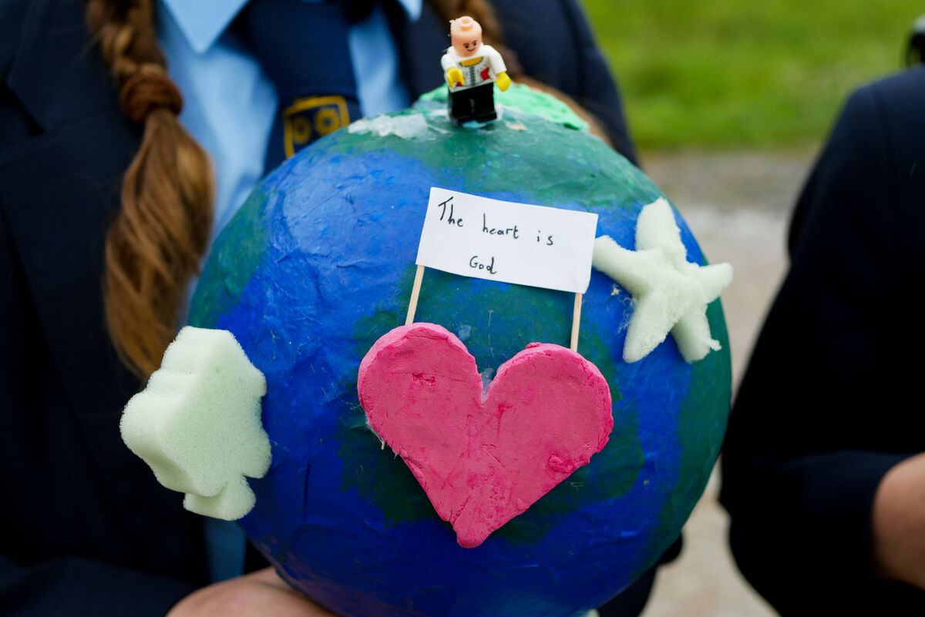
We can share God’s love by working together with all the people in our global family to build a better world – a world where all people have enough food to eat, clean water to drink, and somewhere safe to live, learn and grow.
Notes:
School children campaigning for a better world
Photo credit: CAFOD

Slide 10
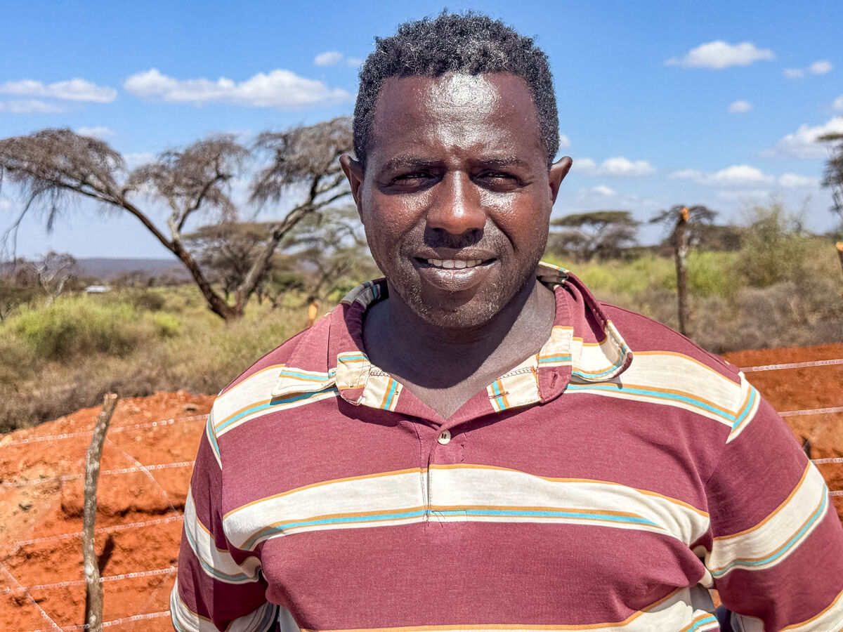
Abbiott works as a climate change officer in the Borana community in Ethiopia where he was born.
He saw how changing weather had badly affected his people. Not enough rain meant crops and cattle died and there was not enough clean water to drink.
“When I was a child, this land was not affected by climate change," says Abbiott. "We had milk, cheese, lots of things. There was no water problem.”
Notes:
Abbiott, Climate change officer, Southern Ethiopia
Photo credit: Louise Norton

Slide 11
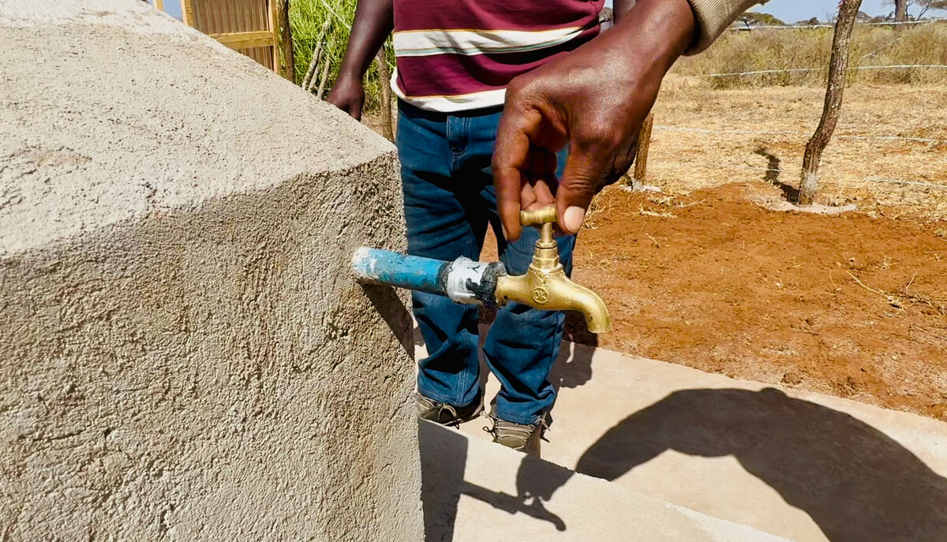
Abbiott went to university to study climate change so that he could help his community, work to build a better world and share God's love.
With CAFOD's help, Abbiott has developed a tank that catches water when rain does fall. It can store enough water for 300 families.
Notes:
CIFA (Community Initiatives Facilitations and Assistance) water tank project
Photo credit: Louise Norton

Slide 12
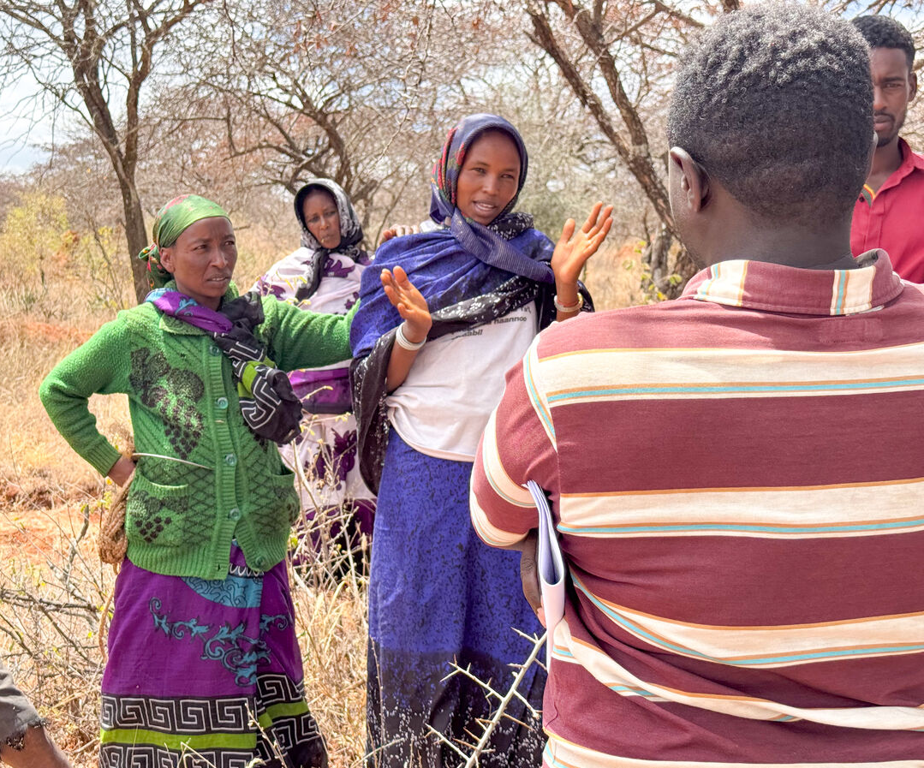
Abbiott wanted to work with his local community because he knows a better world needs all of us.
"Working together is good," he says. "We are working hand in hand."
We can all share God's love and work to build a better world by being kind to one another, praying for our sisters and brothers around the world and raising money for CAFOD.
Notes:
Dalati and Ware with Abbiott, Southern Ethiopia
Photo credit: Louise Norton

Slide 13
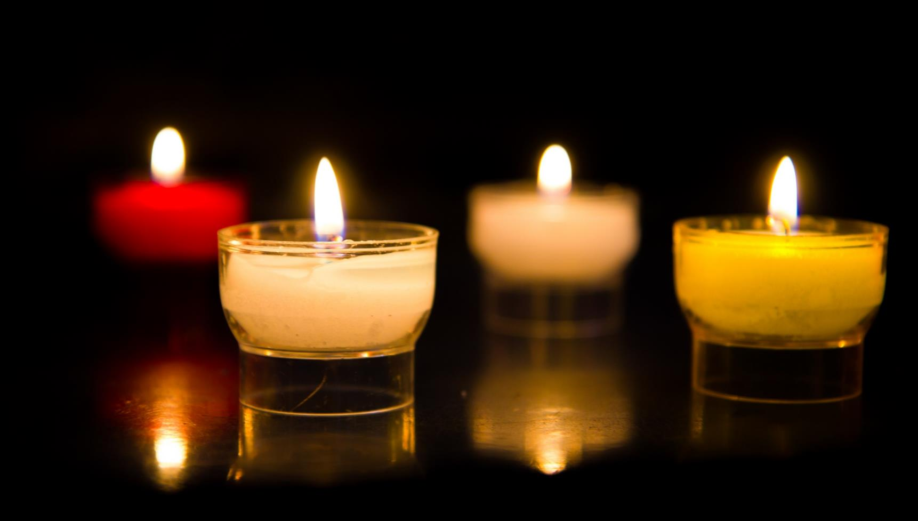
Let us pray…

Slide 14
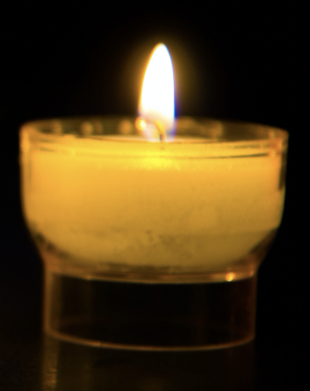
We pray for the Church: that through God’s grace it may be a place of welcome and love for all people, no matter who they are or where they come from. Lord in your mercy…
We pray for all people who are facing poverty or illness: that they may find comfort in God’s love and the love of those around them. May they receive the practical help that they need. Lord in your mercy…
We pray for our parish, family and friends: that we may be moved to share God’s love with one another, working together to build a better world, free from poverty and conflict. Lord in your mercy…

Slide 15
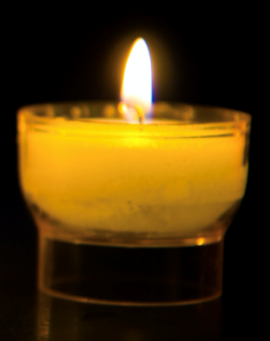
In this Jubilee Year, we pray that we may be signs of hope in our world through all that we do and how we treat one another.
Lord, in your mercy…
Loving God,
We thank you once more for the sign of your great love for us, that is Jesus Christ on the cross. Help us to share your love with others and to support one another to build a better world. Amen.

Slide 16
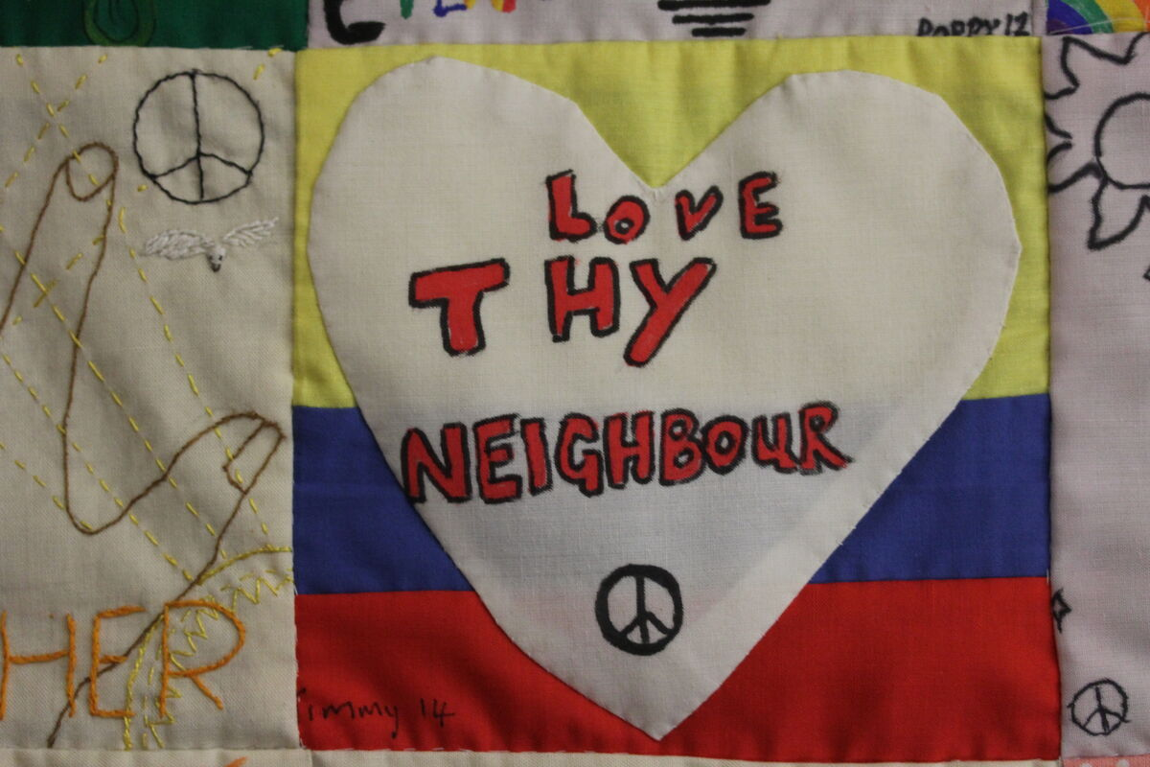

How will you share God’s love with others over the coming week?
Send
Notes:
Hands On Magdalena Medio Norwich wall hanging
Photo credit: Joe Savage

Slide 17

Activity suggestions
Invite the children to colour in the accompanying illustration of a cross and to write/draw around it the signs of God’s love that they see in our world and/or how they will share God’s love with others in our world.
Cut heart shapes out of card and encourage the children to write a prayer saying thank you for the love they receive in their lives. Invite them to pray these at home together with their family during the week and to think of all people around the world in our global family who are also loved by God. You could display these hearts by sticking them around or onto a large cross, which shows us God’s love for the world.
Remind the children to share all that they have heard and thought about in the liturgy today with the people at home. Encourage them to share God’s love through their actions in the coming week.
Notes:
Illustration: Jane Smith

Slide 18
Notes:
Illustration: Emma Metcalfe

Slide 19

Watch our
primary national assembly to find out how to live out your Jubilee Pledge in this Season of Creation!

Slide 20

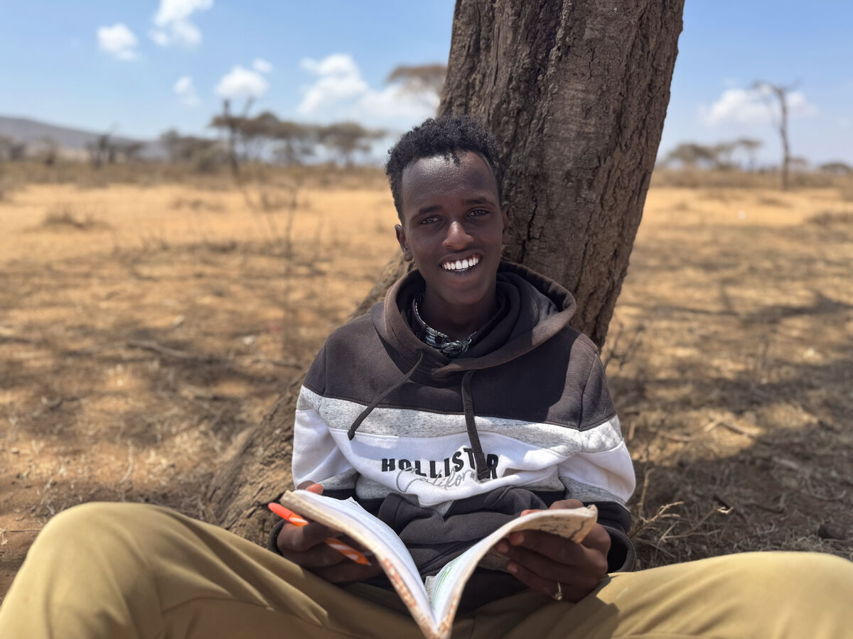
Autumn fundraising resources
Explore our autumn fundraising resources and take action this term.
Autumn 2025 film for children: A better world needs all of us | CAFOD
World_Gifts_Assembly_2025.pptx
Registration for Autumn pack - Primary
School fundraising
Back to school: Explore our resources for the new school year
Notes:
Abadhalee, Southern Ethiopia
Photo credit: Louise Norton

Slide 21
It's not too late to make your Jubilee Pledge!
There's still time to make your Jubilee Pledge!
Many schools have made their Jubilee Pledge to live out Catholic Social Teaching. If you haven't made yours yet, it's not too late!
A better world needs all of us, and the Pledge will be a whole school, long-term commitment to building a fairer world.
Watch our films and download our resources to help you write your Pledge and plan your Pledge Day:
Jubilee pledge for schools
The Jubilee Year is a landmark moment in the life of the global church. School communities are invited to join together as pilgrims of hope, pledging to work together for God’s kingdom of justice, peace and love. Find resources at:
Jubilee for schools 2025 – Pilgrims of Hope

Slide 22
