Slide 1
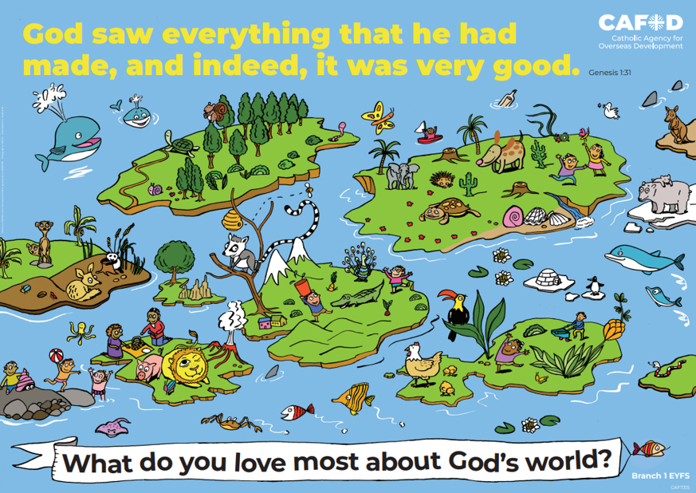
Year 2 RED poster activities
Branch 1: Creation and Covenant
Order the RE CAFOD poster set
Notes:
Timings
This presentation has been designed to last for 10-15 minutes. It can be used as a stand-alone lesson or incorporated into a scheme.
Extension
Although this presentation was designed to simply engage pupils in discussion about key RED themes, the sessions can be developed in many ways. Some of the examples are included below:
Give pupils the poster (or a part of it) to discuss and annotate in groups
Provide pupils with their own A4 version of the poster to put in their own RE books (double page spread). This can be labelled in various ways, such as with references to scripture or Laudato Si’
Invite children to draw or list their own additions and suggestions to the poster
Offer children the opportunity to create their own poster, for example through artwork or through drama (creating freeze frames).

Slide 2
EYFS Year 1 Year 2
“God saw everything that he had made and, indeed, it was very good.” (Gen 1: 31) What do you love most about God’s world? | “We can all work together to protect the earth, our common home” (Based on Laudato Si’ 13) The world is God’s gift to us. How can we take care of it? | “We can all work together to protect the earth, our common home” (Based on Laudato Si’ 13) The world is God’s gift to us. How can we take care of it?
Creation (God, me, family) Stewardship Dignity (special, loved) | Creation Taking care of God’s world Laudato Si’ Pope Francis | Psalms Stewardship Caring for God’s world
EYFS | U1.1.2, U1.1.3, U1.1.4, U1.1.5, D1.1.1, D1.1.2, R1.1.3, R1.1.4 | U2.1.2, U2.1.3, D2.1.2, R2.1.2, R2.1.2
CAFOD poster
Themes
RED outcomes
Notes:
For teachers’ use only.
Note: The RED outcomes which are highlighted are most relevant to these CAFOD posters are highlighted in bold.

Slide 3
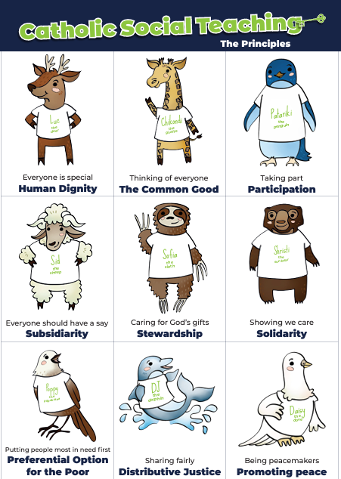
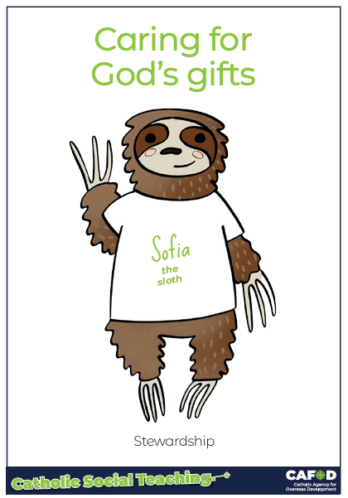
God’s gifts
Stewardship
This means:
Caring for all people
Caring for the world
Making things fair
Sharing with others
Looking after the poor and those in need
.
Notes:
For teachers:
This gives a brief overview of CST which includes stewardship. These posters support CST and look more closely at stewardship and how we can be better stewards.
Catholic Social Teaching helps us to know how to treat each other and the world. One principle is ‘stewardship’. Sofia the sloth reminds us about Stewardship – it is about caring for God’s gifts.
This means:
Caring for all people
Caring for the world
Making things fair
Sharing with others
Looking after the poor and those in need
For teacher support for embedding CST throughout the school see:
https://cafod.org.uk/education/primary-teaching-resources/cst-pack-for-children

Slide 4
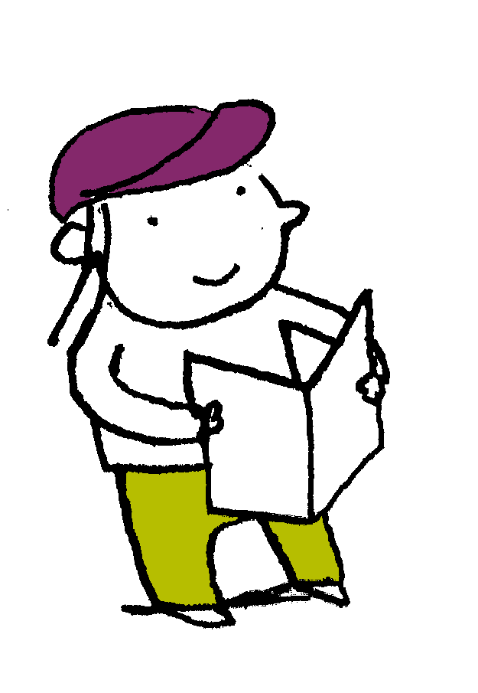
“In the beginning God “In the beginning God made the heavens and the earth…. God created man in his own image, in the image of God he created him; male and female he created them… God saw everything that he had made and, indeed, it was very good.” Genesis 1: 1-31
Scripture
Notes:
Read this piece of scripture before discussing the posters.
Optional: light a candle, play some gentle music and invite pupils to reflect on these words of scripture and what they mean. Read them from the Bible to demonstrate its importance and tell pupils that these words come from Genesis, the first book of the Bible.

Slide 5
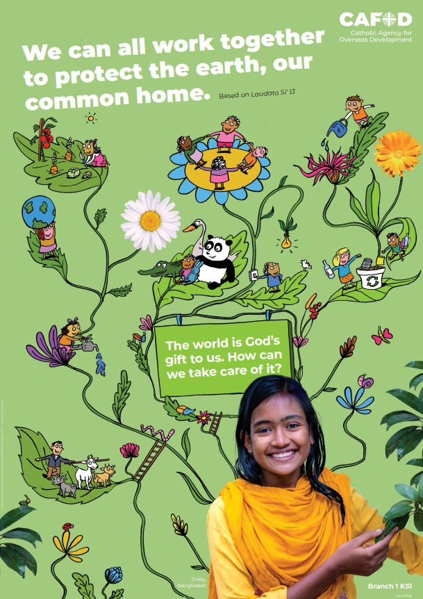
God’s world
Key words: Psalms Stewardship Caring for God’s world
Key questions:
How can we take care of the earth, God’s gift to us?
How can we work together to protect our common home?
Notes:
Explain that you will be looking at this poster. Read through the key words you will be exploring and the key question(s) you will be answering. Ask pupils if they can recognise how this poster links to the words from the Bible they have just heard.

Slide 6
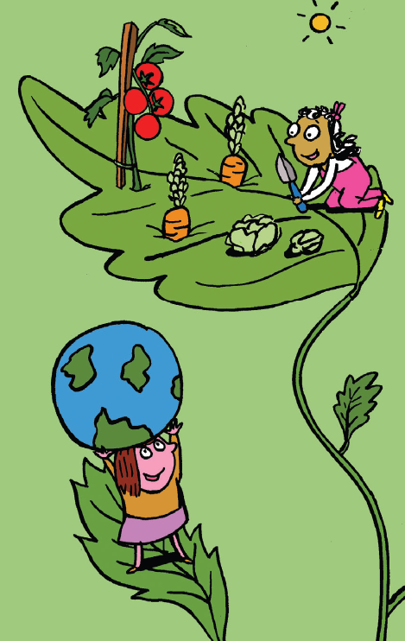
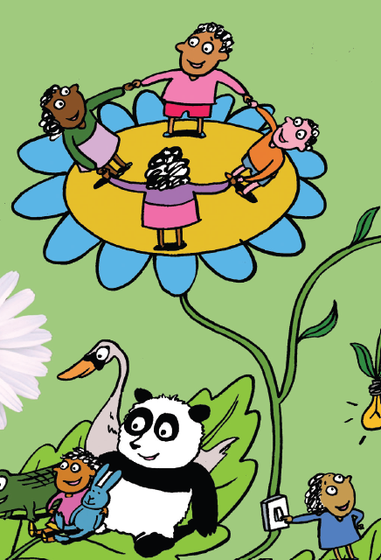
God’s world
Psalms
The psalms give praise to God for creation.
What would you like to give God praise for?
Notes:
Ask the pupils to close their eyes and then read this psalm aloud to the pupils. Repeat.
You are all around me on every side; you protect me with your power. Your knowledge of me is too deep; it is beyond my understanding.
(Psalm 137)
Suggested questions:
What did you hear?
What did the psalmist praise God for?

Slide 7
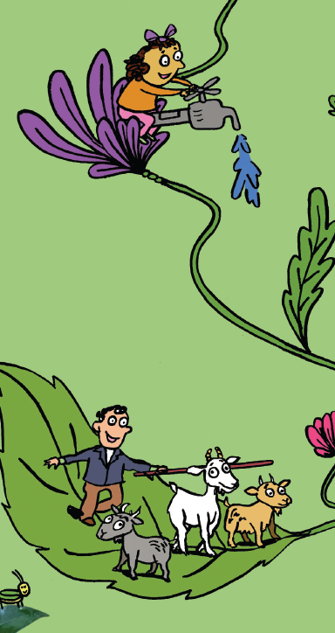
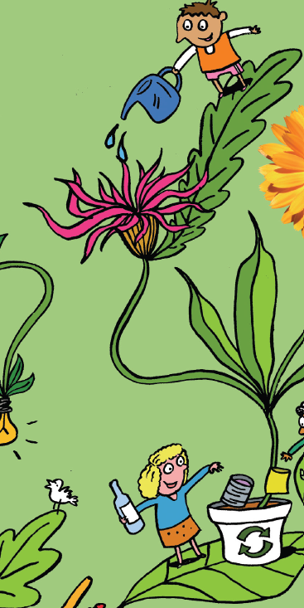
God’s world
Stewardship
Stewardship means that we care for the earth so that we can pass it on to our children.
What kind of an earth do we want to pass on to others?
Is there anything else they could do?
Notes:
Explain what stewardship means and ask pupils what kind of an earth they want to pass on (healthy, clean, safe, beautiful, as God made it…)
Suggested questions:
How does this poster show stewardship? (Recycling, taking care of plants and animals by watering and feeding them, protecting them…)
What could you do to help take care of our common home and your community (or another community around the world that needs your help)?

Slide 8
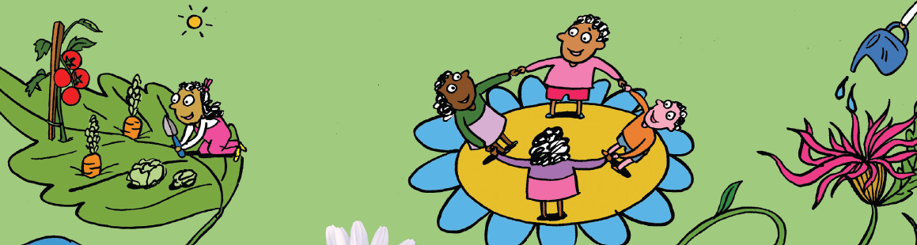
God’s world
I wonder How can we be good stewards of the earth?
What could be added to the picture?
Notes:
Discuss the questions on the slide. Answers may include, but not be limited to:
Turning off lights and not wasting energy
Putting rubbish in the bin
Not wasting food
Only taking what we need and not being greedy…
This slide and the previous two will show some of these actions.

Slide 9
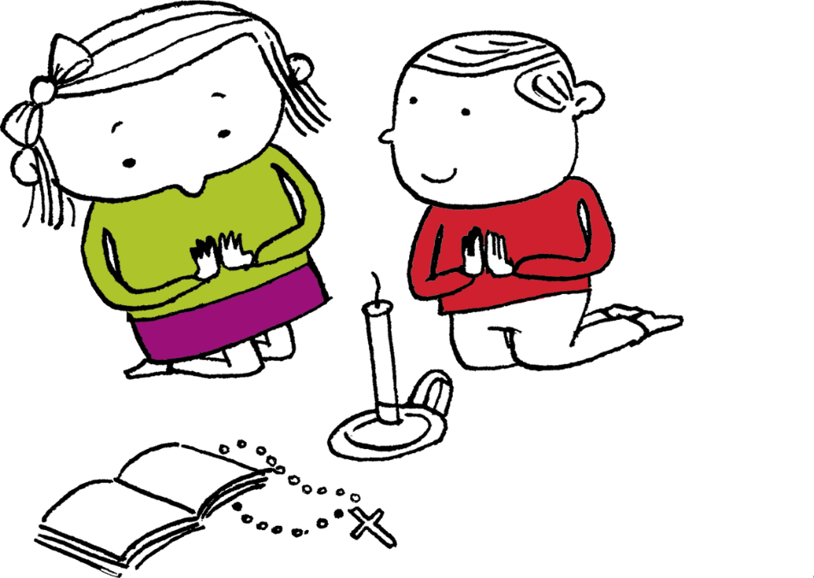
Let us pray
Thank you, God,
for giving us the earth,
which is your gift to us.
Help us to work together to protect the earth, our common home. Amen

Slide 10
God’s world
Key words: Psalms Stewardship Caring for God’s world
Key questions:
How can we take care of the earth, God’s gift to us?
How can we work together to protect our common home?
Notes:
Review learning

Slide 11
Order the RE CAFOD poster set

