Slide 1
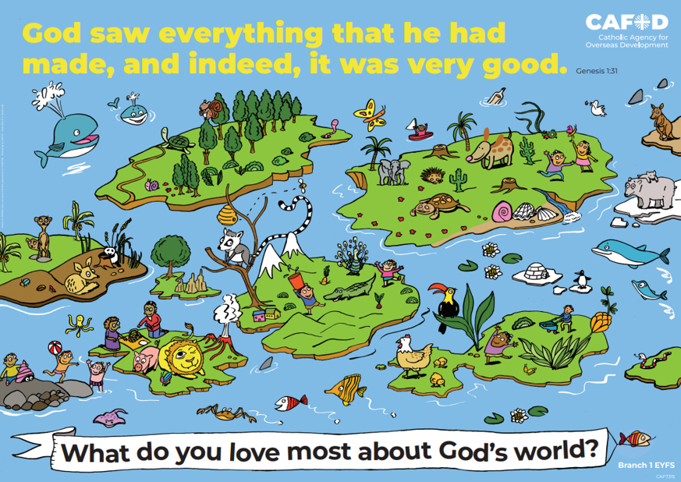
Year 5
RED poster activities
Branch 1: Creation
and Covenant
Order the RE CAFOD poster set
Notes:
Timings
This presentation has been designed to last for 15-20 minutes. It can be used as a stand-alone lesson or incorporated into a scheme.
Extension
Although this presentation was designed to simply engage pupils in discussion about key RED themes, the sessions can be developed in many ways. Some of the examples are included below:
Give pupils the poster (or a part of it) to discuss and annotate in groups
Provide pupils with their own A4 version of the poster to put in their own RE books (double page spread). This can be labelled in various ways, such as with references to scripture or Laudato Si’
Invite children to draw or list their own additions and suggestions to the poster
Offer children the opportunity to create their own poster, for example through artwork or through drama (creating freeze frames).

Slide 2
Year 5 Year 6
“Each community can take from the earth everything it needs to live, but it also has the duty to protect the world for future generations.” (Based on Laudato Si’ 67) How can we be stewards of God’s creation? | “Each community can take from the earth everything it needs to live, but it also has the duty to protect the world for future generations.” (Based on Laudato Si’ 67) How can we be stewards of God’s creation?
Welcoming asylum seekers and refugees Common good Love of neighbour | Laudato Si’ Created world & Stewardship Dignity & equality Greatness of God Damage
U5.1.6, U5.1.2, D5.1.3, R5.1.4 | U6.1.2, U6.1.5, R6.1.1, R6.1.2, R6.1.3
CAFOD poster
Themes
RED outcomes
Notes:
For teachers’ use only.
Note: The RED outcomes which are highlighted are most relevant to these CAFOD posters are highlighted in bold.

Slide 3
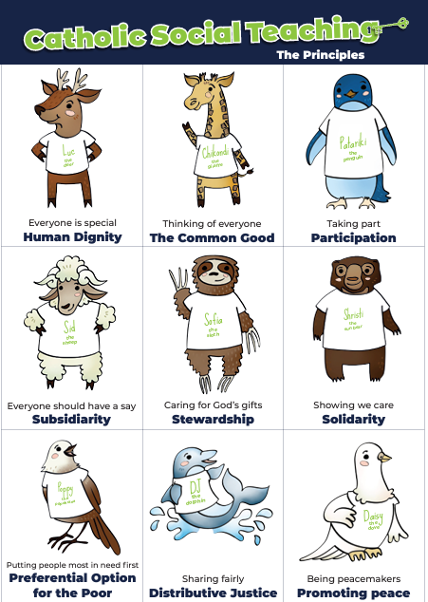
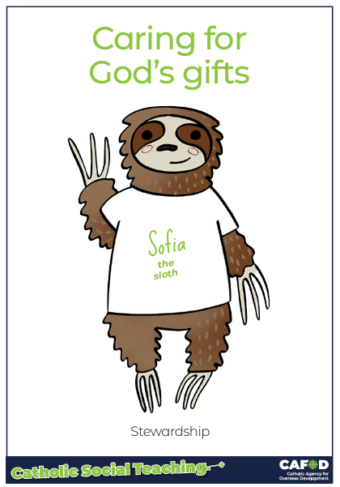
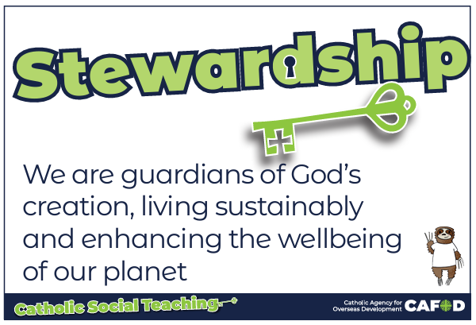
God’s gifts
Notes:
For teachers:
This gives a brief overview of CST which includes stewardship. These posters support CST and look more closely at stewardship and how we can be better stewards.
Catholic Social Teaching helps us to know how to treat each other and the world. One principle is ‘stewardship’. Sofia the sloth reminds us about Stewardship – it is about caring for God’s gifts.
This means:
Caring for all people
Caring for the world
Making things fair
Sharing with others
Looking after the poor and those in need
For teacher support for embedding CST throughout the school see:
https://cafod.org.uk/education/primary-teaching-resources/cst-pack-for-children

Slide 4
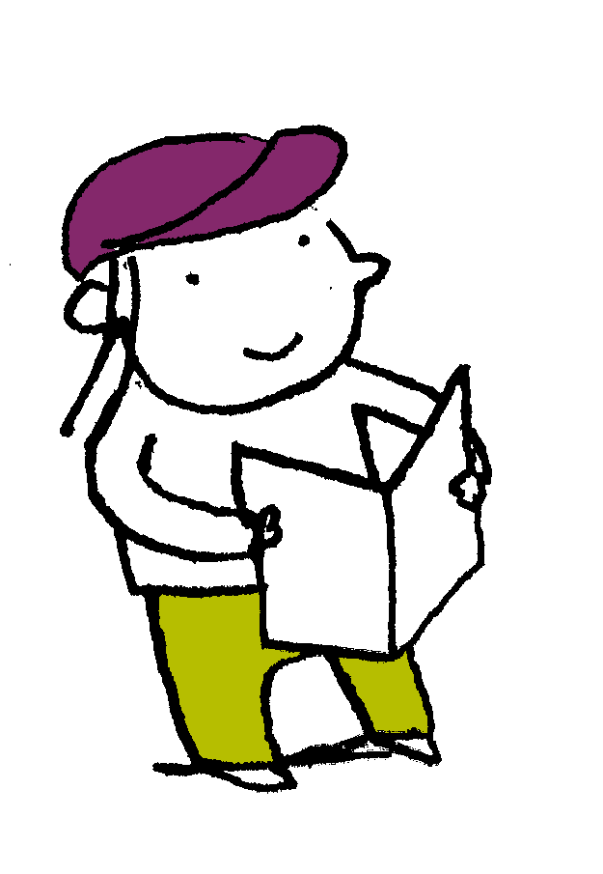
“God blessed them. And God said to them, “Be fruitful and multiply and fill the earth and subdue it and have dominion over the fish of the sea and over the birds of the heavens and over every living thing that moves on the earth.”…. And it was so. And God saw everything that he had made, and behold, it was very good.
Genesis 1: 28-31
Scripture
Notes:
Read this piece of scripture before discussing the posters.
Optional: light a candle, play some gentle music and invite pupils to reflect on these words of scripture and what they mean. Read them from the Bible to demonstrate its importance and tell pupils that these words come from Genesis, the first book of the Bible.

Slide 5
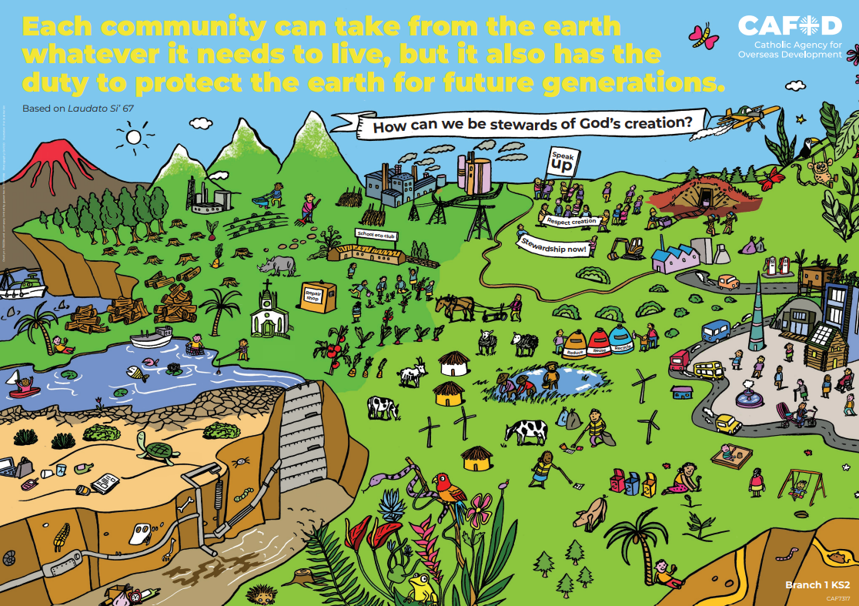
God’s world
Key words:
Common good
love of neighbour,
welcome of asylum seekers and refugees
Key questions:
How can we be stewards of God’s creation?
How can we protect the earth for future generations?
Notes:
Explain that you will be looking at this poster. Read through the key words you will be exploring and the key question(s) you will be answering. Ask pupils if they can recognise how this poster links to the words from the Bible they have just heard.

Slide 6
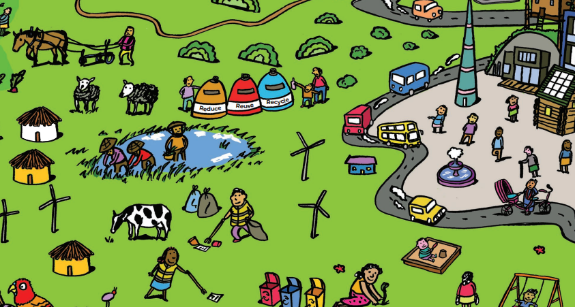
God’s world
Common good
The common good is making sure everyone in society is looked after and can benefit from resources.
In what ways are the people in this picture living out the common good?
What could be added to the picture?
Notes:
Discuss the questions on the slide.
Answers may include:
Taking care of waste (different coloured bins – reduce, reuse, recycle)
Conserving energy (wind turbines)
Keeping the earth clean and tidy (picking up litter)
Cultivating the land
Taking care of the animals (respectful farming)
How does the poster show the common good and looking after the most vulnerable (eg asylum seekers, those living in poverty…)?
Challenge 1: You may wish to ask pupils about how this poster might link to Beatitudes (blessed are the peacemakers, blessed are the merciful, blessed are the meek, blessed are those who hunger and thirst for what is right…). This is a part of future learning for Y5.
Challenge 2: Ask pupils how this poster shows any of the fruits of the Holy Spirit (love, joy, peace, patience, kindness, goodness, faithfulness, gentleness, self-control). This is also a part of future learning for Y5.

Slide 7
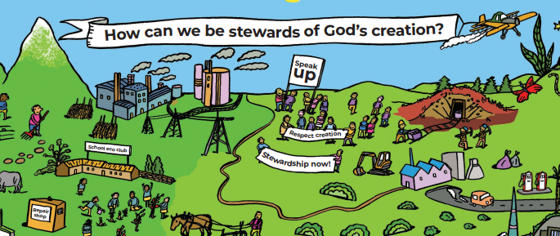
God’s world
Good neighbours and the common good
Are the people in this picture being good neighbours? Explain.
How are they working for the common good?
Notes:
Explain that when people take too much for themselves or waste what they have, others do not get what they need. This is not sustainable or fair.
Discuss the questions on the slide.
Answers might include:
Looking after the poor and vulnerable by being a voice for them
Campaigning for stewardship so that people can get what they need
Working for sustainability
Other answers may also be valid.

Slide 8
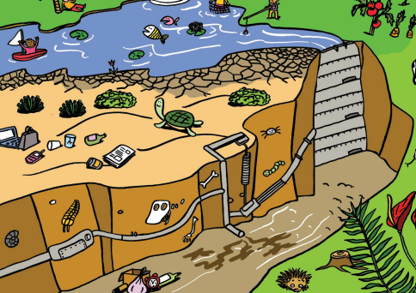
God’s world
Look at this picture.
Describe it using these words:
Common good
Love of neighbour
Notes:
Discuss the slide and how it shows not being a good neighbour by showing them love, or looking after the common good.
Answers might include:
People have left their rubbish lying around
The equipment is broken
There is chemical waste/leakage
There are factory emissions
Discuss the consequences of not loving our neighbour by looking after the common good.
Answers might include: broken relationships with God, the world and others. Also: unhappiness, war and destruction, uncleanliness (inside and out)…

Slide 9
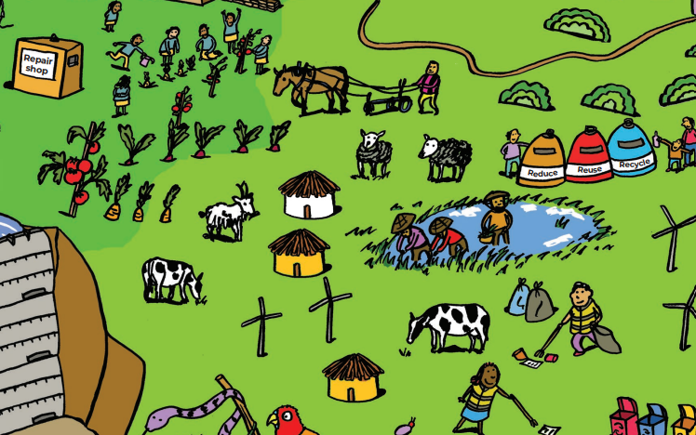
God’s world
Welcoming refugees and asylum seekers
Why is it important to welcome others?
How can everyone contribute to society?
What could be added to the picture to show welcome and dignity?
Notes:
Explain that part of loving our neighbour as Jesus asked means welcoming and including them, respecting their dignity and looking after their wellbeing. This is part of the common good.
Discuss the questions on the slides.
Answers might include:
It is important to welcome others because Jesus told us to (“When I was a stranger, you welcomed me” - Matthew 25:35)
Everyone has human dignity and God loves everyone. All persons are made in his own image
There is dignity of workers
Different people are contributing (and can contribute in some way)
Highlight that it is not what people do and contribute to society that gives them dignity. They have an inherent dignity given by God.
Pupils might say that there is more that could be added to show welcome. Discuss what this could look like, and how they could welcome people in their own contexts.

Slide 10
God’s world
Key words:
Common good
love of neighbour,
welcome of asylum seekers and refugees
Key questions:
How can we be stewards of God’s creation?
How can we protect
the earth for future generations?
Notes:
Review

Slide 11
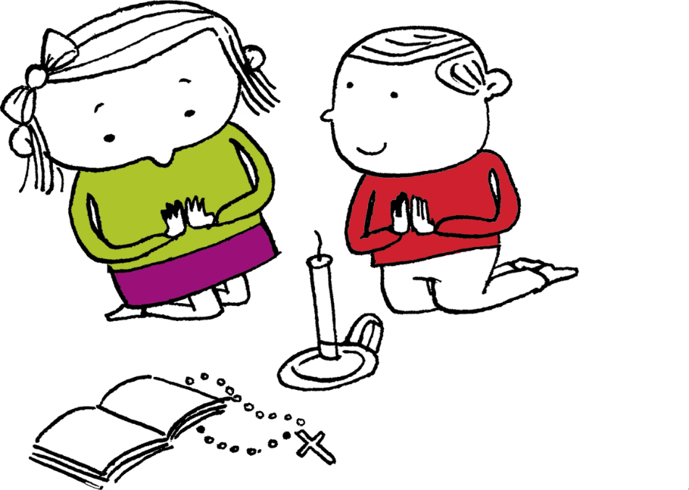
Let us pray
Thank you, God,
For the common good and
for our good neighbours.
Help us to be good
and kind to others,
welcoming strangers
and putting others
before ourselves,
especially those in most need.
Amen

Slide 12
Order the RE CAFOD poster set

