Slide 1
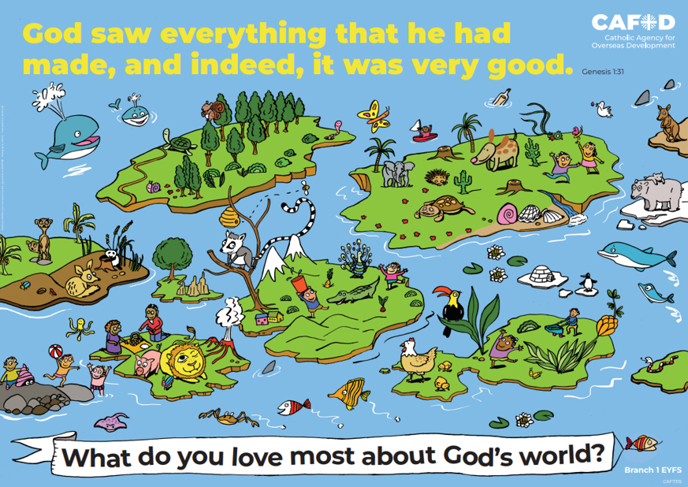
Year 4
RED poster activities
Branch 1: Creation
and Covenant
Order the RE CAFOD poster set
Notes:
Timings
This presentation has been designed to last for 15-20 minutes. It can be used as a stand-alone lesson or incorporated into a scheme.
Extension
Although this presentation was designed to simply engage pupils in discussion about key RED themes, the sessions can be developed in many ways. Some of the examples are included below:
Give pupils the poster (or a part of it) to discuss and annotate in groups
Provide pupils with their own A4 version of the poster to put in their own RE books (double page spread). This can be labelled in various ways, such as with references to scripture or Laudato Si’
Invite children to draw or list their own additions and suggestions to the poster
Offer children the opportunity to create their own poster, for example through artwork or through drama (creating freeze frames).

Slide 2
Year 3 Year 4
“Human life is grounded in three fundamental and closely intertwined relationships: with God, with our neighbour and with the earth itself.” (Pope Francis, Laudato Si’ 66) Why is it important to look after our relationship with God, with our neighbours and with the earth itself? | “Human life is grounded in three fundamental and closely intertwined relationships: with God, with our neighbour and with the earth itself.” (Pope Francis, Laudato Si’ 66) Why is it important to look after our relationship with God, with our neighbours and with the earth itself?
Human dignity Stewardship Ecological virtues Laudato Si’ Canticle of Creation | Good neighbour Virtues of faith, hope and love
U3.1.2, U3.1.3, U3.1.4, U3.1.5, U3.1.6, D3.1.1, D3.1.2, D3.1.3, R3.1.1, R3.1.2, R3.1.3 | U4.1.6, D4.1.1, R4.1.1, R4.1.2
CAFOD poster
Themes
RED outcomes
Notes:
For teachers’ use only.
Note: The RED outcomes which are highlighted are most relevant to these CAFOD posters are highlighted in bold.

Slide 3
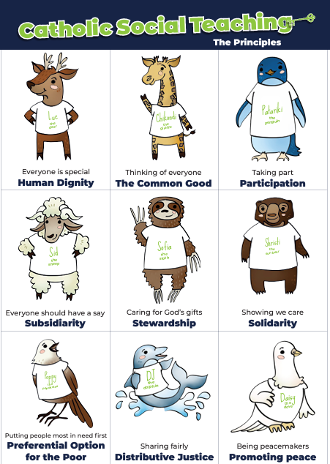
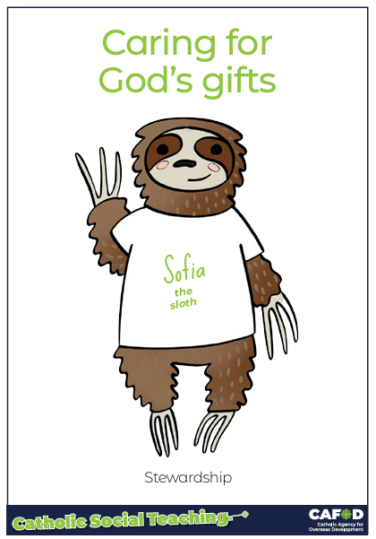
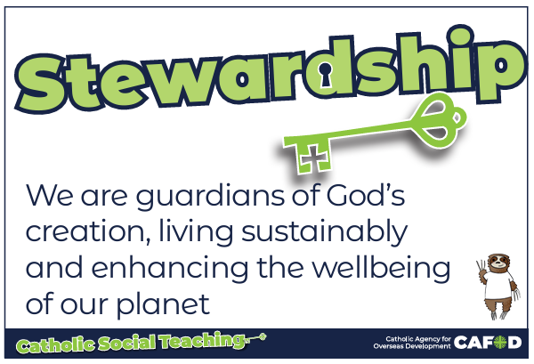
God’s gifts
Notes:
For teachers:
This gives a brief overview of CST which includes stewardship. These posters support CST and look more closely at stewardship and how we can be better stewards.
Catholic Social Teaching helps us to know how to treat each other and the world. One principle is ‘stewardship’. Sofia the sloth reminds us about Stewardship – it is about caring for God’s gifts.
This means:
Caring for all people
Caring for the world
Making things fair
Sharing with others
Looking after the poor and those in need
For teacher support for embedding CST throughout the school see:
https://cafod.org.uk/education/primary-teaching-resources/cst-pack-for-children

Slide 4
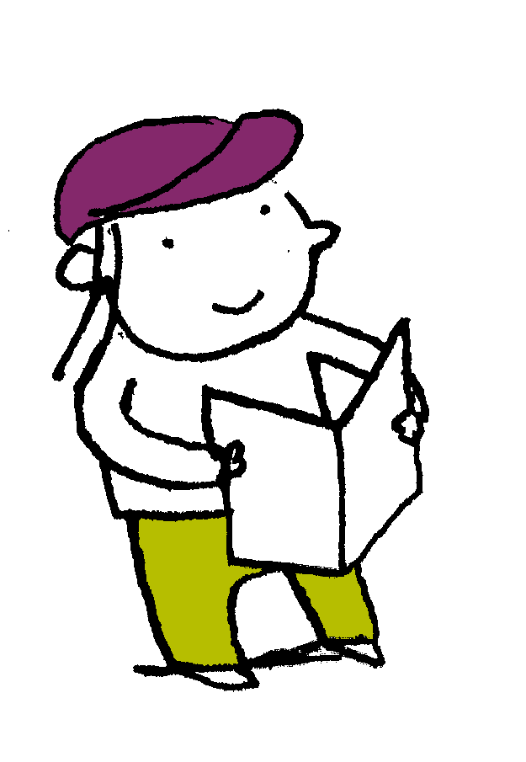
“So God created man in his own image, in the image of God he created him; male and female he created them.
God blessed them. And God said to them, “Be fruitful and multiply and fill the earth and subdue it and have dominion over the fish of the sea and over the birds of the heavens and over every living thing that moves on the earth.”…. And it was so. And God saw everything that he had made, and behold, it was very good.
Genesis 1: 27-31
Scripture

Slide 5
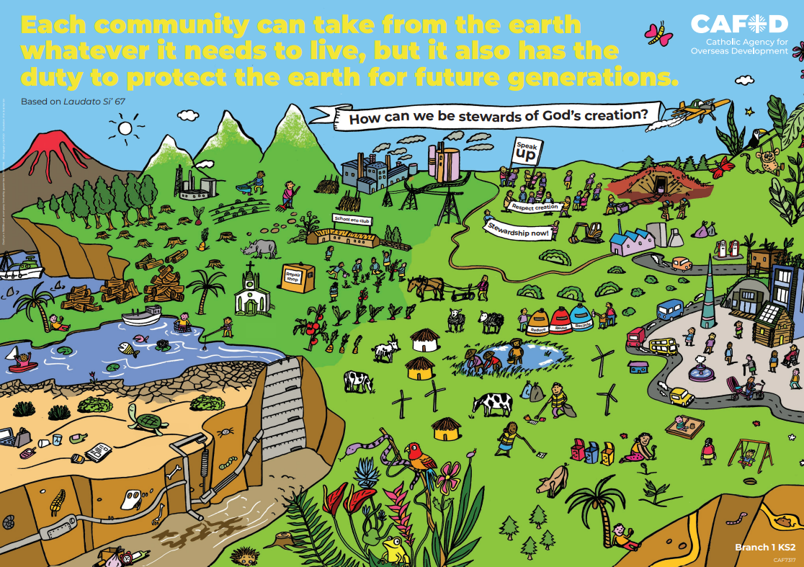
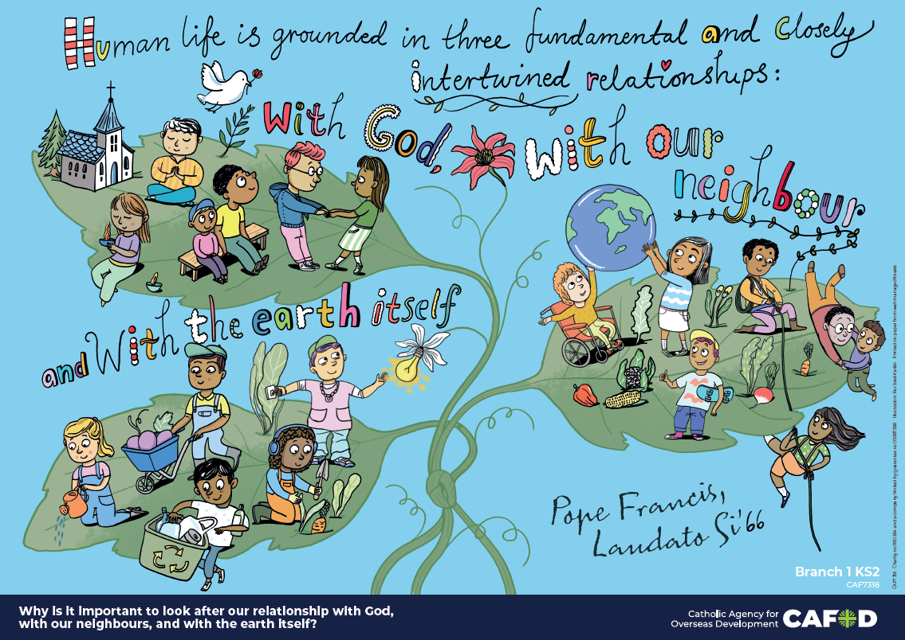
God’s world
Key words:
Good neighbour; virtues of faith, hope and love
Key questions:
Why is it important to look after our relationship with God, with our neighbour and with the earth itself?
Notes:
Explain that you will be looking at these posters. Read through the key words you will be exploring and the key question(s) you will be answering. Ask pupils if they can recognise how these posters links to the word from the Bible they have just heard.
Note that this session may be broken into two small parts or be done as a full lesson.

Slide 6
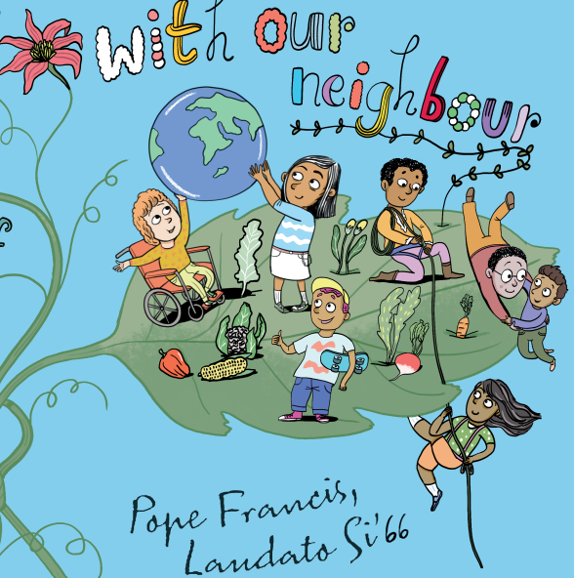
God’s world
Good neighbour
A good neighbour is one who looks after others, near and far, to make sure they have what they need.
In what ways are the people in this picture being good neighbours?
What could be added to the poster?
How could YOU be a good neighbour?
Notes:
Discuss the term ‘neighbour’ and where they might have heard it before (Good Samaritan story). Explain how everyone is our neighbour, not just those who live next door/close by. We have global neighbours too – they live in different countries.
Discuss the questions on the slides.
Answers might include:
Helping those who have fallen or are hurt in any way, or preventing them from doing so by keeping everyone safe
Working together and helping those in difficulty (pulling up with a rope)
Looking after those with disabilities so that they have equal rights and can flourish
Sharing food so everyone has enough to eat
Having a shared responsibility for the earth
Various things could be added to the poster, such as:
Helping people who are weak and vulnerable,
Taking care of those who are sad or lonely

Slide 7
God’s world
Virtues
How are the people in this poster living out the theological virtues of faith, hope and love?
How can the virtues of faith, hope and love help you to be a good neighbour and have good relationships?
Notes:
Explain that faith, hope and love are theological virtues. All virtues are concerned with ideal behaviour and being so that we can live our best life.
Discuss how they are doing this in the poster. Answers might include:
Loving God by loving all he created - neighbour by helping and using kind words, loving earth by looking after the plants
Having faith in God by going to Church and listening to his word, praying and spending time with him
Hoping by offering hopes and dreams to God in prayer, hoping for the best future by preparing the earth (sowing seeds), giving others hope through words and actions
You may also wish to revise previous learning on virtues from Y3 (optional):
The 4 cardinal virtues are named as:
Justice - always ensuring that God, our neighbour and the earth receive their due.
Temperance (temperateness) – enjoying things in moderation.
Prudence (practical wisdom) – exercising good judgement in moral situations.
Fortitude (courage) – demonstrating constancy in pursuit of what’s good, overcoming temptations, obstacles and fears.

Slide 8
God’s world
Faith, hope and love
How can your life
and the lives of others be transformed by the virtues of faith, hope and love?
If you created a virtues poster, what might it include?
Notes:
Discuss what lives would be like without faith, hope and love (no thoughts for the future, no relationship with God, no loving or kind acts…)
Encourage pupils to think about their own lives and if someone has had faith in them, loved them or given them hope. Ask them how this made a difference to them (their feelings, attitudes, behaviour).
Invite pupils to think of ONE thing they could do to demonstrate each virtue. Discuss. Think of how this could be shown on a poster.
NOTE: Pupils could just discuss what they could add to their poster (in theory). Alternatively, they could create a poster (independent/shared, using ART or IT skills)

Slide 9
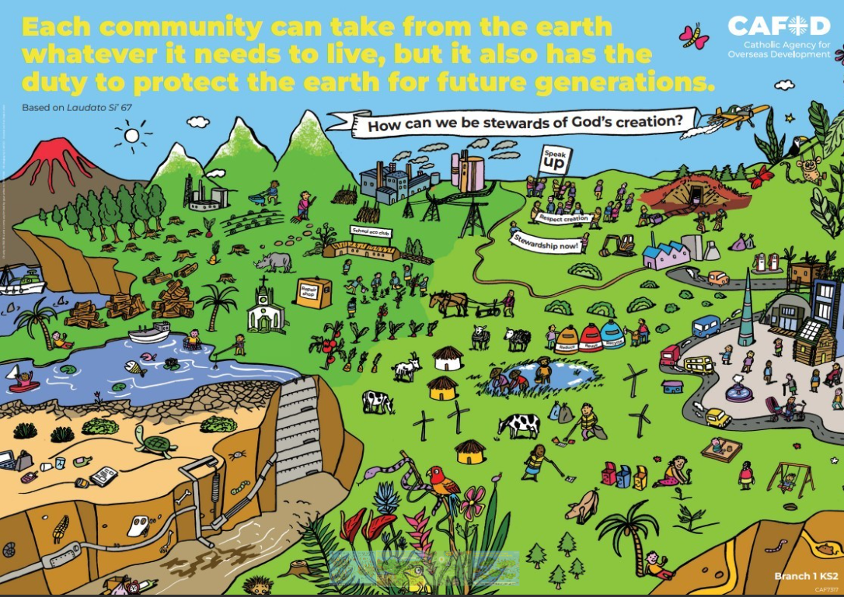
God’s world
Being a good neighbour means thinking of others. We can do this by demonstrating the virtues of faith, hope and love.
Being a good global neighbour involves working together towards a common goal, which is creating a better world (our common home) for the future.
Notes:
Discuss other parts of this poster. Suggested questions:
Is everyone taking care of the world? How do you know? (Draw their attention to the left side and top of the poster). Explain that there is a close up of the left side that we will explore soon.
Discuss what it means to be a good steward and to look after the interests of others, not just our own.

Slide 10
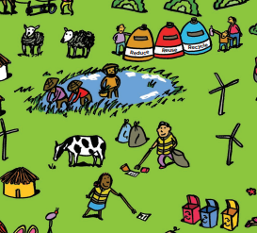
God’s world
Theological virtues
In what way are the people in this picture demonstrating (or not) the virtues of faith, hope and love?
I wonder
What could be added to the poster?
Notes:
Discuss the questions on the slide. Answers might include:
HOPE
They are hoping for the future by: planting seeds to grow, looking after children, looking after the world by reducing, reusing and recycling…
LOVE
They are loving by making sure the plants, animals and people have what they need to survive
FAITH
This is not obvious but there is a church in another part of the poster
Things they could add might include:
Prayer/reflection
Showing loving acts like helping someone who is ill
Showing someone hoping/dreaming of the future

Slide 11
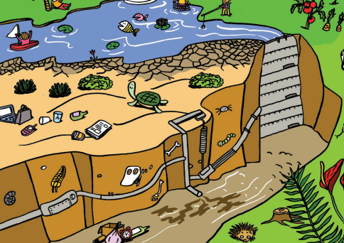
God’s world
Laudato Si’
In Laudato Si’, Pope Francis tells us to be good stewards and cultivate ecological virtues.
I wonder
What would happen to the world if we didn’t live out virtues of faith, hope and love?
Notes:
Ask pupils if everyone is demonstrating virtues in this poster. How do we know?
Answers might include:
People have left their rubbish lying around
The equipment is broken
There is chemical waste/leakage
There are factory emissions
Discuss the consequences of not living out virtues of faith, hope and love.
Answers might include: broken relationships with God, the world and others. Also: unhappiness, war and destruction, uncleanliness (inside and out)…

Slide 12
God’s world
Key words:
Good neighbour; virtues of faith, hope and love
Key questions:
Why is it important to look after our relationship with God, with our neighbour and with the earth itself?
Notes:
Explain that you will be looking at these posters. Read through the key words you will be exploring and the key question(s) you will be answering. Ask pupils if they can recognise how these posters links to the word from the Bible they have just heard.
Note that this session may be broken into two small parts or be done as a full lesson.

Slide 13
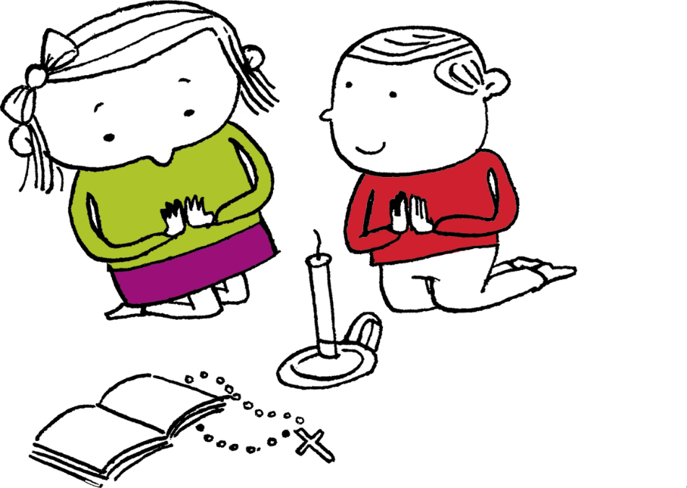
Let us pray
Thank you, God,
For giving us neighbours
to help look after and protect us.
Help us to be good neighbours too.
Give us the gifts and fruits
of your Holy Spirit
so that we can grow
in faith, hope and love.
Amen

Slide 14
Order the RE CAFOD poster set

