Slide 1
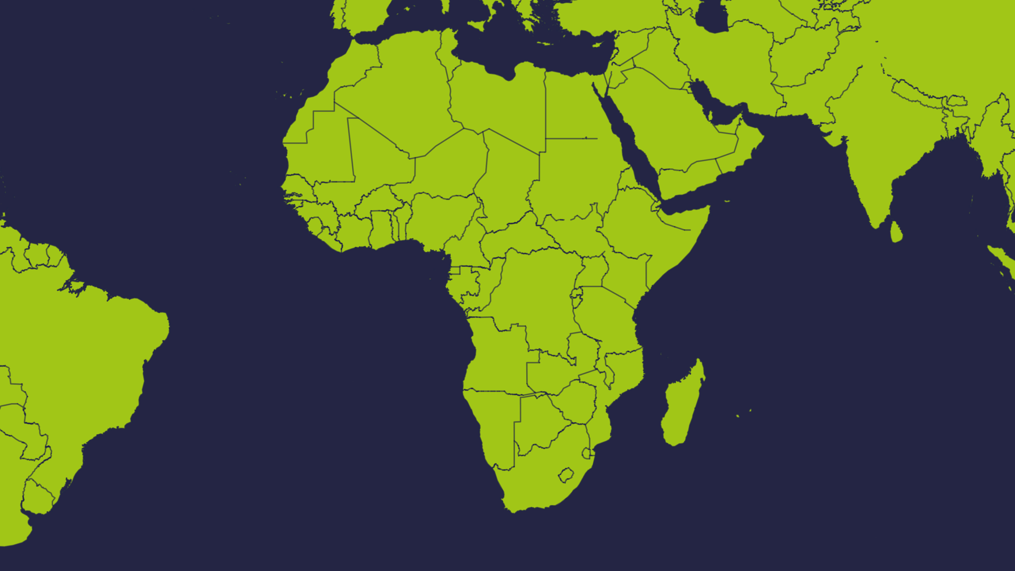
Zimbabwe

Slide 2
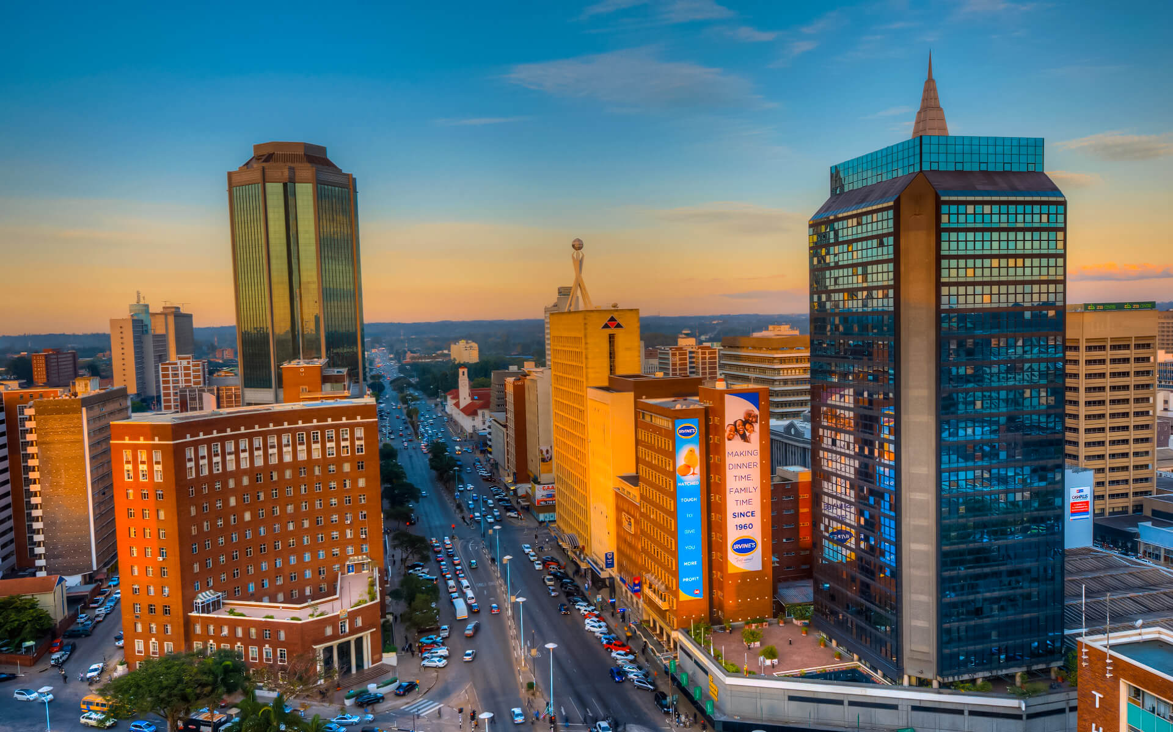
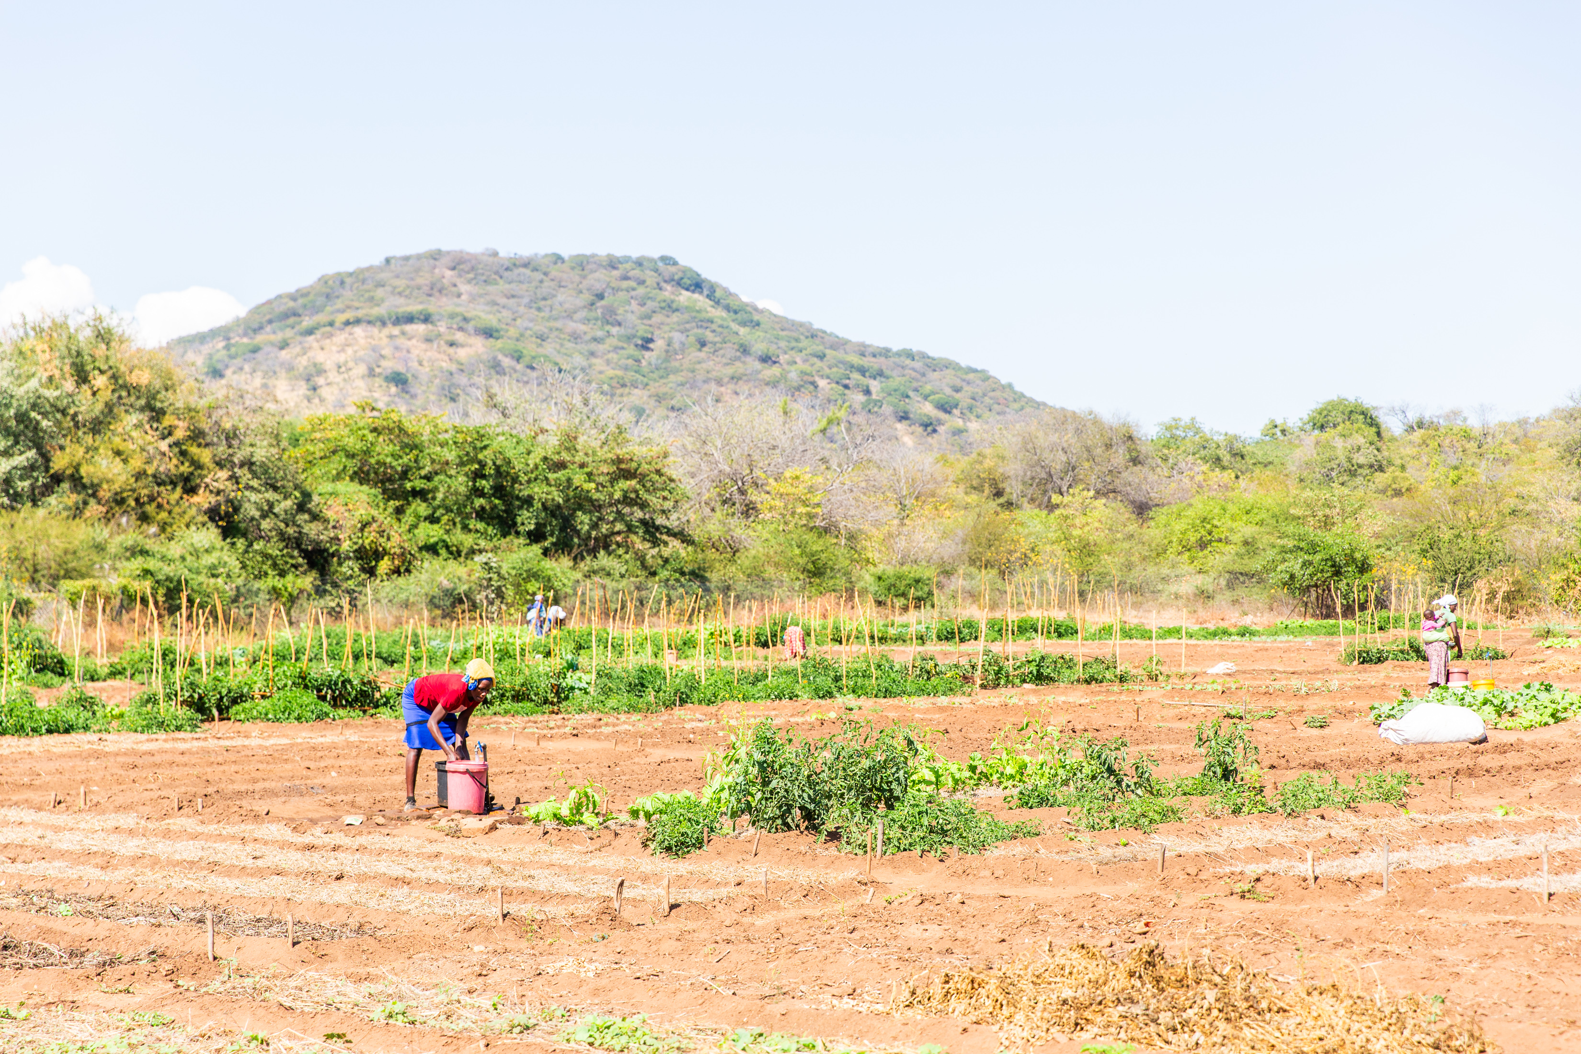
Zimbabwe
Zimbabwe is a country in the south of Africa. Its capital city is Harare.
Zimbabwe is a country with amazing animals and beautiful natural wonders.
Climate change has made Zimbabwe's weather hard to predict for many years.
Capital city: Harare
Poor rainfall leads to drought. This can mean it’s hard to grow crops.
In places with too little water, some children miss school because they need to collect water.
Rushinga, in northern Zimbabwe

