Slide 1
General Election 2024

Slide 3
Teacher Instructions
Hello and welcome to our General Election resource. You can adapt this as you wish.
Printable versions are on our website for you to print and cut out.
Printable ‘Do Now’ and Application activities.
Printable Card sort
The card sort is designed to encourage students to make critical links between different concepts. The students make the links verbally but complete the application activity to show their learning.

Slide 4
DO NOW Activity
6 minutes
Name one product that another country trades with the UK (imported)
Name one multinational corporation.
Name three political parties in the UK.
Name a pressure group or international development charity (not CAFOD!)
Name one country in NATO.
How many countries are represented at the United Nations?
What are the COP conferences about?
How many seats are there in the House of Commons?
What is the name of your constituency?
Name one way you can let the UK government know your thoughts about a particular policy?

Slide 5
Teacher Answers
Name one product that another country trades with the UK (imported) Our Top 5 import goods are cars, refined oil, crude oil, power generators and medicine. Other examples include food e.g cheese, most exotic fruit.
Name one multinational corporation. Apple, Microsoft, Amazon, Alphabet (Google’s parent company), Coca Cola, Nike etc.
Name three political parties in the UK. Liberal Democrats, Green Party, Labour or Conservative but there are over 1000 others. See notes page for list.
Name a pressure group or international development charity (not CAFOD!) Christian Aid, Save the Children, Saint Vincent de Paul Society, Oxfam etc.
Name one country in NATO. UK, America, Norway, Sweden, Spain etc. See notes section for list.
How many countries are represented at the United Nations? 193
What are the COP conferences about? Climate Change
How many seats are there in the House of Commons? 650
What is the name of your constituency?
Name one way you can let the UK government know your thoughts about a particular policy? Petitions, protest, writing to your MP.
Notes:
List of political parties in the United Kingdom – Wikipedia
https://www.nato.int/cps/en/natolive/nato_countries.htm

Slide 6
Video

Slide 7
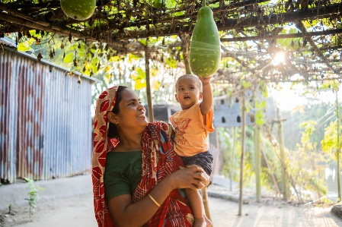
Card Sort Activity
15 minutes
Move the cards around to show how one concept links to another. Make multiple links using these arrows! How many links can you make?
Here is an example.
These concepts link because….
…only a few multinational corporations control seed production.
MULTINATIONAL CORPORATIONS
SEED SOVEREIGNTY
SALINA, SEED FARMER

Slide 8
Application Activity
10 minutes
Use your card sort to help you fill out the following paragraph.
CAFOD, an _____________________________ are asking students to learn three questions to ask their local candidates about certain issues, including seed __________________. International organisations like the _______ ________ have prioritised a few _____________________ corporations to control seeds which means ________ and other seed farmers don’t get to use their own seeds. This can have a knock on effect including……….
In this activity we learnt that……….
Therefore, whoever is chosen to represent us at a national level will be able to influence issues at an international level. CAFOD are asking us to join their _______________ and ______ our local candidates. Every ___________ matters.

Slide 9
Teacher Answers
CAFOD, an international development charity are asking students to learn three questions to ask their local candidates about certain issues, including seed sovereignty. International organisations like World Bank have prioritised a few multinational corporations to control seeds which means Salina and other seed farmers don’t get to use their own seeds. This can have a knock on effect including restricting the diversity of crops.
In this activity we learnt that many things at at international level are interconnected, so an issue relating to food systems can have a direct impact on the world’s poorest people.
Therefore, whoever is chosen to represent us at a national level will be able to influence issues at an international level. CAFOD are asking us to join their campaign and lobby our local candidates. Every voice matters.
Notes:
List of political parties in the United Kingdom – Wikipedia
https://www.nato.int/cps/en/natolive/nato_countries.htm

