Slide 1
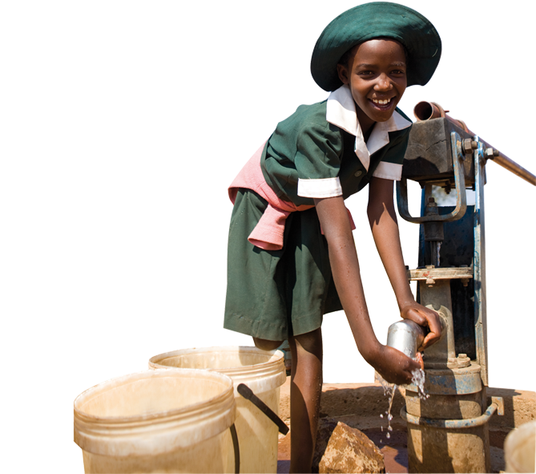
Year 2 Treasures

Slide 2
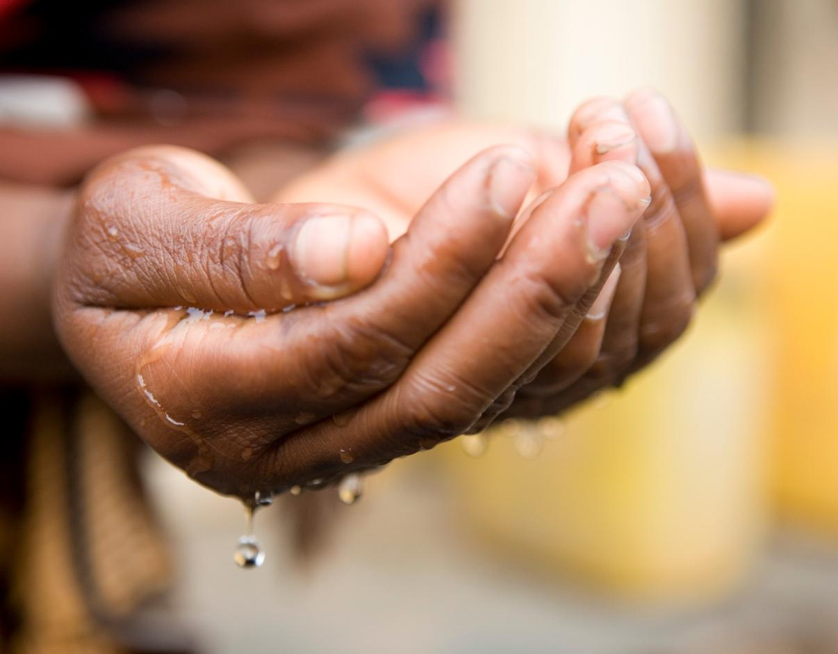
“The poor and needy search for water,
but there is none;
their tongues are dry with thirst…”
Based on Isaiah 41: 17-18

Slide 3
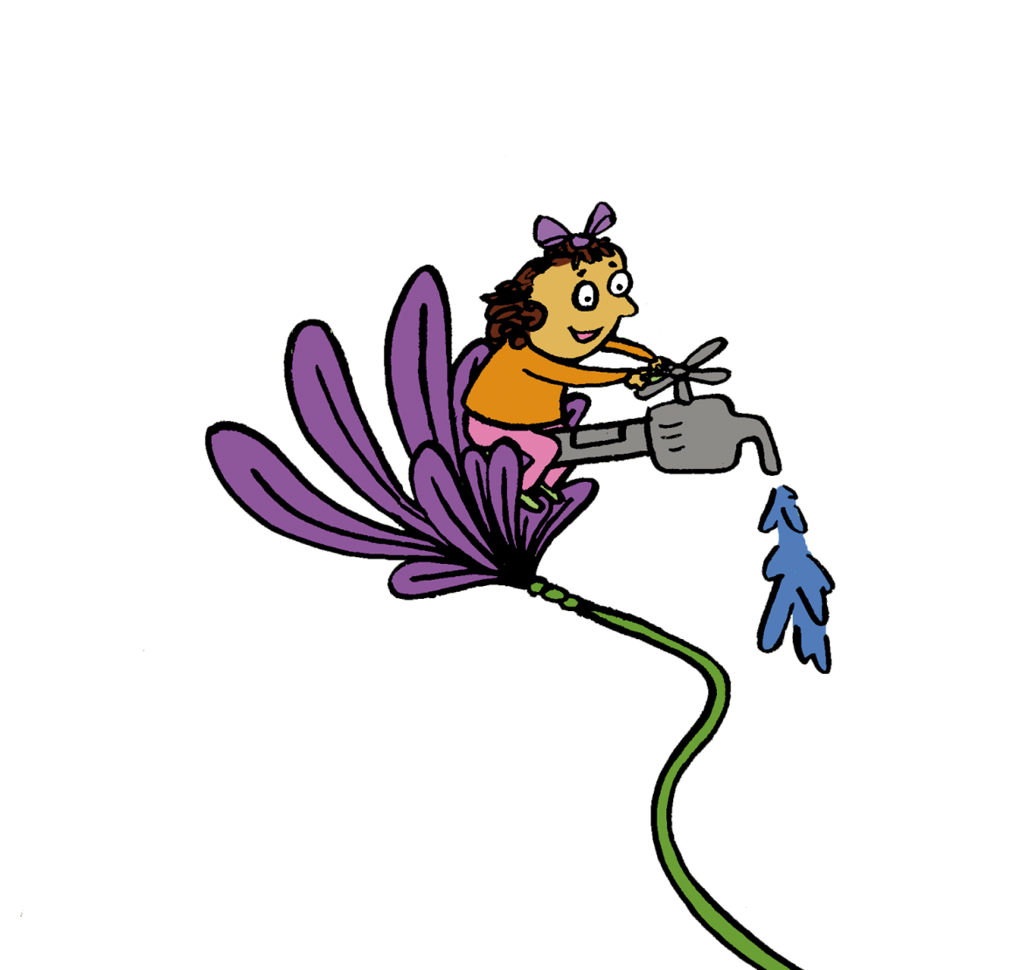
…But I the Lord will answer them.
I will make the rivers flow.
I will turn the desert into pools of water,
and the dry ground into springs”
Based on Isaiah 41: 17-18

Slide 4
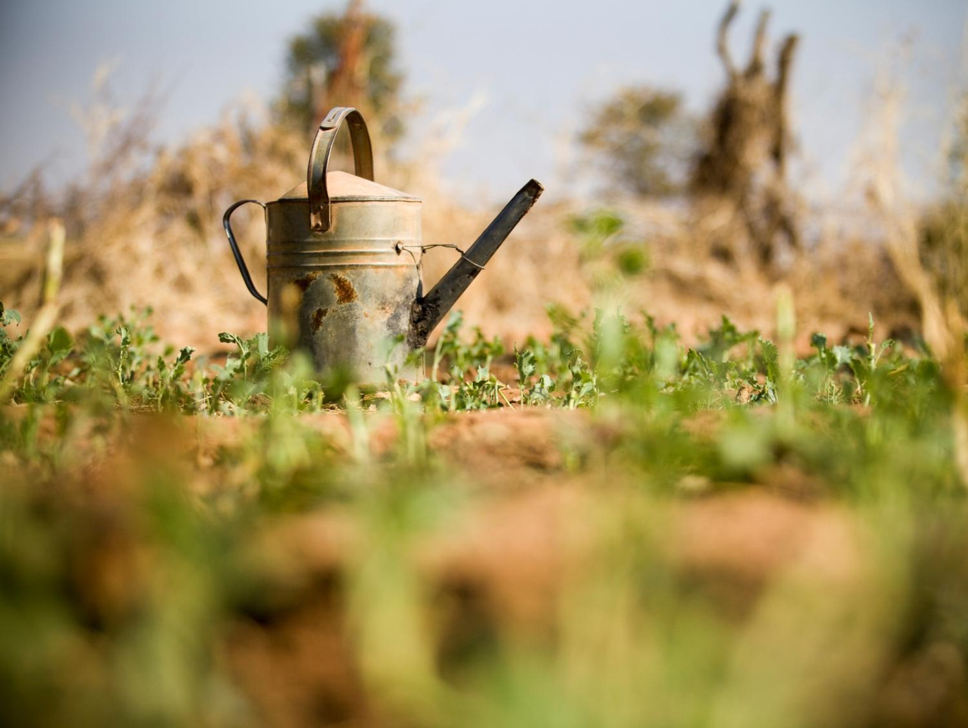
Water is a treasure of God’s world.
Why is it so precious?

Slide 5
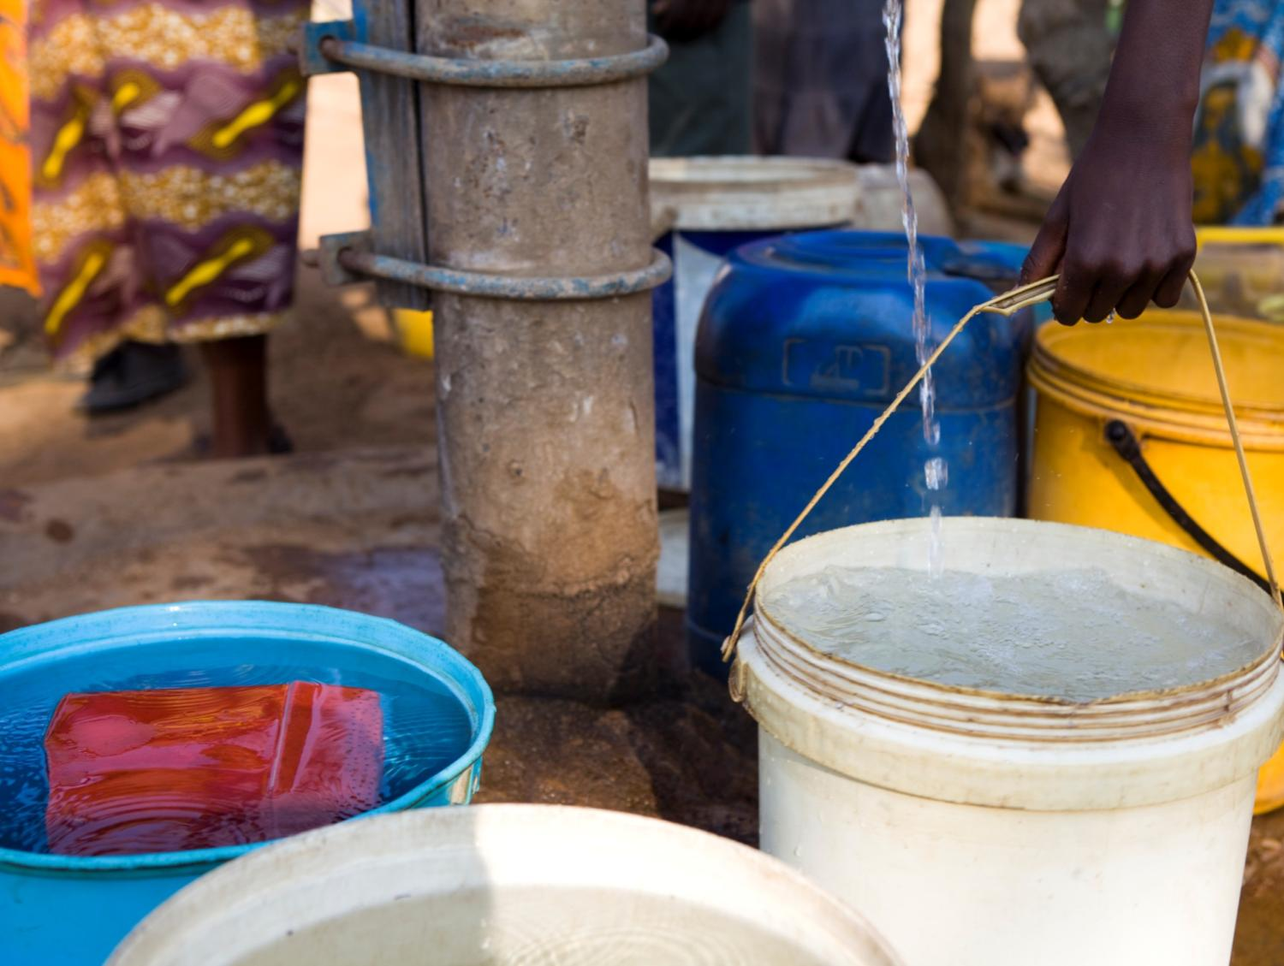
Meet Zimi to find out why water is a precious treasure to her.

Slide 6
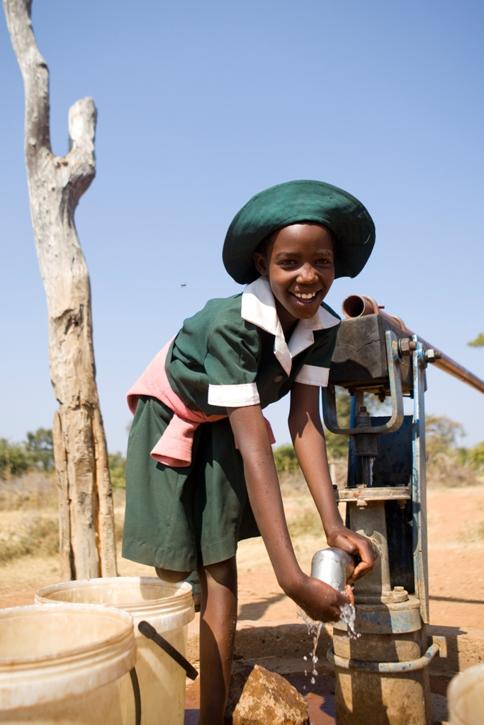
Hi!
My name is Zimi.
I am 10.
I live in a village in Zimbabwe.
Notes:
RAW54477 Zimbabwe

Slide 7
I live with my Aunt because my mum died a few years ago.
I feel sad when I remember my mum but Auntie Judith cares for me well.
I am happy to live here with my family.

Slide 8
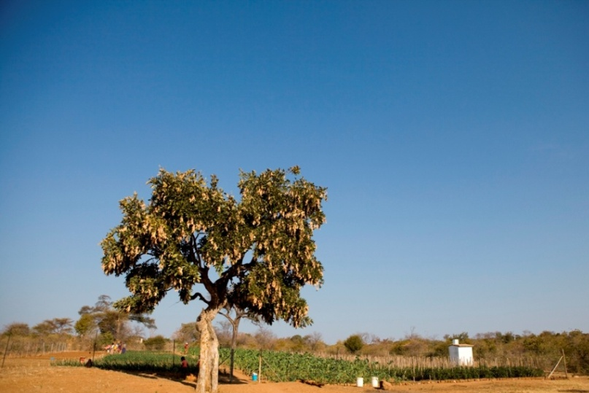
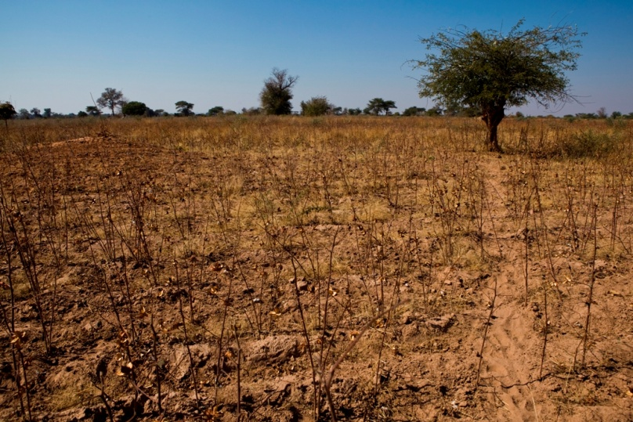
I think water
is very
precious.
In my village there is little rain.
Notes:
Another problem the community faced was a lack of toilets. Everyone used the “bush system” – going to the toilet in the bush – which caused health problems.
RAW54481 Zimbabwe
RAW54282 Zimbabwe

Slide 9
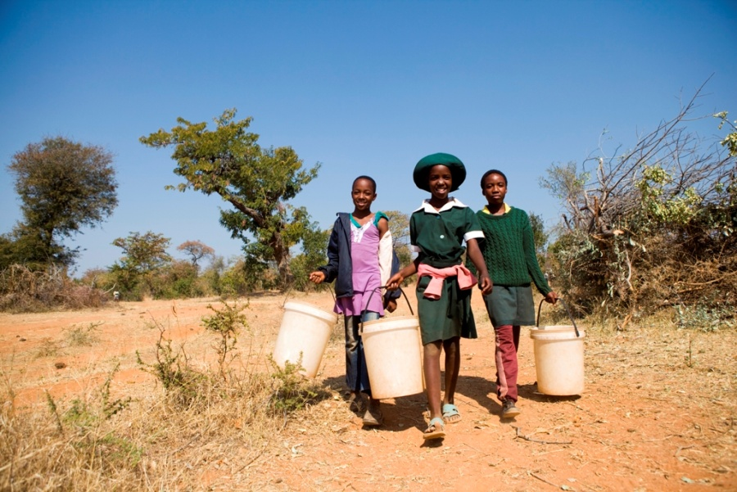
When the wells had no water we had to travel for hours to fetch water from another village.
Notes:
Another problem the community faced was a lack of toilets. Everyone used the “bush system” – going to the toilet in the bush – which caused health problems.
RAW54473 Zimbabwe
The water had no wells because the boreholes broke, which meant that the community had to travel for hours to fetch water from another village.

Slide 10
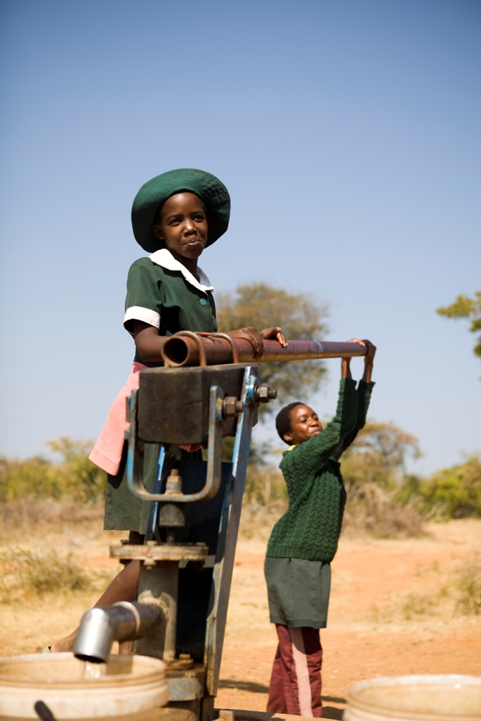
I get a lot of nosebleeds and if water isn’t available, how do I clean my face?
If we don’t have water we can’t wash our hands after break and our exercise books get covered in sand and dirt.

Slide 11
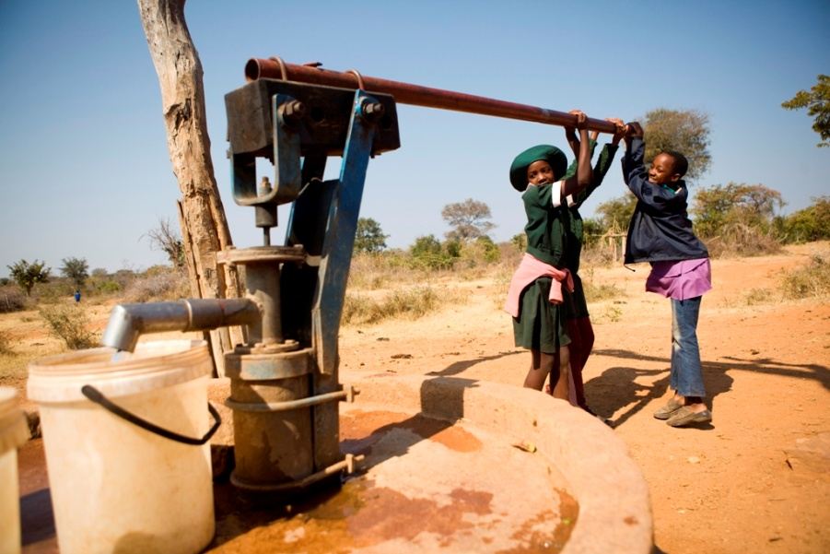
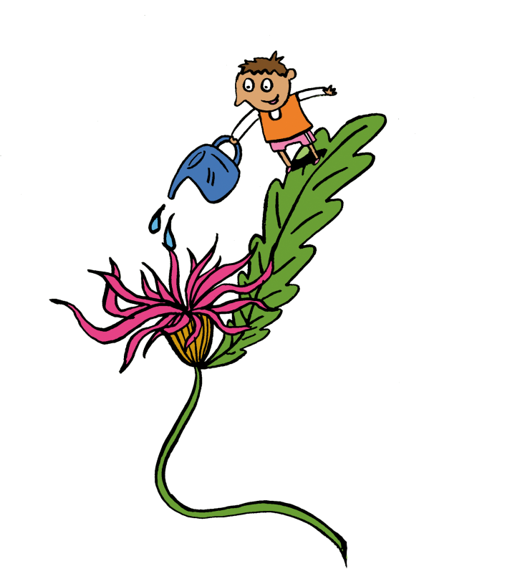
CAFOD helped to fix the wells.
Now we have clean water.
CAFOD also helped to put toilets in my home and school.
Notes:
CAFOD has also set up “nutrition gardens” so that families can grow more crops.
RAW54475 Zimbabwe

Slide 12
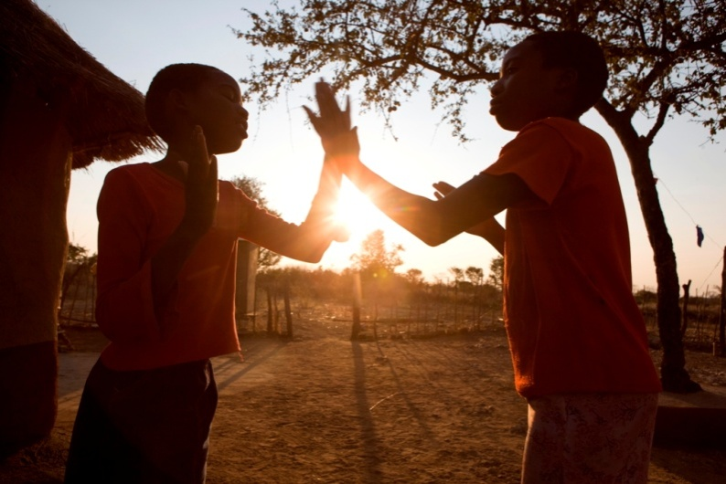
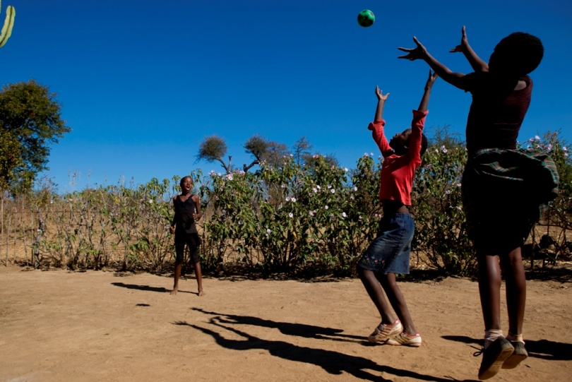
Now the wells are working, I have more time to do things l like.
Before, I would spend most of my spare time fetching water.
Now I have time for
fun stuff.
Notes:
RAW54536 Zimbabwe
RAW54494 Zimbabwe

Slide 13
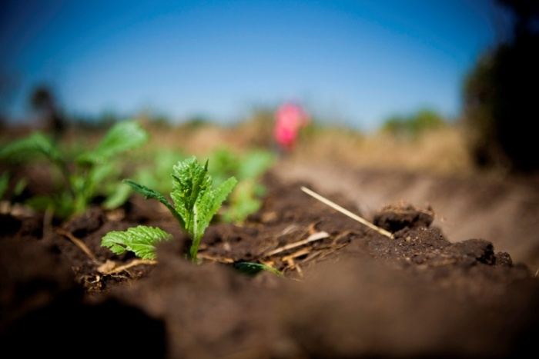
Living in a place without water is very hard.
I think water is very precious
and important in life because without water you cannot survive.
Notes:
RAW54230 Zimbabwe
Zimi’s grandmother, Maida, says: “Without CAFOD we would be suffering a lot. We would be fetching water from far away. Water helps us in so many ways - drinking, cooking, washing. Even our animals drink water and our homes can become beautiful because of water. Water helps me to mend the cracks.”

Slide 14
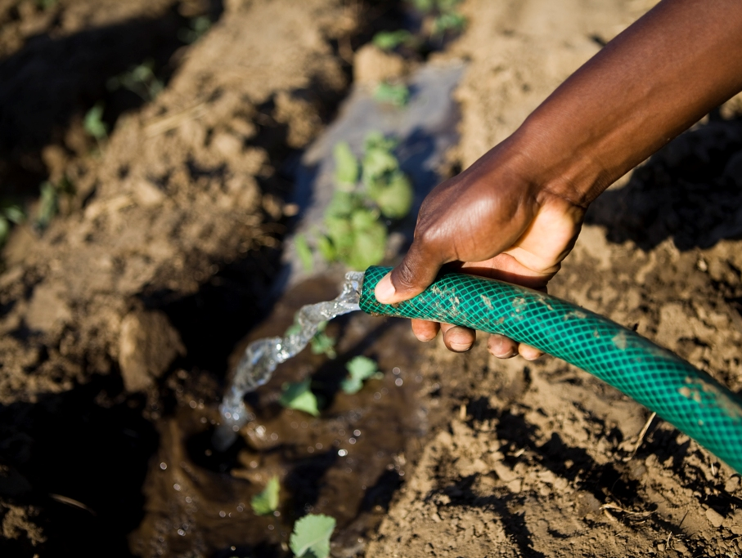
Thank you God for the
treasure of water

Slide 15
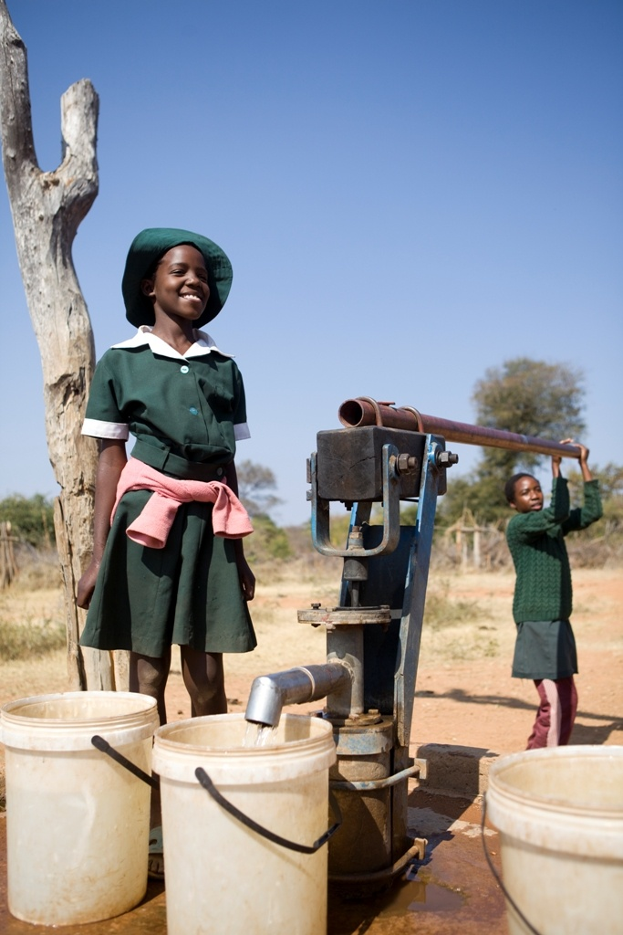
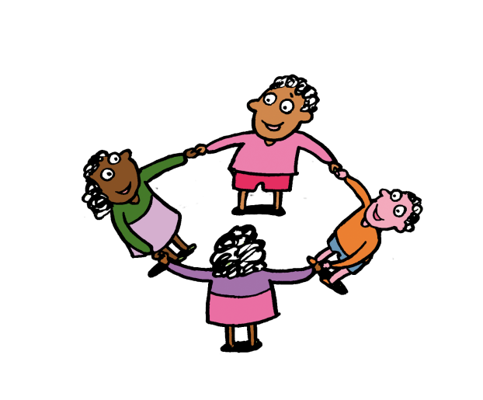
It is good to work with others and share water.
Water is not something that one person should own, it is for everybody to share.
Notes:
RAW54479 Zimbabwe

Slide 16
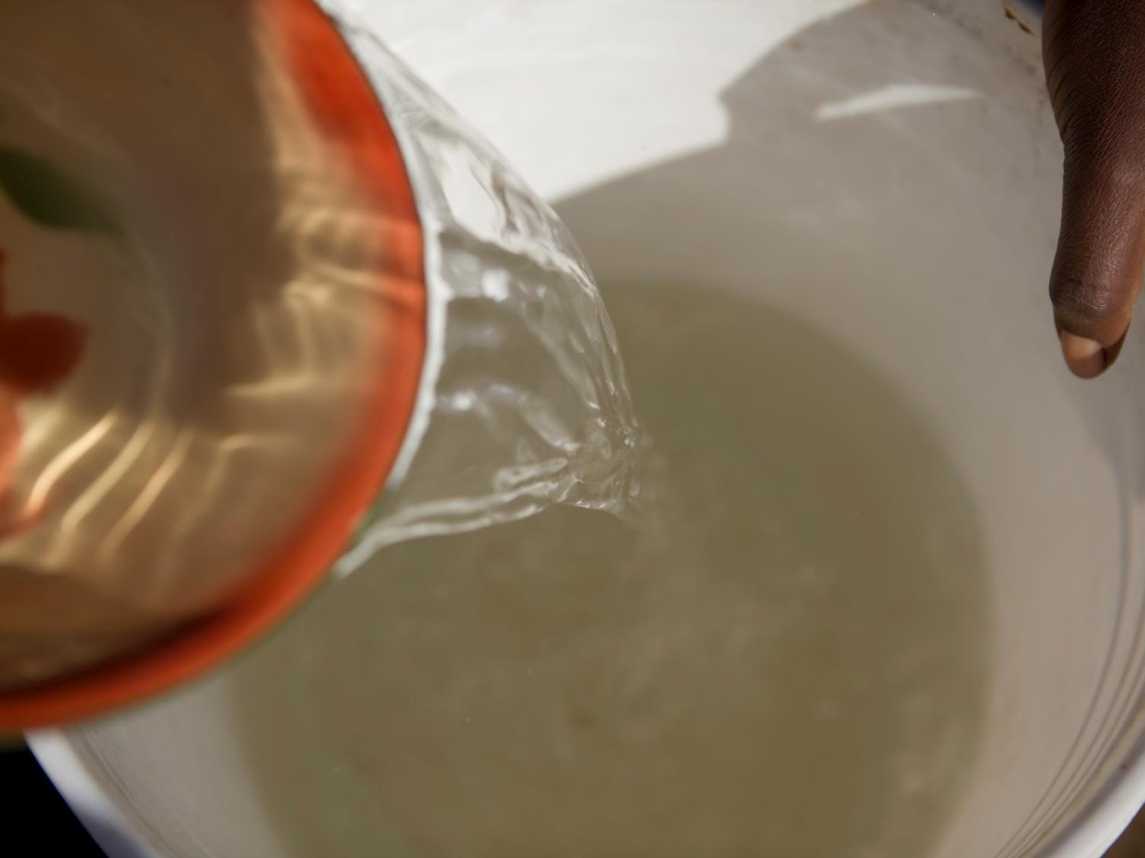
In what ways can we
share God’s treasures?

Slide 17
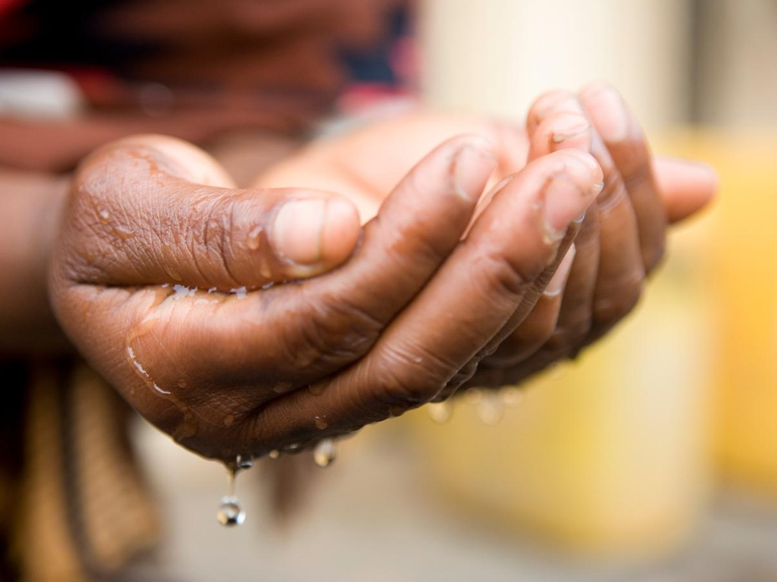
“The poor and needy search for water,
but there is none;
their tongues are dry with thirst.
But I the Lord will answer them.
I will make the rivers flow.
I will turn the desert into pools of water,
And the dry ground into springs”
Based on Isaiah 41: 17-18
Notes:
RAW41636 Nigeria
Halima Mohammed's hands cupping water. Her family has benefited from a constant supply of water due to a rainwater catchment tank provided by CAFOD partner the Archdiocese of Jos.

Slide 18
Photographs by: Simon Rawles
Illustrations:
Per Karlen

