Slide 1
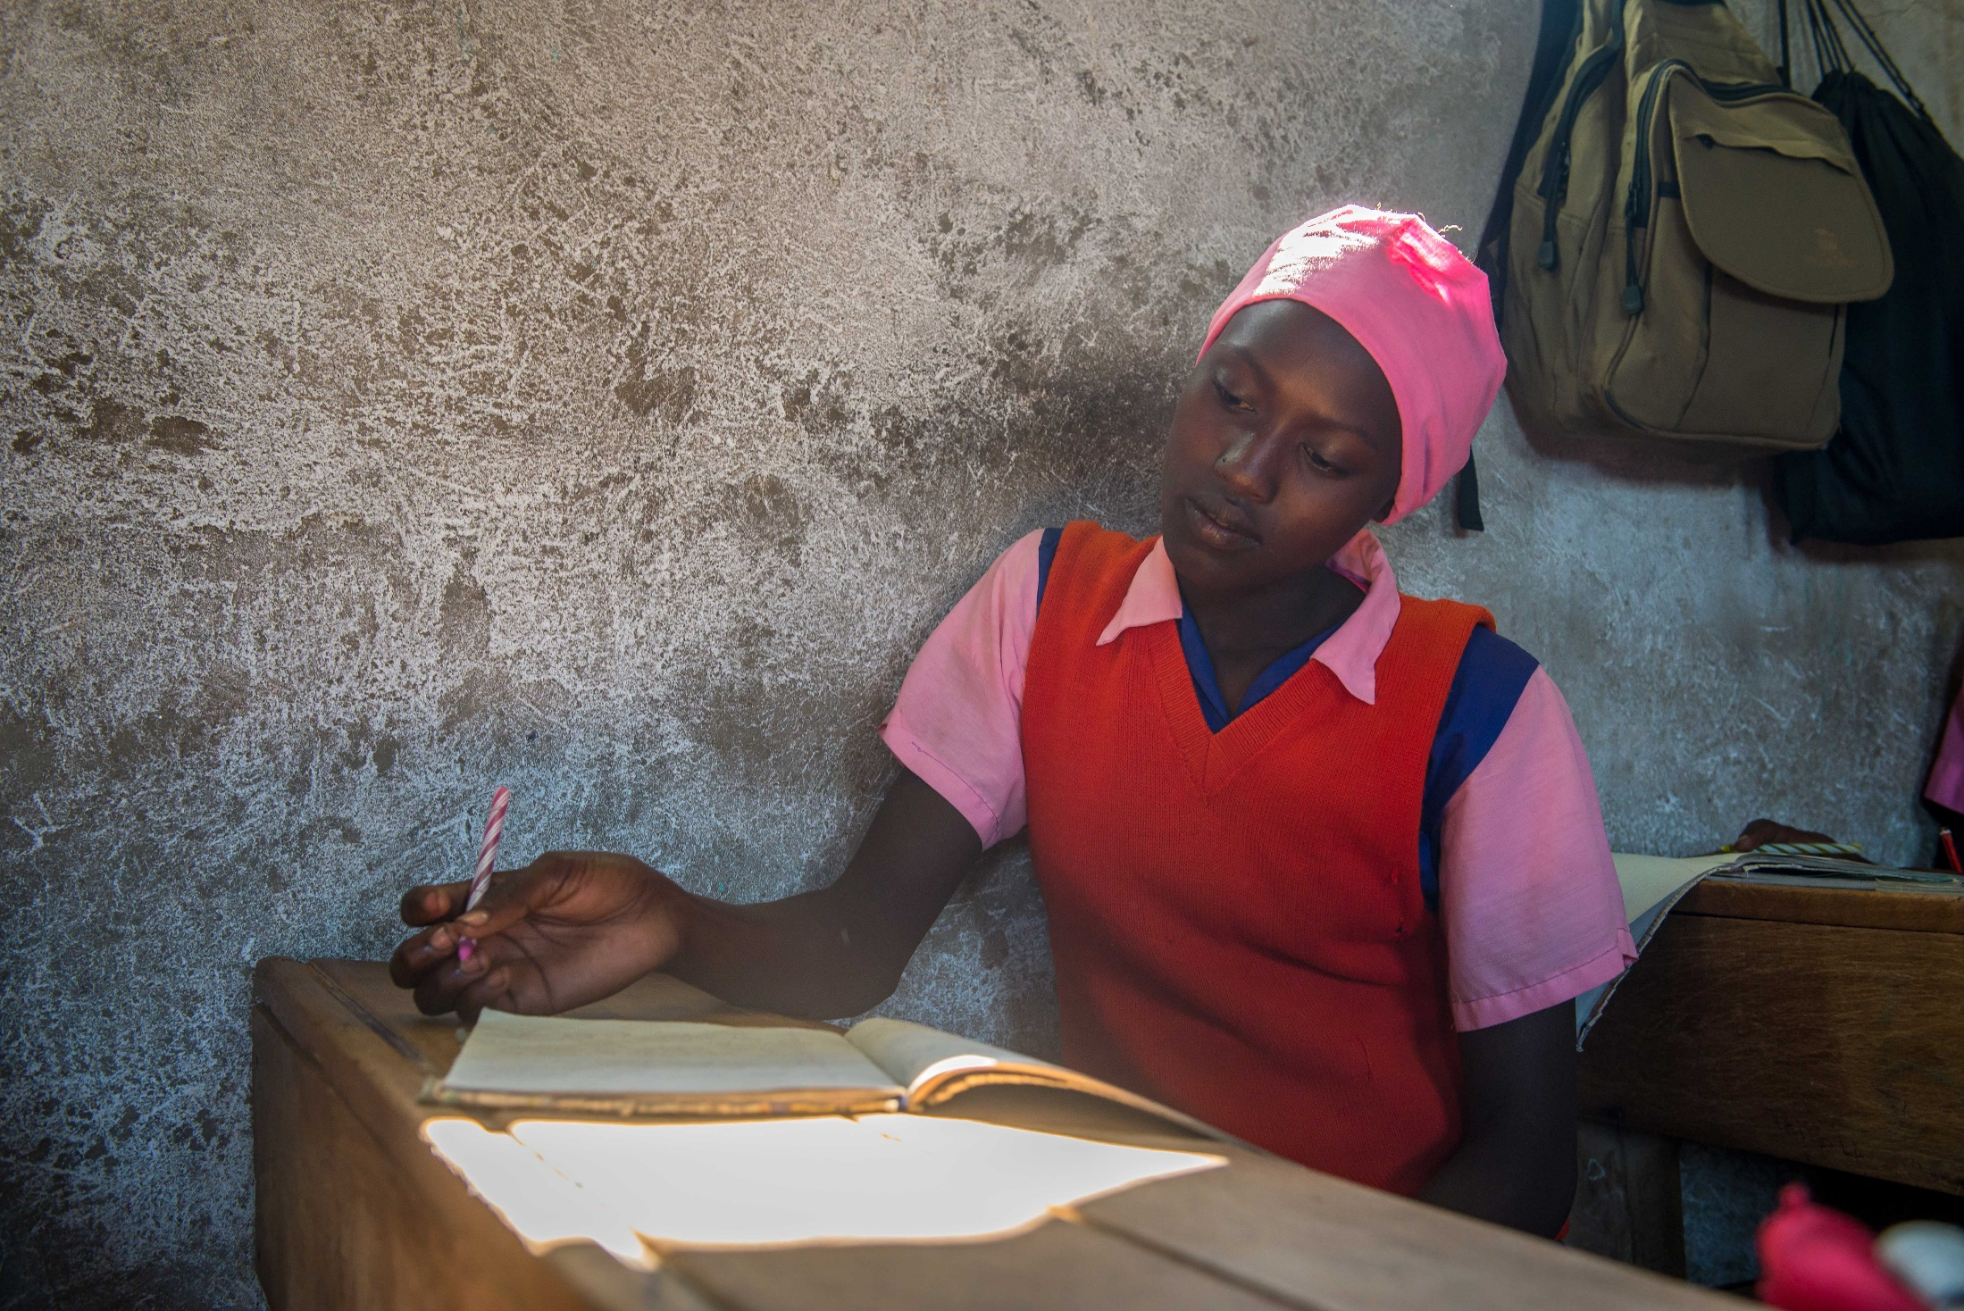
Veronica’s story

Slide 2
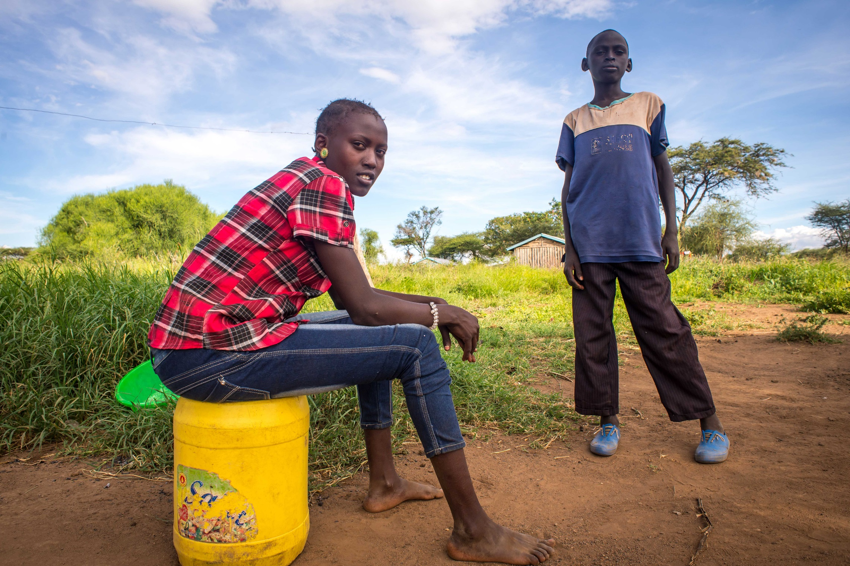
Veronica lives with her family in Kenya.
Notes:
This is a photo of Veronica with her brother.

Slide 3
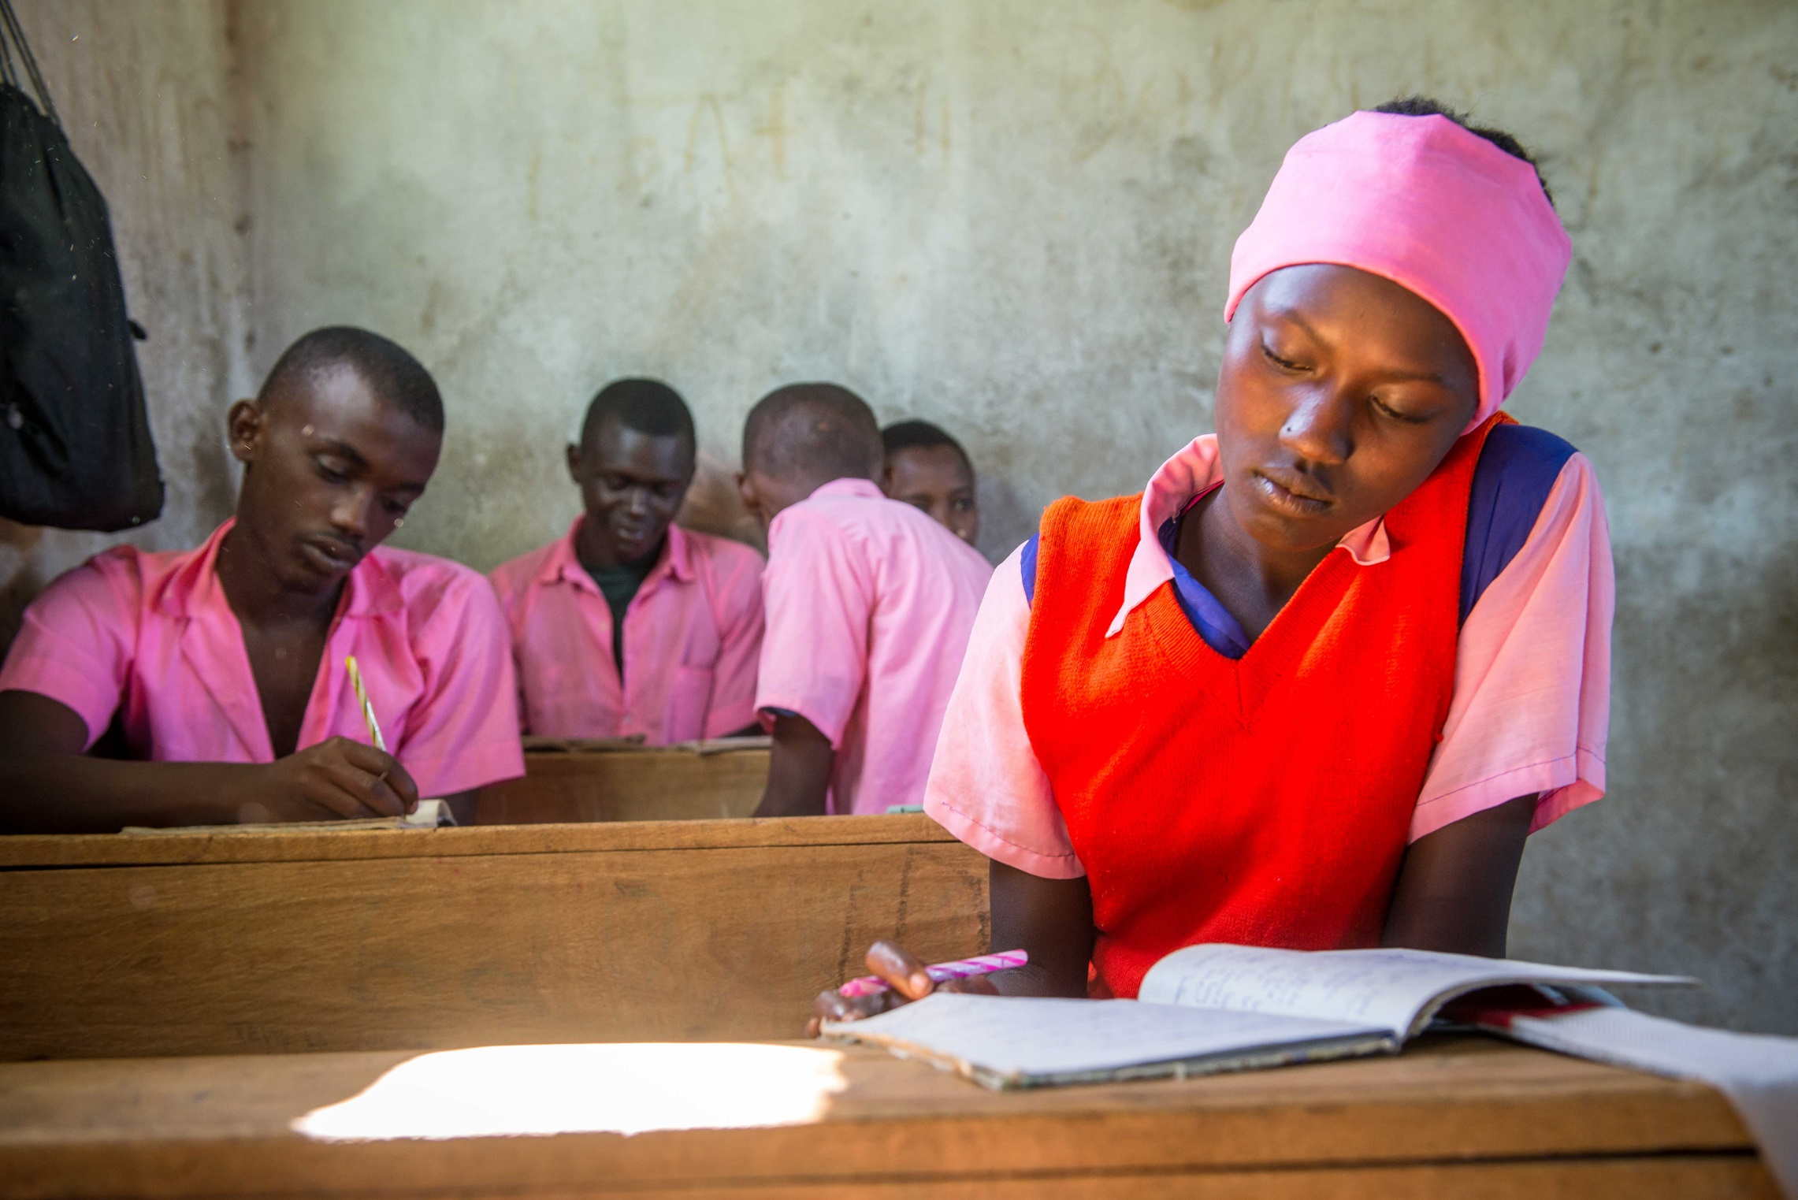
Veronica loves going to school.
For years Veronica has used a paraffin lamp to study at home as her family can’t afford electricity. But burning oil made her cough and she found it hard to concentrate.
Notes:
Veronica’s father didn’t have the opportunity to go to school when he was young, so he wants her to succeed.
In the evening, Veronica helps her mother prepare a meal before studying for her exams. She wants to become a politician.
For years Veronica has used a paraffin lamp to study at home as her family can’t afford electricity. But burning oil made her cough and she found it hard to concentrate. Veronica’s hopes of finishing school were starting to become a distant dream.

Slide 4
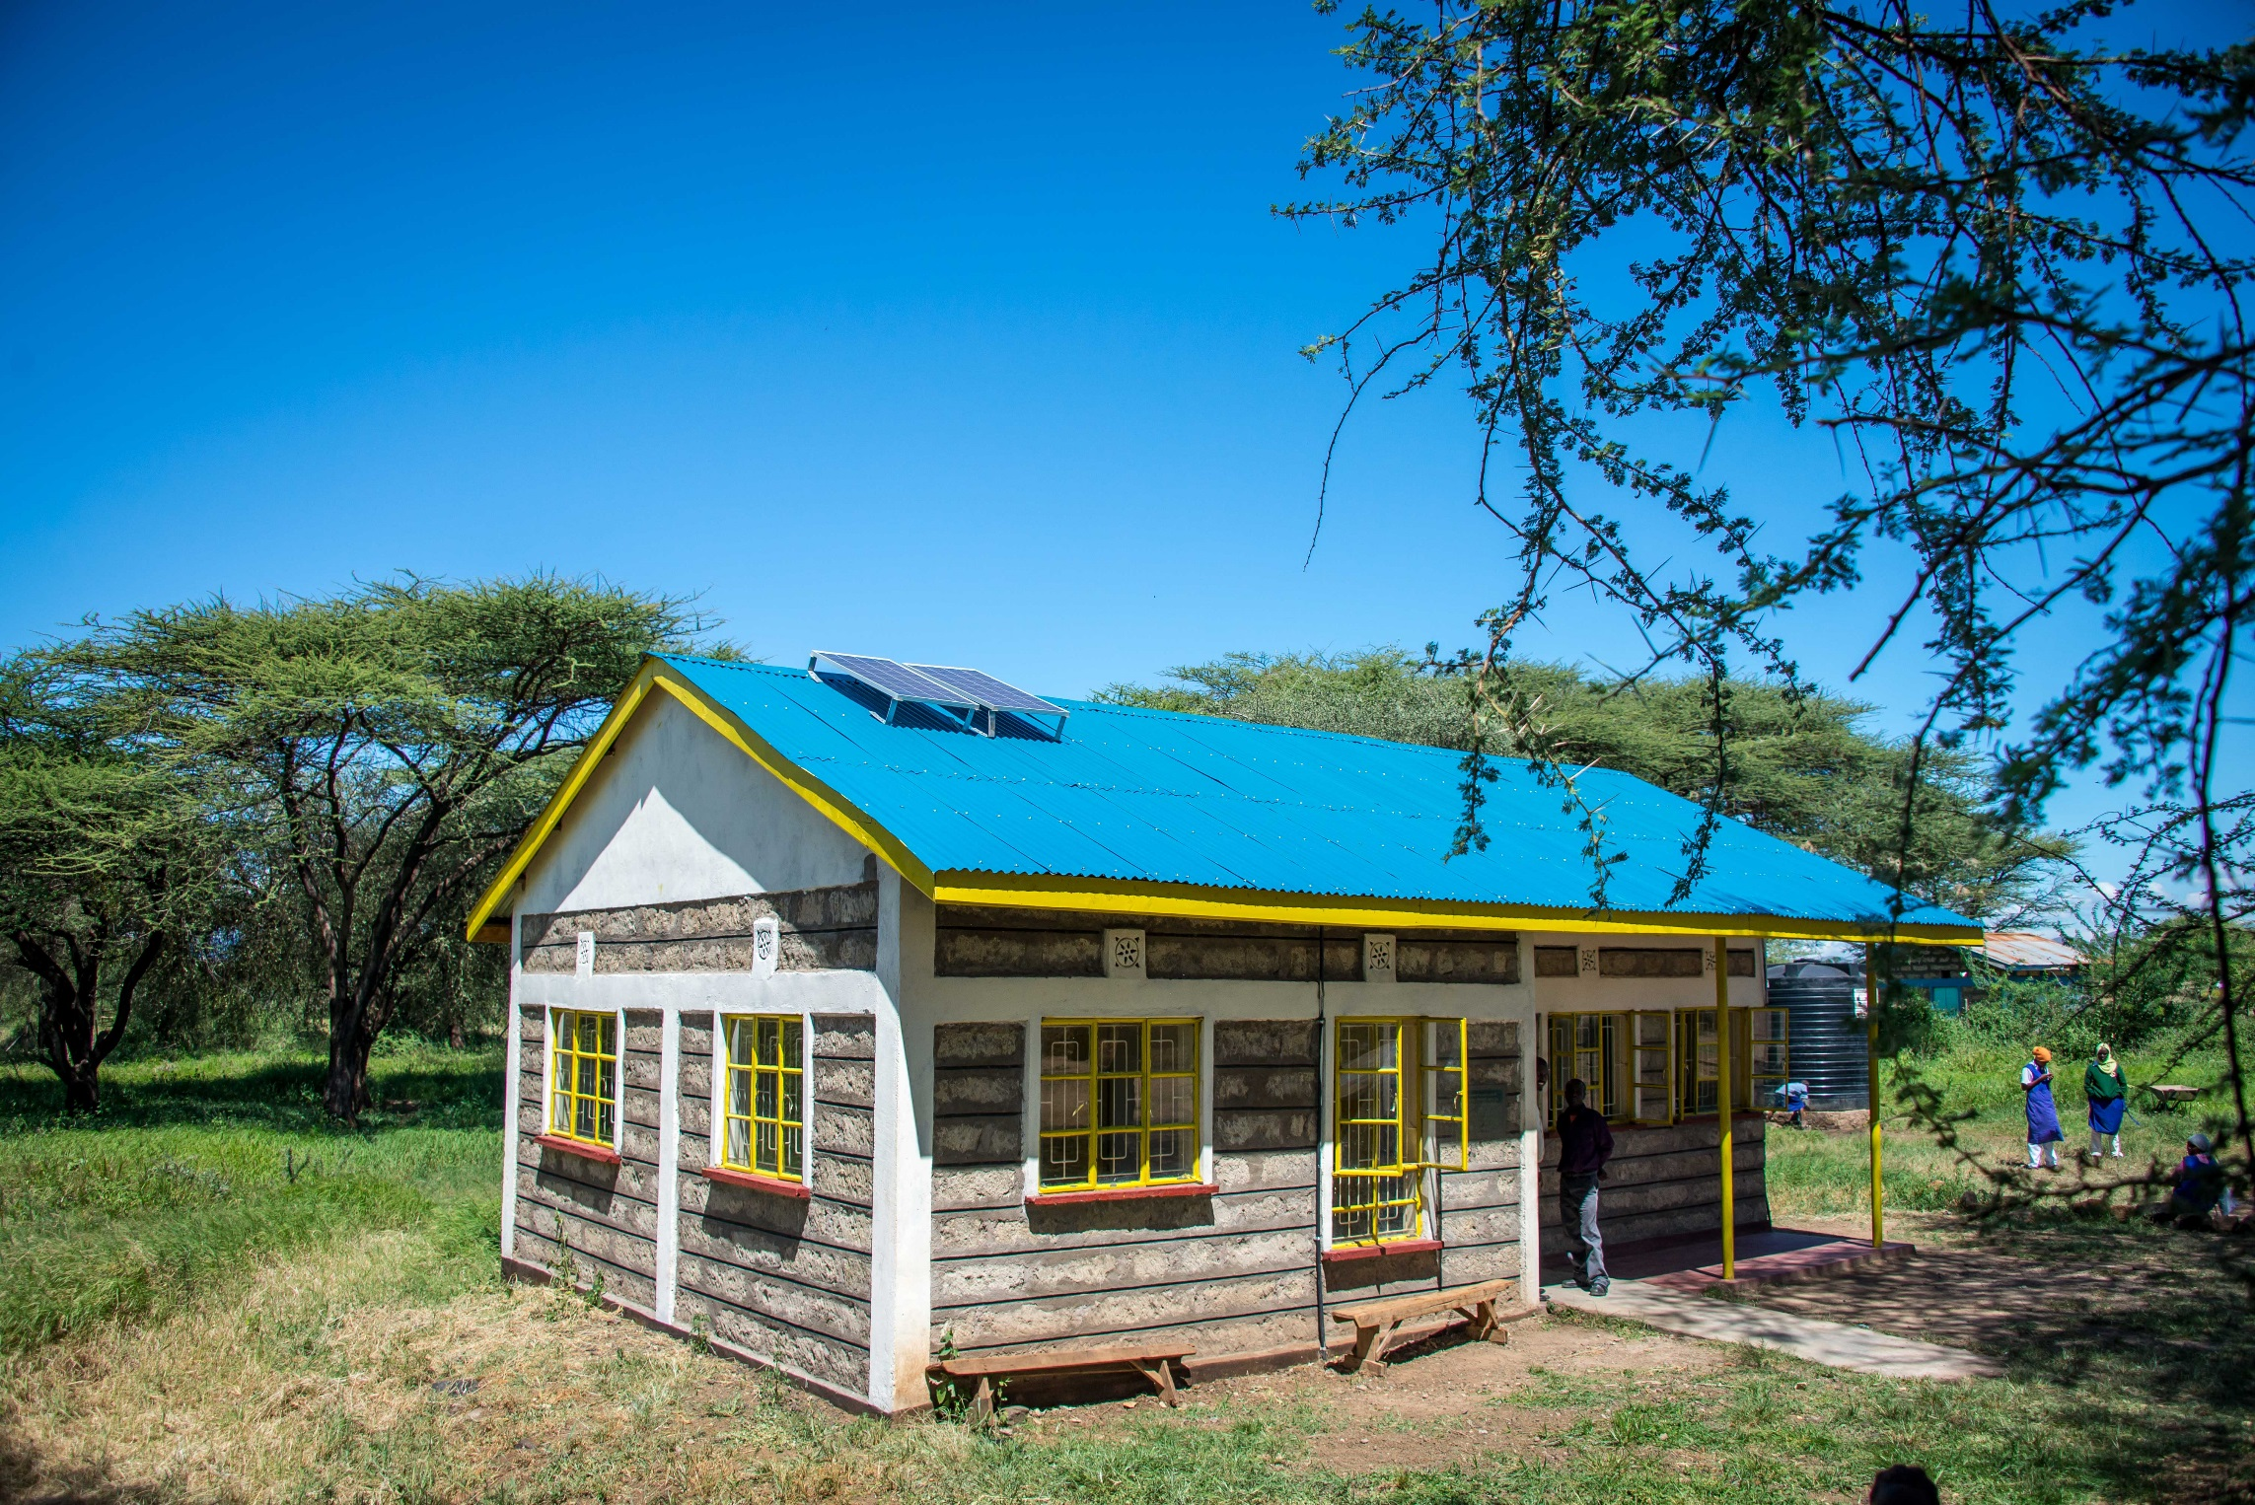
Now she has new hope, thanks to the power of the sun.
Solar panels have been fitted at school, bringing light to the classroom. Veronica can now go to evening classes.

Slide 5
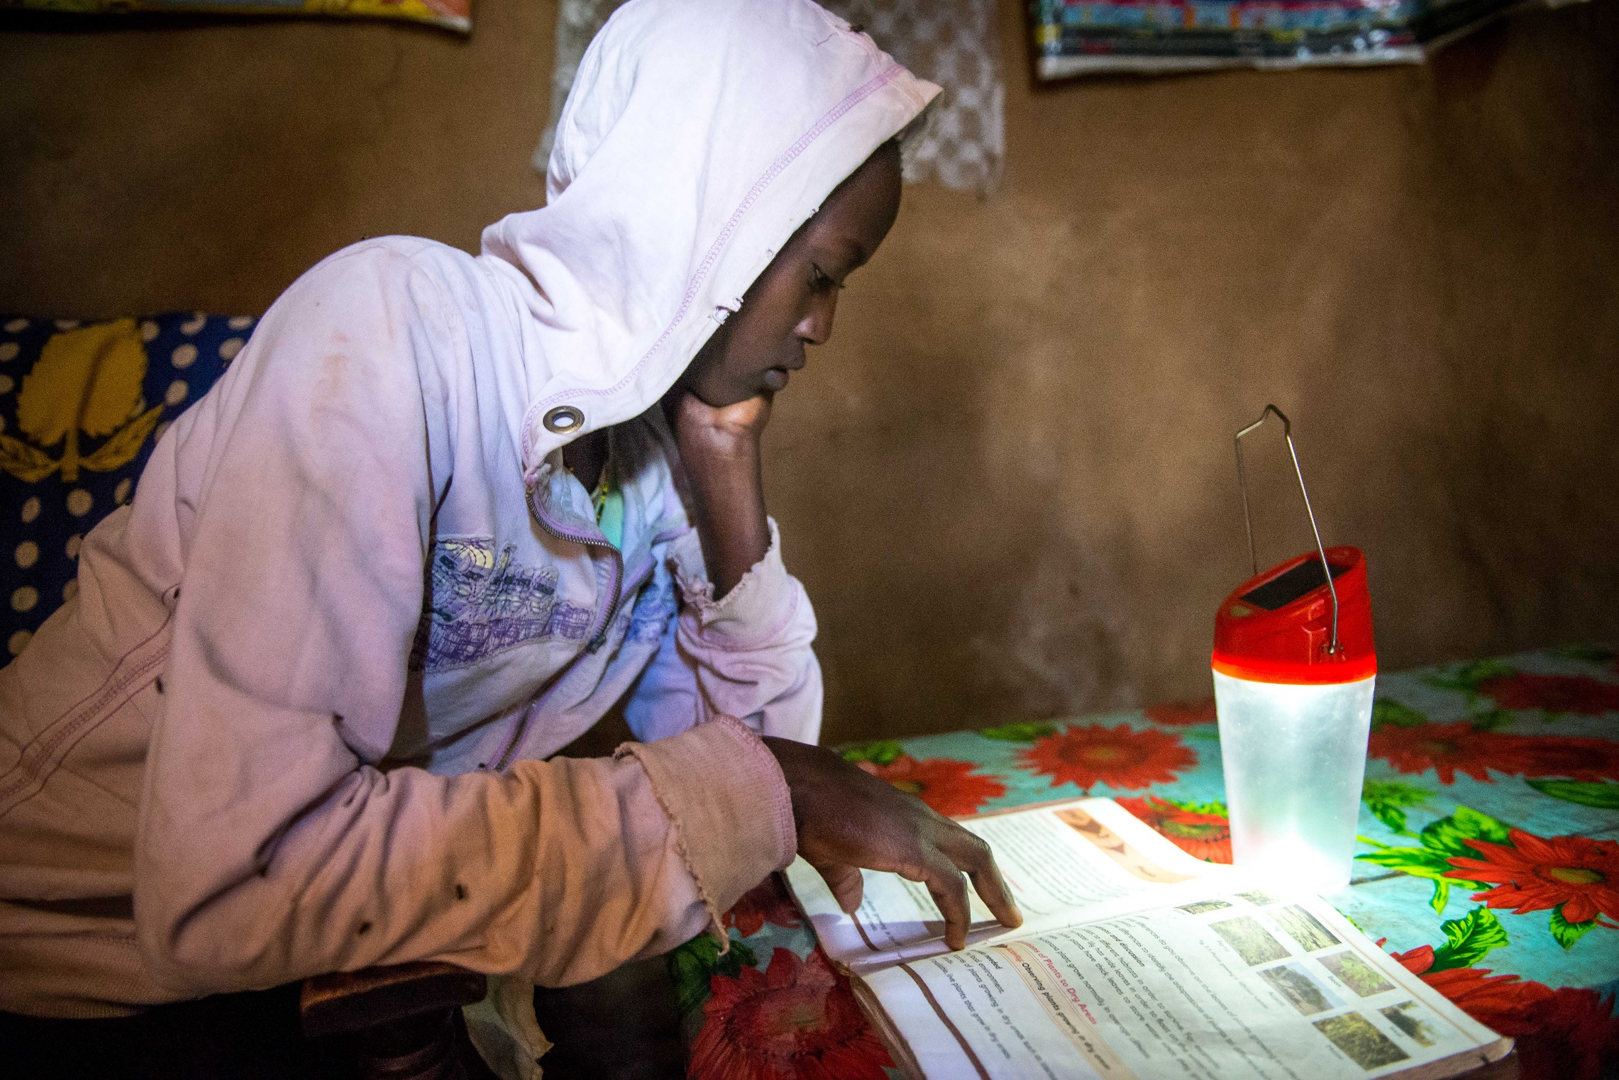
Veronica also now has a solar lamp at home. Through local, renewable energy, Veronica has the power to study and build a bright future for herself.

Slide 6
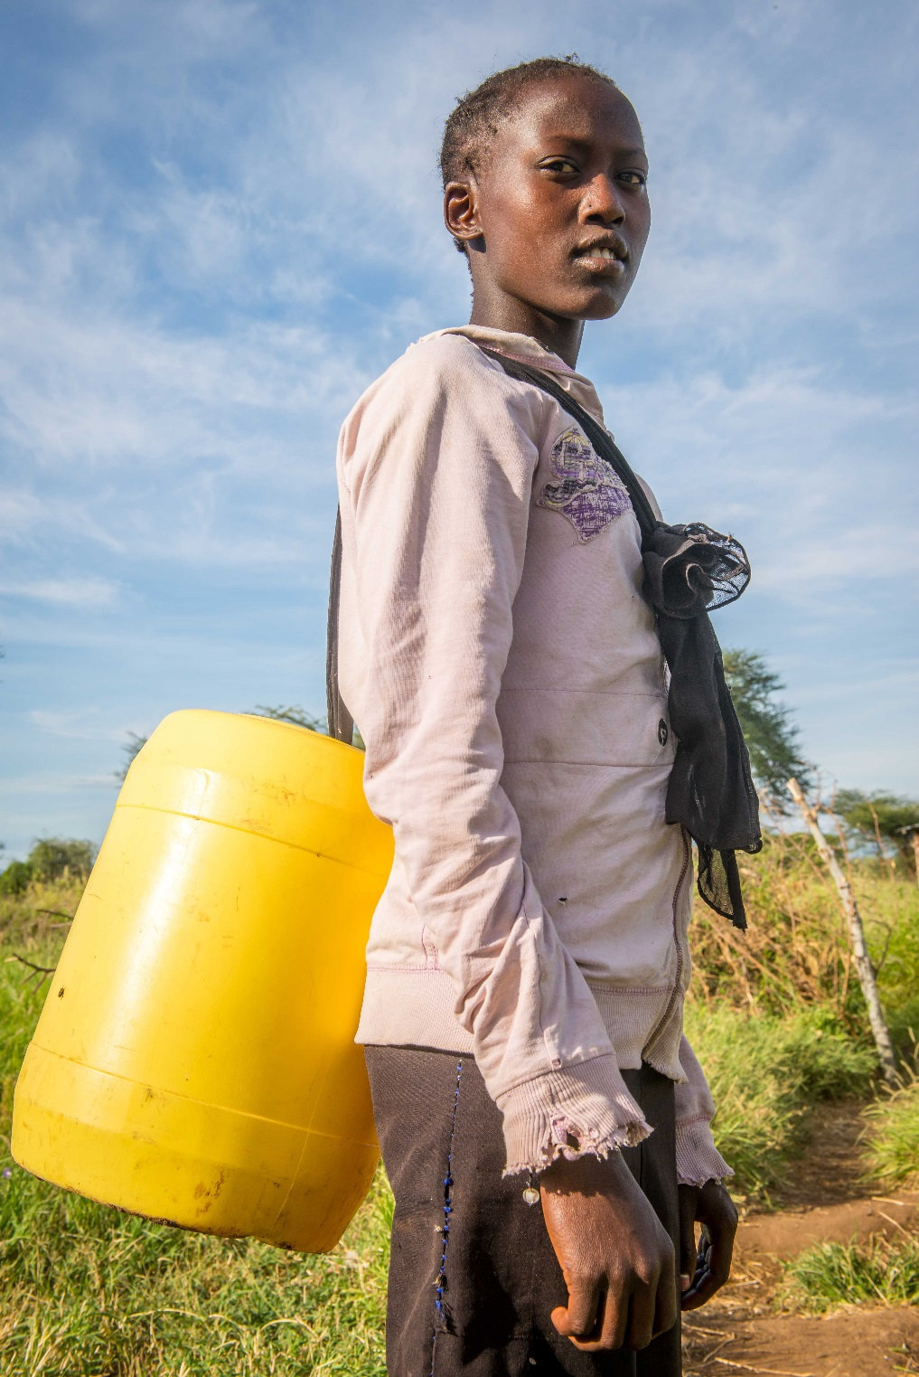
“Now that we have the solar panels at school, I’ll be able to do the extra school work I need to.”
Notes:
Veronica says:
“Now that we have the solar panels at school, I’ll be able to do the extra school work I need to. It’s important to have this time, as I have big exams coming up. School empowers me to achieve my plans for the future.”

Slide 7
Veronica’s story
Photo credits: Annie Bungeroth

