Slide 1

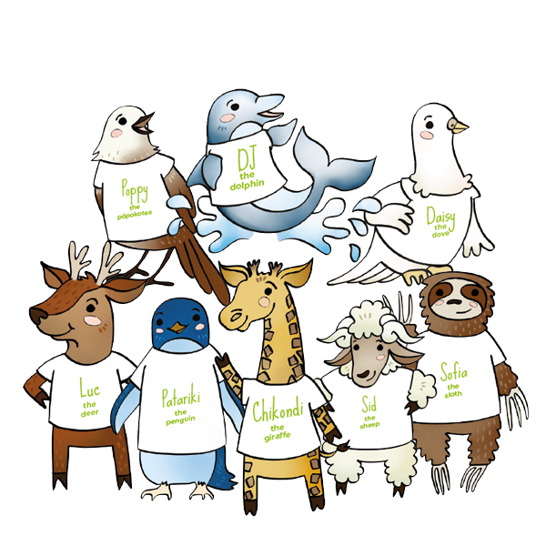

Nursery rhymes
on CST

Slide 2
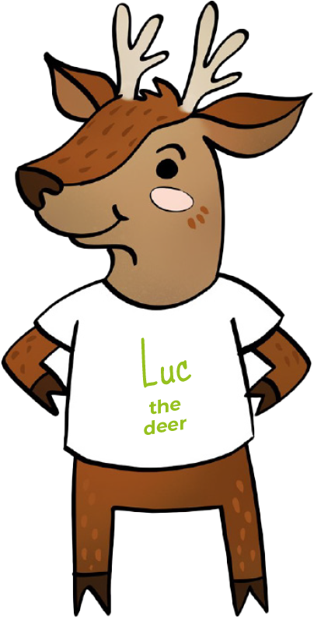
Everyone is special
To the tune of Row, Row, Row your Boat
Can you hear what Luc the deer
Is telling us to see?
Everyone is special
That’s human dignity.

Slide 3
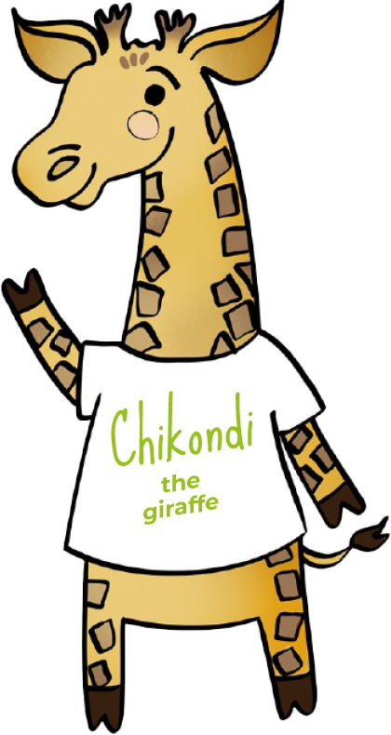
Thinking of everyone
To the tune of the Farmer’s in the Dell
We think of everyone,
We think of everyone,
Chikondi wants the common good
So think of everyone.

Slide 4

Taking part
To the tune of Skip to my Lou
We can take part every day,
We all have a part to play,
Patariki helps us say
“Participation”.

Slide 5
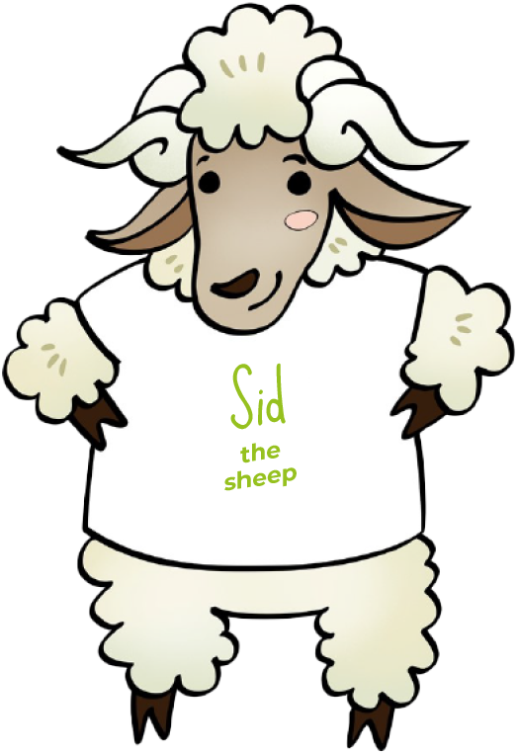
Everyone should have a say
To the tune of Twinkle, Twinkle Little Star
Everyone should have say,
In decisions that are made.
Sid the sheep helps us to see,
It’s subsidiarity.
Everyone should have a say,
In decisions that are made.

Slide 6
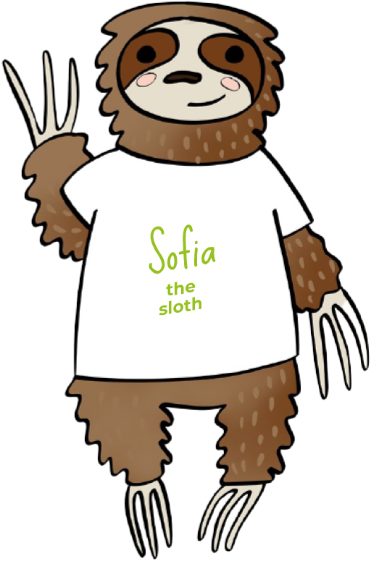
Caring for God’s gifts
To the tune of Here We Go Round the Mulberry Bush
Taking care of all God’s gifts,
Stewardship, stewardship.
Sophia the sloth reminds us all,
To take care of the earth.

Slide 7

Putting people in most need first
To the tune of Mary had a Little Lamb
All the people most in need,
Put them first, put them first.
Poppy says we put them first,
That’s option for the poor.

Slide 8
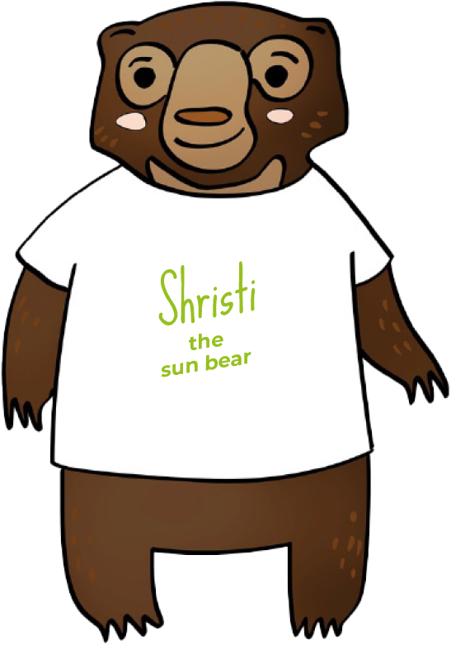
Showing we care
To the tune of Row, Row, Row your Boat
Use your actions and your words
So everyone can see,
You show you care like Shristi bear,
That’s solidarity

Slide 9

Sharing fairly
To the tune of Skip to my Lou
DJ the dolphin wants to share,
With every person everywhere,
So everyone has what they need,
We should share things fairly.

Slide 10
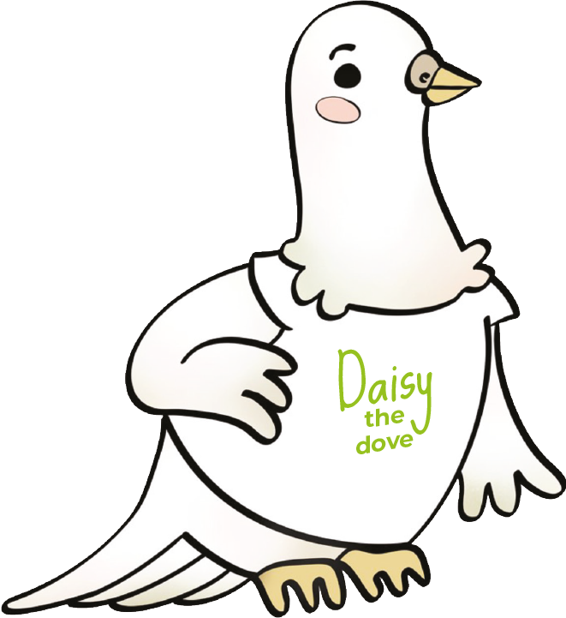
Being peacemakers
To the tune of Bobby Shaftoe/In and Out the Dusty Bluebells
Making friends is building peace,
Forgiving is building peace,
Welcoming is building peace
Just like Daisy dove.

