Slide 1
Who is my neighbour?
Notes:
AQA: Use slide 2 as a starter in Church and the Kingdom of God, Practices or in Theme C: Religion, human rights and social justice
Dialogue 1, when exploring the concept of ‘loving your neighbour’.
Eduqas: In Origins and Meaning, Practices, use slide 2 as a starter in a lesson on the importance of loving one’s neighbour.
Edexcel: In Practices, when teaching on love of neighbour.
How to use: Either project slide 2 and give time to consider and discuss the questions in the notes field, or give each pair of pupils a printout of one slide with its notes, then invite the class to introduce the person on their sheet to the whole class. After hearing the stories of these people, would pupils consider them to be their neighbours? Why/ why not? How do they define the word ‘neighbour’? Remind pupils of the parable of the Good Samaritan, that it was the foreigner who acted as a neighbour to the man who was robbed.

Slide 2
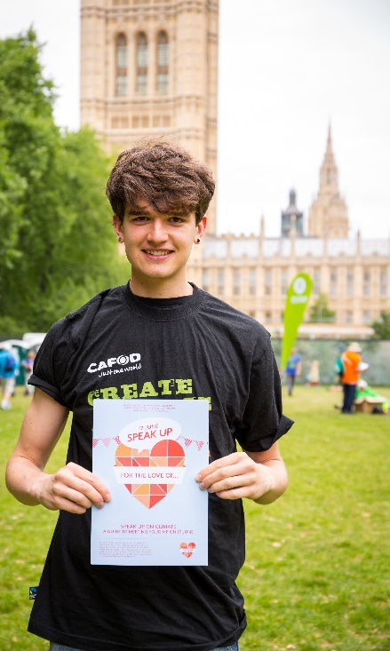
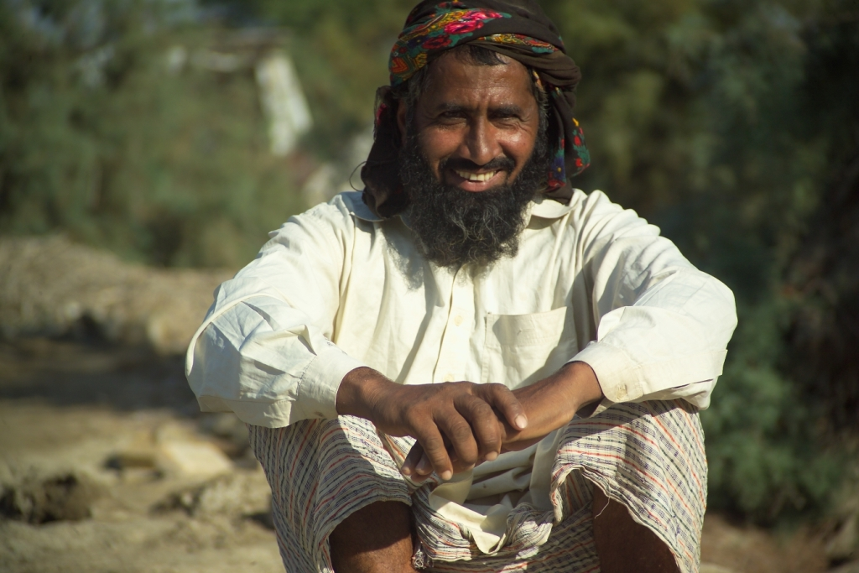
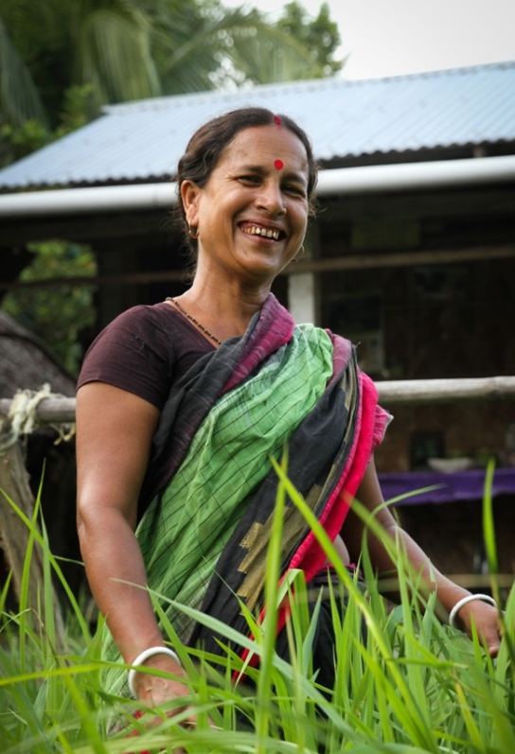
What connects these people?
Notes:
What is the connection? (All are children of God, our sisters and brothers, and therefore ‘neighbours’)
How is each person connected to you?
Which one do you most easily identify with as being a ‘neighbour’ to you? Why?
In what way could you act as a neighbour to these people?

Slide 3
Notes:
CREDIT: Louise Norton/CAFOD
COUNTRY: United Kingdom
CAPTION: A CAFOD supporter holds a ‘Speak Up for the Love of... ‘ heart during the Climate Coalition lobby of Parliament in 2015. Thousands of people travelled to London and lobbied their MPs to demand action on climate change, which is impacting the poorest communities around the world.

Slide 4
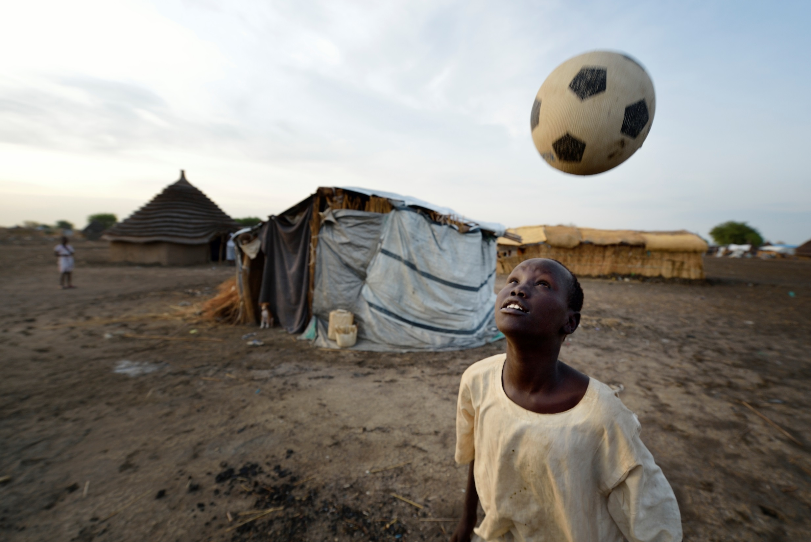
Notes:
CREDIT: Paul Jeffrey/Caritas Internationalis
COUNTRY: South Sudan
CAPTION: A boy plays with a football in a displaced persons’ camp in Agok, South Sudan.
A 2005 peace agreement stated that Abyei - a contested region along the border between Sudan and South Sudan – would have a referendum to decide which country it would join. But, ten years later, the two countries had still not agreed on who could vote.
In 2011, militias aligned with Khartoum (capital of Sudan) drove out most of the Dinka Ngok residents from Abyei, pushing them across a river into the town of Agok. By June 2015, more than 40,000 Dinka Ngok had returned to Abyei with support from Caritas South Sudan, which drilled wells, built houses, opened clinics and provided seeds and tools for the returnees. Yet continuing insecurity meant a greater number remained in Agok, dependent on Caritas and other organisations for food and other support.

Slide 5
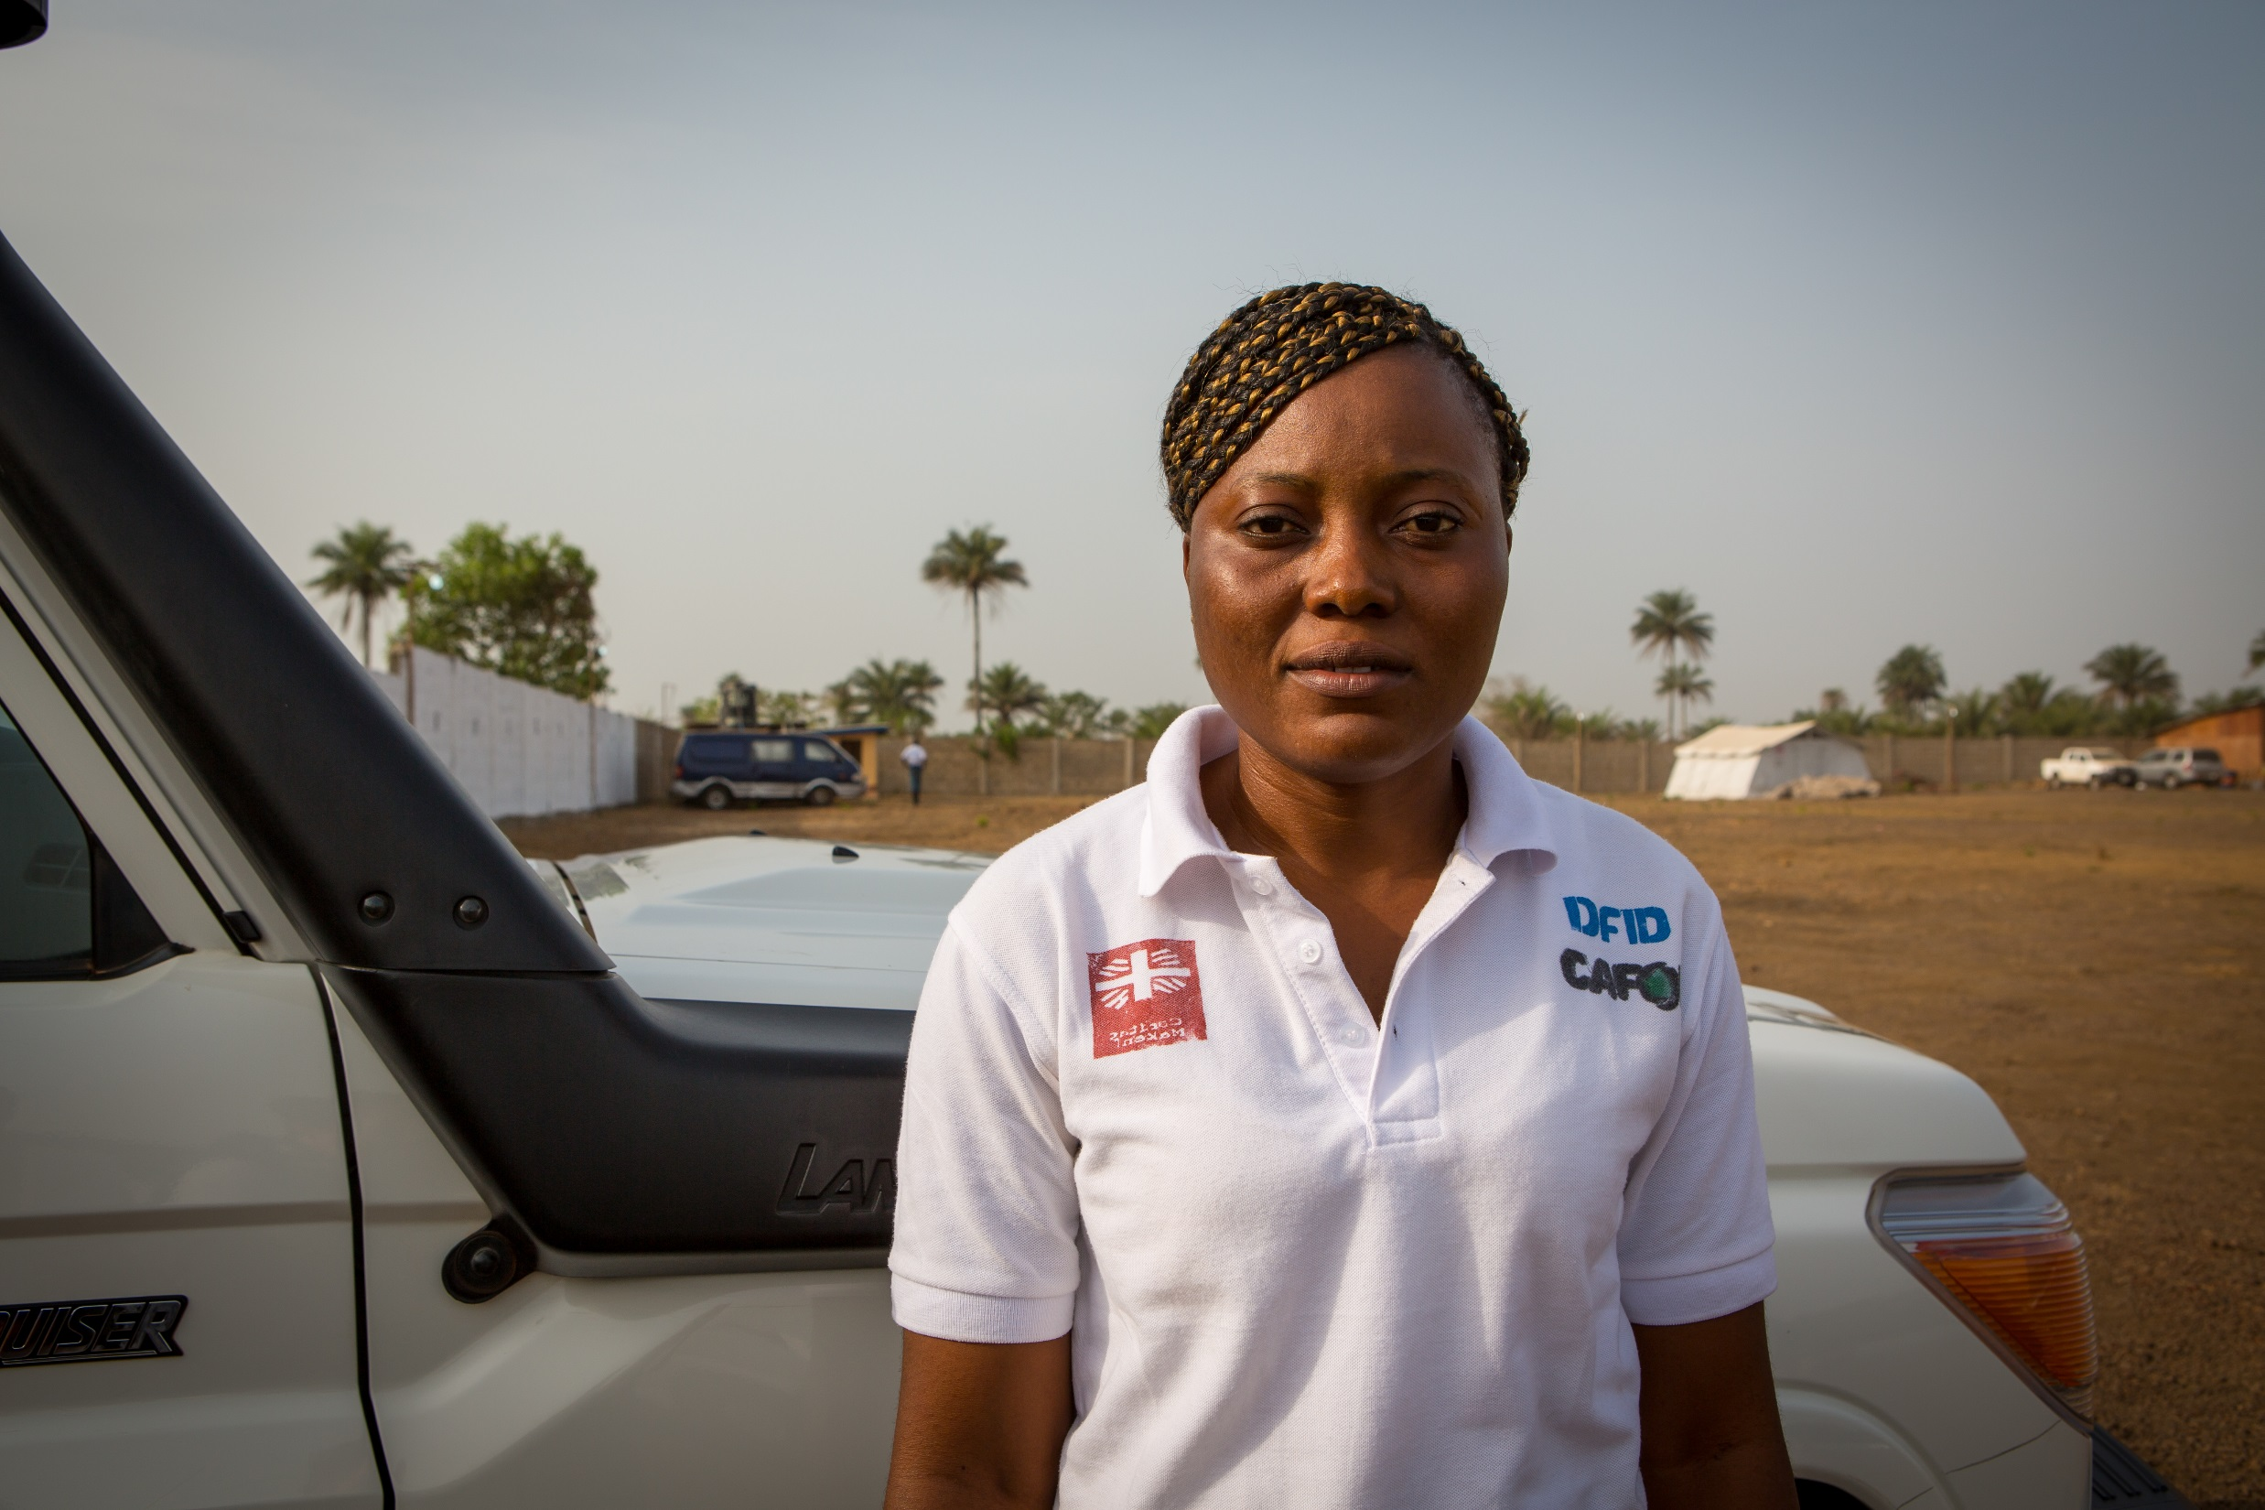
Notes:
CREDIT: Louise Norton/CAFOD
COUNTRY: Sierra Leone
CAPTION: During the Ebola outbreak, CAFOD supported a burial team of 60 Sierra Leoneans in the Kambia District in the north east of the country. The team, eight of whom were women, was comprised of people from all walks of life including school teachers, small business owners and students. They volunteered, despite knowing how dangerous the work could be. As of 27 May 2015, they had safely given dignified burials to 1,479 Ebola victims.

Slide 6
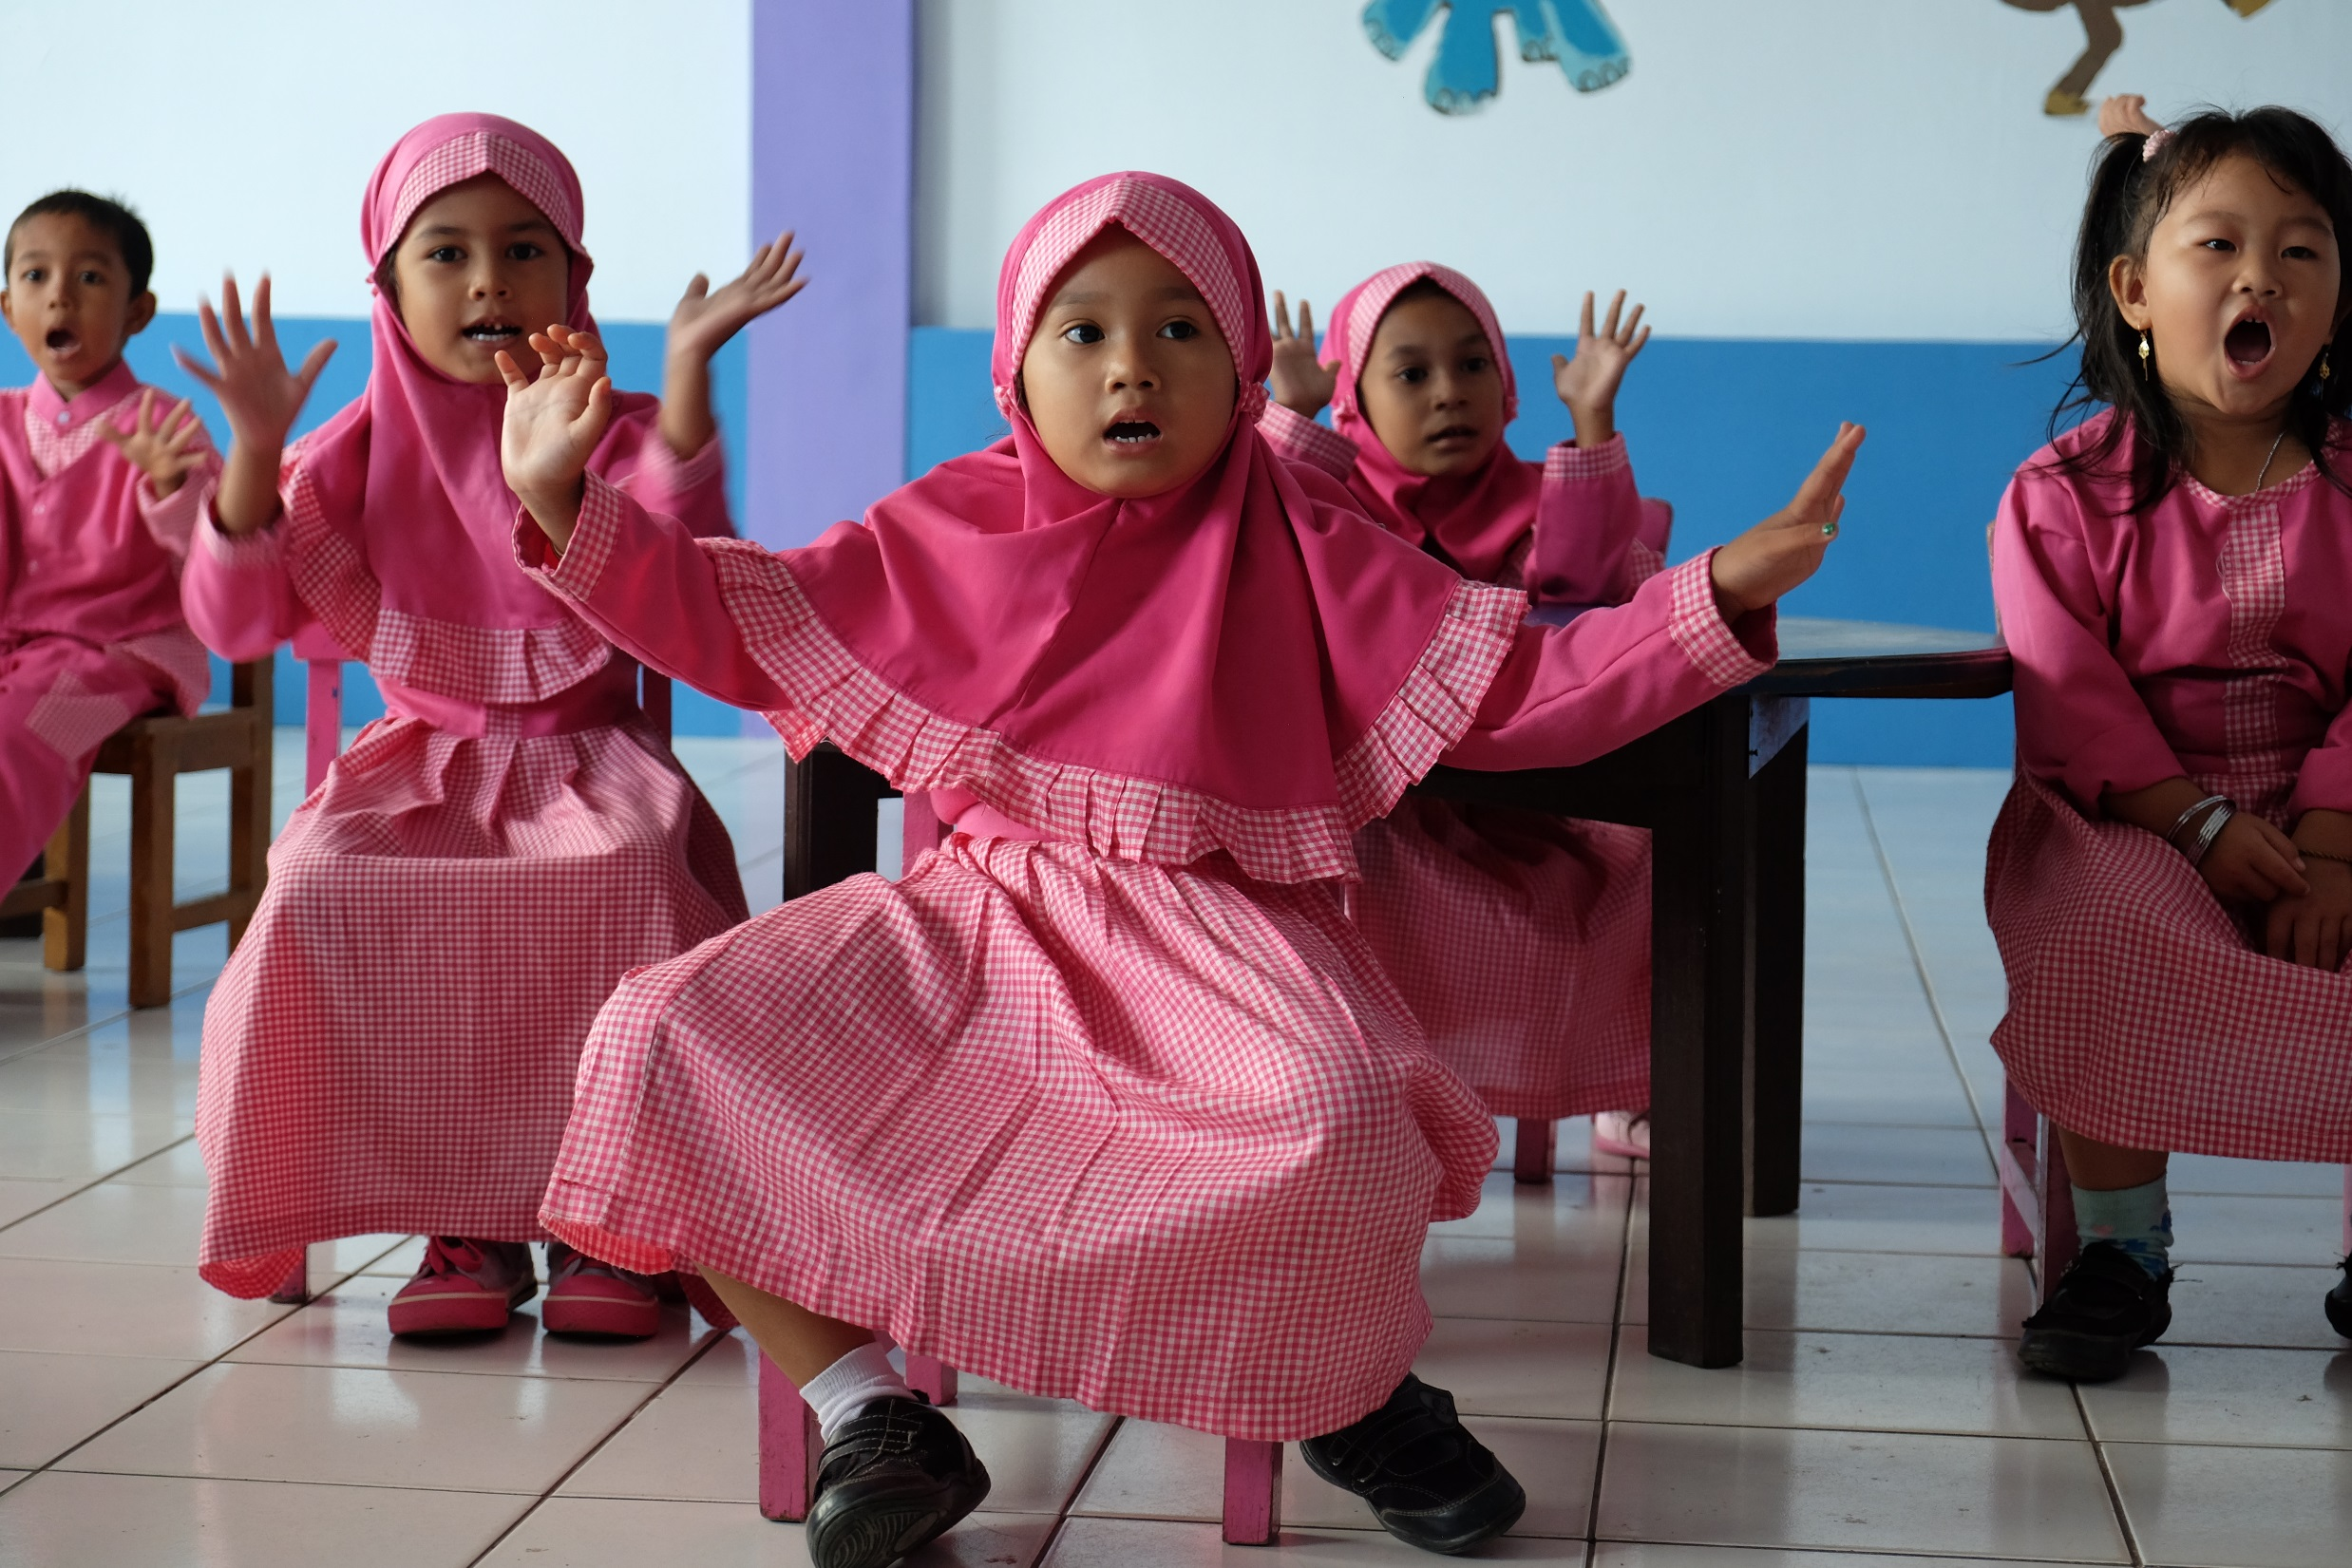
Notes:
CREDIT: Patrick Nicholson/Caritas Internationalis
COUNTRY: Indonesia
CAPTION: CAFOD partner, Catholic Relief Services, rebuilt Nabila School in Meulaboh. Previously, the school was a wooden structure and it was washed away in the Boxing Day tsunami in 2004. The school reopened in 2007. Now 78 children attend kindergarten here and it has a reputation as the best kindergarten in the town.

Slide 7
Notes:
CREDIT: Eleanor Church/CAFOD
COUNTRY: Bangladesh
CAPTION: Sabita Biswas in the vegetable garden in front of her house in Kainmari village, Mongla. Sabita is head of the women's group in her village. They discuss the issues that they face and Sabita represents them at meetings outside the village. CAFOD partner, Caritas Bangladesh, provided training in “Disaster Risk Reduction”, for example by helping villagers to raise their vegetable plots to stop them being washed away by floods. Sabita’s own plot was raised about a metre above the ground.

Slide 8
Notes:
CREDIT: Patrick Nicholson/Caritas Internationalis
COUNTRY: Lebanon
CAPTION: Syrian families in Lebanon’s Bekaa Valley live in makeshift tented camps, as apartments are now too expensive to rent. Conditions are harsh at the best of times. Half the people living here are children and the cold weather puts them, and older people with health conditions, at risk. CAFOD’s partner, Caritas Lebanon, supports the refugees.

Slide 9
Notes:
CREDIT: Susan Kambalu/CAFOD
COUNTRY: Zimbabwe
CAPTION: Danielle Storey went to Zimbabwe in 2016 during her gap year with CAFOD. Here Danielle visits CAFOD partner, Caritas Mutare, which was helping the local community to build toilets with disabled access in Nyanga Bus Depot, where previously there were less accessible latrines with no plumbing. The community had decided that they needed better sanitation after a huge cholera outbreak in Zimbabwe in 2008.

Slide 10
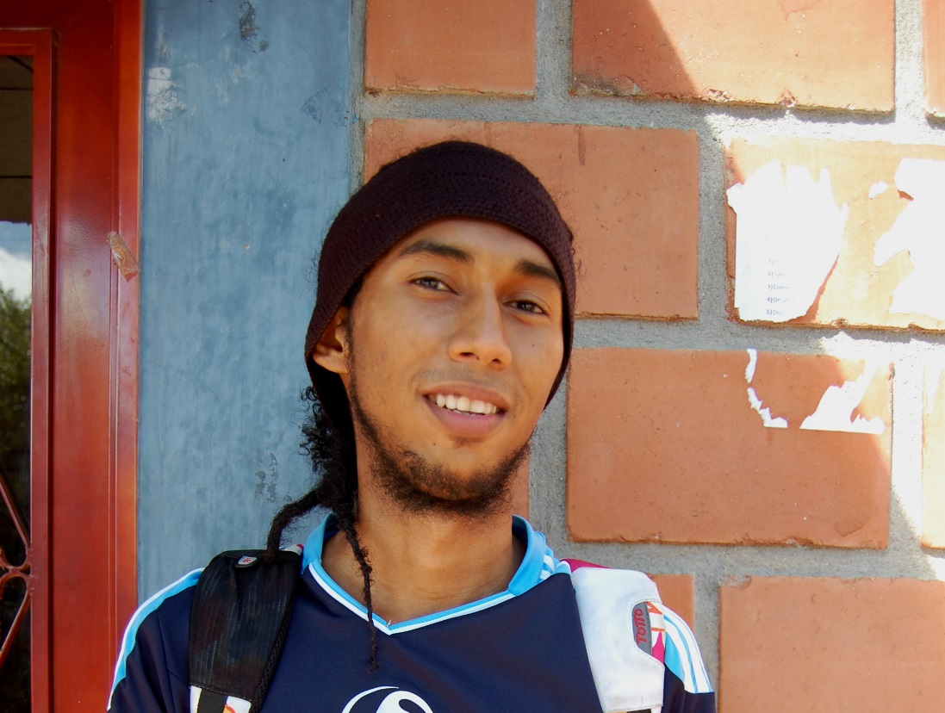
Notes:
CREDIT: Barbara Davies/CAFOD
COUNTRY: Colombia
CAPTION: Rapper, Romario Torres Perez, is part of youth cultural groups that use art and culture to promote HIV prevention messages and to reduce gender based violence in the Magdalena Medio region of Colombia. This project is supported by CAFOD partner, CDPMM.

Slide 11
Notes:
CREDIT: Awais Masroor/Strengthening Participatory Organisation
COUNTRY: Pakistan
CAPTION: In 2013, Mohammad Younus was happy to be rebuilding his home, supported by CAFOD partner, SPO (Strengthening Participatory Organisation). Mohammad’s home had been damaged by Pakistan’s huge floods in 2010, when one-fifth of the country lay under water and 18 million people struggled to find food and drinking water and to keep a roof over their heads.

Slide 12
Credits:
Awais Masroor/Strengthening Participatory Organisation, Paul Jeffrey/Caritas Internationalis,
Patrick Nicholson/Caritas Internationalis,
Louise Norton, Eleanor Church, Susan Kambalu,
Barbara Davies, CAFOD.

