Slide 1

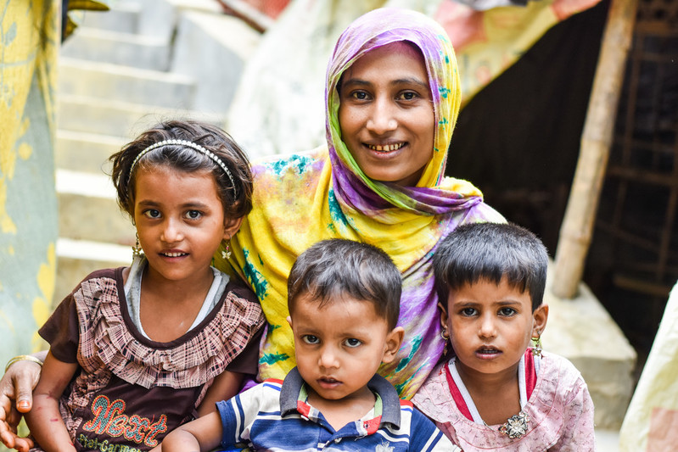

How can I be ready for Jesus
when he comes?
We gather
Notes:
Children’s liturgy – First Sunday of Advent (Year B)
Colour: Purple
Song suggestions: Wait for the Lord (762, Celebration Hymnal for Everyone), O come O come Emmanuel (522, Celebration Hymnal for Everyone)
Welcome: Today is the First Sunday of Advent – a special time when we get ready for the coming of Jesus. Jesus asks us all to keep watch for him so that we will be ready when he comes. Today we are going to think about how we can do that.

Slide 2
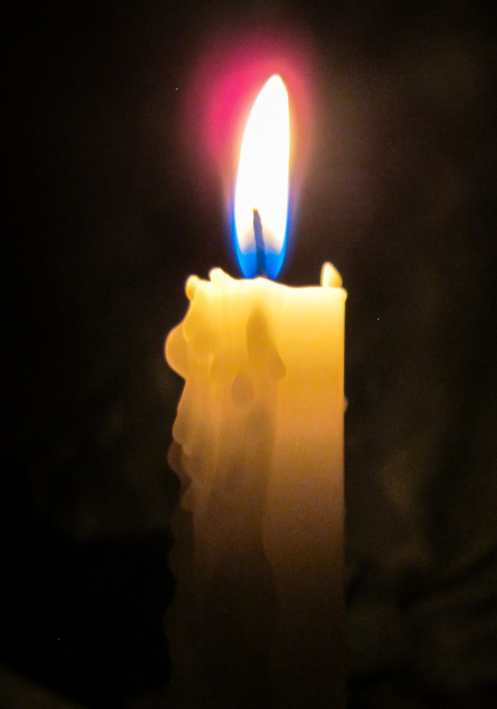
God of love, you sent your Son Jesus into the world to show us how to live. Help us to be ready for when he comes again.
Amen

Slide 3
Let us see, O Lord, your mercy
and show us your saving help.
Notes:
Gospel Acclamation
Let us stand to greet the Gospel
Or
Let us stand and sing the Gospel Acclamation together

Slide 4

Gospel: Mark 13:33-37
Jesus said, “Be on watch, be alert, for you do not know when the time will come. It will be like a man who goes away from home on a journey and leaves his servants in charge, after giving to each one his own work to do and after telling the doorkeeper to keep watch. Be on guard, then, because you do not know when the master of the house is coming — it might be in the evening or at midnight or before dawn or at sunrise. If he comes suddenly, he must not find you asleep. What I say to you, then, I say to all: watch!”
We listen

Slide 5

Gospel reflection – What do you remember?
Jesus promised us that one day he would return. In this gospel story Jesus is telling us that we must be ready when he comes again, but that we cannot be exactly sure when that will be.
As we don’t know when he is coming, we must try to be ready all the time. Although we don’t have to stay awake all night, we can go to sleep!
We respond

Slide 6
Advent is a time when we especially think about getting ready to welcome Jesus, when we remember his birth at Christmas and when he comes again in glory.
In today’s gospel, Jesus asks us to look out and keep our eyes open for what is happening around us, so that we are ready when he comes.
What do you think Jesus wants us to see when we look around us?

Slide 7
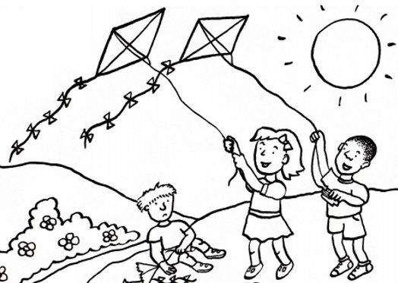
Do we sometimes see people who need our help? People who are lonely? People who are sad? People who do not feel well?
What do you think Jesus would like us to do when we see people who are sad, lonely, poor or sick?
Sometimes we hear the story of people who live a long way away but who also need our help.

Slide 8
Saba lives in a refugee camp in Bangladesh. Three years ago she had to leave her country of Myanmar with her three children because it wasn’t safe for them to live there anymore.

Slide 9
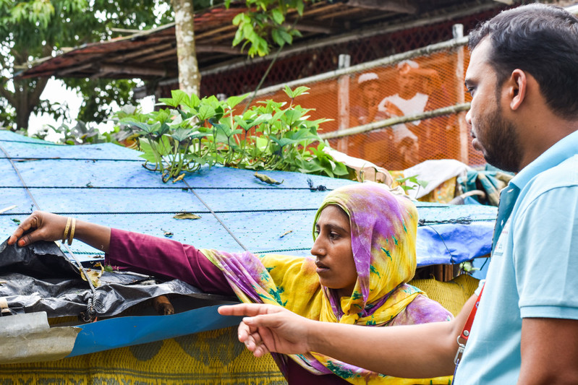
CAFOD has worked with local experts in Bangladesh to help Saba to build a shelter for her family to live in.

Slide 10
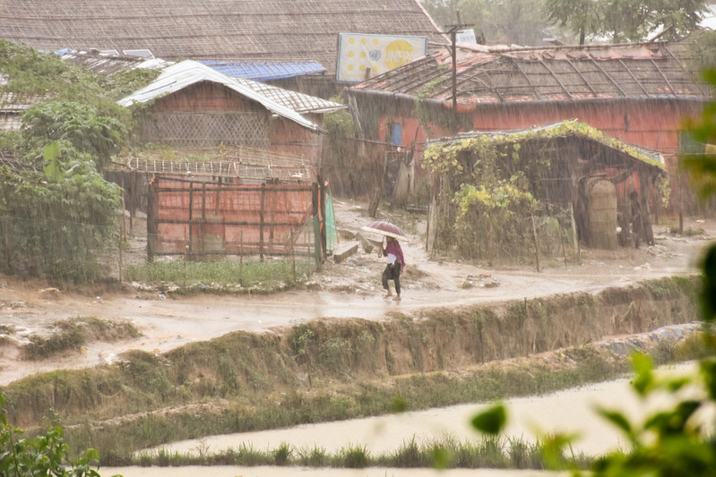
Saba said,
“The shelter kit is the thing that I treat as my treasure… we would just be under the sky if we don’t have a shelter to live in.”

Slide 11
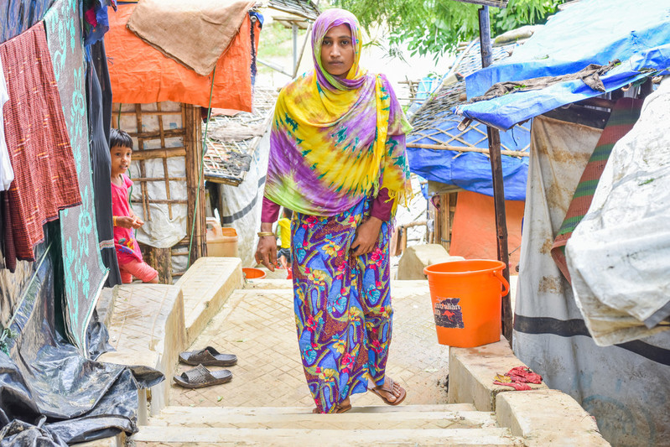
Why do you think it is important to know about the lives of people who are living in other parts of the world?
How do you think you could help someone who has had to leave their home and their country?

Slide 12


Let us pray…

Slide 13

We pray for all people who are poor, sick, sad or frightened: that they may be comforted and find hope for a better future.
Lord, in your mercy…
We pray for our families and friends: that we may always keep our eyes open to the world around us and reach out to all those who need our help.
Lord, in your mercy…

Slide 14
We pray for our parish community: that we may follow the example of Jesus and be ready to welcome him when he comes.
Lord, in your mercy…
Living God, help us to listen to your word, to be kind and generous and helpful to others and to be ready to welcome Jesus when he comes. Amen.

Slide 15
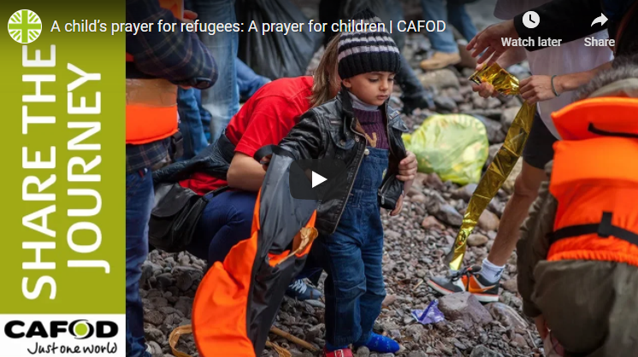
A prayer for refugees
Notes:
You may wish to share this prayer for refugees (2min 15secs)

Slide 16
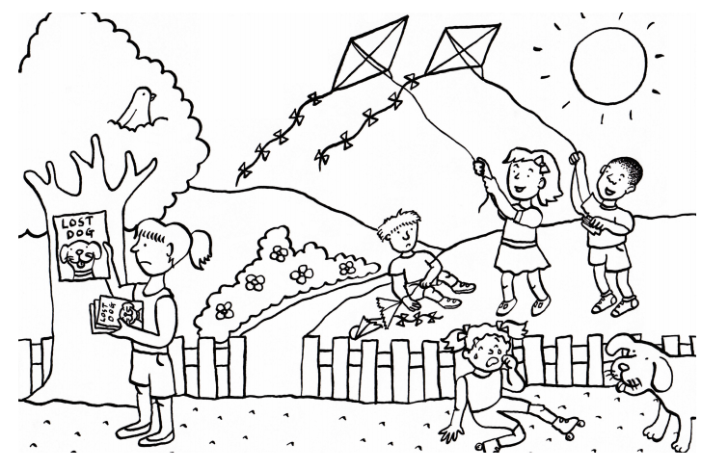

What will you do next time you see or hear about someone who needs your help?
How will you make sure you
are ready for Jesus
when he comes again?
Going forth

Slide 17
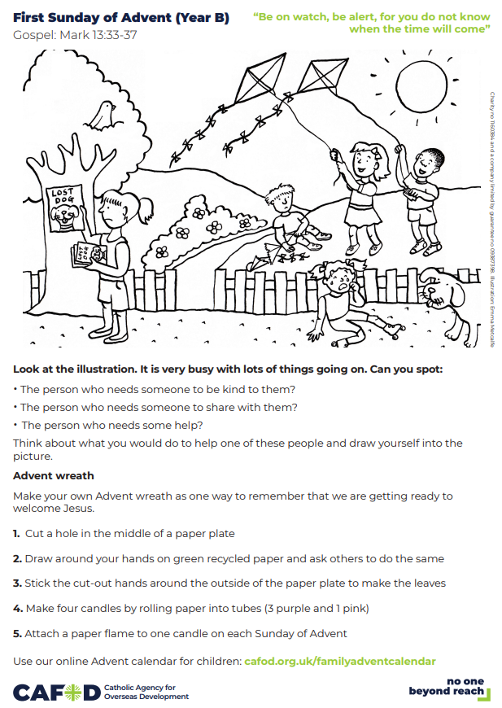
Activity suggestions:
Invite the children to look at the accompanying activity sheet and the picture on it. What can they spot happening in the picture? Encourage them to answer the questions and to think about how they could help some of the people in the picture. They could draw themselves into the picture helping someone or draw on the back what they would do to help. Encourage the children to do the other activities on the sheet either during the liturgy or later today.
Give the children a piece of paper or card with the outline of a window frame on it. Invite them to imagine that they are looking out through the window at the world around them. What do they see? Can they draw someone who needs some help in one corner, and in another corner draw how they would help that person. In another corner, they could write a short prayer for all the people we see in the world who need our help.
Encourage the children to share all that they’ve heard and thought about today with the people at home. Remind them to keep their eyes open this week for people who need their help. Perhaps they could count how many times they see someone who needs their help and how many times they are helpful.
Find more resources on refugees: cafod.org.uk/primary/refugees
Follow our Advent calendar for families throughout the season at cafod.org.uk/familyadventcalendar

Slide 19

Please watch our Advent assembly!
cafod.org.uk/schoolstogether

Slide 20

®
Notes:
Image credits: Inmanuel Chayan Biswas/Caritas Bangladesh
Illustration: Emma Metcalfe

