Slide 1
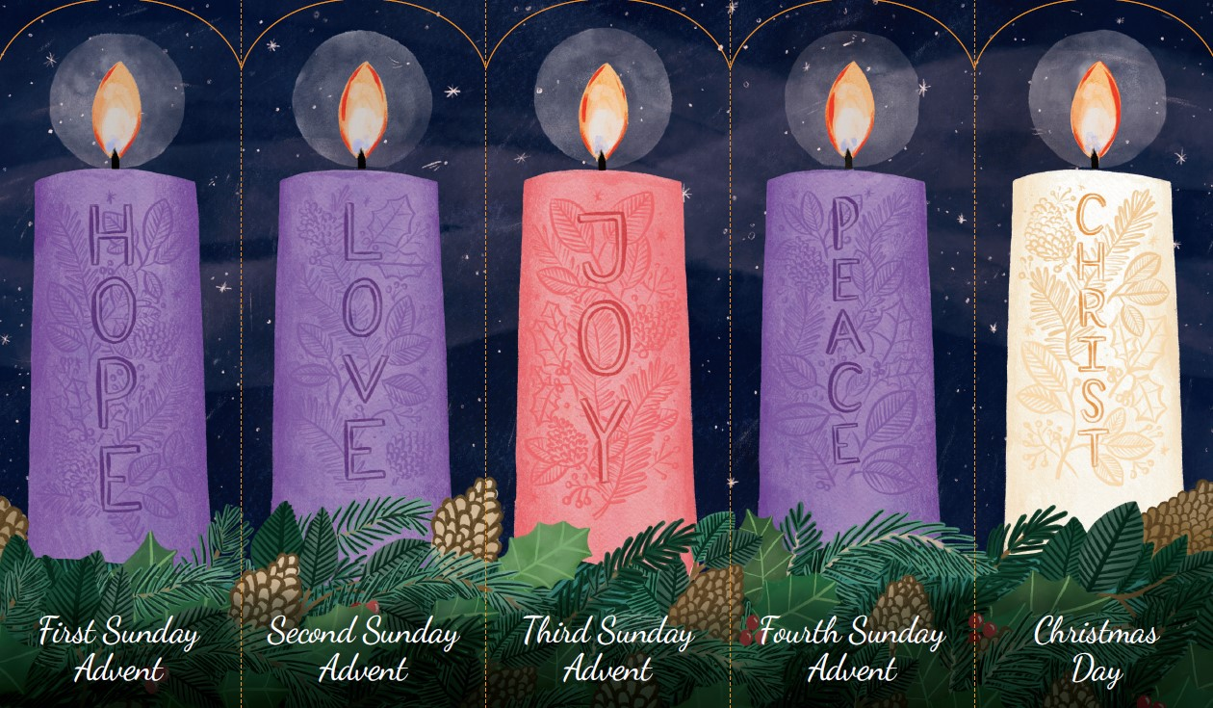
How can I share hope with others this Advent?
Gather

Slide 2
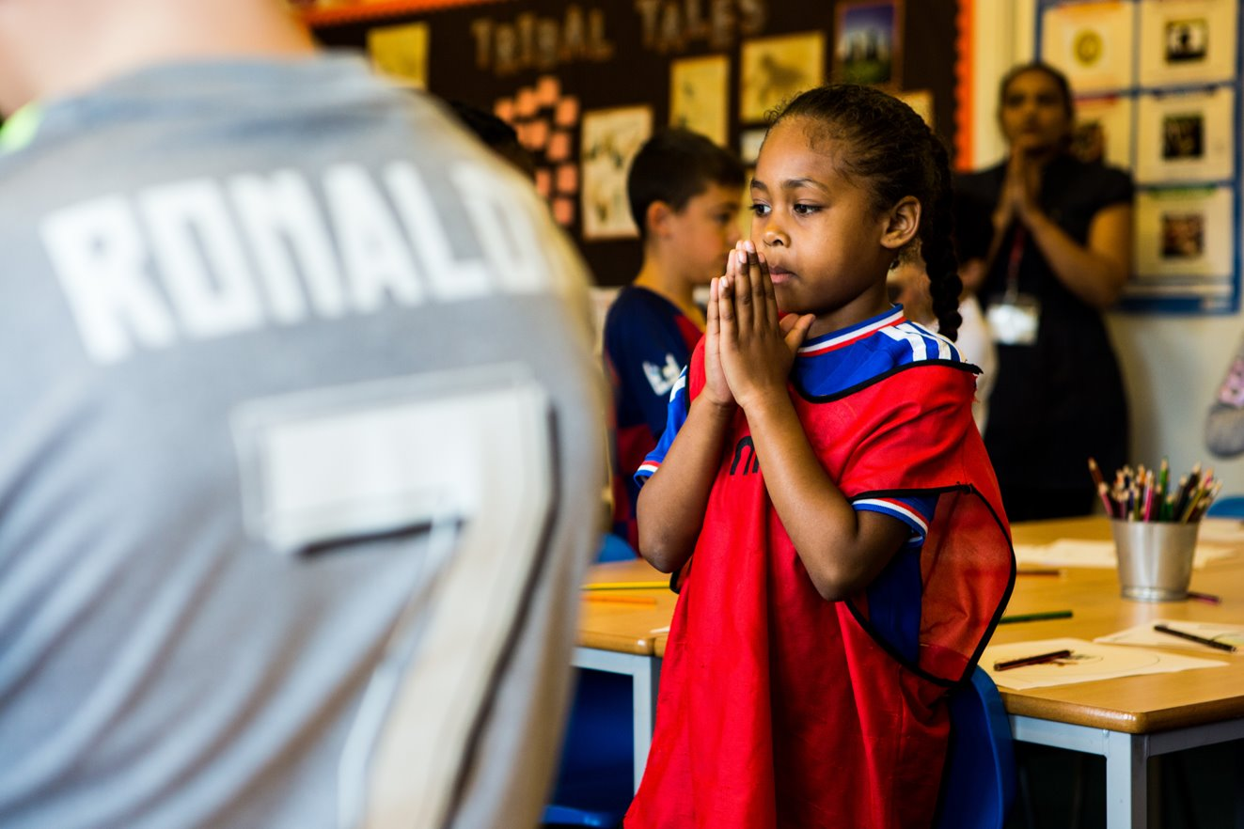
Dear God, because you love us so much you sent your only Son into the world to be with us. Help us to wait in hope with joyful hearts for his coming and to share your hope with others. Amen.
Notes:
Children at Our Lady Queen of Heaven Primary School
Photo credit: Thom Flint

Slide 3
Luke 21:25-28, 34-36
“There will be strange things happening to the sun, the moon, and the stars. On earth, whole countries will be in despair, afraid of the roar of the sea and the raging tides. People will faint from fear as they wait for what is coming over the whole earth, for the powers in space will be driven from their courses. Then the Son of Man will appear, coming in a cloud with great power and glory. When these things begin to happen, stand up and raise your heads, because your salvation is near.”
“Be on your guard. Don’t let yourselves become occupied with too much feasting and drinking and with the worries of this life, or that Day may suddenly catch you like a trap. For it will come upon all people everywhere on earth. Be on the alert and pray always that you will have the strength to go safely through all those things that will happen and to stand before the Son of Man.”
Word
Notes:
This can be a confusing reading for children because it is about the Second Coming rather than Jesus’ birth. Perhaps explain this briefly before discussing.

Slide 4
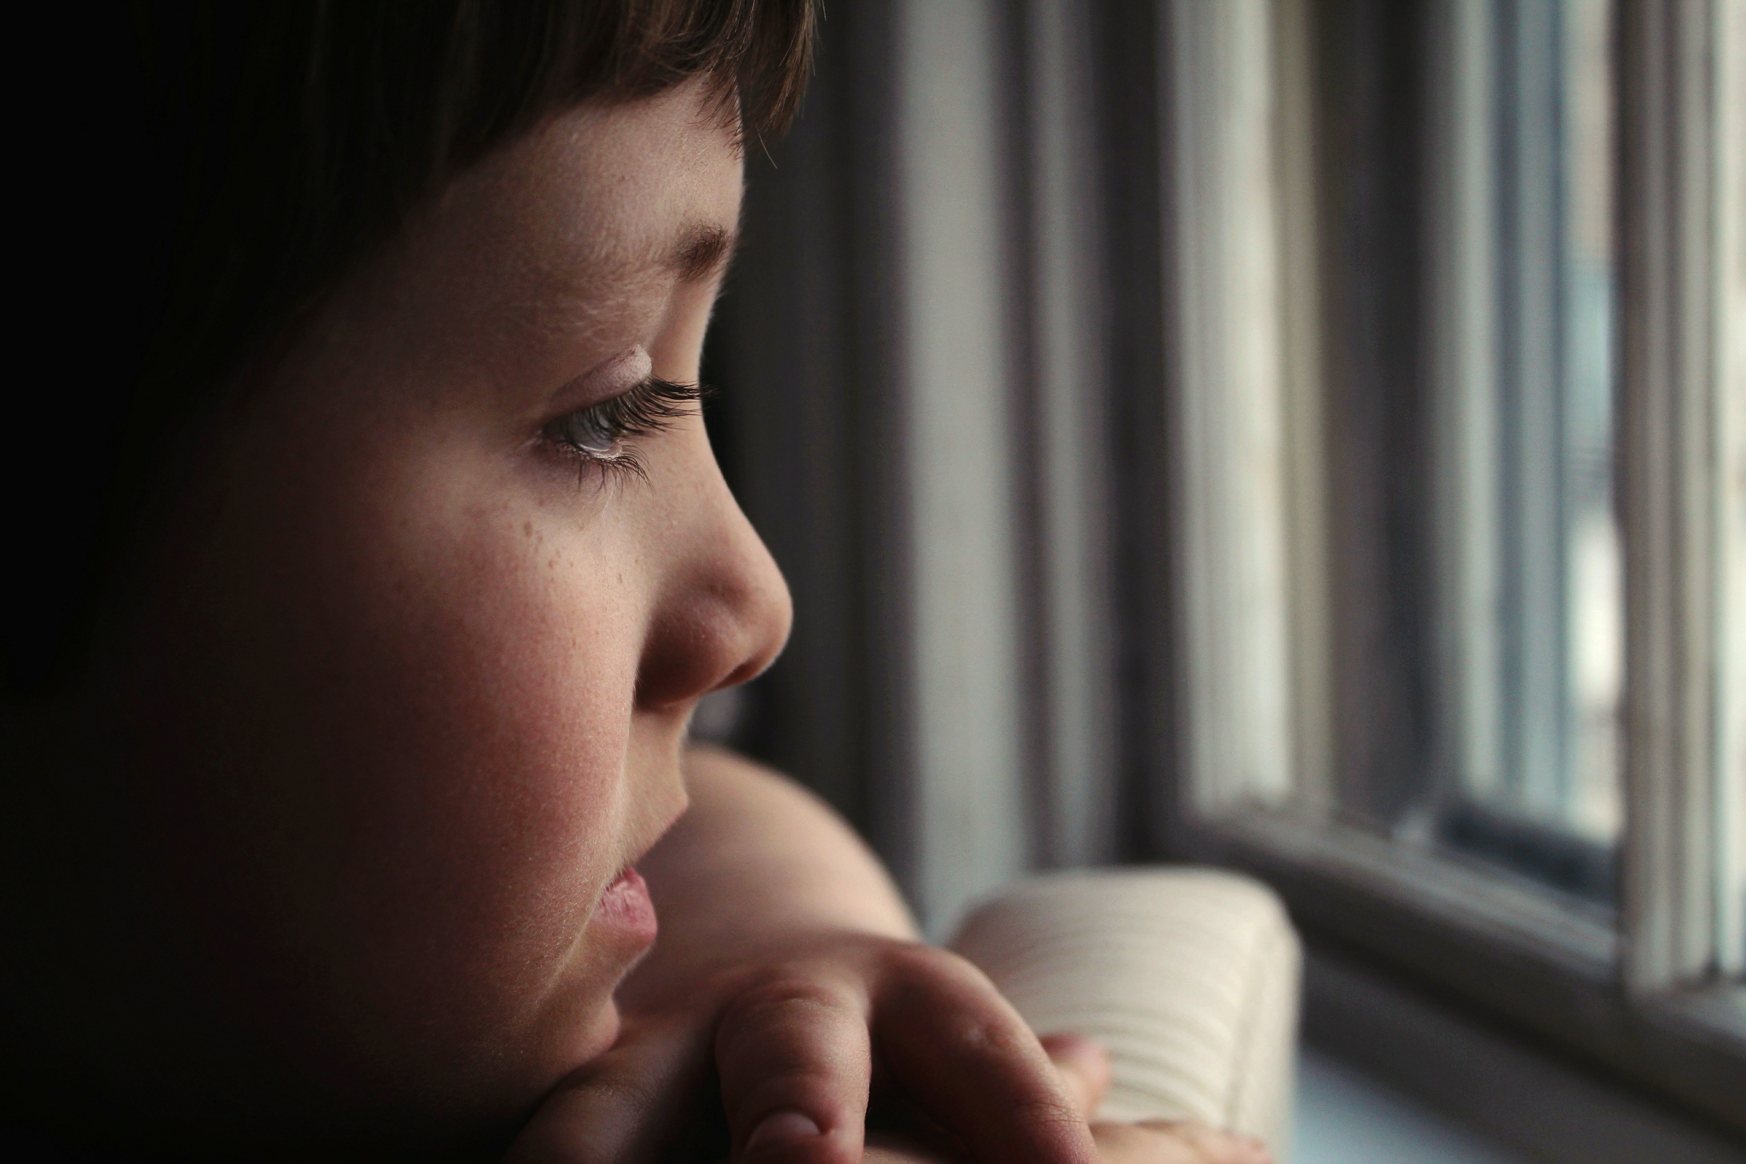
What do you remember from the Gospel reading?
Jesus is talking about when he will come again. Can you remember what he said to his disciples?
Jesus says that he will come again in a cloud with power and great glory. Do we know when Jesus will come again?
Even though we do not know the exact time when Jesus will come again, he says that we need to be ready. We have to wait and watch for him.
Respond
Notes:
Photo credit: Stock image

Slide 5
What’s the most exciting thing you’ve ever had to wait for? Was it the visit of a friend or family member? Was it for a special treat?
How did it feel while you were waiting? Did the time go quickly or slowly? What did you do while you were waiting?
Waiting is not easy, is it? Especially if we don’t know when the thing or the person we are waiting for will arrive.
Notes:
Photo credit: Stock image

Slide 6
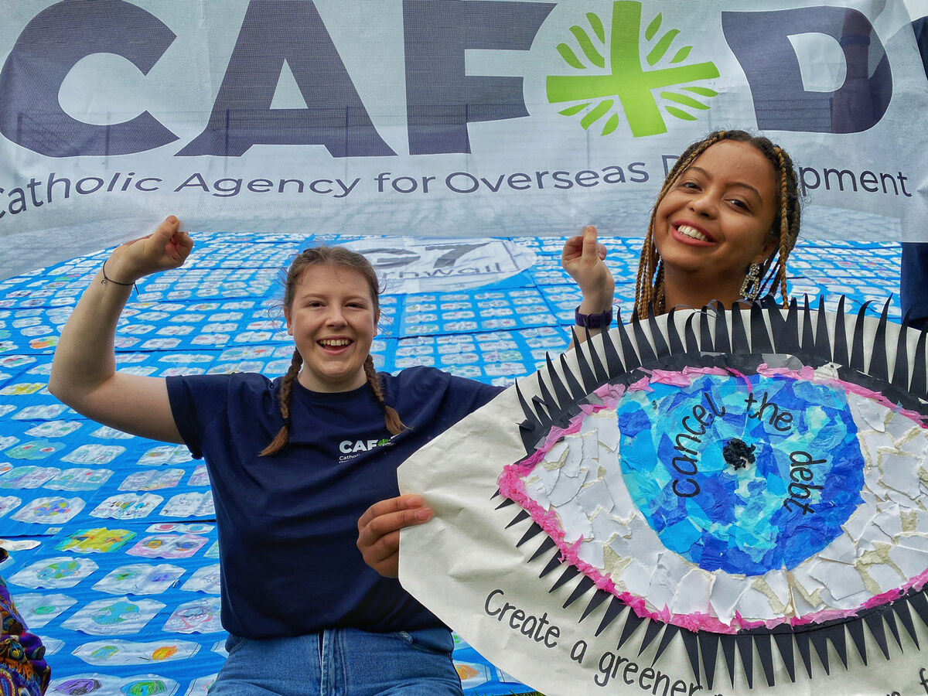
We do not know when Jesus will come again, but in today’s gospel, Jesus tells us to pray and to watch how we behave while we are waiting. This is so that we will be ready when he comes.
How do you think Jesus wants us to behave? How do you think he would like us to treat other people both here and around the world?
Notes:
Campaigners in Cornwall
Photo credit: Annie Bungeroth

Slide 7
Jesus asks us to love one another and to treat other people as we want to be treated. This is whether they’re in our own family or on the other side of the world.
What will you do this week, so that you can try to be ready when Jesus comes again?
The other thing that is special about waiting for Jesus during Advent is hope. We have hope that Jesus will one day come again and make all things new. We have hope because of his birth long ago in a stable in Bethlehem, when he came to show all people God’s love for us.
Notes:
Photo credit: Stock image

Slide 8
Hope is not just a wish for good things to come in the future. It also changes the way that we feel and think and act.
When things are hard, if we have hope that they will get better in the future, that helps us to keep trying and working to change things. And this then often leads to the difficult situation getting better.
We can share hope with others, by being with them in difficult times, by giving them a smile or a hug, or by helping them when something is hard.
Notes:
Photo credit: Stock image

Slide 9
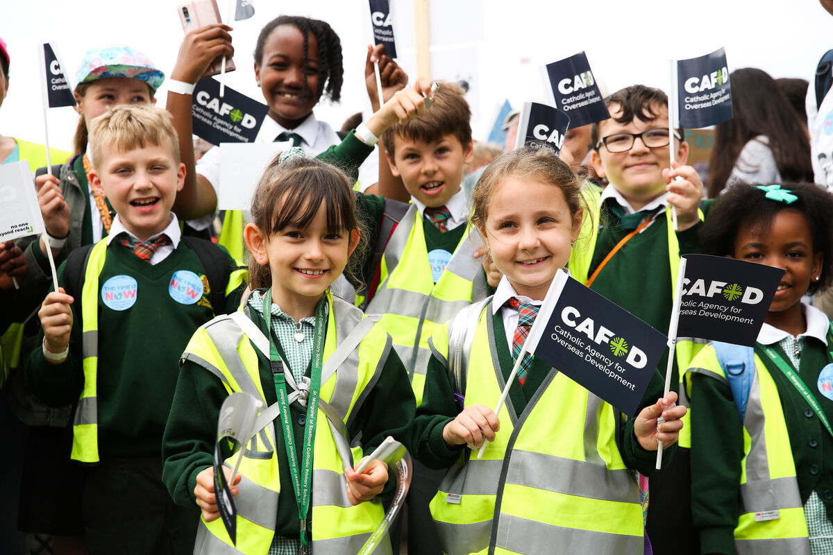
CAFOD is part of a big Church network that helps to bring hope to people all around the world. CAFOD works with them to build a better future for themselves and for their families.
Notes:
London school children
Photo credit: Eleanor Church

Slide 10
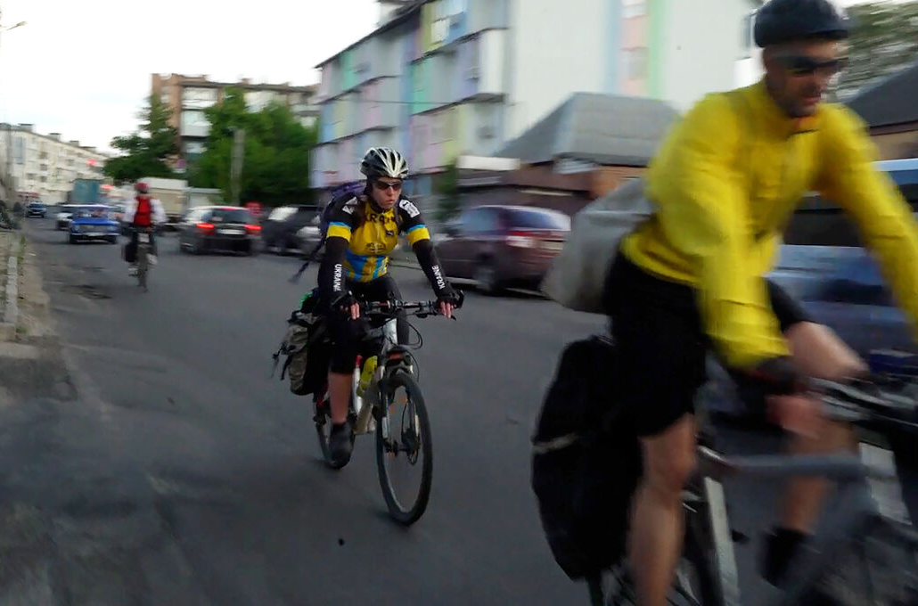
In Ukraine, the war meant many older people and those with disabilities found themselves stuck at home, unable to get food and other things they needed.
Some friends from CAFOD’s church network helped organise a team of brave volunteers. They shared hope by getting on their bikes to deliver food baskets.
Notes:
Viktoria, Aleksander and Yana, cycle volunteers with Depaul Ukraine
Photo credit: Dmytro Minyailo / DEC

Slide 11
Here is Viktoria sharing food and sharing hope with Larysa.
What is your hope this Advent? And how do you think you could share hope with others around the world?
Notes:
Viktoria and Larysa, Ukraine
Photo credit: Dmytro Minyailo / DEC

Slide 12
Let us pray…

Slide 13
We pray for all the leaders in the world: that God may give them the wisdom to treat their people with fairness and compassion, bringing hope to all.
Lord, in your mercy…
We pray for the Church around the world: that she may follow the example of Jesus and work to make the world a fairer place.
Lord, in your mercy…

Slide 14
We pray for our communities, families and friends: that we may treat others as we would wish to be treated and always be ready to welcome Jesus into our lives. Lord, in your mercy…
Loving God, may your love be with us always and bring peace and joy to all people around the world, as we wait in hope for the coming of your Son Jesus. We ask this through Jesus Christ our Lord. Amen.

Slide 15
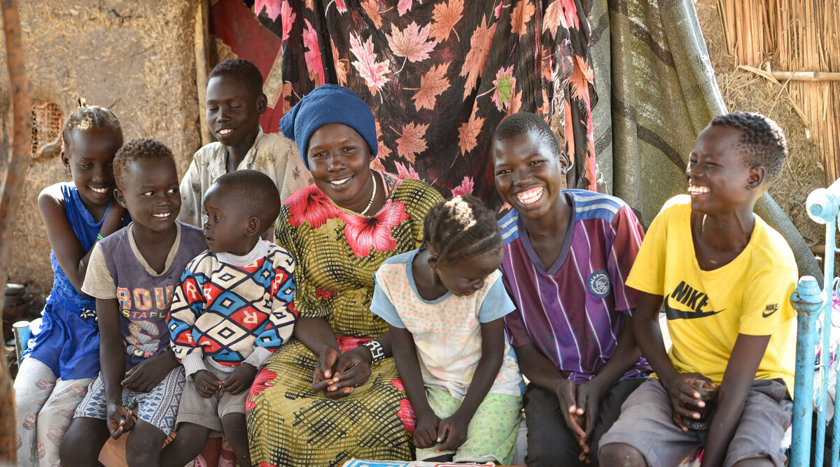
What is your hope this Advent?
And how do you think you could share hope with our brothers and sisters around the world?
Send
Notes:
Yani and her family, Sudan
Photo credit: Ahmed Seed

Slide 16
Advent is here!
Join our national assembly! Come together with schools across England and Wales to mark the start of Advent.
Watch live on Tuesday 28 November at 9.30am or at any time during Advent.
CAFOD's Advent calendar will help us prepare together to be the best people we can be to celebrate the birth of Jesus – reflections, activities, prayers and actions for each day of Advent. Download it here
This Advent, we are asking schools across England and Wales to consider fundraising for a £100 CAFOD Christmas stocking, full of life-changing gifts. Find out more about the stocking and a poster to support your fundraising. Explore World Gifts
Why not use CAFOD Advent prayers cards as part of your Advent preparation? Order them for free here

Slide 17
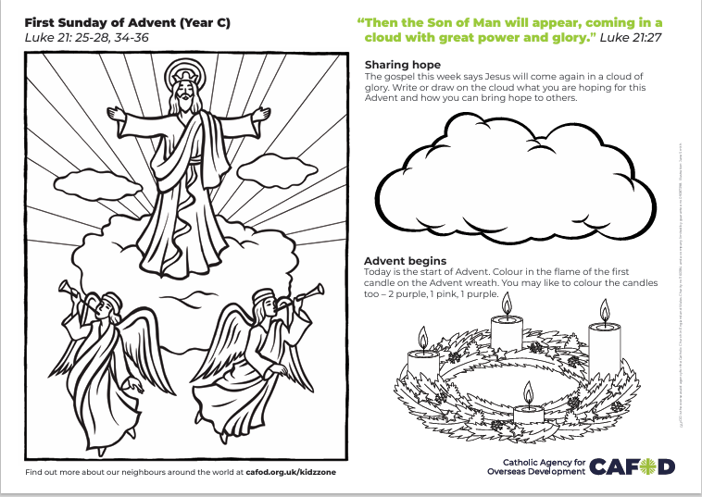
Activity suggestions
Two activity sheets this week!
Colour in Jesus coming in glory and decorate the cloud of hope.
Invite the children to decorate the bauble on the other sheet by drawing their Advent hope and/or how we can share hope in our world, cut it out and hang it on their tree once it is up. You could encourage them to stick the paper template to card to make it stiffer.
Light the first candle on your Advent Wreath if you have one. Use the prayer on the accompanying activity sheet to pray for your group’s intentions at this time and encourage the children to take it home to pray during the week.
Encourage the children to discuss all that they have heard and thought about today with the people at home. Remind them to spend this week really thinking about what they do, so that they can try to be ready when Jesus comes. See if they can share hope with others locally and around the world.

Slide 18
Notes:
Illustration: Freepix

