Slide 1

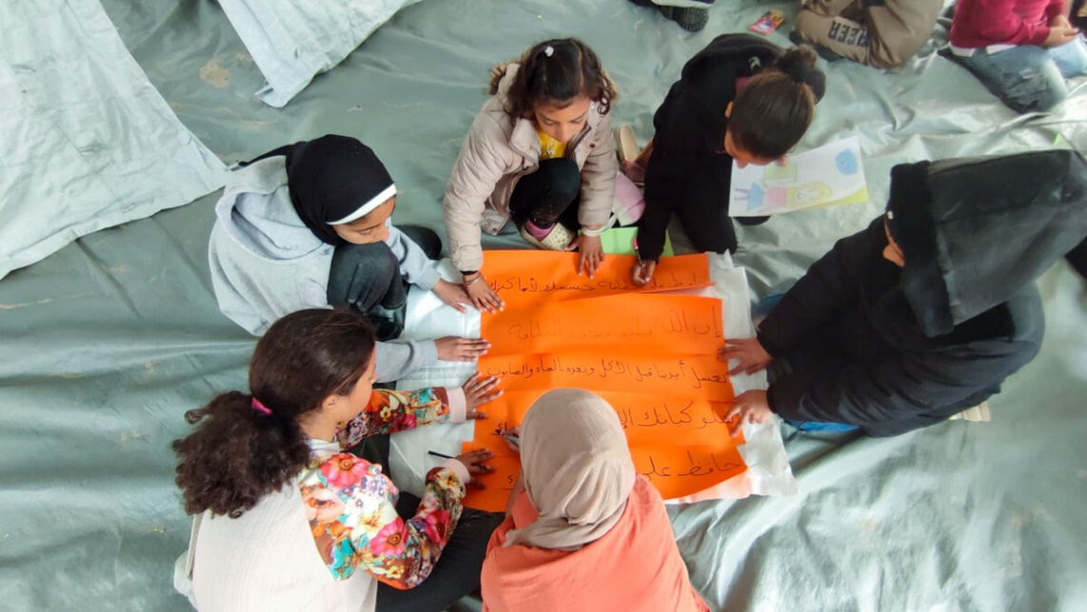
Let us pray
God of love.​
We pray for peace in our world, and an end to war.​
Instead of hatred, let there be love.​
Shelter your children and protect us.​
Guide us and keep us from harm,​
So that we can build a world of love and live our lives in peace.​
Amen.​
Children’s groups in Gaza
Notes:
Image credit: Caritas Jerusalem

