Slide 1
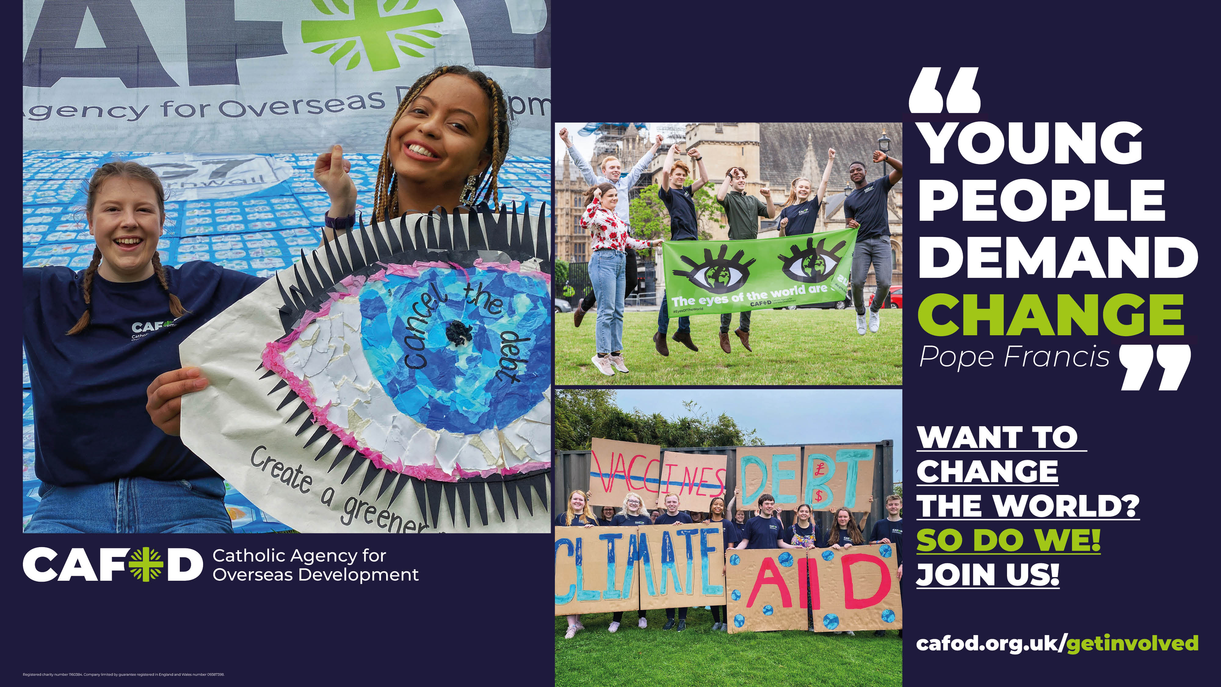
Notes:
Holding screen (as students enter the hall).

Slide 2
Notes:
Good morning/afternoon, everyone. Welcome to our CAFOD assembly.
[Click the green arrow to start the 1-minute video at: https://www.youtube.com/watch?v=4nUNoJYKGM0]

Slide 3
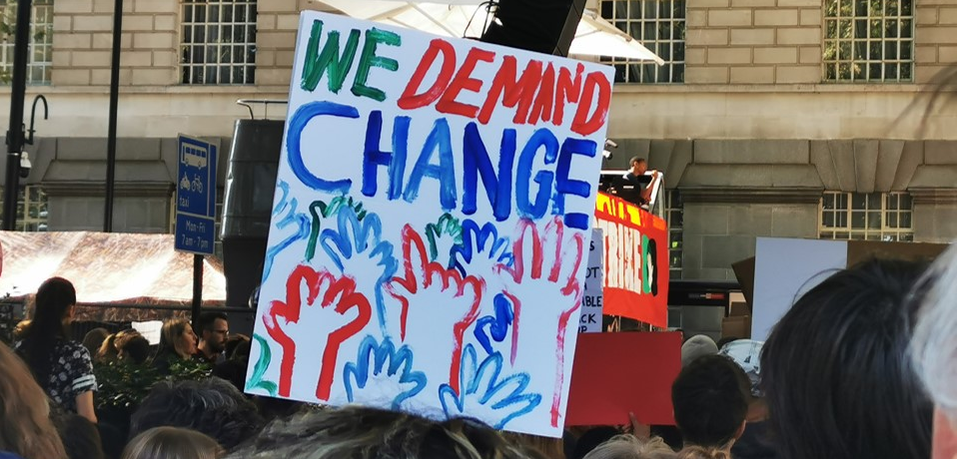
Notes:
Today’s assembly looks at how we can make change happen, to make the world a fairer place.
Changing the world is possible!
By working together and starting small, everyone can help to create a world where all people have clean water to drink, clean air to breathe and enough food to eat.
Where every child has a safe home and can go to school.
Where everyone’s rights are respected, and everyone can live life to the full.

Slide 4
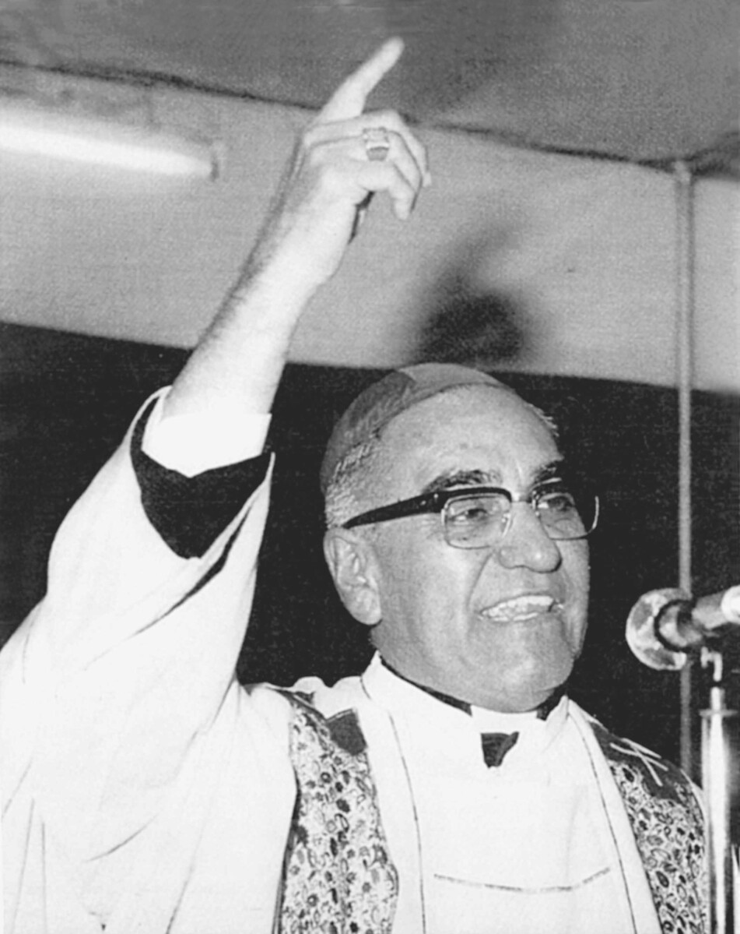
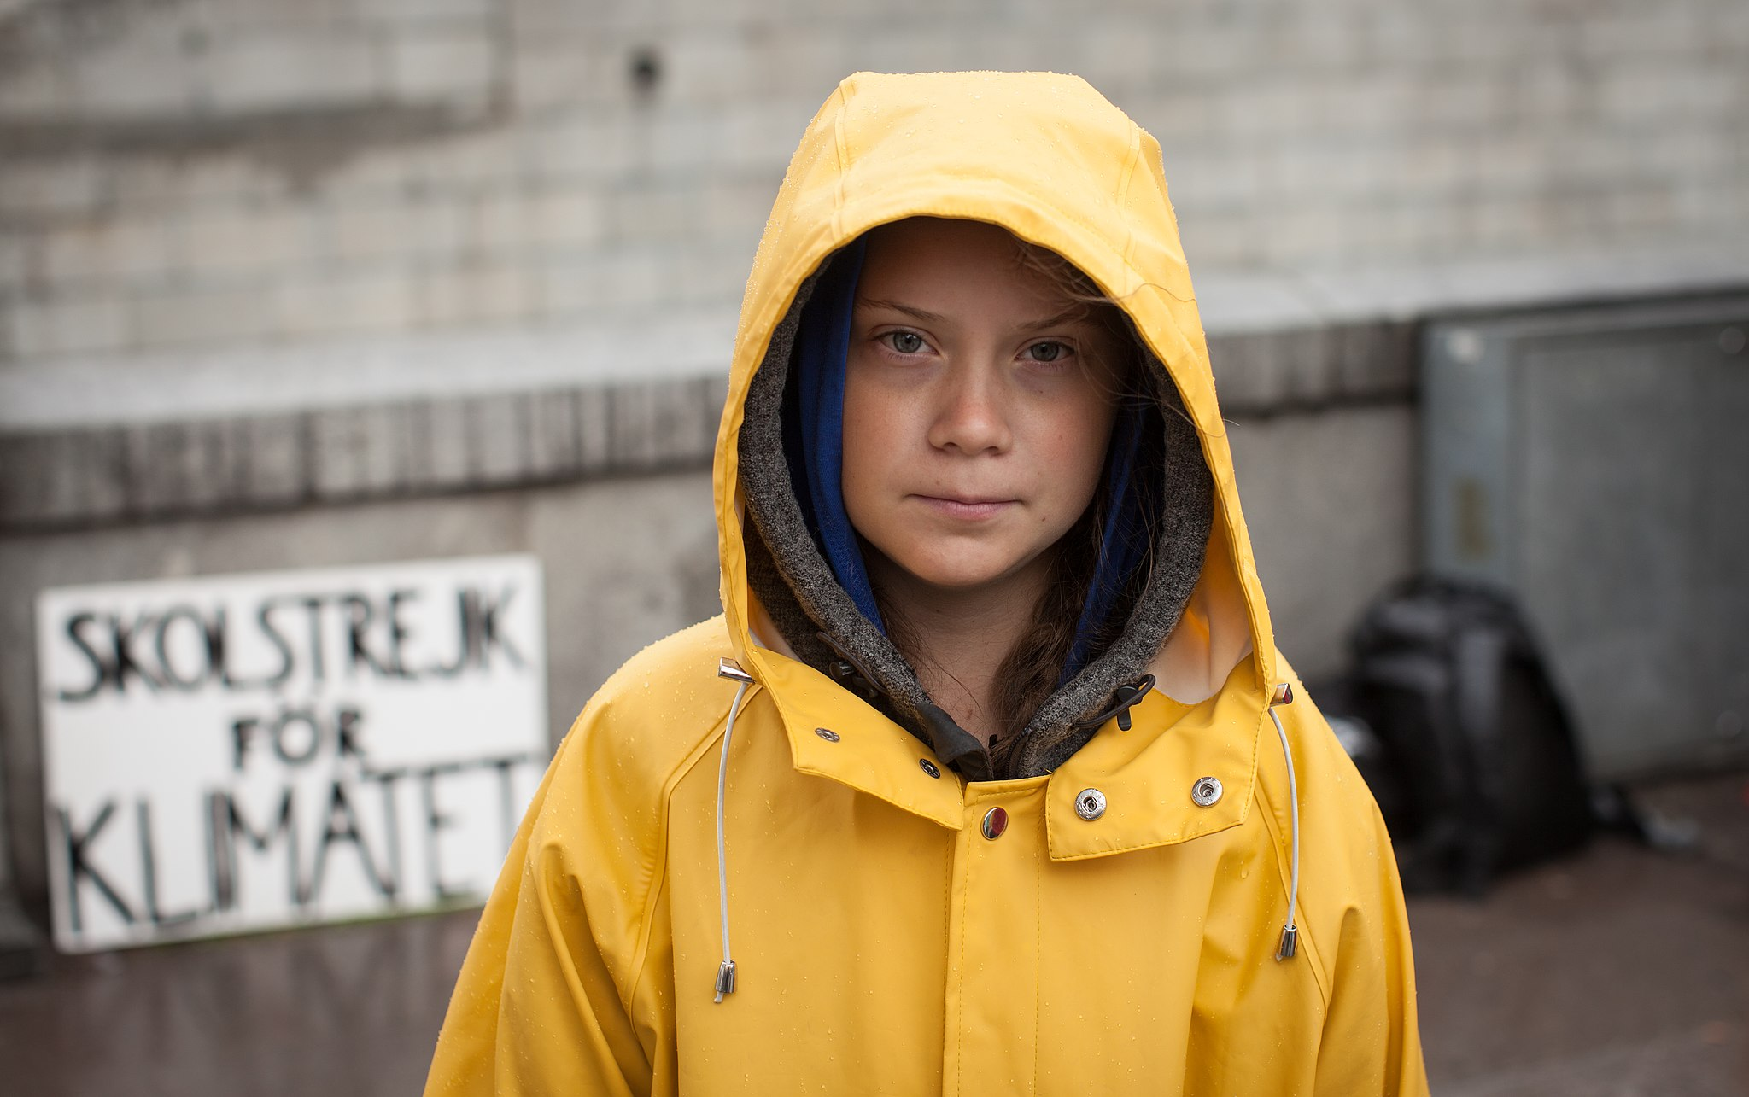
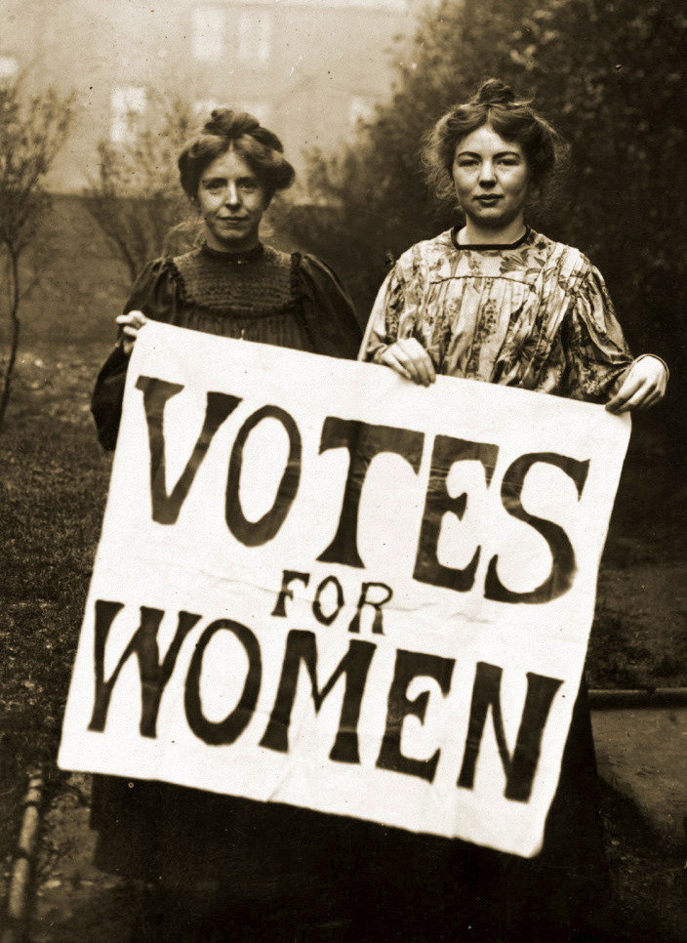
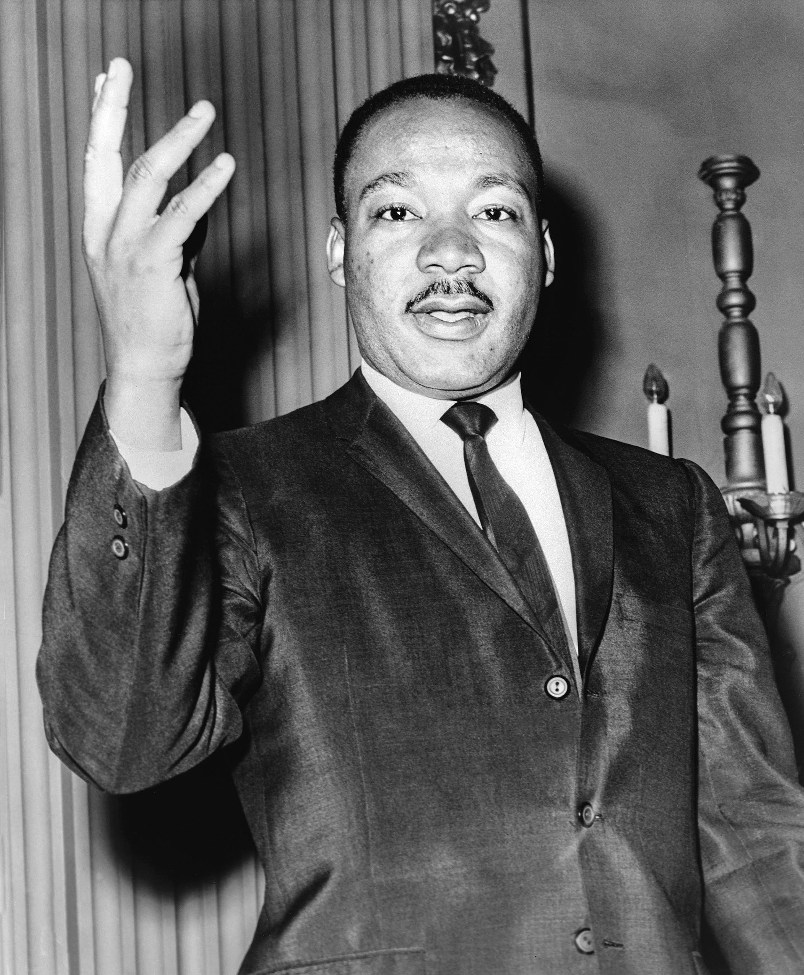
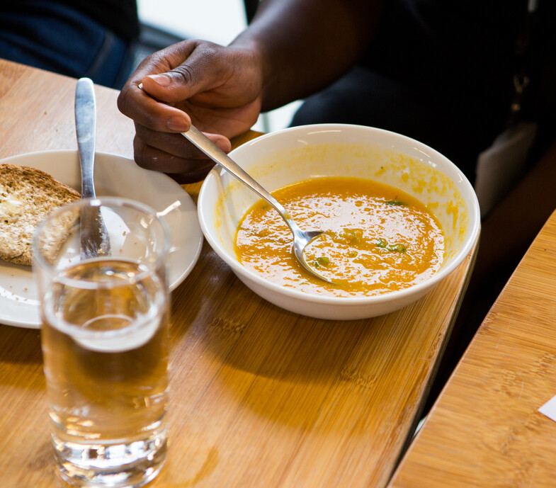
Notes:
Some people who have campaigned against injustice are:
[click] - UK women, demanding the vote in the early 1900s,
[click] - Martin Luther King Junior in the United States, demanding civil rights for black people,
[click] - Greta Thunberg, demanding climate protection,
[click] - Marcus Rashford, demanding free school meals for children during the pandemic,
[click] - Saint Oscar Romero, demanding an end to oppression in El Salvador, and
[click] - Nelson Mandela, demanding an end to apartheid in South Africa.
[Picture credits: wikimedia.org - Creative Commons Attribution-Share Alike 4.0 International license (https://creativecommons.org/licenses/by-sa/4.0/deed.en); CAFOD; Equipo Maiz]

Slide 5
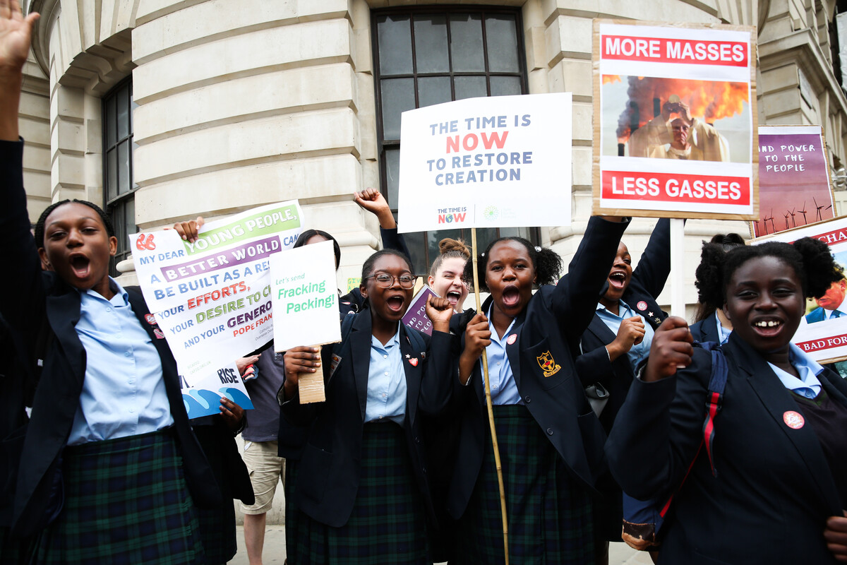
Notes:
These leaders inspired others, who joined them and shouted together for change.
Some of the changes they demanded are not fully realised. For example, there is still poverty in parts of El Salvador, and our climate still needs to be protected.
But they had successes too. Women in the UK can now vote. Mandela became president. And nations are taking steps to protect the climate.
[Picture credit: Eleanor Church]

Slide 6
Notes:
What do YOU want to change about the world? Perhaps you feel passionate about biodiversity or the climate crisis. You may be outraged that 1 in 10 people lives in extreme poverty. Or you might think that peace is what the world needs most of all.
Whatever it is – speak up!

Slide 7
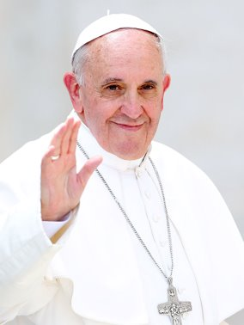
Notes:
Pope Francis said: “Young people demand change”.
Catholic Social Teaching urges us to speak up for the common good; in solidarity with people who are treated unjustly.
If you don’t speak up, who will?
If not now, then when?

Slide 8
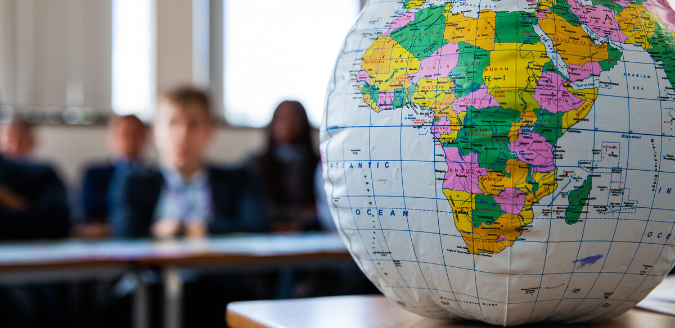
Notes:
Young people have already been demanding change with CAFOD. We saw some of them in the video.
So much about our world needs to change. What will YOU do?
Picture credit: Thom Flint

Slide 9
Notes:
As we hand out a card to each person, we invite you to reflect on the changes you want to see in the world, and how you could help to make them happen by joining with others to demand change.
[Give out cards ordered free from CAFOD Shop. Play quiet music.]
Later, in your own time, we invite you to sign the card as your commitment to campaign for justice, and to keep it in your phone cover or pocket as a reminder.

Slide 10
God of justice, give me a heart ready to work with people of any colour, gender, creed or nation, until all your children can live life to the full. Amen.
Notes:
For now, let’s pray together the prayer on the card:
God of justice, give me a heart ready to work with people of any colour, gender, creed or nation, until all your children can live life to the full. Amen.
[Picture credit: Louise Norton]

Slide 11
cafod.org.uk/DemandChange
Notes:
Thank you.

